Slide 1
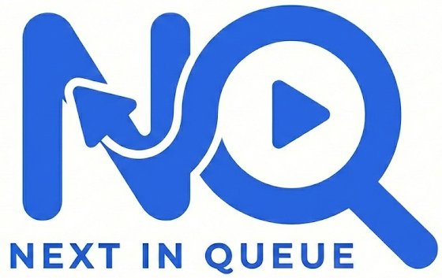
Bringing together content, apps, and logging services to better recommend new media across platforms.

Slide 2
Team Members
Nathan Grilliot – Computer Science
Contact Info: grillinr@mail.uc.edu | github.com/grillinr
Advisor: Professor Will Hawkins

Slide 3
Goals
Develop a great media recommendation system
Unify user preferences across movies, shows, games, books, and more
Make excellent data driven recommendations based on each user's unique interests
Create a simple cross-platform mobile applications

Slide 4
Intellectual Merits
Brings together complex data from several sources
Hard to create relationships without a good ingestion pipeline
Normalizing different media types (games, movies, books) presents a tough challenge
Making the input and recommendation requests responsive requires precise data requests

Slide 5
Broader Impacts
User Experience: Native mobile capabilities (haptics, safe areas, gestures) create more intuitive interactions that improve usability for diverse populations
Scalable: Architecture supports growth to serve larger communities as adoption increases
Open Ecosystem: Built on open-source technologies, enabling community contributions and transparent development

Slide 6
Design Specifications

Slide 7
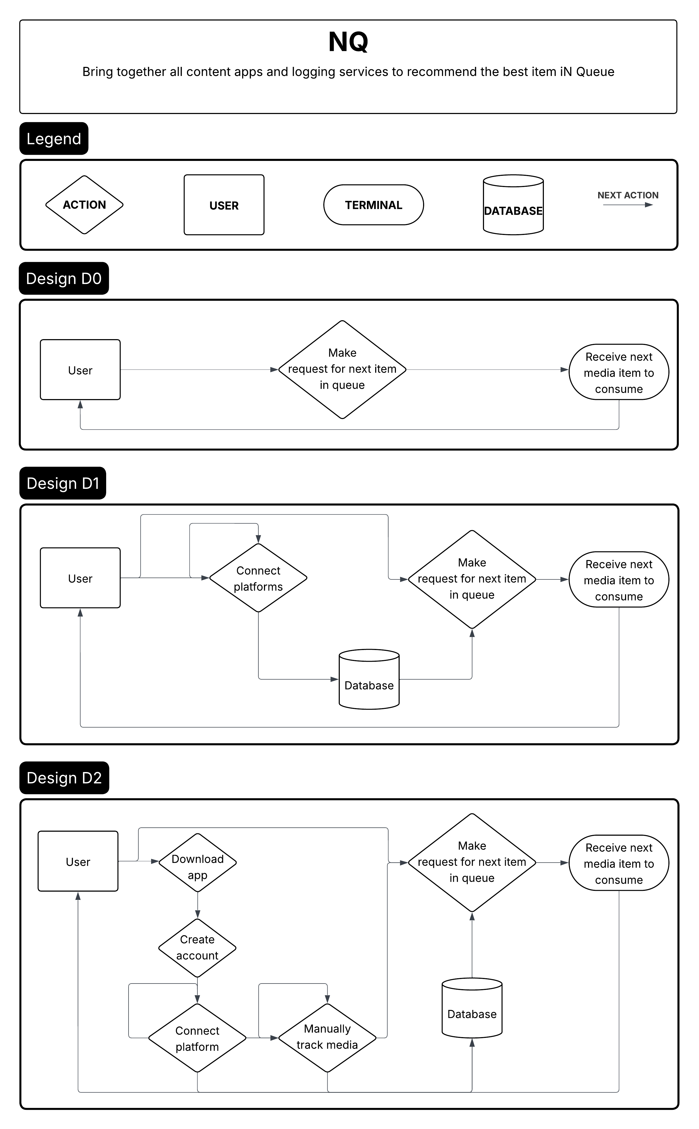
Design Diagrams
Notes:
Implementing the intended functionality requires carefully considering the projects goals from a high level overview down to the implementation details. In design D0, I outlined the main goal of the project—users looking for the next item in queue. From there, we can move into the finer details in design D1, enabling the connection to external platforms to automatically track media consumption history. Finally, the user flow from start to finish in design D2 will require downloading the app and creating an account to store user history. Next, users can choose to use either automatic tracking through platform connections or manual tracking in the app. Finally, NQ will return the best candidate for the next item in queue.

Slide 8
Frontend

Slide 9



Frontend - Technologies

Slide 10
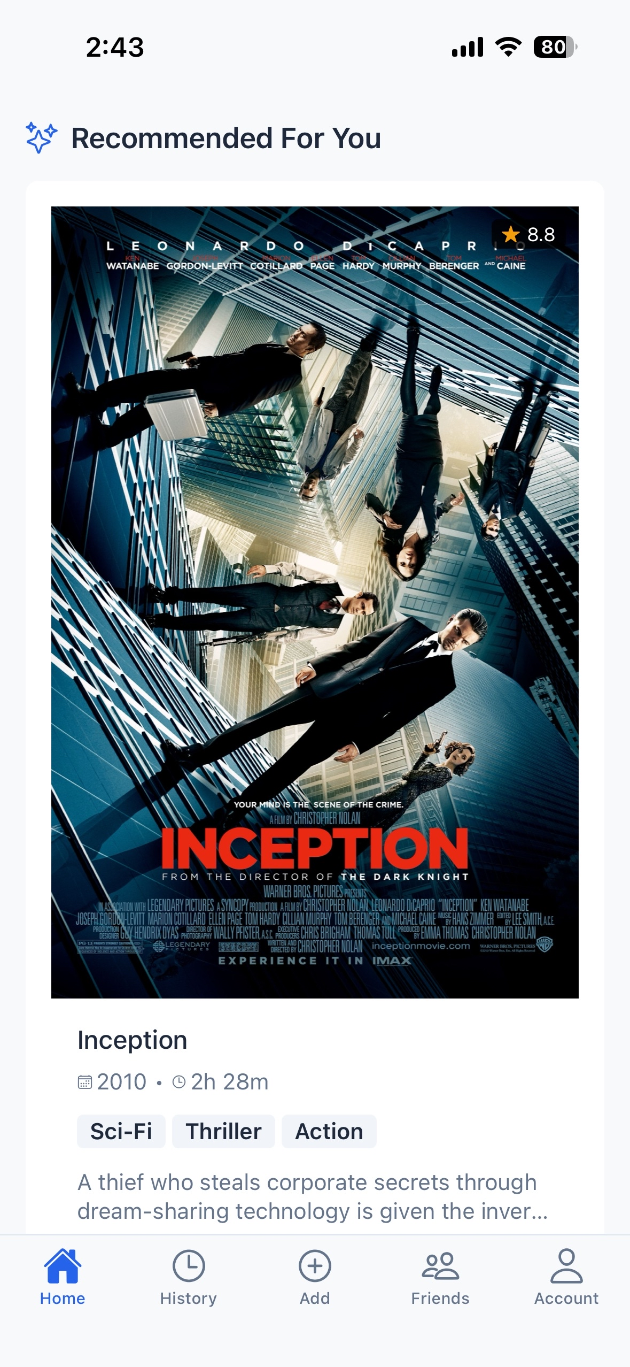
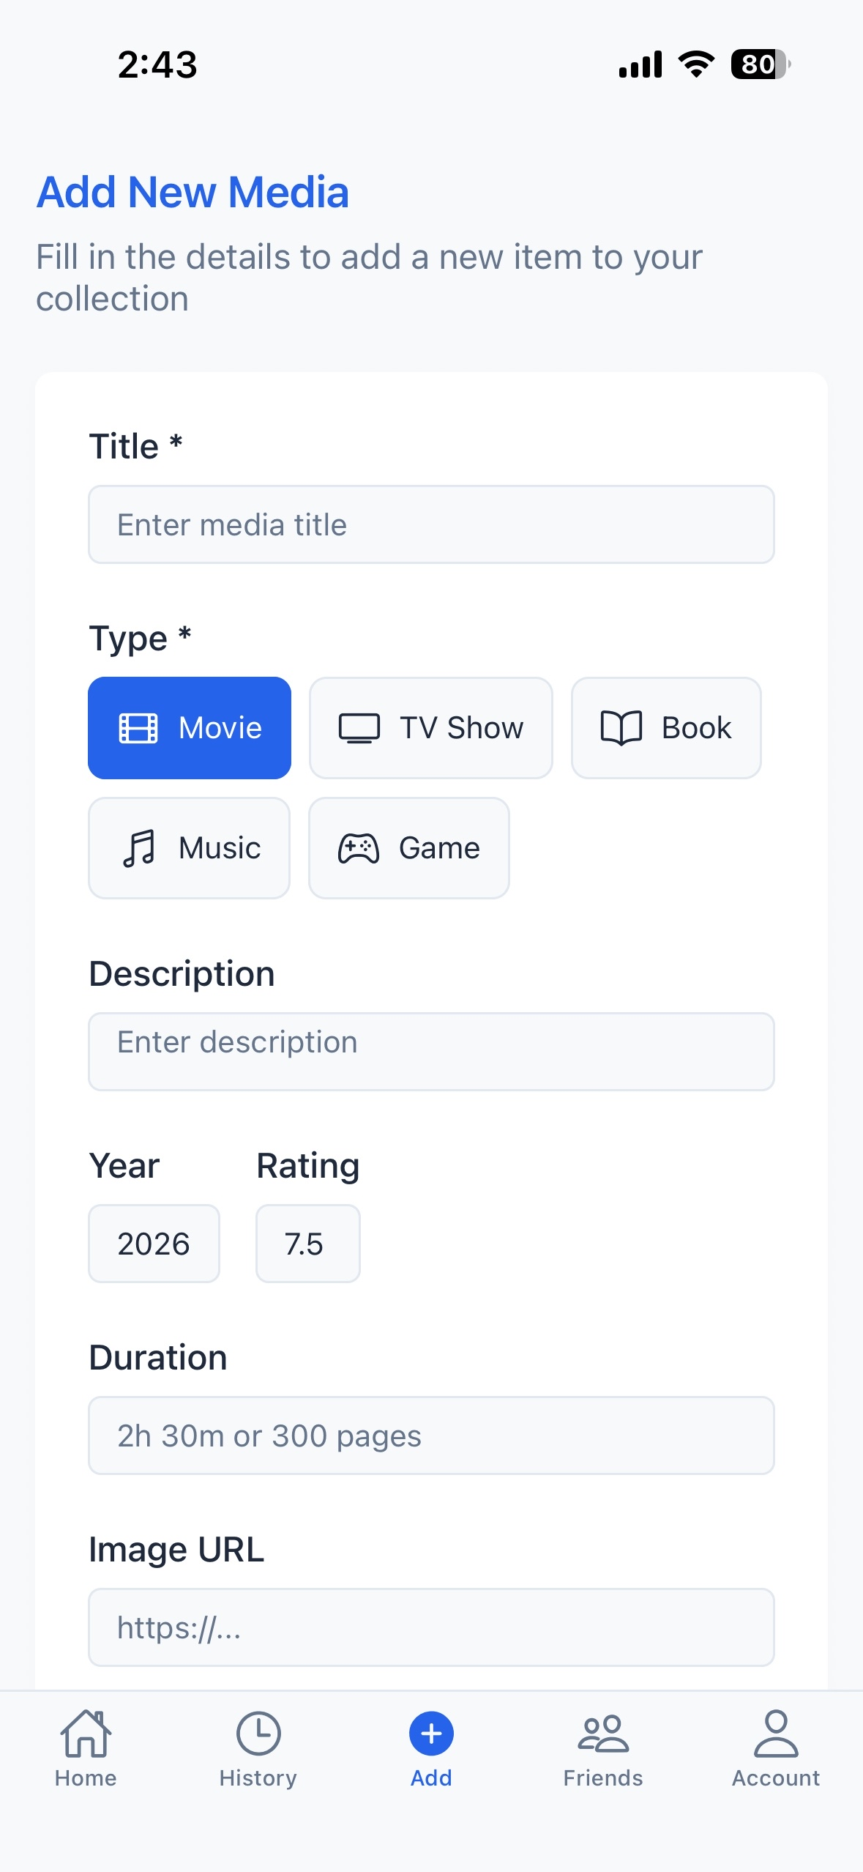
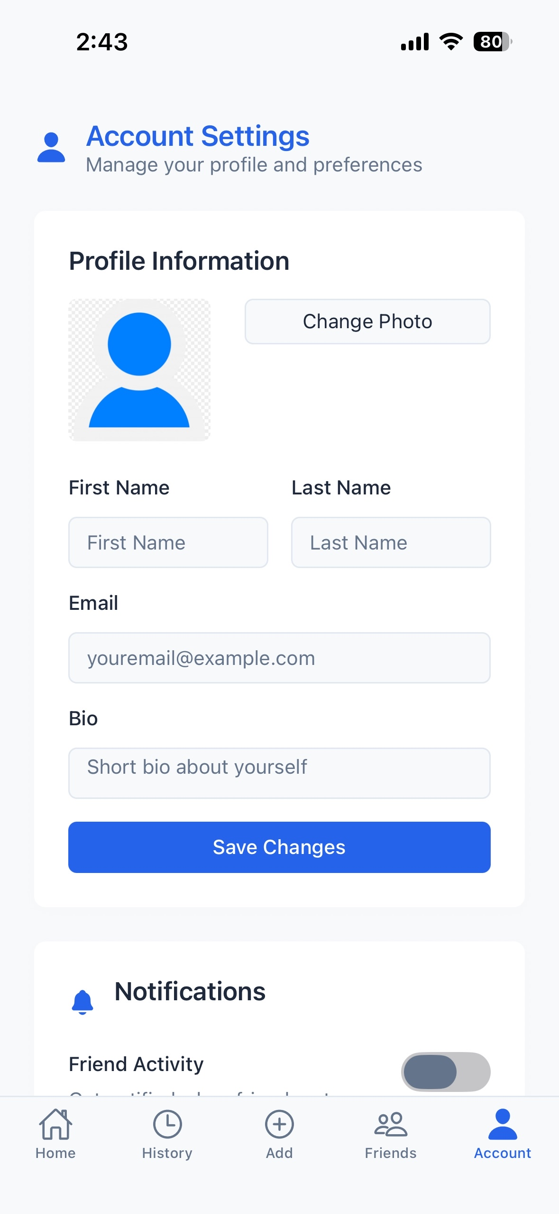
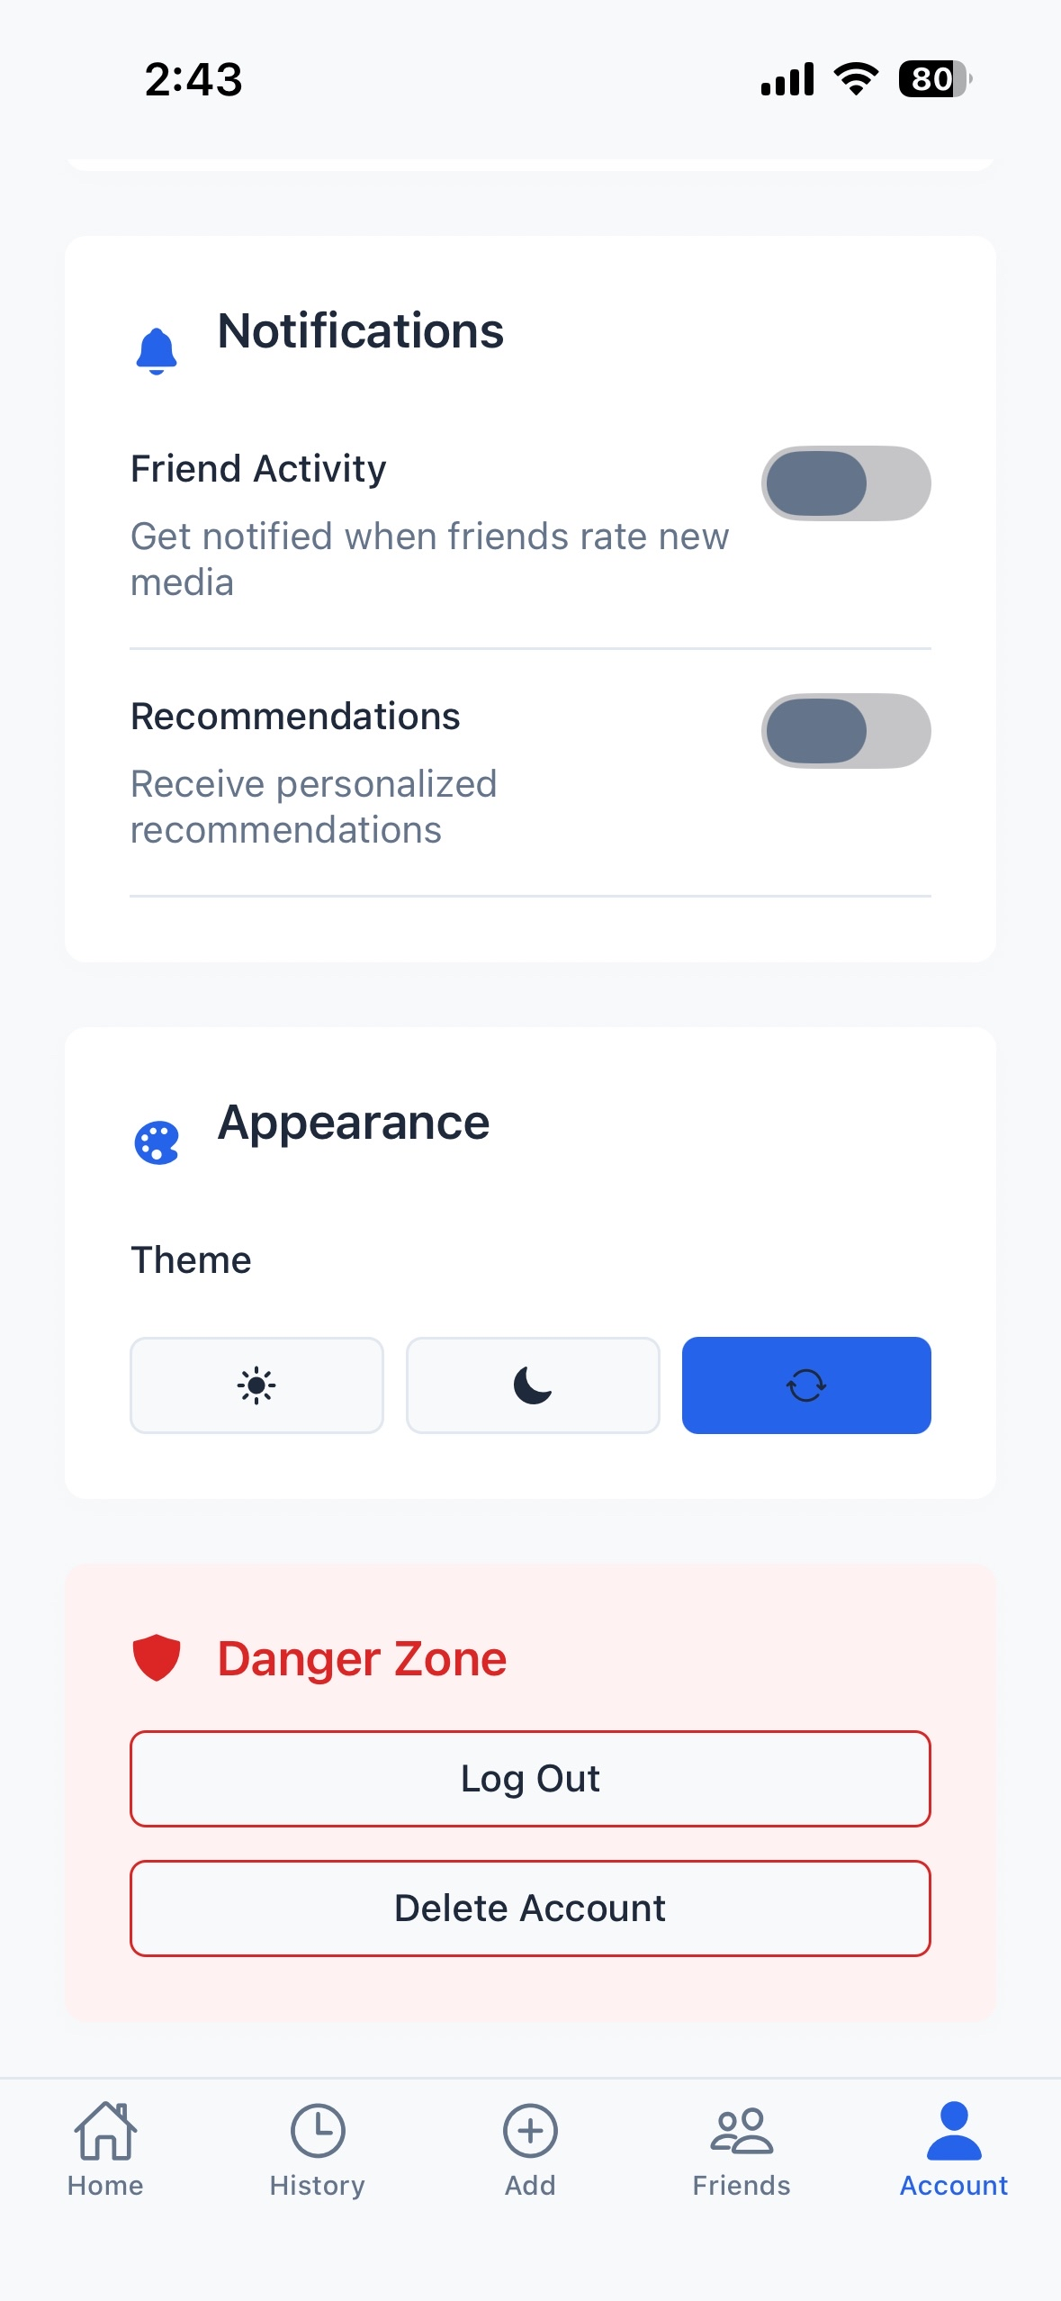
Frontend - Results

Slide 11
Backend

Slide 12



Backend - Technologies

Slide 13
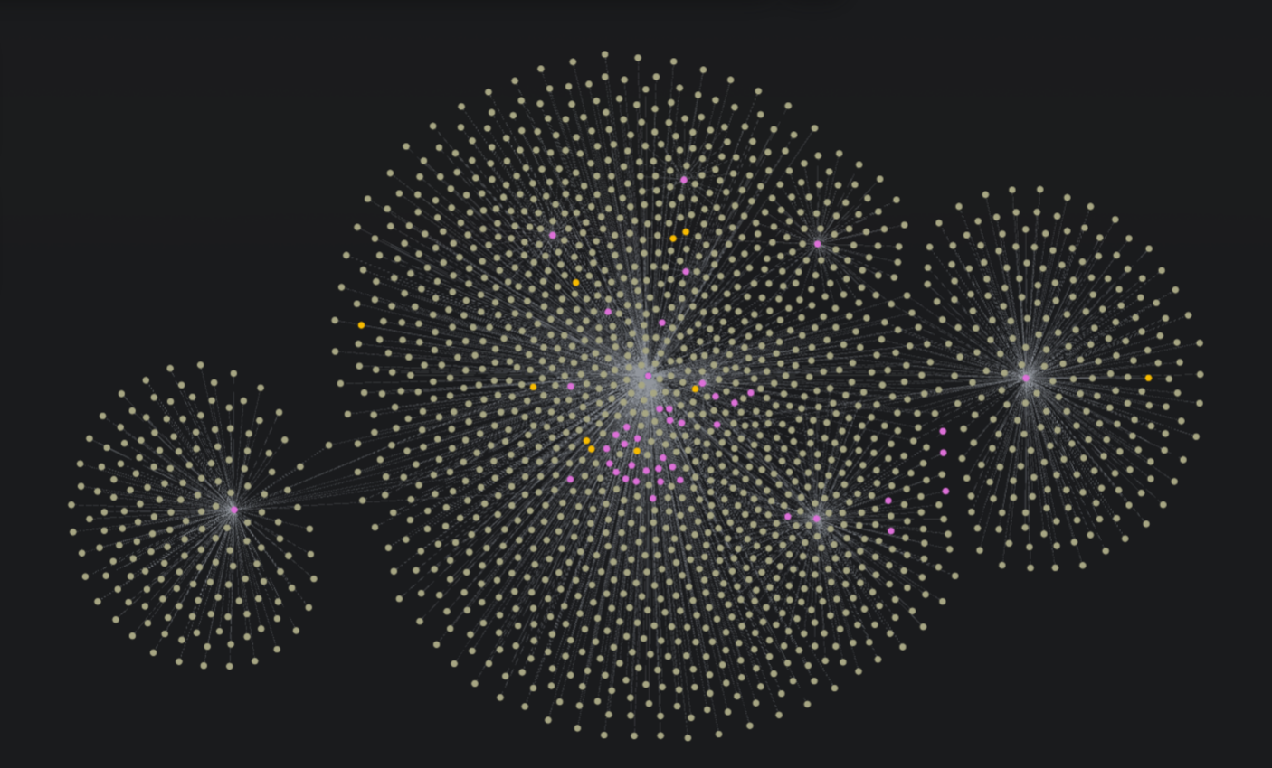
Backend – Results
People
Movie
Genre
Example of data collected by inputting Inception
Inception

Slide 14
Milestones Hit
September: Database is setup with CRUD methods for all media types
November: API is functional and supports GraphQL for querying database
December: Functions for fetching all metadata from available data sources
January: Basic frontend structure for a mobile first user interface

Slide 15
Goals BY End of Term
Users can manually add media items to database by title in the app
Additional related media items are fetched automatically across types (books, movies, games, etc.)
Simple user interface to allow creation of new media item
Tests to verify accuracy of frontend, backend, and integration

Slide 16
Challenges
Limited access to automatically integrating history (Spotify, YouTube, Netflix)
Different APIs provide wildly different quantities and quality of data
New to GraphQL, Neo4j, and React Native

Slide 17
Expected Demo at Expo
Mobile interface to add media items manually
Several OAuth options to link accounts for automatic history tracking
Recommendation engine to give users their most likely next media item
Stretch goal: app is available on App Store/Google Play Store

