Slide 1
Introduction to infectious disease modeling
Alex Grimaudo
alexg8@vt.edu

Slide 2
What is infectious disease modeling?
Mathematical and computational approaches to understand the dynamics of infectious diseases.
When, where, and how of pathogen spread
Duration and size of epidemics
Effectiveness of control strategies

Slide 3
Why model infectious diseases?
Explain epidemics.
Why would we want to estimate the size and duration of an epidemic?
What sorts of metrics might we want to estimate?

Slide 4
Susceptible—Infected—Recovered (SIR) model
Susceptible
Notes:
Explain what susceptible means.

Slide 5
Susceptible—Infected—Recovered (SIR) model
Susceptible
Infected
Notes:
Explain what infected means

Slide 6
Susceptible—Infected—Recovered (SIR) model
Susceptible
Infected

Slide 7
Susceptible—Infected—Recovered (SIR) model
Super-spreader
Susceptible
Infected

Slide 8
Susceptible—Infected—Recovered (SIR) model
Susceptible
Infected
Recovered
Notes:
Explain what recovered means.

Slide 9
Susceptible—Infected—Recovered (SIR) model
Susceptible
Infected
Recovered

Slide 10
Susceptible—Infected—Recovered (SIR) model
Susceptible
Infected
Recovered

Slide 11
Susceptible—Infected—Recovered (SIR) model
Susceptible
Infected
Recovered

Slide 12
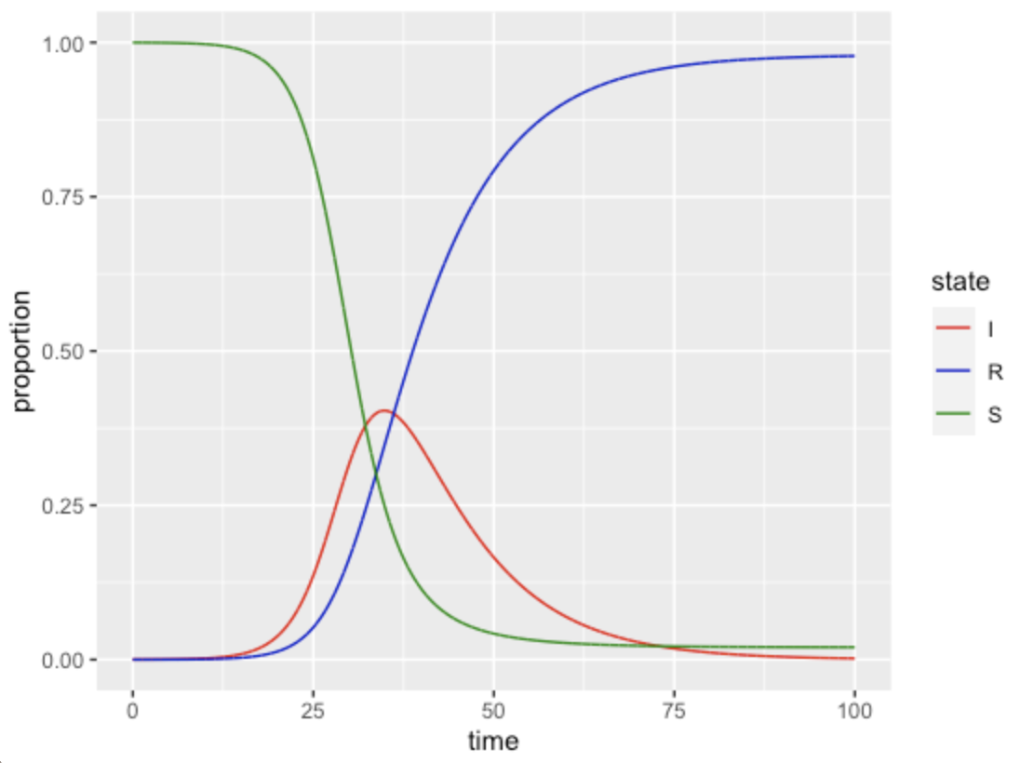
Susceptible—Infected—Recovered (SIR) model
Notes:
NOTE THAT THE Y IS PROPORTIONS.

Slide 13
Susceptible—Infected—Recovered (SIR) model
Susceptible (S)
Infected (I)
Recovered (R)
β
𝛄
β = “transmission rate”, or the rate at which susceptible individuals become infected following a contact with an infected individual.
𝛄 = “recovery rate”, or the rate at which infected individuals recover from infection.

Slide 14
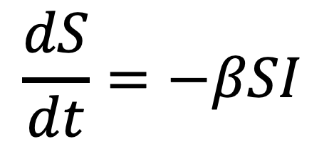
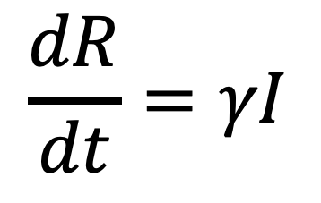
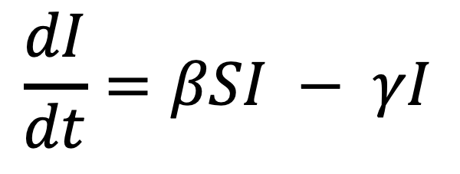
Susceptible—Infected—Recovered (SIR) model
Susceptible (S)
“transmission rate”
Infected (I)
Recovered (R)
“recovery rate”
β
𝛄
$$\frac{dS}{dt}=−βSI$$
$$\frac{dI}{dt}=βSI − γI$$
$$\frac{dR}{dt}=γI$$
Change in susceptible population per unit time.
Change in infected population per unit time.
Change in recovered population per unit time.

Slide 15
Susceptible—Infected—Recovered (SIR) model
Model assumptions
Random mixing -- each individual in the population has an equal probability of interacting with each other individual.
No births, deaths, immigration, or emigration.
Fixed transmission rate.
No latency period – following a successful contact, a susceptible individual is immediately infected and infectious.
Notes:
Think about each of these assumptions. When are they valid and when are they not? How do you think we might change the model structure to take some of these assumptions into account?

Slide 16
Basic reproduction number (R₀)
Susceptible
Infected
Notes:
Explain what infected means

Slide 17
Basic reproduction number (R₀)
(R₀) = 2
Susceptible
Infected

Slide 18
Basic reproduction number (R₀)
How to derive
It’s importance
Common examples
How to estimate from real-world data (we will do this in our code).

Slide 19
Common variants of the SIR model
SI
SEIR
SIRS
Age-structured
Spatial
Multiple host species

Slide 20
Intervention strategies
Vaccination
Quarantine
Social distancing
Culling
Ask students to break into groups and expand on the SIR model we drew to incorporate each of the control strategies (except perhaps social distancing, which might just be a lower beta).

Slide 21
Let’s build some models in R…

