Slide 1
Introduction to infectious disease modeling
Alex Grimaudo
alexg8@vt.edu

Slide 2
What is infectious disease modeling?
Mathematical and computational approaches to understand the dynamics of infectious diseases.
When, where, and how of pathogen spread.

Slide 3
Why model infectious diseases?
Public health / wildlife management resources are limited, despite epidemics (and pandemics) constantly occurring. Knowing when we will need resources, how much, and how best to distribute them will maximize our effectiveness when fighting an epidemic.
Infectious disease modeling can help us estimate:
When epidemics will occur.
Where epidemics will occur.
How big an epidemic will get.
Who is at risk during an epidemic.
Which intervention strategies might be effective (and which will not).

Slide 4
Susceptible—Infected—Recovered (SIR) model
Susceptible
Notes:
Explain what susceptible means.

Slide 5
Susceptible—Infected—Recovered (SIR) model
Susceptible
Infected
Notes:
Explain what infected means

Slide 6
Susceptible—Infected—Recovered (SIR) model
Susceptible
Infected

Slide 7
Susceptible—Infected—Recovered (SIR) model
Super-spreader
Susceptible
Infected

Slide 8
Susceptible—Infected—Recovered (SIR) model
Susceptible
Infected
Recovered
Notes:
Explain what recovered means.

Slide 9
Susceptible—Infected—Recovered (SIR) model
Susceptible
Infected
Recovered

Slide 10
Susceptible—Infected—Recovered (SIR) model
Susceptible
Infected
Recovered

Slide 11
Susceptible—Infected—Recovered (SIR) model
Susceptible
Infected
Recovered

Slide 12
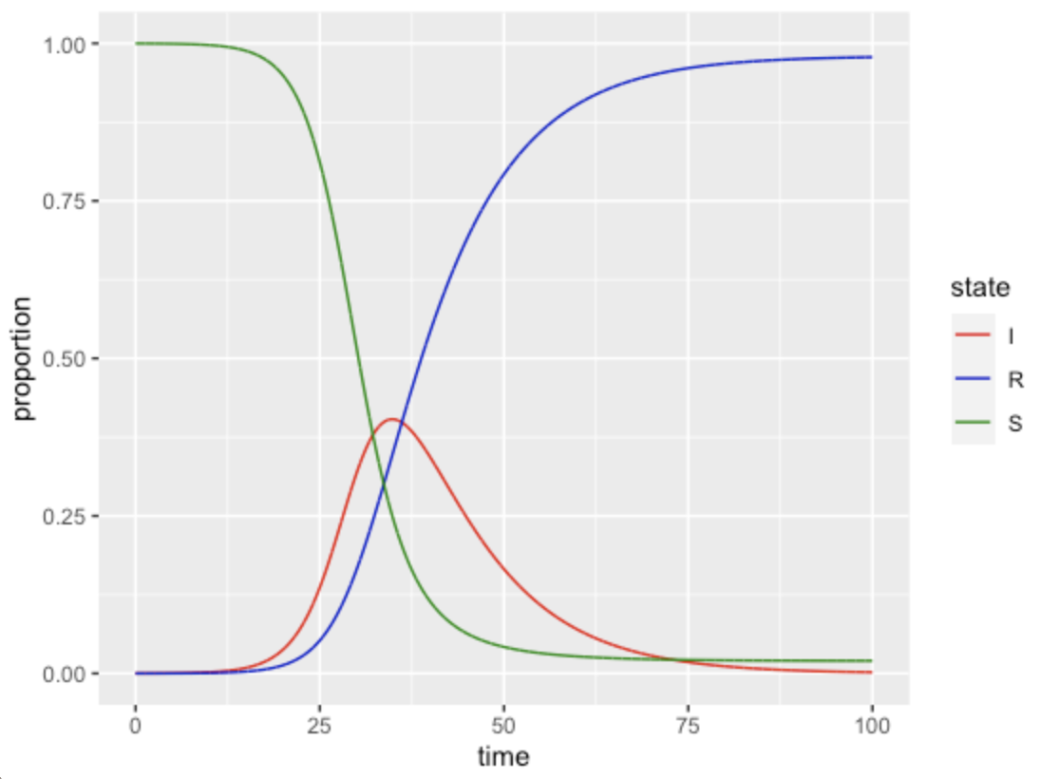
Susceptible—Infected—Recovered (SIR) model
Notes:
NOTE THAT THE Y IS PROPORTIONS.

Slide 13
Susceptible—Infected—Recovered (SIR) model
Susceptible (S)
Infected (I)
Recovered (R)
β
𝛄
β = “transmission rate”, or the per-capita rate at which two individuals come into “effective contact.”
𝛄 = “recovery rate”, or the per-capita rate at which an infected individual loses infection.

Slide 14
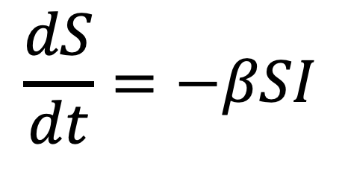
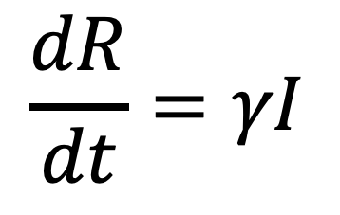
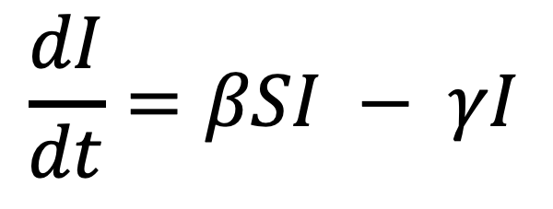
Susceptible—Infected—Recovered (SIR) model
Susceptible (S)
“transmission rate”
Infected (I)
Recovered (R)
“recovery rate”
β
𝛄
$$\frac{dS}{dt}=−βSI$$
$$\frac{dI}{dt}=βSI − γI$$
$$\frac{dR}{dt}=γI$$
Change in susceptible population per unit time.
Change in infected population per unit time.
Change in recovered population per unit time.
Notes:
-BSI = proportion of the susceptible population that comes into effective contact with an infected individual, per unit time.
BS = proportion of susceptible individuals that has an effective contact at all (it can be with another susceptible individual).
Importantly, this assumes density-dependent transmission!
The rate at which new infections occur depends on the density of both susceptible and infected individuals!

Slide 15
Susceptible—Infected—Recovered (SIR) model
Model assumptions
Random mixing -- each individual in the population has an equal probability of interacting with each other individual.
No births, deaths, immigration, or emigration.
Fixed transmission rate.
No latency period – following a successful contact, a susceptible individual is immediately infected and infectious.
Notes:
Think about each of these assumptions. When are they valid and when are they not? How do you think we might change the model structure to take some of these assumptions into account?
Go back to previous slide and think about how we would incorporate:
BIRTH/DEATH/IMM/EMM
LATENCY PERIOD

Slide 16
Basic reproduction number (R₀)
Susceptible
Infected
Notes:
Explain what infected means

Slide 17
Basic reproduction number (R₀)
(R₀) = 2
Susceptible
Infected

Slide 18
Basic reproduction number (R₀)
(R₀) = 4
Susceptible
Infected

Slide 19
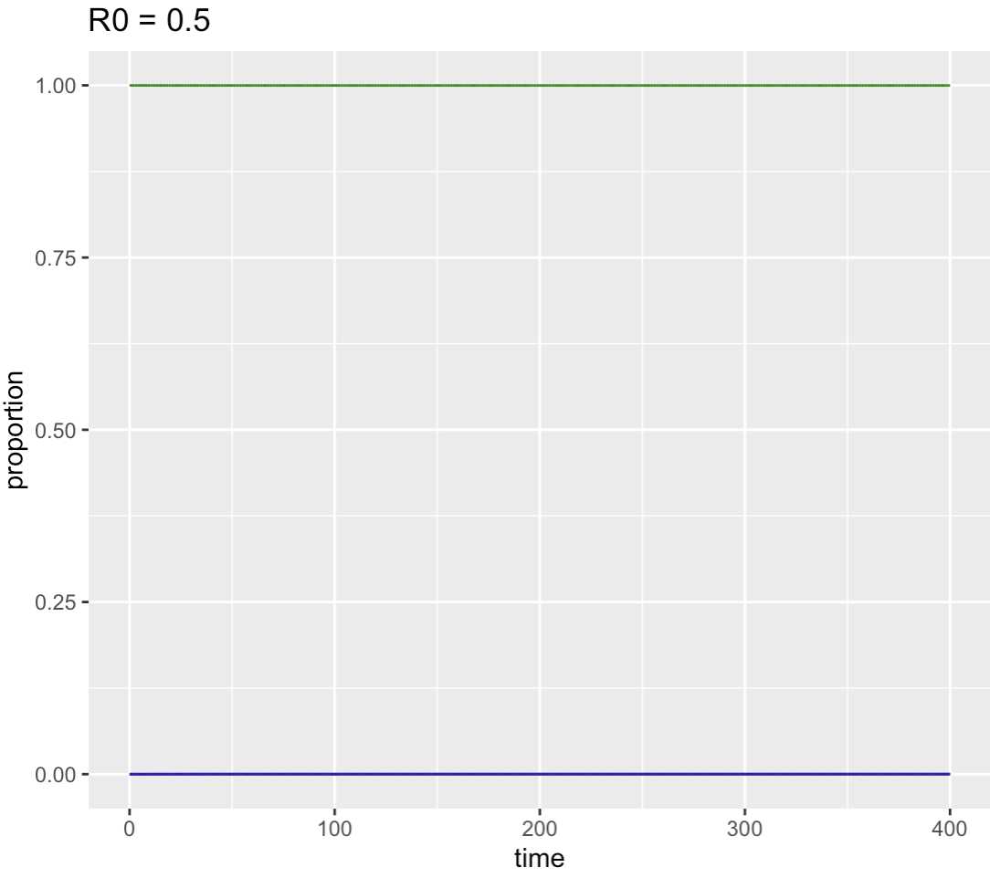
R₀ < 1; no epidemic happens!
R₀ > 1; we have an epidemic…

Slide 20
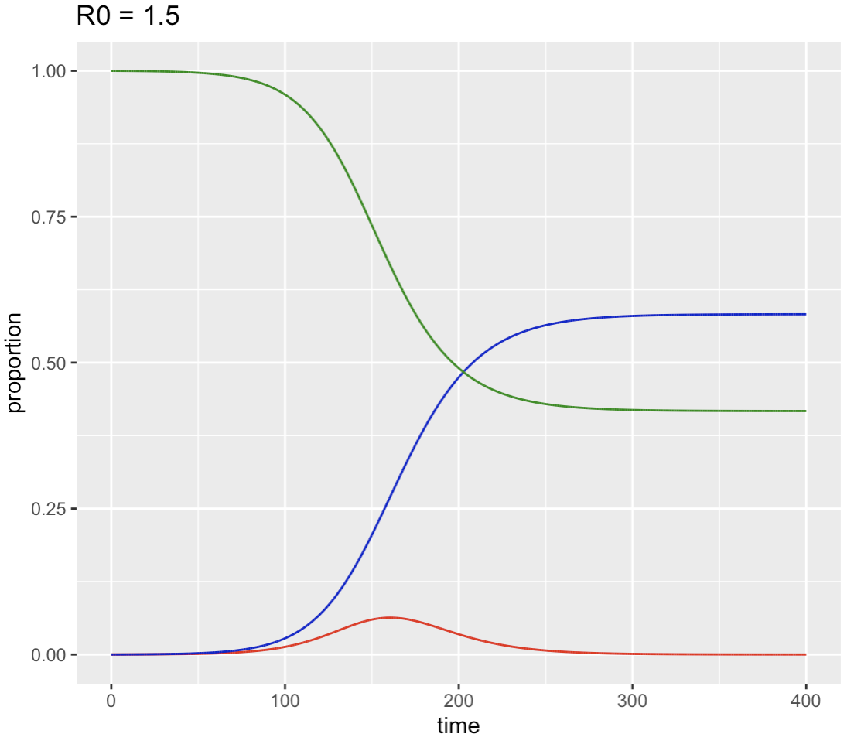
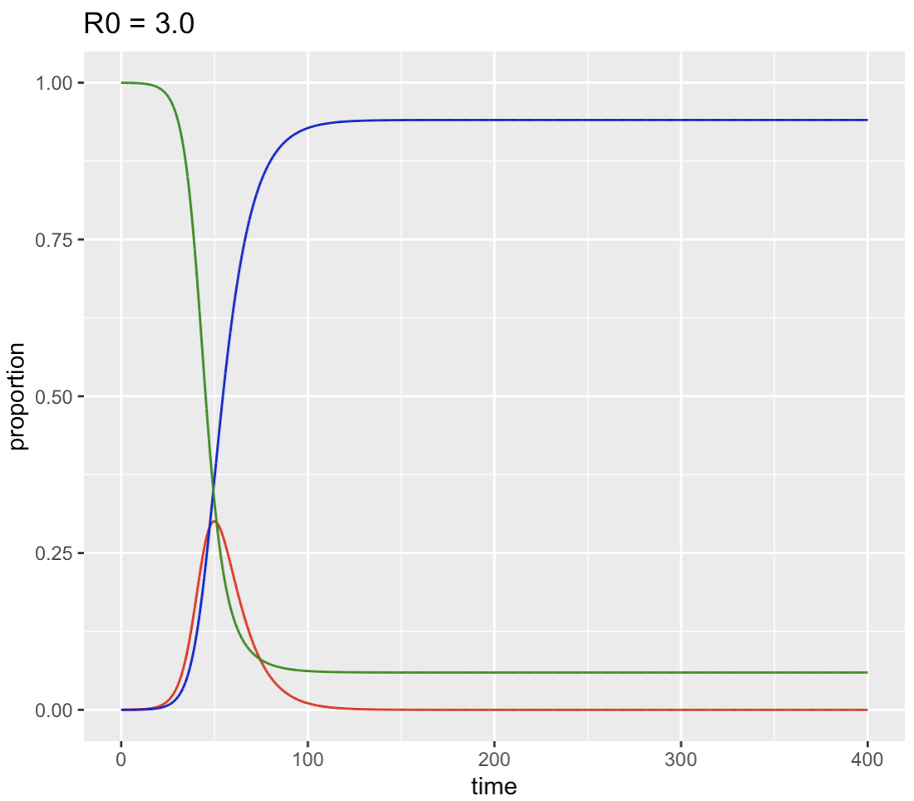
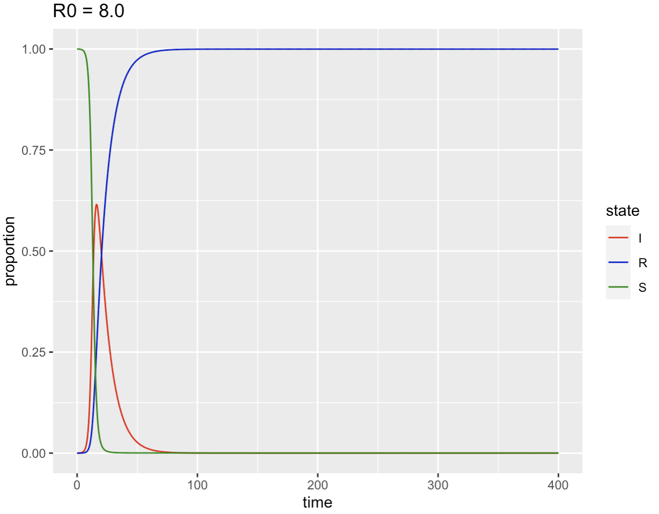
R₀ < 1; no epidemic happens!
R₀ > 1; we have an epidemic…

Slide 21
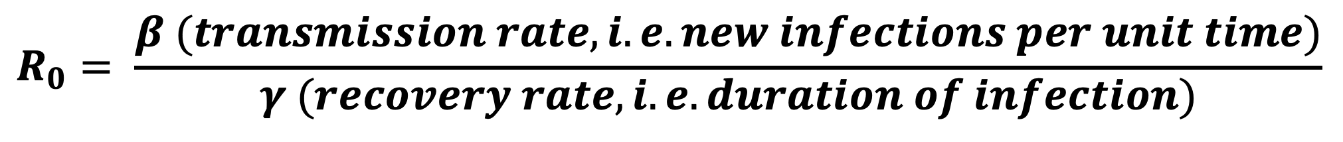
How do we calculate R₀?
Susceptible (S)
“transmission rate”
Infected (I)
Recovered (R)
“recovery rate”
β
𝛄
$$R_{0}= \frac{β (transmission rate, i.e. new infections per unit time)}{γ (recovery rate, i.e. duration of infection)}$$

Slide 22
R₀ (estimated) of various infectious diseases
COVID-19 (initial outbreak): 1.4—2.4
Ebola (2014 outbreak): 1.5—2.5
Smallpox: 3.5—6.0
Measles: 12—18
Notes:
These are estimated from fitting models, like the SIR model, to empirical data and estimating parameters like the transmission rate and recovery rate.

Slide 23
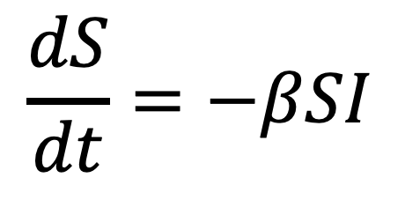
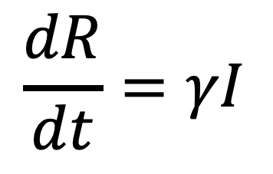
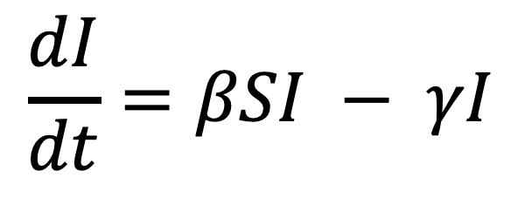
Intervention strategies
Susceptible (S)
“transmission rate”
Infected (I)
Recovered (R)
“recovery rate”
β
𝛄
$$\frac{dS}{dt}=−βSI$$
$$\frac{dI}{dt}=βSI − γI$$
$$\frac{dR}{dt}=γI$$
What are some strategies we might use to reduce the size and speed of an epidemic? How would we incorporate this into our model?
Notes:
Vaccination
Quarantine
Culling
Social distancing

Slide 24
Common variants of the SIR model
SI: Susceptible-Infected
SEI: Susceptible-Exposed-Infected
SEIR: Susceptible-Exposed-Infected-Recovered
SIRS: Susceptible-Infected-Recovered-Susceptible
SEIRS: Susceptible-Exposed-Infected-Recovered-Susceptible
Age-structured: Incorporate age classes into model with varying parameters
Spatial: Introduce a meta-population structure with multiple pools of SIRS
Multiple host species: Introduce SIRS classes for 2+ species that can infect each other.

Slide 25
SIR model exercise in R
Navigate to this GitHub repository: https://github.com/grimaudo-at/SIR_lecture

