Slide 1
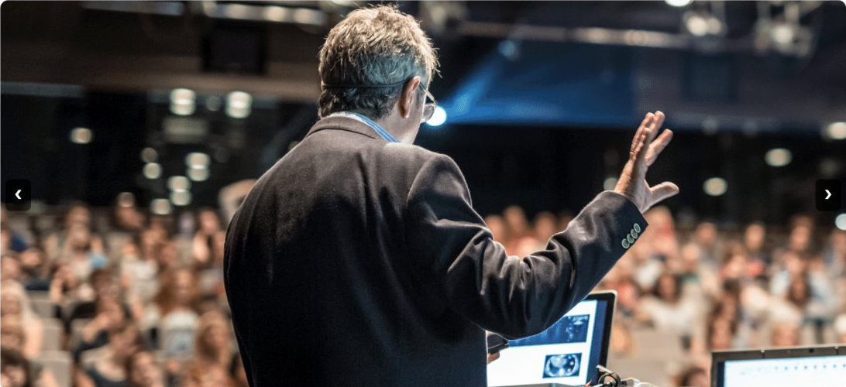
EventHub
By Patrick, Donny, Brody, Andrew, Aaron, Aaron

Slide 2
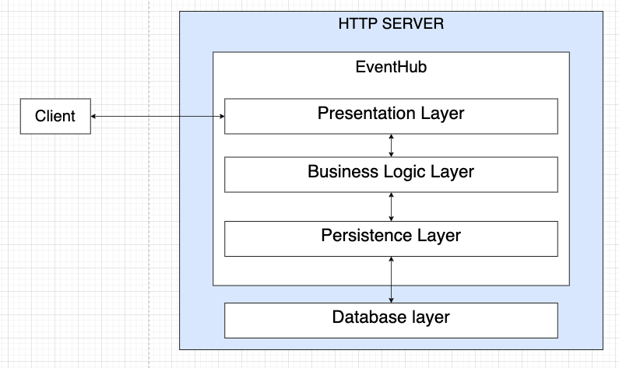
Architecture – Layered Monolith
The client sends requests to the presentation layer, which is handled by controllers in the business logic layer which use repositories in the persistence layer to access the database. A response is then sent back up to the client if necessary.

Slide 3
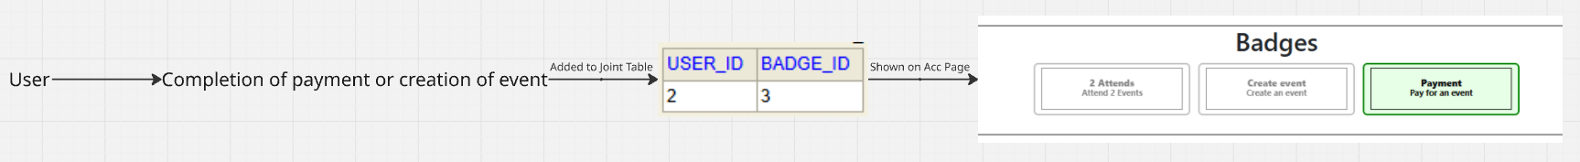
Notable feature 1 - Badges
An achievement system to motivate users to use more of EventHub's features

Slide 4
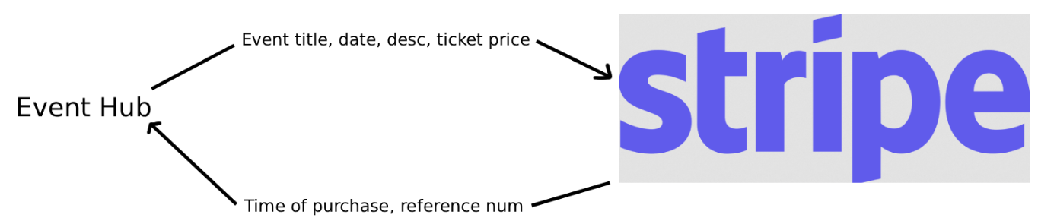
Notable feature 2 - Payments
Third party payment API that handles the purchasing of tickets to events

Slide 5
Development
Late start to tests (All non-feature tests done within the first week like milestone 2)
  Feature tests developed along with the feature
Spring-boot until Docker was implemented in milestone 3 (still spring-boot compatible)
Difficulties with flyway migrations

Slide 6
Communication
Regular meetings on Tuesday 4:00pm, Friday 10:30am and Sunday 10:00pm
Meeting times ranged from 15 minutes to multiple hours
Over time, our communication improved as we grew more comfortable as a team
We each took the lead in areas where our strengths lied

Slide 7
Retro
Collaboration in large teams
Using github project board to allocate tasks
Integrating was far harder than developing individual components
Important to lean into team member strengths
Frequent meetings led to better solutions (less rework when agreement reached)
Frequent meetings ensured we had resources / time to complete important tasks (assigning more people or extending deadlines when issues were found)
Extensive testing felt like high overhead but allowed for easy CI
Notes:
showcase image gallery /event part. Create account > create event > add image.

Slide 8
Contributions of: Patrick Ly
Sign up
Recommended events and interests
Save events
RSVP list
Creator dashboard
Relevant tests
Deploy docker images to AWS ECR

Slide 9
AWS ECR Deployment

Slide 10
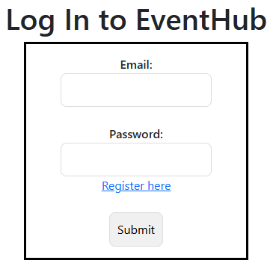
Contributions of: Andrew Loi
Creation of Log in
Creation of Event detail viewing
Creation of Badge system
Relevant functions and tests for features
Notes:
My list of stuff for presentation:
- Do small showing of the event details shown when clicking view event details
- Show badges, then achieve atleast 1 (pay for 1 event, or create one, 2 attends is legit just 2 payments)

Slide 11
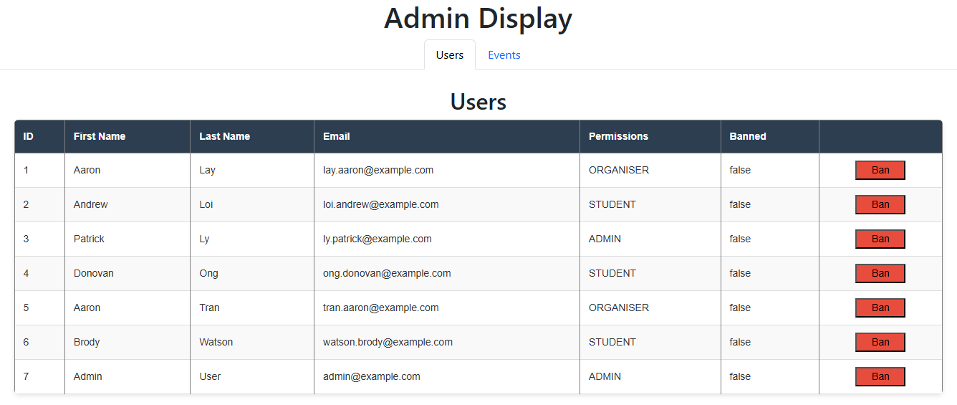
Contributions of: Aaron Tran
Creation of H2 database
Refactoring into MySQL and Docker
Creation of Admin page and associated functionality
Created tests related to my contributions and filled in gaps in other
Notes:
Show admin page

Slide 12
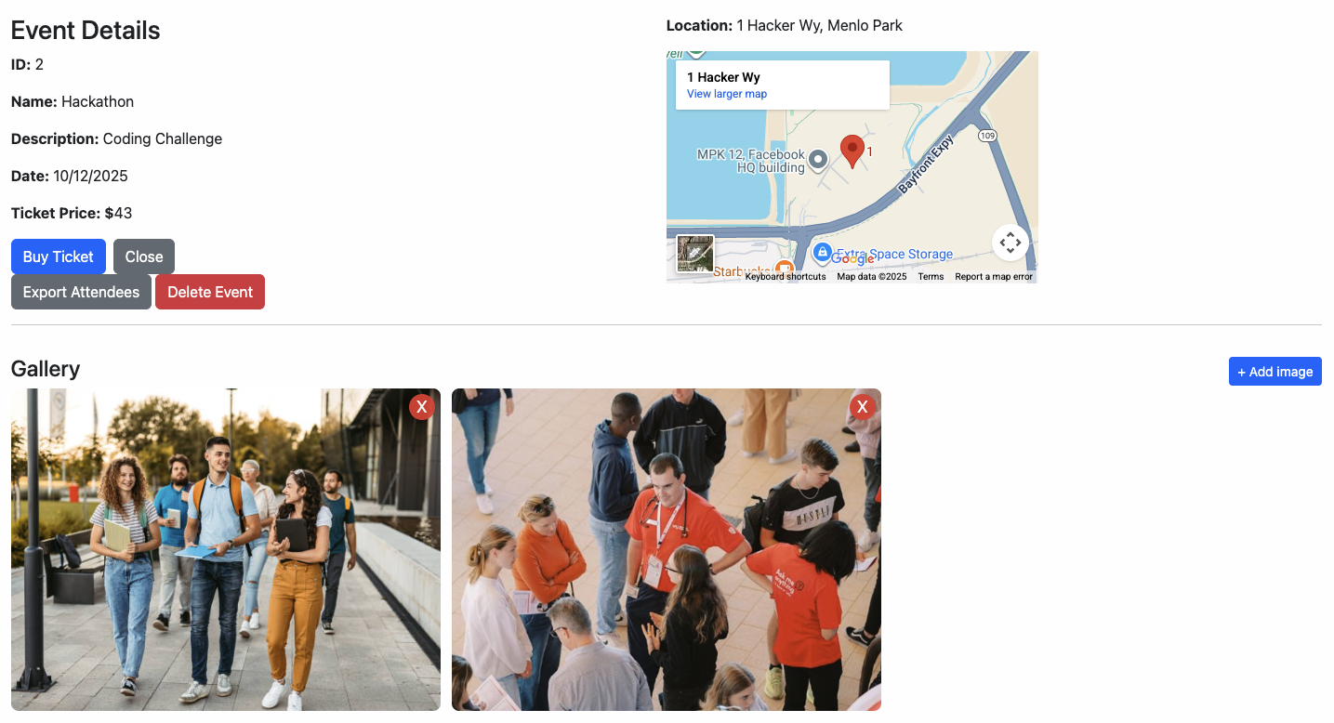
Contributions of: Donovan Ong
Create layout (nav bar and footer)
Create home page
Create / Integrate image gallery with event details
Create payments (later superseded)
Create / Integrate feedback form with event details
Relevant tests

Slide 13
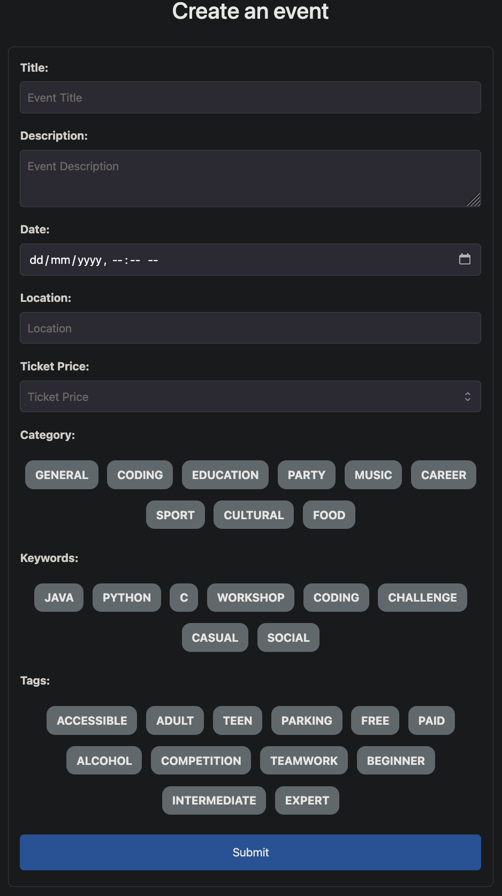
Contributions of: Aaron Lay
Creation of Events Feed
Creation of Create Events Page
Relevant functions for events feed and create events page
Tests for Events Feed, Create Events, Feedback Form and Payment controller

Slide 14
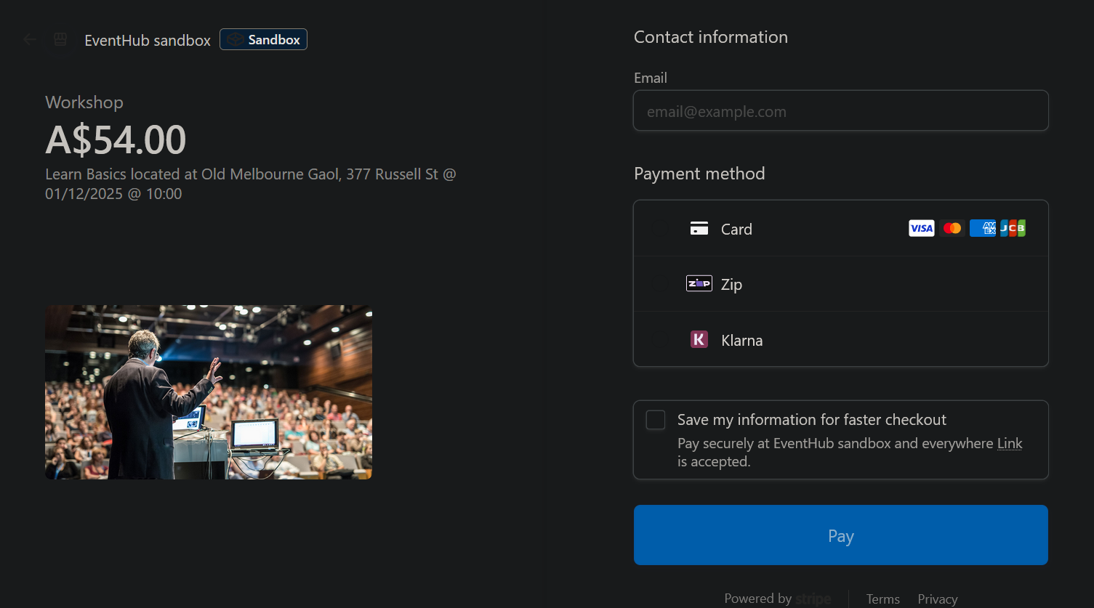
Contributions of: Brody Watson
Embedding of Location for events on Google Maps
Ability to export the attendees of an event to a formatted CSV
Creation / Refactoring of Payments Page
  creation of a receipt page with the option to export the receipt as a pdf
  integration of third-party payment service Stripe

Slide 15
The End

