Slide 1
Tea 06/05/2026

Slide 2
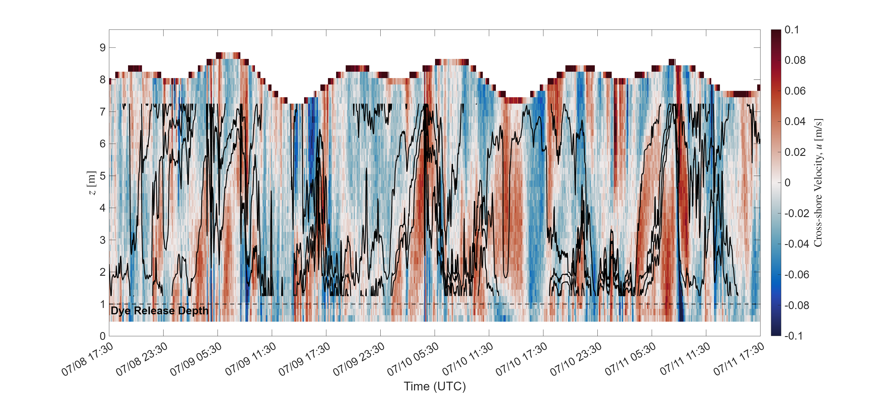
M1 (outside kelp)

Slide 3
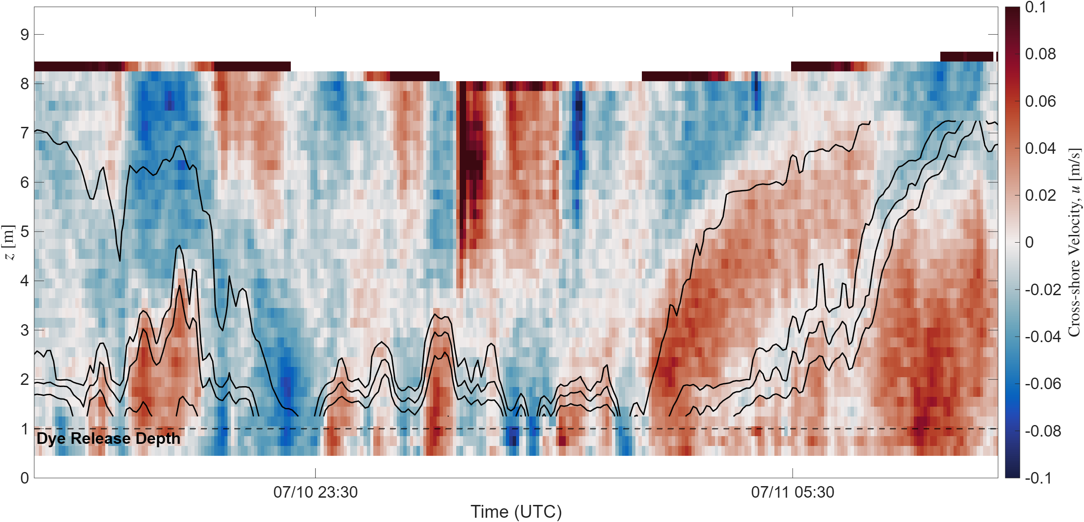
M1 (zoomed)

Slide 4
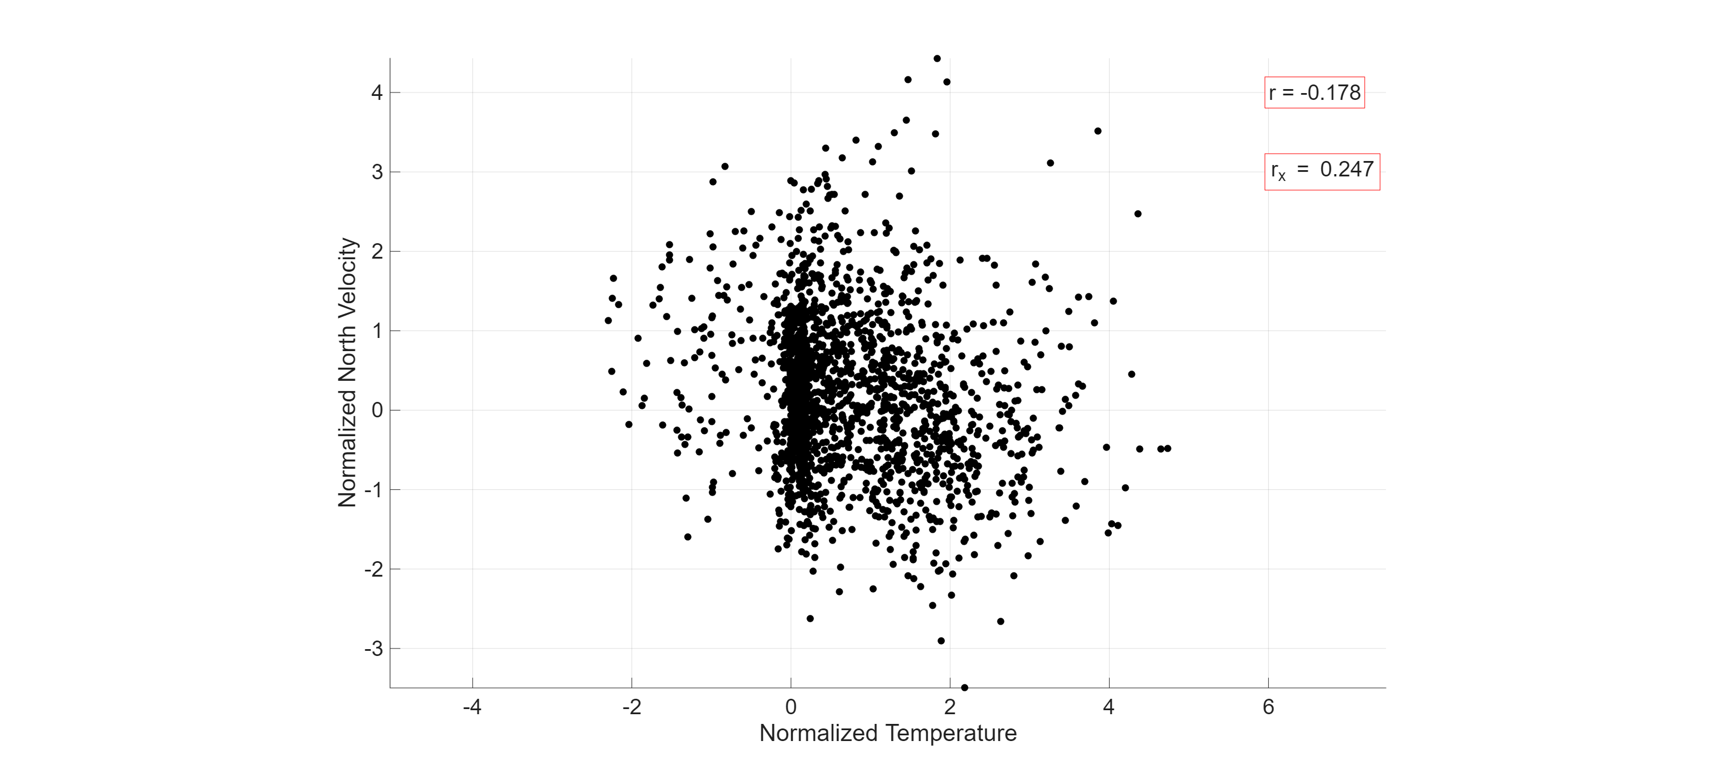
Correlations, Temperature vs Velocity (2.3 mab)

Slide 5
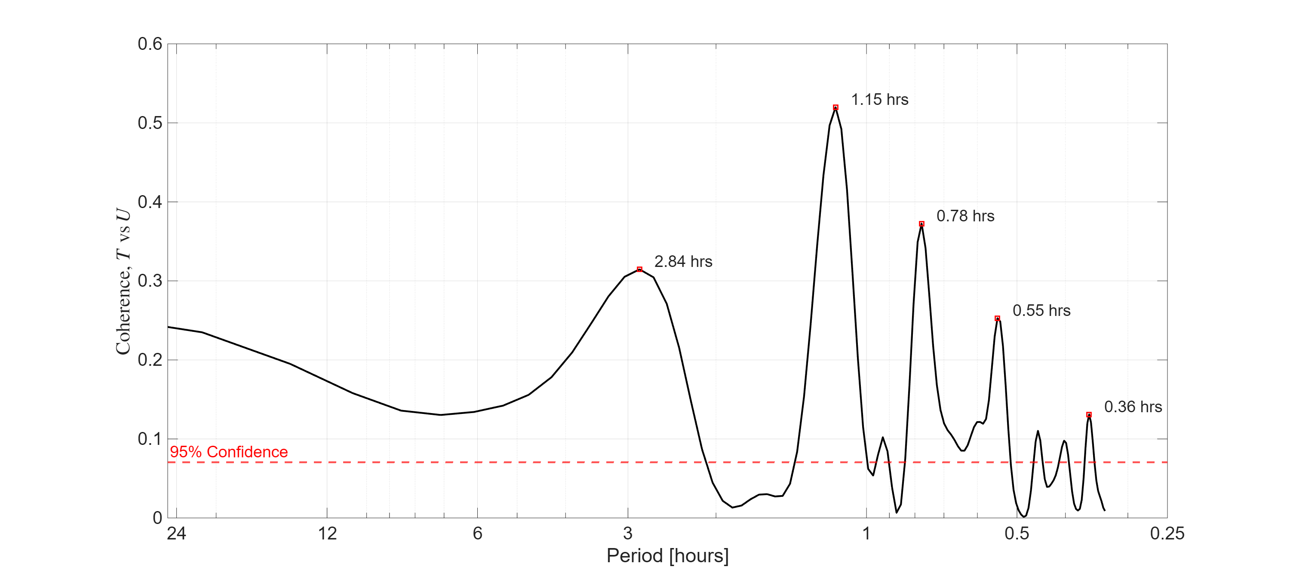
Magnitude-Squared Coherence, M1

