Slide 1
YCSEC-A Poster Outline

Slide 2
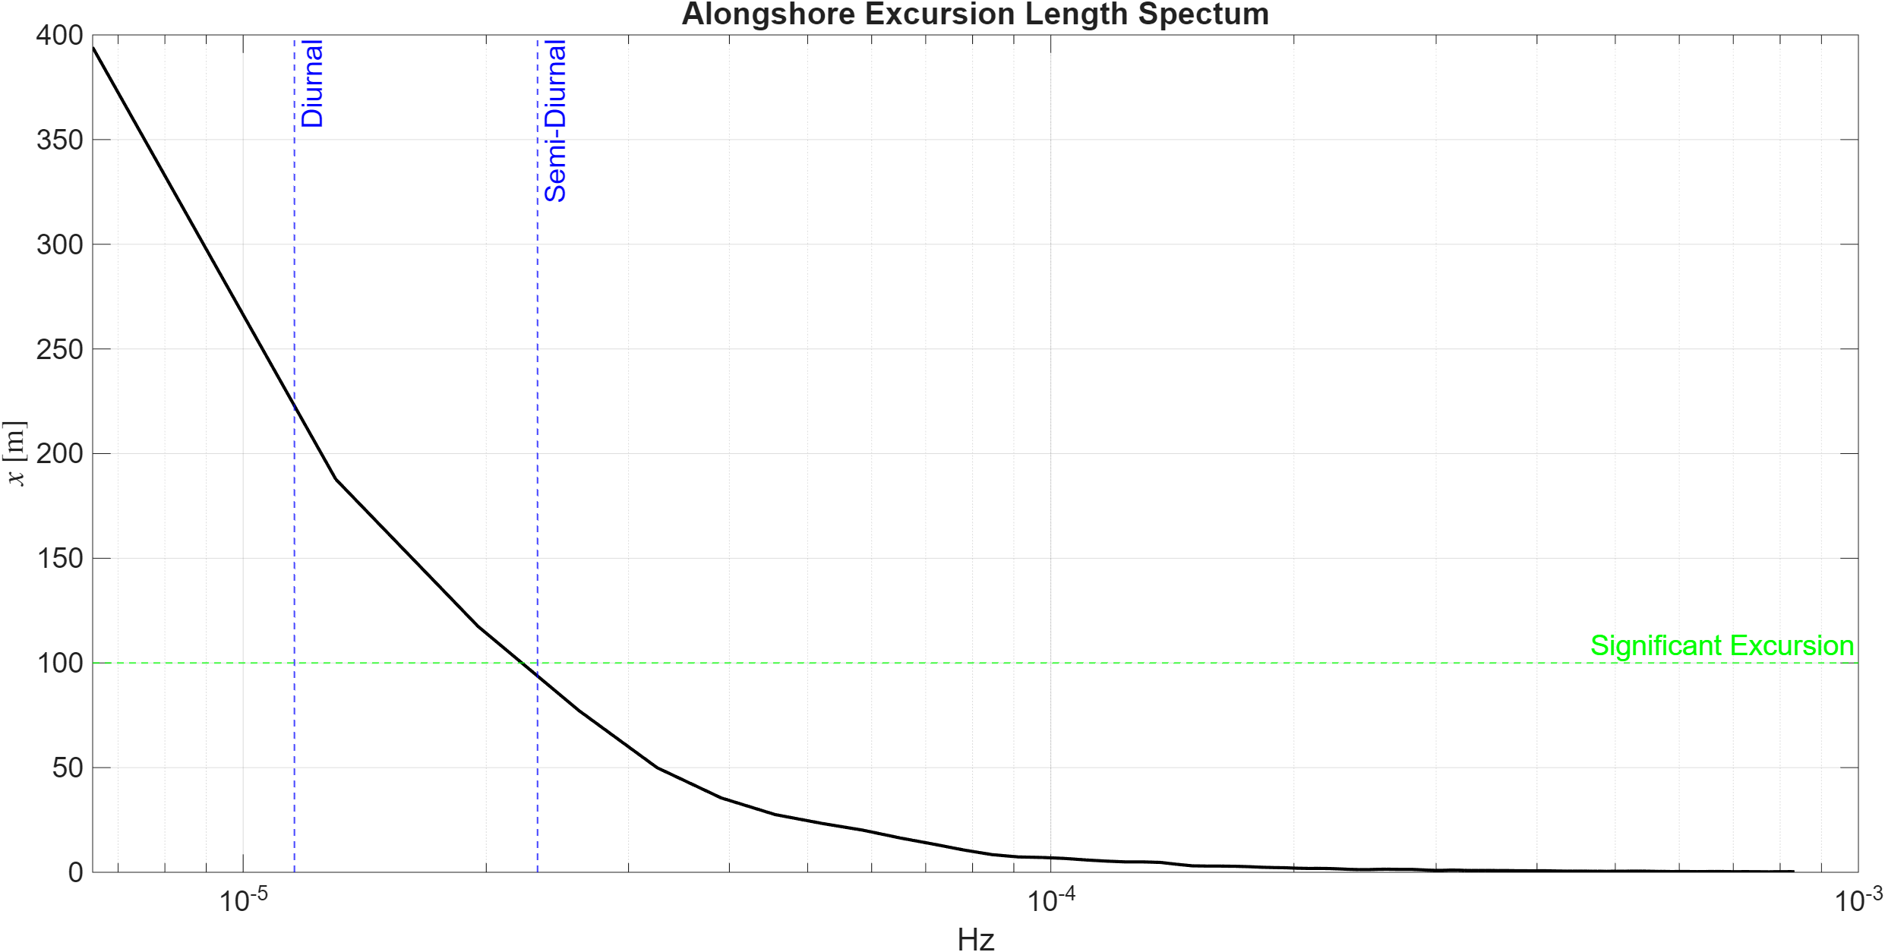
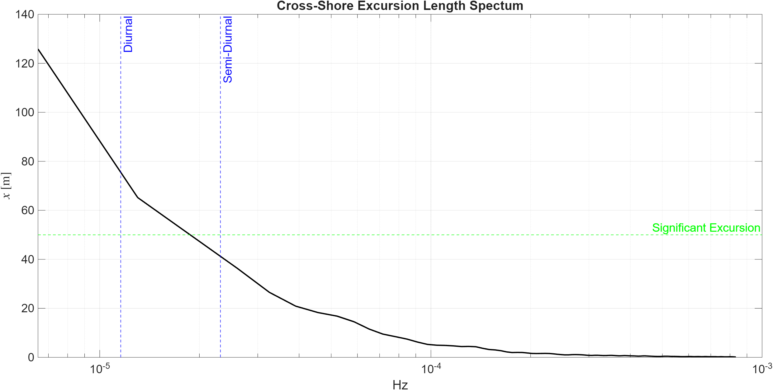

Dominant Advection Currents
$$X_RMS=\sqrt{PSD ∗Δf}/2πf$$
Low frequencies have much larger advection (X_rms) than higher frequency waves

Slide 3
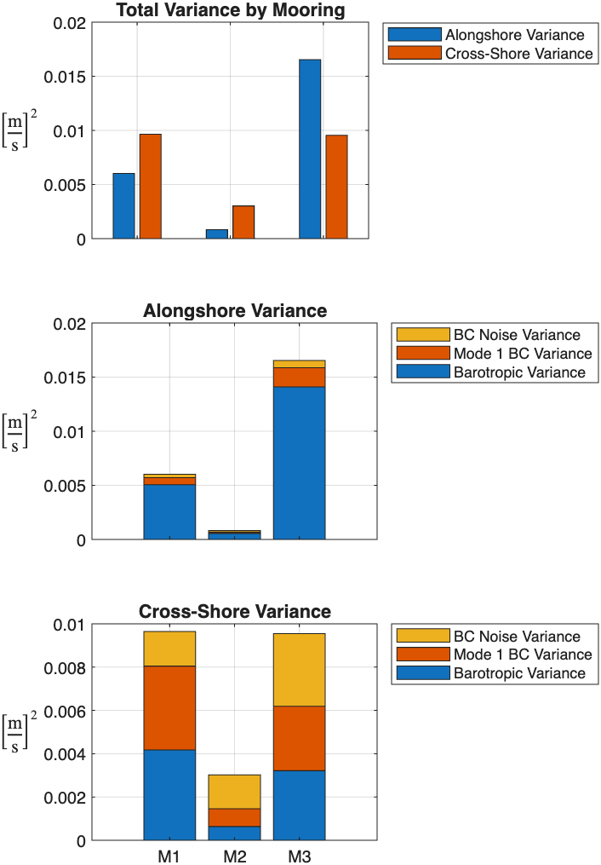
Low-Frequency Variance Breakdown
Alongshore Variance is higher than Cross-shore for M1 and M3. M3 has very large alongshore variance…
Alongshore variance is predominantly barotropic
Cross-shore variance is predominantly baroclinic, with a substantial contribution from 1st baroclinic mode

Slide 4
Low frequency currents
EOFs of velocity and temperature strongly suggest broad-band internal wave action at all moorings. Coherence and phase suggest that velocity and temperature are linked (infer velocities from temp?)

Slide 5
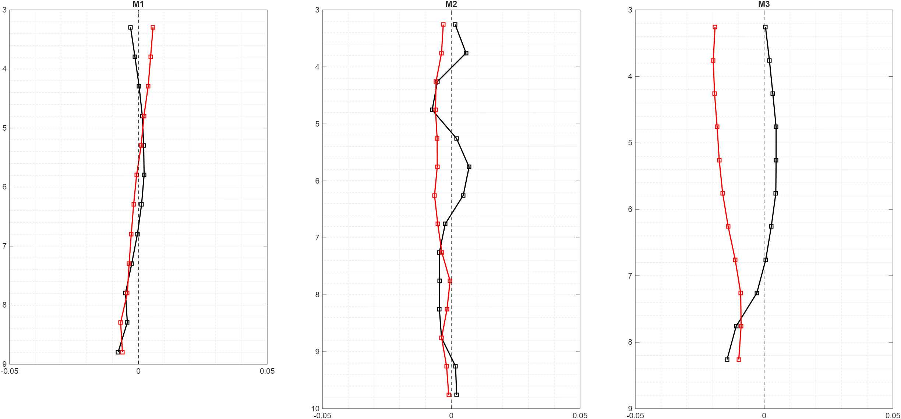
Mean Current Profiles

Slide 6
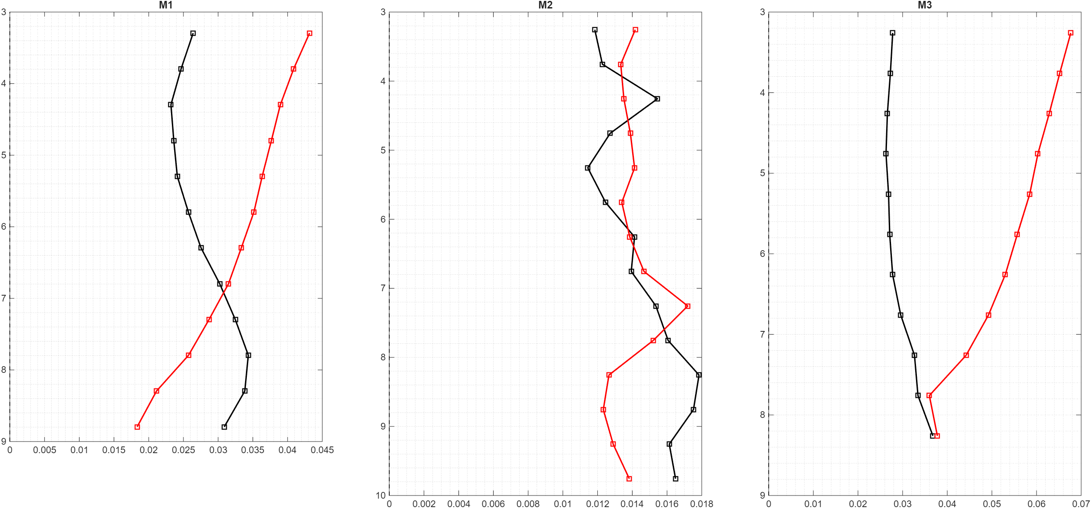
Current Variability

Slide 7
Flow attenuation
Compare flow magnitude at dominant frequencies inside vs outside forest (single scatterplot, or maybe one cross and one alongshore)

Slide 8
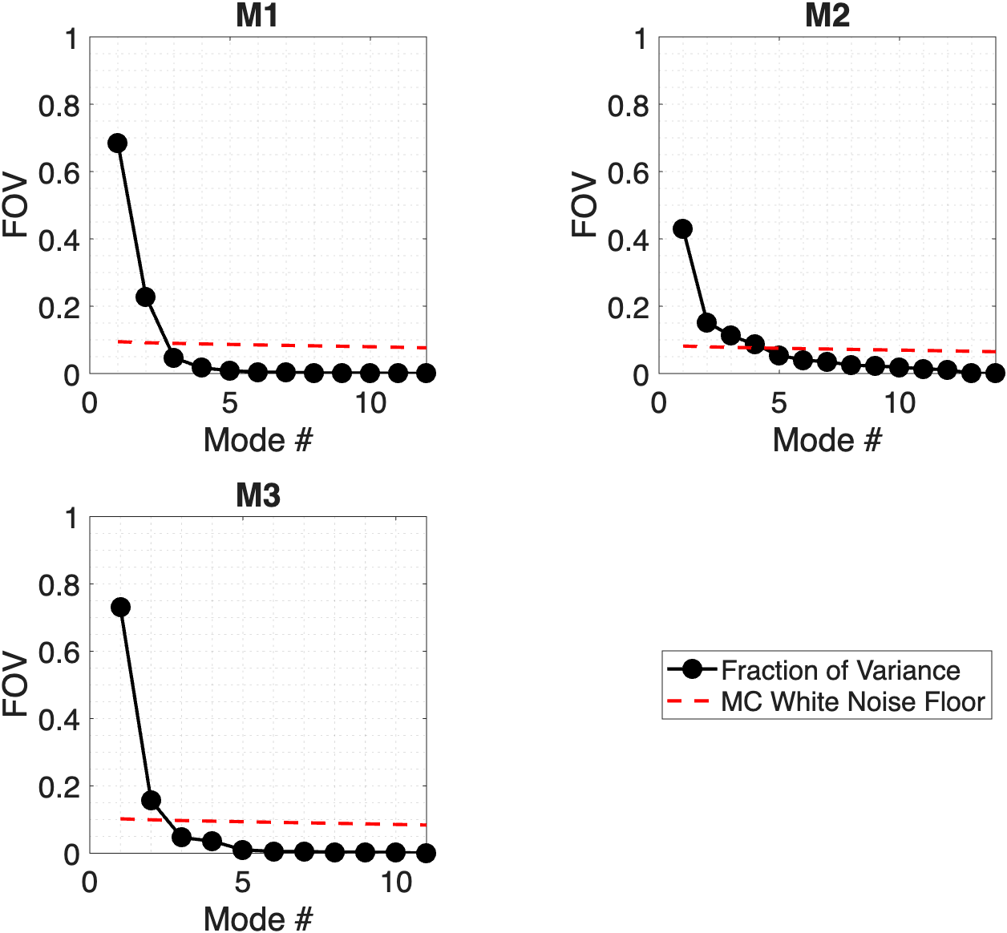
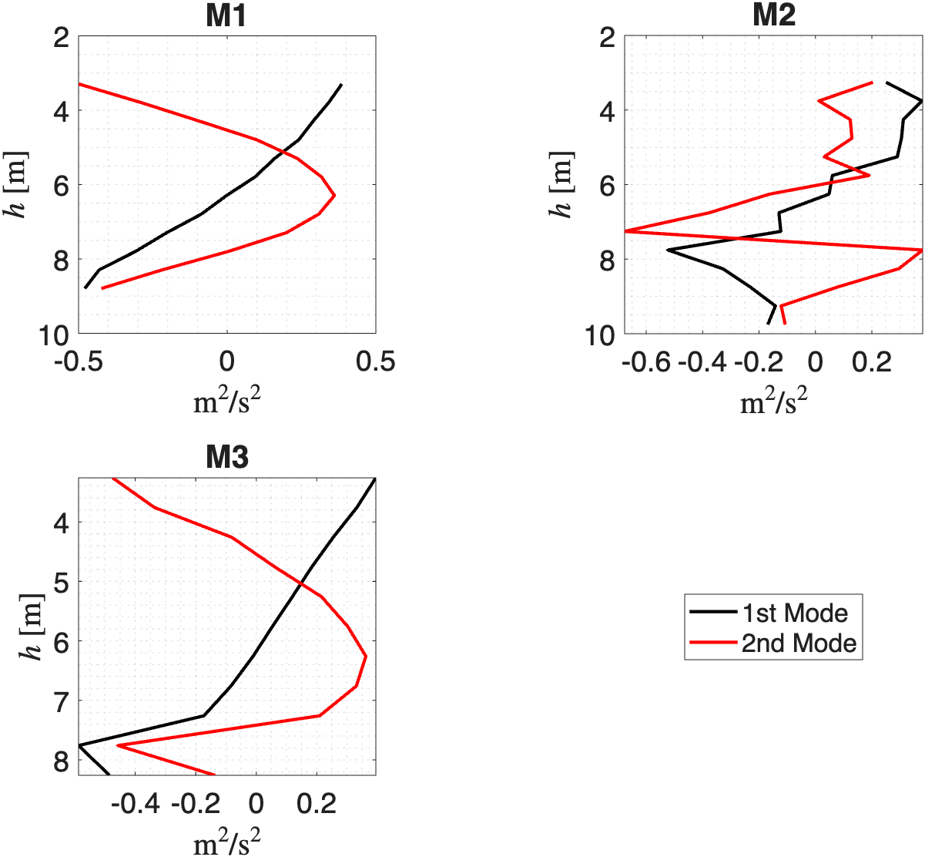
Alongshore Baroclinic Velocity EOFs

Slide 9
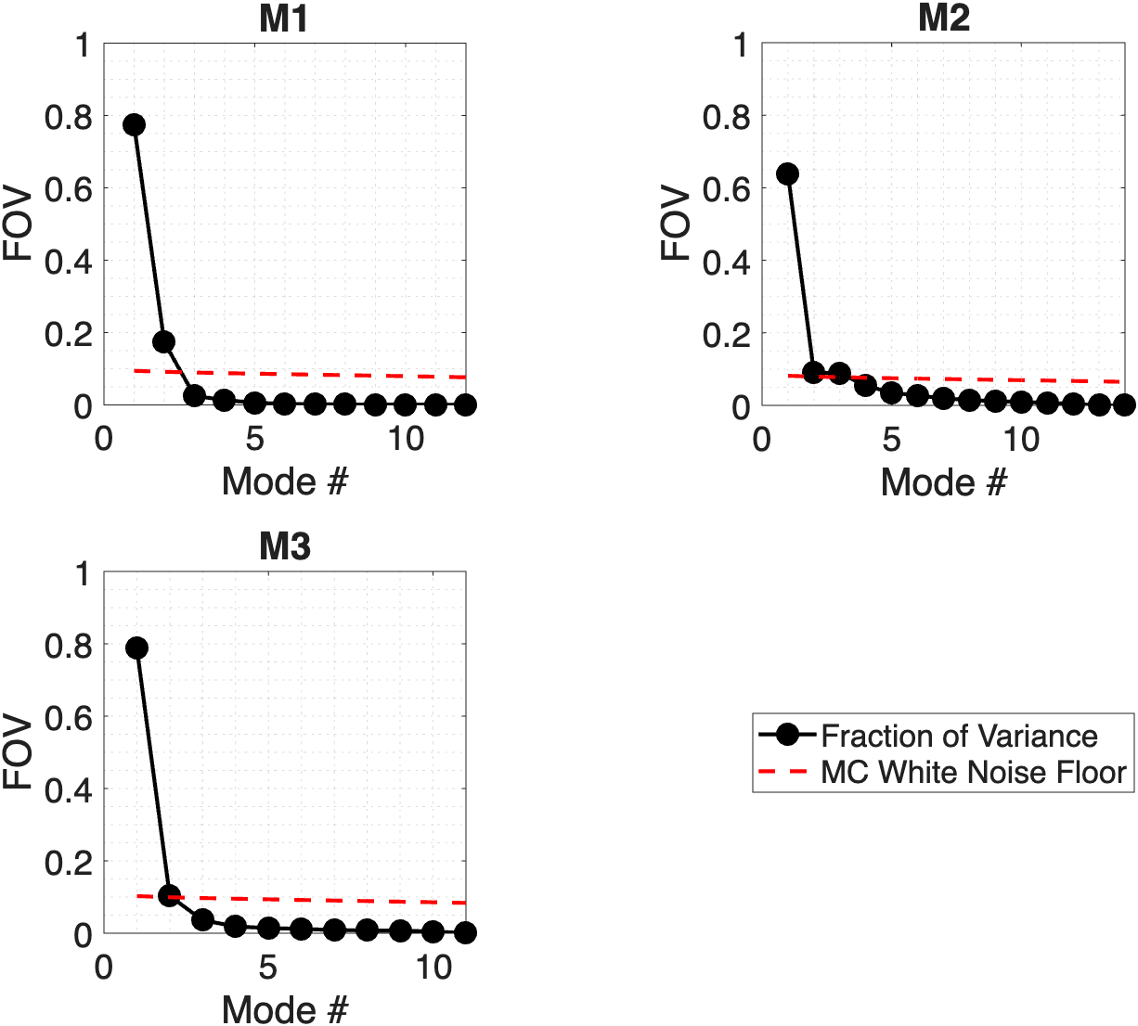
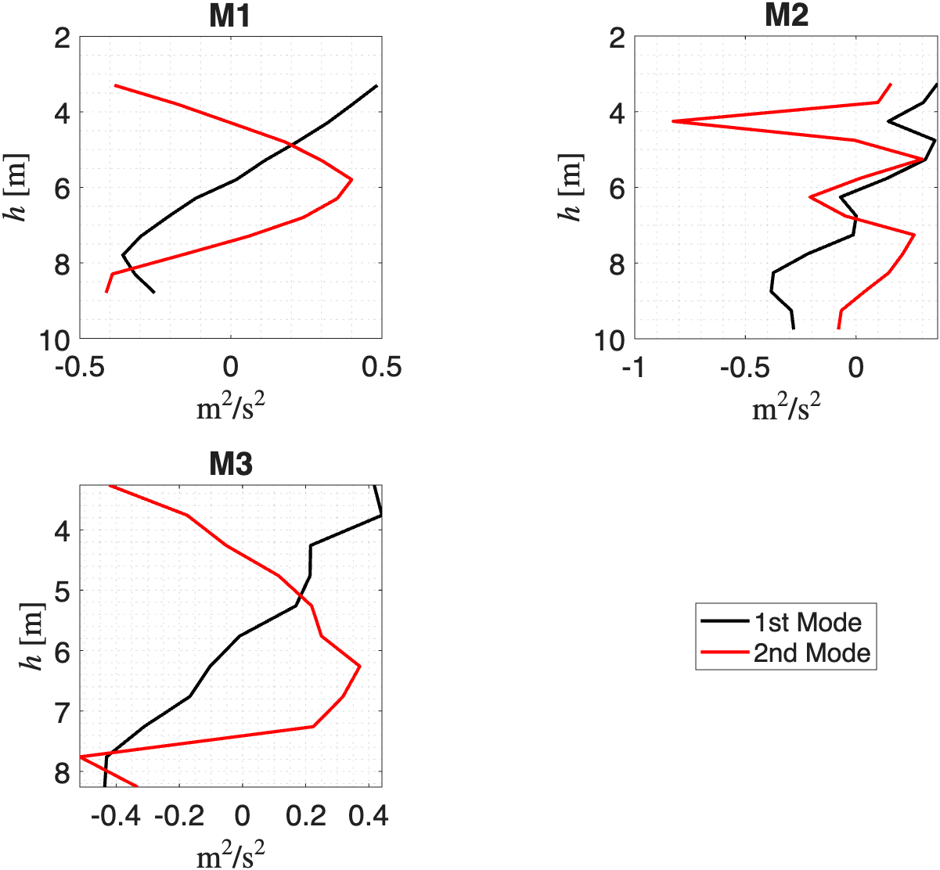
Cross-shore Baroclinic Velocity EOFs

Slide 10
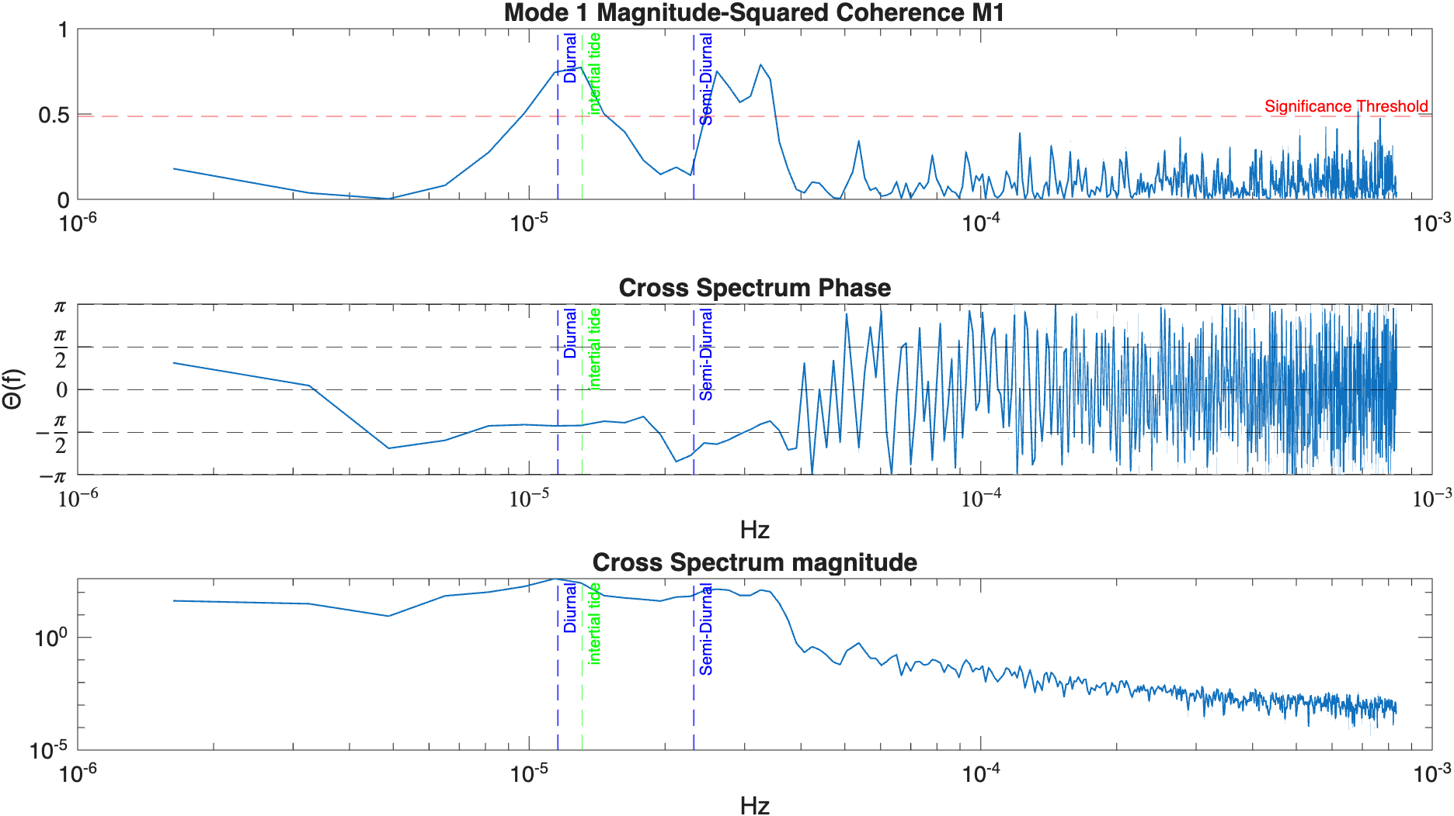
Cross-shore Velocity and Temperature Coherence
Mode one shows high coherence in the diurnal/inertial band and just below the semidiurnal band.
Phase is relatively stable at –pi/2 which is consistent with what is
expected from internal waves
There is material energy at these frequencies.

Slide 11
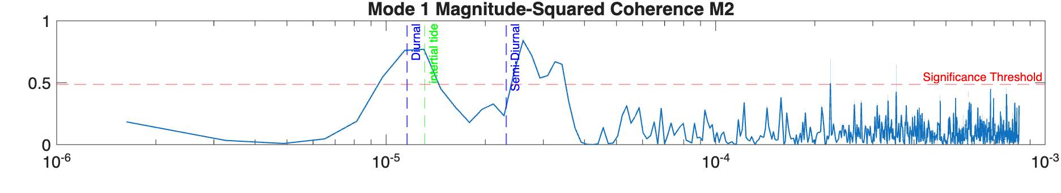

Cross-shore Velocity and Temperature Coherence Between sites

Slide 12
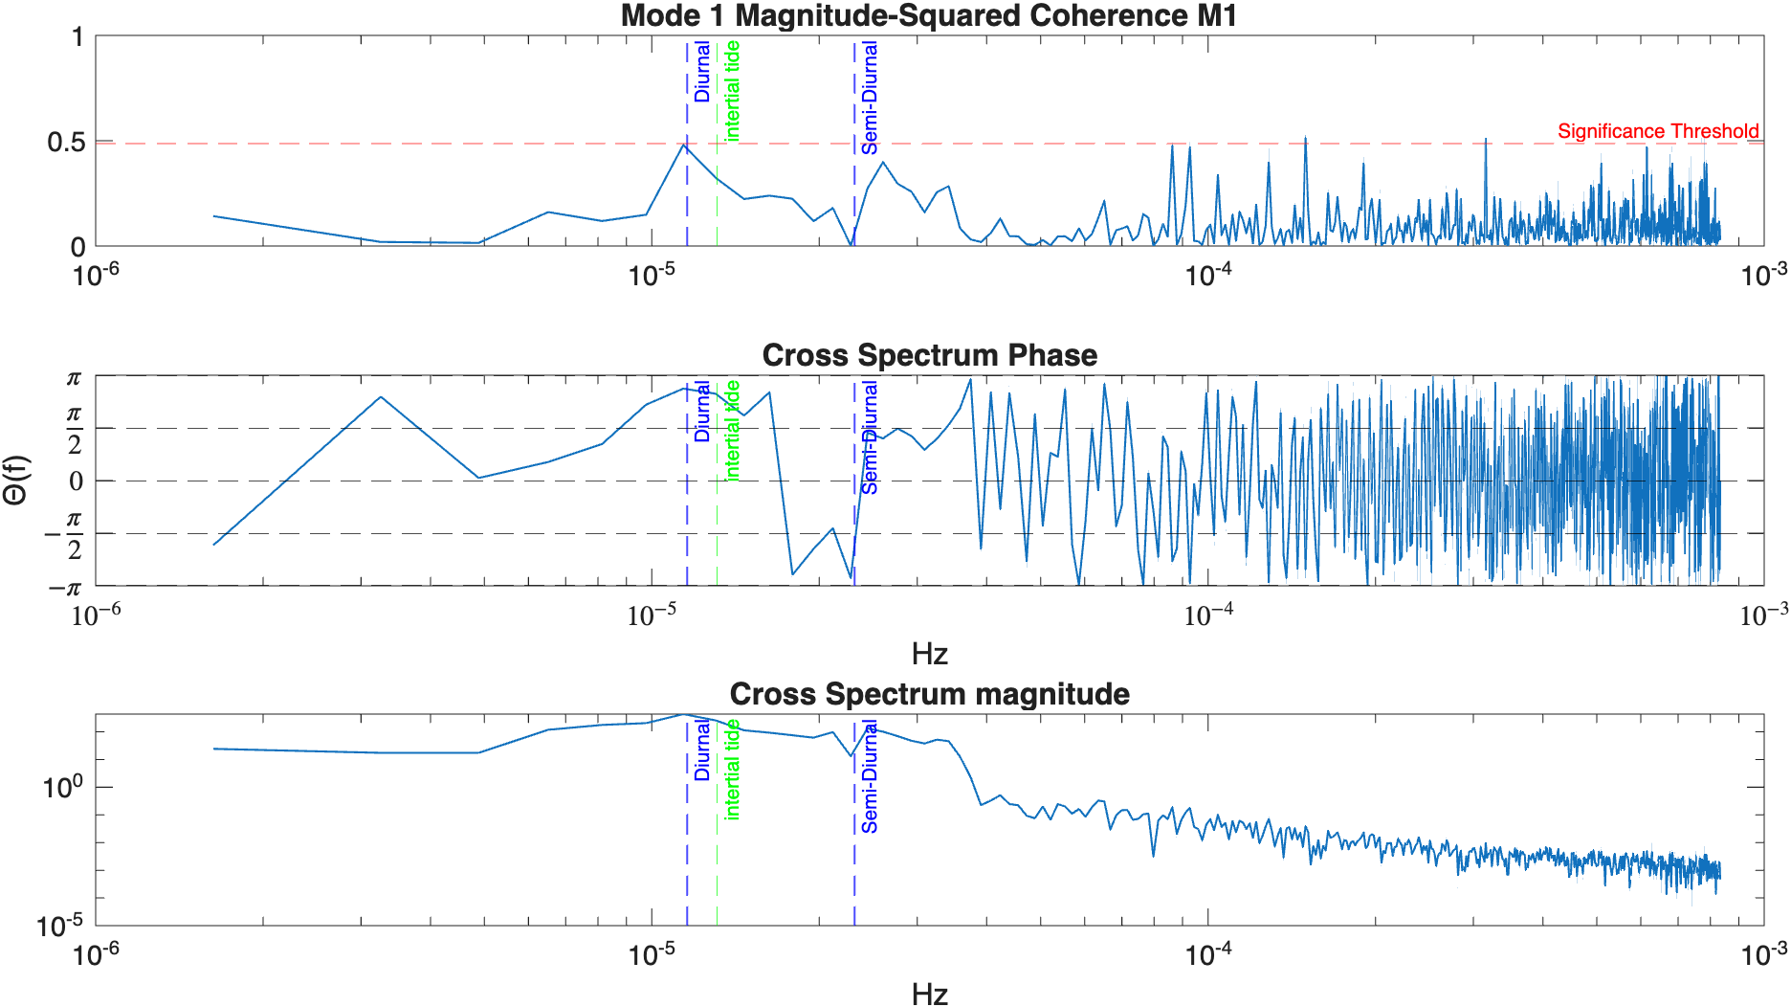
Alongshore Velocity and Temperature Coherence
Mode one shows very little coherence, with small peaks in similar bands to the cross-shore, probably because propagation and coordinate system might not be completely aligned
Phase is much less stable in the alongshore

Slide 13
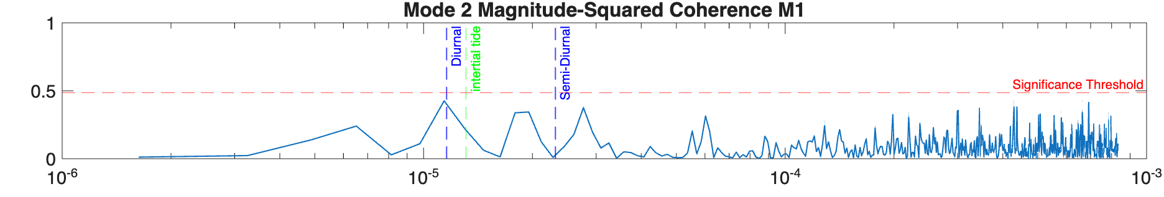


Alongshore Velocity and Temperature Coherence

Slide 14
Wave Energy Dissapation
How do internal waves transform as they move from M4-M1 and M1-M3
How do they transform M1-M2?
How do those two changes compare

