Slide 1
7/16/2026

Slide 2
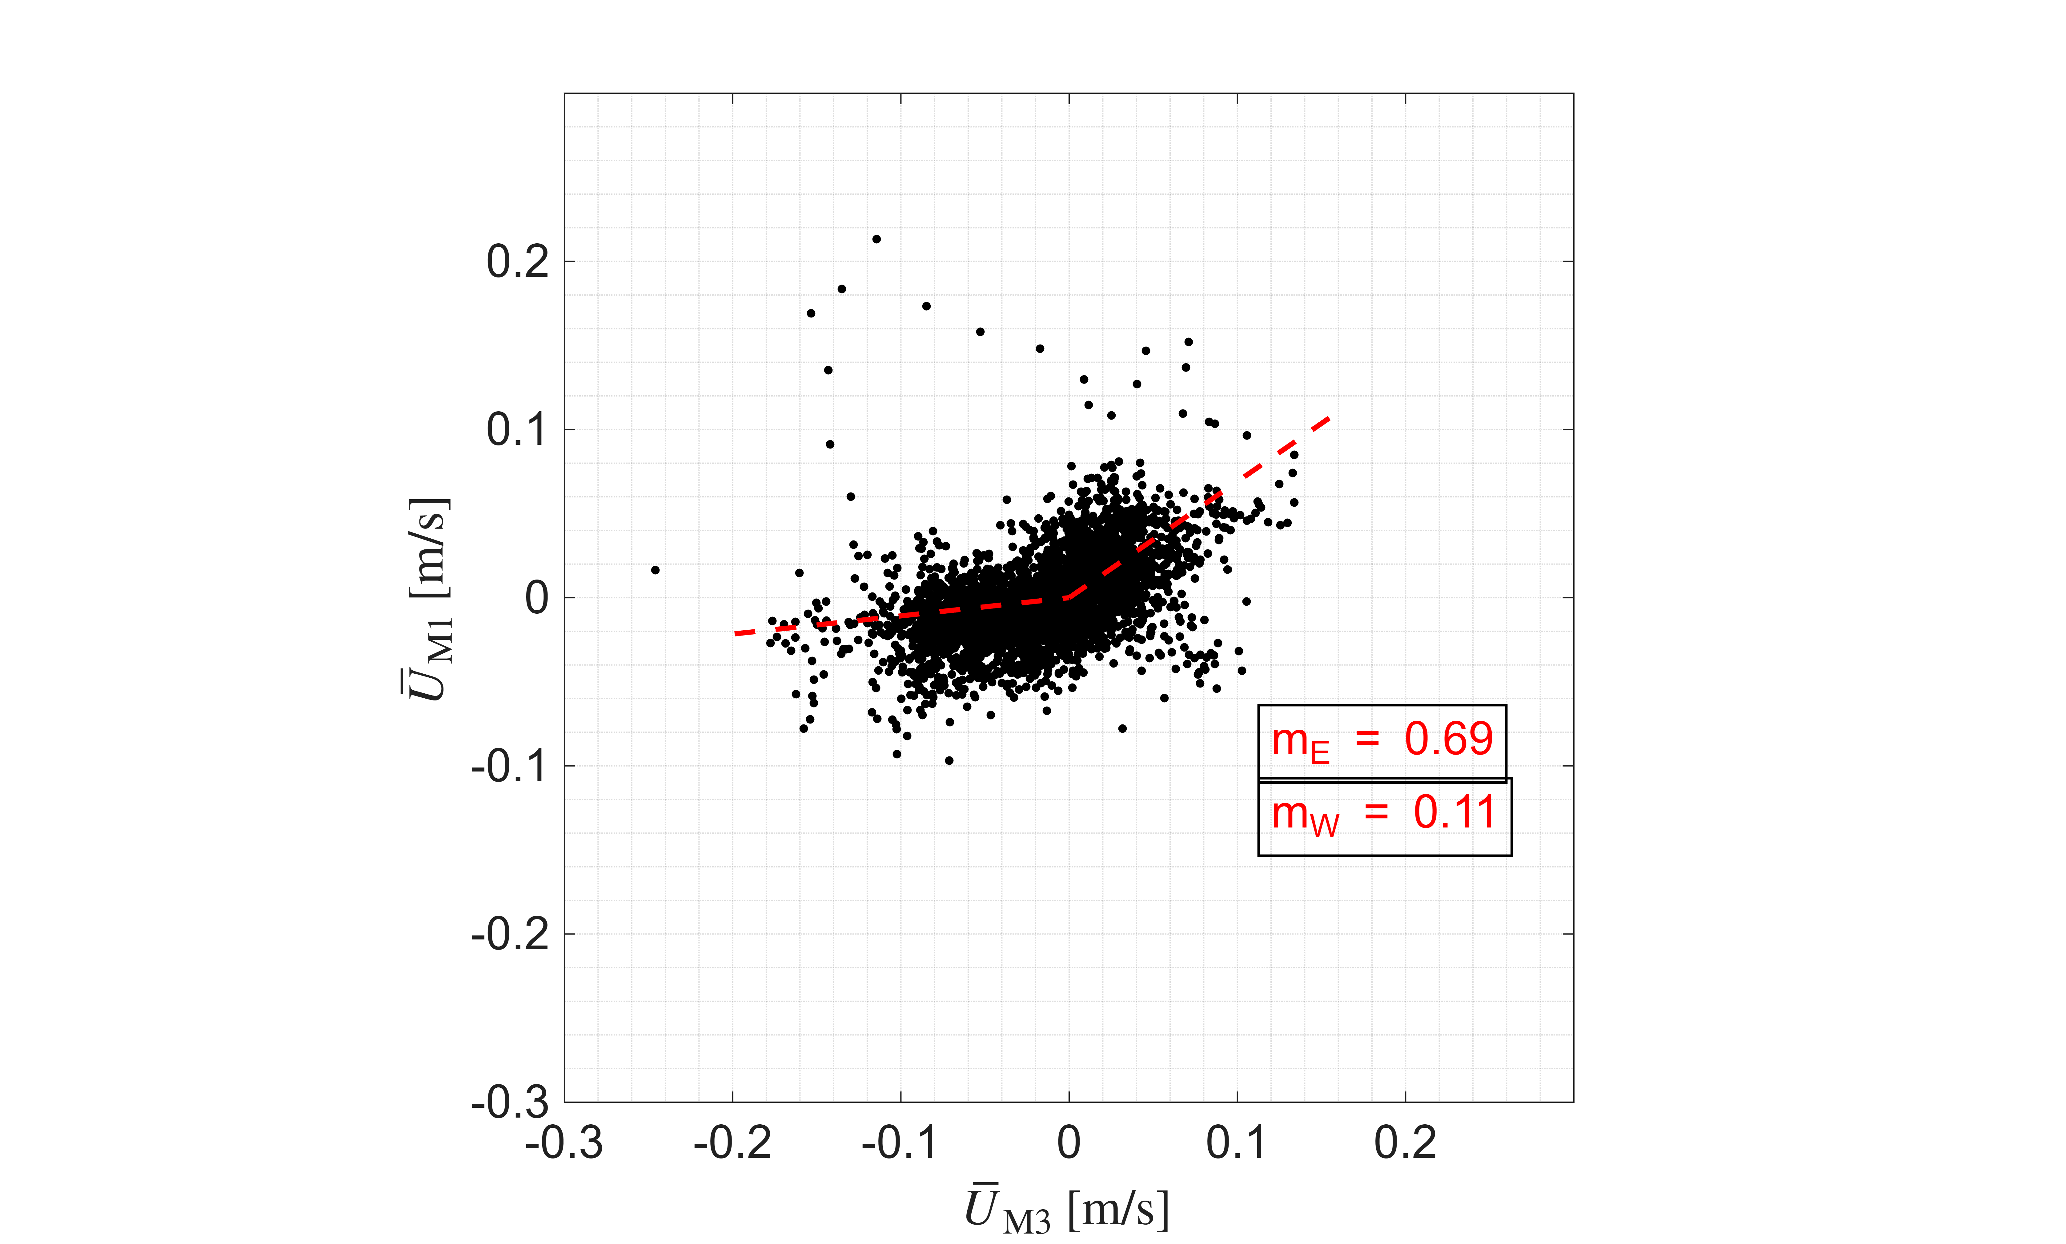
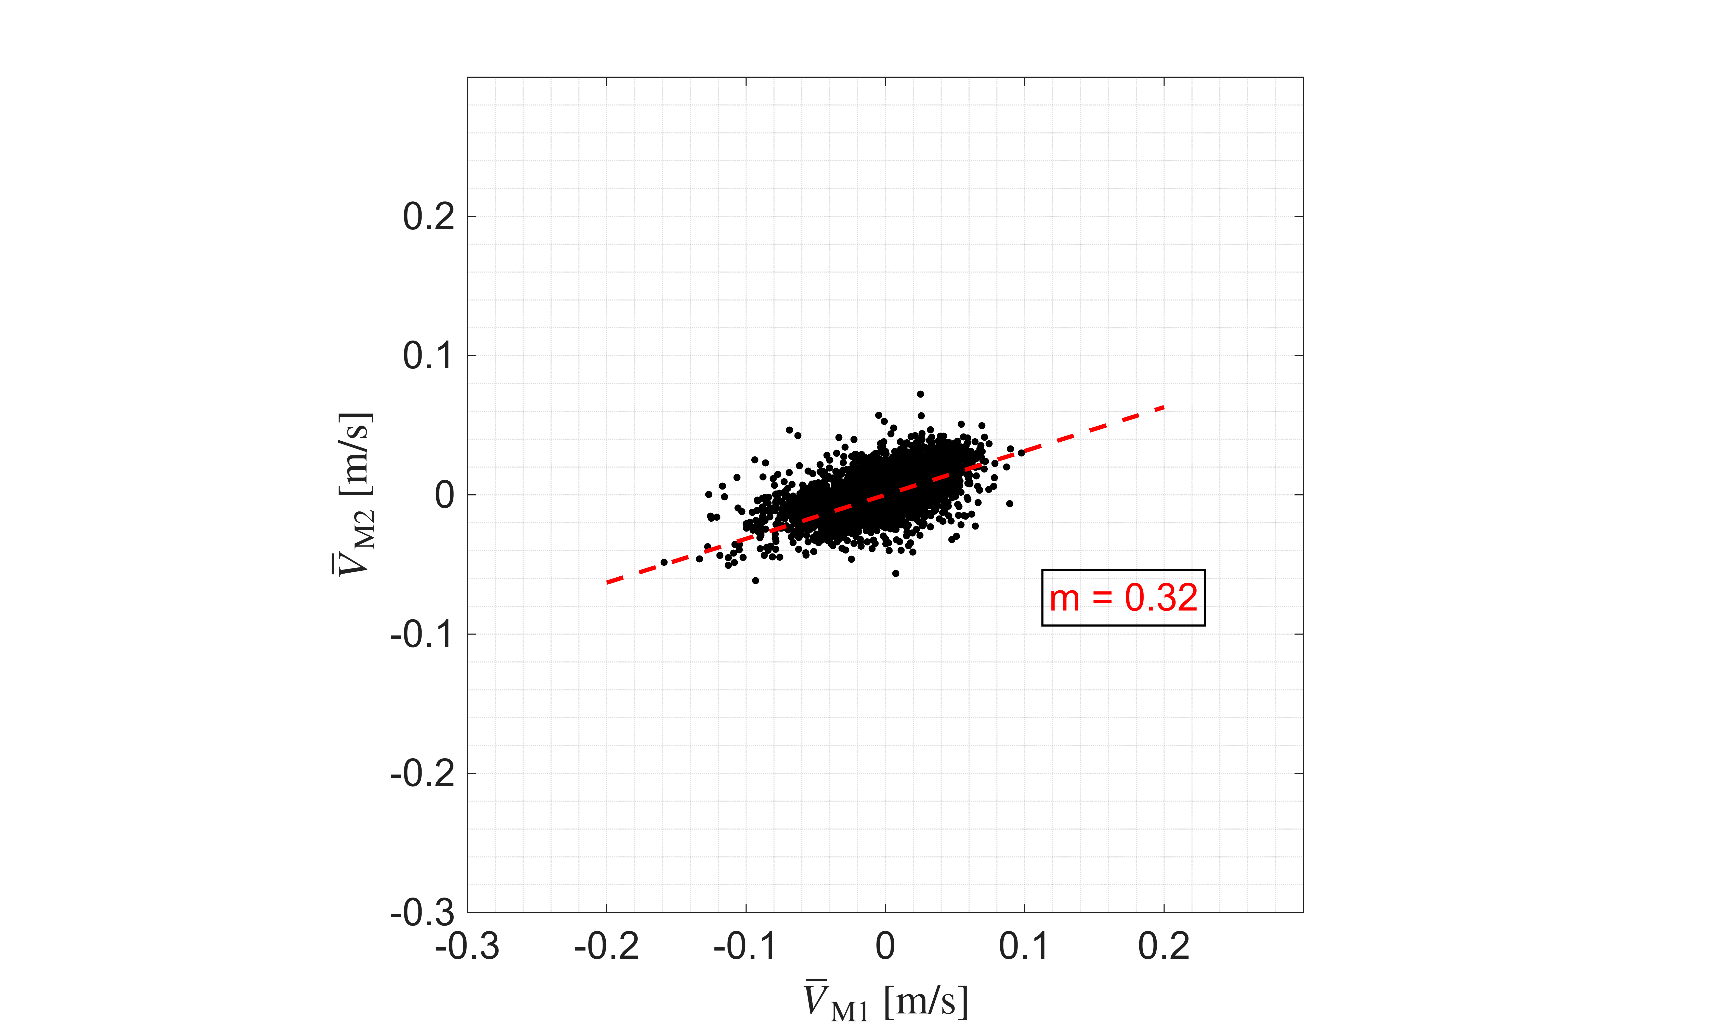
Currents
Near-Bottom Currents are attenuated in both the Cross-shore and Alongshore Directions
Alongshore currents are attenuated differently by direction due to placement relative to forest

Slide 3
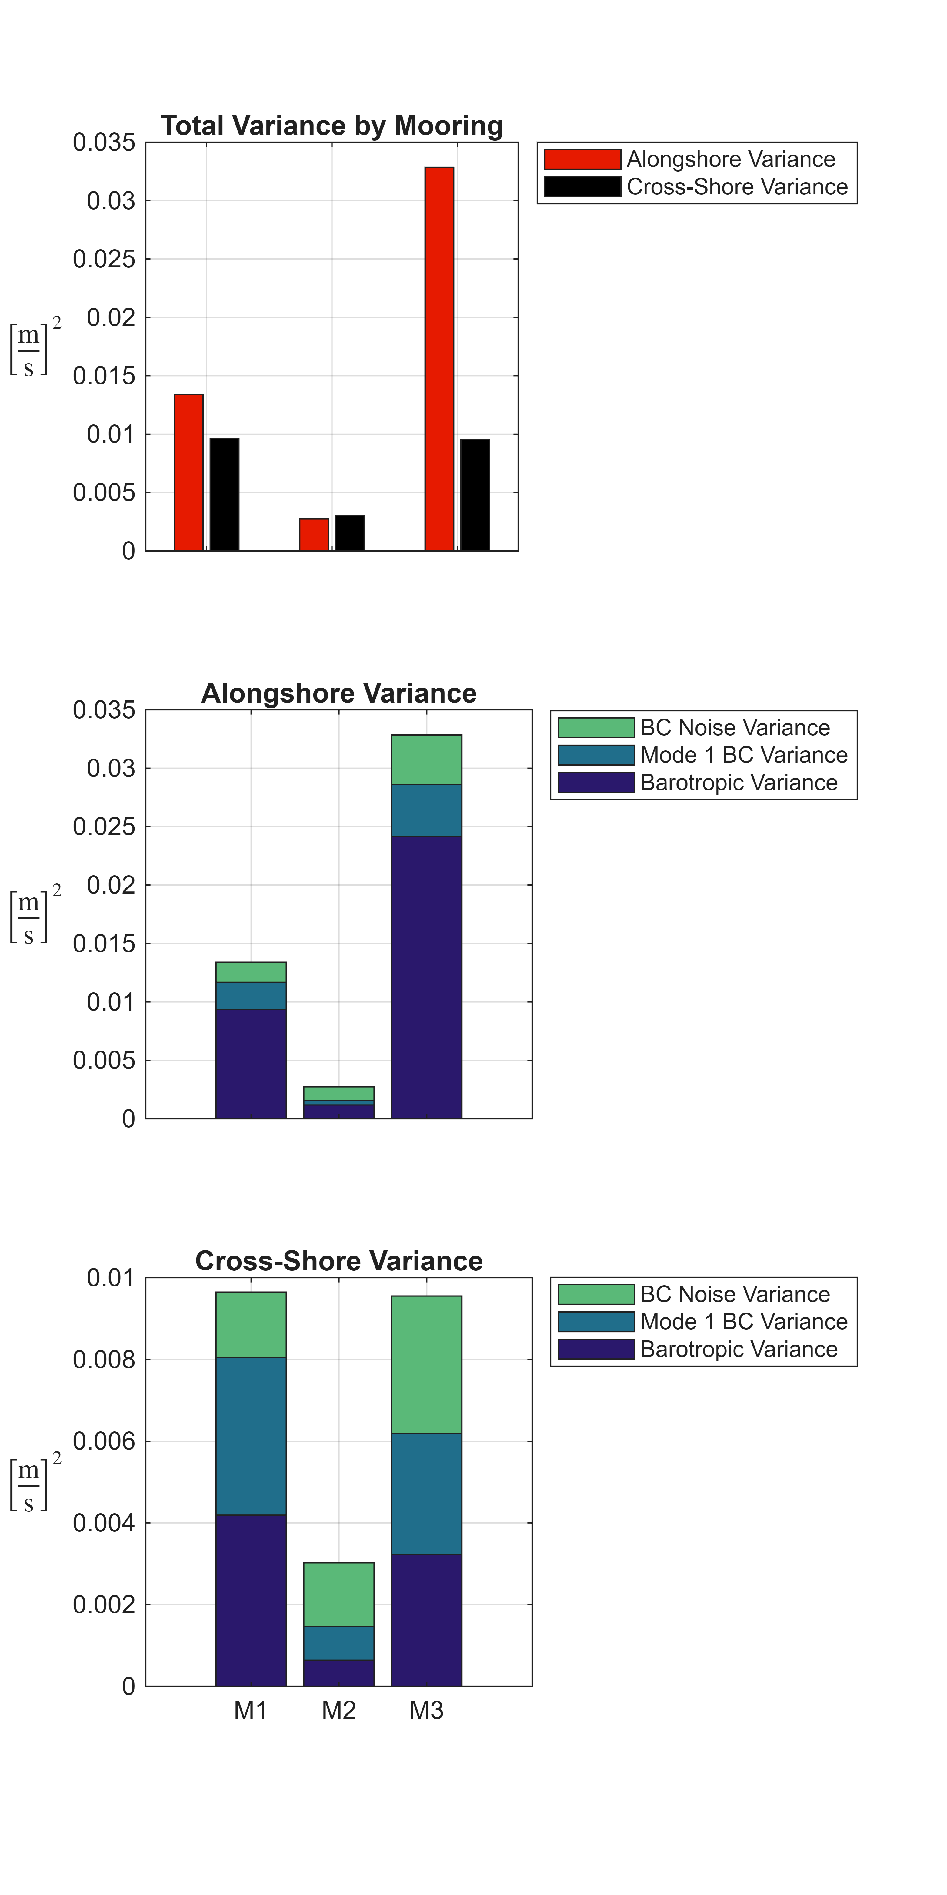
Types of Currents
Most of the variance in the alongshore direction is barotropic/tidal
The variance in the cross-shore is baroclinic, dominated by mode 1
Previous studies indicate that cross-shore currents are more important for nutrient exchange (Jackson 1998)

Slide 4
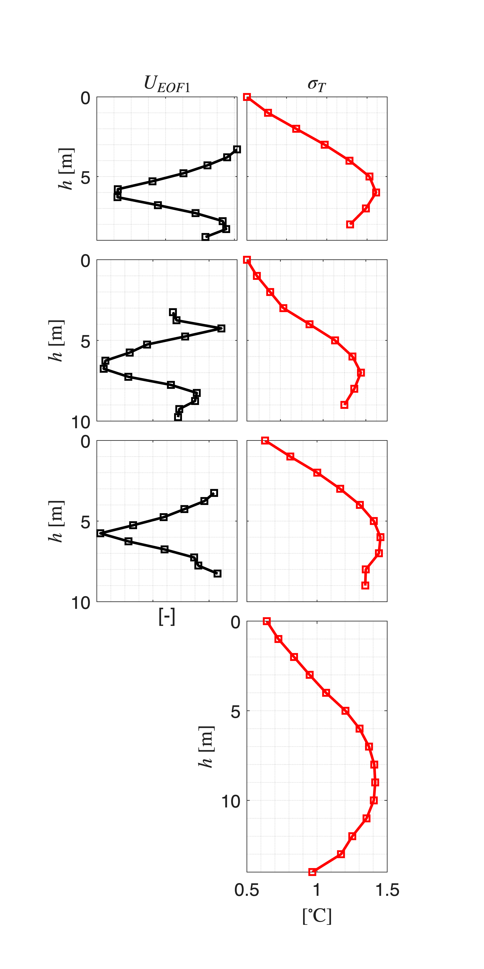
Cross-Shore Baroclinic Currents
Mode 1 cross-shore baroclinic currents and mode 1 reconstructed temperature variability have structures typical of internal waves.

Slide 5
Cross-Shore Baroclinic Currents
Coherence between maxima of velocity and temperature further indicates internal wave motion

