Slide 1
Transparent Surrogate Modeling of Altered-State-Inspired Macro-Dynamics
1/15
This report analyzes the repository as a complete thesis artifact rather than as a conventional software project. The central output of the repository is not a claim that LSD has been mechanistically simulated. Instead, the repository implements a transparent surrogate model of altered-state-inspired macro-dynamics, grounded in coarse whole-brain modules, explicit graph structure, and summary statistics extracted from real resting-state fMRI data.
This repository implements a transparent surrogate model for altered-state-inspired whole-brain macro-dynamics. The system is explicitly positioned as a graph-modulated macro-scale analogue rather than as a receptor model, a simulator of subjective experience, or a clinical decision system. Its scientific aim is modest but non-trivial: to determine whether a simple, interpretable dynamical system can be fitted to empirical placebo resting-state summaries and then perturbed in ways that partially reproduce LSD-associated changes observed in a real dataset.
Computational work on psychedelics often faces an immediate tradeoff between interpretability and expressivity. Highly detailed mechanistic models are difficult to justify with available data and often collapse under parameter uncertainty. Highly flexible machine learning models can discover predictive structure, but they usually make it difficult to explain why a result occurred or which mechanistic story a result should support. The repository analyzed here chooses a different path. It asks whether a transparent, low-dimensional, graph-based surrogate can reproduce selected macro-dynamic signatures associated with psychedelic states while remaining narrow in its claims and explicit in its limitations.
Defense opening framing slide.

Slide 2
Scope and Claim Boundaries
2/15
This report analyzes the repository as a complete thesis artifact rather than as a conventional software project. The central output of the repository is not a claim that LSD has been mechanistically simulated. Instead, the repository implements a transparent surrogate model of altered-state-inspired macro-dynamics, grounded in coarse whole-brain modules, explicit graph structure, and summary statistics extracted from real resting-state fMRI data.
This report analyzes the repository as a complete thesis artifact rather than as a conventional software project. The central output of the repository is not a claim that LSD has been mechanistically simulated. Instead, the repository implements a transparent surrogate model of altered-state-inspired macro-dynamics, grounded in coarse whole-brain modules, explicit graph structure, and summary statistics extracted from real resting-state fMRI data.
This repository implements a transparent surrogate model for altered-state-inspired whole-brain macro-dynamics. The system is explicitly positioned as a graph-modulated macro-scale analogue rather than as a receptor model, a simulator of subjective experience, or a clinical decision system. Its scientific aim is modest but non-trivial: to determine whether a simple, interpretable dynamical system can be fitted to empirical placebo resting-state summaries and then perturbed in ways that partially reproduce LSD-associated changes observed in a real dataset.
The repository is organized around four linked research questions.
Can a small graph-coupled surrogate model generate macro-scale signatures associated with altered-state-like brain dynamics while preserving interpretability?
Can real placebo resting-state summaries extracted from ds003059 be used to calibrate a sober reference regime for that surrogate model?
Derived from the long-form thesis report.

Slide 3
Repository Workflow
3/15
The repository is organized as a staged scientific pipeline. The top-level script scripts/run_pipeline.py orchestrates the major phases. Its command structure reflects the research workflow rather than a generic software release process.
The repository is organized as a staged scientific pipeline. The top-level script scripts/run_pipeline.py orchestrates the major phases. Its command structure reflects the research workflow rather than a generic software release process.
Stage 1 generates synthetic baseline and perturbed simulations and saves graphs, activity traces, FC matrices, diversity summaries, and switching summaries.
Stage 2 either loads preconfigured sober targets or, when the dataset directory is present, generates empirical targets directly from ds003059, fits a sober regime, saves figures, and emits machine-readable provenance.
Stage 3 fits a sober reference regime again, applies a grid of perturbation mechanisms, and ranks them against empirical LSD-minus-placebo target deltas.
Stage 4 performs single-mechanism and pairwise ablation analysis using the best available strengths from Stage 3.
Derived from the long-form thesis report.

Slide 4
Model Assumptions
4/15
The central simulator is defined in the project specification as a graph-coupled stochastic dynamical system with adaptation and an optional low-dimensional top-down constraint. In plain form, each module state evolves under the combined effect of a bistable local potential, a restoring rigidity term, an adaptation term, cross-module graph input, a hierarchy-projection constraint, and stochastic noise.
The central simulator is defined in the project specification as a graph-coupled stochastic dynamical system with adaptation and an optional low-dimensional top-down constraint. In plain form, each module state evolves under the combined effect of a bistable local potential, a restoring rigidity term, an adaptation term, cross-module graph input, a hierarchy-projection constraint, and stochastic noise.
The barrier term determines how deep or shallow a module's local metastable landscape is within the model.
The rigidity term determines how strongly a module is pulled back toward its baseline.
The adaptation term discourages indefinite occupation of the same state.
The graph coupling term allows neighboring modules to influence one another through a weighted adjacency matrix.
Derived from the long-form thesis report.

Slide 5
Dataset and Macro-Module Extraction
5/15
The empirical branch of the repository is anchored to OpenNeuro dataset ds003059, version 1.0.0. The local dataset metadata present in data/ds003059/dataset_description.json identifies the dataset as a derivative release titled Neural correlates of the LSD experience revealed by multimodal neuroimaging, with BIDS version 1.4.0, license CC0, and dataset DOI 10.18112/openneuro.ds003059.v1.0.0. The local README inside the dataset explicitly states that Rest1 and Rest3 are resting-state scans and that Rest2 is a music condition. The repository therefore excludes run-02 and uses only run-01 and run-03.
The empirical branch of the repository is anchored to OpenNeuro dataset ds003059, version 1.0.0. The local dataset metadata present in data/ds003059/dataset_description.json identifies the dataset as a derivative release titled Neural correlates of the LSD experience revealed by multimodal neuroimaging, with BIDS version 1.4.0, license CC0, and dataset DOI 10.18112/openneuro.ds003059.v1.0.0. The local README inside the dataset explicitly states that Rest1 and Rest3 are resting-state scans and that Rest2 is a music condition. The repository therefore excludes run-02 and uses only run-01 and run-03.
sessions ses-LSD and ses-PLCB
task-rest runs only
run-01 and run-03
The key compression step in the repository is the conversion of volumetric BOLD data into eight coarse module time series. This is implemented in src/lsd_thesis/data/ds003059.py. The repository uses a transparent proxy mapping built from the Harvard-Oxford cortical and subcortical atlases as fetched through Nilearn. Each of the eight target modules is associated with a small set of cortical and, when relevant, subcortical atlas labels. These labels are merged into a custom integer-valued label image, and average time series are then extracted for each module.
Derived from the long-form thesis report.

Slide 6
Shared Observable Space
6/15
The repository compares empirical and simulated dynamics in a common metric space. This design choice is one of the most important conceptual commitments in the codebase. Rather than comparing raw time series directly, it compares higher-level observables that are computed in the same way from both empirical module traces and simulated module traces.
The repository compares empirical and simulated dynamics in a common metric space. This design choice is one of the most important conceptual commitments in the codebase. Rather than comparing raw time series directly, it compares higher-level observables that are computed in the same way from both empirical module traces and simulated module traces.
within-network stability: mean FC among modules belonging to the same coarse group
cross-network communication: mean FC among modules belonging to different coarse groups
thalamic coupling: mean FC between the thalamic gateway module and all other modules
hierarchical compression: correlation between mean sensory and associative signals
Derived from the long-form thesis report.

Slide 7
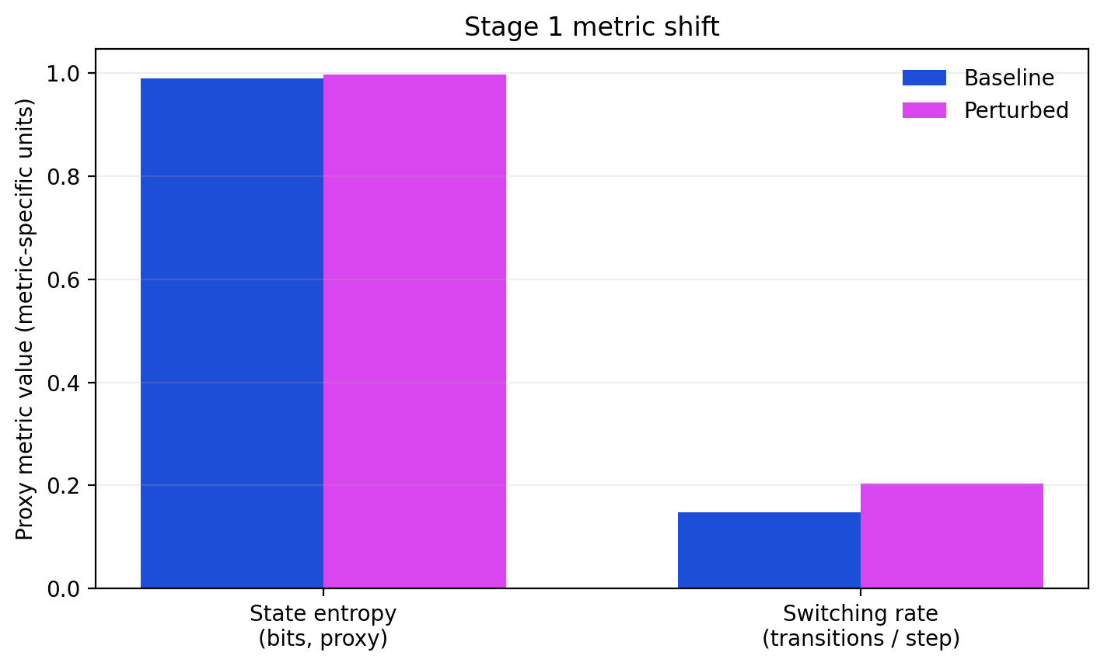
Stage 1 Synthetic Shift
7/15
Stage 1 is the conceptual proof-of-behavior phase. The code runs both the sober baseline regime and the altered-state-inspired YAML regime and compares their outputs on the shared metric space. This stage does not use empirical fitting. It asks whether the hand-designed perturbation at least moves the model in broadly intended directions.
Stage 1 is the conceptual proof-of-behavior phase. The code runs both the sober baseline regime and the altered-state-inspired YAML regime and compares their outputs on the shared metric space. This stage does not use empirical fitting. It asks whether the hand-designed perturbation at least moves the model in broadly intended directions.
baseline entropy: 0.9890
perturbed entropy: 0.9976
baseline switching rate: 0.1471
perturbed switching rate: 0.2032
Derived from the long-form thesis report. These are surrogate macro-dynamics only. They do not claim receptor-level realism, subjective experience, or direct biological measurement.
Stage 1 compares baseline and perturbed proxy values for entropy and switching rate with units shown on the axis labels. - Stage 1 compares baseline and perturbed proxy values for entropy and switching rate with units shown on the axis labels.

Slide 8
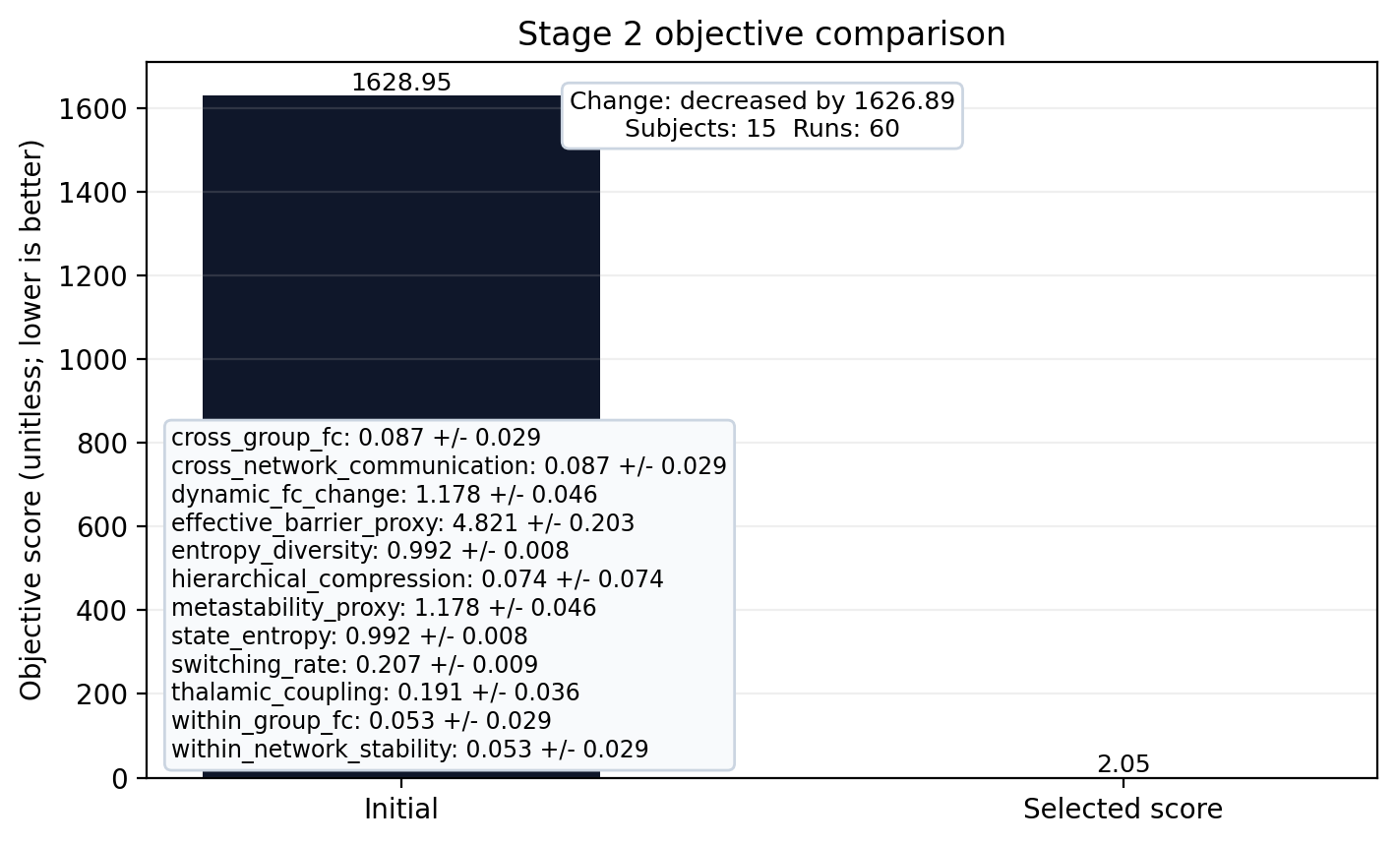
Stage 2 Empirical Bridge and Fit
8/15
The current empirical bridge uses fifteen paired subjects and sixty total resting runs. The Stage 2 fit statement is: Stage 2 objective changed from 1628.945 to 2.054 (decreased); lower scores are better. The selected score comes from the optimization step.
The current empirical bridge uses fifteen paired subjects and sixty total resting runs. The Stage 2 fit statement is: Stage 2 objective changed from 1628.945 to 2.054 (decreased); lower scores are better. The selected score comes from the optimization step.
The code queries the OpenNeuro GraphQL API to reconstruct the dataset file tree.
It filters that file tree to the exact sessions and runs required for the study design.
It downloads only the BOLD files required for the selected rest runs.
It extracts module time series for each run.
Derived from the long-form thesis report. This figure summarizes a cached benchmark anchored to OpenNeuro ds003059 placebo resting-state summary (15 session averages). It is evidence of fit quality and run-to-run consistency, not a proof of generalization.
Stage 2 compares the initial objective with the selected score from the optimization step and summarizes limited repeatability evidence. - Stage 2 compares the initial objective with the selected score from the optimization step and summarizes limited repeatability evidence.

Slide 9
CV5 Internal Validation
9/15
Approved preliminary five-fold subject-disjoint internal validation is complete; this is not external or clinical validation.
Five folds cover the 15 complete paired subjects, with 3 held out per fold.
Fold metrics are descriptive internal-validation summaries, not confidence intervals.
No subject-level motion, FD/DVARS, confound, or censoring stratification was available.
The selected perturbation family is a proxy-objective result, not proof of a biological mechanism.
Defense scope slide derived from the CV5 validation section. Internal validation only; not external or clinical validation, and not subjective-state evidence.

Slide 10
Stage 3 Perturbation-Family Ranking
10/15
In the current evidence, the best-scoring perturbation family is less_hierarchical_constraint at strength 0.25. That result is directionally interesting in proxy-objective space, but it remains a weak macro-level hypothesis rather than a convincing mechanistic explanation.
In the current evidence, the best-scoring perturbation family is less_hierarchical_constraint at strength 0.25. That result is directionally interesting in proxy-objective space, but it remains a weak macro-level hypothesis rather than a convincing mechanistic explanation.
more cross-talk
less hierarchical constraint
more stochasticity
lower switching barrier
Derived from the long-form thesis report.

Slide 11
Stage 4 Ablation and Pairwise Tests
11/15
The best current pairwise combination is less_hierarchical_constraint+lower_switching_barrier. The best single mechanism is lower_switching_barrier (score 5028.2029). The best pair is less_hierarchical_constraint+lower_switching_barrier (score 4819.2698), which outperformed the best single mechanism under the current objective; lower scores are better. This comparison is informative because it shows whether simple perturbation superposition helps under the current objective without turning that objective into a mechanistic claim.
The best current pairwise combination is less_hierarchical_constraint+lower_switching_barrier. The best single mechanism is lower_switching_barrier (score 5028.2029). The best pair is less_hierarchical_constraint+lower_switching_barrier (score 4819.2698), which outperformed the best single mechanism under the current objective; lower scores are better. This comparison is informative because it shows whether simple perturbation superposition helps under the current objective without turning that objective into a mechanistic claim.
best single mechanism: lower_switching_barrier
best single score: 5028.2029
best pairwise mechanism: less_hierarchical_constraint+lower_switching_barrier
best pairwise score: 4819.2698
Derived from the long-form thesis report.

Slide 12
Dashboard and Artifact Layer
12/15
The repository does more than compute numbers. It exposes the pipeline through a dashboard and a dense artifact layer. This is not trivial polish. It is part of the scientific contribution because it makes the model inspectable by people who are not comfortable reading Python source.
The repository does more than compute numbers. It exposes the pipeline through a dashboard and a dense artifact layer. This is not trivial polish. It is part of the scientific contribution because it makes the model inspectable by people who are not comfortable reading Python source.
A model explorer for synthetic simulations, adjustable parameters, and FC or ablation outputs.
An empirical explorer for group-level placebo versus LSD summaries, paired subject/run inspection, windowed FC changes, module traces, and downsampled window-averaged preview slices.
subject selection
run selection
Derived from the long-form thesis report.

Slide 13
Training Benchmarks
13/15
The repository includes a secondary line of work that exports Stage 2 empirical windows into a training-ready dataset and benchmarks a few simple machine learning models. This branch does not replace the surrogate-model thesis. Instead, it asks whether the extracted windows contain enough structure to support auxiliary prediction tasks.
The repository includes a secondary line of work that exports Stage 2 empirical windows into a training-ready dataset and benchmarks a few simple machine learning models. This branch does not replace the surrogate-model thesis. Instead, it asks whether the extracted windows contain enough structure to support auxiliary prediction tasks.
Derived from the long-form thesis report.

Slide 14
What Worked, What Failed, and Validity Risks
14/15
Several aspects of the repository are genuinely strong and should be defended confidently.
Several aspects of the repository are genuinely strong and should be defended confidently.
The repository is strongest when it admits its current failures. Several weaknesses should be framed openly rather than defensively.
The central threats to validity fall into four categories: construct validity, internal validity, external validity, and reproducibility validity.
Derived from the long-form thesis report.

Slide 15
Defendable Conclusion
15/15
For defense purposes, it is helpful to separate claims that the repository clearly supports from claims that it does not support.
For defense purposes, it is helpful to separate claims that the repository clearly supports from claims that it does not support.
The project implements a transparent graph-based surrogate model for macro-scale altered-state-inspired dynamics.
The project derives placebo and LSD-minus-placebo target summaries from a real public neuroimaging dataset rather than relying only on literature summaries.
The project demonstrates that placebo-derived calibration can better align a sober reference regime under the chosen objective.
The project demonstrates that the current model class and the current eight-module extraction are insufficient to reproduce the full empirical altered-state signature robustly.
Derived from the long-form thesis report.

