Slide 1
SUMMARY OF SPMS Presentation

Slide 2

Background
Strategic Performance Management System (SPMS) is the new appraisal tool adopted in the Memorandum Circular No. 6, Series of 2012 issued by the Civil Service Commission (CSC)

Slide 3
Why shift to SPMS? 3 Objectives
1. Alignment
2. Accountability
3. Linkage

Slide 4
Alignment
Linking your IPCRs to OPCRs on Concrete Terms
Aligning your targets to Agency’s Major Final Output (MFO), Vision, Mission and Objectives (VMOs)
and Mandates/OPIF

Slide 5
Accountability
Ensures organizational effectiveness and improvement of employee’s efficiency
Performance targets and measures are based on rational and factual basis
Cascaded to various levels of the organization

Slide 6
Linkage to other HR Systems
Vital inputs to other HR systems such as in the RSP, L & D as well as in your R & R programs
Adherence to the principle of performance-based tenure and incentive system.

Slide 7
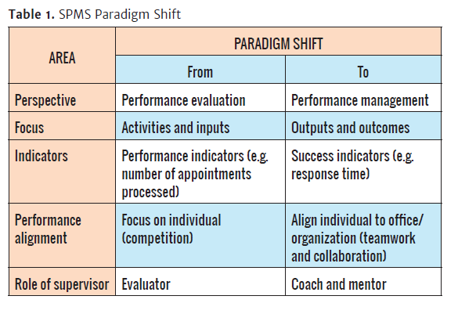
SPMS Paradigm

Slide 8
SPMS Cycle
Performance Planning and Commitment
Performance Monitoring
and Coaching
Performance Review
and Evaluation
Performance Rewarding
and Development Planning

Slide 9
SPMS CYCLE
Head of Office meets with supervisors and employees to agree on outputs to be accomplished.
Determine success indicators
Consider certain factors when setting targets
Competency assessment vis-à-vis competency requirements of the job
Results of assessment to be discussed by the Head of Office and supervisor, and the employee
Professional development plan must be outlined and monitored for ratings of Unsatisfactory and Poor
Regularly monitor the office’s and every individual’s performance
Monitoring and evaluation systems must be in place
Supervisors and coaches play a
critical role.
Assess both office and individual employee’s performance level based on approved targets and measures
Results of assessment shall be impartial
PERFORMANCE MONITORING & COACHING
PERFORMANCE PLANNING & COMMITMENT
PERFORMANCE REVIEW & EVALUATION
PERFORMANCE REWARDING & DEVELOPMENT PLANNING

Slide 10
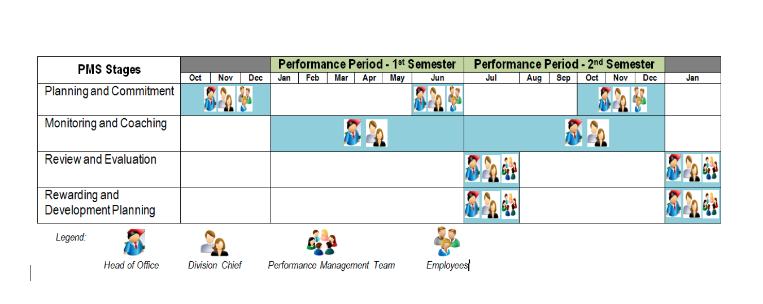
SPMS Calendar

Slide 11
SPMS Dimensions
Quality – means getting the right things done. It refers to the degree to which objectives are achieved as intended and the extent to which issues are addressed with a certain degree of excellence.
Timeliness – measures if the targeted deliverable was done within the scheduled or expected timeframe.
Efficiency – is the extent to which targets are accomplished using the minimum amount of time or resources.

Slide 12
THREE DIMENSIONS OF PERFORMANCE
tangible
measurable
Q
E
T
verifiable
Quality
Efficiency
Timeliness
Accuracy/ No Error
Compliance with rules
Approval of Superior/Acceptability
Complete attachments
Meet standards/ Comprehensiveness/ Completeness
Client Satisfaction
QUANTITY:
Number
Percentage
Action Time
Deadline / Schedule – specify day/date
Working Day or Calendar Day?
Citizen’s Charter

Slide 13
SPMS Categories
Strategic Priorities – these are outputs that implement and deliver the mandates of the agency as identified its strategy roadmap, OPIF, etc.
Core Functions – these are functions that deliver the main services and products of the agency
Support Functions – these are functions that provide necessary resources to enable the agency - its offices and units - to effectively perform its mandate

Slide 14
SPMS General Rules
Under SPMS, not all SIs have to be measured using all the available dimensions
The use and appropriate application of rating dimension for each SI depends on the nature of the targets, to be reviewed and approved by the Head of Office and concurred by the PMT
Thus, there are SIs that carry only 1 dimension or 2 dimensions or all dimensions depending on the final discussions and agreements of concerned parties, including PMT

Slide 15
Rating Scale
Rating |  | Description
Numerical | Adjectival
5 | Outstanding | Extraordinary level of achievement Exceptional job mastery in all major areas of responsibility have demonstrated Marked excellence of achievement and contributions to the organization
4 | Very Satisfactory | Exceeded expectations All goals, objectives and targets were achieved above standards
3 | Satisfactory | Met expectations Most critical annual goals are met
2 | Unsatisfactory | Failed to meet expectations One or more of the most critical goals were not met
1 | Poor | Consistently below expectations Reasonable progress toward critical goals was not made

Slide 16
SPMS Rating Ranges CSC-MC No. 13, Series of 1999
Outstanding (5) = 130 % and UP
Very Satisfactory (4) = 115 % to 129 %
Satisfactory (3) = 100 % - 114 %
Unsatisfactory (2) = 99 % - 51 %
Poor (1) = 50 % and BELOW

Slide 17
SPMS General Rules Grading System
The average performance rating of all individual employees shall NOT go higher than the final performance
rating of the office
( O.R. = or > A. R. E. )

Slide 18
 | INDIVIDUAL PERFORMANCE COMMITMENT AND REVIEW (IPCR)
 | I, ____(name)_____, ____(position) ____ at the ___(department)___, commit to deliver and agree to be rated on the attainment of the following targets in accordance with the indicated measures for the period ________________.
 |  |  |  |  | Signature of Employee Date: -------------
 | APPROVED BY:
 | Name:
 | Position:
 | Date:
 | MFO |  | Actual Accomplishments |  |  | Rating* |  |  |  | Remarks
 |  |  |  |  |  | Q | E | T | Ave.
 | MFO 1
 | MFO 2
 | MFO 3
 | TOTAL RATING
 | FINAL AVERAGE RATING
 | Comments and Recommendation for Development Purposes:
 | The above rating has been discussed with me by my Division Chief
 | Neme and Signature of Ratee: | Name and Signature of Rater:
 | Position: | Position:
 | Date: | Date:
R
A
T
I
N
G
5 – Outstanding
4 – Very Satisfactory
3 – Satisfactory
2 – Unsatisfactory
1 - Poor
Name
Position
Department
Final Rating by Office Head:
Position:
Date:

Slide 19
 | INDIVIDUAL PERFORMANCE COMMITMENT AND REVIEW (IPCR)
 | I, ____(name)_____, ____(position) ____ at the ___(department)___, commit to deliver and agree to be rated on the attainment of the following targets in accordance with the indicated measures for the period ________________.
 |  |  |  |  |  |  |  | Signature of Employee Date: -------------
 | APPROVED BY:
 | Name:
 | Position:
 | Date:
 | Major Final Output |  | Success Indicators (Targats+Measures) |  |  | Actual Accomplishments |  |  | Rating* |  |  |  | Remarks
 |  |  |  |  |  |  |  |  | Q | E | T | Ave.
 | MFO 1
 | MFO 2
 | MFO 3
 | TOTAL RATING
 | FINAL AVERAGE RATING
 | Comments and Recommendation for Development Purposes:
 | The above rating has been discussed with me by my Division Chief
 | Neme and Signature of Ratee: | Name and Signature of Rater:
 | Position: | Position:
 | Date: | Date:
R
A
T
I
N
G
5 – Outstanding
4 – Very Satisfactory
3 – Satisfactory
2 – Unsatisfactory
1 - Poor
Final Rating by Office Head:
Position:
Date:

Slide 20

MAJOR
FINAL
OUTPUT
Very important
Large in number, amount or extent
Prominent/significant
pertaining to or coming at the end; last in place, order, or time
Of or relating to the ultimate purpose or result of a process
Something produced
the quantity or amount produced, as in a given time

Slide 21
MAJOR FINAL OUTPUT (MFO)
“Major Final Outputs refer to the goods and services that your agency is mandated to deliver to external clients through the implementation of programs, projects and activities.”
Civil Service Commission, Guidebook on the Strategic Performance Management System

Slide 22
Success Indicators must be:
S
SPECIFIC
M
MEASURABLE
A
ATTAINABLE
R
REALISTIC
T
TIME-BOUND

Slide 23

CORE FUNCTIONS: At least 2 measures (E&T), better if 3 measures (QET)

Slide 24
 | INDIVIDUAL PERFORMANCE COMMITMENT AND REVIEW (IPCR)
 | I, ____(name)_____, ____(position) ____ at the ___(department)___, commit to deliver and agree to be rated on the attainment of the following targets in accordance with the indicated measures for the period ________________.
 |  |  |  |  |  |  | Signature of Employee Date: -------------
 | APPROVED BY:
 | Name:
 | Position:
 | Date:
 | Major Final Output |  | Success Indicators (Targats+Measures |  |  | Actual Accomplishments |  |  | Rating* |  |  |  | Remarks
 |  |  |  |  |  |  |  |  | Q | E | T | Ave.
 | MFO 1
 | MFO 2
 | MFO 3
 | TOTAL RATING
 | FINAL AVERAGE RATING
 | Comments and Recommendation for Development Purposes:
 | The above rating has been discussed with me by my Division Chief
 | Name and Signature of Ratee: | Name and Signature of Rater:
 | Position: | Position:
 | Date: | Date:
R
A
T
I
N
G
5 – Outstanding
4 – Very Satisfactory
3 – Satisfactory
2 – Unsatisfactory
1 - Poor
During submission of TARGETS
After rating…
Final Rating by Office Head:
Position:
Date:

Slide 25
 | INDIVIDUAL PERFORMANCE COMMITMENT AND REVIEW (IPCR)
 | I, ____(name)_____, ____(position) ____ at the ___(department)___, commit to deliver and agree to be rated on the attainment of the following targets in accordance with the indicated measures for the period ________________.
 |  |  |  |  |  |  | Signature of Employee Date: -------------
 | APPROVED BY:
 | Name:
 | Position:
 | Date:
 | Major Final Output |  | Success Indicators (Targets+Measures |  |  | Actual Accomplishments |  |  | Rating* |  |  |  | Remarks
 |  |  |  |  |  |  |  |  | Q | E | T | Ave.
 | MFO 1
 | MFO 2
 | MFO 3
 | TOTAL RATING
 | FINAL AVERAGE RATING
 | Comments and Recommendation for Development Purposes:
 | The above rating has been discussed with me by my Division Chief
 | Name and Signature of Ratee: | Name and Signature of Rater:
 | Position: | Position:
 | Date: | Date:
R
A
T
I
N
G
5 – Outstanding
4 – Very Satisfactory
3 – Satisfactory
2 – Unsatisfactory
1 - Poor
Final Rating by Office Head:
Position:
Date:

Slide 26

When you rate each of your accomplishment, should you put a rating in all dimensions?
 | Q | E | T
It depends on your SUCCESS INDICATOR

Slide 27
Let’s practice!
SUCCESS INDICATOR | ACTUAL ACCOMPLISHMENT | Q | E | T
Accurately prepare reply to 100% of received letters 15 mins. from instruction | Accurately prepared reply to 100% of received letters 15 mins. from instruction | Yes | Yes | Yes
Prepare reply to 100% of received letters 15 mins. from instruction | Prepared reply to 100% of received letters 15 mins. from instruction | X | Yes | Yes
Accurately prepare reply to letters 15 mins. from instruction | Accurately prepared reply to letters 15 mins. from instruction | Yes | X | Yes
Accurately prepare reply to 100% of received letters | Accurately prepared reply to 100% of received letters | Yes | Yes | X

Slide 28

Let’s Rate!
SUCCESS INDICATOR | Q | E | T
Quality, Efficiency, Time
Efficiency & Time
Efficiency only
Quality & Time

Slide 29
Sample Rating Standard
Adjectival Rating | Numerical Rating | Can be Exceeded | Can’t be Exceeded
Outstanding | 5 | 130% and above | 96%-100%
Very Satisfactory | 4 | 115% to 129% | 88% to 95%
Satisfactory | 3 | 100% to 114% | 75% to 87%
Unsatisfactory | 2 | 99% to 51% | 51% to 74%
Poor | 1 | 50% and below | 50% and below

Slide 30
“100% of requested letters accurately prepared 15 mins. from instruction”
Q
E
T
No error = 5
1 minor error = 4
2 or more minor errors = 3
1 major revision = 2
2 or more major revisions = 1
130% ^ = 5
115-129% = 4
100-114% = 3
99%-51% = 2
50% & less = 1
Less than 15 mins. = 5
15 mins. = 4
16-20 mins. = 3
21-25 mins.-1 hr. = 2
More than 1 hr. = 1

Slide 31
imeliness
T
Superiors can have a differentaction time from that of their subordinates, to give them time allowance to review the output of their staff & further improve it
Superior | Staff
Submit draft within 1 hour from request | Submit draft within 15 mins. from request

Slide 32
Let’s practice!
SUCCESS INDICATOR | ACTUAL ACCOMPLISHMENT | Q | E | T | Ave
Accurately prepare reply to 100% of received letters 15 mins. from instruction | Accurately prepared reply to 100% of received letters 15 mins. from instruction | 5 | 5 | 4 | 4.67
Prepare reply to 100% of received letters 15 mins. from instruction | Prepared reply to 100% of received letters 15 mins. from instruction | - | 5 | 4 | 4.5
Accurately prepare reply to letters 15 mins. from instruction | Accurately prepared reply to letters 15 mins. from instruction | 5 | - | 4 | 4.5
Accurately prepare reply to 100% of received letters | Accurately prepared reply to 100% of received letters | 5 | 5 | - | 5

Slide 33

FORMULA
Total of all average / # of entries
4.67 + 4.5 + 4.5 + 5 = 18.67/4
= 4.67 Final Numerical Rating

Slide 34
 | INDIVIDUAL PERFORMANCE COMMITMENT AND REVIEW (IPCR)
 | I, ____(name)_____, ____(position) ____ at the ___(department)___, commit to deliver and agree to be rated on the attainment of the following targets in accordance with the indicated measures for the period ________________.
 |  |  |  |  |  |  |  | Signature of Employee Date: -------------
 | APPROVED BY:
 | Name:
 | Position:
 | Date:
 | MFO |  | Success Indicators (Targats+Measures) |  |  | Actual Accomplishments |  |  | Rating* |  |  |  | Remarks
 |  |  |  |  |  |  |  |  | Q | E | T | Ave.
 | MFO 1
 | MFO 2
 | MFO 3
 | TOTAL RATING
 | FINAL AVERAGE RATING
 | Comments and Recommendation for Development Purposes:
 | The above rating has been discussed with me by my Division Chief
 | Neme and Signature of Ratee: | Name and Signature of Rater:
 | Position: | Position:
 | Date: | Date:
R
A
T
I
N
G
5 – Outstanding
4 – Very Satisfactory
3 – Satisfactory
2 – Unsatisfactory
1 - Poor
Final Rating by Office Head:
Position:
Date:

Slide 35

A MUST:
Filling out of
“Comments & recommendation for development purposes”

Slide 36
“Comments & recommendation for development purposes”
Comments, observation or
recommendations
On performance, competency
assessment or critical incidents
Used for HR development purposes or
interventions
Notes:
Remarks may be a justification on high or poor rating.

Slide 37

9th
What is the purpose of “REMARKS” column ?

Slide 38
Sanctions
Starting January 2015, all agencies (NGAs, GOCCs, GFIs, SUCs, LGUs) must fully migrate to and adopt SPMS
No functional SPMS means agency’s ineligibility to Grant of Step Increment based on Meritorious Performance pursuant to Joint CSC-DBM Circular No. 1, Series of 2012

Slide 39
Sanctions
No SPMS, all personnel actions will be affected such as promotions, incentives, scholarships, learning and development and other rewards and recognition programs
Administrative sanction for violation of reasonable office rules and regulations and simple neglect of duty for supervisors or employees responsible for delay or non-submission OPCR and IPCR

Slide 40
Sanctions
An Office/Unit or individual employee can file an appeal with the PMT within ten (10) days from the date of receipt of their performance evaluation rating
The PMT shall decide on the appeals within one (1) month from receipt of such appeal
Officials or employees who are separated from the service on the basis of Unsatisfactory or Poor performance rating can appeal their separation to the CSC or its Regional Office within fifteen (15) days from receipt of the order or notice of separation

