Slide 1

Hospital Distance in dallas by income

Slide 2
Introduction and Business Problem
Access to hospitals can save lives.
The physical distance patients have to travel to get to a hospital is crucially important
In the United States, the quality of healthcare received often depends on the socioeconomic status of the patient.
Hospitals have an incentive to locate in high income areas
Background

Slide 3
Introduction and Business Problem
I will explore whether there is any link between the physical distance one must travel to get to a hospital and the wealth of the person requiring treatment
For this exercise, I will focus on hospitals in Dallas, Texas.
I will explore whether any link exists between people's income and the physical distance they must travel to get to local hospitals
Problem

Slide 4

Introduction and Business Problem
This information could be of interest to policymakers and hospital administrators who are looking to understand the scope of the issue and make decisions in the best interest of the public.
Interest

Slide 5

Data
I needed two primary pieces of information to complete this analysis: income and hospital locations.
Then, we need a way to geo-locate this data
Feature Selection

Slide 6
Data
The US Census publishes a report of income as reported in tax filings. Kaggle has taken this data and compiled it into a user-friendly .csv format. This data can be accessed with a Kaggle account at:
https://www.kaggle.com/goldenoakresearch/us-household-income-stats-geo-locations
The locations of hospitals were taken using Foursquare's API.
Data Sources

Slide 7
Data
Both datasets required cleaning and, eventually, merging.
This was done using PANDAS software.
I filtered out extranious columns, as the datasets were quite large.
I selected the subset of data that applied to the Dallas Texas region. I defined and removed "NaN" values (records in which no income data was available).
Data Cleaning

Slide 8
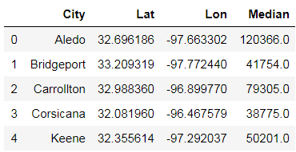
Methodology
First I imported PANDAS and cleaned the data.
This included dropping unnecessary columns, dropping rows with "NaN" values, and changing all data types to the correct format for analysis
The following data table header summarizes the data from the Kaggle income table
Cleaning

Slide 9
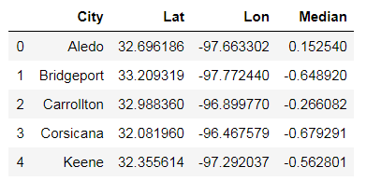
Methodology
I then normalized the income data
Normalizing Income Data

Slide 10
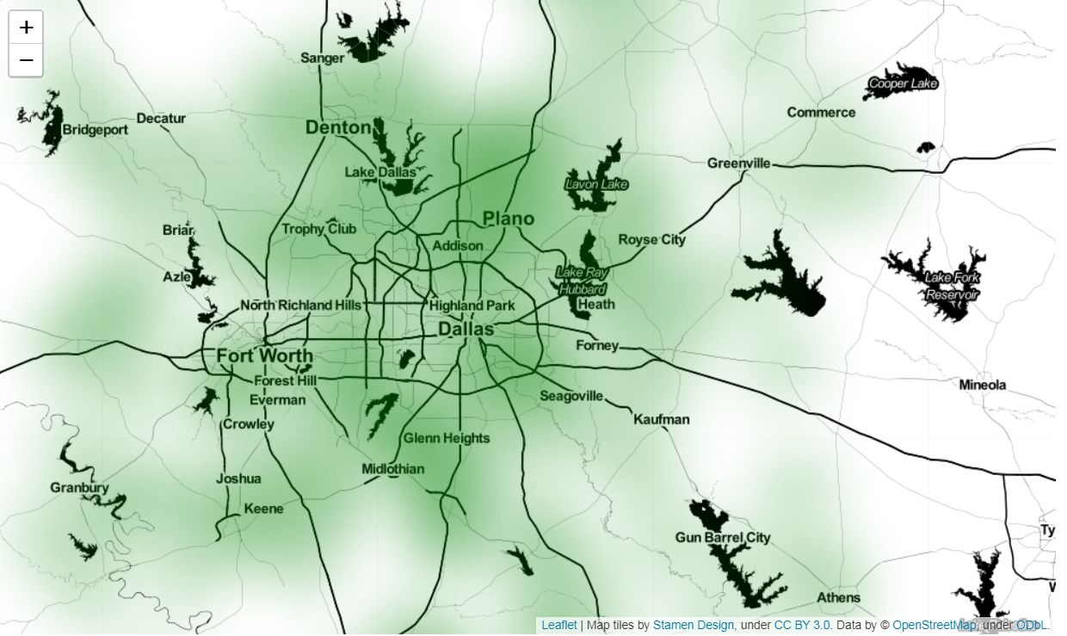
Methodology
Using Folium and the Folium heatmap plugin, I created a heatmap showing the dispersion of median incomes around the Dallas metro area
Mapping Median Income

Slide 11
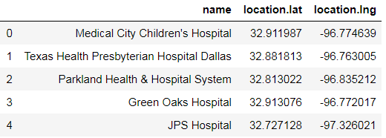
Methodology
Next, I imported the locations of Dallas-area hospitals using the Foursquare API.
I imported the data to a PANDAS dataframe.
I then cleaned the data, dropping unneeded columns. The following table header shows a sample of the data extracted
Importing and Cleaning Hospital Data from Foursquare

Slide 12
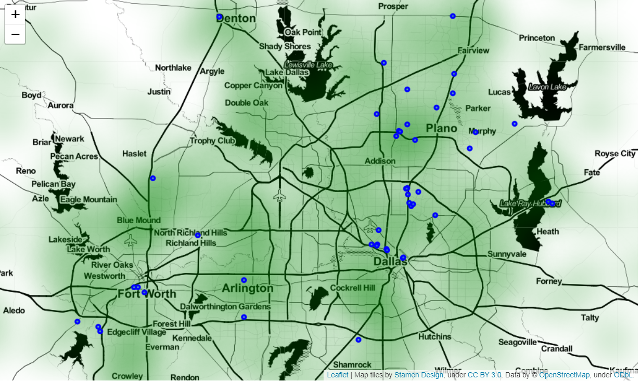
Methodology
Next, I overlaid the hospital locations on top of our income heatmap.
A visual inspection shows that hospitals appear to be clustered around areas of high income.
Hospital Locations Overlaying Income Map

Slide 13
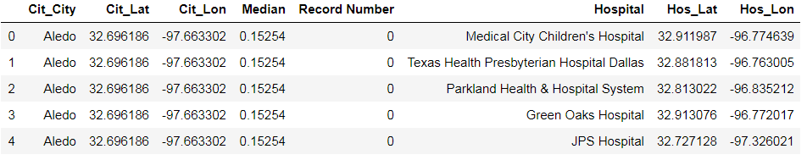
Methodology
Next, I combined the two dataframes.
I created a new column in the income dataframe to serve as a record number.
Combining Dataframes

Slide 14
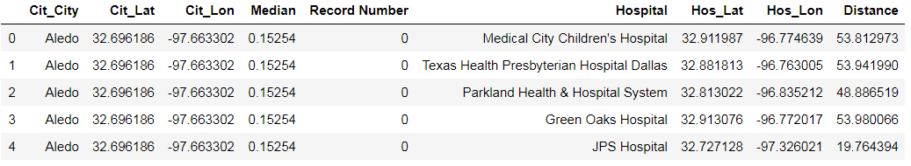
Methodology
Next, I use Python's "geopy.distance" library to calculate the distance between each respondant and each hospital.
The header of the resulting table is shown below.
Calculating Hospital Distance

Slide 15
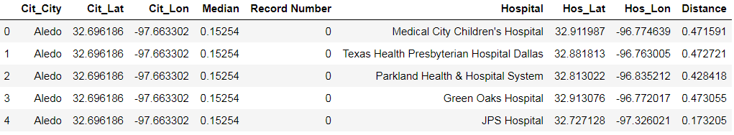
Methodology
Finally, I normalized the calculated distances.
Normalizing Data

Slide 16
Results
Applying a statistical analysis to the distances and median incomes, we find that in fact, there is a relationship.
Lower median income is significantly correlated with hospital distance.
Statistical Analysis

Slide 17
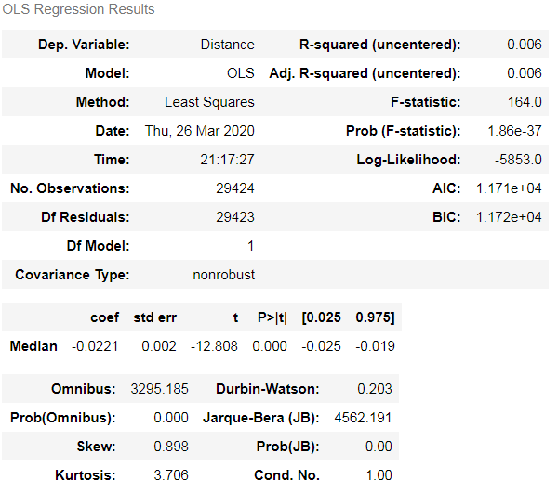
Results
We see that using least squares, the analysis returns a standard error of 0.002
This implies statistical significance.
The coefficient value is negative, implying that the lower one's income, the farther they live from a hospital
Statistical Analysis

Slide 18
Results
On the other hand, we calculated a rather low R-squared value of 0.006.
This implies that although income may be one factor, other factors also influence hospital location.
Statistical Analysis

Slide 19
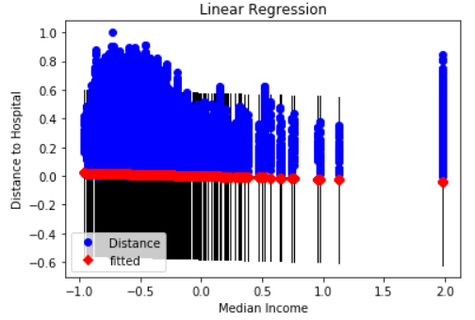
Results
On the other hand, we calculated a rather low R-squared value of 0.006.
This implies that although income may be one factor, other factors also influence hospital location.
Statistical Analysis

Slide 20
Results
We continue this analysis by looking at the distance of each income respondent to the hospital nearest to them.
To do this, I used PANDAS groupby method.
Statistical Analysis

Slide 21
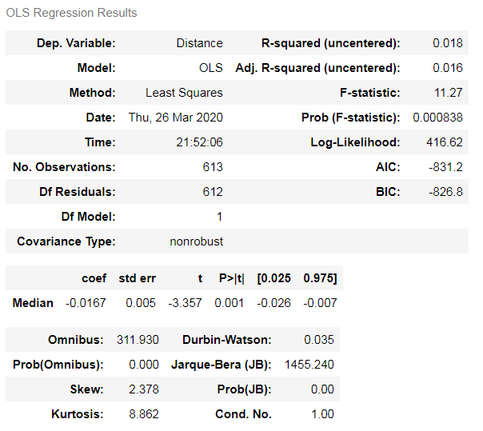
Results
We see that using least squares, the analysis returns a standard error of 0.005.
This implies that the relationship between income and distance to hospitals is statistically significant
Statistical Analysis

Slide 22
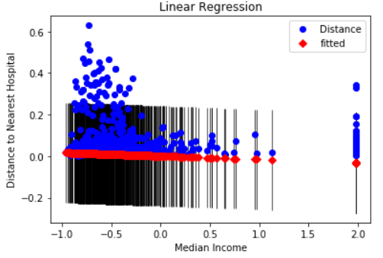
Results
R-squared value in this case was a bit higher at 0.018, this is still low.
This implies that while income is important, other factors also influence hospital location
Statistical Analysis

Slide 23
Discussion
There is a statistically significant relationship between median income and hospital distance.
However, as our low r-squared value shows, income is only one factor that models hospital location.
In order to build a stronger model, we would want to look at other factors that could influence hospital location such as population, tax incentives to build hospitals, highway access, and other things.
We must also question whether Dallas is a good representation of the United States as a whole
Further study would have to be done in other cities to see whether this is the case.
Further Study

Slide 24
Conclusion
Distance to hospital is a critical factor in likelihood of patient recovery.
We reviewed whether there was a link between median income and distance of travel to hospitals in Dallas, TX
We found that the relationship was statistically significant.
We found that income only explains a small part of why hospitals are located where they are
Further study should be done to examine other factors
Significant, but not the whole story.

