Slide 1
MINIMAL PATH IN BKK NETWORK
Network science – term project
Akhin MOUSTAFA
Daniel grimm

Slide 2


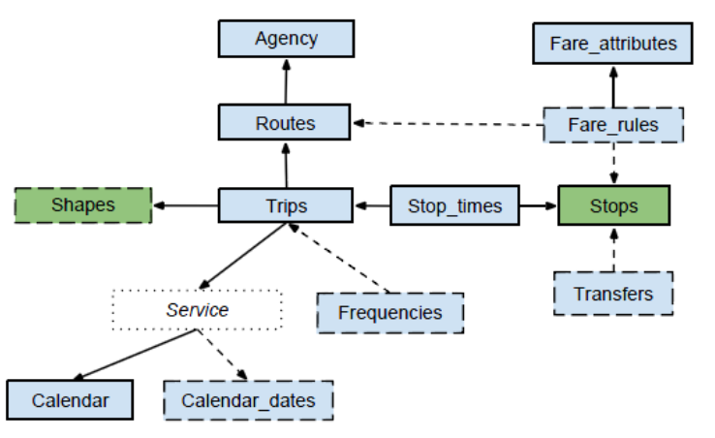
Data source
https://bkk.hu/apps/gtfs/
agency.txt
calendar_dates.txt
feed_info.txt
pathways.txt
routes.txt
shapes.txt
stop_times.txt
stops.txt
trips.txt
GTFS format

Slide 3
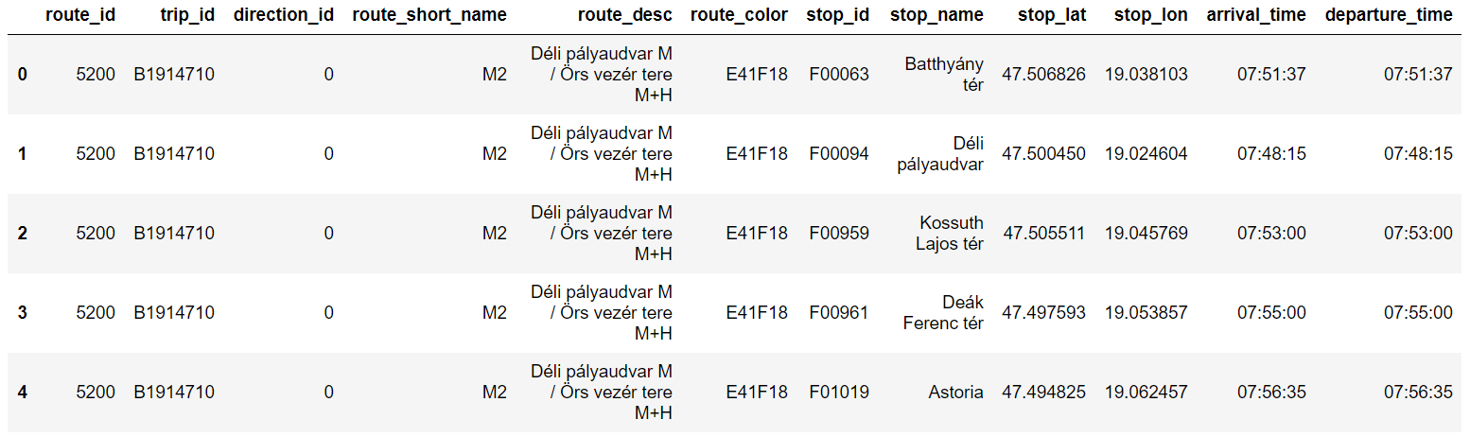
Data pre-processing
REMOVING UNNECESSARY COLUMNS
JOINING TABLES (dataframes)

Slide 4
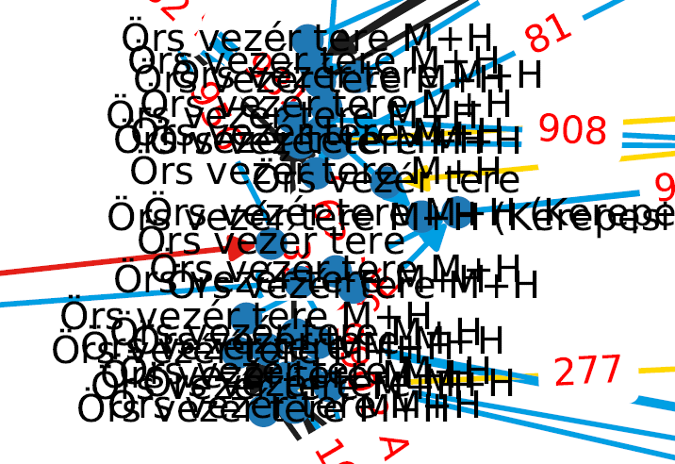
CREATING Network by networkx
UNDIRECTED - We assume that all lines have two directions.
WEIGHTED - Time difference between stations according to the schedule + 5s.
ONE HUGE COMPONENT, dense near to the center, gets sparser as we getting further from it.
PROBLEM:
Due to inconsistency in the dataset,
we have the same stations multiple times.

Slide 5
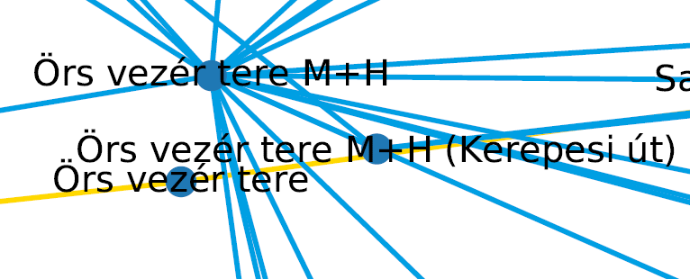
SOLUTION
It is possible that there are different stations with the same name (for example in different districts).
Merging all nodes with the same name (stop_id) would create new problems
We had to take into acccount the distance among these stations too!
Number of nodes has been decreased from ~3900 to ~2300 in the network.

Slide 6
algorithm
PREREQUISITES
We created multiple versions of the network, based on the transportation schedule:
Morning
Noon
Evening
Random

Slide 7
BFS (Breadth First search)
Suitable for visiting all nodes of the network.
Other options
Dijkstra algorithm (Source to destination)
Ford Bellman algorithm (not mentioned during the course).

Slide 8
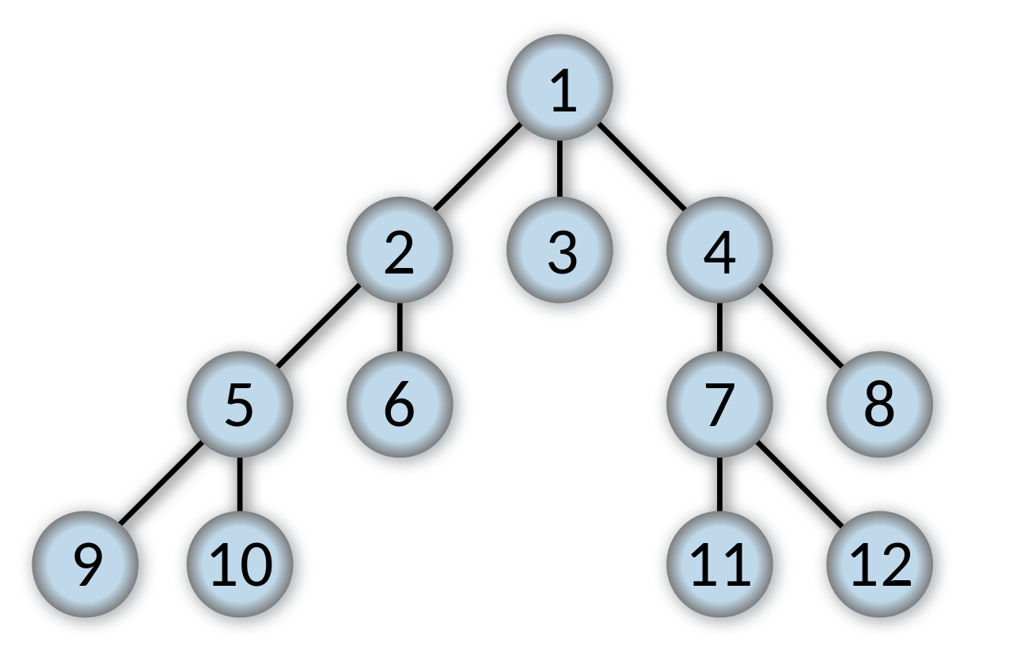
Shortest path in BKK network
BFS is a property of Networkx
Calculate the weight of each edge.
Arrival time – departure time
Add 5 seconds

Slide 9
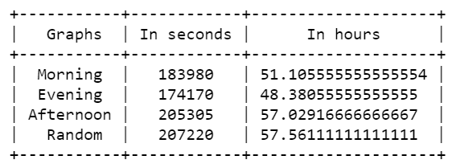
Result
The starting point is similar in all graphs

Slide 10
Thank you ☺
Questions!

