Slide 1
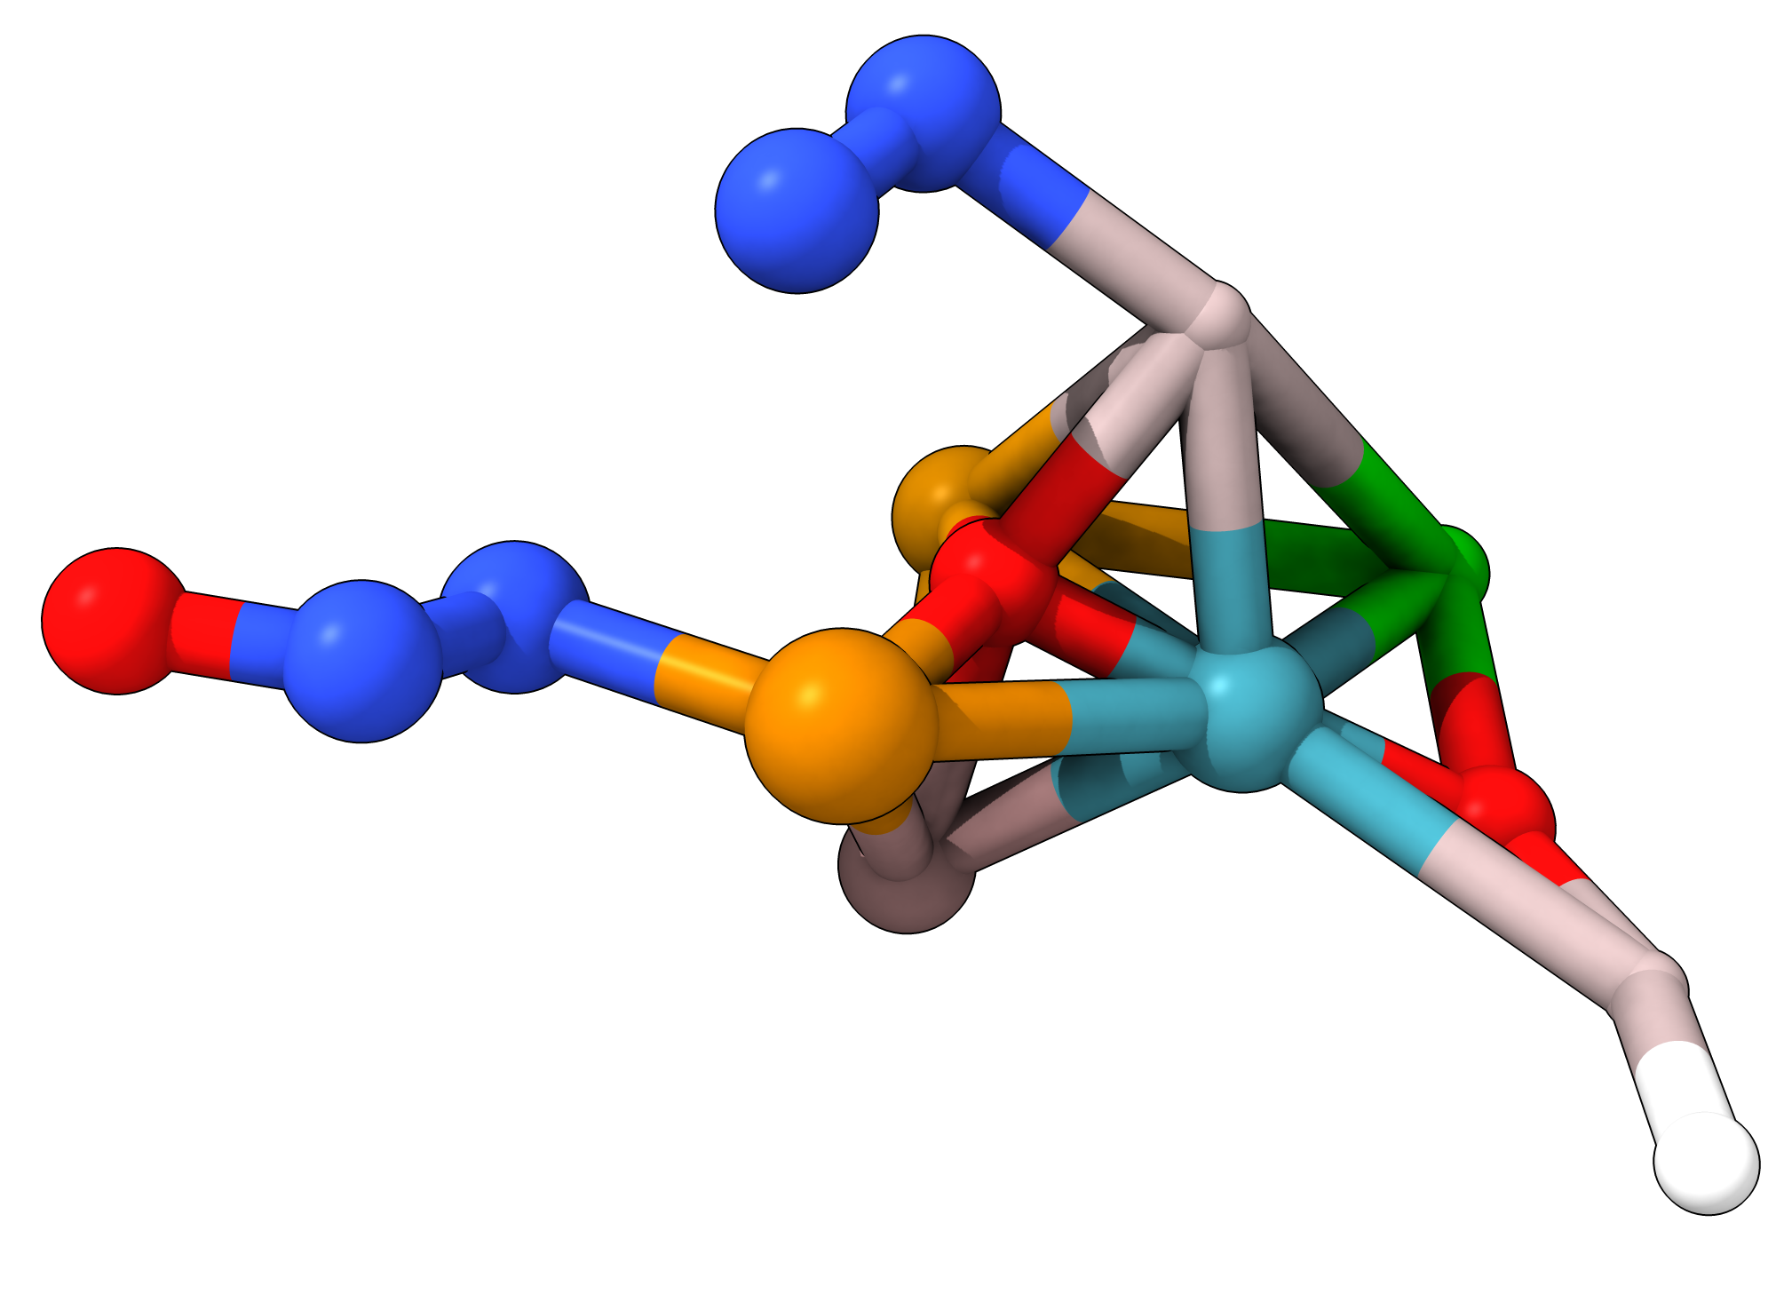
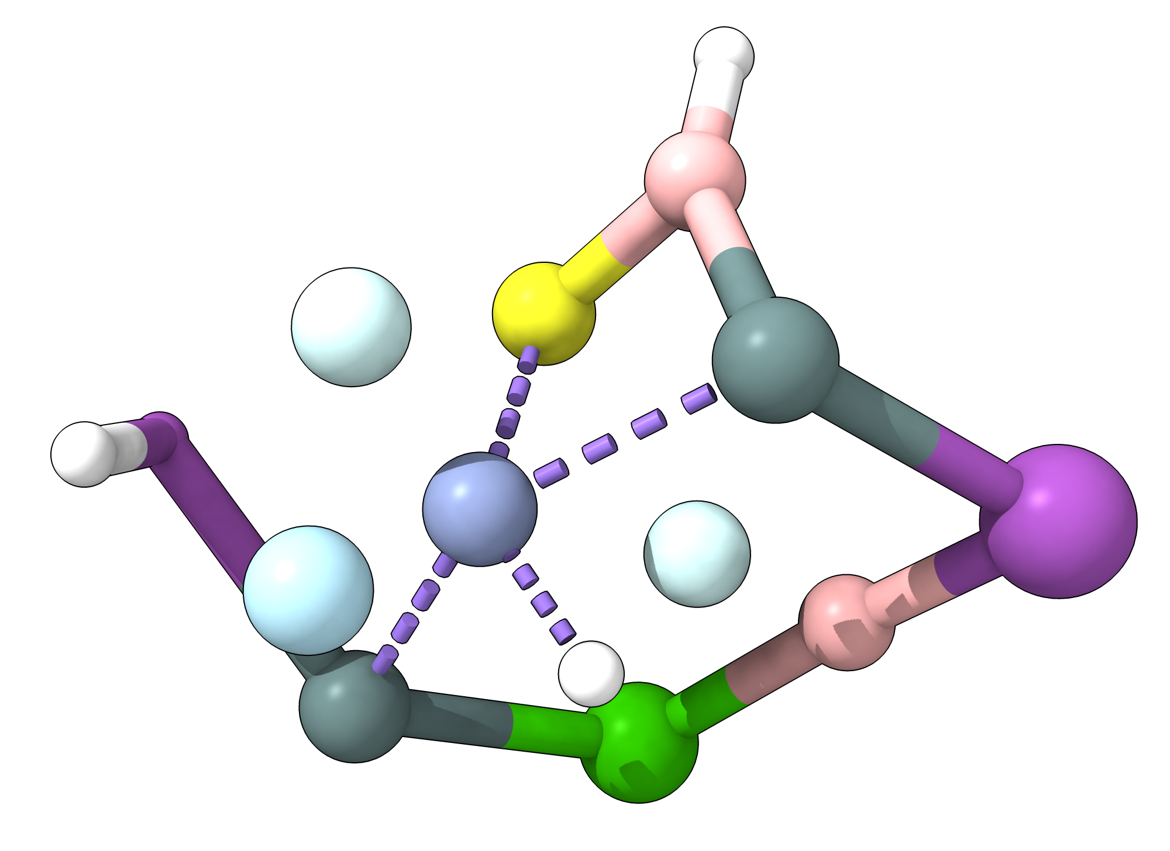
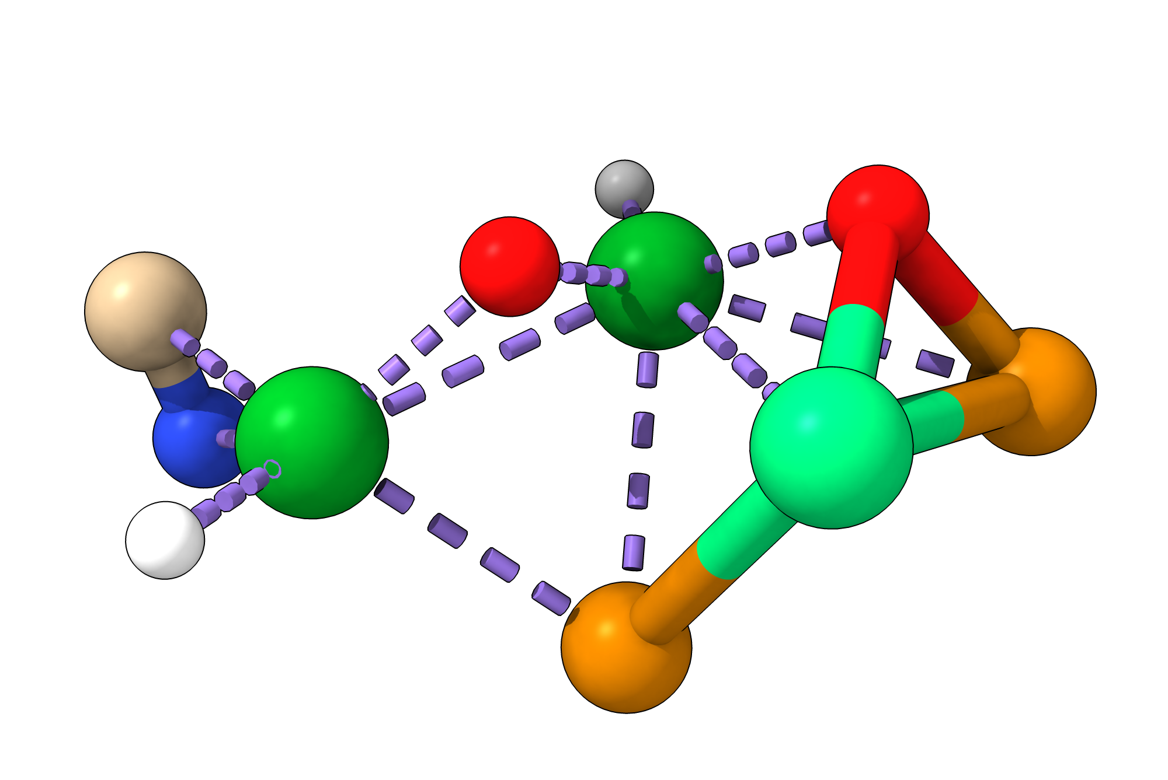
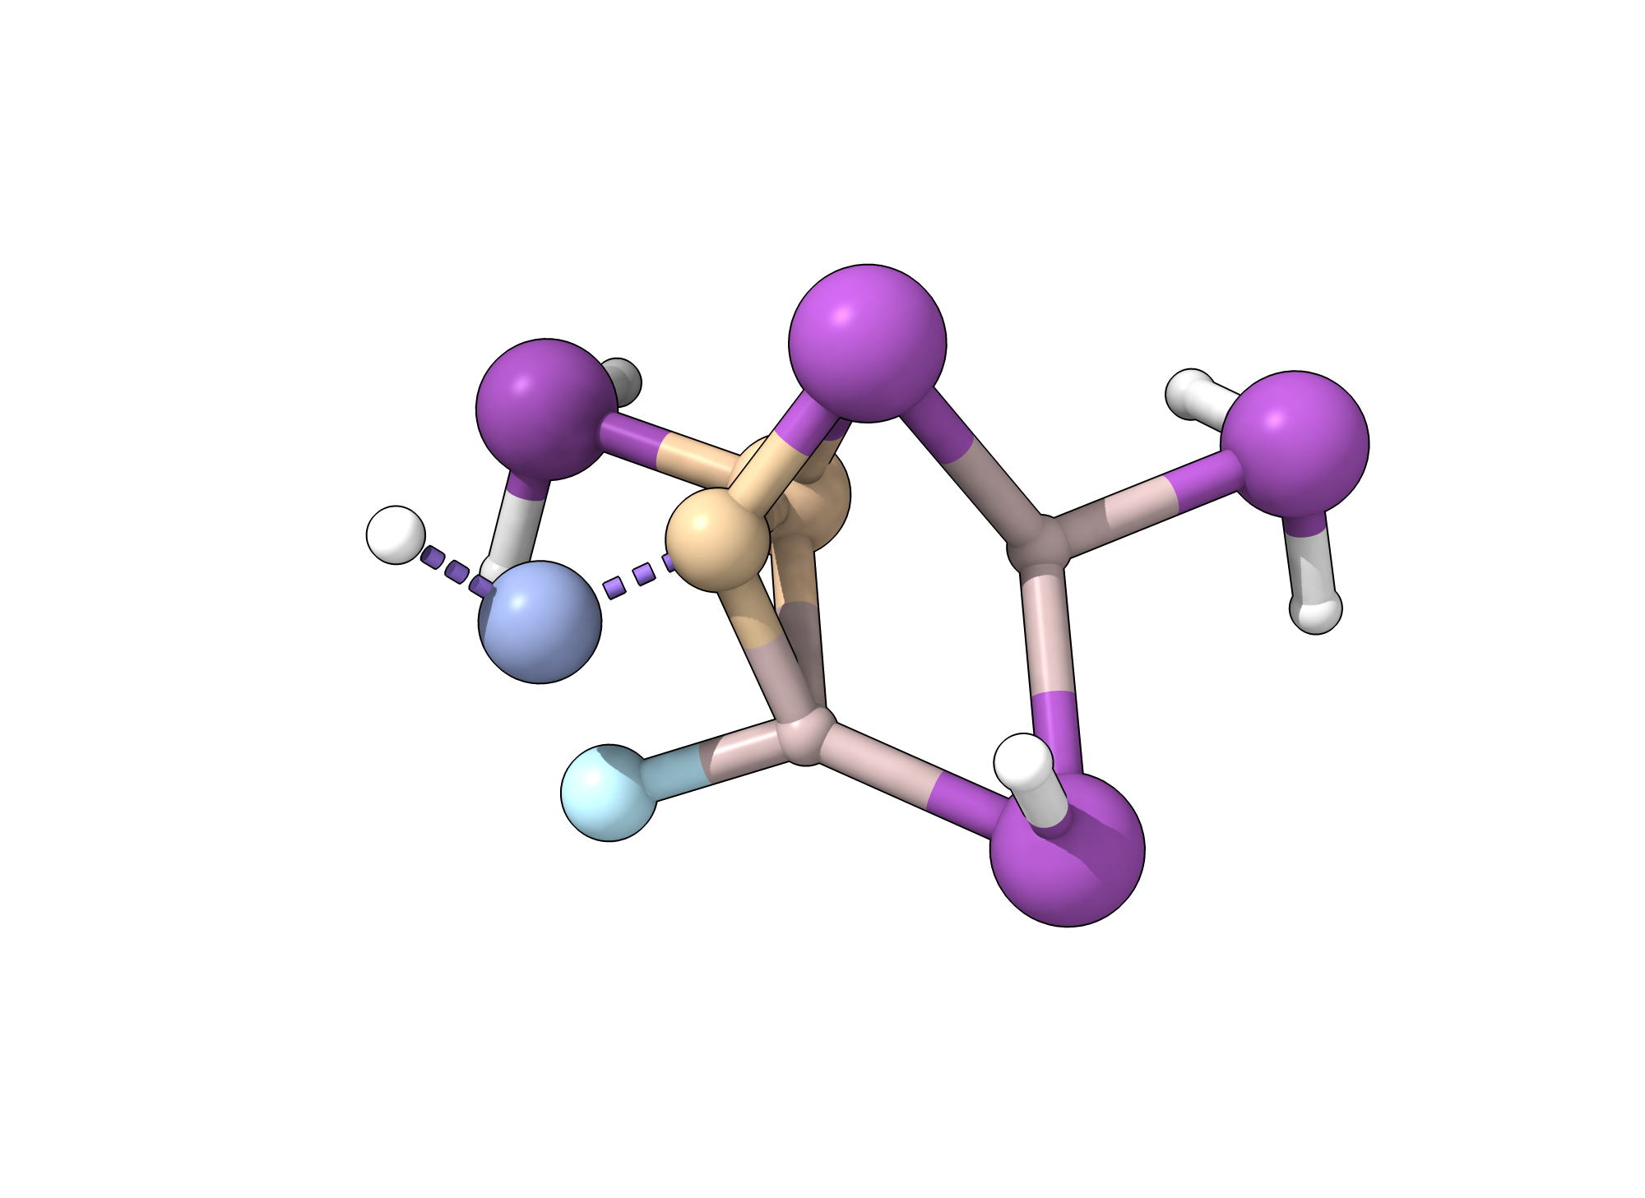
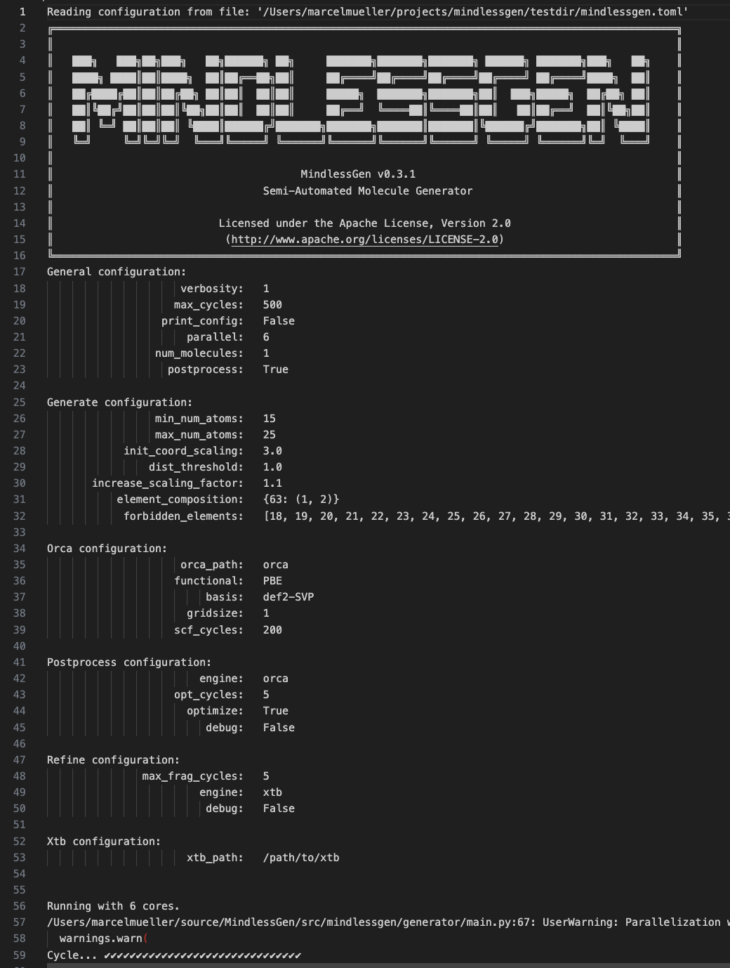
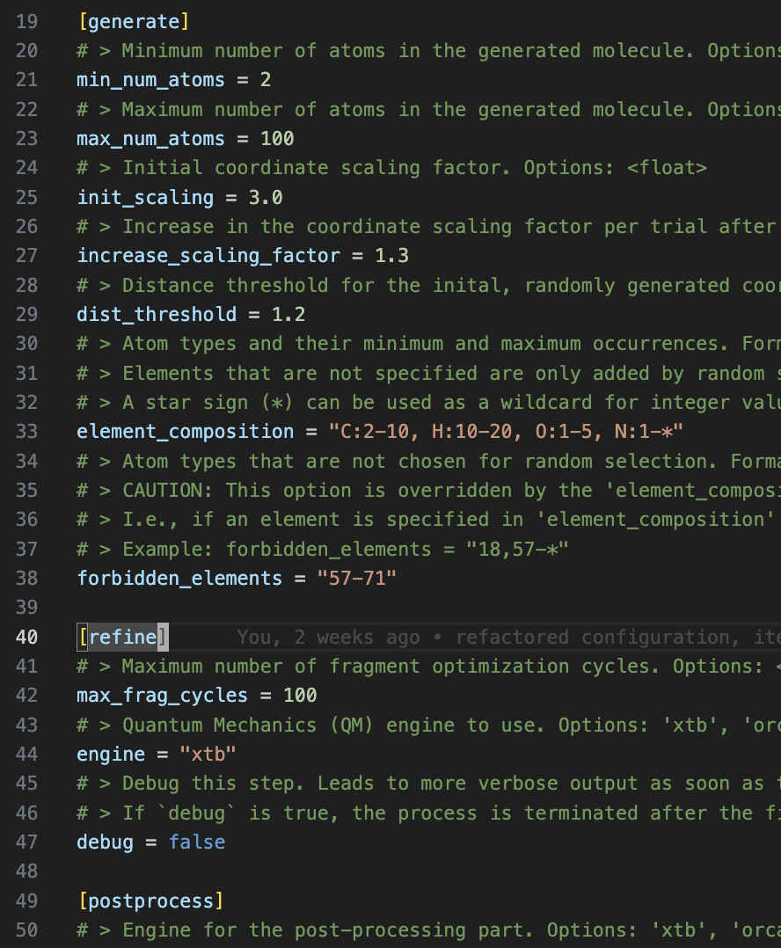


MindlessGen
H₃He₂B₂Ne₁S₁Ca₁Cr₁Sn₂Bi₂
H₁N₄O₃Al₂Ga₁Se₁-Sr₁Te₁Xe₁
Generate ”mindless” molecules from scratch!
… powered by xTB and ORCA.
C₁H₂N₁O₂-Te₂Er₁Lu₂
C₁H₆Ne₁Al₂Si₁Cr₁Bi₄
Simple but extensive input in TOML format
SotA Python code base
Detailed atom composition possible
Self-consistent fragment detection
xTB geometry optimization & DFT sanity check
Isomerization reactions
github.com/grimme-lab/MindlessGen

