Slide 1
EQ2321: Project 1
Hanqi Yang & Qian Zhou

Slide 2
2 Bandwidth of Speech
2.1&2.2 | cut-off frequency/Hz
 | hear what is said | hear a degradation
male44.wav | 2000 | 500
female44.wav | 2500 | 1000

Slide 3
2 Bandwidth of Speech
2.3 The frequency of human speech is approximately between 300Hz and 4kHz.
In digital communication, according to the Nyquist theorem, the minimum sampling frequency is two times the highest frequency of the voice signal.
So the sampling frequency of 8kHz can be used for POTS.

Slide 4
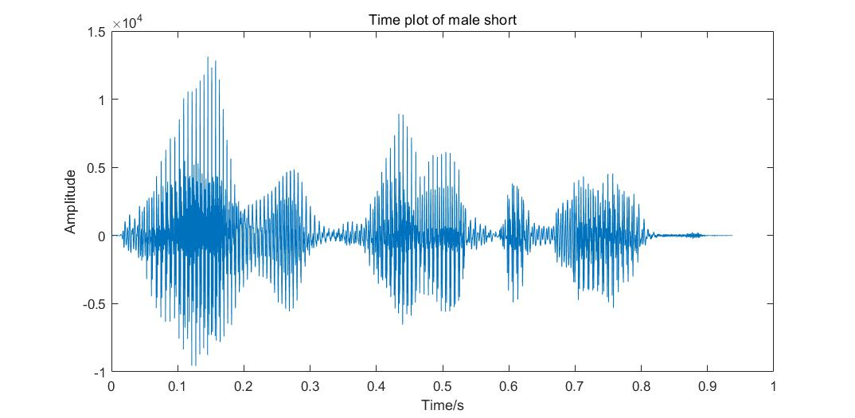
3 Voiced and Unvoiced Speech Sounds
3.1
Voiced
Unvoiced

Slide 5
3 Voiced and Unvoiced Speech Sounds
3.2
Highest pitch
Highest pitch：169.5Hz
Lowest pitch:
140.8Hz
Lowest pitch

Slide 6
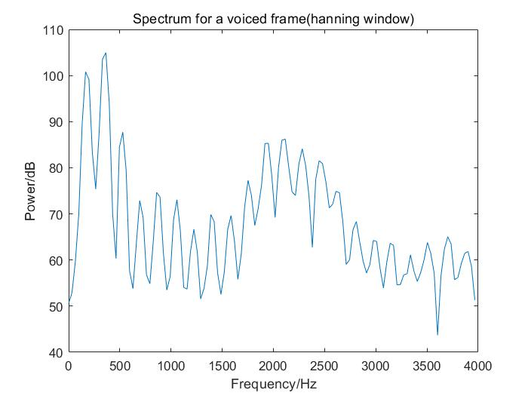
3 Voiced and Unvoiced Speech Sounds
3.3
from 0.25s to 0.28s

Slide 7
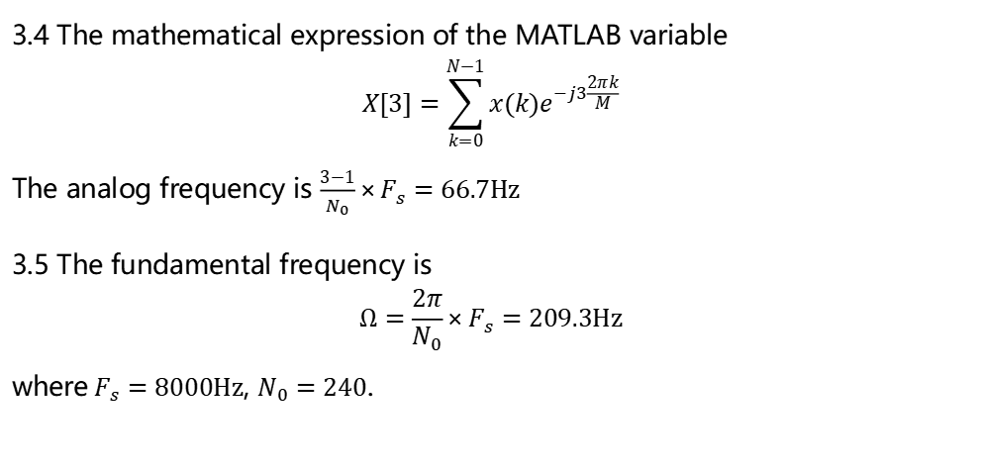
3 Voiced and Unvoiced Speech Sounds
3.4 The mathematical expression of the MATLAB variable
$$X[3]=\sum_{k=0}^{N−1}{x(k)e^{−j3\frac{2πk}{M}}}$$
The analog frequency is $\frac{3−1}{N_{0}}×F_{s}=66.7Hz$
3.5 The fundamental frequency is
$$Ω=\frac{2π}{N_{0}}×F_{s}=209.3Hz$$
where $F_{s}=8000Hz$, $N_{0}=240$.

Slide 8
3 Voiced and Unvoiced Speech Sounds
3.6 The appropriate frame length is 10-30 ms. The variation in mouthpiece is what causes the signal to be not stationary, so there should be no significant variation in mouthpiece during a frame, i.e. the frame length should be less than the phoneme length.
If the frame length is too long, there is no guarantee that the signal will be stationary; if the frame length is too short, the signal resolution will be reduced.

Slide 9
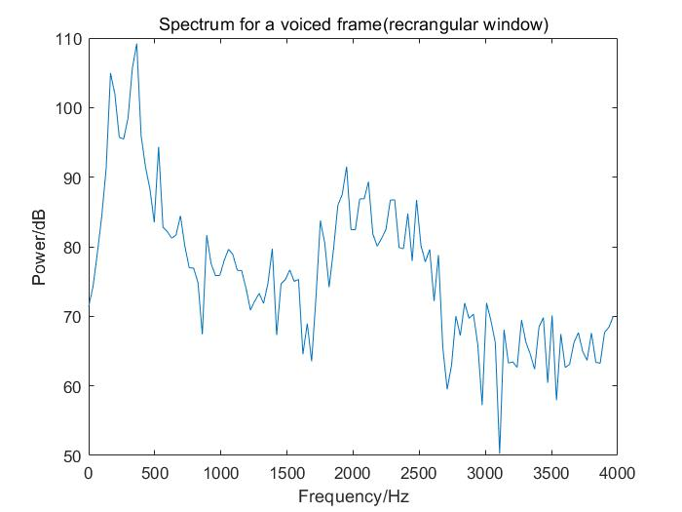
3 Voiced and Unvoiced Speech Sounds
3.7
from 0.25s to 0.28s
The rectangular window:
narrow main-lobe;
high frequency resolution;
high side-lobe;
severe interference;
The Hanning window:
low side-lobe;
concentrated energy;

Slide 10
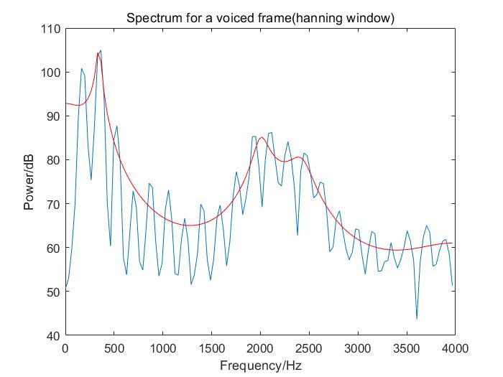
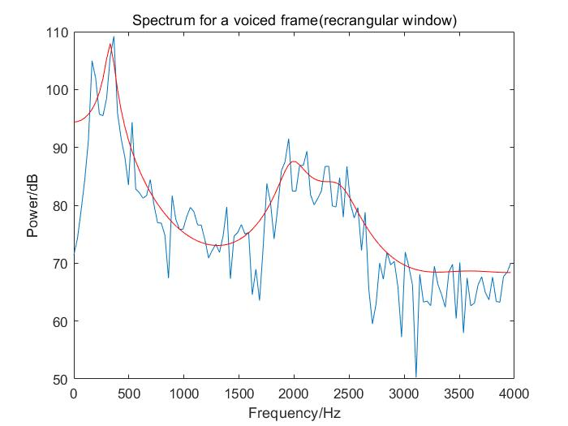
3 Voiced and Unvoiced Speech Sounds
3.8

Slide 11
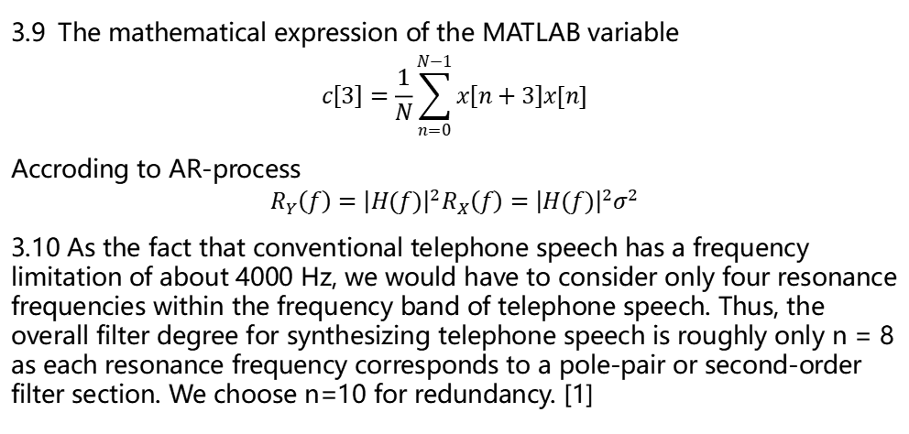
3 Voiced and Unvoiced Speech Sounds
3.9 The mathematical expression of the MATLAB variable
$$c\left[3\right]=\frac{1}{N}\sum_{n=0}^{N−1}{x\left[n+3\right]x[n]}$$
Accroding to AR-process
$$R_{Y}\left(f\right)={\left|H(f)\right|}^{2}R_{X}\left(f\right)={\left|H(f)\right|}^{2}σ^{2}$$
3.10 As the fact that conventional telephone speech has a frequency limitation of about 4000 Hz, we would have to consider only four resonance frequencies within the frequency band of telephone speech. Thus, the overall filter degree for synthesizing telephone speech is roughly only n = 8 as each resonance frequency corresponds to a pole-pair or second-order filter section. We choose n=10 for redundancy. [1]

Slide 12
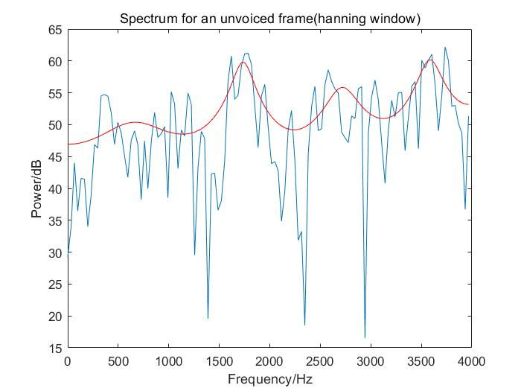
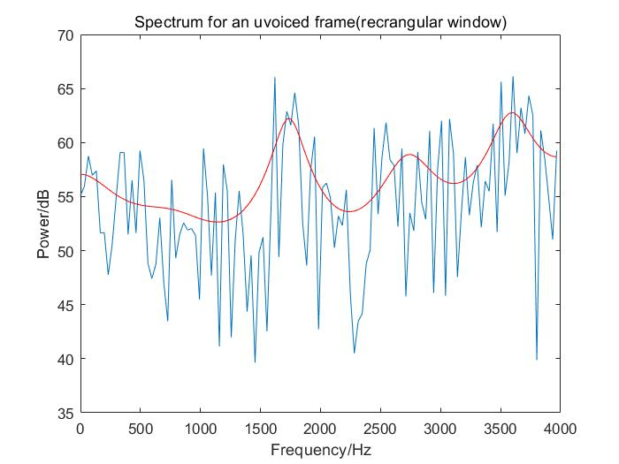
3 Voiced and Unvoiced Speech Sounds
3.11
from 0.82s to 0.85s

Slide 13
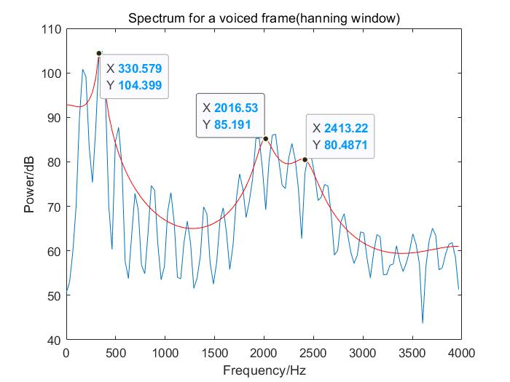
4 Formants
4.1
ih
F1: 330 → 390
F2: 2016 → 1990
F3: 2380 → 2550

Slide 14
4 Formants
4.2 Each vowel has a corresponding formant frequency, and this frequency does not change with pitch.
If the fundamental frequency is below the formant frequency, however, the vocal sound will be rich and full; if the fundamental frequency is above the formant frequency, the sound will be distorted.

Slide 15
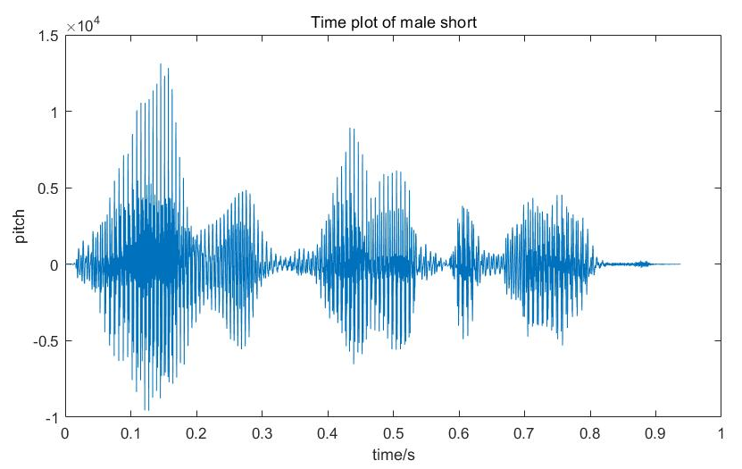
5 Phonemes and Allophones
5.1
n aʊ h i z w ʌ n ɒvð e m əʊ st

Slide 16
5 Phonemes and Allophones
5.2 Consonants may be voice sound, so they can have formant frequency. Examples: /b/, /d/, /ð/.
5.3 Diphthongs involve a gliding transition of the articulators from one vowel to another vowel. Examples: /əʊ/ as in “boat”, /ju/ as in “you”.
5.4 There are 42 phonemes in American English. [1]

Slide 17
5 Phonemes and Allophones
5.5 The acoustic representation associated with a phoneme is called a phone.[1]
An allophone is one of a set of multiple possible spoken sounds, or phones, or signs used to pronounce a single phoneme in a particular language. Example: [t] (as in stop [stɒp]) and the aspirated form [tʰ] (as in top [ˈtʰɒp])
There are two types of allophones, based on whether a phoneme must be pronounced using a specific allophone in a specific situation or whether the speaker has the unconscious freedom to choose the allophone that is used. [2]

Slide 18
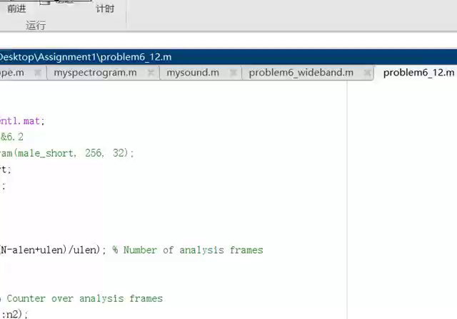
6 The Spectrogram
6.1&6.2

Slide 19
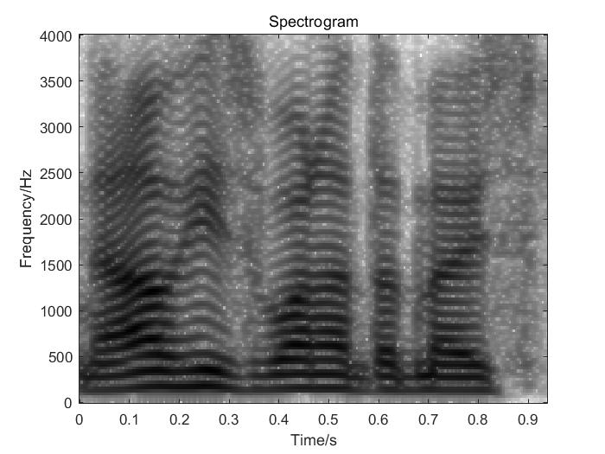
6 The Spectrogram
6.3
alen=256, ulen=32

Slide 20
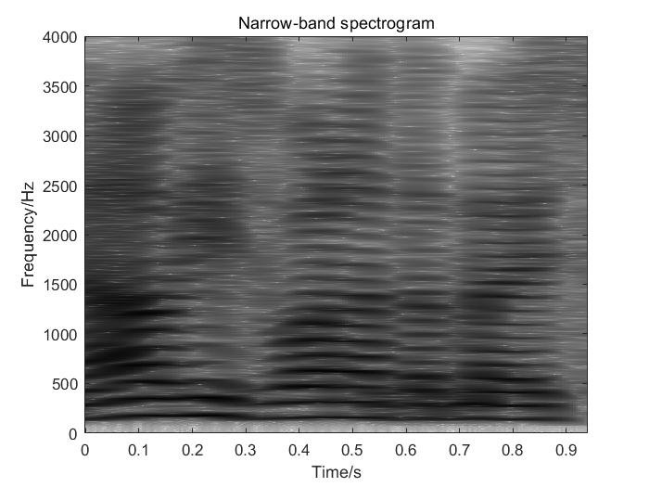
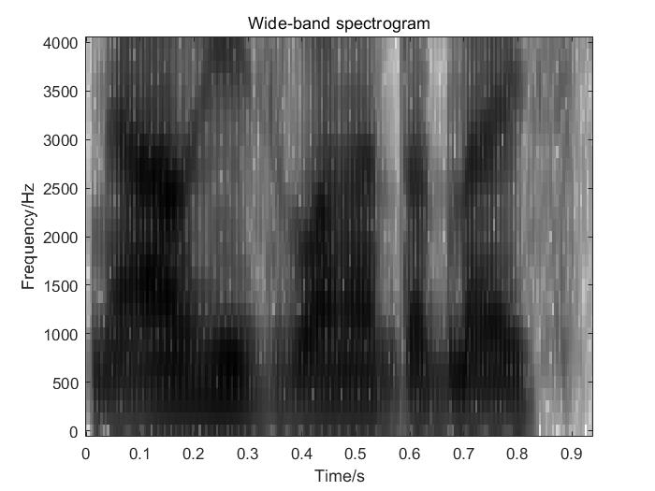
6 The Spectrogram
6.4&6.5
fundamental frequency track
alen=1024, ulen=32
alen=64, ulen=32
with zero-padding

Slide 21
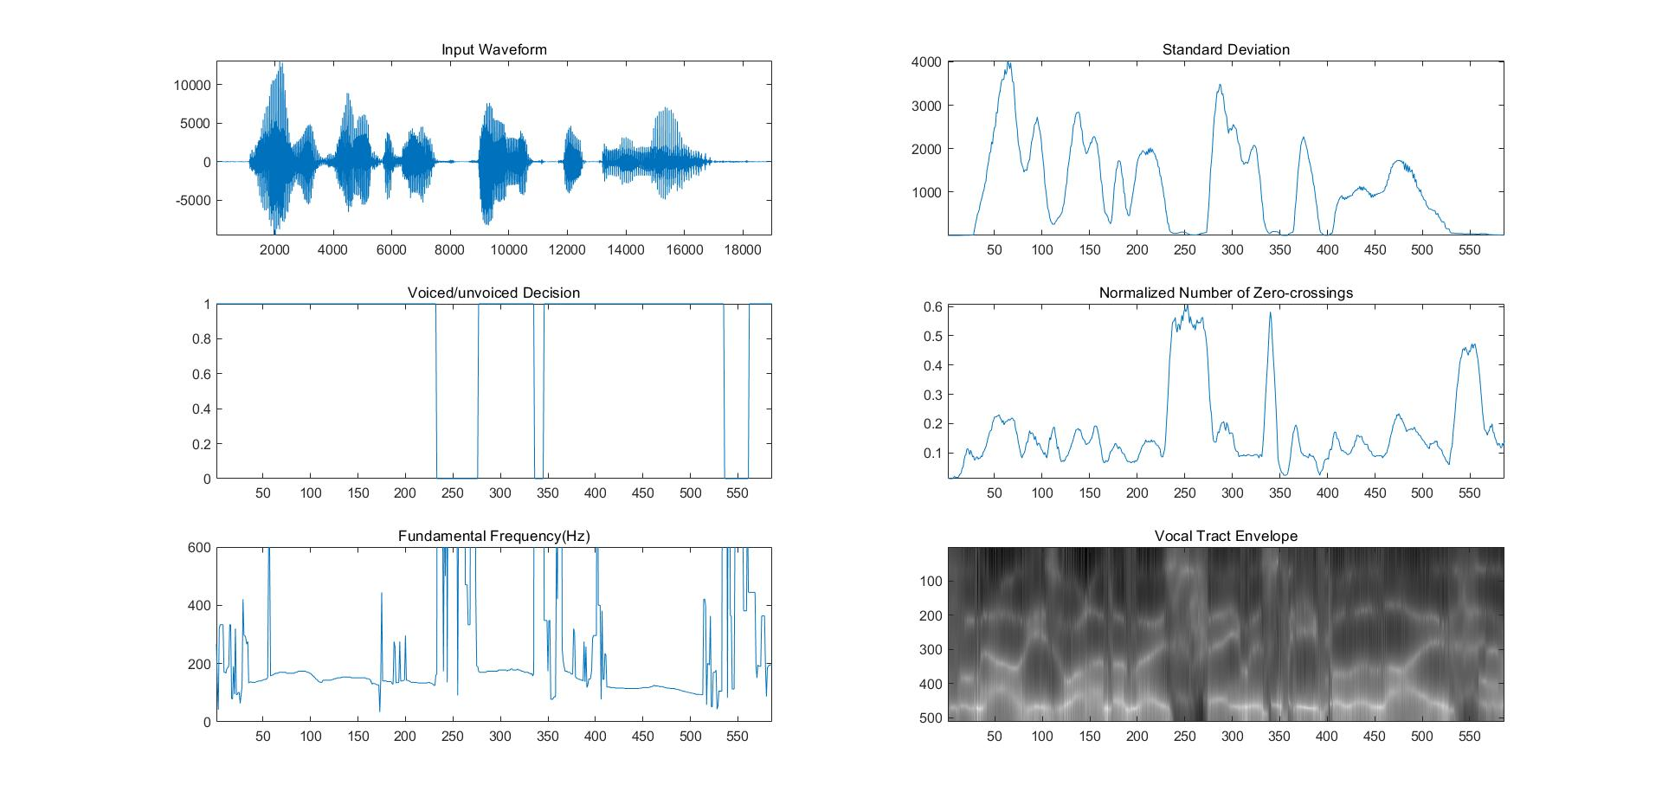
7 Speech Parameter Estimation
“male long” with alen=256, ulen=128

Slide 22
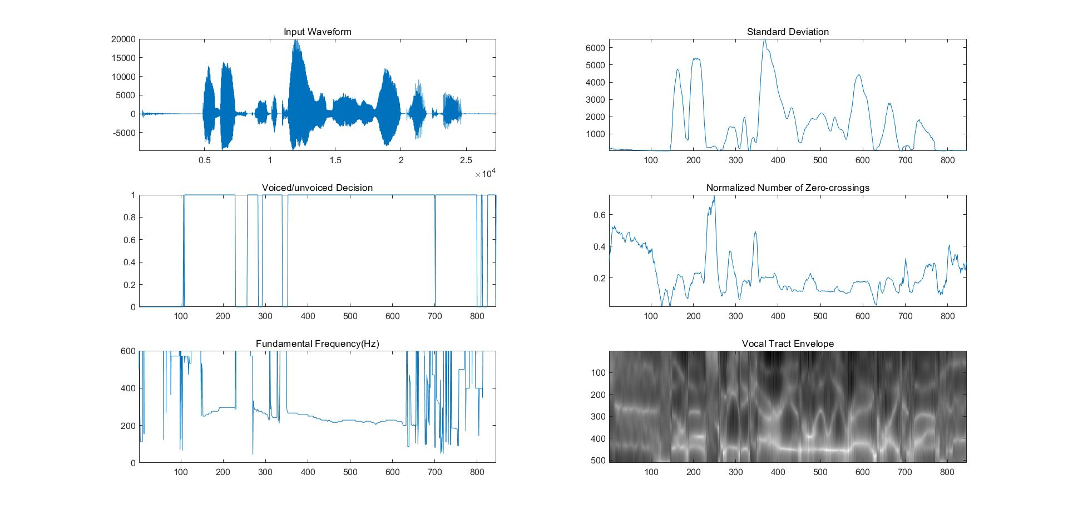
7 Speech Parameter Estimation
“female long” with alen=256, ulen=128

Slide 23
7 Speech Parameter Estimation
7.6
The choice of detection threshold is not appropriate.
The sound is not clear enough.
7.7 If the fundamental power is very low, a situation where harmonics are mistaken for the fundamental frequency may lead to a doubling of the pitch. The same interpretation may also occur in the case of a pitch halving.

Slide 24

8 The Vocoder
Synthesis 1
Synthesis 2
Synthesis 3
Synthesis 4

Slide 25
Reference
[1] Digital speech transmission: Enhancement, coding and error concealment. By Peter Vary and Rainer Martin.
[2] https://en.wikipedia.org/wiki/Allophone

