Slide 1
EQ2341 Assignment 5
System Demonstration: Song Recognition
Hanqi Yang, hanqi@kth.se
Qian Zhou, qianzho@kth.se
May 27th, 2022
Notes:
Remember to introduce our country, major.

Slide 2

Application and Database
Distinguishing between a few brief snippets of hummed melodies.
We use our own data and voices to train.
 |  | Training |  | Test
 |  | Hanqi | Qian | Hanqi | Qian
Melody A | Little Star | 10 | 10 | 2 | 2
Melody B | Happy birthday | 10 | 10 | 2 | 2
Melody C | Brother John | 10 | 10 | 2 | 2

Slide 3

Feature Extraction
Read melody files
Read files to get wav‘s sampling rate and signal data.
Get music feature
Get pitch frequency, intensity and correlation of each melody.
Extract feature
Eliminate noise components.
Generate features based on semitones.

Slide 4
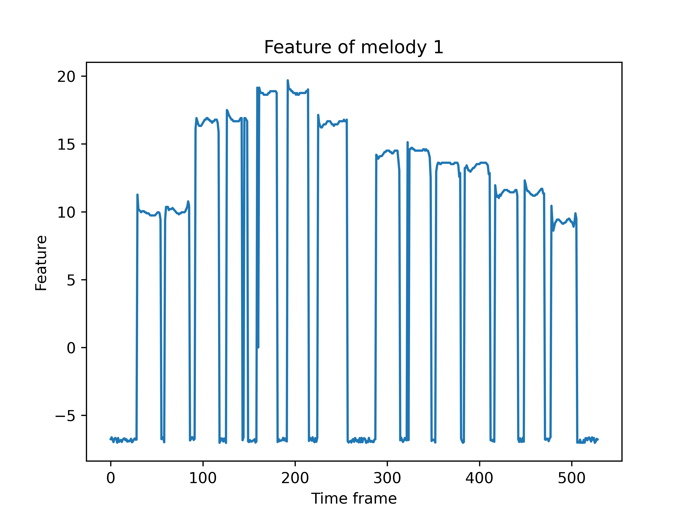
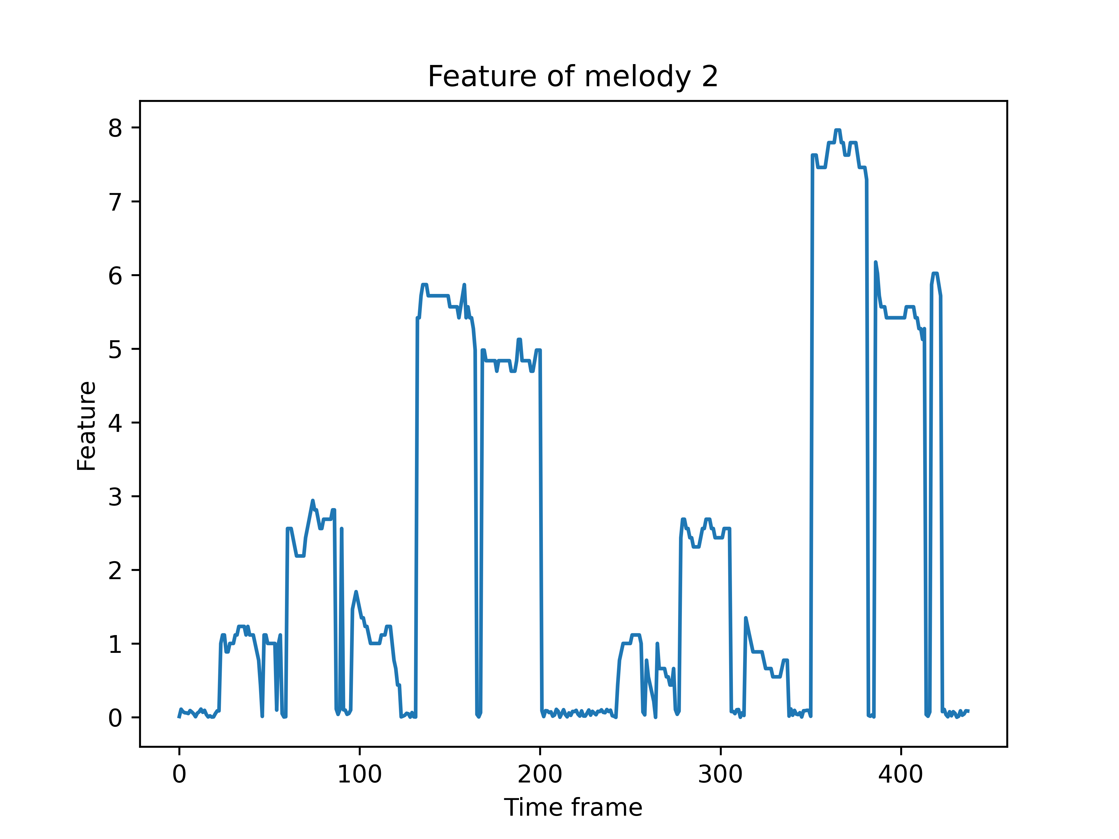
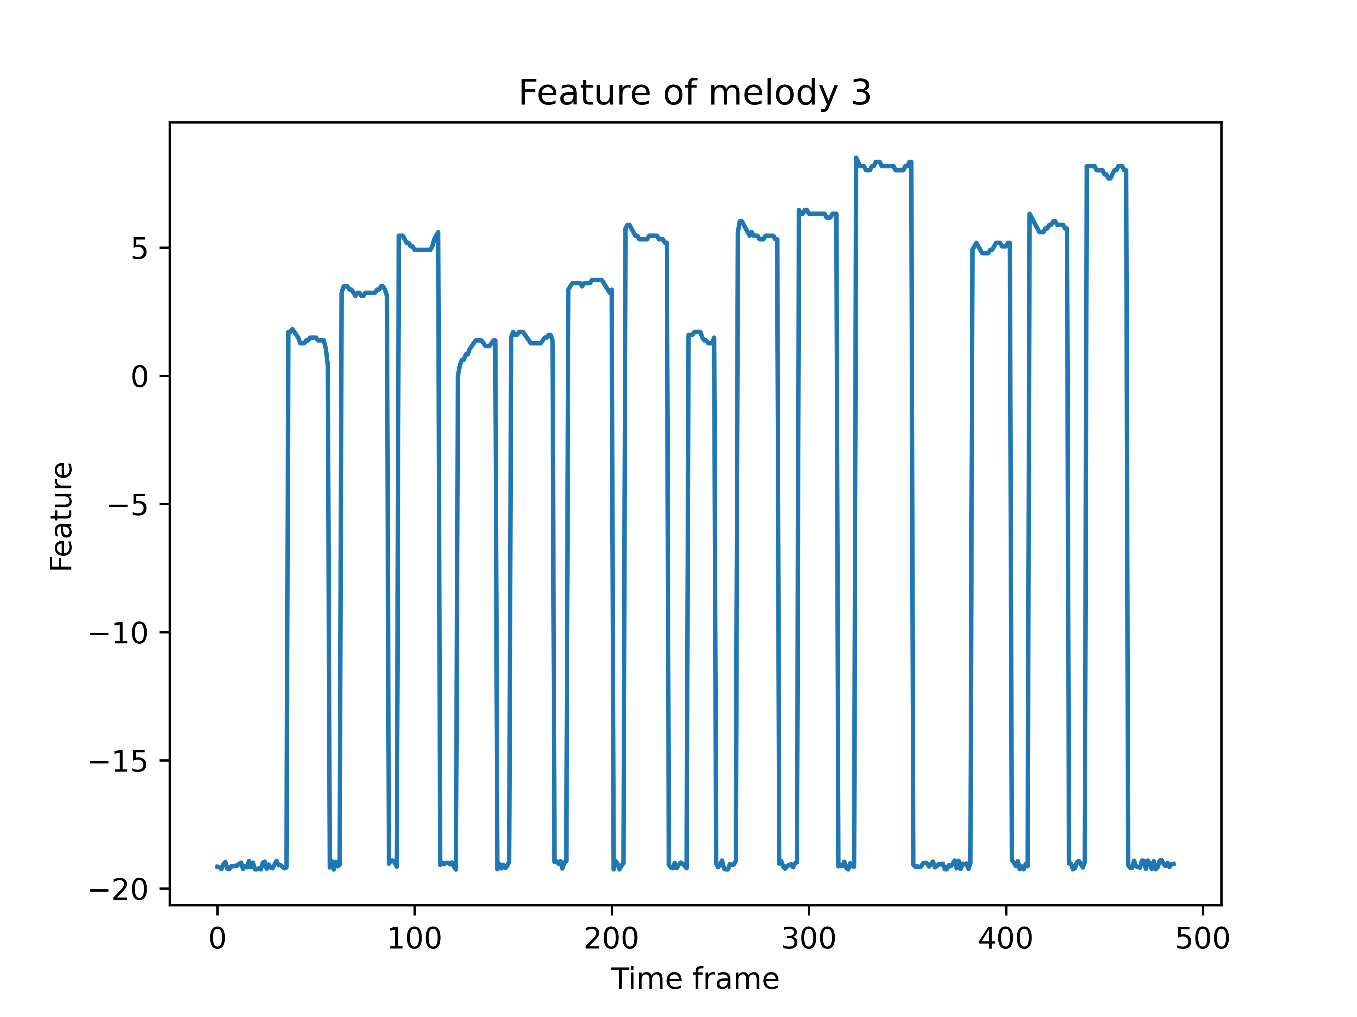
Feature Extraction
Comparison of the features of three melodies

Slide 5
HMM System Design
Testing Set
Testing Set
Feature
Feature Extractor
HMM Training
HMM Model
Training Set
Training Set
Feature
Performance evaluation

Slide 6
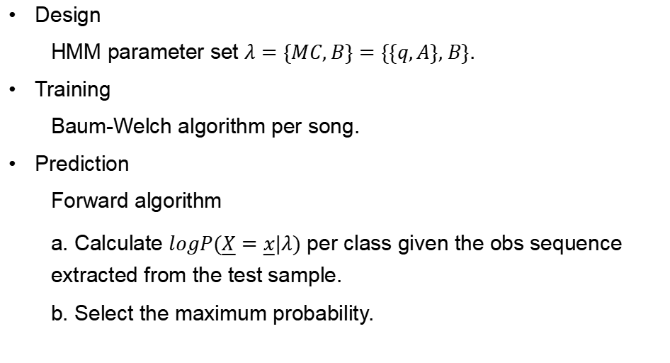
HMM implementation
Design
HMM parameter set $λ=\{MC, B\}=\{\{q,A\}, B\}$.
Training
Baum-Welch algorithm per song.
Prediction
Forward algorithm
a. Calculate $logP(\underline{X}=\underline{x}|λ)$ per class given the obs sequence extracted from the test sample.
b. Select the maximum probability.

Slide 7
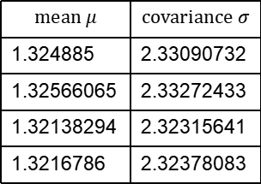
Trained Matrix
q:
0.1885425 | 0.16211513 | 0.32020771 | 0.32913467
B:
mean $μ$ | covariance $σ$
1.324885 | 2.33090732
1.32566065 | 2.33272433
1.32138294 | 2.32315641
1.3216786 | 2.32378083
0.2688196 | 0.18329328 | 0.224296 | 0.32359112
0.20451465 | 0.33292653 | 0.27438849 | 0.18817034
0.30051905 | 0.27732585 | 0.20020113 | 0.22195397
0.30827782 | 0.23850963 | 0.20038111 | 0.25283144
A:

Slide 8
Result
10 training samples and 2 test samples per melody from Hanqi
 | Melody1 | Melody2 | Melody3
Test sample 1 | √ | ×(Misjudged as 3) | √
Test sample 2 | ×(Misjudged as 3) | ×(Misjudged as 3) | √
10 training samples and 2 test samples per melody from Qian
 | Melody1 | Melody2 | Melody3
Test sample 1 | √ | ×(Misjudged as 1) | ×(Misjudged as 1)
Test sample 2 | √ | ×(Misjudged as 1) | ×(Misjudged as 1)

Slide 9
Result
20 training samples and 4 test samples per melody from two persons
 | Melody1 | Melody2 | Melody3
Test sample 1 | √ | ×(Misjudged as 3) | √
Test sample 2 | √ | ×(Misjudged as 3) | √
Test sample 3 | √ | ×(Misjudged as 3) | √
Test sample 4 | √ | ×(Misjudged as 3) | √

Slide 10
Result and Problems
Correctness rate:
50% (10 training samples and 2 test samples per melody from Hanqi)
33.3% (10 training samples and 2 test samples per melody from Qian)
66.6% (20 training samples and 4 test samples per melody from two persons)
Problems:
Insufficient number of samples in the training set.
The extracted features are not sufficient to distinguish the second song from
the other two.
Poor quality of HMM model.

Slide 11
Conclusion and improvements
Conclusion:
A pattern recognition system capable of distinguishing between a few brief
snippets of hummed melodies. (66% correct rate)
Improvements:
Increase dataset of melody B to get a higher accuracy.
Increase the number and diversity of samples.
Better feature extractor.
Better HMM model.

Slide 12
Thank you for your listening!
Hanqi Yang, hanqi@kth.se
Qian Zhou, qianzho@kth.se

