Slide 1
201 Walkthrough:
Autoscaling OpenStack natively with Heat, Ceilometer and LBaaS

Slide 2



Speakers
Jason Grimm
Consulting Systems Engineer
Cisco OpenStack Private Cloud
Sharmin Choksey
Technical Leader
Cisco Cloud Services
Shixiong Shang
Chief Technology Officer
Nephos6
Agenda
Introductions <
About The Workshop <
Environment Setup <
Background & Use Cases <
Theory <
Hands-On <

Slide 3
About The Workshop

Slide 4
Workshop Tips, Logistics and Flow
We all work for or with Cisco, but this is not a marketing workshop
This is highly technical focused and all content and tools are 100% FOSS; Free and Open-Source Software, non-proprietary
Please connect to http://cisco.webex.com/rooms/jasgrimm
This will provide chat, voting, questions, etc. and allow us to see when everyone is ready to proceed
Session recording will be made available
Please work with your peers at your table
Due to bandwidth constraints and other potential technical issues all of you may not be able to get a test environment up in time, double up as necessary
Materials for the presentation are available for download at https://github.com/grimmtheory/autoscale

Slide 5
Environment Setup
Virtual Box, Ubuntu, DevStack, etc.

Slide 6
Workshop Tips, Logistics and Flow
We all work for or with Cisco, but this is not a marketing workshop
This is highly technical focused and all content and tools are 100% FOSS; Free and Open-Source Software, non-proprietary
Please connect to http://cisco.webex.com/rooms/jasgrimm
This will provide chat, voting, questions, etc. and allow us to see when everyone is ready to proceed
Session recording will be made available
Please work with your peers at your table
Due to bandwidth constraints and other potential technical issues all of you may not be able to get a test environment up in time, double up as necessary
Materials for the presentation are available for download at https://github.com/grimmtheory/autoscale

Slide 7
Background & Use Cases
What is Autoscaling and when / how is it used?

Slide 8
Background

Slide 9
Theory
Heat, Ceilometer, Neutron w/ LBaaS

Slide 10
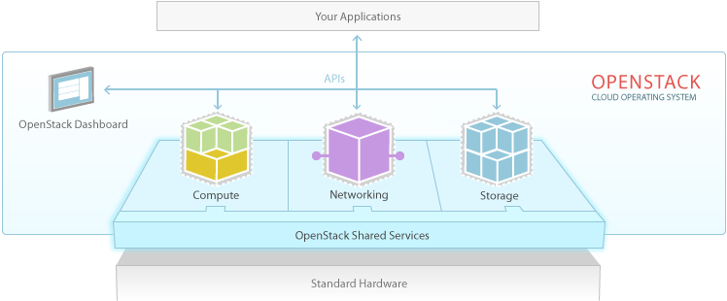
HEAT OpenStack Orchestration Service Heat makes “clouds” rise
heat
The heat tool is a CLI which communicates with the heat-api to execute AWS CloudFormation APIs. End developers could also use the heat REST API directly.
heat-api
The heat-api component provides an OpenStack-native REST API that processes API requests by sending them to the heat-engine over RPC.
heat-api-cfn
The heat-api-cfn component provides an AWS Query API that is compatible with AWS CloudFormation and processes API requests by sending them to the heat-engine over RPC.
heat-engine
The heat engine’s main responsibility is to orchestrate the launching of templates and provide events back to the API consumer.
OpenStack resource abstraction and orchestration:
VM Instances
Networks
Routers
…
“Typically” Virtual
(See Ironic Project)
Infrastructure resource abstraction and orchestration:
Compute Power
Switches
Block Storage
…

Slide 11
CEILOMETER OpenStack Orchestration Service Meteorological device: measure distance from the ground to the clouds

Slide 12
Hands-On Workshop
Basic Heat Operations, Advanced Heat Operations, Autoscale

Slide 13
References

Slide 14
References
DevStack Configuration Guide – http://docs.openstack.org/developer/devstack/configuration.html
Materials for the presentation are available for download at https://github.com/grimmtheory/autoscale
Heat Orchestration Template (HOT) guide – http://docs.openstack.org/developer/heat/template_guide/hot_guide.html
Heat on DevStack guide – http://docs.openstack.org/developer/heat/getting_started/on_devstack.html

