Slide 1
201 Walkthrough:
Autoscaling OpenStack natively with Heat, Ceilometer and LBaaS

Slide 2


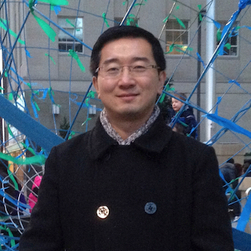
Speakers
Jason Grimm
Consulting Systems Engineer
Cisco OpenStack Private Cloud
Sharmin Choksey
Technical Leader
Cisco Cloud Services
Shixiong Shang
Chief Technology Officer
Nephos6
Agenda
Introductions <
About The Workshop <
Environment Setup <
Background & Use Cases <
Theory <
Hands-On <

Slide 3
Introductions
About the speakers: Jason, Sharmin and Shixiong

Slide 4





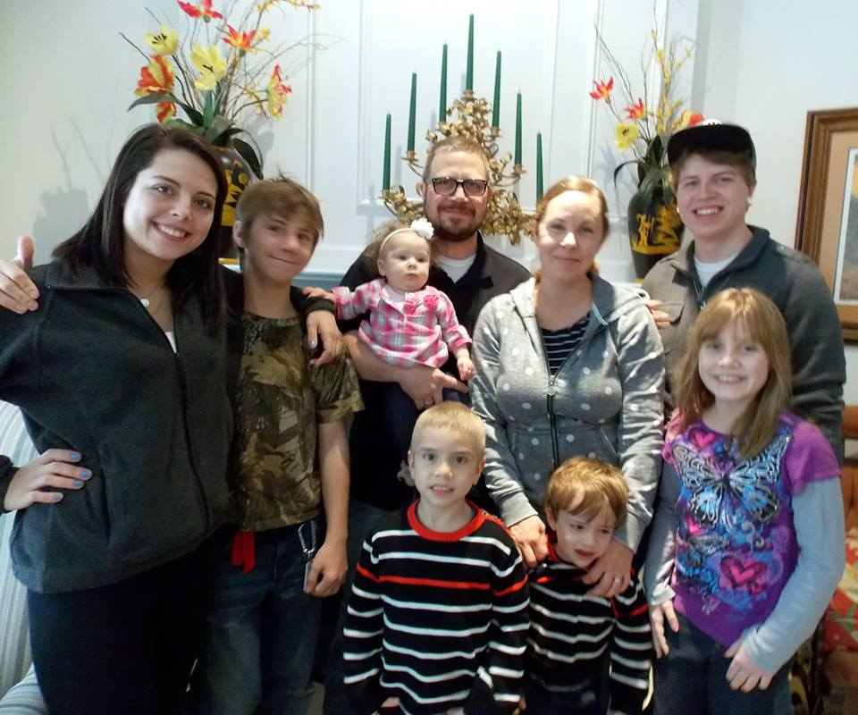









Introduction: Jason Grimm
Georgia
Boston
Key West
Atlanta
Canton
Lots of hats…
Husband
Father
Veteran
Farmer
Racker
Architect
Lots of hobbies…
Music
Movies
Politics
Collecting
Comedy
Reading
US Naval Intelligence
1992-1996
Freelance Consulting
1996-2000
Startup Co-Founder
2000-2004
Dell
2004-2013
Mirantis
2013
Rackspace
2013-2015
Cisco
2015-

Slide 5
Introduction: Sharmin Choksey

Slide 6
Introduction: Shixiong Shang

Slide 7
About The Workshop

Slide 8
Workshop Tips, Logistics and Flow
We all work for or with Cisco, but this is not a marketing workshop
This is highly technical focused and all content and tools are 100% FOSS; Free and Open-Source Software, non-proprietary
Please connect to http://cisco.webex.com/rooms/jasgrimm
This will provide chat, voting, questions, etc. and allow us to see when everyone is ready to proceed
Session recording will be made available
Please work with your peers at your table
Due to bandwidth constraints and other potential technical issues all of you may not be able to get a test environment up in time, double up as necessary
Materials for the presentation are available for download at https://github.com/grimmtheory/autoscale

Slide 9
Environment Setup
Virtual Box, DevStack, VM Images, etc.

Slide 10
Background & Use Cases
What is Autoscaling and when / how is it used?

Slide 11
Theory
Heat, Ceilometer, Neutron w/ LBaaS

Slide 12
Hands-On Workshop
Basic Heat Operations, Advanced Heat Operations, Autoscale

Slide 13
References

Slide 14
References
DevStack Configuration Guide – http://docs.openstack.org/developer/devstack/configuration.html
Materials for the presentation are available for download at https://github.com/grimmtheory/autoscale

