Slide 1
GLASSBOX
A crypto trading agent you can actually trust.
Five AI analysts debate every move. A rulebook and a safety guard can overrule them. Every decision is signed and logged, so you can see exactly what it did — and why.
Binance Agent OS hackathon · 20,000 USDC prize pool · runs in safe paper mode out of the box, no exchange keys required

Slide 2
THE PROBLEM
AI trading agents are black boxes.
Most autonomous trading agents will happily move real money — but they can't show you why they made a trade, they have no hard limits you can trust, and they keep no record you can't quietly edit afterwards. For a platform that wants to let agents trade on people's behalf, that's the whole problem.
No visibility
You can't see the reasoning behind a trade.
No hard limits
Nothing it can't override when it matters.
“Would you let a stranger trade your savings, never explain a single decision, and hand you a logbook they can rewrite?”
No proof
Records that can be edited aren't evidence.
GlassBox · risk-first crypto trading agent
2

Slide 3
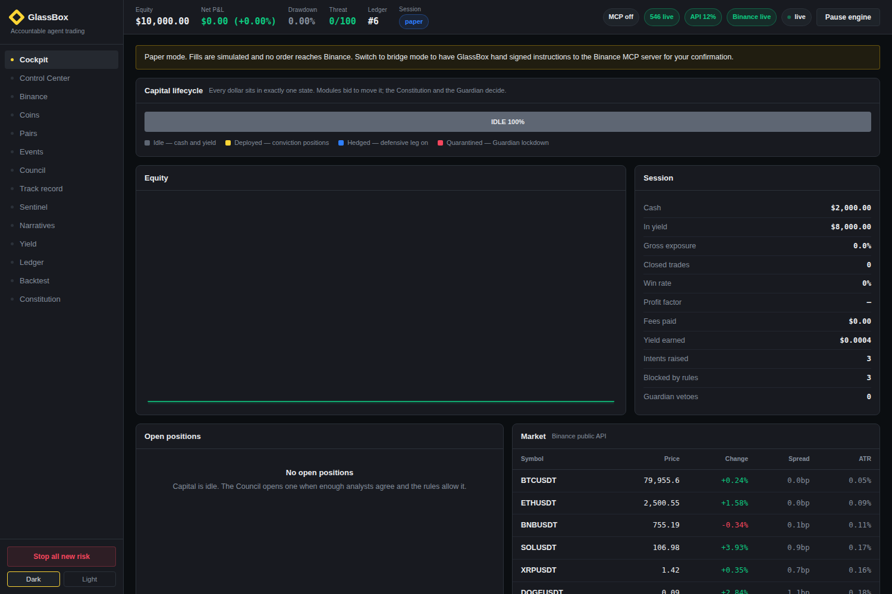
WHAT IT IS
A trading agent with its reasoning on the outside.
GlassBox trades crypto on live Binance data. What makes it different is that the safety and the explanation aren't bolted on afterwards — they sit at the centre. You watch it think, you set the rules it can't break, and you get a signed receipt for everything.
See it think. every analyst’s view, in plain language
Set the guardrails. hard rules the AI cannot argue with
Keep the proof. a tamper-evident log of every decision
Launches in one step — nothing to configure, no keys to paste.
GlassBox · risk-first crypto trading agent
3

Slide 4
HOW IT WORKS
Every trade passes five checkpoints.
1
2
3
4
5
Watch
→
Debate
→
Check rules
→
Safety veto
→
Sign & log
Reads live Binance prices, order books and trades.
Five AI analysts weigh in independently.
A rulebook approves, shrinks or blocks the trade.
A guard can override it if danger spikes.
The decision is recorded and can’t be altered.
The point: the AI does the thinking, but it never gets the last word. Two independent gates — the rulebook and the safety guard — sit between any decision and real money.
GlassBox · risk-first crypto trading agent
4

Slide 5
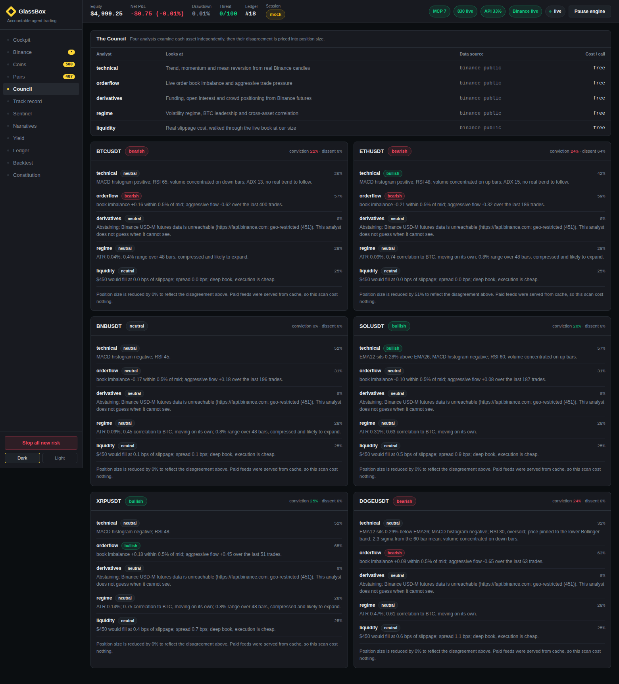
FEATURE · THE COUNCIL
Five analysts argue. Disagreement shrinks the bet.
Instead of one opinion, five specialists each read the market through a different lens — price trend, order flow, derivatives, market regime and liquidity. When they agree across genuinely different methods, that’s real confidence. When they don’t, GlassBox automatically takes a smaller position rather than pretending the split doesn’t exist.
Why it’s strong
The losing argument is kept too — you see the case against every trade, not just the pitch for it. Three analysts inside one method agreeing counts as one idea, not three.
GlassBox · risk-first crypto trading agent
5

Slide 6
FEATURE · THE CONSTITUTION
A rulebook the AI cannot argue with.
The limits live in a plain rulebook, written in a simple text file, and checked by ordinary code AFTER the AI has finished reasoning. The agents can’t edit it, talk their way around it, or ignore it. Break a rule and the trade is shrunk or refused — not negotiated.
constitution.yaml
max_position_pct: 15
max_leverage: 10 # hard ceiling → DENY
daily_loss_limit_pct: 4
17 rules, position size, leverage cap, loss limits, cooldowns
cooldown_after_loss: 30m
require_stop_loss: true
Fails closed — when unsure, it blocks rather than allows
confirm_above_pct: 14 # ask a human first
Big trades pause for your confirmation before they run
blackout_windows: [FOMC, CPI]
GlassBox · risk-first crypto trading agent
6

Slide 7
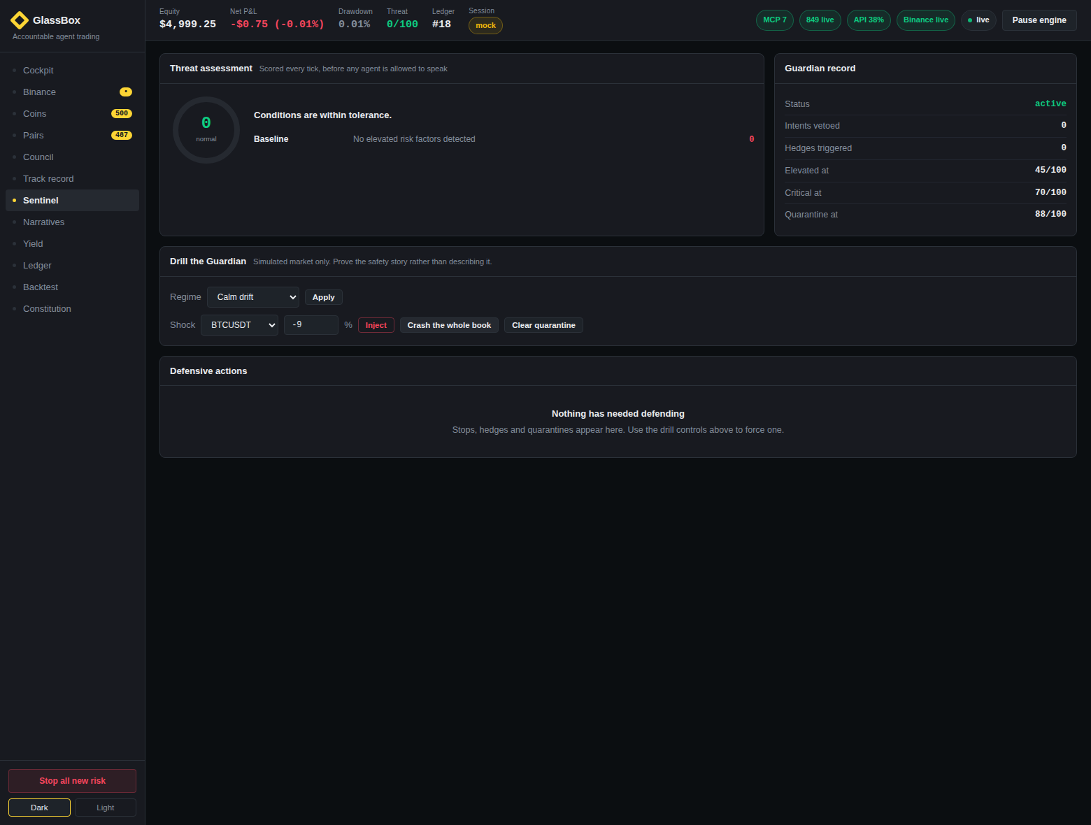
FEATURE · THE GUARDIAN
A safety guard that can pull the plug.
Independently of the analysts, a Guardian scores danger every few seconds — sudden price moves, volatility spikes, correlations breaking down, losses mounting. If it crosses the line it can veto a trade the rulebook already approved, hedge, or freeze all capital until things calm down.
Why it’s strong
A second, independent brake. The panel scores threat every few seconds against preset lines for elevated, critical and quarantine — and a one-click drill lets you crash the whole book on demand to watch it respond, so the safety isn’t just a claim.
GlassBox · risk-first crypto trading agent
7

Slide 8
FEATURE · THE PROOF
A logbook that can’t be quietly rewritten.
Every decision — the analysts’ arguments, the rule check, the Guardian’s call, the order and its outcome — is written to a signed, chained record. Edit or delete any past entry and the chain breaks for that entry and every one after it. You can verify the whole history from the very first record at any time.
Analysts’ arguments (incl. the losing side)
Rulebook verdict + which rule applied
Guardian threat score at decision time
Signed & hash-chained — tampering is detectable, not hidden
Order, price, fees and outcome
Anchored to Binance’s clock so history can’t be back-dated
SHA-256 signature linking to the previous record
GlassBox · risk-first crypto trading agent
8

Slide 9
FEATURE · ASK THE DESK
Talk to it about any coin — in plain English.
A built-in analyst you can chat with about any Binance pair, even ones it doesn’t trade — reachable from a chat button in the corner on every screen. Ask a broad question and it gives a full read; a follow-up gets a short answer. You can even paste a wallet address or transaction hash and it looks it up across ten chains. Every number it states is computed live from real data — it can’t make things up.
BTCUSDT is at $79,404, flat on the day. The Council reads it bullish at 16% — a low-conviction call resting on a single lens (order flow). RSI 47, mid-range; funding roughly neutral.
is it bullish?
Leaning yes, but only weakly: the Council is bullish at 16%. The case rests on a single method family, so I’d call it fragile until a second lens agrees. I wouldn’t treat it as a green light on its own.
what about risk?
Free to switch on
Works with no setup. Paste a free Groq or Gemini key — or an OpenAI (GPT) or Anthropic (Claude) key — to make it fully conversational. Models are auto-discovered, and the UI speaks eight languages.
Portfolio-wide the Guardian threat is calm (0/100). This pair’s volatility is ~0.1% per candle, so at 10x leverage a routine tick is ~1% of margin — size accordingly. Not a crowded-long setup.
GlassBox · risk-first crypto trading agent
9

Slide 10
FITS THE BRIEF
All four agent workflows — covered.
The hackathon asks for agents that handle data, trading, payments and on-chain work. Here's exactly where GlassBox lands on each.
Data & Analysis
Five-analyst Council, live indicators, the Ask-the-Desk chat, and signed decision reports with a running track record.
Covered
Reports · Market Analysis · Portfolio Insights
Trading Workflows
Council signals drive autonomous spot and leveraged-futures trades — every one gated by the rulebook and the Guardian.
Covered
Signals · Strategies · Automated Actions
Payment Workflows
Agent-to-agent USDC payments and per-use x402 data purchases — screened by a spending policy and signed to the ledger (paper / Base Sepolia).
Covered
Agent-to-Agent · Automated Payments
Onchain Workflows
Stake, unstake, claim and swap from the dashboard, plus wallet/transaction lookups across 10 chains — every action on the signed ledger (paper).
Covered
Staking · DeFi · Onchain Actions
GlassBox · risk-first crypto trading agent
10

Slide 11
WHY IT’S THE STRONGEST FIT
Most agents chase returns. This one earns trust.
An “Agent OS” has to let autonomous agents touch real money. The blocker isn’t cleverness — it’s trust and safety. That’s exactly the gap GlassBox is built to fill.
A typical trading agent
GlassBox
✕
One opinion, taken on faith
✓
Five lenses; disagreement shrinks the bet
✕
Reasoning you can’t inspect
✓
Every argument shown in plain language
✕
Limits the model can talk around
✓
Hard rules enforced by code, not the model
✕
Logs that can be edited
✓
Signed, tamper-evident record
✕
“Trust the returns”
✓
“Verify what it did” — from genesis
GlassBox · risk-first crypto trading agent
11

Slide 12
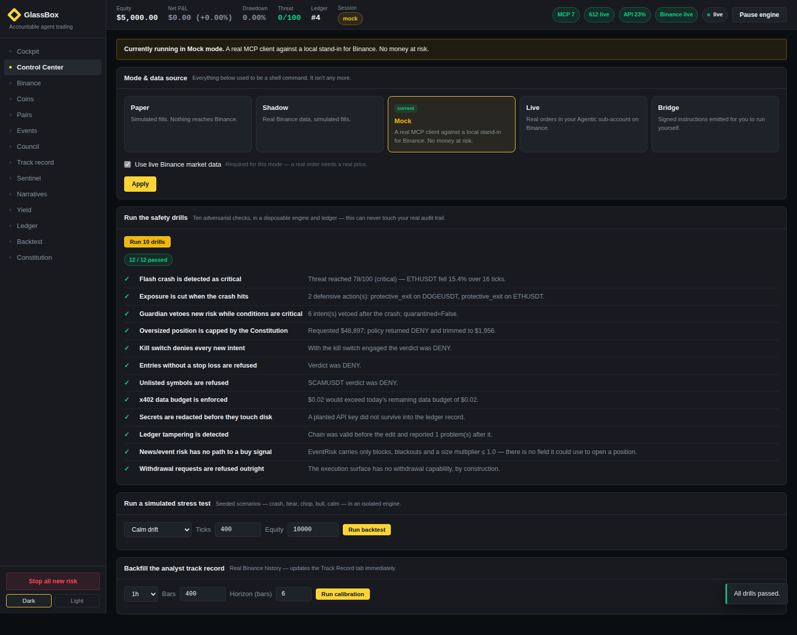
IT’S REAL, NOT A MOCK-UP
Built, tested, and running on live data.
200+
17
5
10
automated tests passing
hard safety rules enforced
independent AI analysts
blockchains supported
What that means
The safety story isn’t a promise on a slide. The crash response, the rule blocks and the tamper-checks all run as tests and on-demand drills you can trigger from a button — and pass.
GlassBox · risk-first crypto trading agent
12

Slide 13
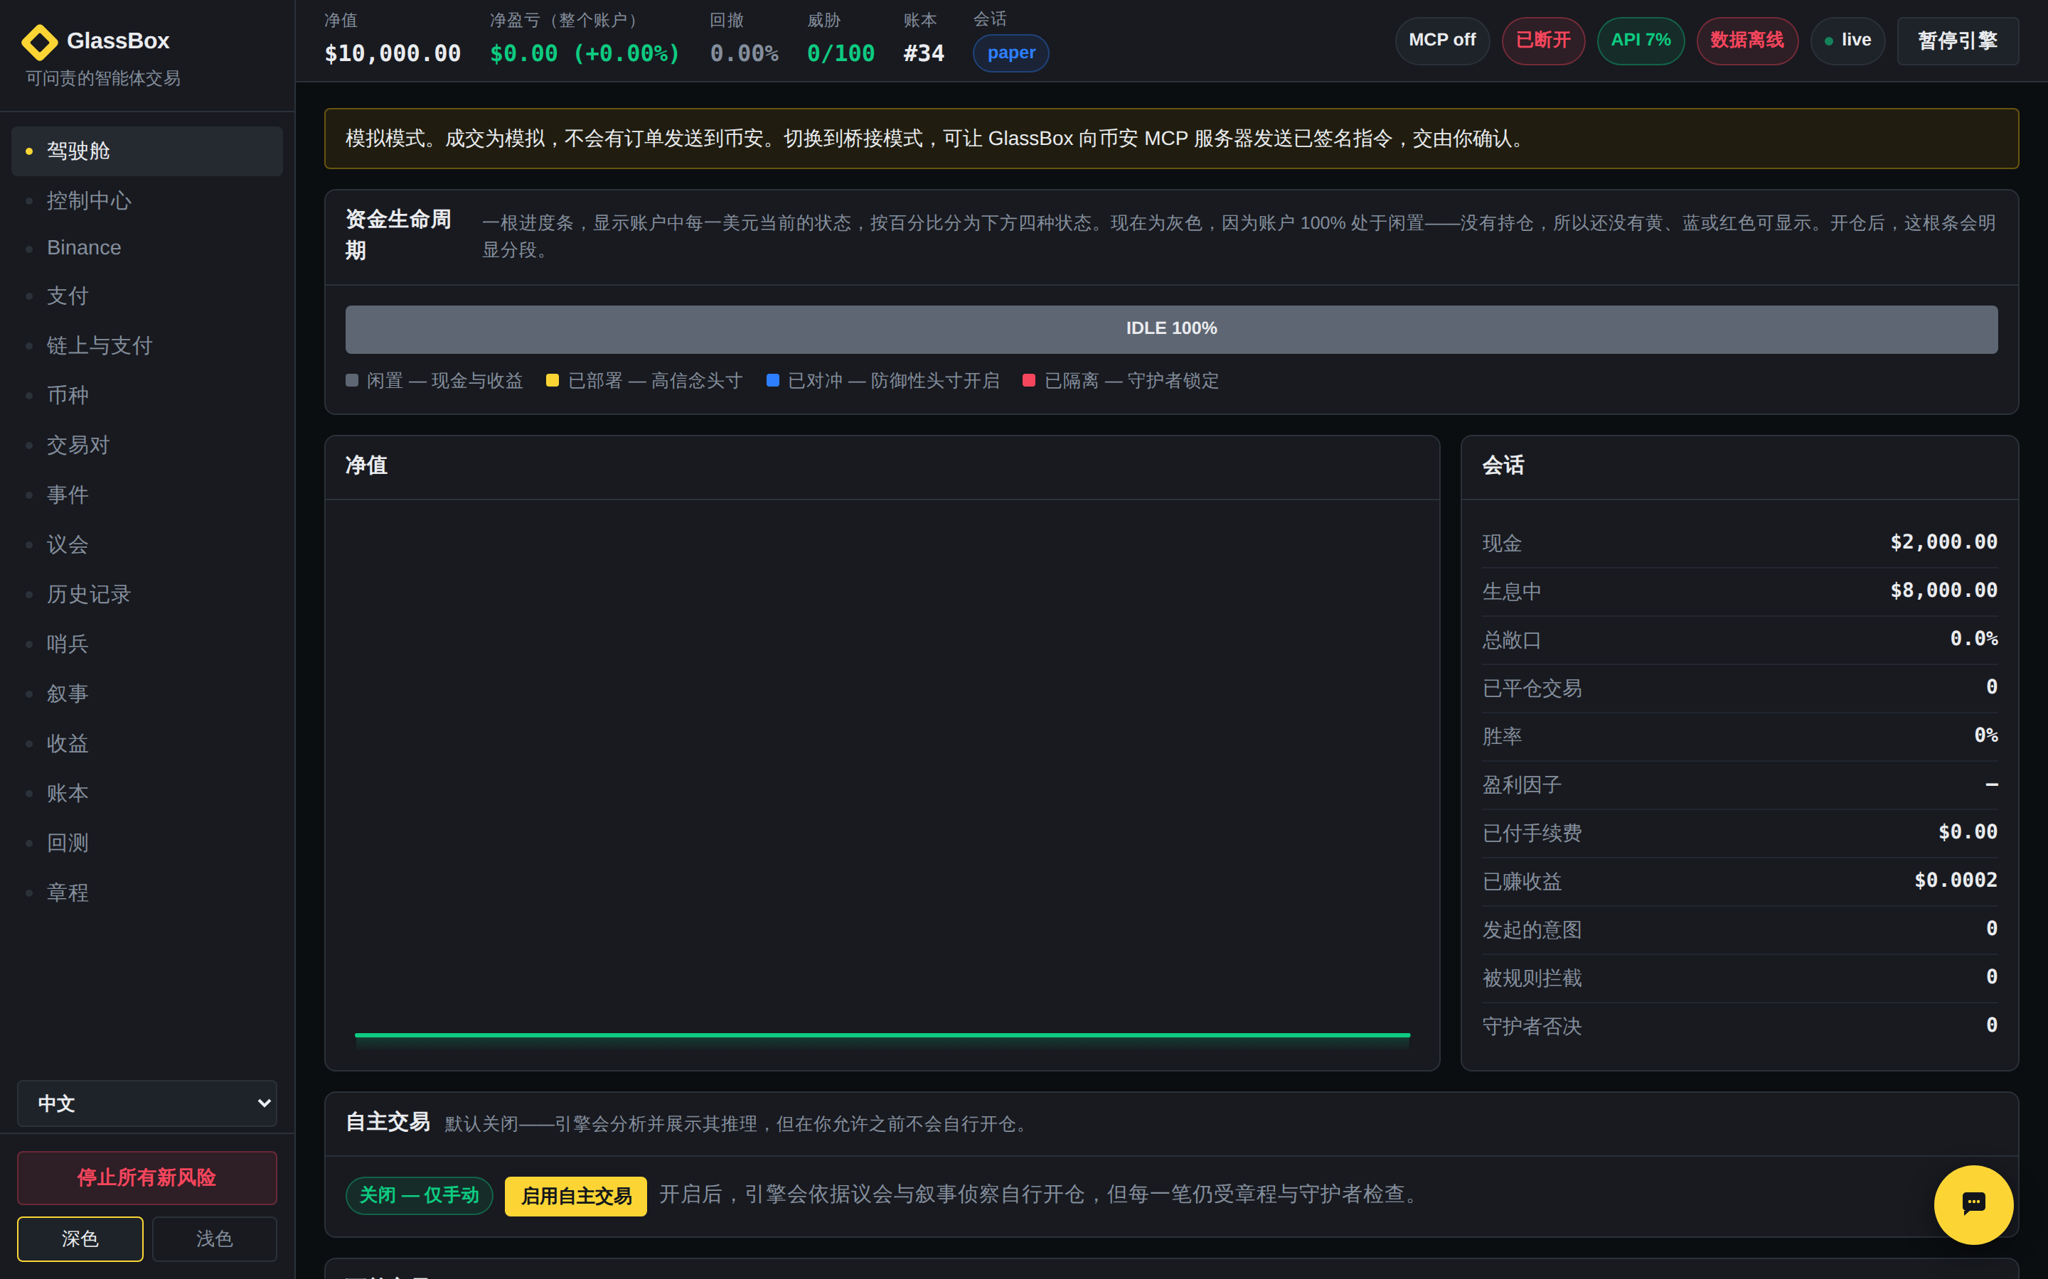
FEATURE · YOUR LANGUAGE
The whole dashboard, in your language.
Not just the menu — every panel, control, status line and empty state reads in the language you pick, and the analyst answers your questions in it too. Eight languages ship today, including non-Latin and right-to-left scripts, switched live from the left rail with no reload.
中文 · العربية · हिन्दी · Русский · Español · Français · Português · English
How it works
It translates the interface's own text and re-applies on every render — so panels the agent draws on the fly are covered too. Live prices, tickers and the analyst's numbers stay exactly as they are.
GlassBox · risk-first crypto trading agent
13

Slide 14
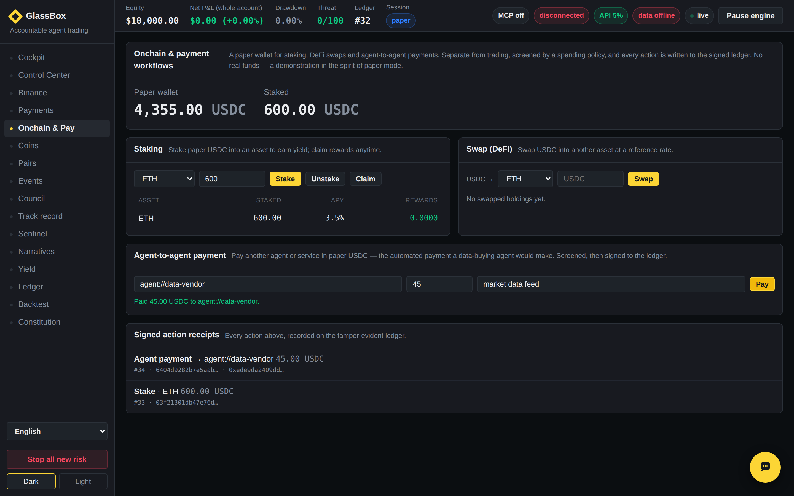
FEATURE · PAYMENTS & ON-CHAIN
Agent payments and on-chain actions — screened, then signed.
Beyond trading, the agent can pay another agent or service in USDC, and stake, unstake, claim or swap on-chain — the two remaining competition workflow categories. Every action passes a spending policy first, then lands on the same tamper-evident ledger as everything else, with a signed receipt.
Honest scope
A paper wallet on testnet by default. The workflow and its governance are real and auditable; no mainnet funds move — consistent with GlassBox running paper-first everywhere.
GlassBox · risk-first crypto trading agent
14

Slide 15
Trust is the missing piece for autonomous trading.
GlassBox ships it — visible reasoning, unbreakable rules, and a signed record, on real Binance data.
Try it in one step: unzip → double-click START.bat → open the dashboard. It runs in safe paper mode by default; turn on live Binance data with one toggle.

