Slide 1
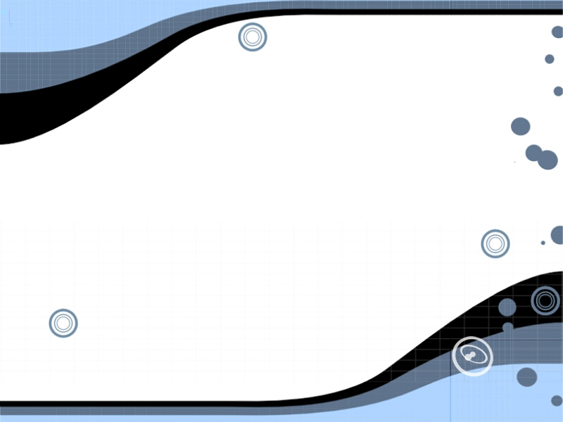
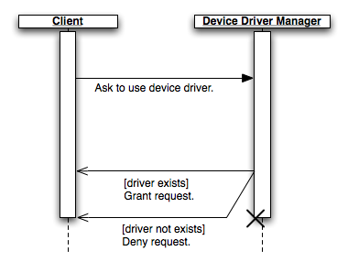
A User-Space Device Driver Framework
Wednesday, April 4, 3:30 PM - 4:15 PM: EB 1033
William Grim of the Computer Science department will discuss the development of a driver model that is safer and more reliable than traditional driver models.
The presentation will be short, with the primary focus on the question/answer session.
Sponsored by the Computer Association of SIUE (CAOS).

