Slide 1
A User-Space Device Driver Framework
Thesis Defense
by
William M. Grim
grimwm@gmail.com
http://symbolx.org/

Slide 2
Committee
Chairperson: Dr. Stephen Blythe
Member: Dr. Brad Noble
Member: Dr. Hiroshi Fujinoki

Slide 3
Introduction
Design
  Minix overview
  DDF sequences
  DDF classes
Testing Methods
  Unit testing
  Mock objects
  Performance
Results
Conclusions and Future Enhancements

Slide 4
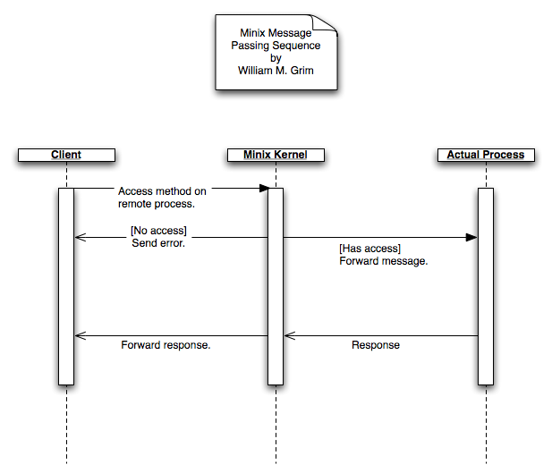

Slide 5
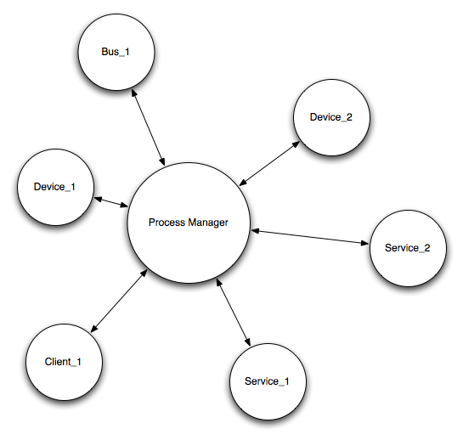
Minix’s DDF User View

Slide 6
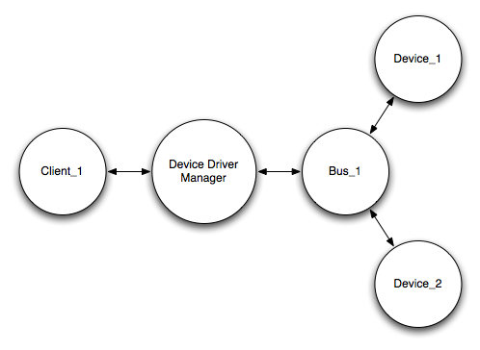
DDM User View

Slide 7
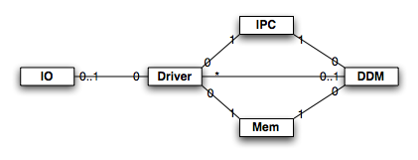
DDF Overview

Slide 8
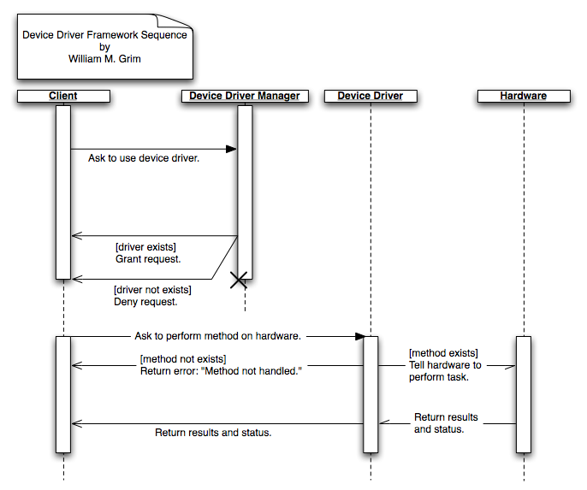

Slide 9
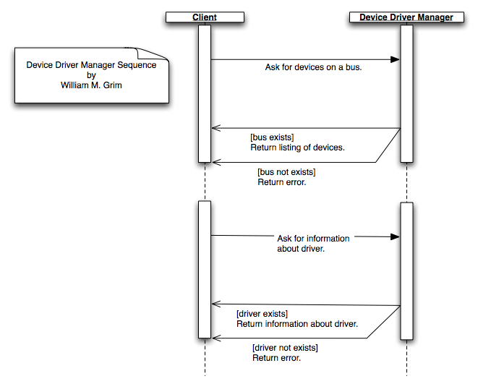

Slide 10
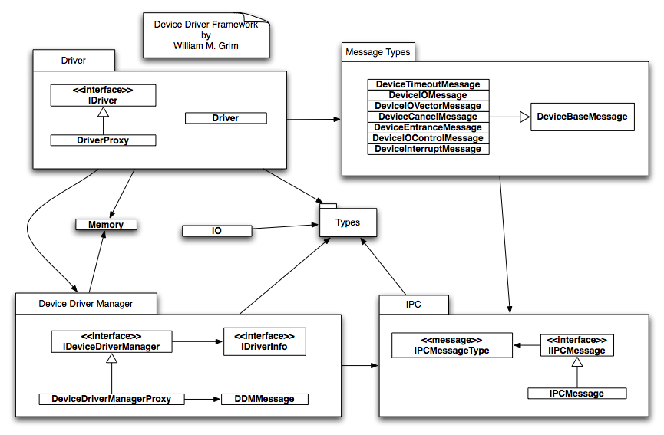

Slide 11
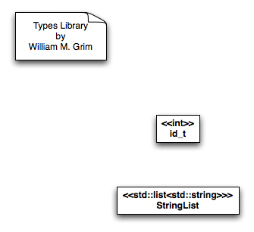

Slide 12
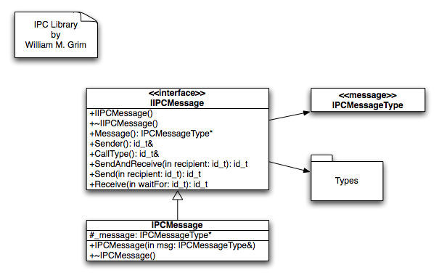

Slide 13
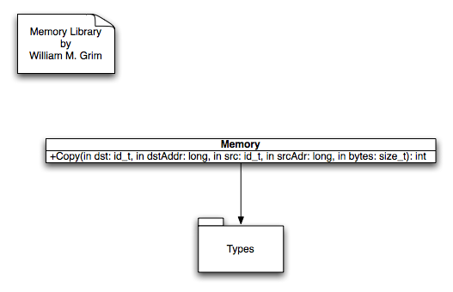

Slide 14
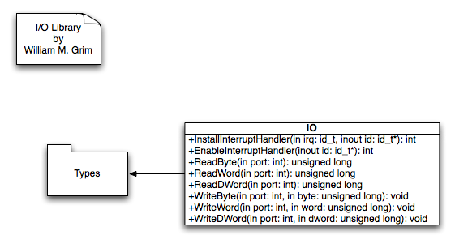

Slide 15
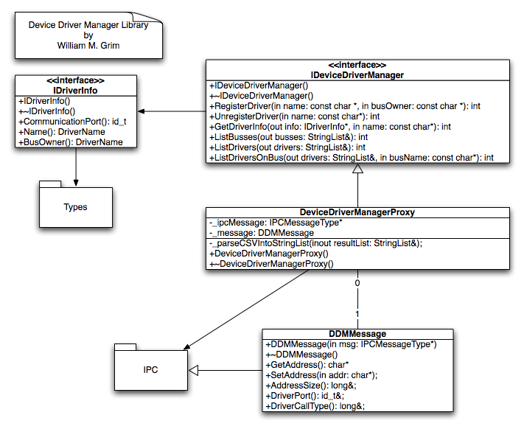

Slide 16
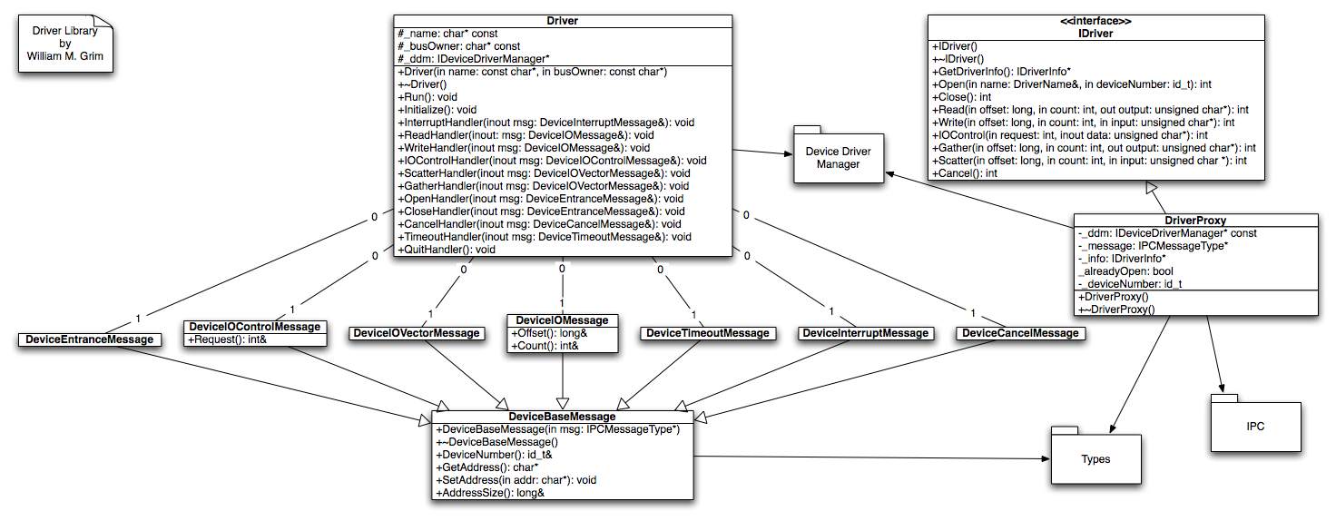

Slide 17


Slide 18
Unit Testing
Set of classes accepting tuples:
  (actual result, expected result)
Success:
  Test # successful.
Failure:
  This sentence of words.
  NOT EQUAL TO
  This other sentence of words.

Slide 19
Unit Testing Extent
All classes and methods tested.
All tests passed.

Slide 20
Unit Testing Example
std::cout << IntegerTest::compare(500,500) << ‘\n’;
std::cout << StringTest::compare(“This sentence of words.”, “This other sentence of words.”) << ‘\n’;
bool x,y;
std::cout << BoolTest::compare(x,y) << ‘\n’;

Slide 21
Mock Objects
Mimics real object
Uses:
  Incomplete code
  Non-deterministic output
Usage statistics
Proper execution order
Keyboard driver

Slide 22
Performance Measuring
5,000 method calls each:
  Open
  Read
  Write
  Close
Existing framework
New framework

Slide 23
Timing Results
Framework | Open | Read | Write | Close
Existing Average | 0.0042 | 0.0056 | 0.0050 | 0.0042
Existing Std. Deviation | 0.0647 | 0.0746 | 0.0705 | 0.0647
New Average | 0.0054 | 0.0048 | 0.0042 | 0.0062
New Std. Deviation | 0.0733 | 0.0691 | 0.0647 | 0.0785

Slide 24
Conclusions
Platform-independent drivers
Hierarchical driver view
C++ may not be optimal language

Slide 25
Future Enhancements
DMA Memory Allocation
Dynamically Linked Libraries
DDM Hot-Upgrade System
Access Control Layer

Slide 26
Questions
Stormtrooper: “Let me see your identification.”
Obi-Wan: [waves hand] “You don’t need to see his identification.”
Stormtrooper: “We don’t need to see his identification.”

Slide 27
Questions
Committee: “We need to ask you some questions.”
Me: [waves hand] “You don’t need to ask any questions.”
Committee: “We don’t need to ask you any questions.”
Me: [waves hand] “You’re giving me an A.”
Committee: “We’re giving you an A.”

