Slide 1
A Framework for Device Drivers in Microkernel Operating Systems
A Presentation by William “Mike” Grim

Slide 2
Topics Covered
Goals.
Types of kernels.
Advantage to microkernels.
Microkernel performance.
Related research.
Proposed design and deliverables.

Slide 3
Topic Not Covered
Bootstrapping issues.
  Only a roadblock to project realization.
  Not enough time.

Slide 4
Thesis Goals
Provide a device driver framework.
Enhance safety of driver execution.
Maintain or increase driver performance in comparison to monolithic operating systems.

Slide 5
What is a kernel?
Provides an abstraction of the hardware.
Most privileged process running on a computer.

Slide 6
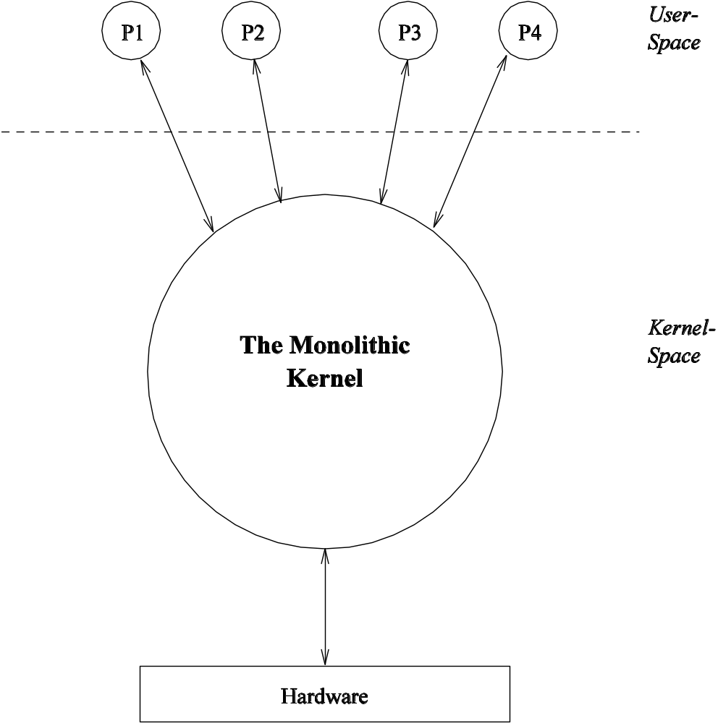
Monolithic Kernel

Slide 7
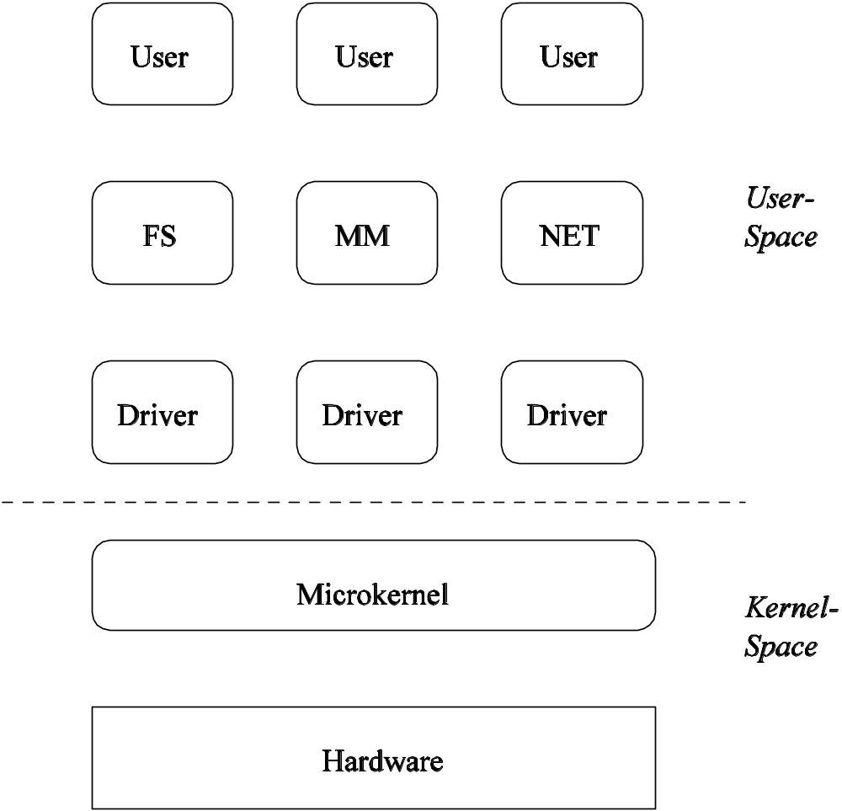
Microkernel

Slide 8
Advantages to Microkernels
Uniform interface for message passing.
Services can be extended easily without reboots.
Can meet changing demands.
Code can be rigorously tested.
More portable to new hardware.
Clear object-oriented design.

Slide 9
Reliability
Microkernels provide increased reliability:
  NASA spacecraft.
  Medical systems.
  Banking.
  Real-time environment monitoring.
  …

Slide 10
Performance
History of performing poorly.
New generation matches or exceeds monolithic OS performance.
  Message passing is two to three times faster than typical system call.

Slide 11
Goals Restated
Provide a device driver framework.
Enhance safety of driver execution.
Maintain or increase driver performance in comparison to monolithic operating systems.

Slide 12
Deva/Fabrica
User-space device driver framework for GNU Hurd-L4.
Never fully completed.
Suffers some design complexities.

Slide 13
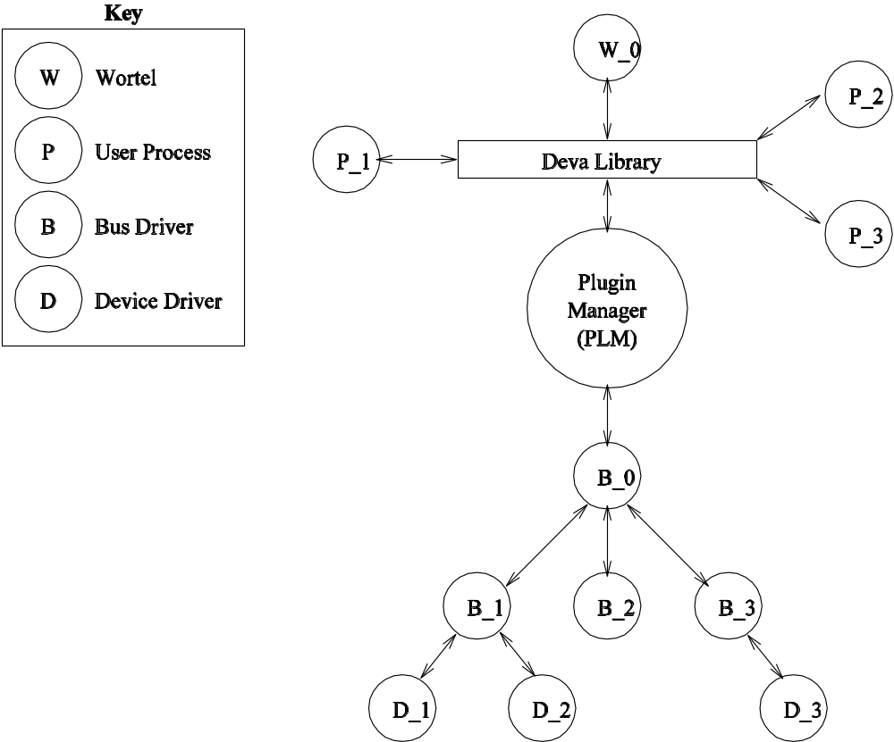
Deva/Fabrica Overview

Slide 14
Bus Drivers
Notify PLMs of I/O insertion/removal.
Provide metadata about device to device drivers.
  Addresses
  IRQ #’s
  DMA channel IDs
  …

Slide 15
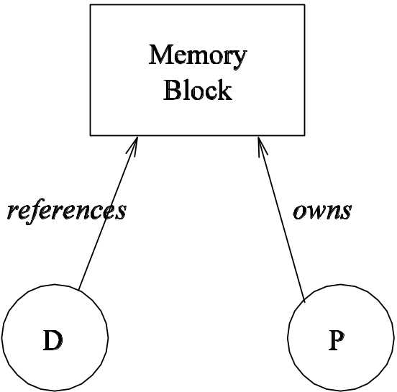
Device Drivers
User-space processes provide memory buffers.
  Avoids memory-memory copy.
  Prevents user memory from entering protected memory.

Slide 16
Special Service: Wortel
System-central IRQ logic server.
Runs in kernel space.
Enables IRQ rerouting.
Does not explicitly handle daisy-chaining:
  Drivers with peers must handle passing IRQs.

Slide 17
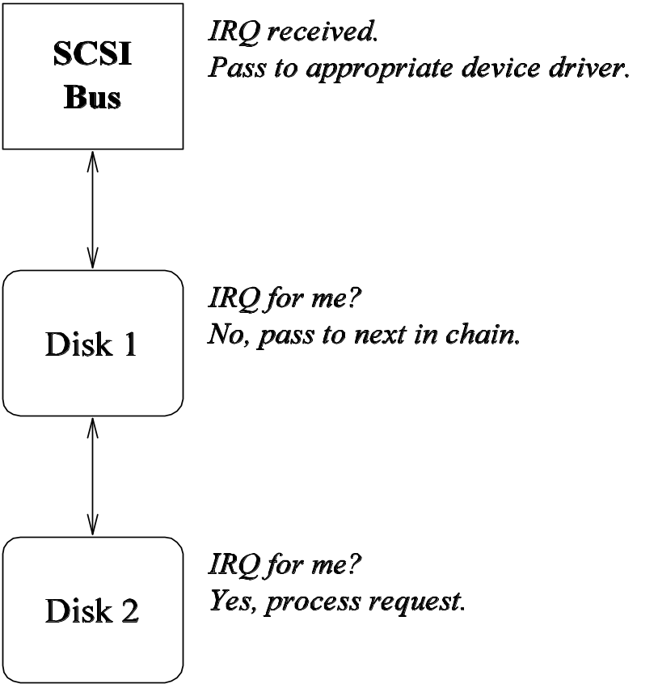
Daisy-Chained Drivers

Slide 18
Special Service: Plugin Manager
Asks deva to (un)load drivers as bus events are received.
Maintains list of currently loaded drivers.

Slide 19
Special Service: Deva
Provides an OS abstraction.
Handles (un)loading of drivers.
  Counter-intuitive (why not PLM)?
  Consistent with providing abstraction to OS when asking FS for drivers.

Slide 20
Problems
Nine device classes:
  Block
  Character
  Network switching
  …
Only two needed:
  Block
  Character
    Plus raw.

Slide 21
Problems
Never fully implemented in part due to complexity.

Slide 22
Minix 3.0
Aims to greatly reduce size of Minix 2.0.4.
Moves device drivers to user-space.

Slide 23
Minix 3.0 Overview

Slide 24
Getting Access to Hardware
Kernel handles actual I/O.
Drivers can install ISRs via syscalls.
  Policies kernel supports:
    Do nothing.
    Read a port.
    Write a port.

Slide 25
Getting Access to Kernel Data
Drivers can get copies of kernel data via syscalls.

Slide 26
Performance
No final analysis done.
Expected performance:
  IPC takes about 5 us. on modern CPU.
  IPC frequency is about 1000 / s.
  5 us. * 1000/s. * 100% = 5 * 100% = 0.5% utilization.
Limited scalability: kernel handles raw I/O and basic ISR policies.

Slide 27
My Proposal
Primarily based on deva/fabrica.
Three stages I will deliver:
  Abstraction libraries.
  Device driver manager.
  Limited number of device drivers for testing.

Slide 28
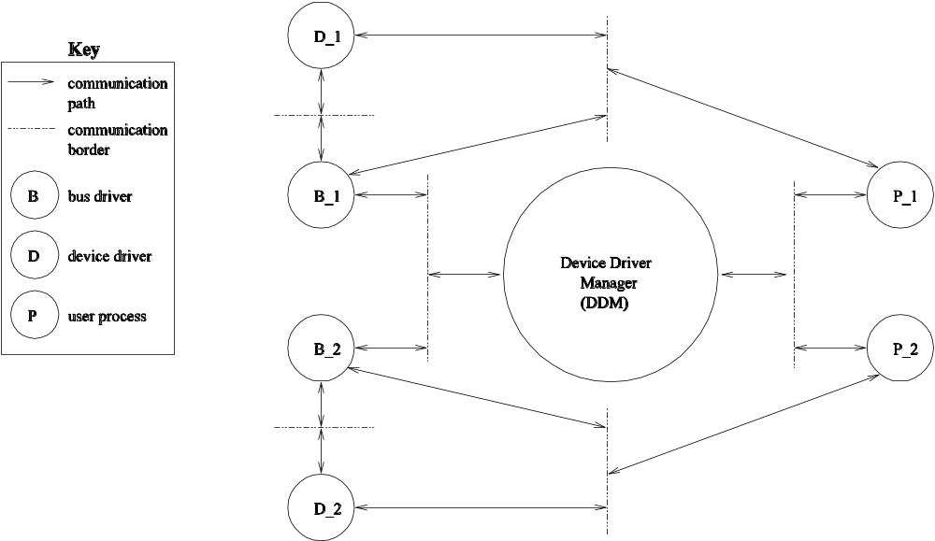
Overview

Slide 29
Supported Device Classes
Block
Character
dev_raw(): leverages support from microkernel providing memory mapping

Slide 30
Device Scheduling
Each device associated with unique FIFO request queue.
Highly authorized client processes may lock device.
  Useful in multiprocessor systems.
  CD-RW
  Printers
Drivers will have unrestricted access to entire FIFO queue.
  Allows request reordering.

Slide 31
Device and Bus Drivers
Hierarchy mirrors actual hardware topology.
Bus drivers control bus and all I/O ports on it.
Device drivers may request bus drivers give them direct I/O port access.

Slide 32
Abstraction Library Goals
Efficient:
  Maintain low IPC frequency.
  Provide primitives to keep computational overhead down.
Object-oriented.
Usable like shared objects.
Fill the “communication border” duties of my “overview.”

Slide 33
Operating System Abstraction
Proxy to the OS:
  Slab allocation.
  Threading.
  Security context handling.
Has intimate knowledge of host OS.
It is the OS to the framework internals.

Slide 34
Driver Abstraction
Set of libraries abstracting the driver interfaces.
One API: Multiple implementations.
  IDE bus driver.
  IDE disk driver.
  PCI driver.
  NE2000 driver.

Slide 35
Driver Abstraction
Bus drivers won’t provide operations for communicating directly with hardware.
Shared library will handle read/write to device.
  Helps eliminate need of driver writers to write assembly.
Easily the most difficult section of entire DDF.

Slide 36
DDM Abstraction
Facilitates communication amongst OS and device drivers with DDM.
External clients will use it when requesting access to drivers.
Internal clients will use it to ask the DDM to load more drivers.

Slide 37
DDM: Goals
Maintain list of currently registered drivers.
Provide access to drivers.
(Un)load drivers on request.

Slide 38
DDM Protocols
Bootstrapping (not covered here)
Upgrading
Fault tolerance

Slide 39
Upgrade Protocol
Allows users to update DDM on-the-fly without reboots.
Steps:
  New DDM freezes operation of current DDM.
  Current DDM sends new DDM its state information.
  Current DDM tells all clients to use new DDM.
  Current DDM shuts down and new DDM takes over.

Slide 40
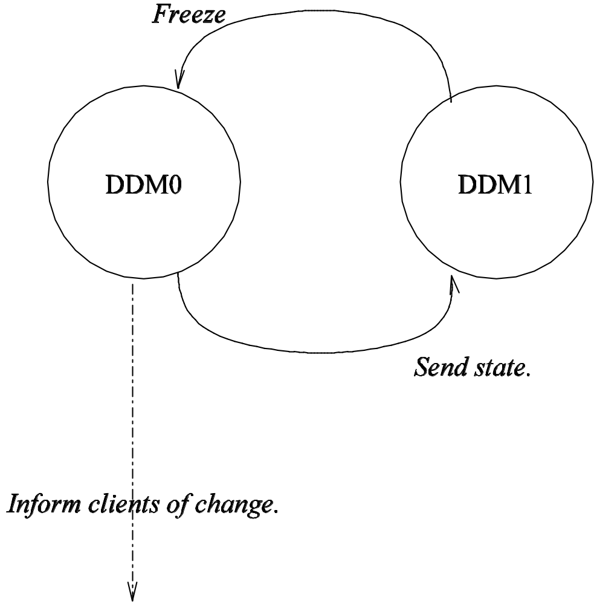
Upgrade Protocol Overview

Slide 41
Fault Tolerance
None given; microkernel primitives assumed sufficient.
Logging of critical messages to event log.

Slide 42
Expected Deliverables
Fully functioning DDF.
Limited number of device drivers.

Slide 43
Expected Performance
To be roughly on par with current monolithic OS.
Will have to wait for final realization for real benchmarks:
  Common applications.
  Specialized timing code.

Slide 44
Question Time

