Slide 1

A User-Space Device Driver Framework
A Thesis by William Grim
Advising Chair: Dr. Stephen Blythe
Committee Board Member: Dr. Brad Noble
Committee Board Member: Dr. Hiroshi Fujinoki
Computer Science, SIUE

Slide 2
Introduction
Introduce common terminology.
Overview of a device driver.
Demonstrate project’s design.
Conclude presentation with thoughts on improvement.
Notes:
Will go quickly over first few slides in the interest of time in order to get to the meat of the subject at hand.

Slide 3
What is an operating system?
Hardware
Kernel-Space
User-Space

Slide 4
What is a device driver?
Software that controls hardware.
Acts on behalf of everyday software:
  MS Word
  Adobe Photoshop
Examples of device drivers:
  Network card support.
  Keyboard/Mouse support.

Slide 5
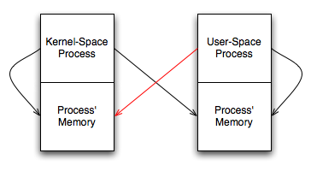
What is kernel-space and user-space?
Notes:
Kernel-Space Process: has access to all of the CPU instruction set and has access to all memory on the system
User-Space Process: only has access to limited CPU instruction set and only has access its own memory

Slide 6
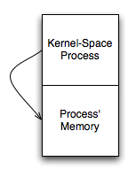
What happens when something goes wrong?
Notes:
Kernel-space software can negatively impact arbitrary user-space software.

Slide 7
What happens when something REALLY goes wrong?
Computer software goes to that little binary place in the sky.
We obviously don’t want this…
Notes:
Kernel-space software can also negatively impact arbitrary kernel-space software, such as the operating system.

Slide 8
What does this thesis achieve?
Creates a Device Driver Framework (DDF).
Places device drivers into user-space.
Improves safety.
Improves flexibility.
Improves ease-of-development.

Slide 9
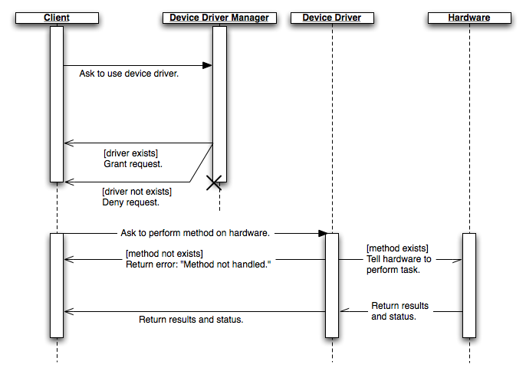
How does the DDF operate?

Slide 10
Conclusion
More work is needed to take thesis to the next level.
More performance testing is needed against more traditional operating systems.
Shows promise for this kind of design.

Slide 11
Questions?
?
?
?
?
?
?
?

