Slide 1

Understanding the Mechanism of Hsp70 Conformational Cycling using Normal Mode Analysis
Matthew P. Grindle¹, Katherine Conners¹, Dr. Riina Tehver², and Dr. Andrea N. Kravats¹
¹Miami University – Oxford, OH
²Denison University – Granville, OH

Slide 2
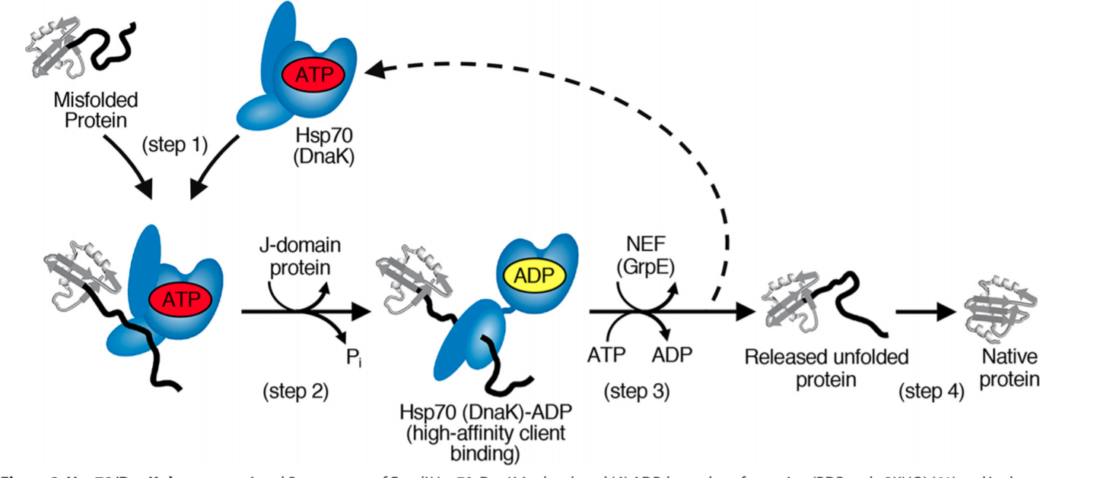
Hsp70 – A ubiquitous ATP-Dependent Molecular Chaperone
Abundant molecular chaperone involved in the refolding of misfolded and aggregated proteins by ATP-dependent conformational changes
Direct interactions with cochaperones such as Hsp40 (J-Domain) and NEF affect Hsp70’s cycle of conformational change
Genest et al., J. Biol. Chem., 2019

Slide 3
Hsp70 Interacts Directly NEF

