Slide 1
EV Charging station planning
Athul Dinesh
Coursera capstone

Slide 2
Electric vehicles in india
EV infrastructure is still lagging behind in India
Not enough government incentive for EV manufacturers.
Lack of charging infrastructure
Cities like Bengaluru are spearheading the EV movement in India in the recent years

Slide 3
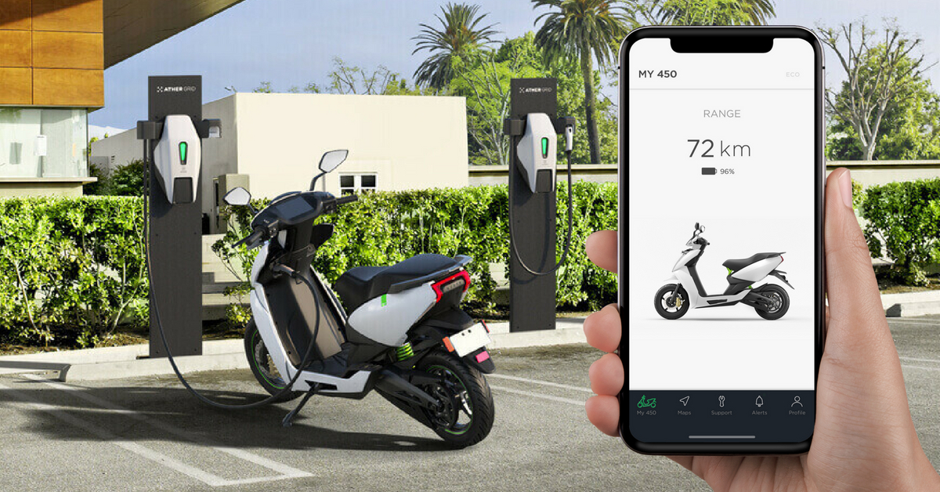
Ev in bengaluru
Companies like:
-Ather
-Mahindra Electric
are growing in popularity

Slide 4
Business problem
Charging infrastructure is a major challenge for EV manufacturers
The problem to be solved is to identify locations that have the most requirement for charging stations.

Slide 5
The Data
Bengaluru Neighborhood data from Wikipedia.
Nearby venues data from the Foursquare API

Slide 6
Methodology
The data is prepared b using one hot encoding
Clustering is done using the kmeans package from the scikitlearn library.
Number of cluster is set to 5
The clusters made are then analyzed.

Slide 7
Result
Clearly cluster 0,3 and 4 have the best venue density.
This translates to high traffic and hence has a high demand for charging stations.
Also multiple charging stations can be set up based on density of the cluster

Slide 8
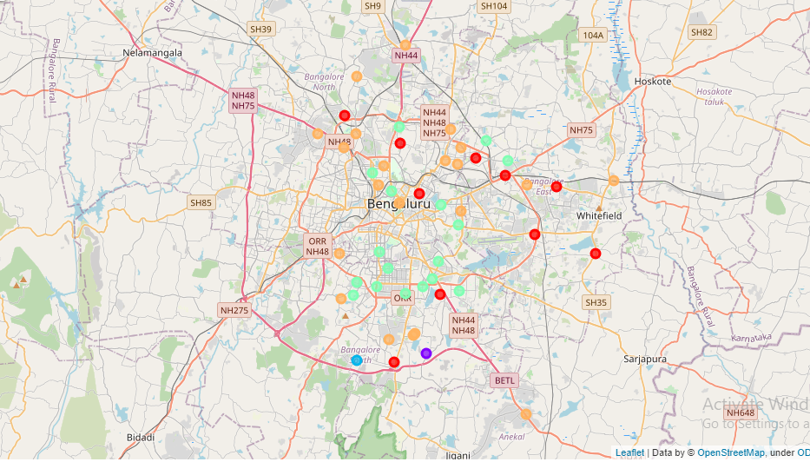
Bengaluru Clusters

Slide 9
Conclusion
This study showed how venues data can be used to explore and identify popular locations in the city.
This study can be used by the municipality to update policies and standardize charging infrastructure.

