Slide 1

Dynamic RAG
with Griptape

Slide 2
Agenda
What Is Griptape?
What Is RAG?
Challenges w/ RAG
Dynamic RAG
Demo

Slide 3
What Is Griptape?
Notes:
Griptape is a modular Python framework for integrating LLMs and other models with enterprise data and APIs.
Differences:
Minimal prompt engineering
Keeping data off the prompt by default

Slide 4
agent
pipeline
workflow
?
?
?
task
task
task
task
task
task
task
task
task
task
task
task
task
task
task
Notes:
Core abstractions:
Structures and tasks
Tasks can be focused on a variety of things
Summarization,
Querying
Extraction
Chain-of-thought
Drivers are used to abstract connections to the underlying services while keeping the overall framework high level

Slide 5
What Is RAG?

Slide 6
Retrieval
Augmented Generation
Retrieve and vectorize data from external knowledge bases.
Query vectorized data and augment LLM prompts.
Notes:
RAG is used in place of fine-tuning.
Fine-tuning can be costly and challenging.
RAG solves this. Developer pre-processes the data or automates that process and augments queries.
Learn more from the previous episode of “Generative AI and Data Science On AWS”

Slide 7
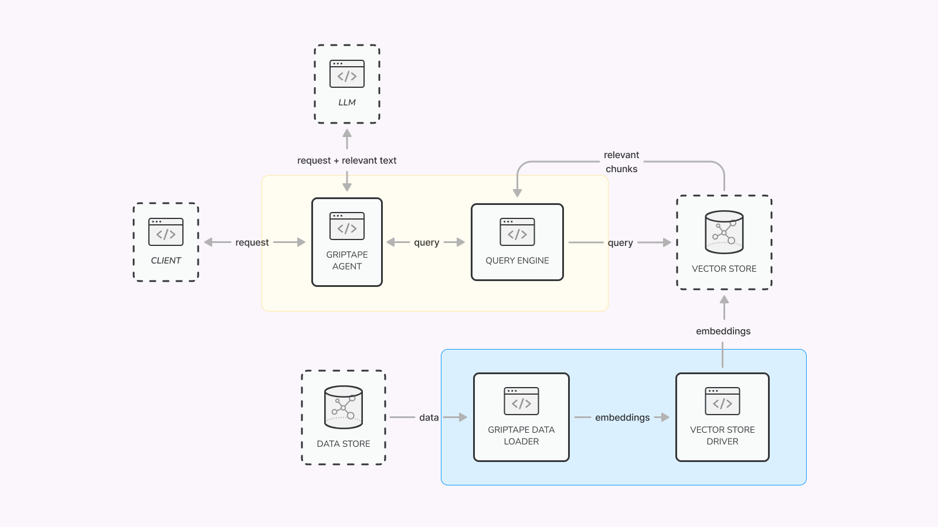

Slide 8
Dynamic RAG

Slide 9
Challenges
w/ RAG
Data pre-processing costs.
Knowledge is always limited by pre-processed data.
Data can quickly become outdated.
Notes:
Pre-processing can be costly in terms of operation costs
Data sources are ultimately static and are limited by what was originally processed.
Data in the sources can become outdated.

Slide 10
Dynamic
RAG
Data is vectorized and cached in real time.
Works great with small data.
Enables off prompt patterns.
Notes:
Dynamic RAG takes advantage of chain-of-thought
CoT prompting enables complex reasoning capabilities through intermediate reasoning steps
ReAct (reasoning and acting) https://react-lm.github.io/

Slide 11
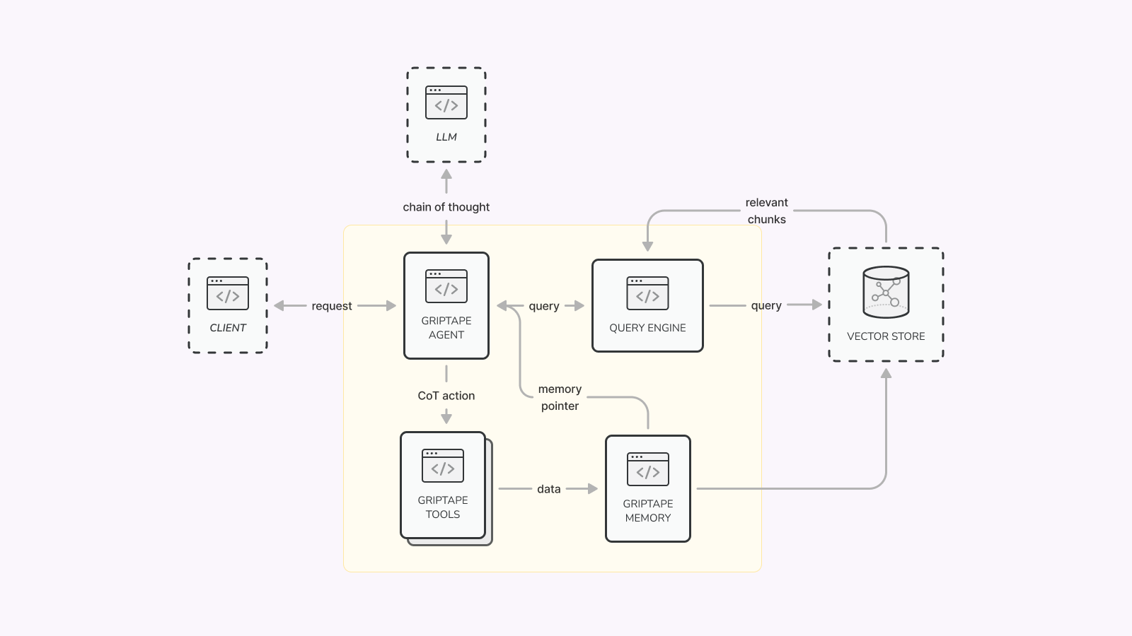

Slide 12
Demo

Slide 13

https://www.griptape.ai
https://github.com/griptape-ai/griptape

