Slide 1
Practical – 04: JavasCript – I
USCS307: Web Programming (WP)

Slide 2
What is JavaScript?
JavaScript was initially created to “make web pages alive”.
The programs in this language are called scripts.
They can be written right in a web page’s HTML and run automatically as the page loads.
Scripts are provided and executed as plain text.
They don’t need special preparation or compilation to run.
JavaScript is a client-side scripting language developed by Brendan Eich.

Slide 3
Why JavaScript?
When JavaScript was created, it initially had another name: “LiveScript”.
But as it evolved, JavaScript became a fully independent language with its own specification called ECMAScript, and now it has no relation to Java at all.
Today, JavaScript can execute not only in the browser, but also on the server, or on any device that has a special program called the JavaScript engine.
The browser has an embedded engine sometimes called a “JavaScript virtual machine”.

Slide 4
How do engines work?
Engines are complicated. But the basics are easy.
The engine (embedded if it’s a browser) reads (“parses”) the script.
Then it converts (“compiles”) the script to the machine language.
And then the machine code runs, fast.

Slide 5
What can in-browser JavaScript do?
Modern JavaScript is a “safe” programming language.
For instance, in-browser JavaScript is able to:
  Add new HTML to the page, change the existing content, modify styles.
  React to user actions, run on mouse clicks, pointer movements, key presses.

Slide 6
What can in-browser JavaScript do?
  Send requests over the network to remote servers, download and upload files (so-called AJAX and COMET technologies).
  GET and SET cookies, ask questions to the visitor, show messages.
  Remember the data on the client-side (“local storage”).

Slide 7
What makes JavaScript unique?
There are at least three great things about JavaScript:
  Full integration with HTML/CSS.
  Simple things are done simply.
  Support by all major browsers and enabled by default.

Slide 8
A Simple JavaScript Program
Place all your JavaScript code within <script> tags (<script> and </script>) if you are keeping your JavaScript code within the HTML document itself.
Syntax:
<script type="text/javascript"> … </script>

Slide 9
Modify your directories (folder)
D/E [Drive] <as per your list available on your computer>
Class Folder – SYCS
Batch Folder – B5
Roll No Folder – 1111
Course Folder – USCS307
Create your respective Prac_04 folder within your directory.
Open Notepad Editor to type the programs.

Slide 10
a) Performing Mathematical Operations

Slide 11
Question – 01: (Fibonacci Series)
Write a JavaScript code to accept the number from the user and print the Fibonacci Series up to the number entered by the user.

Slide 12
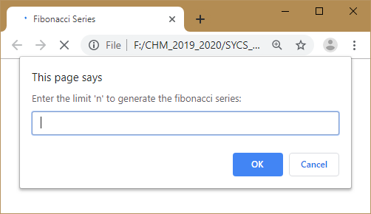

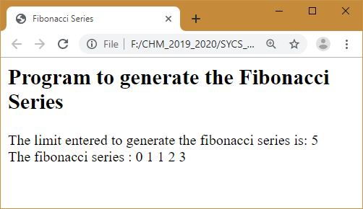

Slide 13
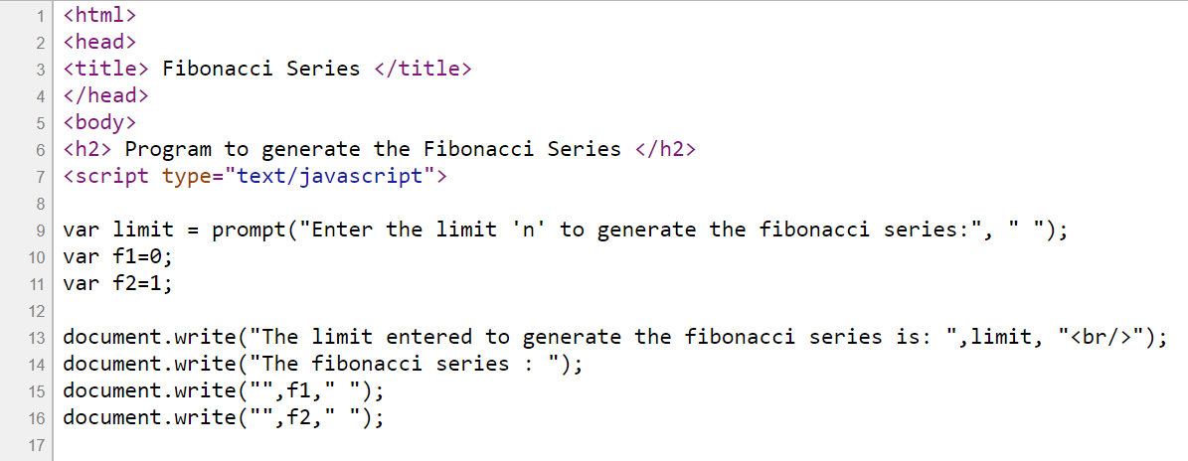
FileName: P4_A1.htm

Slide 14
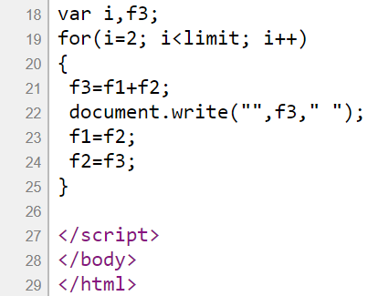
FileName:
P4_A1.htm
Save your file and Double click the file “P4_A1.html” to execute.

Slide 15
Question – 02: (Factorial)
Write a JavaScript code to accept the number from the user and print the factorial of the number.

Slide 16
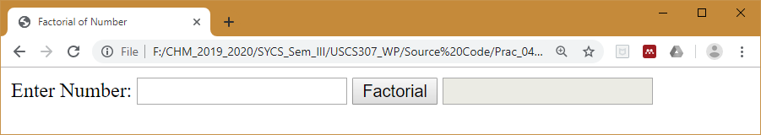
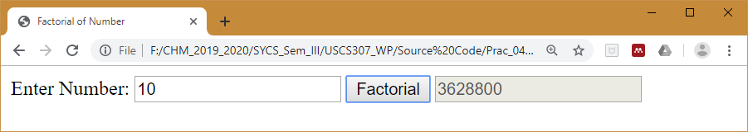

Slide 17
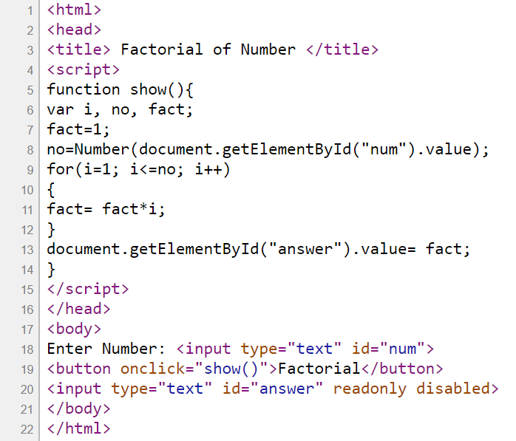
FileName:
P4_A2.htm
Save your file and Double click the file “P4_A2.htm” to execute.

Slide 18
Question – 03: (Prime Numbers Range)
Write a JavaScript code to accept 2 numbers from the user (lower bound, upper bound) and print the prime numbers within the range of the numbers entered by the user.

Slide 19
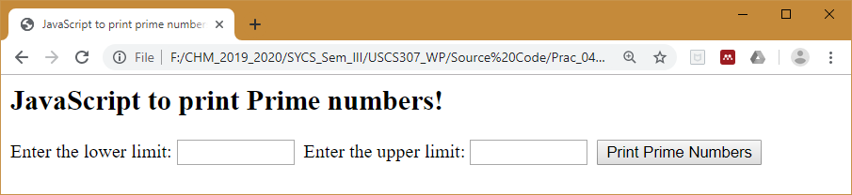
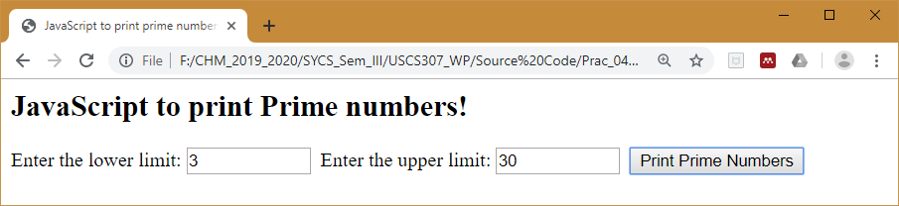
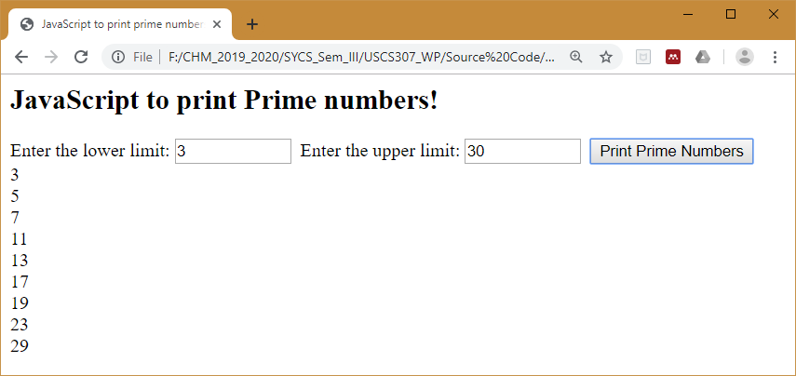

Slide 20
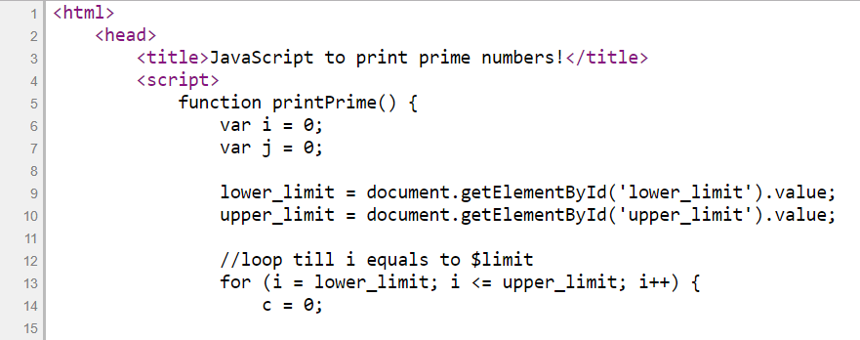
FileName: P4_A3.htm

Slide 21
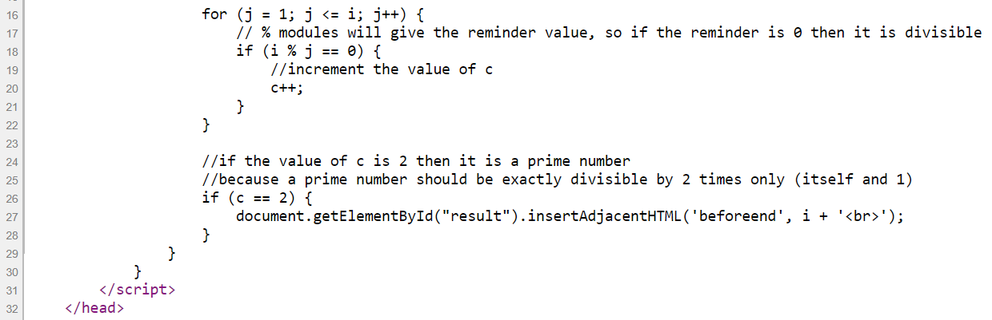
FileName: P4_A3.htm

Slide 22
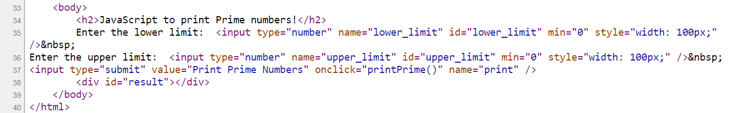
FileName:
P4_A3.htm
Save your file and Double click the file “P4_A3.htm” to execute.

Slide 23
Question – 04: (Evaluating Expressions)
Write a JavaScript code to accept the expression from the user evaluate it and print result.

Slide 24
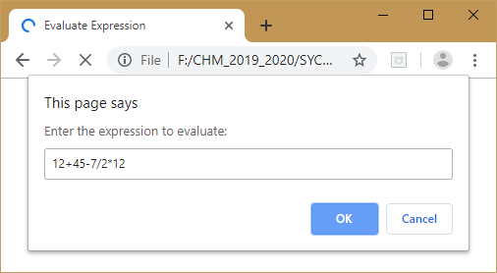
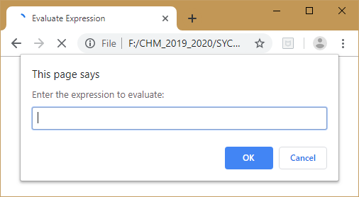
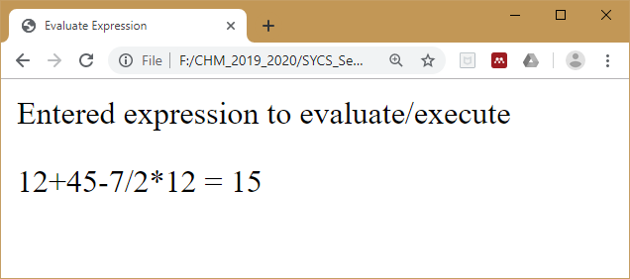

Slide 25
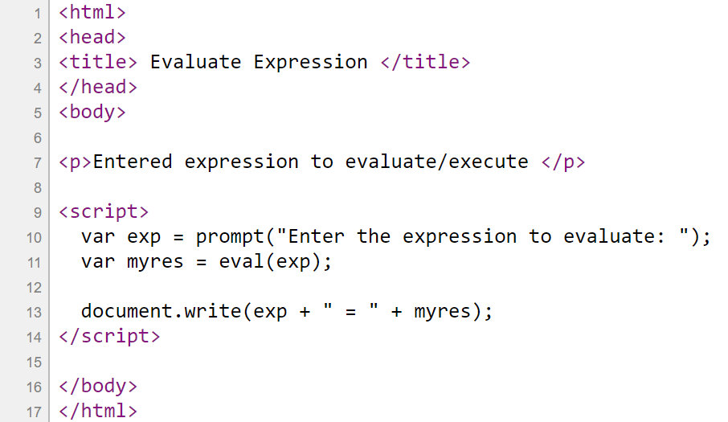
FileName:
P4_A4.htm
Save your file and Double click the file “P4_A4.htm” to execute.

Slide 26
Question – 05: (Reverse of Number)
Write a JavaScript code to accept a number from the user and print the reverse of the number.

Slide 27
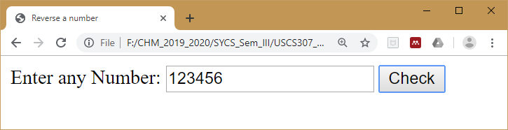
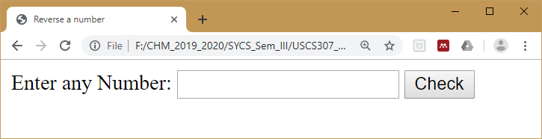
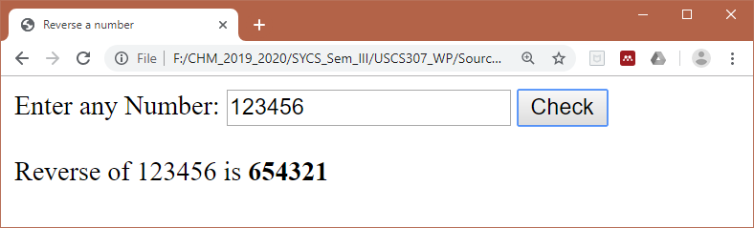

Slide 28
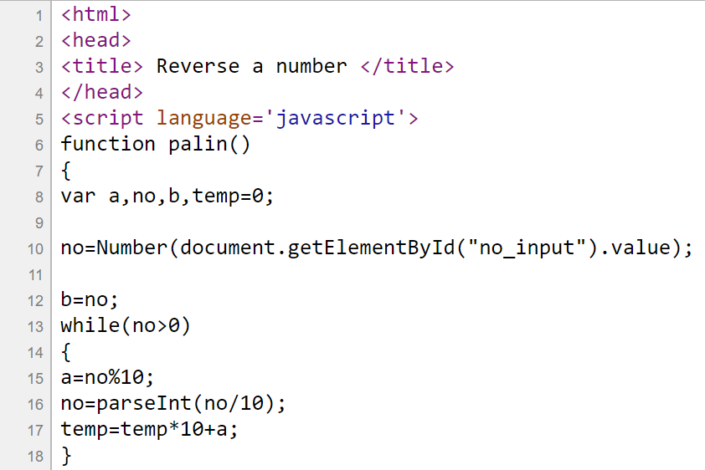
FileName:
P4_A5.htm

Slide 29
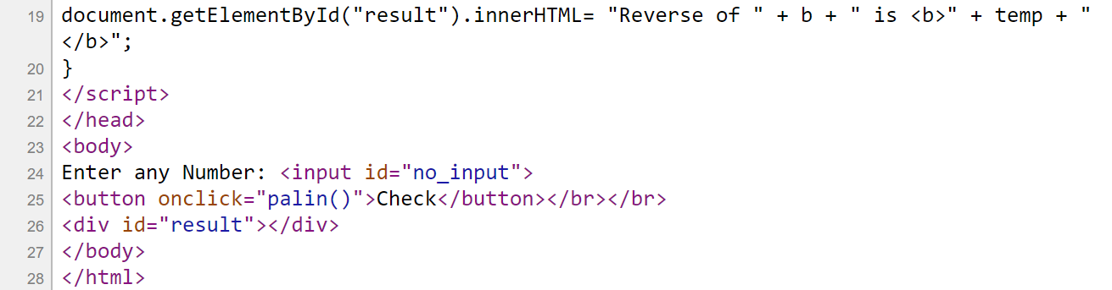
FileName:
P4_A5.htm
Save your file and Double click the file “P4_A5.htm” to execute.

Slide 30
b) Validating various Form Elements

Slide 31
Question – 06: (Basic and Data Format Validation)
Write a JavaScript code to validate various form elements which contains Name, Email, Zip Code, Country. Following validations should be validated:
Basic Validation − First of all, the form must be checked to make sure all the mandatory fields are filled in.
Data Format Validation − Secondly, the data that is entered must be checked for correct form and value. Your code must include appropriate logic to test correctness of data. (Numeric value for Zip Code, Email validations such as @, dot position, etc. Also, the ‘@’ must not be the first character of the email address, and the last dot must at least be one character after the ‘@’ sign.)

Slide 32
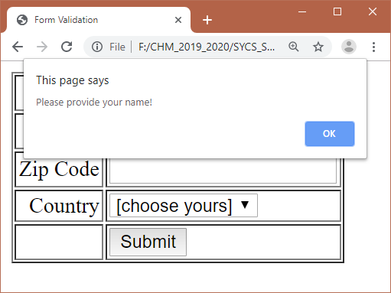
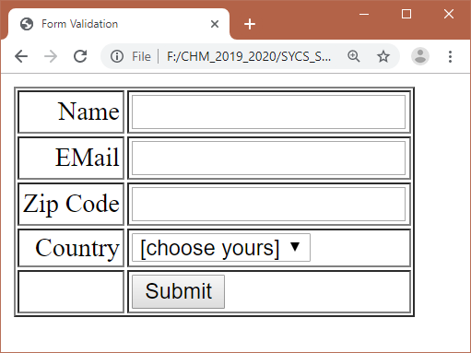

Slide 33
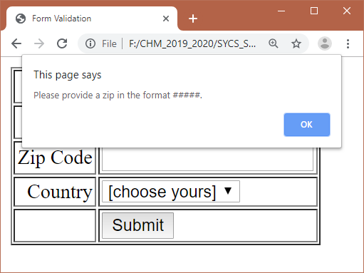


Slide 34
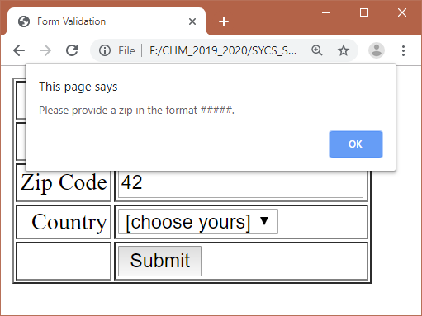
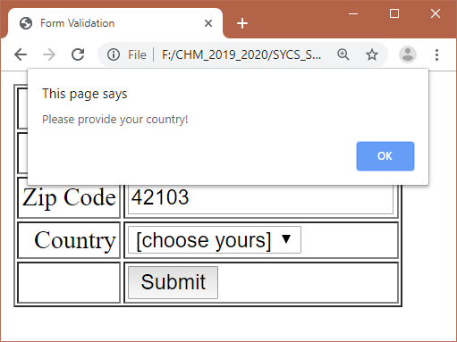

Slide 35
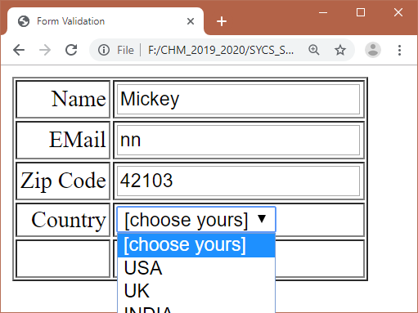
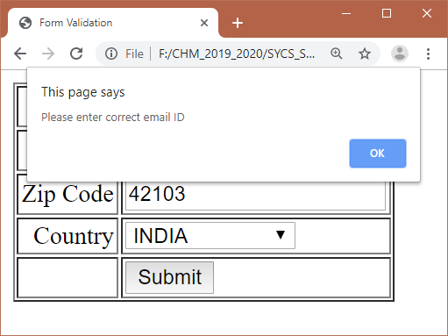

Slide 36
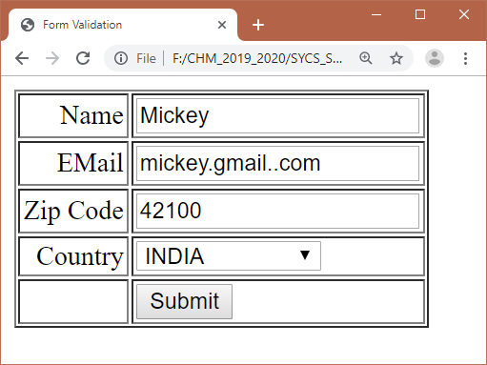


Slide 37
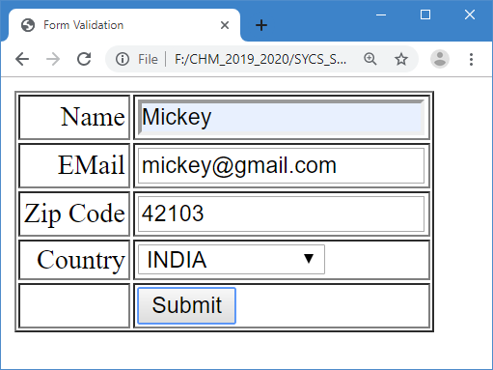

Slide 38
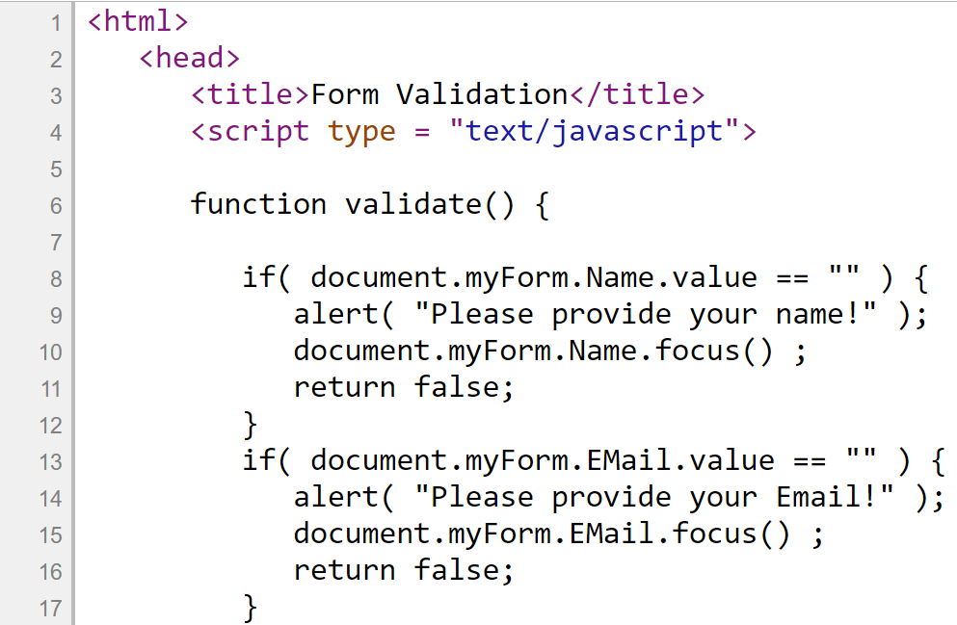
FileName:
P4_B6.htm

Slide 39
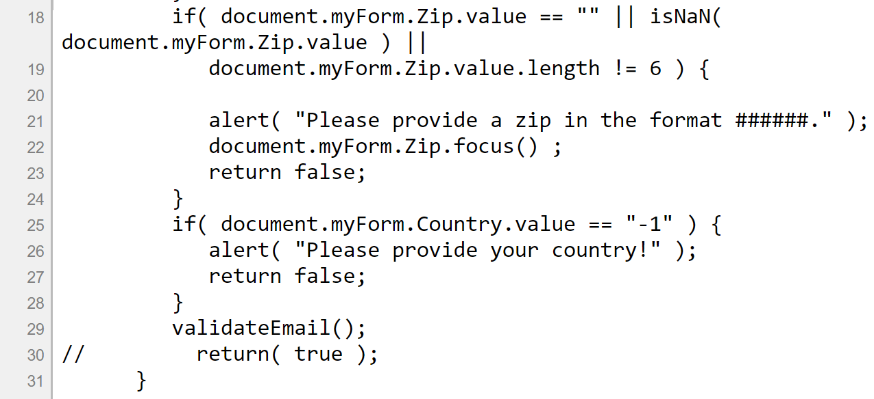
FileName:
P4_B6.htm

Slide 40
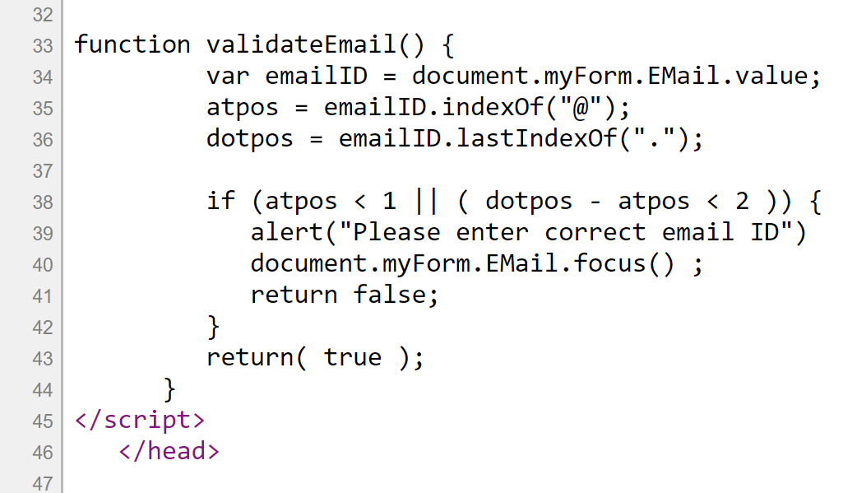
FileName: P4_B6.htm

Slide 41
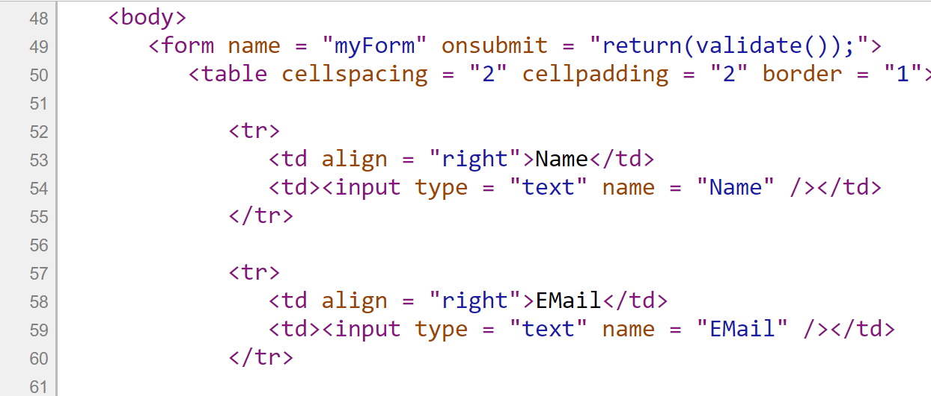
FileName: P4_B6.htm

Slide 42
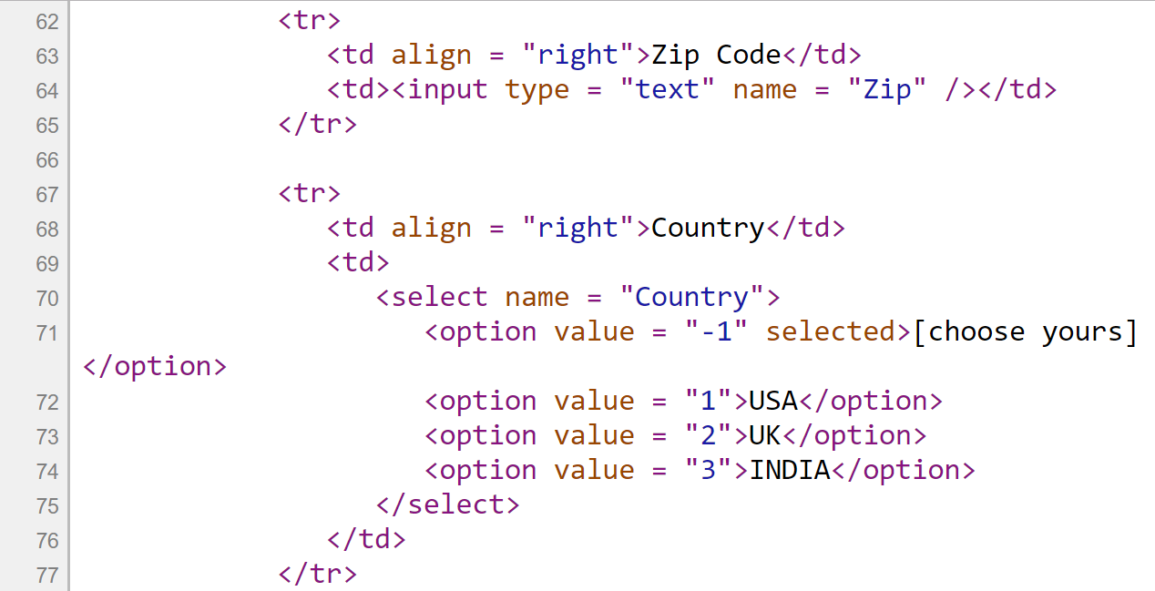
FileName: P4_B6.htm

Slide 43
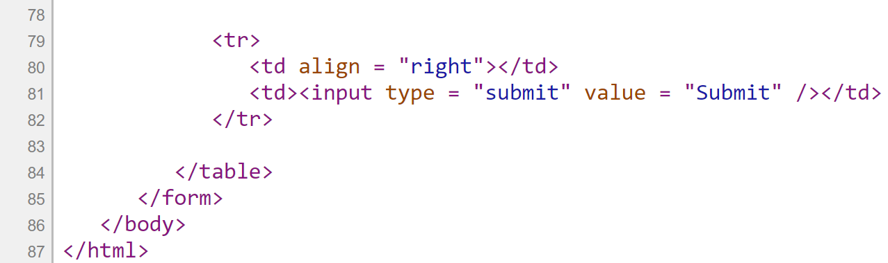
FileName: P4_B6.htm
Save your file and Double click the file “P4_B6.htm” to execute.

