Slide 1
Multithreaded Sorting
Vilas Dhuri
Rishabh Gupta
Saharsh Shivhare
CMPE 180C Operating System Project Instructor: Jahan Ghofraniha

Slide 2
Contents
Introduction Multithreaded Sorting
Problem Statement
Implementation
Testing
Conclusion

Slide 3
Introduction
Thread: A thread is the smallest unit of processing that can be performed in an OS.
Multithreading: Multi-threading is way to improve parallelism by running the threads simultaneously in different cores of your processor.
Merge Sort is a popular sorting technique which divides an array into two halves and then start merging them when sufficient depth is reached.
QuickSort is a popular sorting technique based on divide and conquer algorithm where an element is chosen as a pivot and the array is partitioned around it.

Slide 4
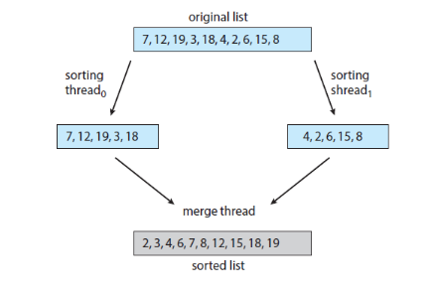
Multithreaded Sorting
Implement a Multithreaded Sorting Application using C++ pthread API
Two separate threads sort each sublist using quicksort and merge sort algorithms.
Two sublists are then merged by a third thread—a merging thread—which merges the two sublists into a single sorted list

Slide 5
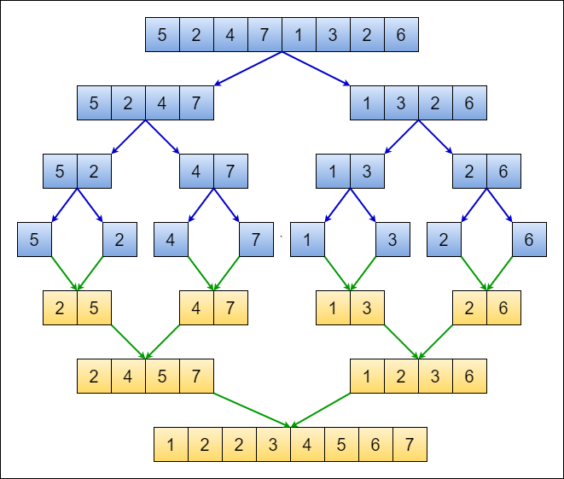
Merge Sort Algorithm
Divide it in two at the midpoint
Conquer each side in turn (by recursively sorting)
Merge two halves together

Slide 6
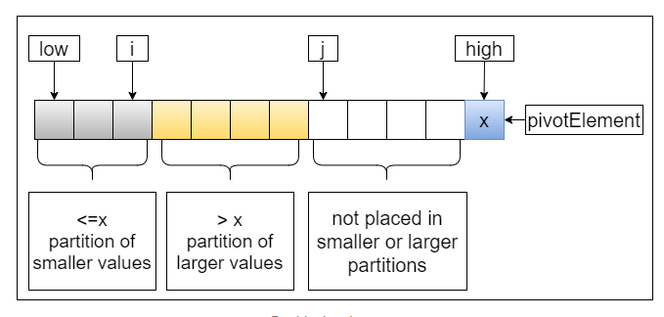
QuickSort Algorithm
Quicksort uses a divide and conquer strategy
Partition array into left and right sub-arrays
Our implementation takes last element as pivot, places the pivot element at its correct position in sorted array.
Recursively sort left and right sub-arrays
Concatenate left and right sub-arrays in O(1) time

Slide 7
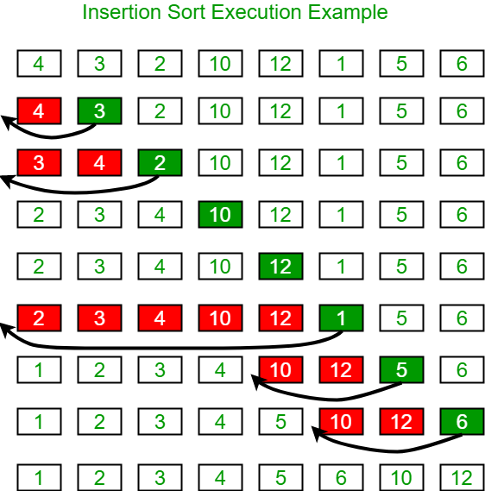
Insertion Sort Algorithm
The array is virtually split into a sorted and an unsorted part.
Values from the unsorted part are picked and placed at the correct position in the sorted part.

Slide 8
Pthread Functions
pthread_t thread ID
- the threadID keeps track of to which thread we are referring pthread_create
pthread_attr_t attr
- Set of thread attributes
pthread_attr_init – This function initializes the thread attributes object pointed to by attr with default attribute values. Then the object can be used in one or more pthread_create calls that create threads.
int pthread_create(pthread_t *thread, const pthread_attr_t *attr, void *(*start routing) (void*), void *arg) – Creates the thread and start the execution of the function pointer
int pthread_join(pthread_t thread, void **value_ptr)
- puts calling thread ‘on hold’ until ‘thread’ completes

Slide 9
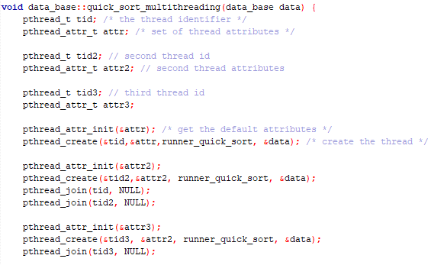
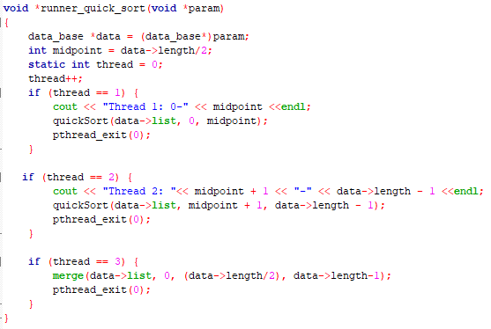
Implementation

Slide 10
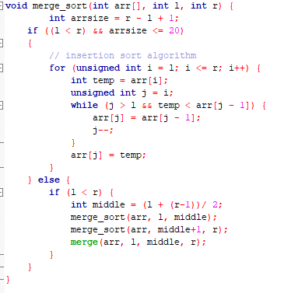
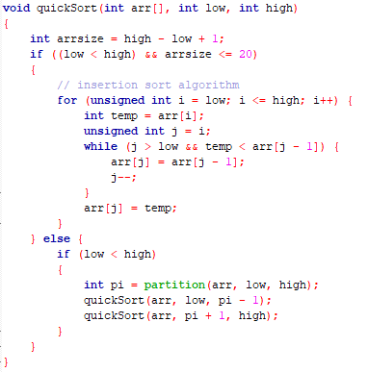
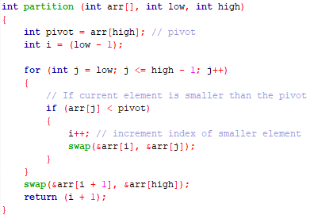
Implementation

Slide 11
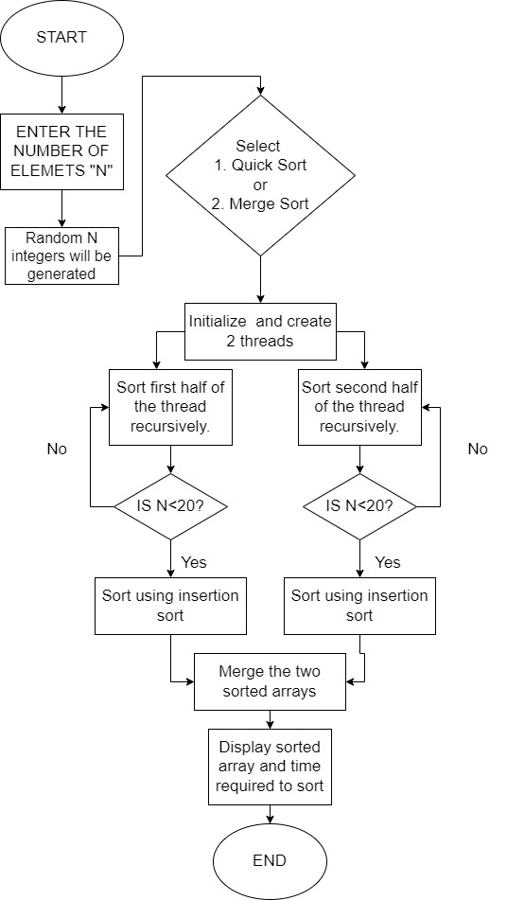
Implementation
The flowchart explains the flow of our implemented Multithreaded Sorting Application

Slide 12
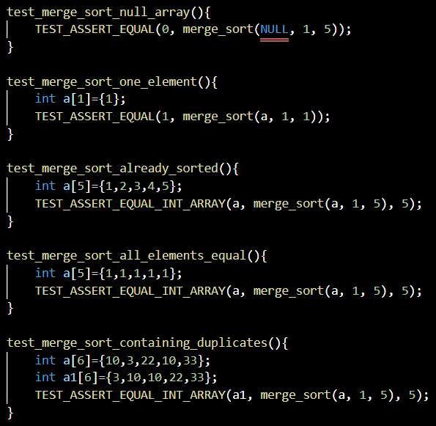
Testing
We used “CMock” [6] to test the code coverage and proper execution and flow of our program.
CMock generates mocks and stubs. It's useful for interaction-based unit testing, which involves determining how one module interacts with another.
We used “CMock” [6] to test the code coverage and proper execution and flow of our program.
CMock generates mocks and stubs. It's useful for interaction-based unit testing, which involves determining how one module interacts with another.

Slide 13
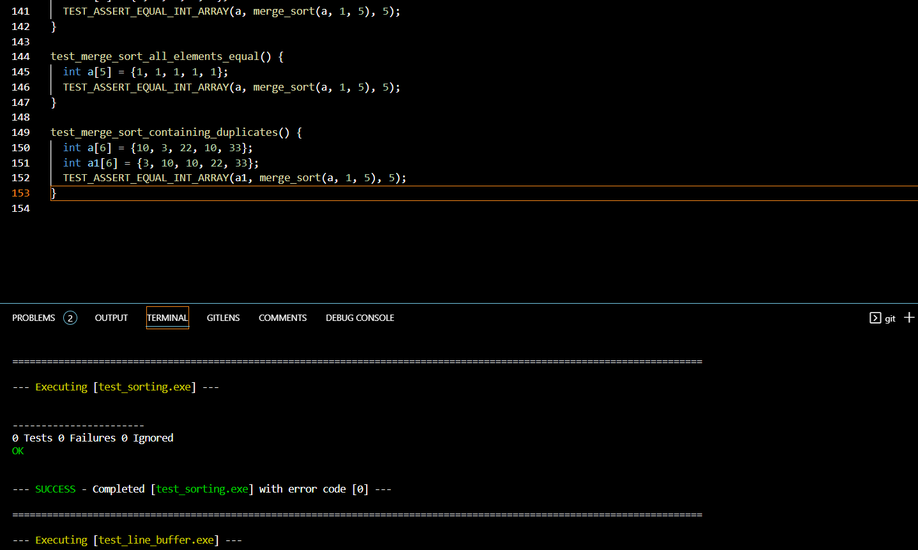
Testing

Slide 14
Conclusion
Multithreading allowed the execution of multiple parts of a program at the same time
Multithreading lead to maximum utilization of the CPU by multitasking.

Slide 15
Thank You!

