Slide 1
Progress Report
Period of time covered: 19 May 2017 – ?? 2017
Person: Grishina Olga
Project: PASA
Manager:
Mentor: Lobanov Alexander

Slide 2


Agenda
  Goals
  Achieving the goals
  Results
  Plans for the future

Slide 3
Goals
  To gain technical experience in future work (Programming (C/C++), Windows/Linux, etc).
  To gain team-working experience
  To improve my technical English
  To learn working with source code

Slide 4
Ways to achieve.
  1.Theory
  Programming
    C/C++, Windows Socket programming
    Tools: Eclipse, cmd, bash
    2. Practice
    Eclipse Installation
    MinGW Installation
    GTest Installation

Slide 5
Training Task
The creation of two programs (client and server) that allow you to exchange text messages.
Writing documentation on the use and operation of the program.
Writing unit tests using gtest and gmock framwork

Slide 6
Application requirements
At the start the client must to establish a connection with the server and download a list of available users.
If the client cannot establish a connection, the client should display a message in the console about it and quit the application.
The client must provide a console menu that allows you to:
  To display a list of currently available users.
  To write and send a message to the available users.
  To complete the client's work.
The client must display incoming messages, if the user does not now write a new message to someone users.
If the incoming message arrives when the user writes a new message, the message should be displayed after the user has finished writing the message.

Slide 7
Application requirements
If the user disconnected from the server at the time of writing a new message to this user, the client should display a message to the console after the user has finished writing a message.
Messages between the interlocutors should go directly, not through the server.
If the connection to the server is lost, the client must immediately display a message about it and complete its work.
The server must track and inform all clients about changes in the list of available users (appearance of a new user, loss of communication with a known user).
The server should log the following events to the file: the appearance of a new client, loss of communication with a known user.

Slide 8
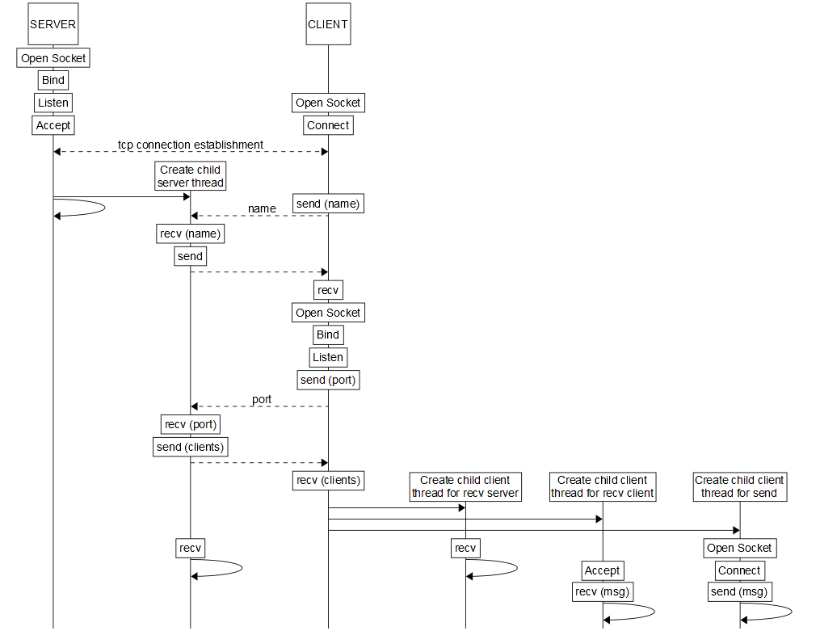
Communication schemes between programs
1. A scheme for sending messages between the client
and the server when the client connects to the server

Slide 9
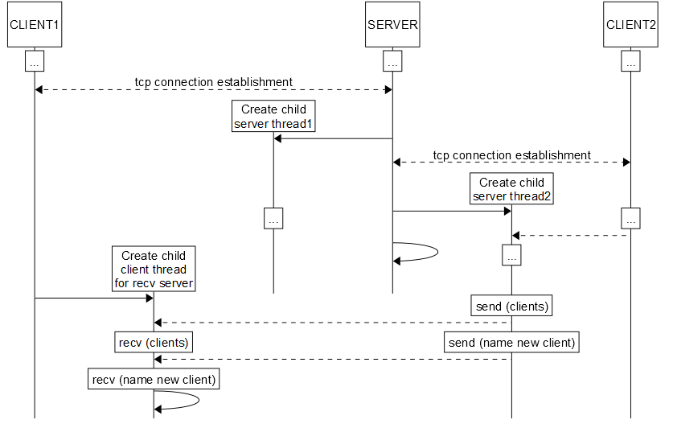
Communication schemes between programs
2. A scheme for sending messages from the server
to the client when another client is connected

Slide 10
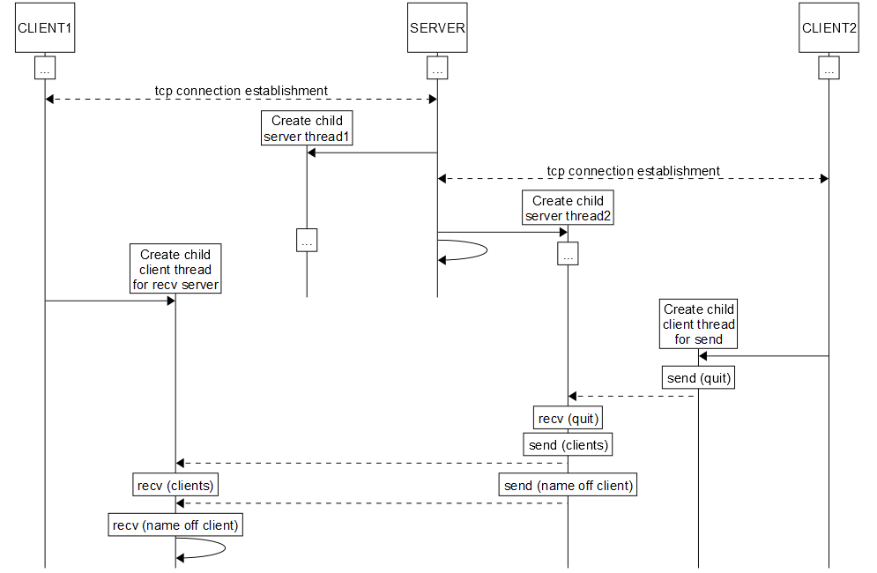
Communication schemes between programs
3. A scheme for sending messages between clients and
the server when one of the clients is disconnected.

Slide 11
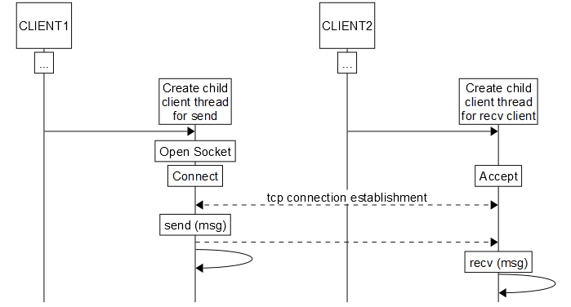
Communication schemes between programs
4. Message transfer scheme between customers.

Slide 12
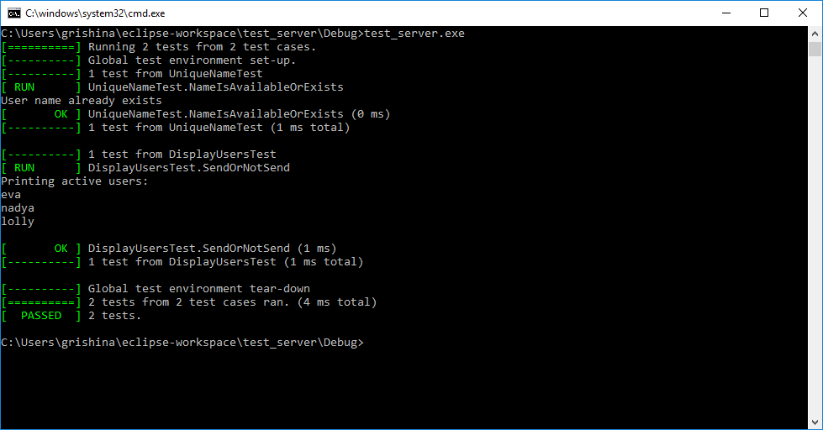
Unit testing
1. Unit testing for server application

Slide 13
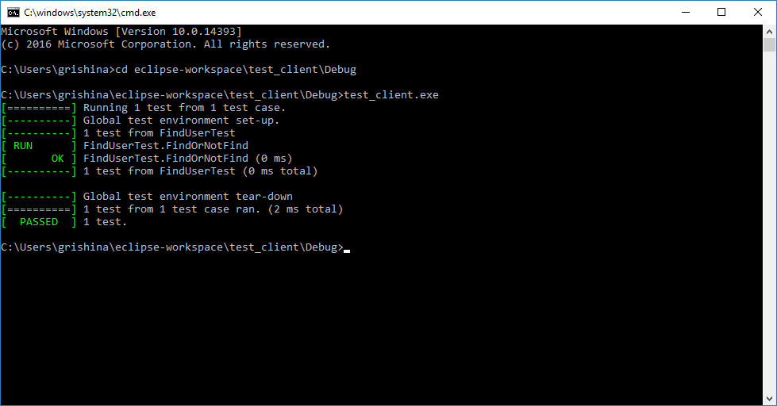
Unit testing
2. Unit testing for client application

Slide 14
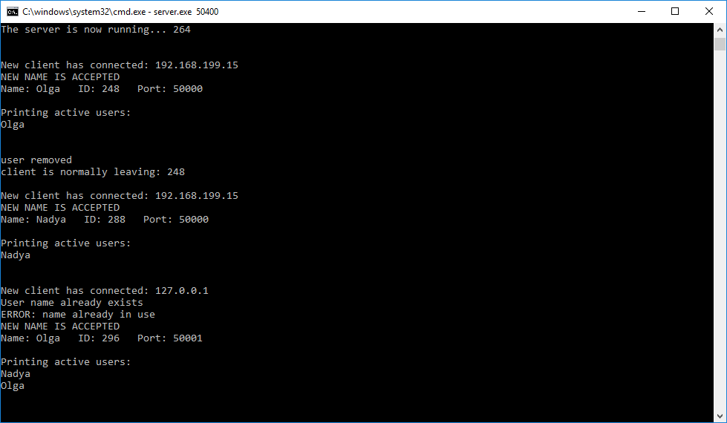
Demonstration of applications
1. Server application.

Slide 15
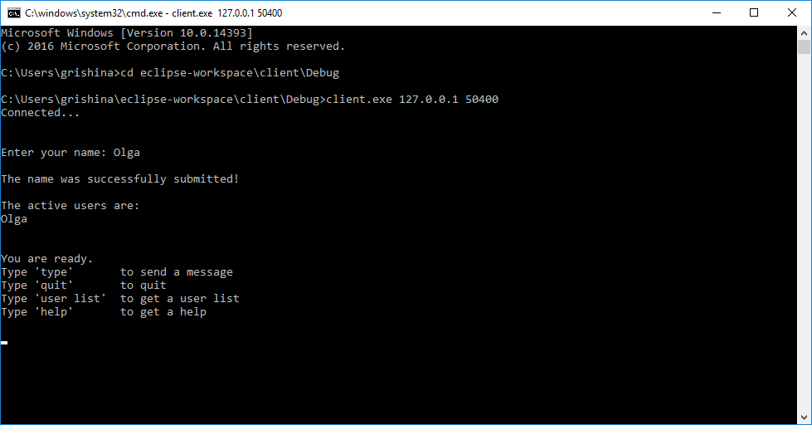
Demonstration of applications
2. Client application

Slide 16
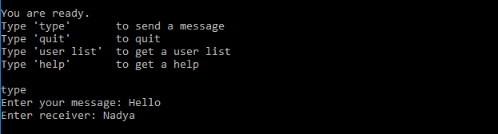
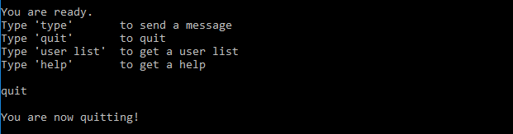
Demonstration of applications
2.1 Command “type”
2.2 Command “quit”

Slide 17
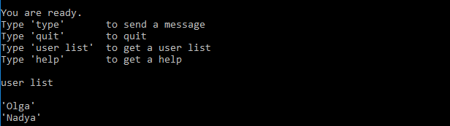
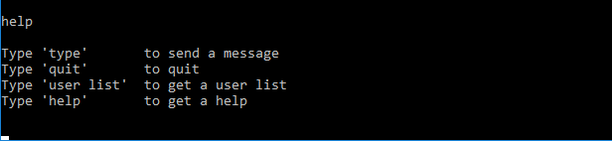
Demonstration of applications
2.3 Command “user list”
2.4 Command “help”

Slide 18
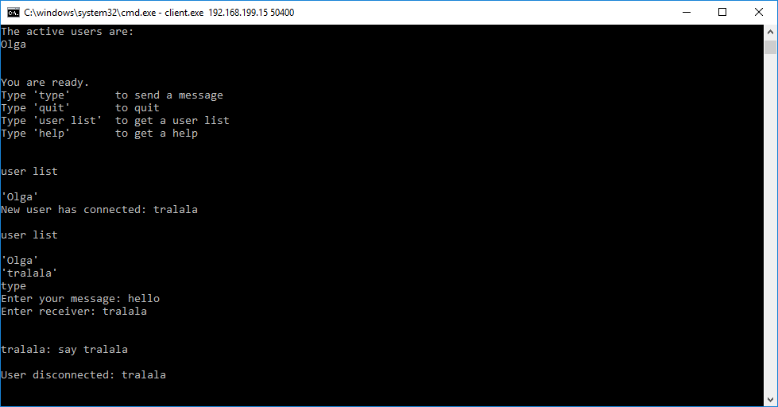
Demonstration of applications
2.5 Example of messaging between clients

Slide 19
Results
  Improved my technical skills
Improved English level

Slide 20
Plans for the future
  Gain more experience in programming
  Improve my English

Slide 21

Any questions?..

Slide 22
Thank you for your attention!

