Slide 1
Project Title - Learn Smarter — AI-Powered Personalized Education
Team Members: Yi Chen, Joshua, Grishm, Aung Phyo Paing, Ei Ei San, Htet Htet Win (2503079B)

Slide 2
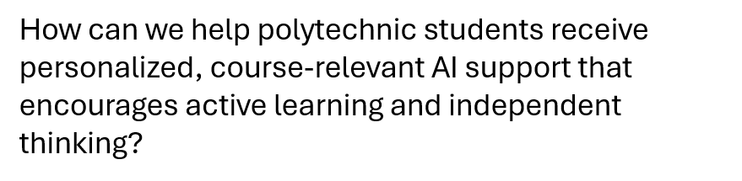
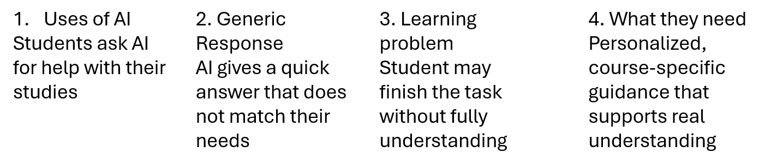
Stage 1 – Empathy
Design Challenge – Learning with AI

Slide 3
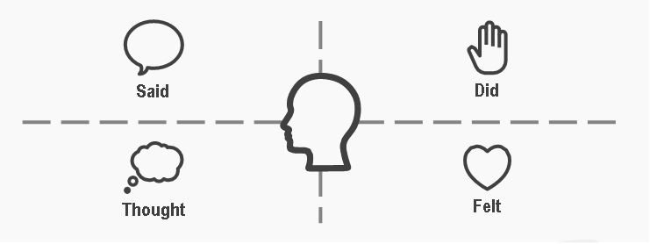
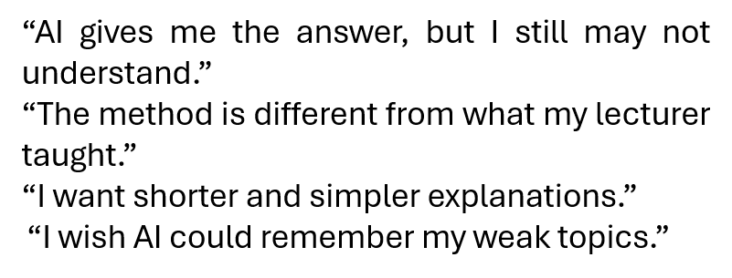
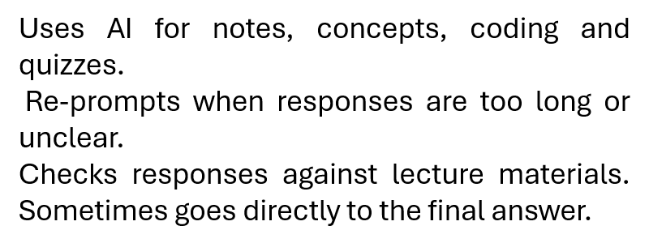
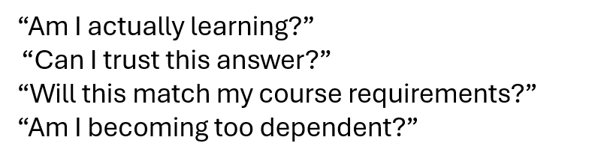
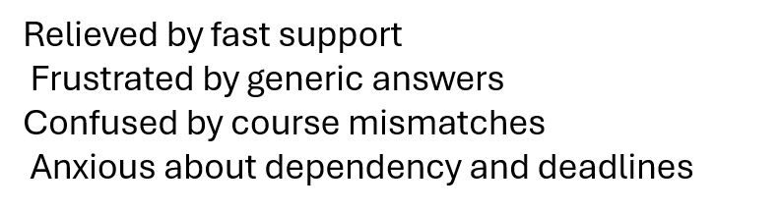
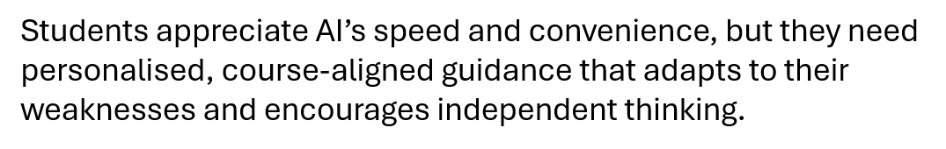
Stage 1 – Empathy - Empathy Map
What did the user SAY?
What did the user DO?
What did the user THINK
How did the user FEEL?

Slide 4
Stage 1 – Empathy - Develop Insight
Students Want More Than Fast Answers
SPEED ≠ UNDERSTANDING Students finish later | ONE STYLE DOES NOT FIT ALL Needs change based on subject and urgency.
COURSE ALIGNMENT = TRUST Students trust answers that match their lessons | AI SHOULD REMEMBER Students want progress and weaknesses tracked.

Slide 5


Stage 2 - Define (POV Statement)
Polytechnic students who need a way to receive personalized guidance while studying with AI.
needs a way to
partner name/description
Receive personalized, course-relevant learning guidance
learn independently without becoming over-reliant on AI-generated answers.
user’s need
because
Generic AI responses may help them finish tasks quickly but do not always help them understand concepts or learn independently
insight
Students value AI for its speed, but generic and direct answers may help them complete tasks without understanding their mistakes, weak areas or how to solve similar problems independently.

Slide 6
Stage 3 - Ideate (“How Might We…” Statement)
design an AI study companion that provides personalized and course-relevant learning support
How might we
do what
polytechnic students who regularly use AI for studying
for
for whom
help them understand concepts, improve their weak areas, and learn independently instead of relying only on direct answers
In order to
benefit, gain or result we’d like to see

Slide 7
Stage 3 - Idea 1
1. AI Learning Coach
Solution: An AI study assistant that learns how each student studies over time. Instead of giving the same answer to everyone, it:
Tracks topics the student struggles with.
Adjusts explanations
Creates personalized quizzes based on weak areas.
Plans revision schedules before tests.
Gives hints instead of directly giving the answer.
Innovation: The AI adapts to the student's learning style and progress rather than acting like a normal chatbot.
This encourages active learning instead of copying answers.

Slide 8
Stage 3 - Idea 2
2. AI Study Companion with Reflection
Solution: Instead of immediately answering questions, the AI:
Asks guiding questions.
Lets students attempt the problem.
Explains mistakes.
Gives another similar question.
Tracks improvement over time.

Slide 9
Stage 3 - Idea 3
3. AI + Lecturer Integration
Solution: An AI platform connected to the polytechnic's course materials
-Uses lecture slides, tutorials, and assignment requirements
-Gives answers based on what the lecturer actually teaches
-Warns students if they are relying too much on AI
Suggests which lecture notes to review
Innovation: Course-specific AI instead of general AI

Slide 10
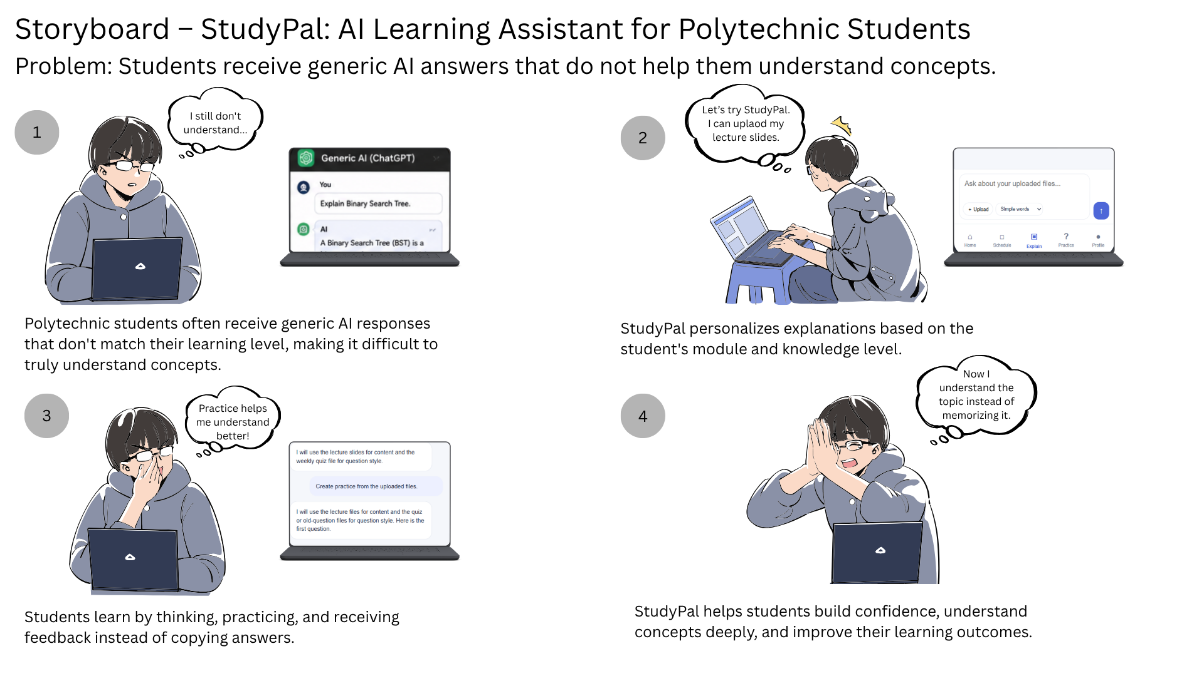
Stage 4 – Prototype - Storyboard

Slide 11
Stage 4 – Prototype – Picture/Video of Prototype

Slide 12
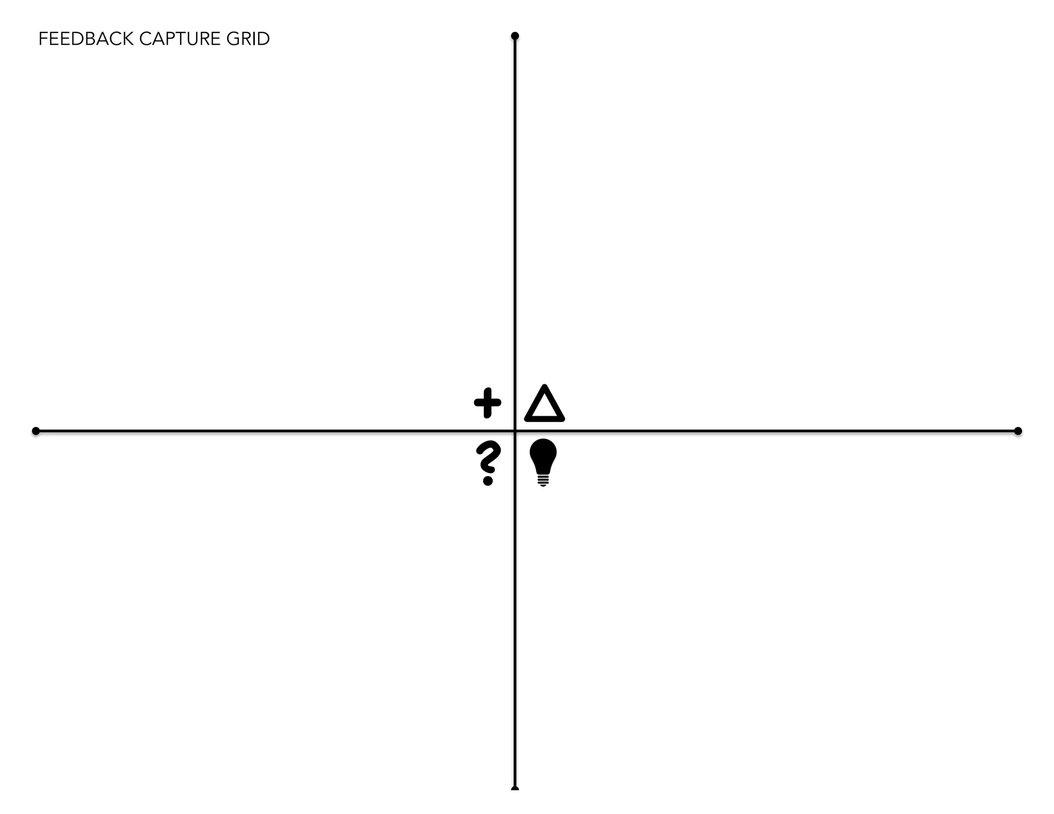
Stage 5 – Testing (Tester 1 Chill Student)
Like
The home page clearly displayed upcoming assignments, tests and overdue study steps.
Dislike
The student felt that there were too many different sections and wanted a faster way to ask a question directly from the home page.
Wishes
A simpler home screen with a quick-question box.
Feedback: “The deadline tracking is useful, but I would probably still use ChatGPT because it is faster to start asking questions.”
Questions
“Why do I need to open a subject chat before asking a question?”
Ideas
Add a Quick Help button on the home page that automatically places the question into the correct subject chat.
Rating : 2/5

Slide 13
Stage 5 – Testing ( Tester 2 Busy student with CCA)
Like
The student liked that StudyPal could detect assignment and test dates from a teaching plan and automatically create study steps.
Dislike
The generated study plan did not consider the student’s CCA, part-time work or available study time.
Wishes
Flexible study steps based on personal availability.
Feedback:“It saves time because I don’t need to enter every deadline, but the study dates may not fit my actual schedule.”
Questions
“What happens if StudyPal detects the wrong deadline from my file?”
Ideas
Show a confirmation screen containing all detected subjects and dates before creating the schedules. Connect the plan to the student’s calendar.
Rating : 3/5

Slide 14
Stage 5 – Testing ( Tester 3 High achieving student)
Like
The student liked having separate chats for different subjects and being able to choose between:
Simple words
Step-by-step explanation
Examples
Short summary
They also liked that practice questions could follow the style of uploaded weekly quizzes.
Wishes
The AI should state which uploaded file and page were used for each explanation.
Feedback:“This is more useful than a normal chatbot because the explanation and questions come from my own module files.”
Questions
“How can I confirm that the explanation matches exactly what my lecturer taught?”
Ideas
Add source references, page numbers and a lecturer-verified indicator.
Rating : 4.5/5

Slide 15
Stage 5 – Testing ( Tester 4 student struggling academically)
Like
The student liked the Simple Words explanation option.
Disliked:
The Practice section mainly asked multiple-choice questions and did not provide a hint before submission. The student also felt that receiving only “correct” or “not correct” feedback was insufficient.
Wishes
More guidance before revealing the correct answer.
Feedback:“I may still not understand why my answer is wrong. I need smaller hints and an easier explanation.”
Questions
“What happens if I keep answering the same topic incorrectly?”
Ideas
Add:
A Give Me a Hint button
A Start from the Basics option
A full explanation after each incorrect answer
Easier follow-up questions when the student struggles
Rating : 2/5

Slide 16
Stage 5 – Testing ( Tester 5 energetic and interactive learner)
Like
The student liked having schedules, explanations and practice activities in one application. The score bar and progress indicators made revision feel more engaging.
Wishes
More visual and interactive learning formats.
Feedback:“The app is organised and the quiz progress is motivating, but I want more than normal multiple-choice questions.”
Questions
“Can StudyPal remember the mistakes I repeatedly make across different practice sessions?”
Ideas
Add a weak-topic dashboard containing:
Frequently incorrect topics
Flashcards
Visual explanations
Daily revision challenges
Personalised quiz recommendations
Rating : 4/5

Slide 17
BUSINESS MODEL CANVAS : | BUSINESS MODEL CANVAS: | BUSINESS MODEL CANVAS: | BUSINESS MODEL CANVAS: | BUSINESS MODEL CANVAS: | BUSINESS MODEL CANVAS:
Student’s name: | Student’s name: | Class: | Date: | Date:
Key Partners | Key Activities | Value Proposition | Value Proposition | Customer Relationship | Customer Segments
1. Polytechnic lecturers 2. Ai and cloud service providers | 1. Maintain Ai study features and quiz generation 2. Update course material and track student progress | 1.Personalised AI study support based on weak topics and learning progress 2.Course-relevant explanations, quizzes and revision plans from uploaded materials |  | 1.Personalised reminders and progress tracking 2.Guided learning support through hints, quizzes and explanations | 1.Polytechnic students who use AI for studying 2.Schools or lecturers who want better AI-supported learning tools
 | Key Resources |  |  | Channels
 | 1.AI model, uploaded lecture materials, student progress data 2.Developers, UI/UX designers, cloud storage |  |  | 1.Mobile app / web app 2.School learning portal or student recommendations
Cost Structure | Cost Structure | Cost Structure | Revenue Streams | Revenue Streams | Revenue Streams
1.AI API, cloud hosting and data storage costs 2.App development, maintenance and security costs |  |  | 1.Freemium model with paid premium features 2.School subscription or institutional licence

Slide 18
INNOVATION & ENTREPRENEURSHIP INTERDISCIPLINARY LEARNING ROADMAP
 | Problem Statement | Ideation | Prototyping
Disciplines to be integrated How is each discipline relevant to the problem? What substantial contribution does each discipline make? What are some of the recommended resources for each discipline? Discipline 1: Artificial Intelligence & Data Analytics Discipline 2 : Education & Learning Psychology Discipline 3: User Experience & Software Design | Discipline 1: AI and data analytics helped us identify that existing AI tools usually provide generic responses and do not track students’ learning levels, weak topics or progress over time. | Discipline 1: This discipline contributed ideas such as adaptive explanations, personalized quizzes, weak-topic detection, course-material analysis and automatic revision recommendations. | Discipline 1: It was applied in StudyPal through subject-specific AI chats, different explanation modes, automatic schedule generation, personalised practice questions and progress tracking.
 | Discipline 2: Learning psychology helped us understand that students may complete tasks using AI without developing genuine understanding, especially when answers are provided immediately. | Discipline 2: It contributed learning methods such as guiding questions, hints, active recall, reflection, spaced revision and adjusting difficulty according to student performance. | Discipline 2: It was applied through guided explanations, practice questions, feedback after mistakes, step-by-step learning and revision plans that encourage independent learning.
 | Discipline 3: UX research helped identify students’ frustration with long responses, complicated interfaces, repeated prompting and AI answers that do not match their course needs. | Discipline 3: It contributed ideas such as a simple dashboard, clear subject navigation, quick-help options, explanation-style selection and an organised study schedule. | Discipline 3: It was applied in StudyPal’s interactive interface, including the Home dashboard, Schedule, Explain, Practice and Progress sections, with clear and student-friendly navigation.

