Slide 1
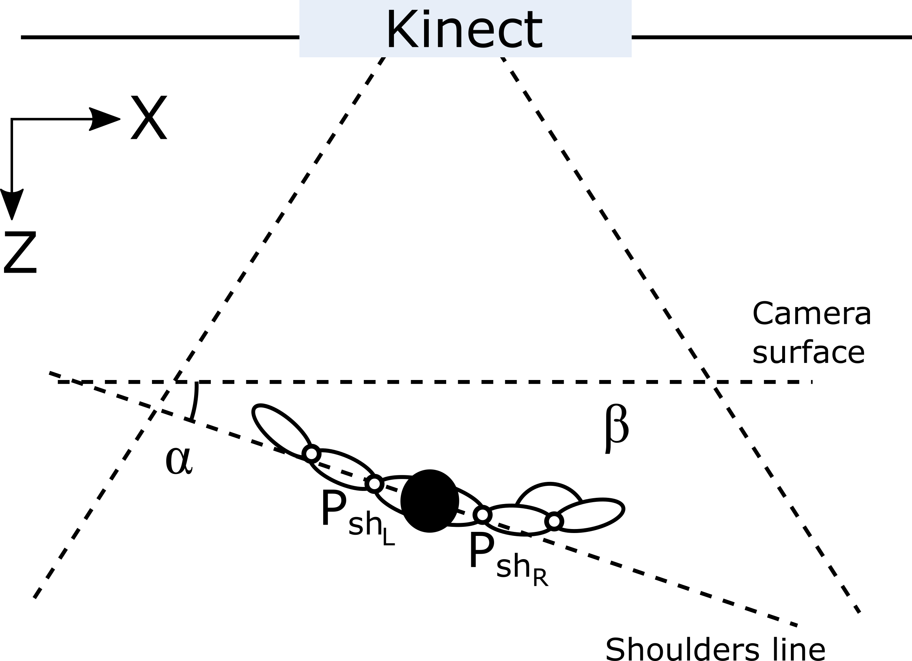

Slide 2
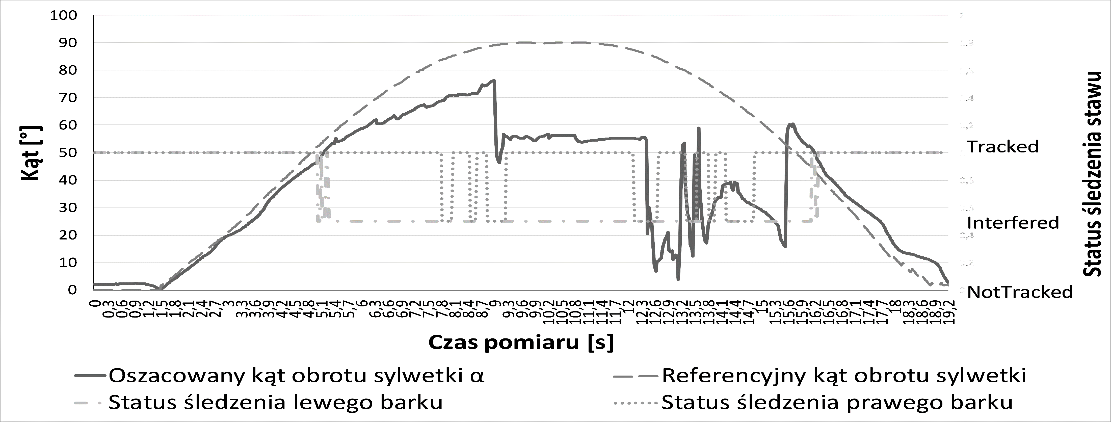
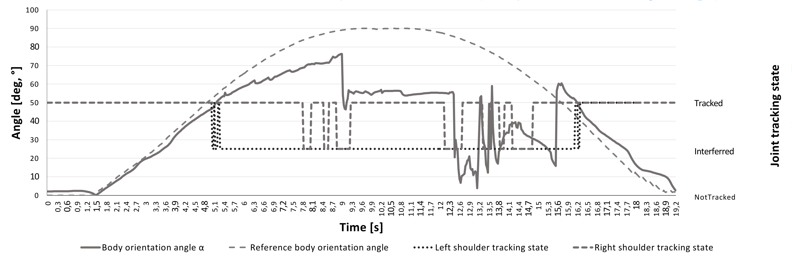
Joint tracking state
Angle [°]
Time [s]
Estimated body orientation angle α
Reference body orientation angle
Left shoulder tracking state
Right shoulder tracking state

Slide 3
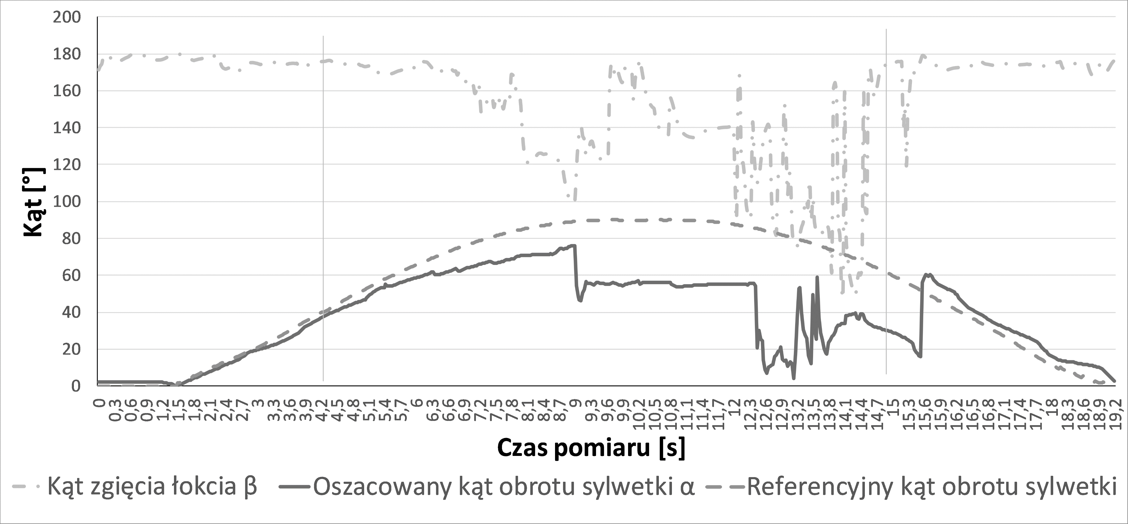
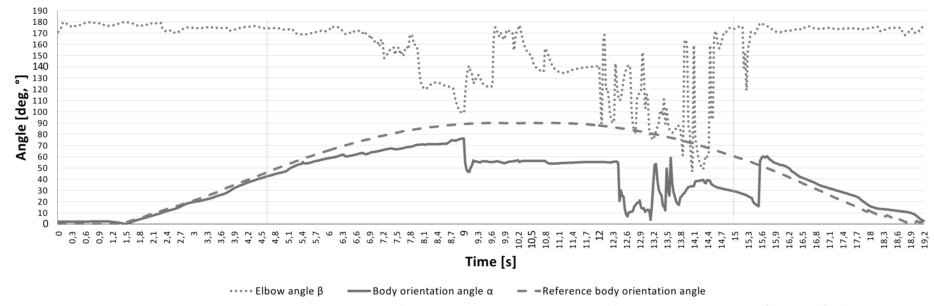
Angle [°]
Time [s]
Elbow angle β
Estimated body orientation angle α
Reference body orientation angle

Slide 4
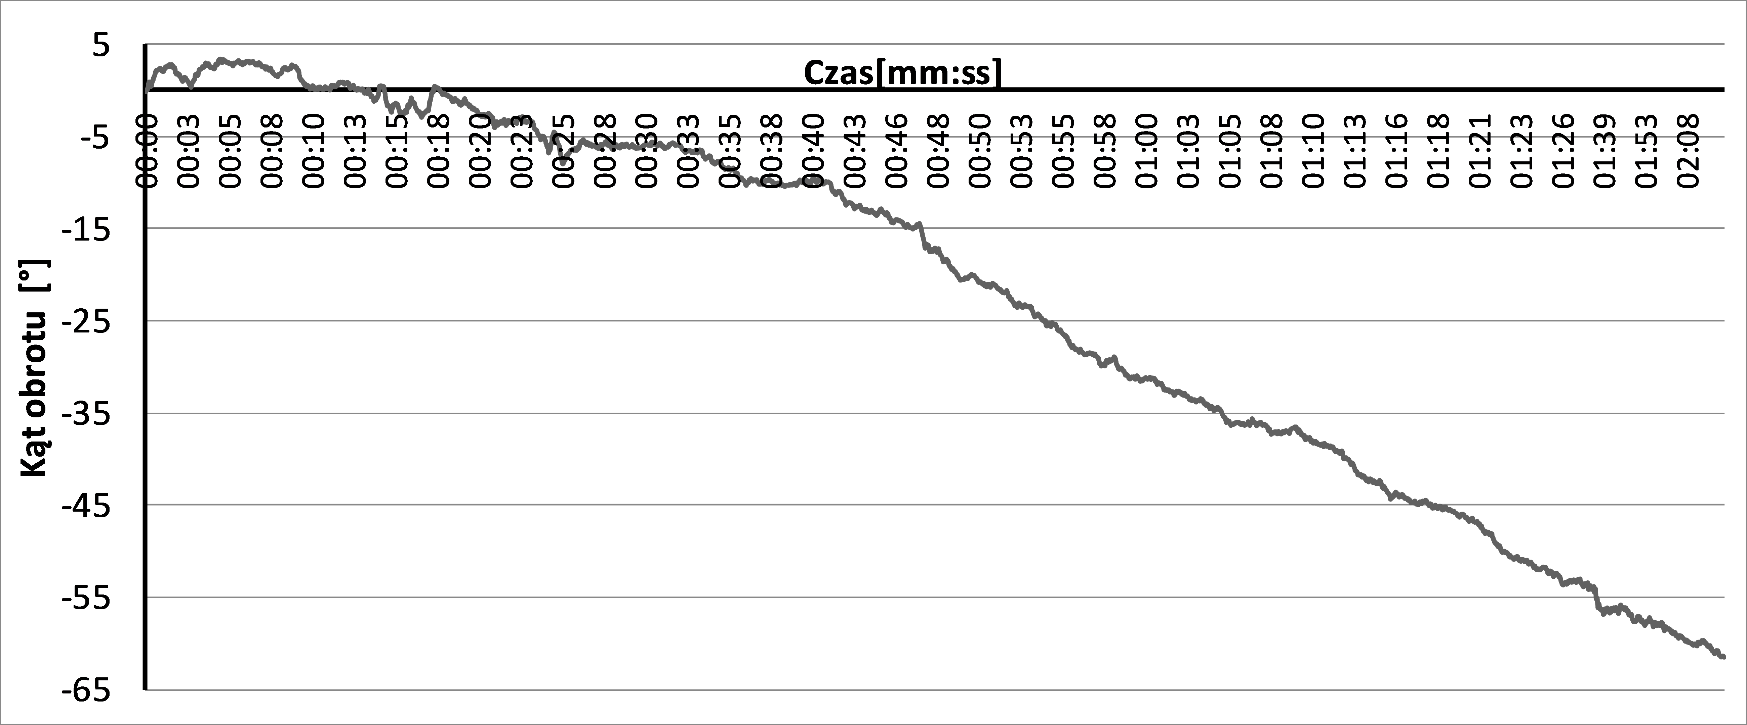
Time [min:sec]
Angle [°]

Slide 5
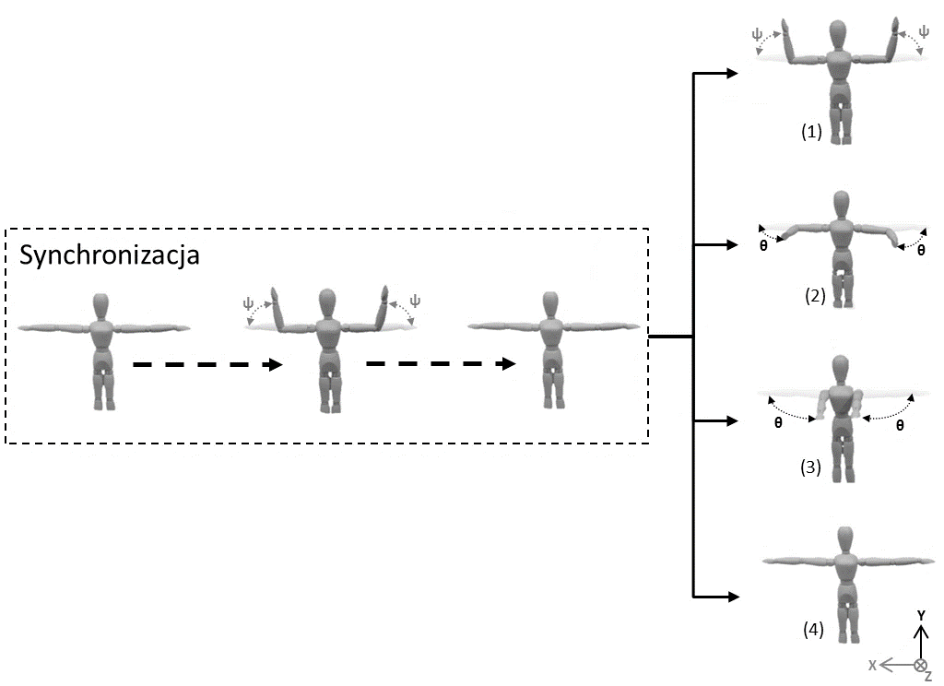
Synchronization routine

Slide 6
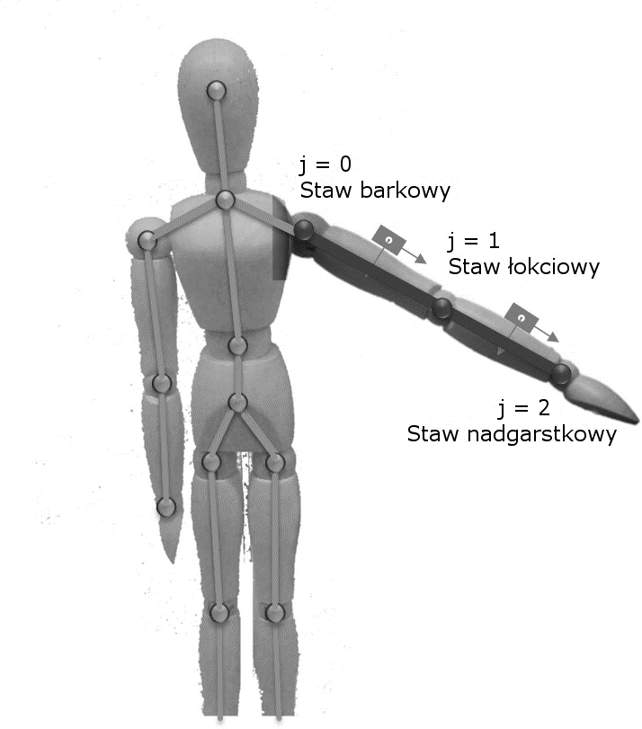
Shoulder joint
Elbow joint
Wrist joint

