Slide 1
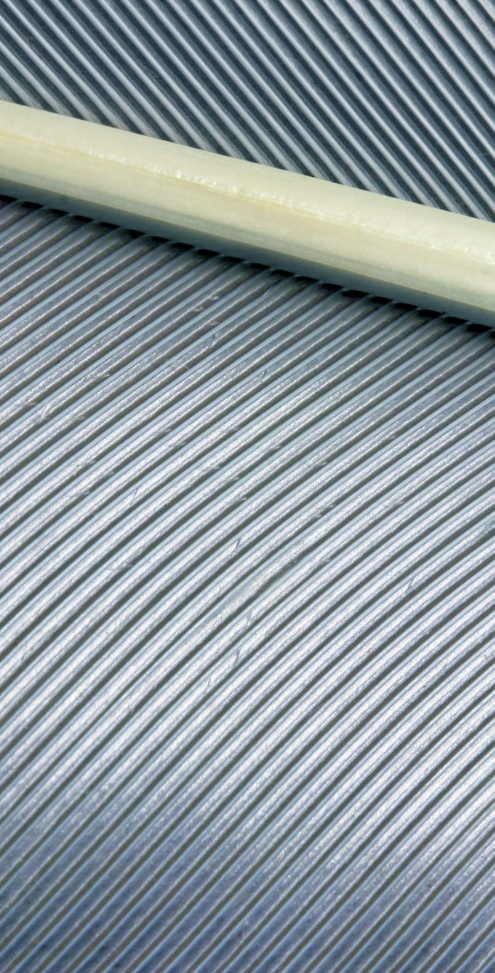
Properties and Reusability of PLA-Bamboo Composites for Sustainable 3D Printing
Student: Ritesh Gupta
Roll No.: 244103227
Guide: Dr. Ujendra Kumar Komal
Department of Mechanical engineering

Slide 2
Introduction
Growing need for sustainable composites in 3D printing
PLA is common but has low strength & thermal stability
Bamboo (renewable, strong) and Rice Husk Ash (agro-waste, silica-rich) can improve properties
Project: Fabrication & analysis of PLA/Flax or PLA/RHA filament for better strength, durability & eco-friendliness

Slide 3
Literature Review (Part 1)
S. | Author | Work done | Material | Result | Reference
1 | Abir Saha et al | Developed 3D-printing filaments from banana fiber waste + PLA, printed samples with different infill densities, raster angles, and bioinspired patterns; optimized using Taguchi DOE and VIKOR method. | PLA (4043D) + Banana microfibers | Tensile ~62 MPa, Flexural ~80 MPa, Compressive ~61 MPa, Impact ~22 kJ/m²; optimum = 50% infill, 45° raster, 9% fiber, honeycomb | Saha, A., Gujar, V., Bagla, A., Kumari, P., & Kundanati, L. (2025). 3D-Printing of PLA-Banana Fiber Sustainable Biocomposites with Bioinspired Infill Patterns. Preprints. https://doi.org/10.20944/preprints202508.1698.v1
2 | Skosana et al. | Comparative study on 3D FDM printing of PLA composites reinforced with flax, PALF, and hemp fibres; studied effect of alkali treatment and PLA coating | PLA matrix + 10 wt% flax, PALF, hemp fibres | Hemp composites showed highest tensile strength (29.12 MPa) and thermal stability (306°C); surface treatment improved fibre–matrix bonding; PLA coating caused embrittlement; hemp identified as most suitable for automotive use | Skosana, S. J., Khoathane, C., Malwela, T., & Webo, W. (2025). Comparative study on 3D fused deposition modeling of PLA composites reinforced with flax, PALF, and hemp fibres. Journal of Composite Materials, 59(19), 2293–2306. https://doi.org/10.1177/00219983251329097
3 | Xing et al. (2025) | Investigated in situ 3D printing of continuous plant fiber yarn-reinforced PLA composites, focusing on crystallization, rheology, and mechanical properties. Compared flax, bamboo, and flax–Tencel hybrid yarns. | PLA with flax, bamboo, and flax–Tencel fibers (up to 50.79% volume fraction) | Flax/PLA composites showed highest tensile strength (132.16 MPa, +342% vs. neat PLA) and 22.2% lower density. Plant fibers enhanced PLA crystallization and rheology. Flax fibers outperformed carbon fibers in compressive strength of honeycomb structures. | Skosana, S. J., Khoathane, C., Malwela, T., & Webo, W. (2025). Comparative study on 3D fused deposition modeling of PLA composites reinforced with flax, PALF, and hemp fibres. Journal of Composite Materials, 59(19), 2293–2306. https://doi.org/10.1177/00219983251329097

Slide 4
Literature Review (Part 2)
4 | Somsuk et al. (2025) | Studied the effect of rice husk and rice straw fibres (100/200 mesh) with and without NaOH treatment on 3D-printed PLA composites. | PLA reinforced with 5–20 wt% rice husk and rice straw fibres. | Fine (200 mesh) and alkali-treated fibres improved stiffness, flexural strength, and impact resistance. Tensile strength dropped at higher fibre loadings due to poor stress transfer. SEM showed fewer voids with treated fibres | Somsuk, N., et al. (2025). Enhancing Mechanical Properties of 3D-Printed PLA Composites Reinforced with Natural Fibers: A Comparative Study. Journal of Composites Science, 9(180), 1–15. https://doi.org/10.3390/jcs09000180
5 | Raja et al. (2025) | Investigated effects of banana and pineapple fibre powders (1–3 wt%) on mechanical and morphological properties of PLA composites prepared as 3D-printable filaments. | PLA reinforced with 1%, 2%, and 3% banana and pineapple fibre powders. | 2% banana fibre increased compressive strength by 27.97% and flexural strength by 3.95%; tensile strength decreased by 5.6% compared to neat PLA. Hardness improved, with maximum at 1% pineapple fibre. FESEM showed voids and interfacial gaps, fewer in 2% banana fibre composites. | Raja, R., Nagarjun, J., Kurien, R. A., & Jannet, S. (2025). 3D printing of tailored polymer composites: enhancing sustainability with banana and pineapple fiber particle reinforcements. Engineering Research Express, 7(2), 025442. https://doi.org/10.1088/2631-8695/addb2c
6 | Guo et al. (2025) | Investigated the effect of natural wollastonite fibres on mechanical, thermal, crystallization, degradation, and antibacterial properties of PLA composites prepared via melt compounding and FDM | PLA reinforced with wollastonite fibres (various wt%). | WF improved tensile and flexural strength, enhanced crystallinity and thermal stability, accelerated hydrolytic degradation, and imparted antibacterial activity (against E. coli and S. aureus). | Guo, Y., et al. (2025). Natural wollastonite fiber simultaneously enhanced the mechanical, degradation, and antibacterial properties of PLA composites. Polymer Composites, 46(7), 5501–5514. https://doi.org/10.1002/pc.29234

Slide 5
Key Findings
Natural fibers (flax, banana, hemp, rice husk, bamboo) improve PLA strength & stability
Flax fiber gave highest tensile strength & thermal stability
Rice husk fibers improved impact and flexural strength; treatment enhanced bonding
Low % of bamboo/pineapple fibers improved strength & hardness
Surface treatments reduced voids and improved fiber–matrix bonding

Slide 6
Research Gap
Most studies focus on single natural fiber reinforcement in PLA.
Limited work on PLA/bamboo and PLA/basalt as filler for 3D-printable PLA composites.
Comparative studies of Flax vs. RHA in PLA filaments are scarce.
Few works address fabrication, design, and analysis of such filaments for additive manufacturing.
Need for eco-friendly, strong, and durable filaments tailored for 3D printing.

Slide 7
Objectives
Fabricate PLA/bamboo and PLA/basalt filaments for 3D printing.
Design test specimens & components in SolidWorks.
Print specimens with optimized parameters using Cura.
Evaluate tensile, flexural, impact, hardness, and tribological properties.
Optimize process parameters for enhanced strength & durability

Slide 8
Methodology
Collection & preparation of PLA/bamboo and PLA/basalt .
Surface treatment of fibers (NaOH / PLA coating).
Compounding PLA + fibers → filament preparation.
CAD modeling in SolidWorks.
3D printing using FDM (Cura).
Mechanical & tribological testing.

Slide 9
Planned Test Conditions
Composite filaments PLA/bamboo and PLA/basalt
Fiber/filler loadings: 5%, 10%, 15% (optimized for strength & printability).
3D printing parameters:
Infill density: 40%, 70%, 100% (to study lightweight vs dense prints).
Raster angle: 0°, 30°, ±60° (different from conventional 45°).
Infill patterns: Rectilinear, Hexagonal, Triangular (instead of honeycomb/gyroid)
Testing
Mechanical: tensile, flexural, impact, hardness.
Thermal: DSC, TGA
Morphology: SEM, XRD for bonding & dispersion.

Slide 10
Expected Outcomes & Future Work
Enhanced tensile, flexural, and impact strength vs pure PLA.
Improved wear resistance and durability.
Comparison of flax vs rice husk ash composites.
Optimized printing parameters for eco-friendly composites.
Future: Industrial scaling, thermal & biodegradation studies.

Slide 11
Thank you

