Slide 1
TDC
Technical Document Center
T.D.C
TDC
Technical Document Center
TDC
Technical Document Center
T.D.C

Slide 2
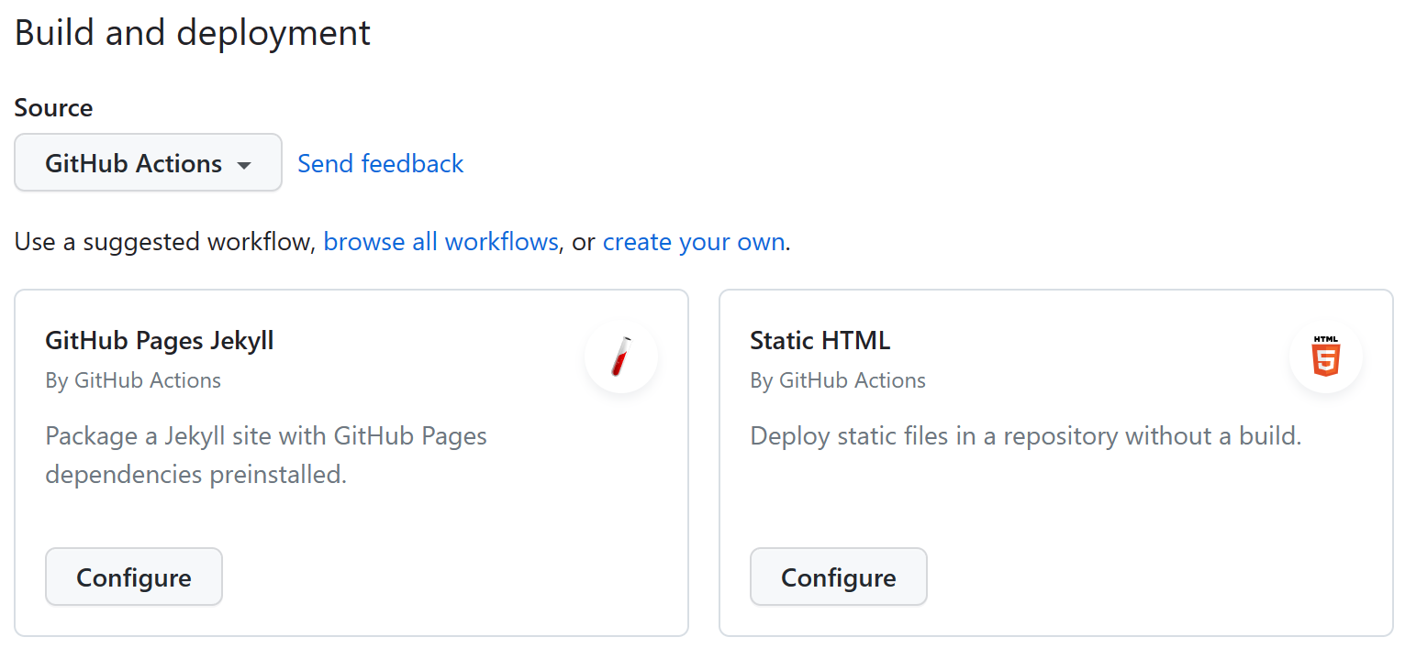


Slide 3
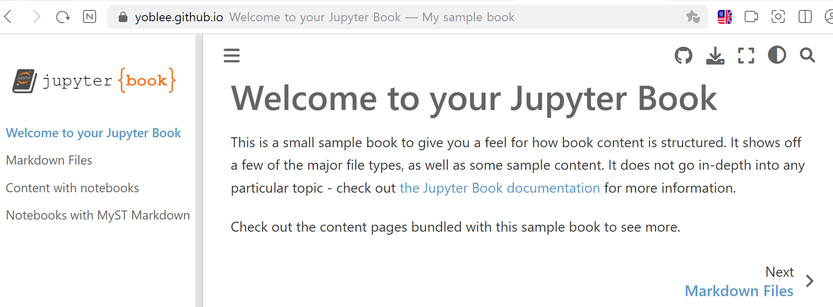

Slide 4
T.D.C

Slide 5


