Slide 1
TDC
Technical Document Center
TDC
Technical Document Center
TDC
Technical Document Center
T.D.C

Slide 2
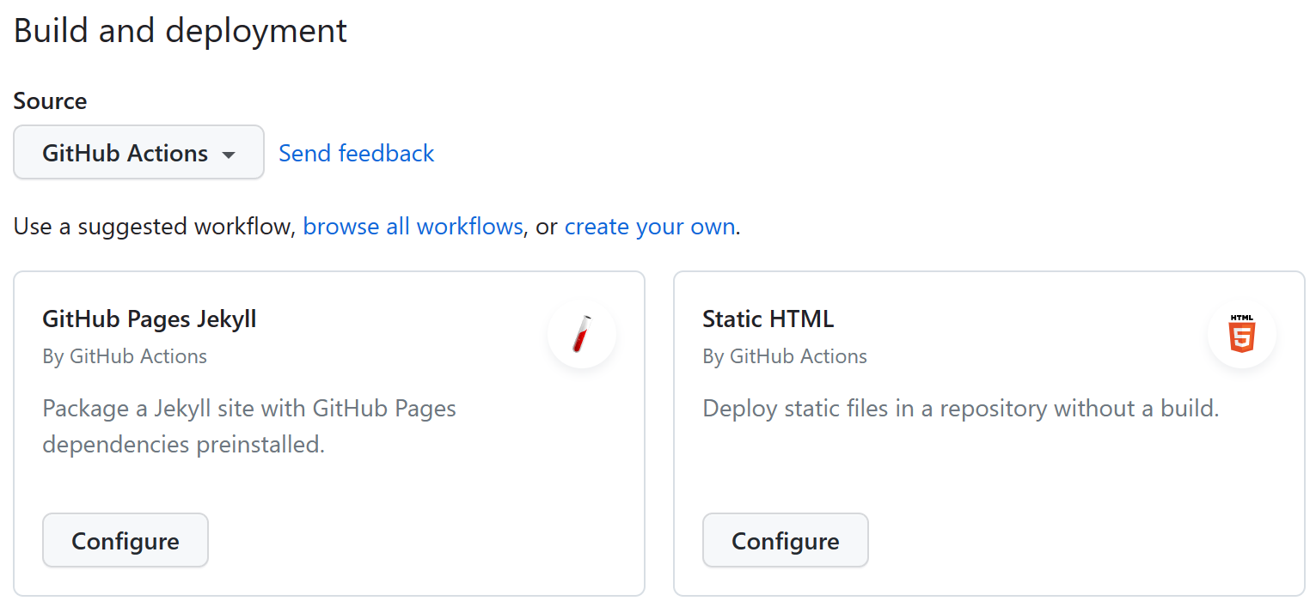


Slide 3
