Slide 1
Recognize Uno Card using Python and OpenCV
Gritsanapong Punti

Slide 2
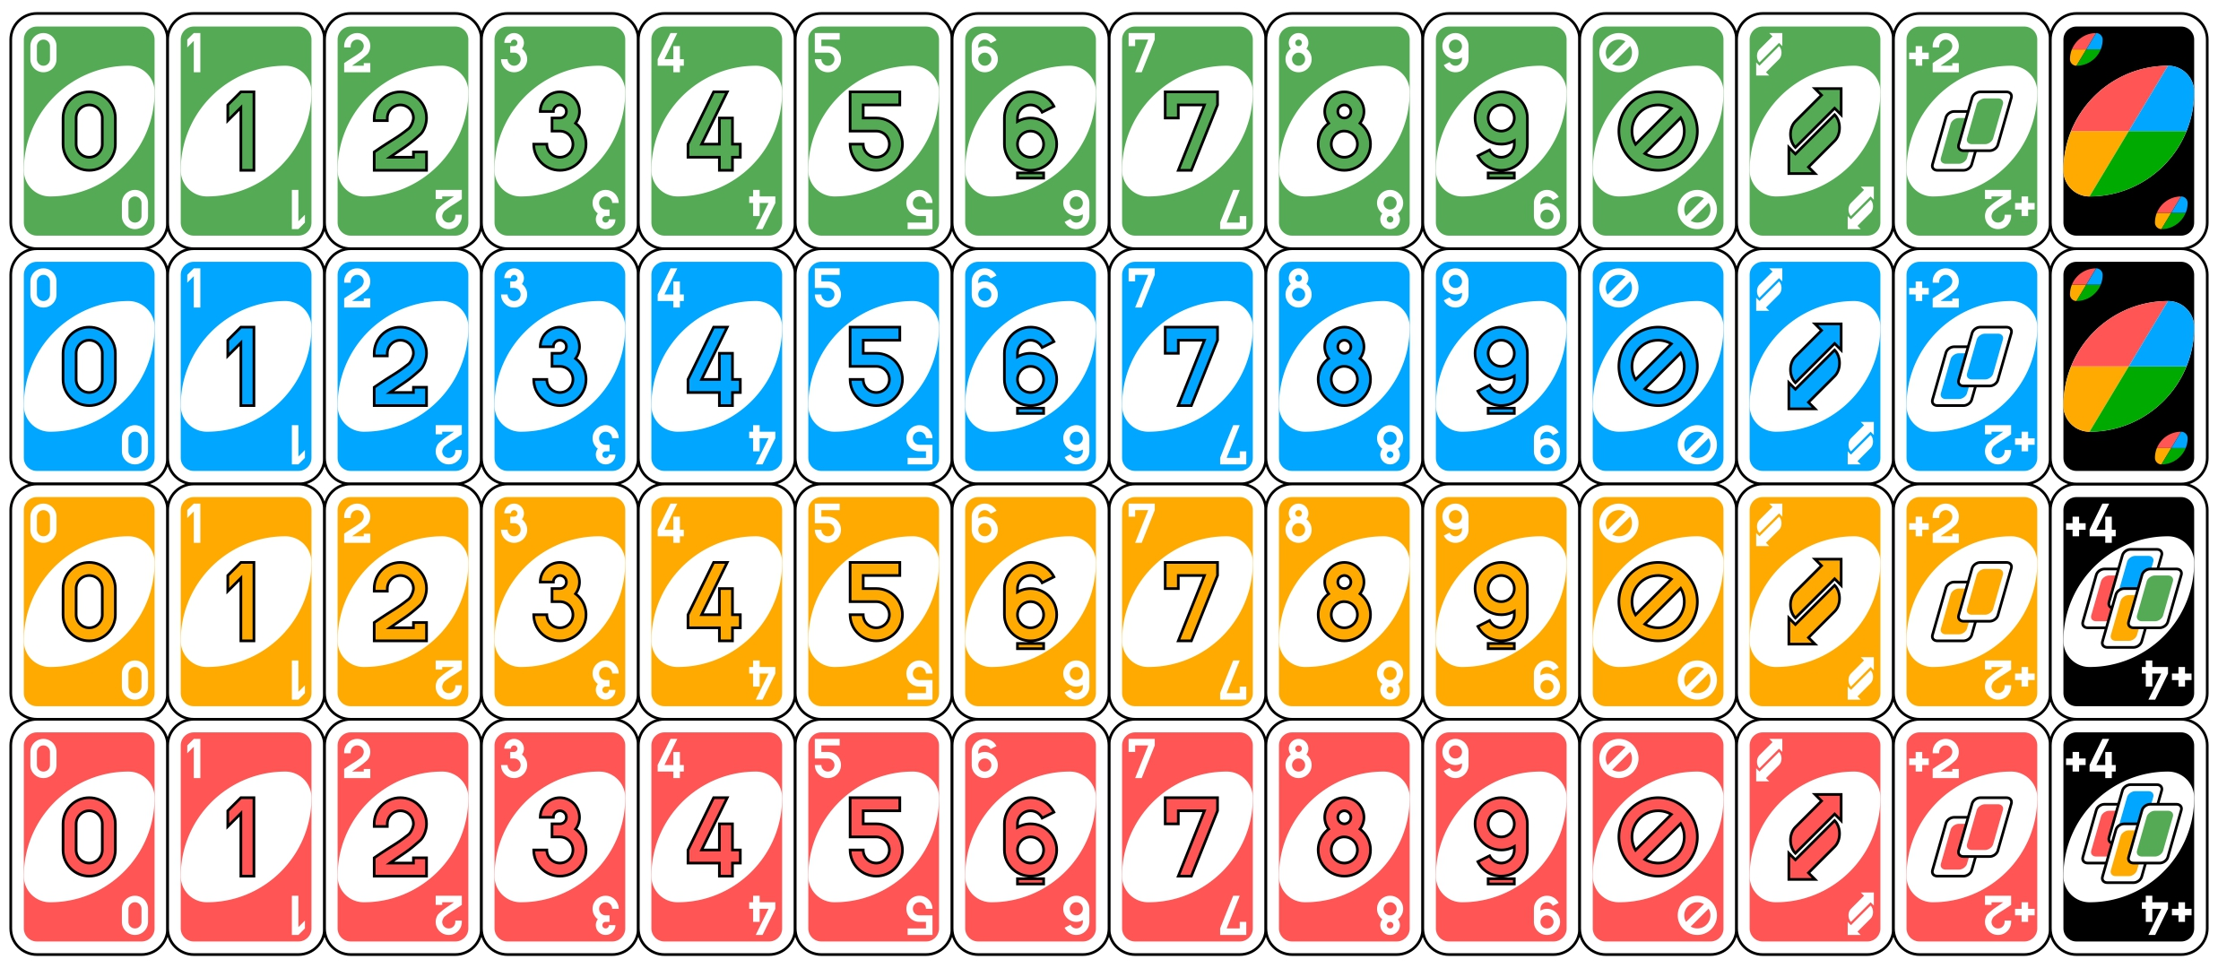
Dataset

Slide 3
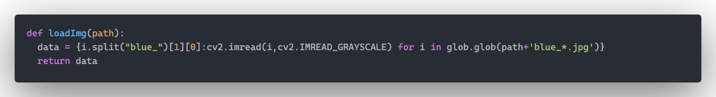
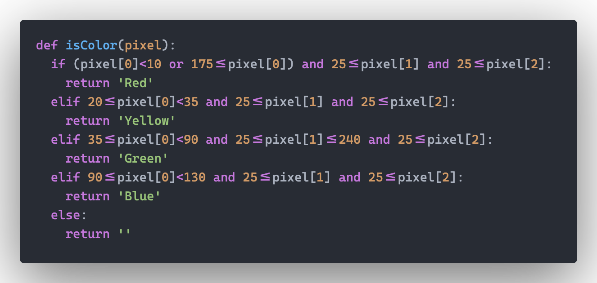

Slide 4
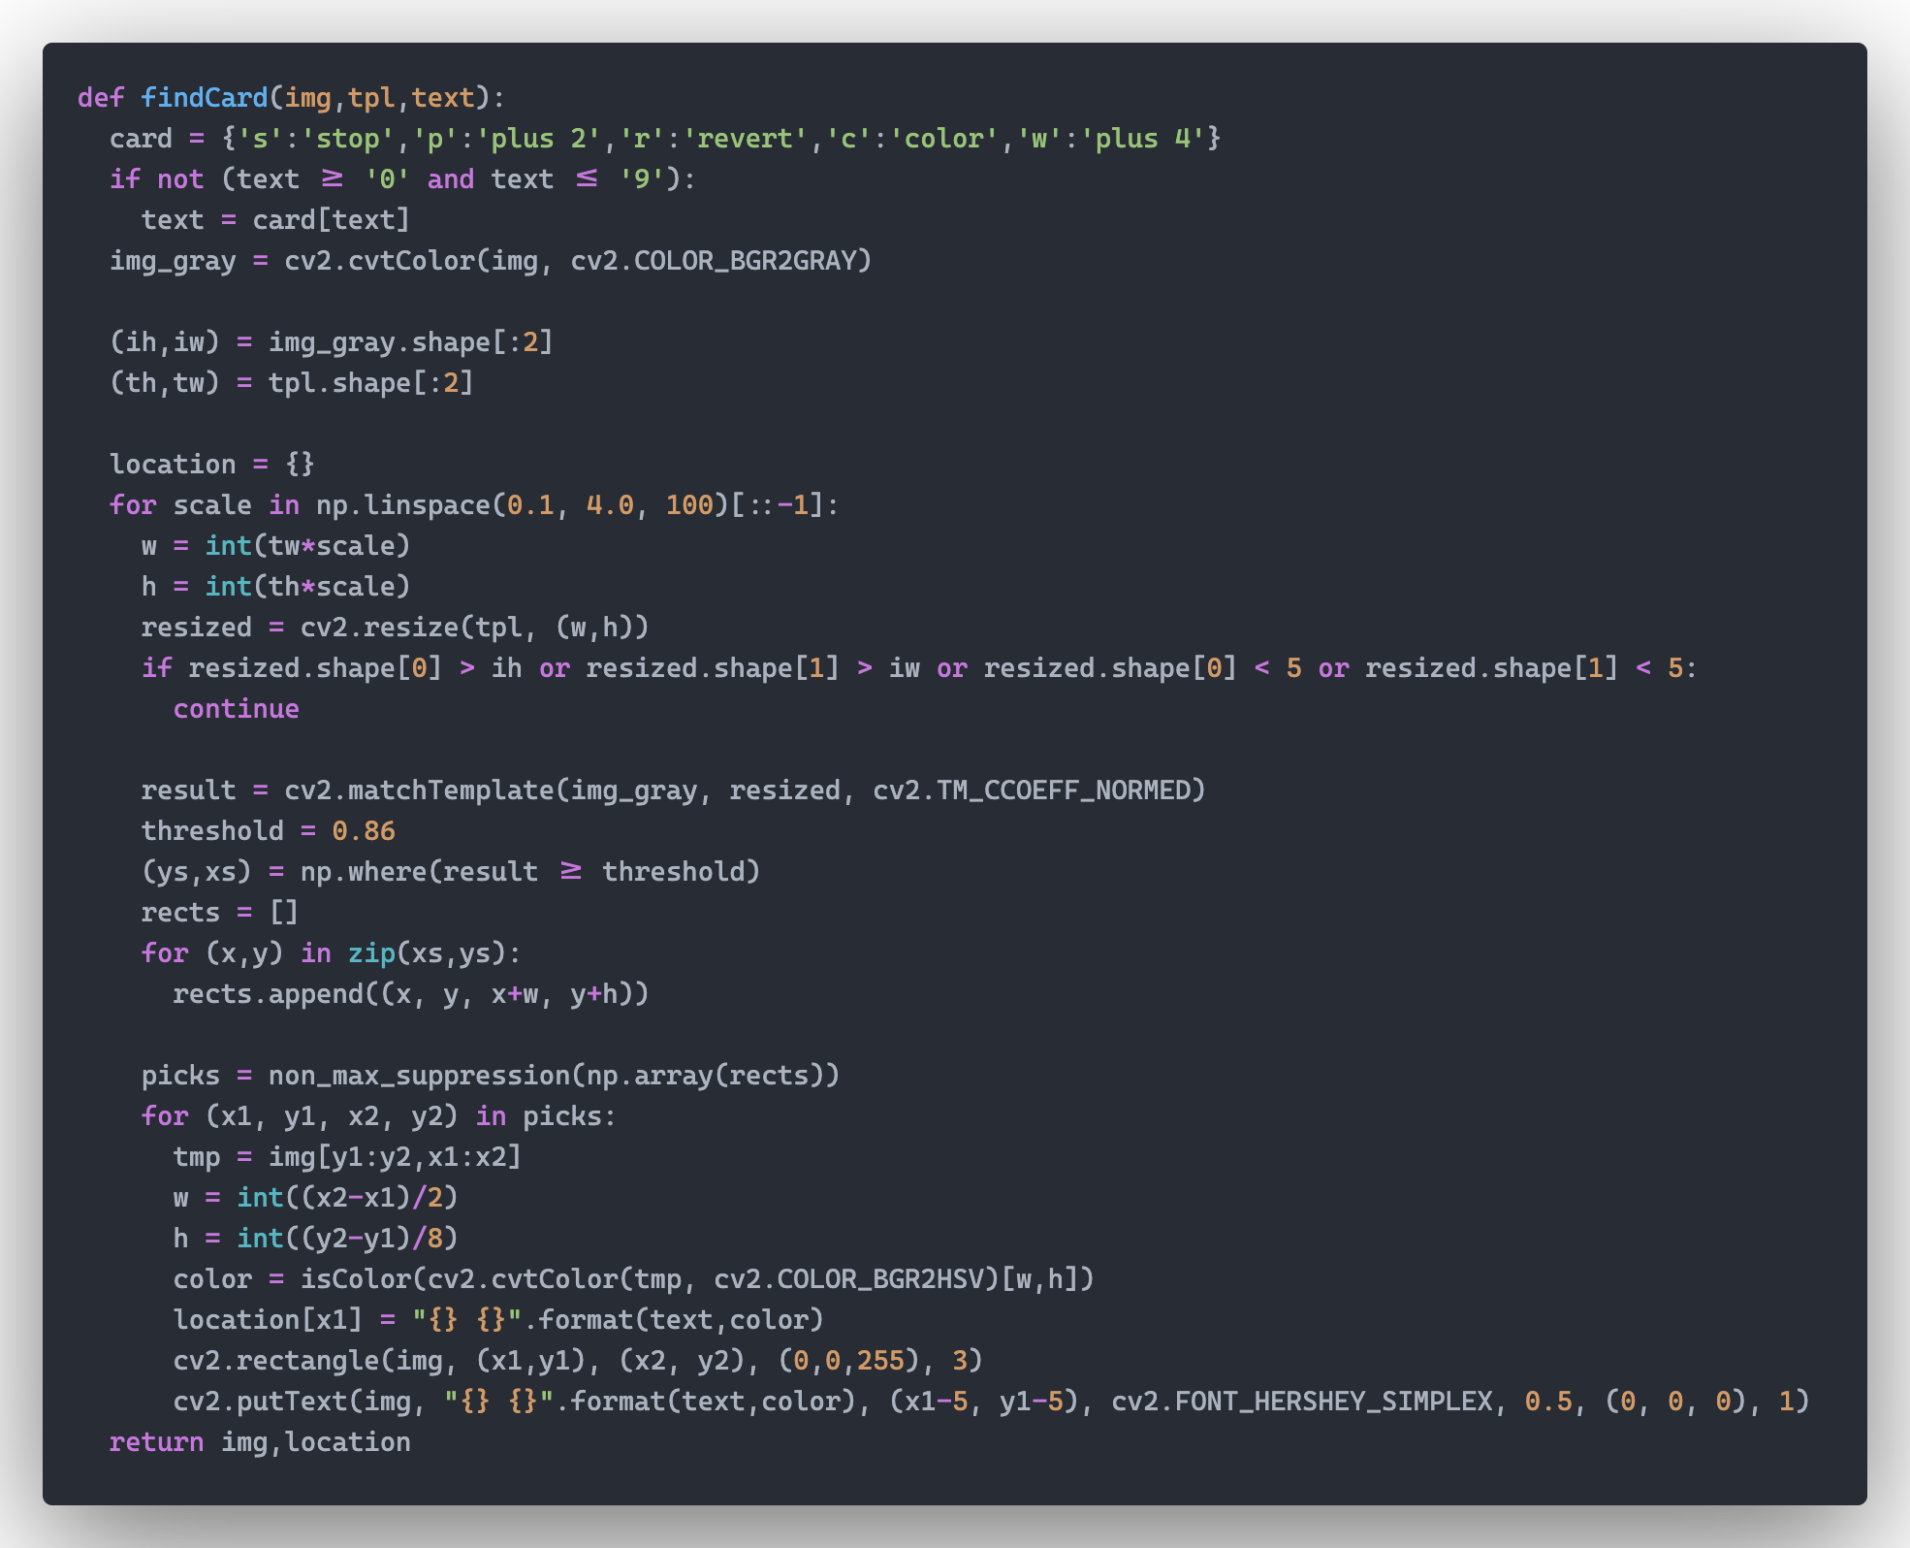

Slide 5
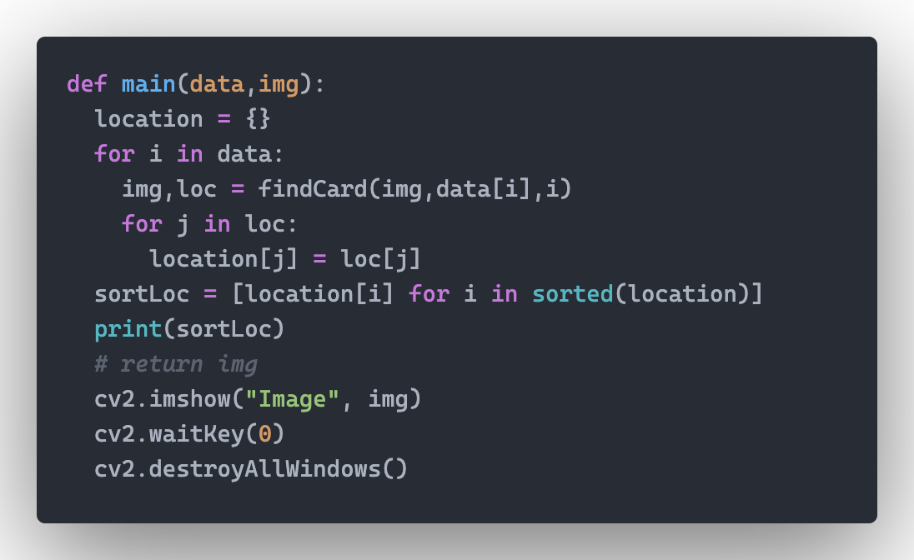

Slide 6
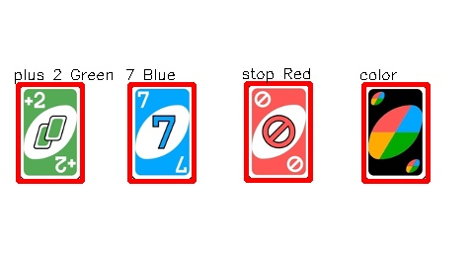




Data test
Result

Slide 7
youtube: https://youtu.be/snctEAEspm4
github: https://github.com/gritsp/recognize-unocard-python

