Slide 1
Wondering if this is a good time
to buy or sell a property?
Using Python, PostGreSQL, AWS RDS, Machine Learning and Tableau, our dashboard should help users with making that decision.

Slide 2
Project link and team presentation
Github: https://github.com/grittins/Team1_Project
Team members:
Anne Lecomte @padawanne - anne-lecomte@hotmail.com
Derek Mears @mearsdj - derek.j.mears@gmail.com
Rezwan Ferdous @grittins - grittins1@gmail.com
Shivali Sahai @shivalisahai - shivali.sahai@gmail.com
Wayne Jin @jinwei1207 - waynejin0110@gmail.com
Communication Protocols:
We are communicating through Slack and working together on Tuesdays and Thursdays on Zoom (within the class hours and afterwards using another Zoom room).
We are also meeting once a week, when it fits our respective schedules.

Slide 3
Predicting Toronto Housing Market
Our project aims at predicting Toronto house prices and with that; to consider the best timing to buy or sell a property.
This question impacts every Torontonian in some way, regardless of their status or current employment situation. We chose to investigate this as we had been wondering how an average person could afford a house in Toronto in the current economy. The goal is therefore to predict average house prices while taking into account the type of houses (attached/detached/condo), the location, the timing, interest rates, inflation rate and recession periods.
This could be used by governments and policy makers looking for ways to balance the growth of house prices, but also by realtors, investors, or any individual interested in the Toronto housing market.

Slide 4
Table of contents
Project Overview
Overview of the tools
Datasets Description and Sources
Before/After of the primary dataset
Preparing the data
ERD & Database
Machine Learning Model
Dashboard Overview

Slide 5
Project overview
Using datasets capturing Toronto House Prices of the last 21 years (2001-2022), Canada Recession Indicator, Mortgages Rates, Inflation Rates, we will build a ML model to predict the prices for the next year.
Once the data is cleaned, a PostGreSQL database is set up. We will then connect it to the Amazon RDS cloud in order to use the data within our ML model.
We will run the predictions, export the results and finally use Tableau to create an interactive dashboard for users to test and learn if the timing fits their budget.

Slide 6
Overview of the tools
Amazon RDS
Cloud DB
PostGreSQL
pgAdmin4
Excel
VBA
Dashboard
Tableau
Dash & Python
Machine Learning
Jupyter
Python

Slide 7
Datasets Description and Sources
TRREB (Toronto Regional Real Estate Board) quarterly house sales reports, from 2001 to 2022.
→ We were given access to internal csv reports that are not found on their website, and these are the files we are using. We first started working with the pdf files found on their website and converting these to excel.
Bank of Canada Mortgage Rates
Canada Recession Indicator
Toronto Neighbourhoods GeoJSON

Slide 8
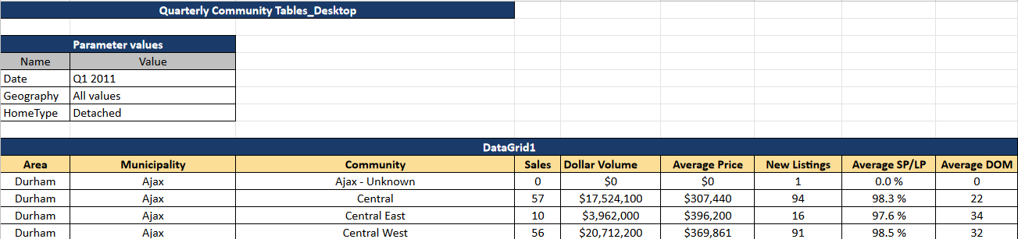
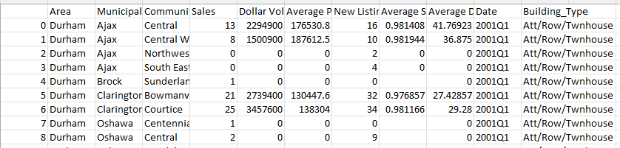
What the raw data looked like -vs- After Conversion
The data we are using was presented into individual quarterly reports that we converted into a single csv file, using Python (pandas and openpyxl) and Excel VBA.
Below is a snippet of our final csv file, containing 21 years of house prices, by location and house type.

Slide 9
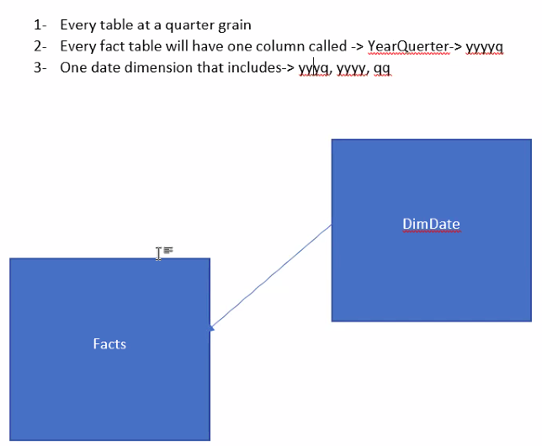
Preparing the data
With the help of our amazing TA Sina,
we’ve decided a date format to be consistent within our datasets.
The chosen format was “yyyyq”, which would be “20224” for the last trimester of 2022.

Slide 10
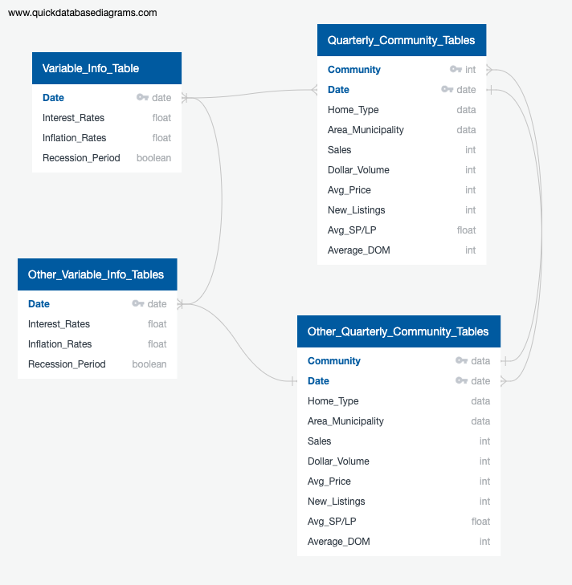
ERD & Database
On the right, you can see the ERD we based our database on.
We started locally with PostGreSQL to sketch the database we desired, then we connected it to an online database using AWS RDS.
This is how our Machine Learning Model will access the data and predict the house prices for the next 4 quarters.
Since our primary dataset is quarterly based, we have had to adapt the other sets.

Slide 11
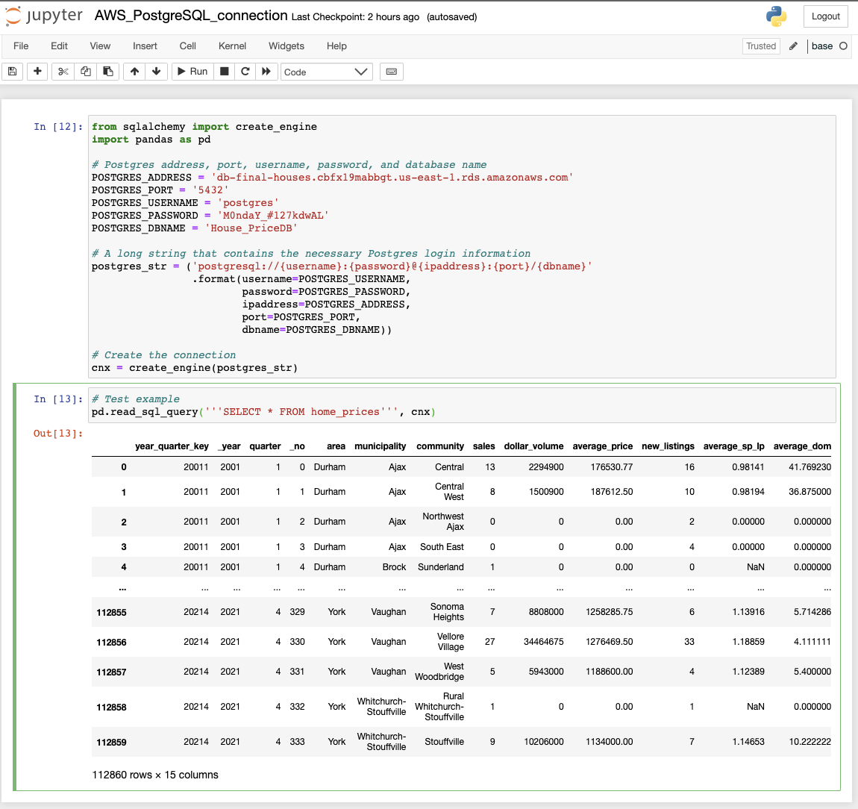
AWS - Jupyter Connection
We linked the database to Jupyter Notebook
as seen here.

Slide 12
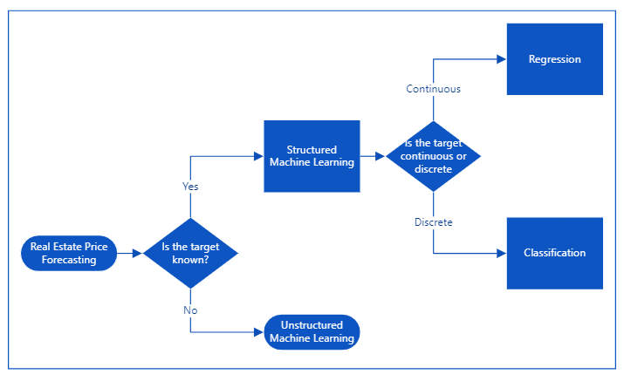
Machine Learning
This flowchart indicates how we decided to go with a supervised Machine Learning, using sklearn linear model for price prediction.

Slide 13
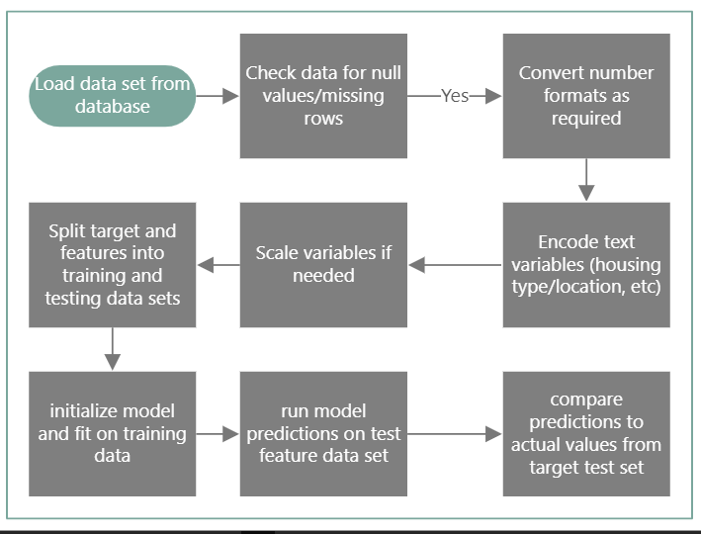
The flowchart will guide us for building our ML model and throughout our analysis.

Slide 14
Linear Regression approach will be modelled for the factors affecting house prices. For the model, the following X-variables will be taken into account.
Time Period
House-Type
Location
Interest Rates
Inflation Rate
Recession Period
A simple database diagram was sketched for the initial understanding of how the datapoints are connected (as seen on our ERD).

Slide 15
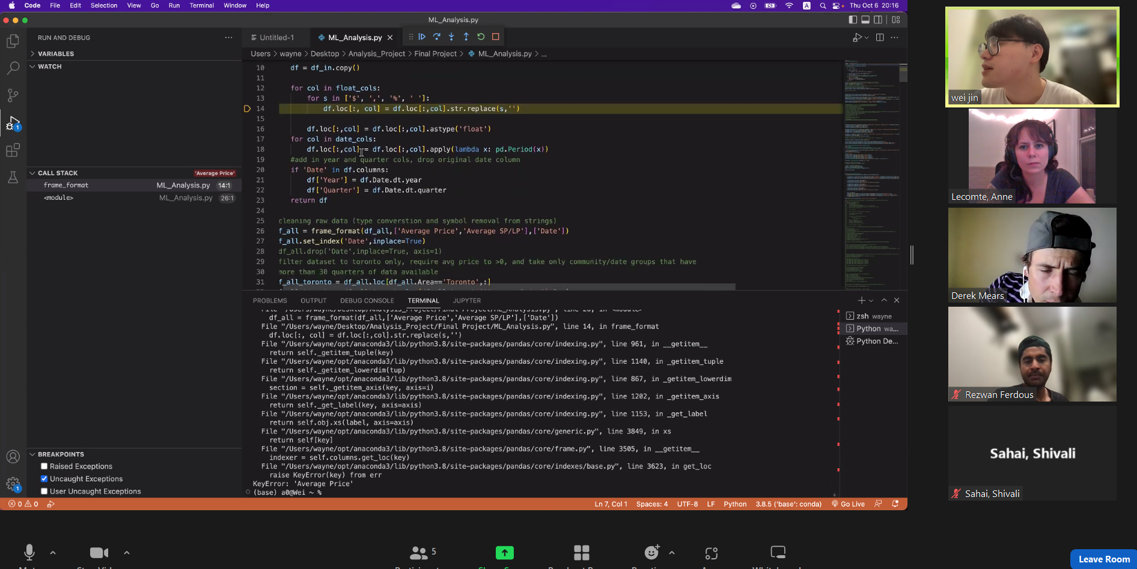
Data Preprocessing
The preprocessing can be seen here.
It includes these steps:
strip symbols from numeric columns, including ',', '$', and '%'
convert columns to float
filter data to for 'Toronto' only (i.e. use column 'area' and
filter for 'Toronto'
filter to include only rows where Average_Price>0
check for additional na rows (there aren't any)
group data by community and building type and count rows.
if less than 30 rows, filter out.

Slide 16
Feature engineering and selection
Description of data split into training and testing sets
As economically relevant macro variables for forecasting housing prices, we selected
5 year mortgage rates
Canadian CPI inflation
a Canadian recession indicator.
Rather than encoding community (a text variable representing a contiguous geographical area of Toronto) with dummy variables, we generate forecasts for each community individually, under the assumption that pricing dynamics are sufficiently different by community to justify that approach. We might need to test to confirm.
Plotted autocorrelation in price time series, saw evidence of statistically significant autocorr back 6 quarters.
Also plotted partial autocorr, which showed significant at 1 and 2 previous quarter lags.
Since we are dealing with time series, we can't employ a random splitter (i.e. sklean test_train_split).
Instead we tried sktime temporal_test_train_split, but it had difficulties splitting our data accurately.
Ultimately we manually split the data using a cut off date of 2018Q4, so used 2001Q1-2018Q4 for training and 2019Q1-2021Q4 for testing. We would prefer to re-estimate entire models on rolling quarterly basis and forecast 4 quarters forward and test over longer period, but the feasibility is to be decided.

Slide 17
Description of model choice
Work in progress.
The initial model is sktime NaiveForecaster, this will be the baseline against which we can measure other models. The model parameters chosen means the model uses a seasonal window and chooses the most recent training value. The benefits of current model are simplicity and interpretability, limitations are that it's best guess for the future are exactly equal to past values. So, as an aside, this model is no good for actual use, but will be a useful baseline to compare others with.
Change in model choice
We tried Facebook Prophet, but it is not optimized for low frequency data (i.e. hard to work with and hard to get cross validation results because the auto calculators require some inputs to be specified as pandas time deltas, which can't be larger than days, and distance between quarters is variable.
We tried sklearn linear regression, but it was difficult to get look ahead forecasts without generating large dataframes of inputs.

Slide 18
Description of model training
Work in progress.
Trained on data split as described above. We only ran naiveoforecaster so far.
We intend to try several others and hopefully select the best model.
Current accuracy score: 17.4%
The accuracy score currently in use is mean absolute percentage error.

Slide 19
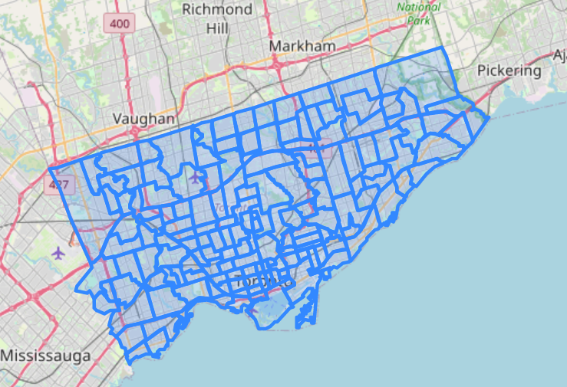
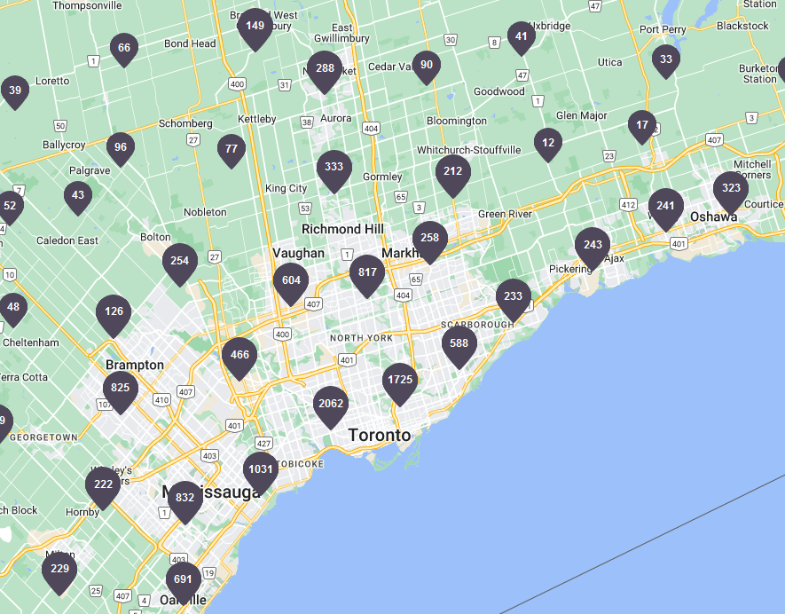
Dashboard Overview
Here is the original blueprint of our dashboard. The idea was to present the data on an interactive map, similar to these:
Source: https://open.toronto.ca/dataset/neighbourhoods/
Source:
https://www.realtor.ca/map

Slide 20
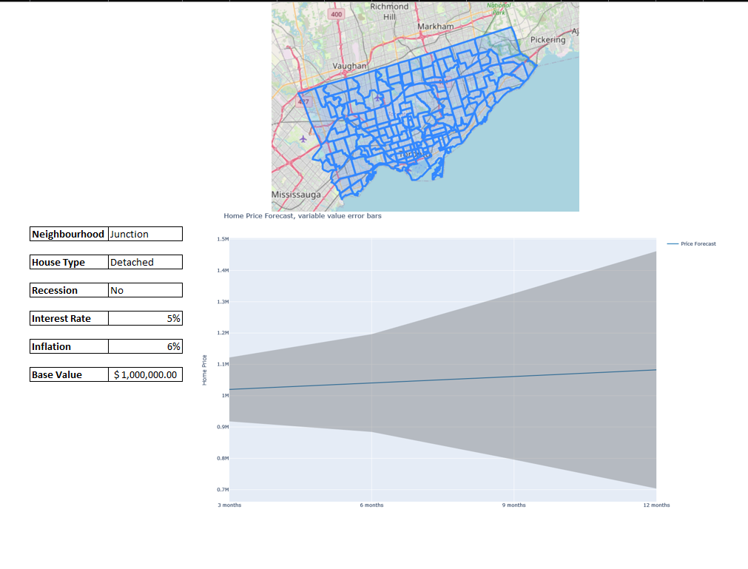
The dashboard first blueprint can be seen here.
The idea was for users to be able to make quick searches
Entering their preferred criteria
Using the interactive map
Accessing the prices forecast produced by our Machine Learning model

Slide 21
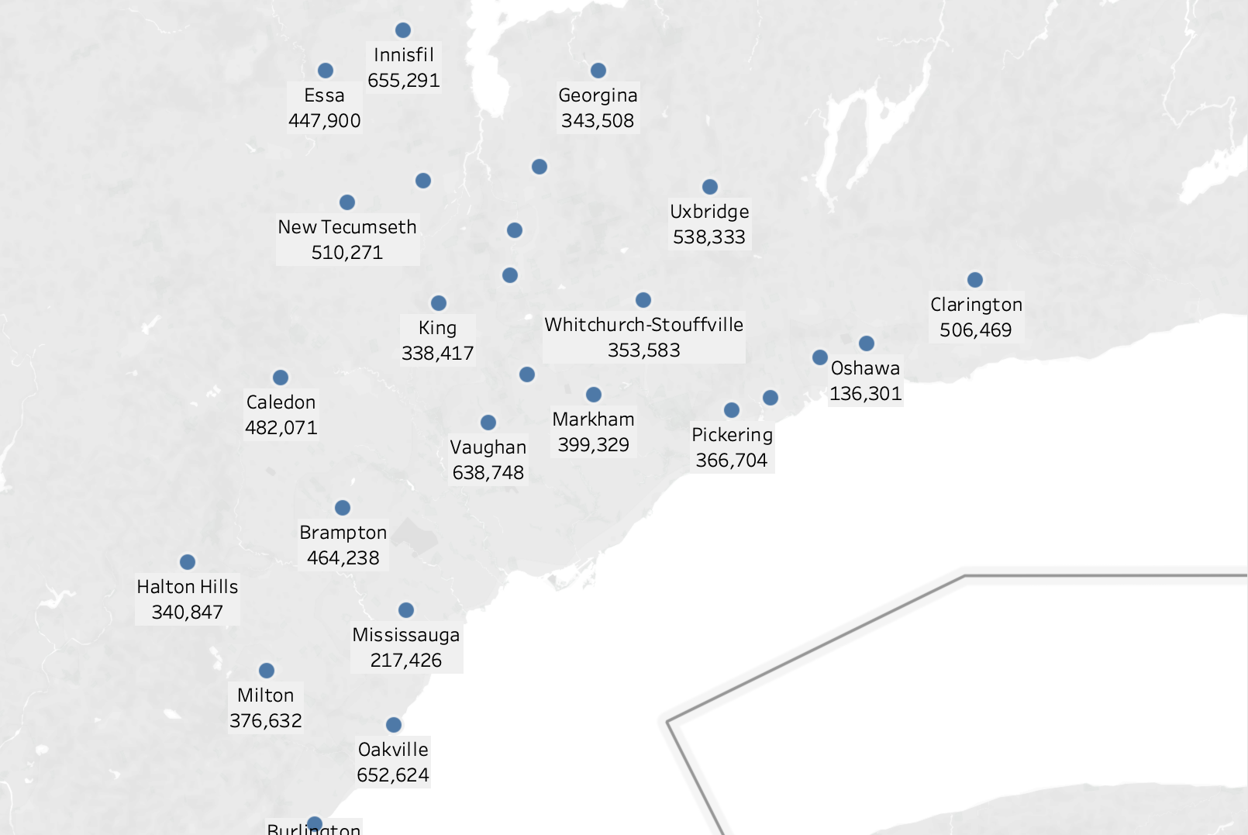
Dashboard 1
Link: https://public.tableau.com/app/profile/wei.jin4205/viz/TorontoHouseAnalysis/Story1?publish=yes
One of the visualisations is a map where users can filter through prices history according to location, time and building type.

Slide 22
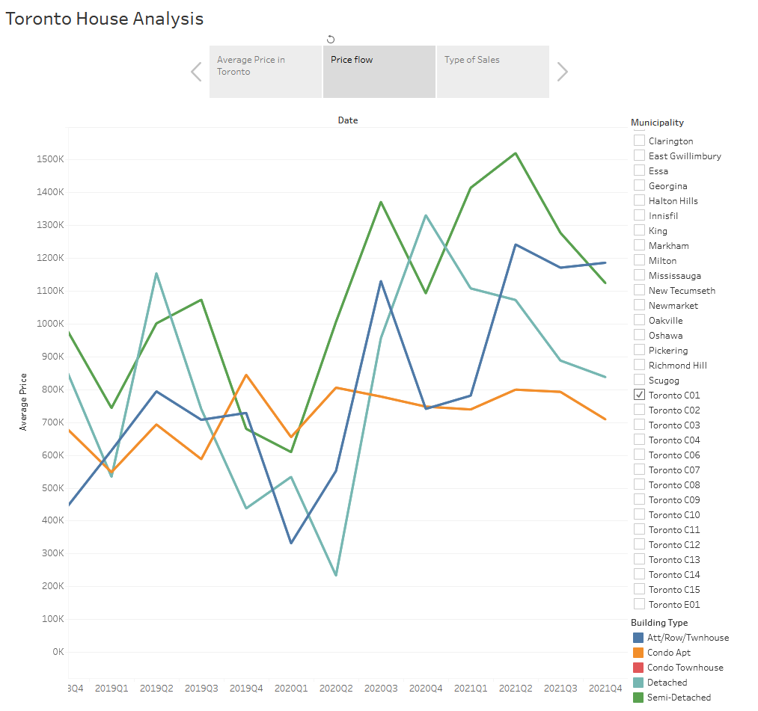
Dashboard 2
We also included a line chart of the price evolution of
different building types that can then be filtered
by location.

Slide 23
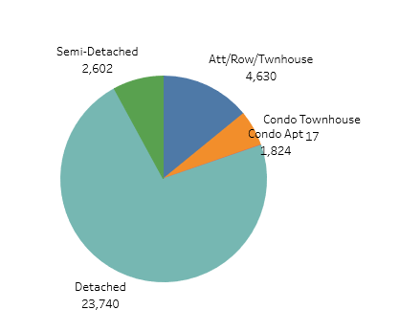
Dashboard 3
This pie chart displays the ratio of sales by building types.

