Slide 1
Topic: Programming in Python
Ferran Carrascosa Mallafrè

Slide 2
Index
Specific objectives
Guided activity
Contents:
Python Basics
Plots with Matplotlib
Object collections
Flow control
Data management
Conclusions

Slide 3
Specific goals
Perform data read and write operations with Python.
Know how to choose the appropriate Python data structure for each problem.
Have the bases to carry out descriptive analysis through tables and graphs in Python.
Develop small pieces of code in Python.

Slide 4
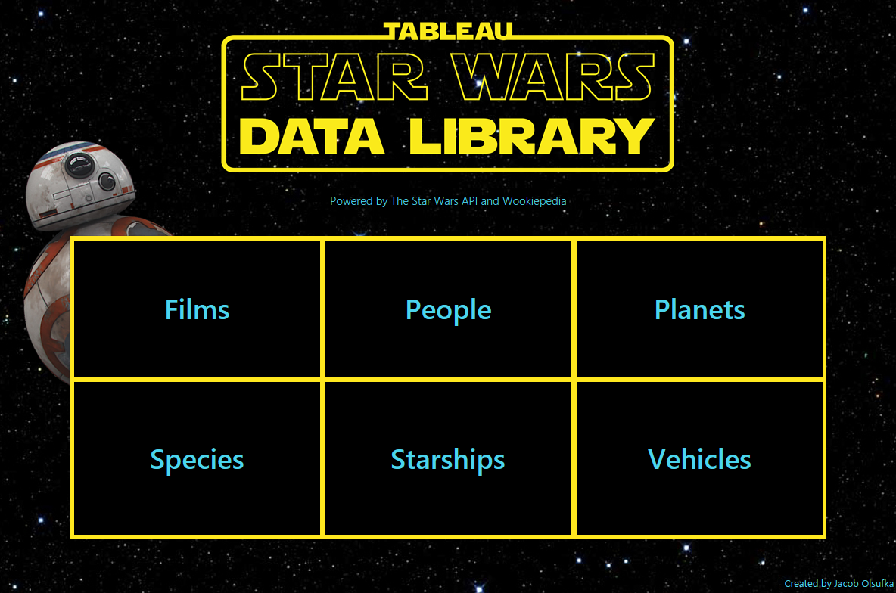
Data
Examples based on SWAPI

Slide 5
1. Python Basics
Entorno jupyter/Colab
Editar un notebook
Comandos mágicos y shell
Instalar packages des de Python

Slide 6
1.1. Edit a notebook and Magic commands
Cell type: Code (Y key) or Mardown (M key)
Mode: Edition or Vision
Run: Ctrl+Enter, run and forward (Shift+Enter)
Insert Cell: Before (Key A), After (Key B)
Copy, paste, scroll up, down
Colab: Same keyboard shortcuts but with Ctr+M+
Run .py script: %run holaMundo.py
History: %history 1-3
Execution time line: %time linea
Cell execution time: %%time

Slide 7
1.2. Shell commands and installing Python packages
List files and directories: !dir
List previous directory: !dir ..
Install packages: !pip install nombre_paquete
Import a package: import nombre_paquete

Slide 8
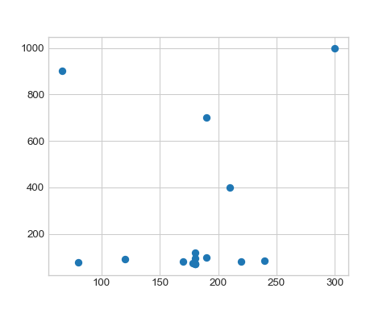
2. Plots with Matplotlib
import matplotlib.pyplot as plt import numpy as np import pandas as pd entidades = ['planets','starships','vehicles','people','species'] entidades_df = {x: pd.read_pickle('../www/' + x + '_df.pkl') for x in entidades} entidades_df['species']["num_peliculas"] = entidades_df['species'].films.apply(lambda x: len(x)) species_df = entidades_df['species'][["classification","average_height","average_lifespan","num_peliculas"]].dropna() nombre = species_df.index.values # prepara datos clasificacion = species_df.classification.values altura_media = species_df.average_height.values vida_media = species_df.average_lifespan.values num_peliculas = species_df.num_peliculas.values plt.style.use('seaborn-whitegrid'); plt.scatter(x=altura_media,y=vida_media) plt.show();
plt.scatter()

Slide 9
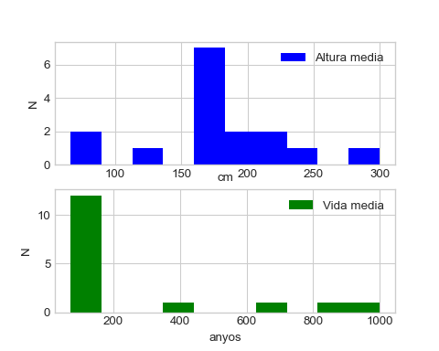
2. Plots with Matplotlib. Matlab-style interface
plt.figure(); # create the plot figure # create the first panel and configure the axes. plt.subplot(2, 1, 1); # rows, columns, panel number plt.hist(altura_media, color="blue", label="Altura media"); plt.xlabel("cm",labelpad=-6); # labelpad scroll title up plt.ylabel("N"); plt.legend(); # create the second panel and configure the axes plt.subplot(2, 1, 2); plt.hist(vida_media, color="green", label="Vida media"); plt.xlabel("anyos"); plt.ylabel("N"); plt.legend(); plt.show();
Matlab-style interface

Slide 10
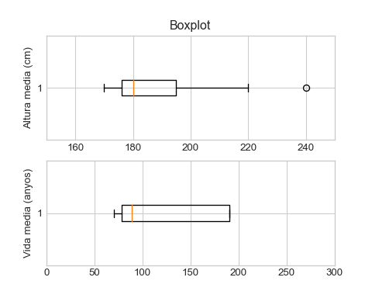
2. Plots with Matplotlib. object oriented interface
# The grid of plots is created
# ax will be a vector of 2 Axes objects fig, ax = plt.subplots(2); # Call the plot() method on the appropriate object ax[0].boxplot(altura_media, vert=False); ax[1].boxplot(vida_media, vert=False); ax[0].set(xlim=(150, 250),ylabel='Altura media (cm)',title='Boxplot'); ax[1].set(xlim=(0, 300),ylabel='Vida media (anyos)'); plt.show();
object oriented interface

Slide 11
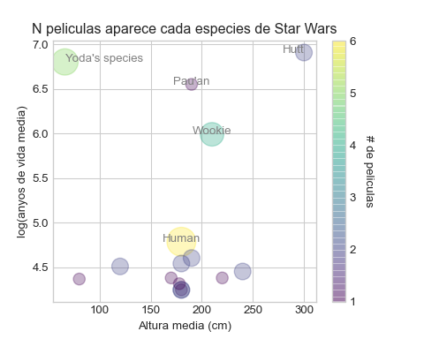
2. Plots with Matplotlib. Personalization.
# We recover the species graph plt.scatter(altura_media, np.log(vida_media), c=num_peliculas, s=100*num_peliculas, alpha=0.3,cmap='viridis') # color legend cbar = plt.colorbar(); # Show the palette cbar.ax.get_yaxis().labelpad = 15 # give space to the title cbar.ax.set_ylabel('# de peliculas', rotation=270) # added title plt.title("N peliculas aparece cada especies de Star Wars") plt.xlabel("Altura media (cm)") plt.ylabel("log(anyos de vida media)"); # Add labels to the plot style = dict(size=10, color='grey') plt.text(300, np.log(1000), "Hutt", **style, ha='right') plt.text(66, np.log(900), "Yoda's species", **style, ha='left') plt.text(190, np.log(700), "Pau'an", **style, ha='center') plt.text(210, np.log(400), "Wookie", **style, ha='center') plt.text(180, np.log(120), "Human", **style, ha='center'); plt.show();
Personalization

Slide 12
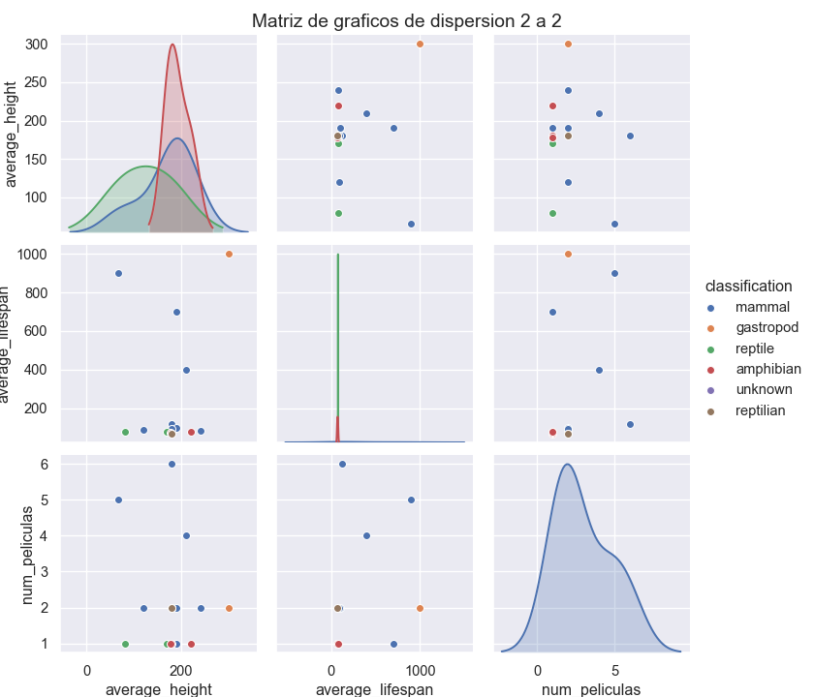
2. Plots with Matplotlib. seaborn
import seaborn as sns import warnings sns.set() warnings.filterwarnings('ignore') # Species of more than one individual sns.pairplot(species_df, hue="classification", height=2.5); plt.gcf().subplots_adjust(top=0.95) plt.suptitle('Matriz de graficos de dispersion 2 a 2') plt.show();
Seaborn library

Slide 13
3. Collections of objects. basic types
Example | Builders | Datatype
x = “Hola Mundo” | x = str(“Hello World”) | str
x = 20 | x = int(20) | int
x = 20.5 | x = float(20.5) | float
x = True | x = bool(5) | bool
To know the type of the object use type()
Boolean Operations : and, or y not
Boolean comparators : <, <=, >, >=, == y !=
Casting: str, int, float y bool.

Slide 14
3. Collections of objects. Lists, text, tuples and ranges
# Lists lista1 = [True, 'Texto', 3.1416] len(lista1)
## 3
[1,2,3] + [4,5,6]
## [1, 2, 3, 4, 5, 6]
[1,2,3] * 2 #'Text' in lista1
## [1, 2, 3, 1, 2, 3]
max([1,5,7,3])
## 7
len('abcd') # Text
## 4
"ab" + "cd"
## 'abcd'
"abc" * 2
## 'abcabc'
' '.join(["Soy","texto"])
## 'Soy texto'
# Tuples a = (1,2,3) a, b = 2, 6 # Ranges range(3,6)
## range(3, 6)
a = {'uno': 1, 'dos': 2} # Dictionaries a["uno"]
## 1
a.keys()
## dict_keys(['uno', 'dos'])
a.items()
## dict_items([('uno', 1), ('dos', 2)])

Slide 15
3. Colecciones de objetos. Filtros, List comprehension y Math
# Filters a = [3,7,2,9,2,8,6] a[0]
## 3
a[-2]
## 8
a[1:5]
## [7, 2, 9, 2]
a[1:5:2]
## [7, 9]
a[:4]
## [3, 7, 2, 9]
a = "no soy una lista" a[3:]
## 'soy una lista'
# List Comprehension a = [0,1,0,2,0,3,4,0] b = [1 / x for x in a if x != 0] b
## [1.0, 0.5, 0.3333333333333333, 0.25]
a = {'uno': 1, 'dos': 2, 'tres': 3} b = {k: v*v for k,v in a.items()} b
## {'uno': 1, 'dos': 4, 'tres': 9}
import math math.pi
## 3.141592653589793
math.sqrt(2)
## 1.4142135623730951
Look funciones math: log, log10, exp, pow, cos, floor…

Slide 16
3. Numpy. Ufunc
b_np = np.array([True, False, False]) # boolean s_np = np.array(['f', 'h', 'j']) # string i_np = np.array(range(3))#integer f_np = np.array([2.4, 1.5, 3.0]) # floating point ej_np = (b_np, s_np, i_np, f_np) [x.dtype for x in ej_np]
## [dtype('bool'), dtype('<U1'), dtype('int32'), dtype('float64')]
i_np.astype(str) # casting
## array(['0', '1', '2'], dtype='<U11')
np.array([1,2,3]) * 2 # scalar multiplication
## array([2, 4, 6])
np.sqrt(np.array([1,2,3,4])) # raiz
## array([1. , 1.41421356, 1.73205081, 2. ])
# sequences np.arange(0,6,2)
## array([0, 2, 4])
np.zeros(3)
## array([0., 0., 0.])
np.ones(3)
## array([1., 1., 1.])
np.tile([1.2], 2)
## array([1.2, 1.2])
np.repeat([1.2], 2)
## array([1.2, 1.2])

Slide 17
3. Numpy. Filters and Editing
Dimension: x.shape
Filters: x[2,:], x[[0,2,4]], x1[(x1<4) | (x1>8)]
Modify a value : x[1,1] = 20.765
Vector to vector : x2[1,:] = x2[0,:] * 10
Value to vector : x[[1,2],[2,2]] = 55
Reshape : x.reshape(fils, cols)
Concatenate same dimension :
filas: np.concatenate([a1, a2])
columnas: np.concatenate([a3, a4], axis=1)
Concatenate different dimension :
filas: np.vstack([a1, a2])
columnas: np.hstack([a3, a4])
Array Broadcasting : Alineamiento para facilitar operaciones entre arrays de distinta dimensión.
Converting to lists : a.tolist()
Missing values : np.nan
# VIEWS NOT COPIED a = np.array([1, 'm', [2, 3, 4]], dtype=object) b = a b[0] = 10 a
## array([10, 'm', list([2, 3, 4])], dtype=object)
c = a.copy() # COPIES OF ARRAYS c[0] = 20 print(a) # but it's not perfect
## [10 'm' list([2, 3, 4])]
c[2][0] = 30 print(a)
## [10 'm' list([30, 3, 4])]
import copy # DEEP COPIES OF ARRAYS
d = copy.deepcopy(a) d[2][0] = 40 print(a)
## [10 'm' list([30, 3, 4])]

Slide 18
3. Pandas. Series and Dataframe
Series: a = pd.Series([1.2, 0.4, 2.3], index=['a','b','c'])
Acces to numpy: a.values
Acces to indexes: a.index
Access to indexes: a.index
Mismas capacidades de slicing, funciones, fancy indexing que los arrays numpy
Indices to filter: a[['b','c']]
Index access: a.loc[1]
Access by position: a.iloc[1]
Dataframe: df = pd.DataFrame(a,columns=["v1"])
row/column indices: df.index, df.columns
Numpy acces: df.values
Column access: df.v1, df["v1"]
Create column: df["v2"] = df["v1"] * 2
First/last rows: df.head(), df.tail()
Create/rename: df.reanme(), df.drop()
Mismas capacidades de filtros, copy que numpy
Ufunc: Now with index alignment
Missing values: None y np.nan, pd.isnull() y ~pd.isnull()

Slide 19
4. Flow control. Functions, conditions and loops
def valor_absoluto(num): """ returns the absolute value """ if num >= 0: return num else: return -num
List Comprehension: [x for x in range(5) if x%2==0]
Numpy conditionals: np.where()
for x in lista: print(x) for clave in diccionario: print(clave) for clave, valor in diccionario.items(): print(clave, valor) for x,y in zip(l1,l2): print(x,y) for nombreCol,variable in dataframe.iteritems(): print(nombreCol,", tiene tipo:",variable.dtype) for nombreFila,fila in dataframe.iterrows(): print(nombreFila,fila.v1,fila.v2)

Slide 20
5. Data management. Import and export data
Read line by line: with open('www/mtcars.csv') as f:, f.readline()
Read with separator: pd.read_table("www/mtcars.csv",sep=',', decimal=".")
Read csv: mtcars = pd.read_csv("www/mtcars.csv")
Escritura pickle: mtcars.to_pickle("www/mtcars.pkl")
Lectura pickle: mtcars_pkl = pd.read_pickle("www/mtcars.pkl")

Slide 21
5. Data management. Joins between tables and aggregates
Solumn sorting: df.columnas.sort_values(ascending=False)
Reset indices : df.reset_index()
Union by columns : pd.concat([df1, df2], ignore_index=True)
Union by rows : df1.append(df2)
duplicates and deletion : df.duplicated(), df.drop_duplicates(keep=False)
Crossing by key fields : pd.merge(df1,df2, ...)
1- left_on=["v1"], right_on=["w1"], left_index=True o right_index=True
2- how= puede vale: “inner”,“outer”,“left” y “right”
3- how="outer"
Descriptives: df.describe(include='all')
Numpy: np.sum(~np.isnan(x)), np.mean(x), np.std(x), np.min(x), np.quantile(x, [0.25,.5,.75]) y np.max(x)
Pandas: x.count(), x.mean(), x.std(), x.min(), x.quantile([0.25,.5,.75]) y x.max()

Slide 22
5. Data management. Aggregated by subgroups
Tables of frequencies or counts : df.col.value_counts()
Crosstabs: pd.crosstab()
Column partitioning: pd.cut(), pdqcut()
pd.Categorical type: df.col.cat.categories
Grouping: df.groupby(["col1","col2"])[["col3","col4"]].median()
Also df.groupby() is a wildcard for all other operations :
Aggregation : df.groupby(["col1"]).agg(["min","median","mean"])
Filtros agregados: df.groupby(["c1"]).filter(lambda x: x['c3'].median() > 90)
Added filters : df.groupby(["c1"]).c3.transform(lambda x: np.abs(x - x.median()))
pivoting of boards : df.pivot_table( index='f1', columns='c1', aggfunc={'c2':'count', 'c3':'median'})

Slide 23
5. Data management. Dates
Create date times : fecha = datetime(year=2020, month=9, day=7)
Get components :
import locale
locale.setlocale(locale.LC_TIME, 'es_ES.UTF-8')
fecha.strftime('%A')
## 'lunes'
Numpy: np.array('2020-09-07', dtype=np.datetime64)
numpy operations : fecha + np.arange(12)
Pandas: fecha=pd.to_datetime("2020-9-7")
Masks: fecha.strftime("%A, %d de %m de %Y")
Pandas indexation:
index = pd.DatetimeIndex(['2019-08-07', '2019-09-07'])
fecha = pd.Series([0, 1, 2, 3], index=index)
Select ranges : fecha['2019-08-07':'2020-08-07']
Assign a frequency : fecha.to_period('D')
Operations : fecha - fecha[0]

Slide 24
Conclusiones
General purpose language
Accompanied by a set of packages for scientific computing
Allows data visualization
Ideal for productive data processing environments
It is used in all phases of data analysis:
Data acquisition and preparation
Data analysis
Handling and storage
Communication of results
Event prediction

