Slide 1
Electrotechnics & Electronics
Course Instructor:
Dr. Mohd. Tauheed Khan

Slide 2
Welcome you all

Slide 3
Introduction
Name
hails ( City, Country)
Course understanding and expectations
Software known ( Pspice, Hspice, OrCAD MATLAB, etc..)
Project/Programming experience (if any)

Slide 4
Eletrotechnics and Electronics: Course Outline
Theory
Principle of Electricity
Charge
Current
Voltage
Power and Energy
Electric Circuits theory
Laws and theorems
Calculations and Analysis
Electromagnetic devices
Transformers
Fundamentals of electronics
Semiconductor Material and Devices
I-V Characteristics of Diode, BJT and CMOS transitors
Transducer and Sensors
Operational amplifier and its application
Electric measuring Instruments
Ammeter
Voltmeter
Energy Meter
Practice
Resistivity and conductivity: Calculation and dependence
Kirchhoff's Laws
Circuit Theorems
Electric Circuits: Calculation and analysis
I-V Characterise: Diode, BJT, CMOS Transistors
Amplifier Circuits
Instrumentation Amplifier

Slide 5
Principle of Electricity
Basic Concepts and definitions
Charge
Current
Voltage or Potential Difference
Energy
Power

Slide 6
Charge
Fundamental electric charge carrying particles are electron ( negative charge) and protons (positive charge)
Magnitude = 1.602x10-19 C.
Denoted by Q, q and Unit is Coulomb.
Coulomb’s Law F=Q₁Q₂/4π↋ d² N

Slide 7


Current
Current can be defined as the motion of charge through a conducting material, measured in Ampere (A). Electric current, is denoted by the letter i or I.
Current is the quantity of total charge that passes through an arbitrary cross section of a conducting material per unit second.
I= Q/t or Q= It
The current can also be defined as the rate of charge passing through a point in an electric circuit.
The charge transferred between time t1 and t2 can be obtained as

Slide 8
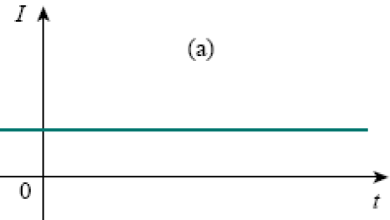
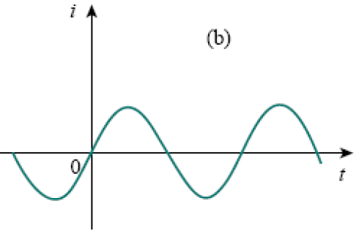

Types of Current
Direct Current (DC): Remains constant with time
Alternating Current (AC): Varies with time
Iab= -Iba

Slide 9
Question
The total charge entering a terminal is given by =5 sin4πt . Calculate the current at t=0.5s .
Ans- Current = 31.42mA

Slide 10
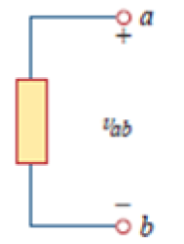
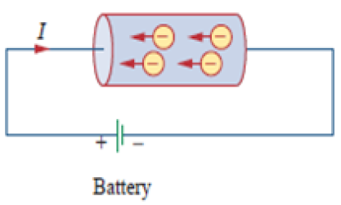
Voltage or Potential difference
Voltage (or potential difference) is the energy required to move charge from one point to the other, measured in volts (V). Voltage is denoted by the letter v or V.
V_{ab} = dw/dq
where w is energy in joules (J) and q is charge in coulombs (C). The voltage Vab or simply V is measured in volts (V).
1 volt = 1 joule/coulomb = 1 newton-meter/coulomb

Slide 11

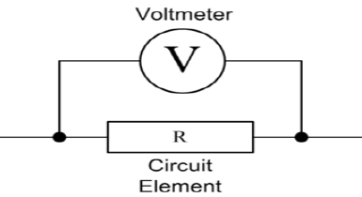
Voltage or Potential difference
Voltage is always measured across a circuit element as shown in Fig.
Question: An energy source forces a constant current of 2 A for 10 s to flow through a light bulb. If 2.3 kJ is given off in the form of light and heat energy, calculate the voltage drop across the bulb.
Ans- 115 V

Slide 12


Energy and Power
Energy is the capacity to do work.
Work done (Energy) is to move a charge Q, from one point (point a) to by a voltage V.
W= Vq Joule
Power is the time rate of expending or absorbing energy, measured in watts (W). Power, is denoted by the letter p or P.
Mathematically,
Where p is power in watts (W), w is energy in joules (J), and t is time in seconds (s).
the magnitude of current I and voltage are given, then power can be evaluated as the product of the two quantities and is measured in watts (W).
Questions
An electric heater consumes 1.8Mj when connected to a 250 V supply for 30 minutes. Find the power rating of the heater and the current taken from the supply.
Ans- 4A

Slide 13
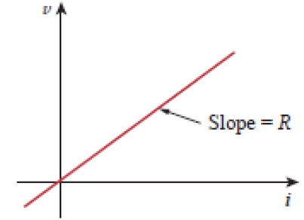
OHM’S LAW
Ohm’s law states that at constant temperature, the voltage (V) across a conducting material is directly proportional to the current (I) flowing through the material.
Mathematically,
Vα I
V=RI
Where the constant of proportionality R is called the resistance of the material.
The V-I relation for resistor according to Ohm’s law is depicted in Fig. below:
Fig. 1.6 V-I Characteristics for resistor
Limitations of Ohm’s Law:
1. Ohm’s law is not applicable to non-linear elements like diode, transistor etc.
2. Ohm’s law is not applicable for non-metallic conductors like silicon carbide.

Slide 14
Circuit’s Element
An element is the basic building block of a circuit. An electric circuit is simply an interconnection of the elements. Circuit analysis is the process of determining voltages across (or the currents through) the elements of the circuit.
There are 2 types of elements found in electrical circuits.
Active elements (Energy sources): The elements which are capable of generating or delivering the energy are called active elements.
E.g., Generators, Batteries
Passive element (Loads): The elements which are capable of receiving the energy are called passive elements.
E.g., Resistors, Capacitors and Inductors

Slide 15
ACTIVE ELEMENTS (ENERGY SOURCES)
The energy sources which are having the capacity of generating the energy are called active elements. The most important active elements are voltage or current sources that generally deliver power/energy to the circuit connected to them.
There are two kinds of sources
a) Independent sources
b) Dependent sources

Slide 16
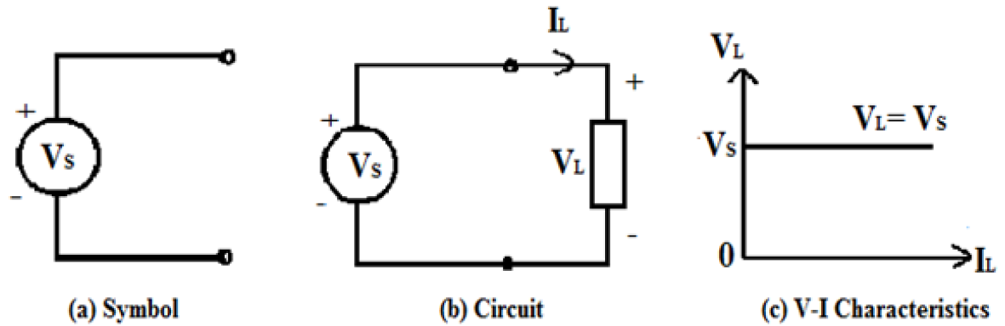
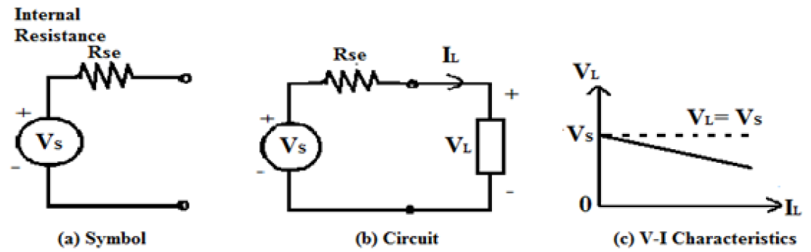
INDEPENDENT SOURCES
An ideal independent source is an active element that provides a specified voltage or current that is completely independent of other circuit elements.
e.g. an ideal independent voltage source delivers to the circuit whatever current is necessary to maintain its terminal voltage.
Practical Independent Voltage Source:
Practically, every voltage source has some series resistance across its terminals known as internal resistance, and is represented by Rse.
V_{L}= V_{S} - I_{L} R_{se}

Slide 17
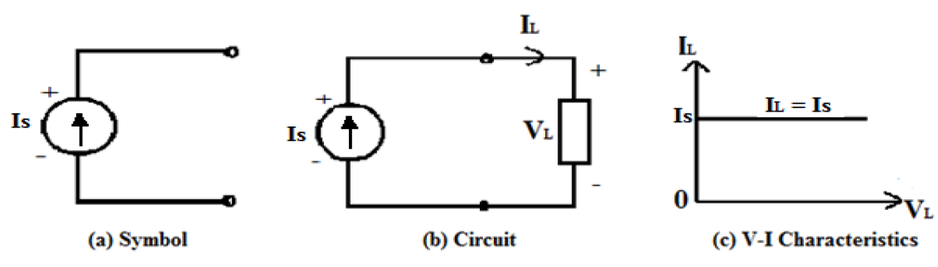
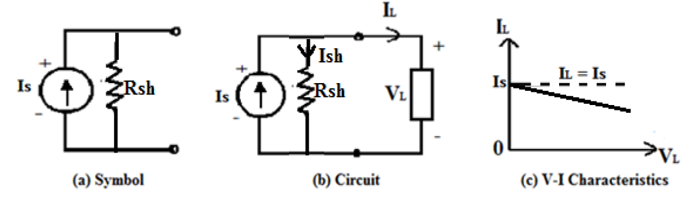
INDEPENDENT SOURCES
An ideal independent current source is an active element that gives a constant current through its terminals irrespective of the voltage appearing across its terminals.
e.g. the current source delivers to the circuit whatever voltage is necessary to maintain the designated current.
Practical Independent Current Source:
Practically, every current source has some parallel/shunt resistance across its terminals known as internal resistance, and is represented by R_{sh}.
I_{L} = I_{s} - I_{sh} (ideally R_{sh} should be infinity)

Slide 18
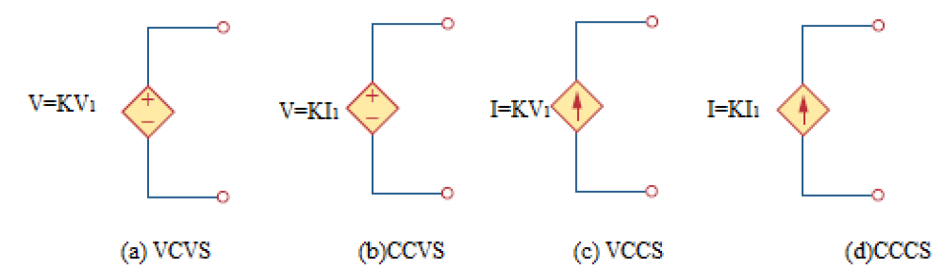
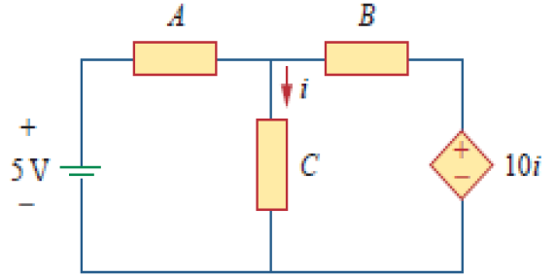
DEPENDENT (CONTROLLED) SOURCES
An ideal dependent (or controlled) source is an active element in which the source quantity is controlled by another voltage or current.
Four possible types of dependent sources, namely:
1. A voltage-controlled voltage source (VCVS)
2. A current-controlled voltage source (CCVS)
3. A voltage-controlled current source (VCCS)
4. A current-controlled current source (CCCS)
Symbols for Dependent voltage source and Dependent current source
The source in right hand side is current-controlled voltage source
Dependent sources are useful in modelling elements such as transistors, operational amplifiers, and integrated circuits.

Slide 19
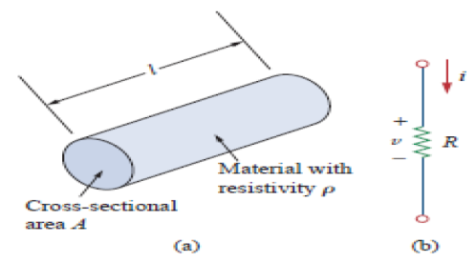

PASSIVE ELEMENTS (LOADS)
Passive elements are those elements which are capable of receiving the energy. Some passive elements like inductors and capacitors are capable of storing a finite amount of energy, and return it later to an external element.
RESISTOR
Materials in general have a characteristic behaviour of resisting the flow of electric charge. This physical property, or ability to resist the flow of current, is known as resistance and is represented by the symbol R. The Resistance is measured in ohms ( Ω). The circuit element used to model the current-resisting behaviour of a material is called the resistor.
Fig. (a) Typical Resistor, (b) Circuit Symbol for Resistor
The resistance of a resistor depends on the material of which the conductor is made and geometrical shape of the conductor
The inverse of the resistance is called the conductance and inverse of resistivity is called specific conductance or conductivity The symbol used to represent the conductance is G and conductivity is .

Slide 20



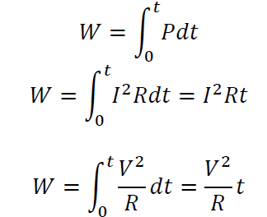
PASSIVE ELEMENTS (LOADS)
Thus conductivity and its units are Siemens per meter
By using Ohm’s Law, The power dissipated in a resistor can be expressed in terms of R as below
The power dissipated by a resistor may also be expressed in terms of G as
The energy lost in the resistor from time 0 to t is expressed as
Where V is in volts, I is in amperes, R is in ohms, and energy W is in joules.

Slide 21
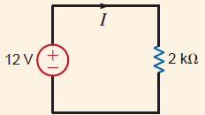
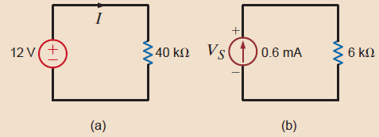
Practice Examples:
Question1: In the circuit in below Figure below, determine the current and the power absorbed by the resistor
Answer1:
Current: 6mA
Power: 0.072Watt
Question2: Given the circuits in below Figures., find (a) the current I and the power absorbed by the resistor in Fig. a, and (b) the voltage across the current source and the power supplied by the source in Fig. b.
Answer2:
(a) I = 0.3 mA, P = 3.6 mW;
(b) P = 2.16 mW. Vs= 3.6 V,

Slide 22
NETWORK/CIRCUIT TERMINOLOGY
Network Elements: The individual components such as a resistor, inductor, capacitor, diode, voltage source, current source etc. that are used in circuit are known as network elements.
Network: The interconnection of network elements is called a network.
Circuit: A network with at least one closed path is called a circuit. So, all the circuits are networks but all networks are not circuits.
Branch: A branch is an element of a network having only two terminals.
Node: A node is the point of connection between two or more branches. It is usually indicated by a dot in a circuit.
Loop: A loop is any closed path in a circuit. A loop is a closed path formed by starting at a node, passing through a set of nodes, and returning to the starting node without passing through any node more than once.
Mesh or Independent Loop: Mesh is a loop which does not contain any other loops in it.

Slide 23
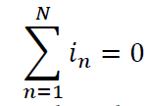
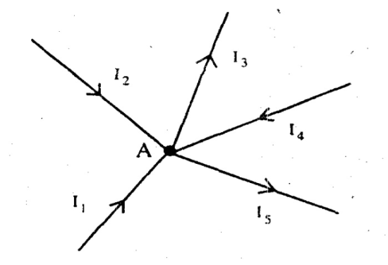
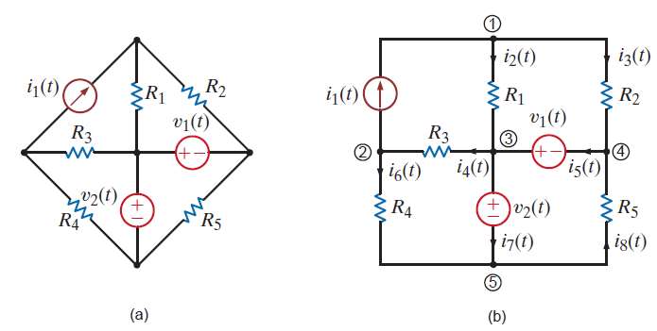
KIRCHHOFF’S LAWS : KCL
KIRCHHOFF’S CURRENT LAW (KCL)
Statement: Algebraic sum of the currents meeting at any junction or node is zero. The term 'algebraic' means the value of the quantity along with its sign, positive or negative.
Applying Kirchhoff’s current law to the junction A
I1 + I2 - I3 + I4 - I5= 0 (algebraic sum is zero)
I1 + I2 + I4 = I3 + I5
(sum of currents towards the junction = sum of currents flowing away from the junction).
Currents meeting in a junction

Slide 24
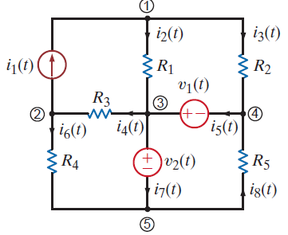
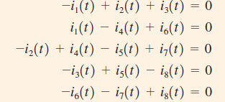
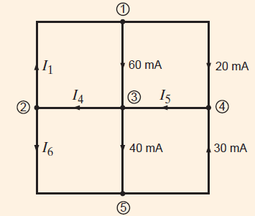
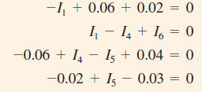
KIRCHHOFF’S LAWS : KCL
KIRCHHOFF’S CURRENT LAW (KCL)
Let us write KCL for every node in the network in Fig. 2.5, assuming that the currents
leaving the node are positive.
The KCL equations for nodes 1 through 5 are
Topological diagram for the circuit in above Fig.

Slide 25

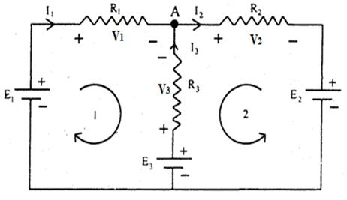
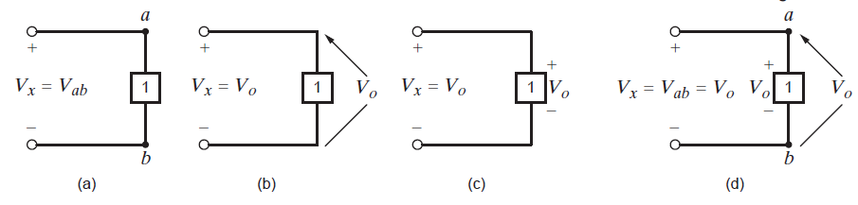
KIRCHHOFF’S LAWS : KVL
KIRCHHOFF’S VOLTAGE LAW (KVL)
Statement: Algebraic sum of all the voltages around a closed path or closed loop at any instant is zero. Algebraic sum of the voltages means the magnitude and direction of the voltages; care should be taken in assigning proper signs or polarities for voltages in different sections of the circuit.
Mathematically, KVL implies that
For loop1 it is considered around clockwise
+ E1 - V1 + V3 - E3 = 0
+ E1 - I1 R1 + I3 R3 - E3 = 0
E1 - E3 = I1 R1 - I3 R3
For loop2 it is considered anticlockwise
+ E2+ V2+ V3 – E3 = 0
+ E2 + I2 R2 + I3 R3 – E3 = 0
E2 – E3 = - I2 R2 - I3 R3
Circuit for KVL

Slide 26
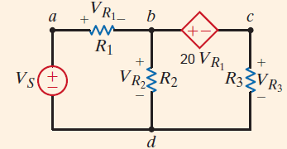

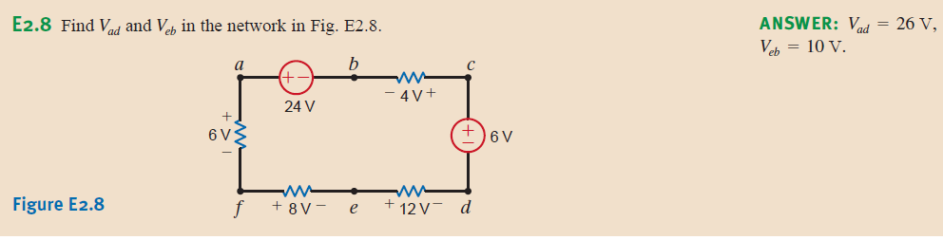
KIRCHHOFF’S LAWS : KVL
KIRCHHOFF’S VOLTAGE LAW (KVL)
Example: Given the network in Fig. 2.13 containing a dependent source, let us write the KVL equations for the two closed paths abda and bcdb.
Solution: The two KVL equations are
KCL and KVL are very Important and Useful Laws

Slide 27
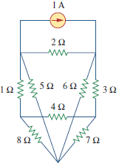
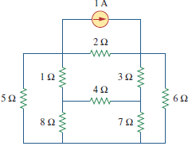
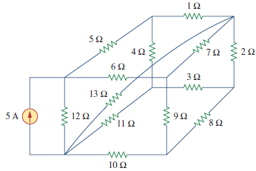
Mesh Analysis: Mesh analysis provides another general procedure for analyzing circuits, using mesh currents as the circuit variables. Using mesh currents instead of element currents as circuit variables is convenient and reduces the number of equations that must be solved simultaneously. Recall that a loop is a closed path with no node passed more than once. A mesh is a loop that does not contain any other loop within it.
Mesh analysis is not quite as general as nodal analysis because it is only applicable to a circuit that is planar. A planar circuit is one that can be drawn in a plane with no branches crossing one another; otherwise it is non planar. A circuit may have crossing branches and still be planar if it can be redrawn such that it has no crossing branches.
For example, the circuit in Fig. 1.18(a) has two crossing branches, but it can be redrawn as in Fig. 1.18(b). Hence, the circuit in Fig. 1.18(a) is planar. However, the circuit in Fig. 1.19 is non planar, because there is no way to redraw it and avoid the branches crossing.
Fig. 1.18(a)
Fig. 1.18(b)
Fig. 1.18 (a) A planar circuit with crossing branches,
(b) the same circuit redrawn with no crossing branches.
Fig. 1.19 :A non planar circuit.

Slide 28
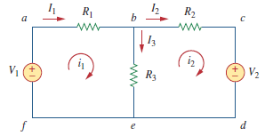
A mesh is a loop which does not contain any other loops within it.
Fig. 1.20: A circuit with two meshes
In Fig. 1.20, for example, paths abefa and bcdeb are meshes, but path abcdefa is not a mesh. The current through a mesh is known as mesh current. In mesh analysis, we are interested in applying KVL to find the mesh currents in a given circuit.
Steps to Determine Mesh Currents:
1. Assign mesh currents to the n meshes.
2. Apply KVL to each of the n meshes. Use Ohm’s law to express the voltages in terms of the mesh currents.
3. Solve the resulting n simultaneous equations to get the mesh currents.

Slide 29
To illustrate the steps, consider the circuit in Fig. 1.20. The first step requires that mesh currents and are assigned to meshes 1 and 2. Although a mesh current may be assigned to each mesh in an arbitrary direction, it is conventional to assume that each mesh current flows clockwise.
As the second step, we apply KVL to each mesh. Applying KVL to mesh 1, we obtain
-V₁+ R₁i₁+R₃ (i₁-i₂) = 0
or
(R₁ + R₃) i₁ - R₃i₂ = V₁
(i)
For mesh 2, applying KVL gives
R₂ i₂ + V₂ + R₃(i₂ - i₁) = 0
or
(ii)
- R₃ i₁ + (R₂ + R₃)i₂ = -V₂
Note in Eq. (i) that the coefficient of is the sum of the resistances in the first mesh, while the coefficient of is the negative of the resistance common to meshes 1 and 2. Now observe that the same is true in Eq. (ii).

Slide 30

The third step is to solve for the mesh currents. Putting Eqs. (i) and (ii) in matrix form yields
(iii)
which can be solved to obtain the mesh currents i₁ and i₂. and We are at liberty to use any technique for solving the simultaneous equations.
if a circuit has n nodes, b branches, and l independent loops or meshes, then l = b – n + 1. Hence, l independent simultaneous equations are required to solve the circuit using mesh analysis.

Slide 31
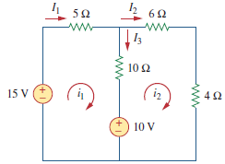
Question : For the circuit in Fig. P6, find the branch currents and using mesh analysis.
Solution:
We first obtain the mesh currents using KVL.
For mesh 1,
-15 + 5i₁ + 10(i₁ - i₂) + 10 = 0
or
3i₁ - 2i₂ = 1
(i)
For mesh 2,
6i₂ + 4i₂ + 10(i₂ - i₁) + 10 = 0
or
Fig. P6
i₁ = 2i₂ - 1
(ii)
METHOD 1 Using the substitution method, we substitute Eq. (ii) into Eq. (i), and write
6i₂ - 3 - 2i₂ = 1 i₂ = 1 A

Slide 32



METHOD 2 To use Cramer’s rule, we cast Eqs. (i) and (ii) in matrix form as
We obtain the determinants
Thus,
as before.

Slide 33
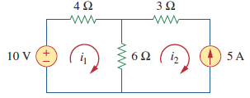
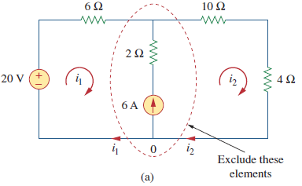
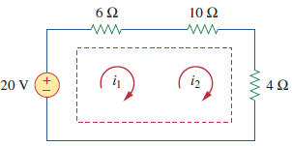
Mesh Analysis with Current Sources: Applying mesh analysis to circuits containing current sources (dependent or independent) may appear complicated. But it actually easier the presence of the current sources reduces the number of equations
CASE 1: When a current source exists only in one mesh: Consider the circuit in Fig. 1.21, for example. We set i₂ = -5A and write a mesh equation for the other mesh in the usual way; that is
-10 + 4i₁ + 6(i₁ - i₂) = 0 i₁ = -2A
Fig. 1.21
CASE 2 When a current source exists between two meshes: Consider the circuit in Fig. 1.22(a), for example. We create a super mesh by excluding the current source and any elements connected in series with it, as shown in Fig. 1.22(b). Thus,
A super mesh results when two meshes have a (dependent or independent) current source in common
(b)
Fig. 1.22

Slide 34
Therefore, applying KVL to the super mesh in Fig. 1.22(b) gives
-20 + 6i₁ + 10i₂ + 4i₂ = 0
6i₁ + 14i₂ = 20
(1)
We apply KCL to a node in the branch where the two meshes intersect. Applying KCL to node 0 in Fig. 1.22(a) gives
i₂ = i₁ + 6
(2)
Solving Eqs. (1) and (2), we get
i₁ = -3.2 A, i₂ = 2.8 A
Note the following properties of a super mesh:
1. The current source in the super mesh provides the constraint equation necessary to solve for the mesh currents.
2. A super mesh has no current of its own.
3. A super mesh requires the application of both KVL and KCL.
Notes: Having understood the fundamental laws of circuit theory (Ohm’s law and Kirchhoff’s laws), we are now prepared to apply these laws to develop two powerful techniques for circuit analysis: nodal analysis, which is based on a systematic application of Kirchhoff’s current law (KCL), and mesh analysis, which is based on a systematic application of Kirchhoff’s voltage law (KVL).

Slide 35
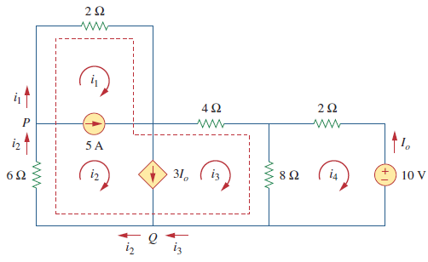
Question: For the circuit in Fig. P7, find i₁ to i₄ using mesh analysis.
Answer:
i₁ = -7.5 A, i₂ =-2.5 A, i₃ = 3.93 A, i₄ = 2.143 A
Fig. P7

Slide 36
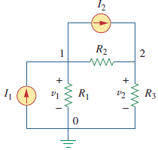
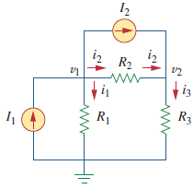
Nodal Analysis : Nodal analysis provides a general procedure for analyzing circuits using node voltages as the circuit variables. Choosing node voltages instead of element voltages as circuit variables is convenient and reduces the number of equations one must solve simultaneously.
In nodal analysis, we are interested in finding the node voltages. Given a circuit with ‘n’ nodes without voltage sources, the nodal analysis of the circuit involves taking the following three steps.
Steps to Determine Node Voltages:
1. Select a node as the reference node. Assign v₁, v₂, . . . . , v_{n-1} voltages to the remaining n-1 nodes. The voltages are referenced with respect to the reference node.
2. Apply KCL to each of the n-1 non reference nodes. Use Ohm’s law to express the branch currents in terms of node voltages.
3. Solve the resulting simultaneous equations to obtain the unknown node voltages.
The first step in nodal analysis is selecting a node as the reference or datum node. The reference node is commonly called the ground since it is assumed to have zero potential.
(a)
(b)
Fig. 1.23

Slide 37
As the second step, we apply KCL to each non reference node in the circuit. To avoid putting too much information on the same circuit, the circuit in Fig. 1.23(a) is redrawn in Fig. 1.23(b), where we now add i₁, i₂, and i₃ as the currents through resistors R₁, R₂, and R₃ respectively.
At node 1, applying KCL gives
I₁= I₂ + i₁ + i₂
(1)
At node 2,
(2)
I₂ + i₂ = i₃
We now apply Ohm’s law to express the unknown currents i₁, i₂, and i₃ in terms of node voltages.
i = (v_{higher} – v_{lower})/R
(3)
i₁ = (v₁ – 0)/R₁
i₂ = (v₁ – v₂)/R₂
(4)
i₃ = (v₂ – 0)/R₃
Substituting Eq. (4) in Eqs. (1) and (2) results, respectively, in
I₁= I₂ + (v₁/R₁) + (v₁ – v₂)/R₂
(5)
I₂ +(v₁ – v₂)/R₂ = v₂/R₃
(6)

Slide 38
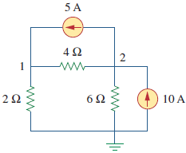
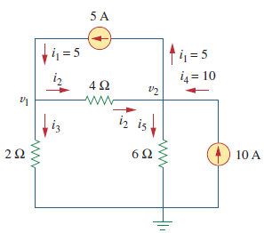
Question: Calculate the node voltages in the circuit shown in Fig. P8(a).
(a)
(b)
Fig. P8
Solution: Consider Fig. P8(b), where the circuit in Fig. P8(a) has been prepared for nodal analysis. The reference node is selected, and the node voltages v₁ and v₂ are now to be determined.
At node 1, applying KCL and Ohm’s law gives
i₁ = i₂ + i₃
5 = [(v₁ – v₂)/4 ] + [(v₁ – 0)/2]
Multiplying each term in the last equation by 4, we obtain
20 = v₁ - v₂ + 2v₁
or
3v₁ - v₂ = 20
(1)

Slide 39
At node 2, we do the same thing and get
i₂ + i₄ = i₁ + i₅
[(v₁ - v₂)/4] + 10 = 5 + [(v₂ – 0)/6]
Multiplying each term by 12 results in
3v₁ - 3v₂ + 120 = 60 + 2v₂
or
(2)
3v₁ - 5v₂ = -60
Now we have two simultaneous Eqs. (1) and (2). We can solve the equations using any method and obtain the values of
METHOD 1: Using the elimination technique, we add Eqs. (1) and (2).
4v₂ = 80
v₂ = 20V
Substituting v₂ = 20 in Eq. (1) gives
3v₁ – 20 = 20
v₁ = 13.333V
METHOD 2 To use Cramer’s rule, we need to put Eqs. (1) and (2) in matrix form as
The determinant of the matrix is
= 15 – 3 = 12

Slide 40
We now obtain v₁ and v₂ as
If we need the currents, we can easily calculate them from the values of the nodal voltages.
i₁ = 5 A
i₂ = (v₁-v₂)/4 = -1.6668A
i₃ = v₁/2 = 6.666A
i₄ = 10 A
i₅ = v₂/6 = 3.33A
The fact that is negative shows that the i₂ current flows in the direction opposite to the one assumed.

Slide 41
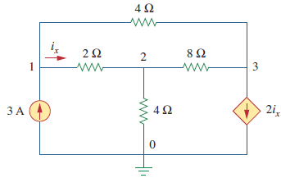
Question: Determine the voltages at the nodes in Fig. P9
Fig. P9
Solution:
v₁ = 4.8 V, v₂ = 2.4 V, v₃ = -2.4 V

Slide 42
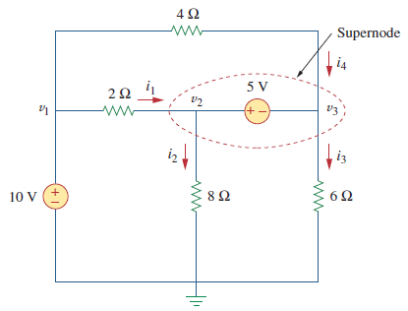
Nodal Analysis with Voltage Sources: We now consider how voltage sources affect nodal analysis. Consider the following two possibilities.
CASE 1 If a voltage source is connected between the reference node and a non-reference node, we simply set the voltage at the non-reference node equal to the voltage of the voltage source. In Fig. 1.24, for example,
v₁ = 10 V
CASE 2 If the voltage source (dependent or independent) is connected between two non-reference nodes, the two non-reference nodes form a generalized node or super-node; we apply both KCL and KVL to determine the node voltages.
Fig. 1.24
Note the following properties of a super-node:
1. The voltage source inside the super-node provides a constraint equation needed to solve for the node voltages.
2. A super-node has no voltage of its own.
3. A super-node requires the application of both KCL and KVL.

Slide 43
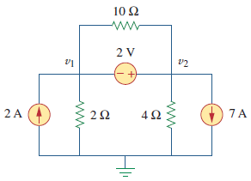
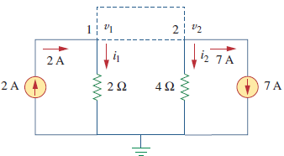
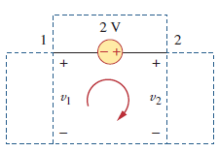
Question: For the circuit shown in Fig. P10, find the node voltages.
Fig. P10
Fig. P10.1(a)
Solution: The super-node contains the 2-V source, nodes 1 and 2, and the 10-ohm resistor. Applying KCL to the super-node as shown in Fig. P10(a) gives
2 = i₁ + i₂ + 7
Expressing i₁ and i₂ in terms of the node voltages
Fig. P10.1(b)
2 = [(v₁ – 0)/2]+ [(v₂-0)/4] + 7
8 = 2v₁ + v₂ + 28
or
v₂ = -20 - 2v₁
(1)
To get the relationship between and we apply KVL to the circuit in Fig. P10(b). Going around the loop, we obtain

Slide 44
-v₁ -2+ v₂ = o
v₂ = v₁ +2
(2)
From Eqs. (1) and (2), we write
v₂ = v₁ +2
v₁ +2 = -20 - 2v₁
or
3v₁ = -22
v₁ = -7.333A
and
v₂ = -7.333 +2
v₂ = -5.333A
Summary :
1. Nodal analysis is the application of Kirchhoff’s current law at the non-reference nodes. (It is applicable to both planar and non-planar circuits.) We express the result in terms of the node voltages. Solving the simultaneous equations yields the node voltages.
2. A super-node consists of two non-reference nodes connected by a (dependent or independent) voltage source.
3. Mesh analysis is the application of Kirchhoff’s voltage law around meshes in a planar circuit. We express the result in terms of mesh currents. Solving the simultaneous equations yields the mesh currents.
4. A super-mesh consists of two meshes that have a (dependent or independent) current source in common.
5. Nodal analysis is normally used when a circuit has fewer node equations than mesh equations. Mesh analysis is normally used when a circuit has fewer mesh equations than node equations.

Slide 45
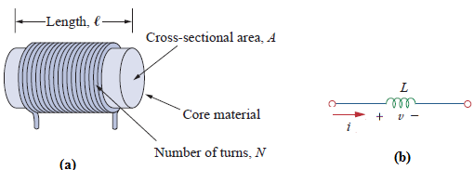
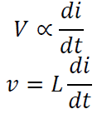


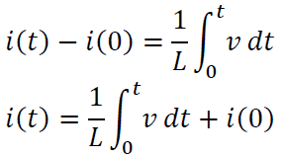
Cont…
INDUCTOR
A change in the magnitude of the current changes the electromagnetic field.
Therefore, a change in current produces change in the electromagnetic field, which induces a voltage across the coil according to Faraday's law of electromagnetic induction. i.e., the voltage across the inductor is directly proportional to the time rate of change of current.
Fig. (a) Typical Inductor, (b) Circuit symbol of Inductor
Where L is the constant of proportionality called the inductance of an inductor. The unit of inductance is Henry (H).we can rewrite the above equation as
Integrating both sides from time 0 to t, we get
we note that the current in an inductor is dependent upon the integral of the voltage across its terminal and the initial current in the coil

Slide 46

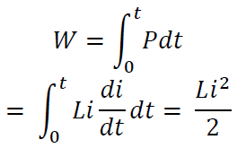

Cont…
INDUCTOR
The power absorbed by the inductor is
The energy stored by the inductor is
From the above discussion, we can conclude the following.
1. The induced voltage across an inductor is zero if the current through it is constant. That means an inductor acts as short circuit to DC.
2. A small change in current within zero time through an inductor gives an infinite voltage across the inductor, which is physically impossible. In a fixed inductor the current cannot change abruptly i.e., the inductor opposes the sudden changes in currents.
3. The inductor can store finite amount of energy. Even if the voltage across the inductor is zero
4. A pure inductor never dissipates energy, only stores it. That is why it is also called a non-dissipative passive element. However, physical inductors dissipate power due to internal resistance.
Question- Find the current through a 5-H inductor if the voltage across it is
Also, find the energy stored at t = 5 s. assume initial conditions to be zero.

Slide 47
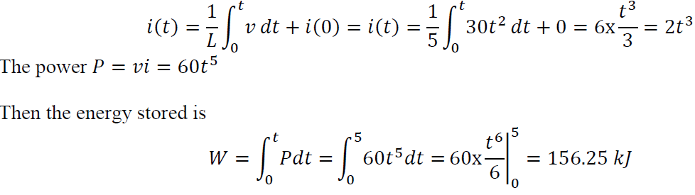


Cont…
Solution:
CAPACITOR
Any two conducting surfaces separated by an insulating medium exhibit the property of a capacitor. A capacitor stores energy in the form of an electric field that is established by the opposite charges on the two electrodes.
Fig. (a) Typical Capacitor, (b) Capacitor connected to a voltage source, (c) Circuit Symbol of capacitor
When a voltage source v is connected to the capacitor, as in Fig (c), the source deposits a positive charge q on one plate and a negative charge — q on the other. The capacitor is said to store the electric charge. The amount of charge stored, represented by q, is directly pro-proportional to the applied voltage v so that
Where C, the constant of proportionality, is known as the capacitance of the capacitor. The unit of capacitance is the farad (F).

Slide 48






Cont…
Although the capacitance C of a capacitor is the ratio of the charge q per plate to the applied voltage v, it does not depend on q or v. It depends on the physical dimensions of the capacitor.
For example, for the parallel-plate capacitor shown in Fig. (a), the capacitance is given by
Where A is the surface area of each plate, d is the distance between the plates, and is the permittivity of the dielectric material between the plates.
The current flowing through the capacitor is given by
We can rewrite the above equation as
Integrating both sides from time 0 to t, we get
From the above equation we note that the voltage across the terminals of a capacitor is dependent upon the integral of the current through it and the initial voltage
The power absorbed by the capacitor is
The energy stored by the capacitor is

Slide 49



Cont…
From the above discussion we can conclude the following,
1. The current in a capacitor is zero if the voltage across it is constant; that means, the capacitor acts as an open circuit to DC.
2. A small change in voltage across a capacitance within zero time gives an infinite current through the capacitor, which is physically impossible. In a fixed capacitance the voltage cannot change abruptly. i.e., A capacitor will oppose the sudden changes in voltages.
3. The capacitor can store a finite amount of energy, even if the current through it is zero.
4. A pure capacitor never dissipates energy, but only stores it; that is why it is called non-dissipative passive element. However, physical capacitors dissipate power due to internal resistance.
Question:
Solution:

