Slide 1

3D retrospectively
motion-corrected
brain MRI using
structure-guided priors
G. Rizzuti, A. Sbrizzi, T. van Leeuwen
IICU,
28/02/2022

Slide 2
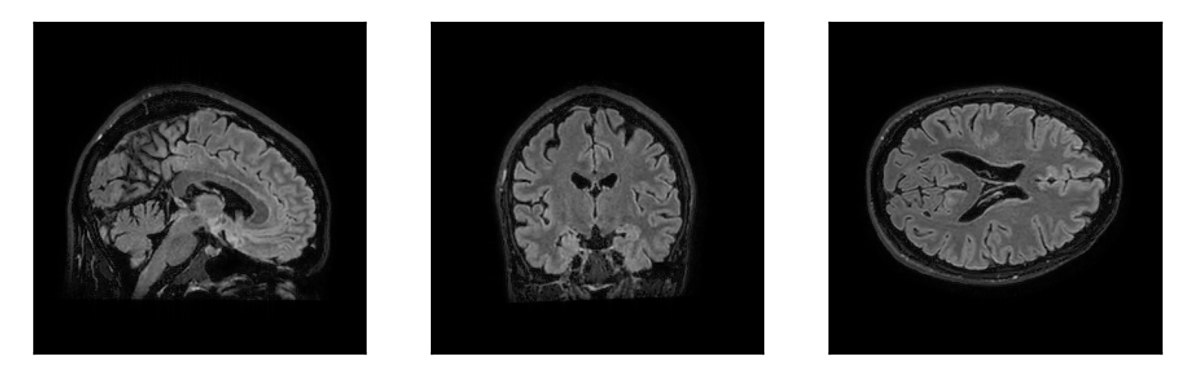
Motion artifacts in MRI
Sagittal
Coronal
Axial
M. Zaitsev et al., 2015, “Motion Artifacts in MRI: A Complex Problem With Many Partial Solutions”

Slide 3
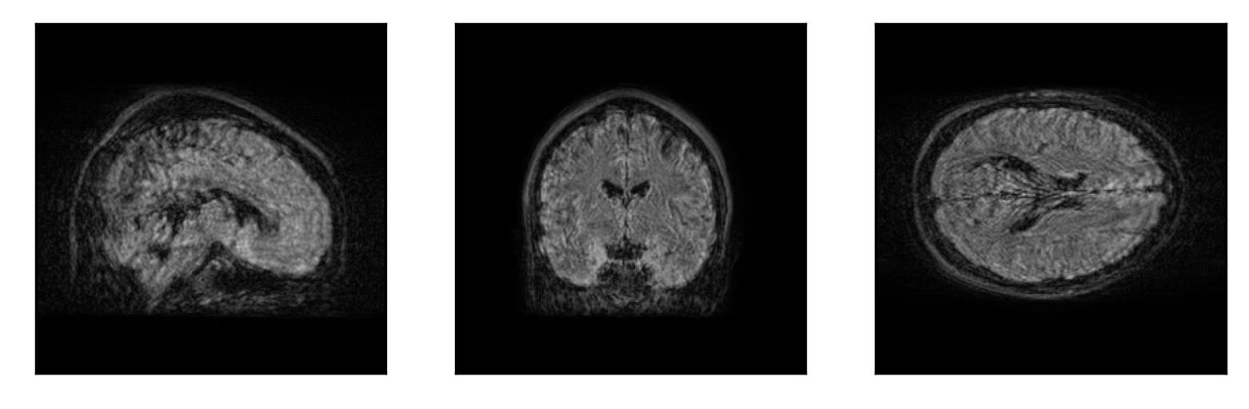
Motion artifacts in MRI
Sagittal
Coronal
Axial
M. Zaitsev et al., 2015, “Motion Artifacts in MRI: A Complex Problem With Many Partial Solutions”

Slide 4
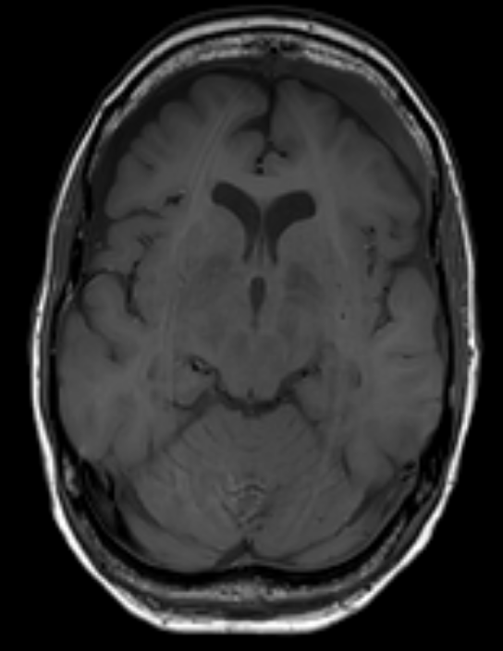
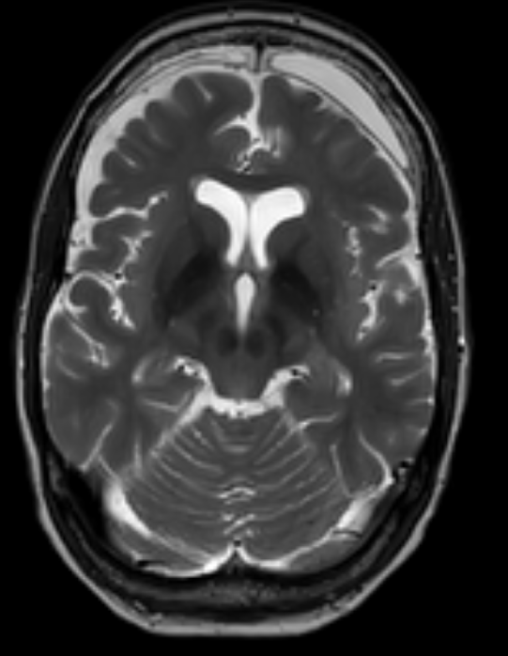
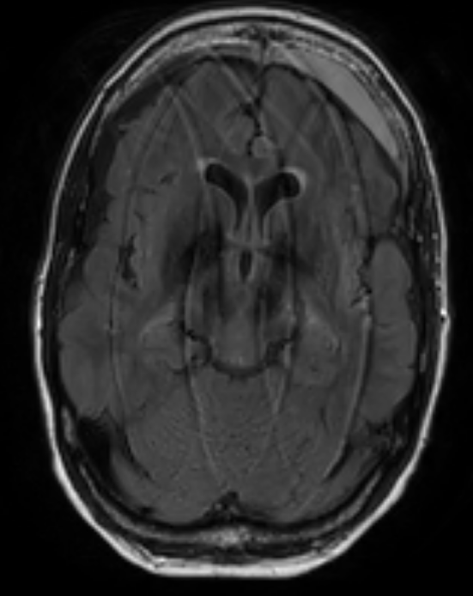
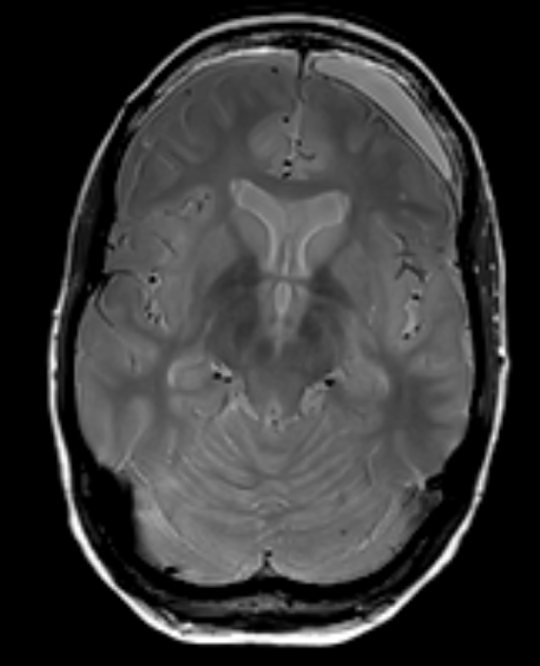
Method: sketch
T1w
T2w
FLAIR
PDw
  Detect corrupted contrast(s)
  Select well-resolved contrast(s)
  Motion estimation / regularized reconstruction
  using structure-guided priors

Slide 5
Method: prerequisites
T1w
T2w
FLAIR
PDw
Post-processing:
  input from amplitude/phase reconstructions
  no need for scan modifications/navigators/markers
Assumptions: rigid motions, clean scan available (this talk: dense Cartesian sampling)

Slide 6
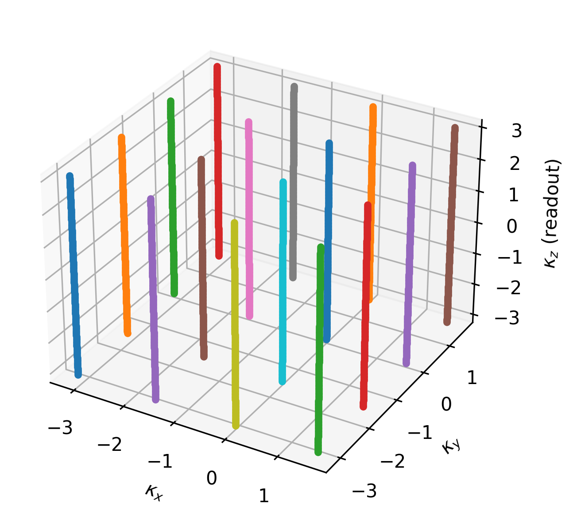
Sequential dynamic sampling
t5
t1
t6
t2
...
t3
t4
rigid motion parameters

Slide 7
Rigid motion in x-space

Slide 8
Rigid motion in k-space
NFFT
FINUFFT, https://finufft.readthedocs.io/

Slide 9
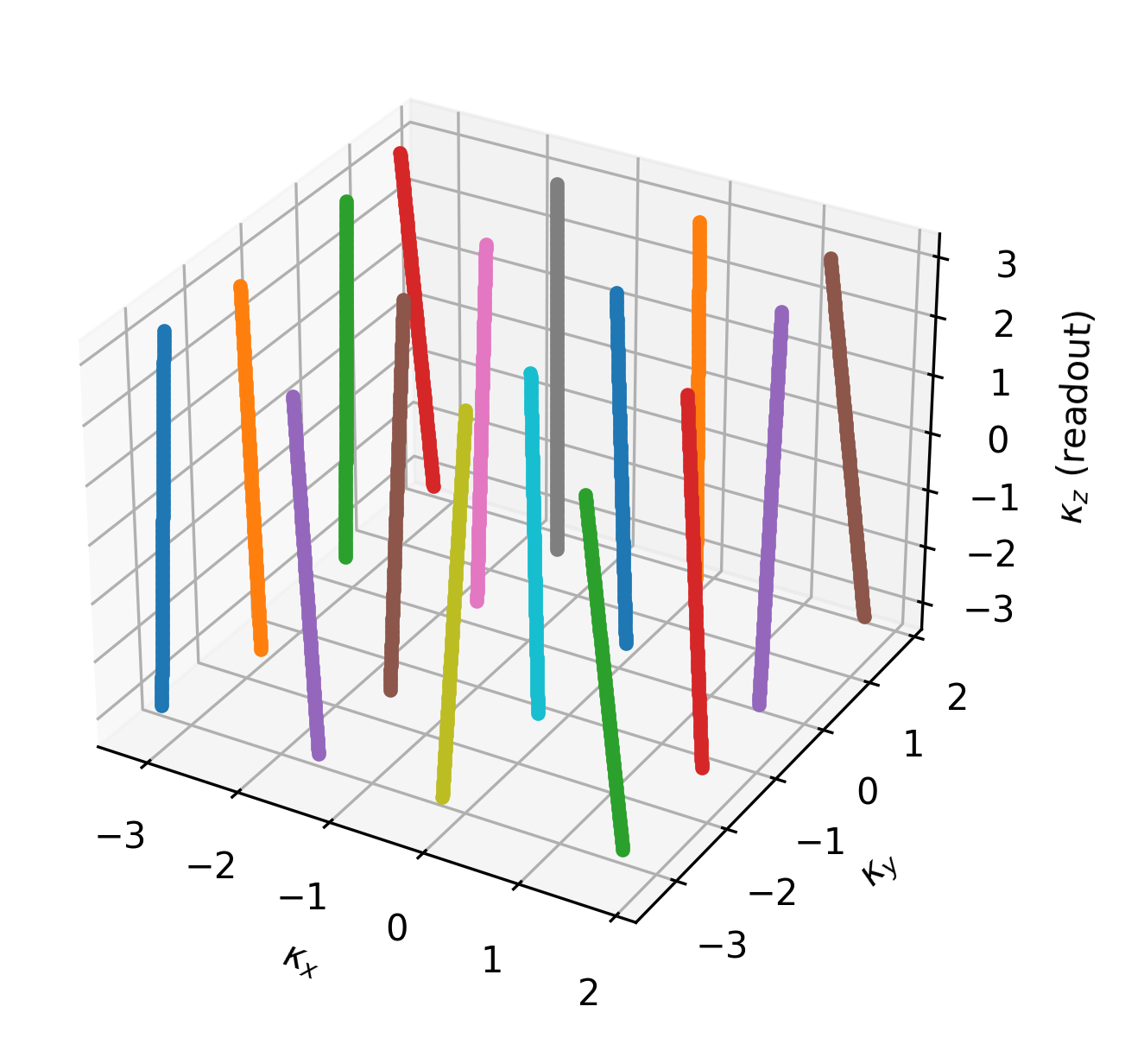
(Motion-induced) effective sampling
Nominal sampling
Effective sampling

Slide 10
Variational problem

Slide 11
Regularization

Slide 12
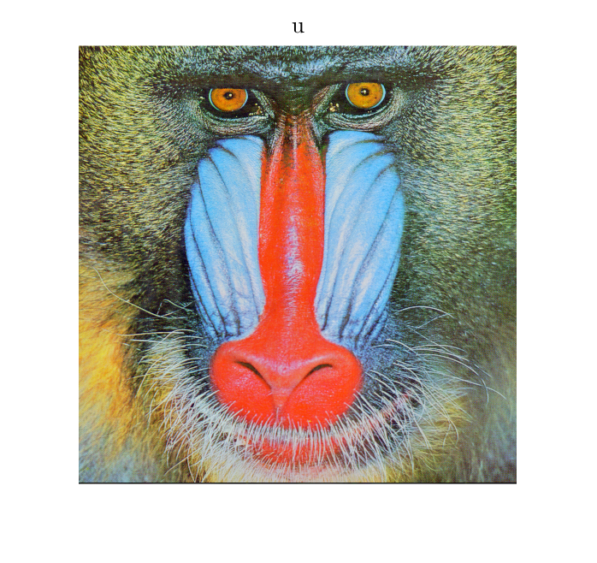
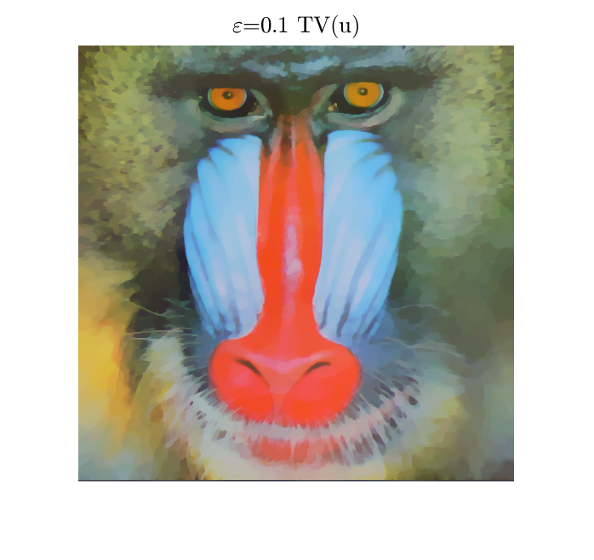
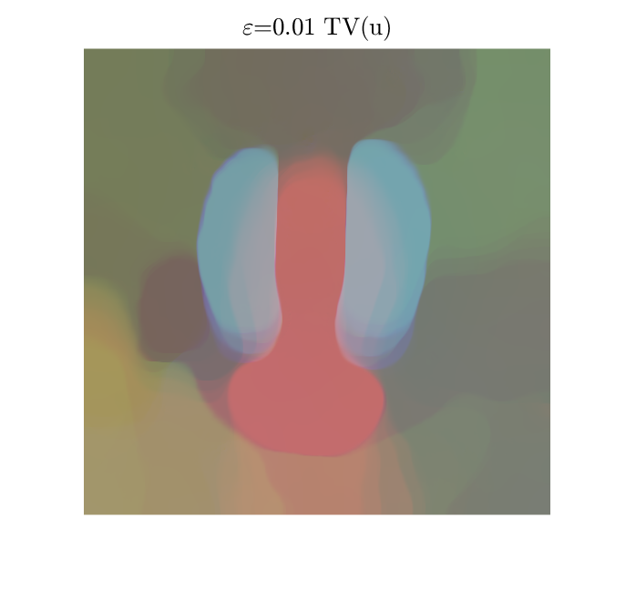
Regularization
B. Peters, et al., 2018, “Projection methods and applications for seismic nonlinear inverse problems with multiple constraints”

Slide 13

Regularization: structure-guided TV
T1w
T2w
FLAIR
PDw
M. J. Ehrhardt, M. M. Betcke, 2015, “Multi-Contrast MRI Reconstruction with Structure-Guided Total Variation”

Slide 14
Optimization strategy
Alternately:
1. Reconstruction (FISTA, primal-dual, ADMM)
A. Beck, M. Teboulle, 2009, “Fast Gradient-Based Algorithms for Constrained Total Variation Image Denoising and Deblurring Problems”
E. Esser, et al., 2010, “A General Framework for a Class of First Order Primal-Dual Algorithms for Convex Optimization in Imaging Science”

Slide 15
Optimization strategy
Alternately:
2. Motion estimation (2nd order methods)
...or single update (variable projection)
G. Golub, V. Pereira, 2003, “Separable nonlinear least squares: the variable projection method and its applications”
T. van Leeuwen, A. Aravkin, 2021, “Variable projection for non-smooth problems”

Slide 16
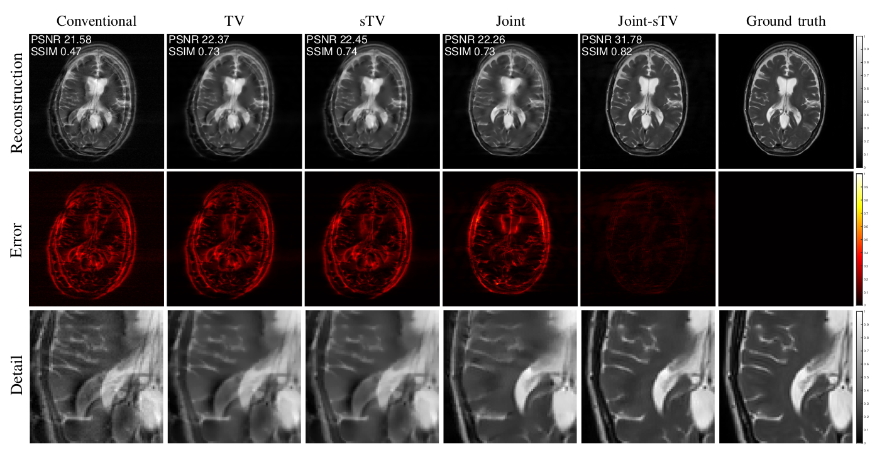
2D synthetics, sudden motion

Slide 17
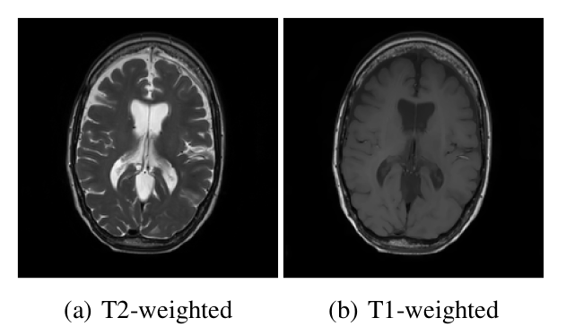
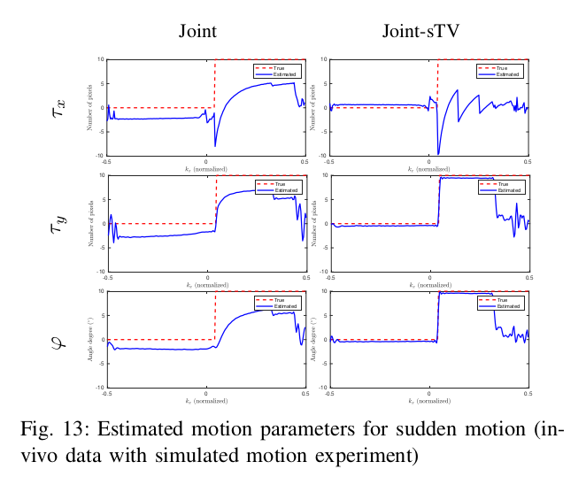
2D synthetics, sudden motion

Slide 18
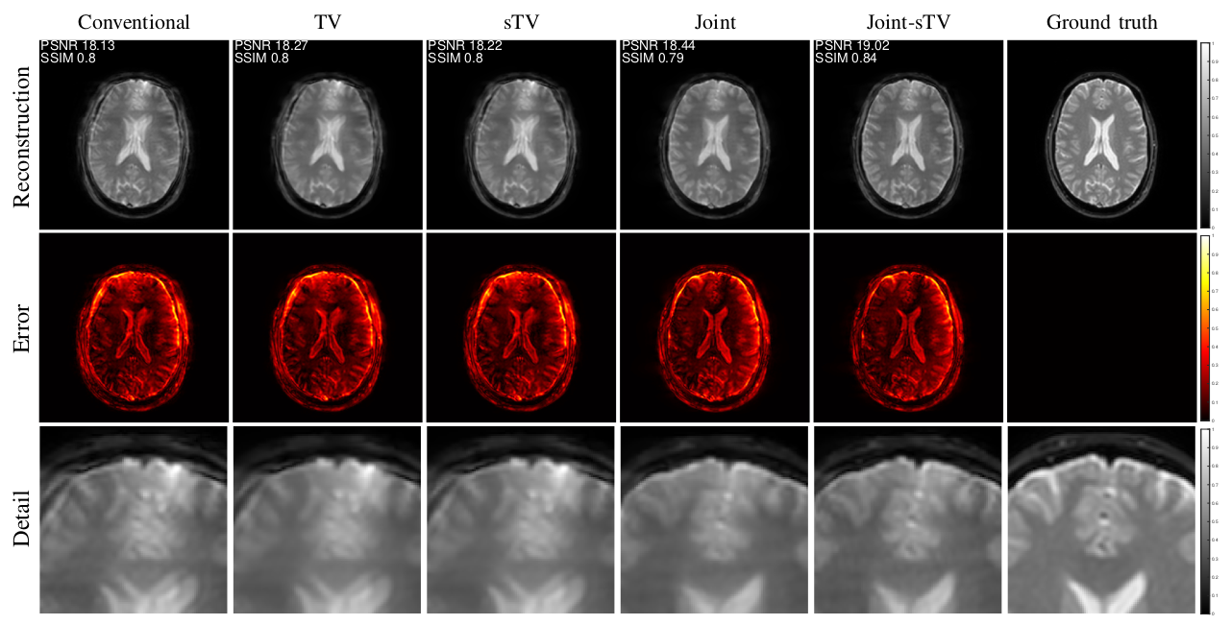
“2D” in-vivo, sudden motion

Slide 19
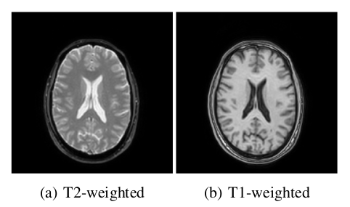
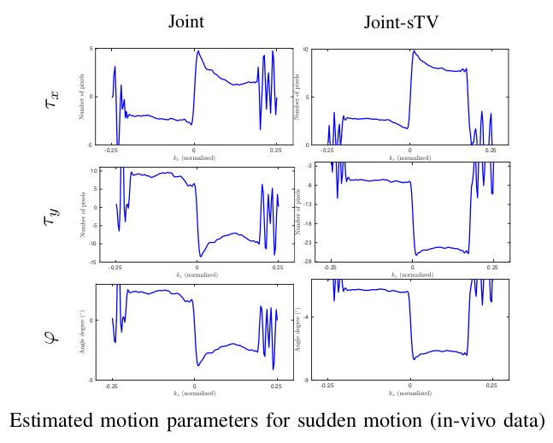
“2D” in-vivo, sudden motion

Slide 20
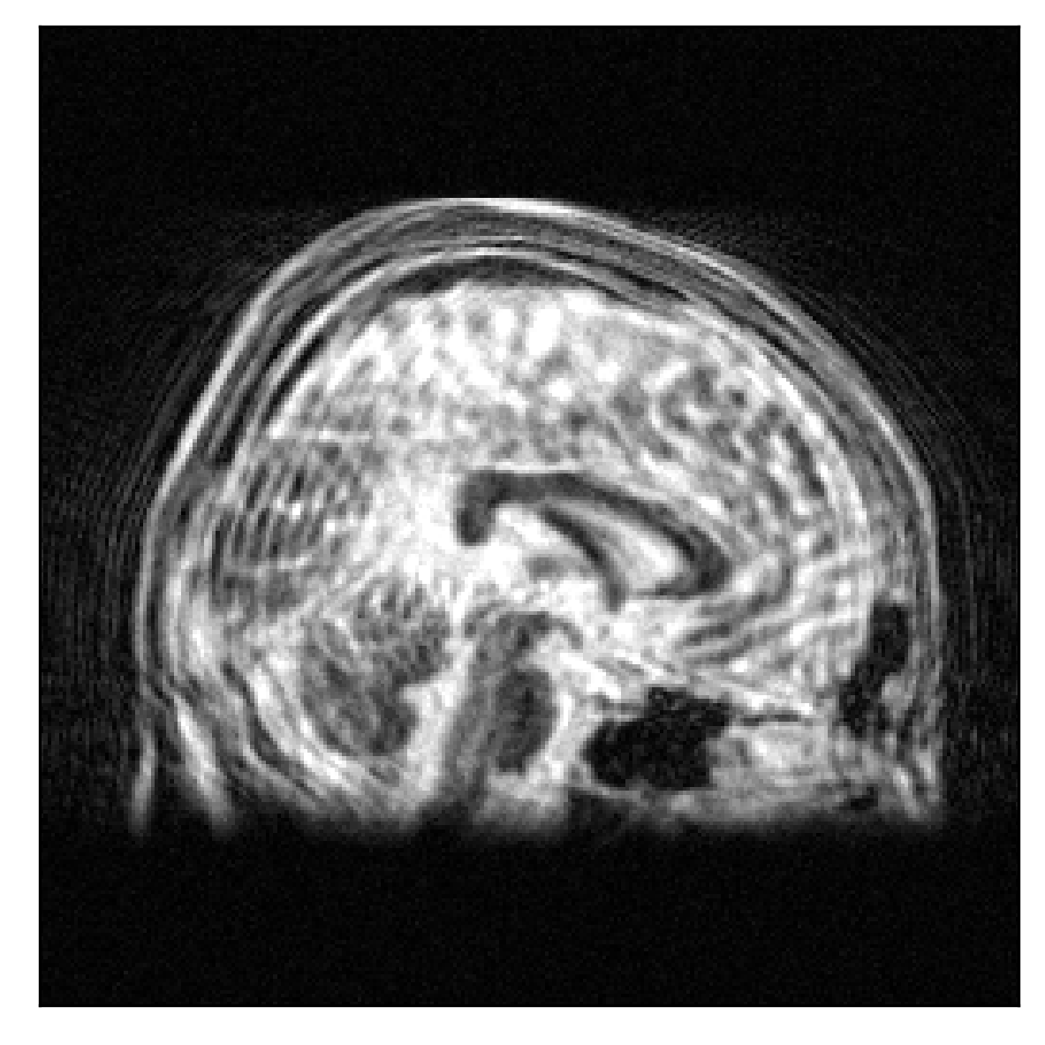
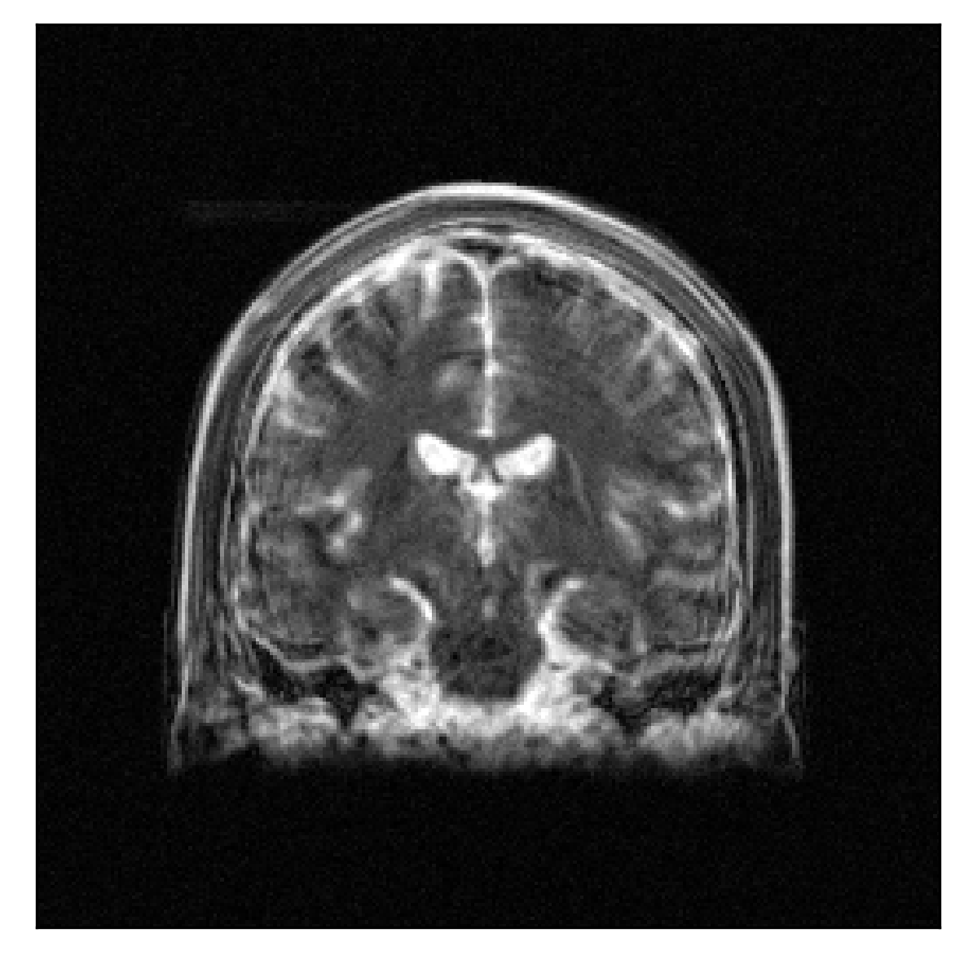
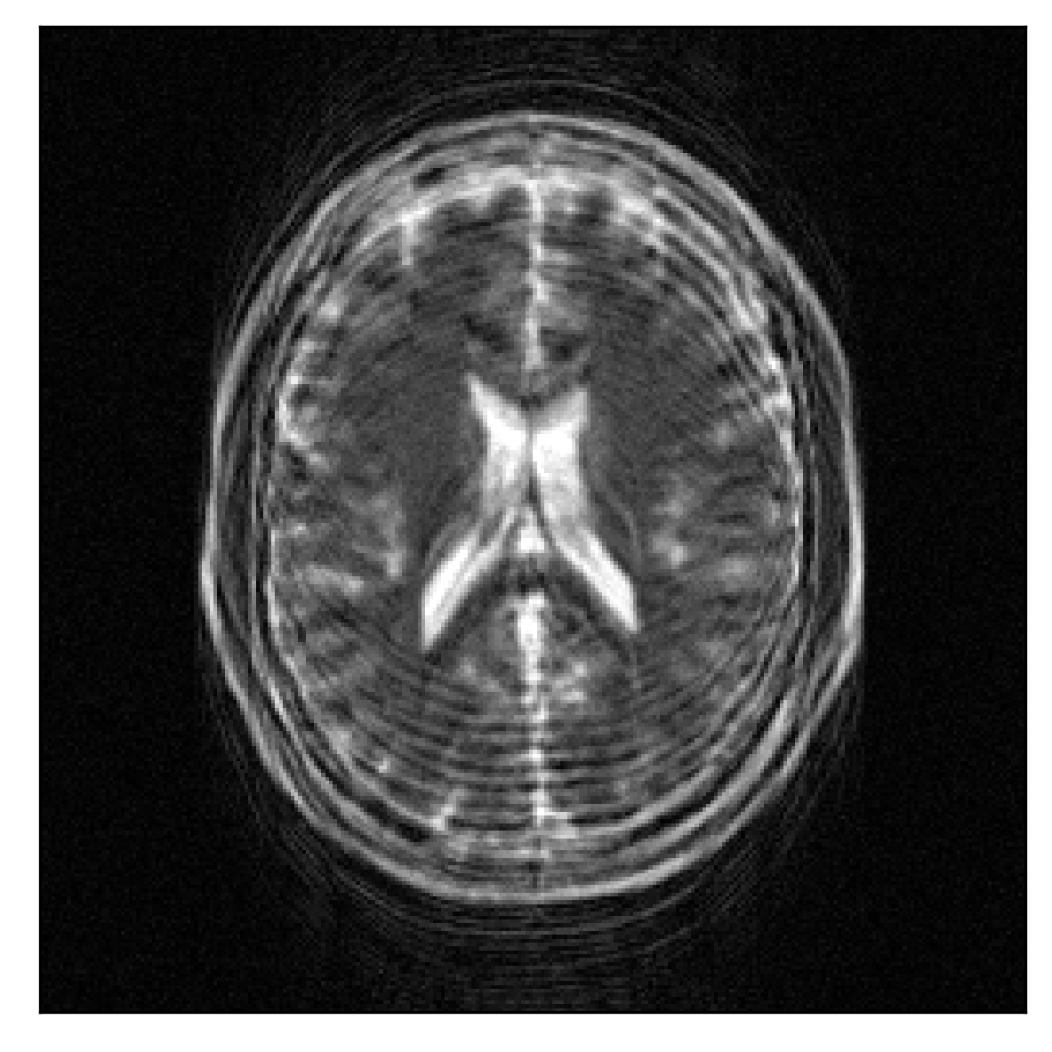
3D synthetics, random motion
Conventional, SSIM=0.238, PSNR=23.4

Slide 21
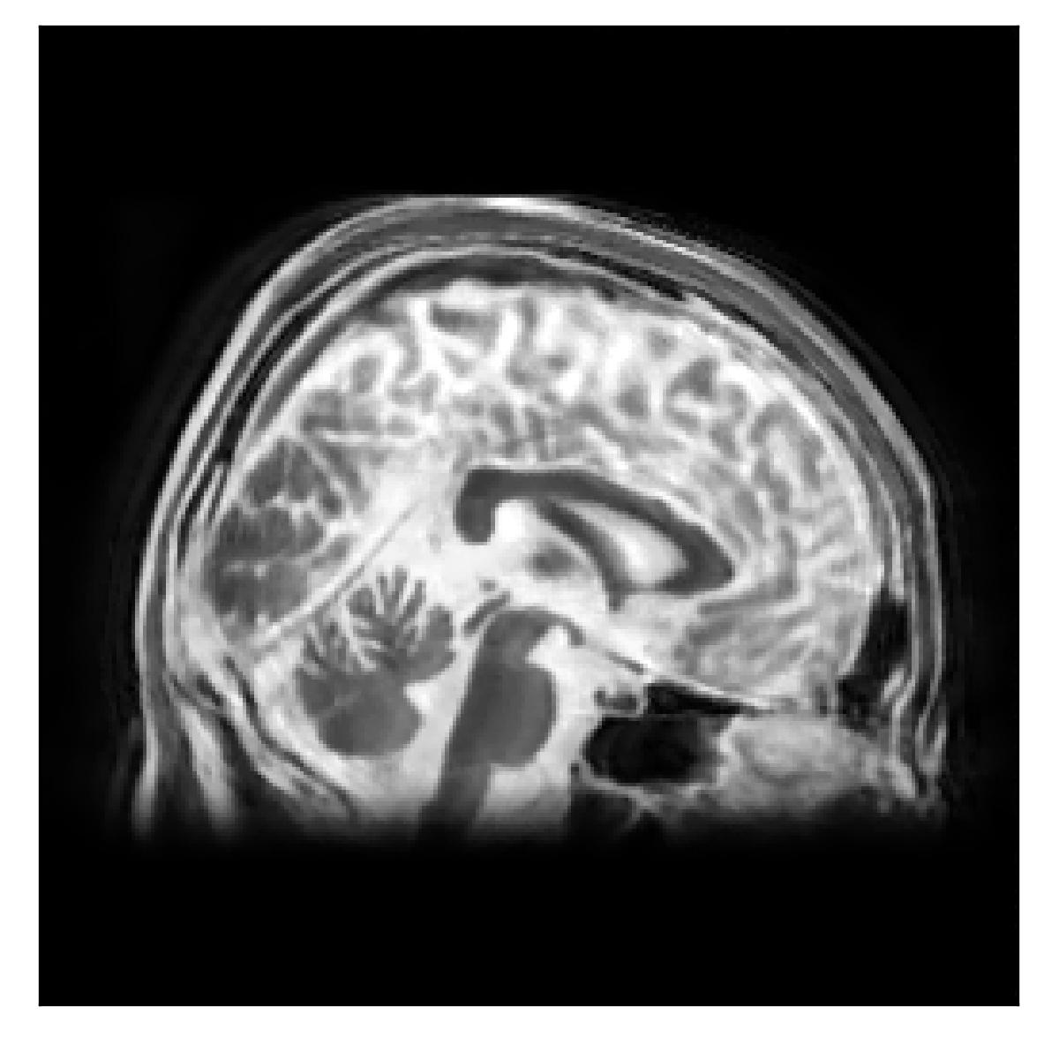

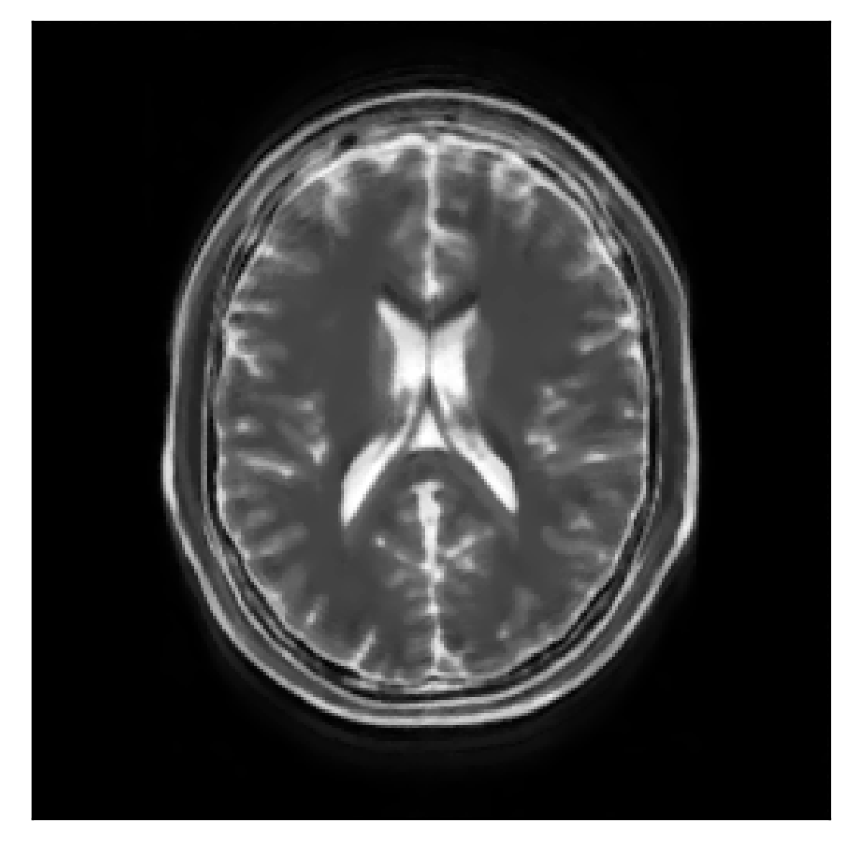
3D synthetics, random motion
Joint TV, SSIM=0.90, PSNR=27.2

Slide 22
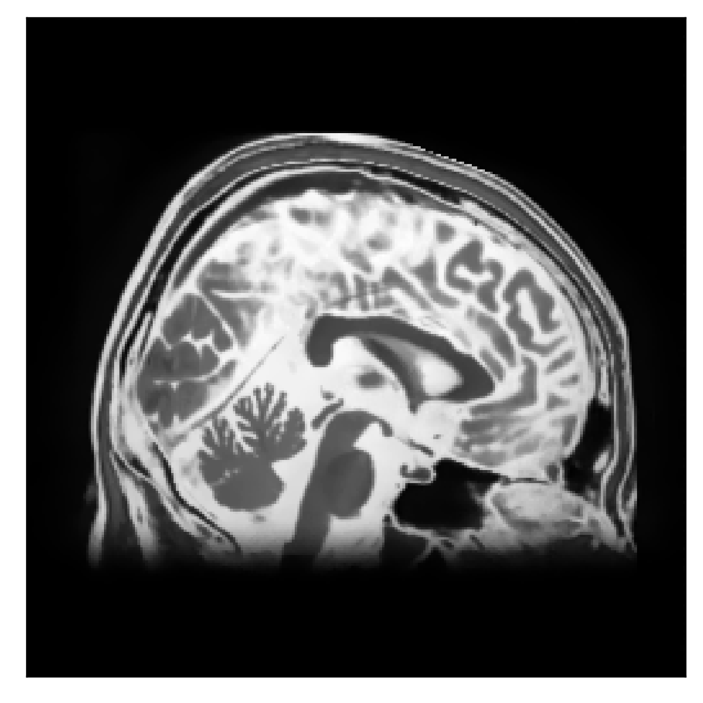

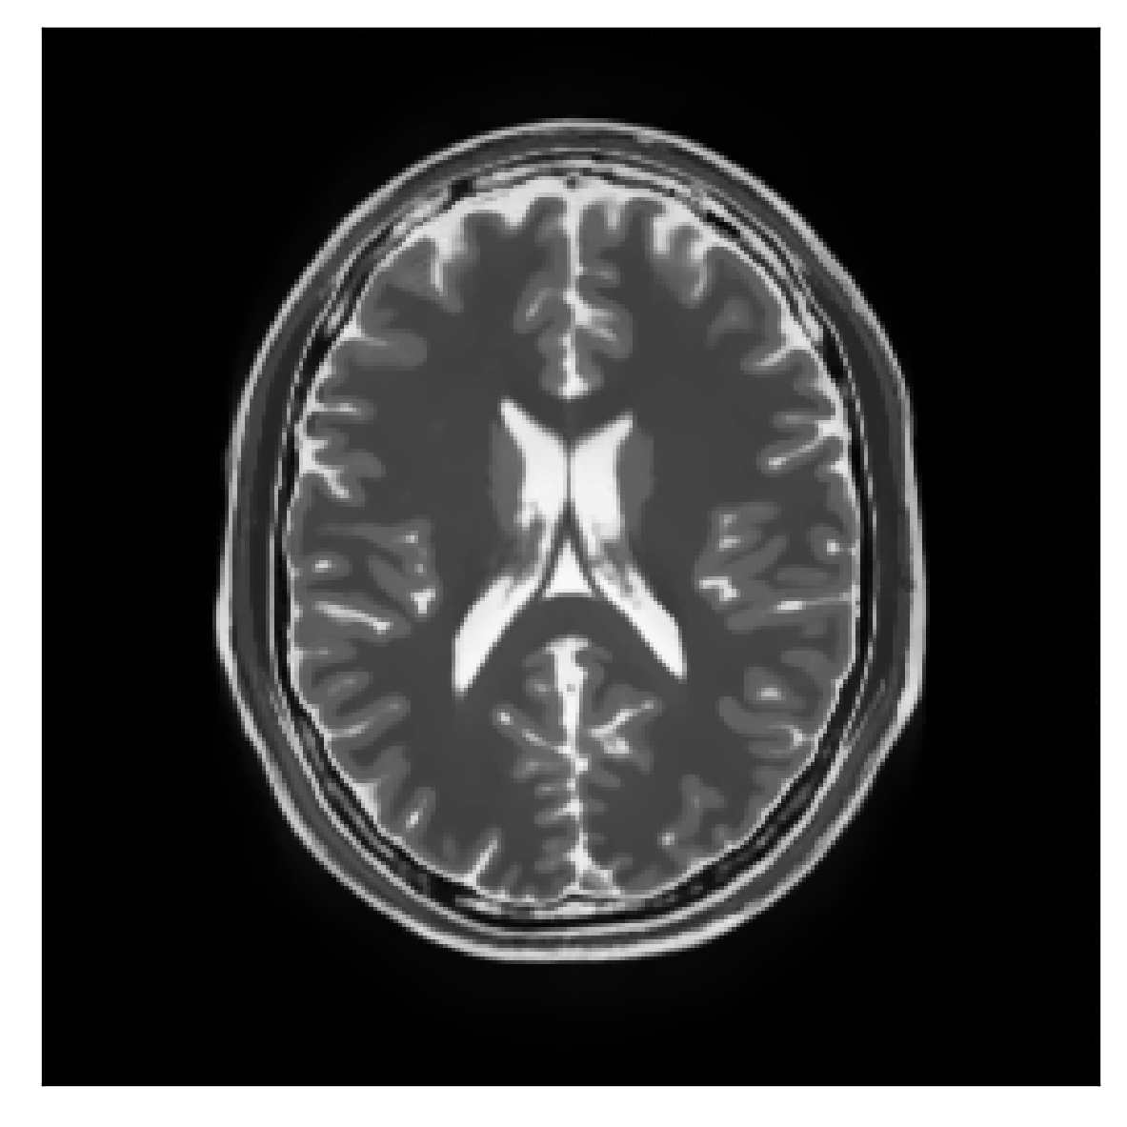
3D synthetics, random motion
Joint sTV, SSIM=0.965, PSNR=38.5

Slide 23


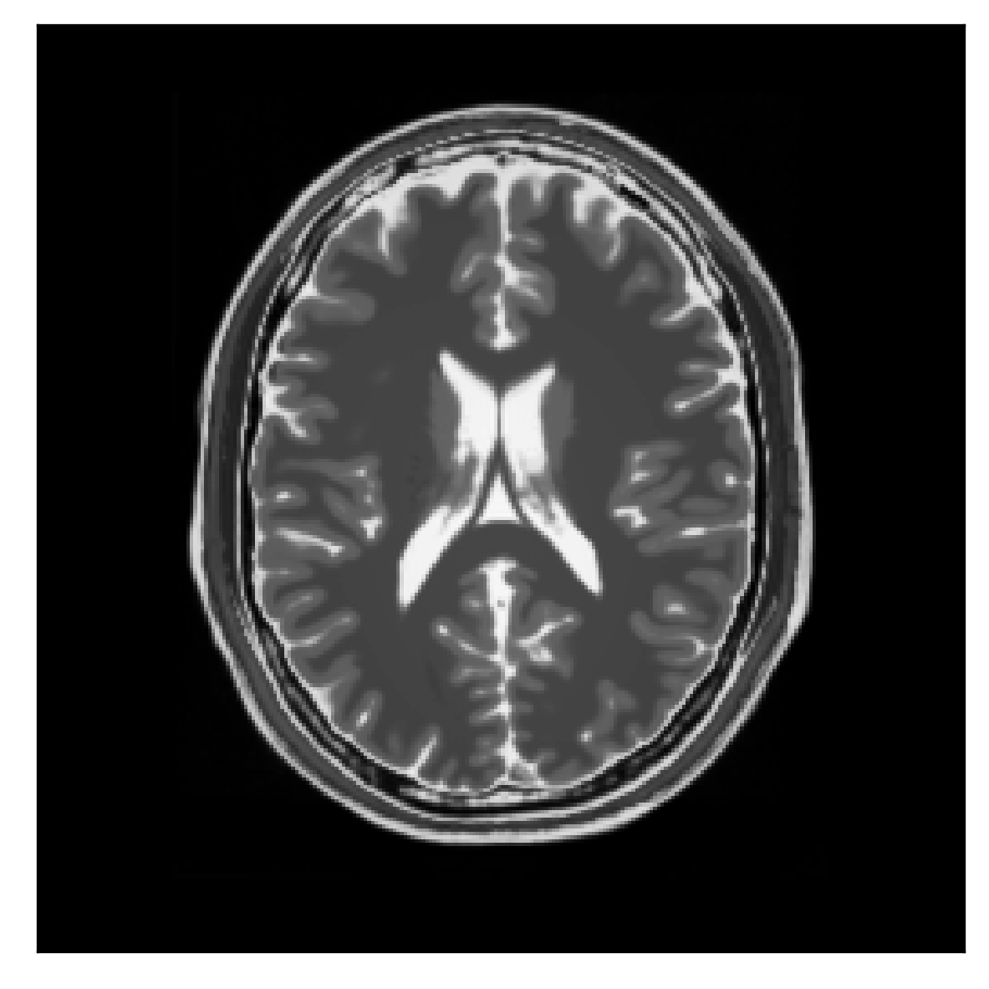
3D synthetics, random motion
Ground truth

Slide 24
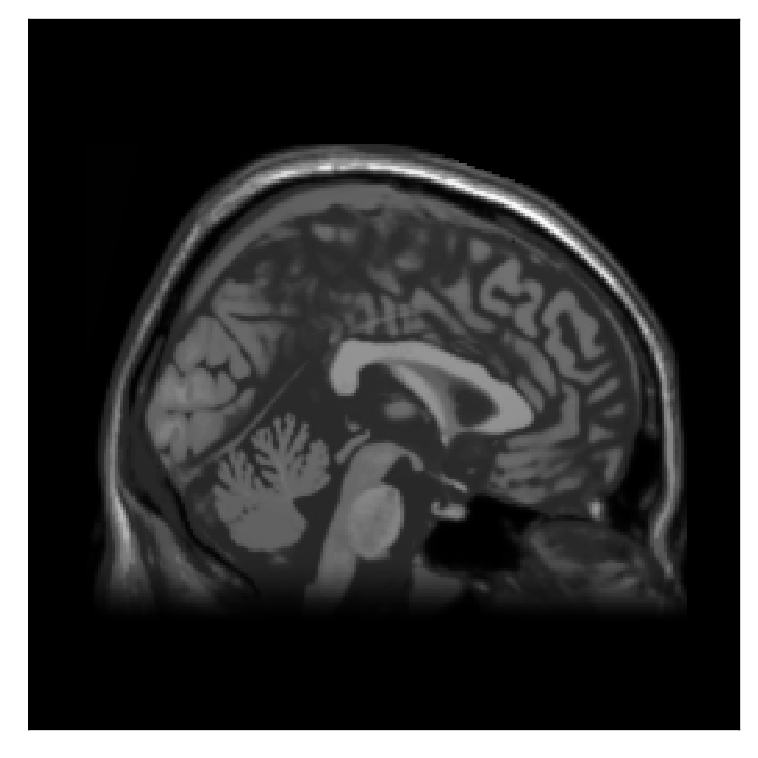
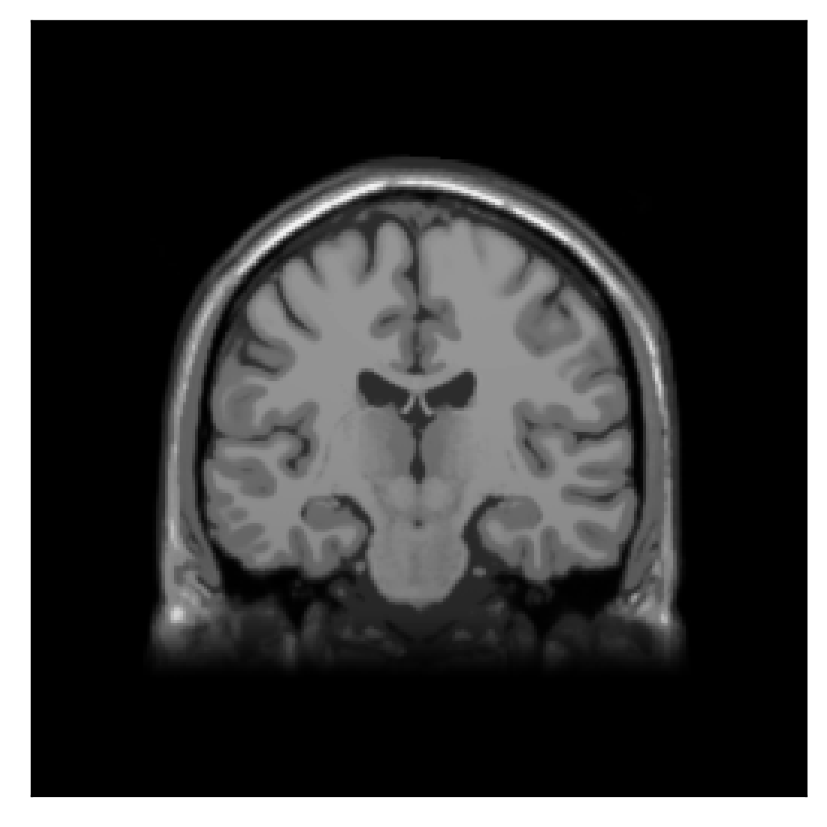
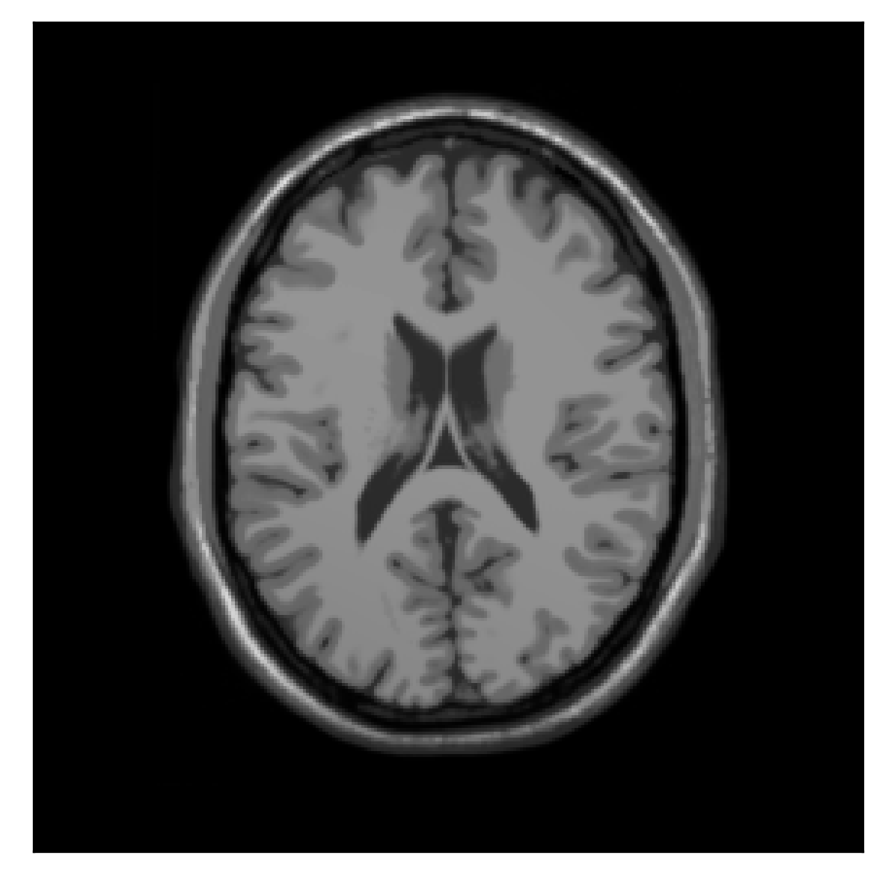
3D synthetics, random motion
Structural prior

Slide 25
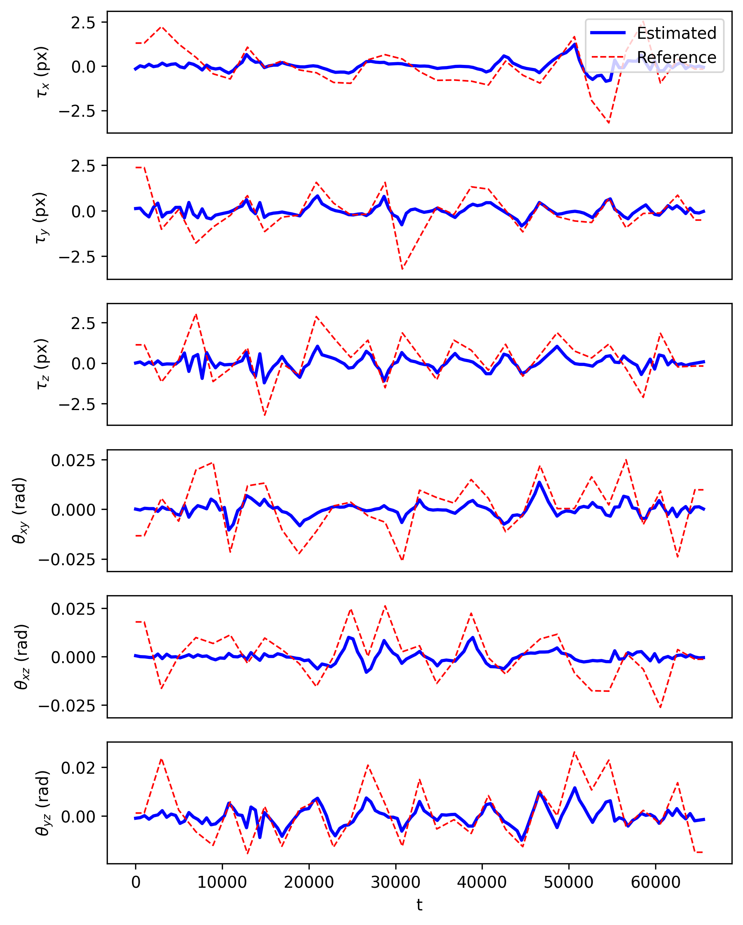
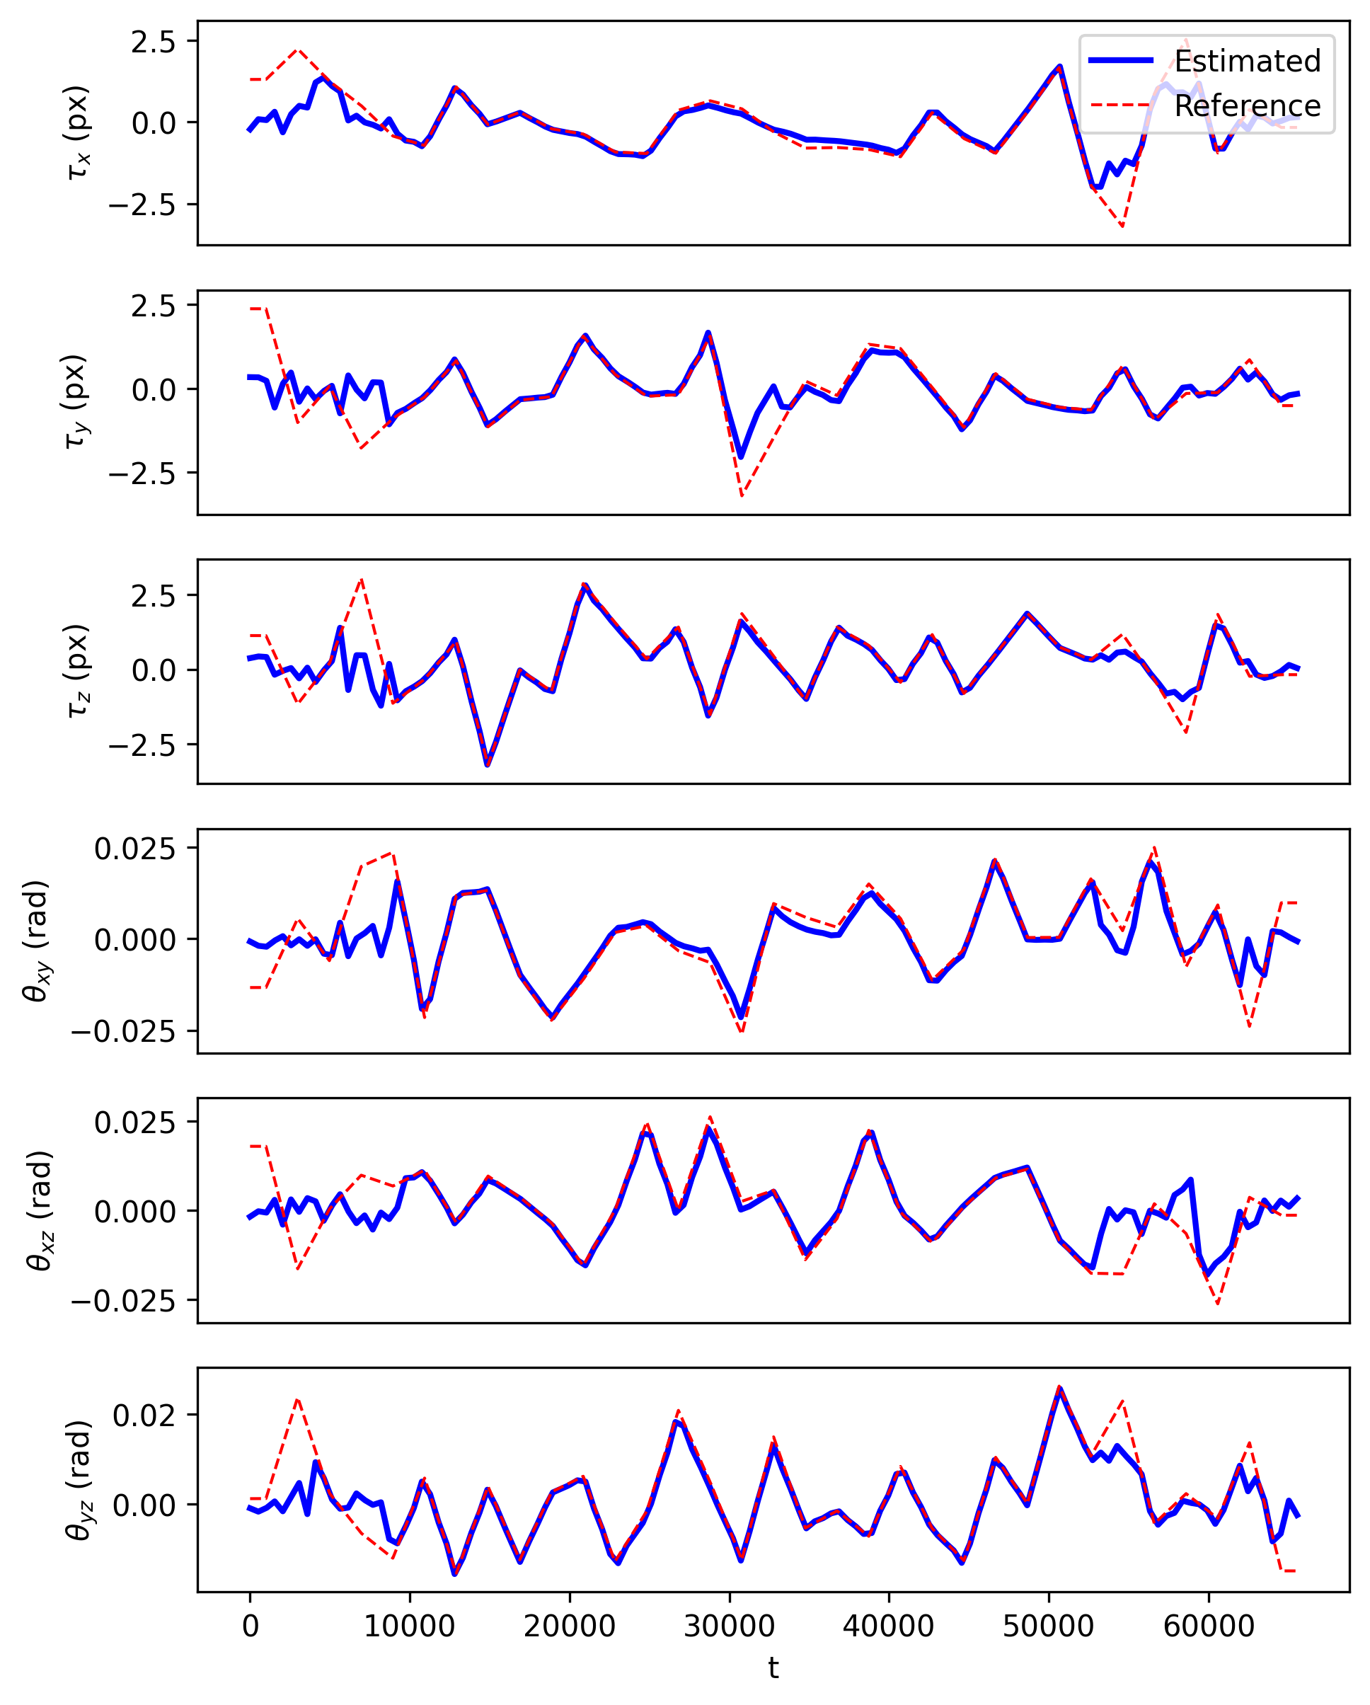
3D synthetics, random motion
Joint TV
Joint sTV

Slide 26
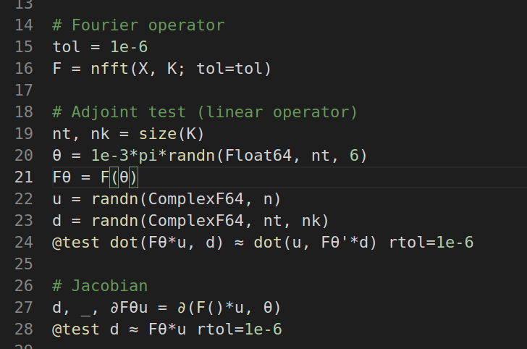
Software
Julia packages:
Structure-guided TV: FastSolversForWeightedTV.jl
Differentiable rigid-motion perturbed NFFT:
UtilitiesForMRI.jl

Slide 27
Discussion/Conclusions
Structure-guided > conventional prior?
Computational aspects:
  NFFT vs FFT
  timings
Phase-wrapping artifacts in motion estimation
To do:
  realistic motion?
  non-rigid motion?

Slide 28
References
J. B. Andre et al., 2015, “Toward quantifying the prevalence, severity, and cost associated with patient motion during clinical MR examinations.”, J Am Coll Radiol
F. Godenschweger et al., 2016, “Motion correction in MRI of the brain”, Phys Med Biol. 61(5)
Cordero-Grande et al., 2018, “Three-Dimensional Motion Corrected Sensitivity Encoding Reconstruction for Multi-Shot Multi-Slice MRI: Application to Neonatal Brain Imaging”, Magn Reson Med 79
Cordero-Grande et al., 2020, “Motion-corrected MRI with DISORDER: Distributed and incoherent sample orders for reconstruction deblurring using encoding redundancy”, Magn Reson Med 84
M. Zaitsev, 2015, “Motion Artifacts in MRI: A Complex Problem With Many Partial Solutions”, J Magn Reson Imaging 42
A. Barnett, et al., 2019, “A parallel non-uniform fast Fourier transform library based on an “exponential of semicircle” kernel”, SIAM J. Sci. Comput., 41(5)
A. Barnett, et al., 2021, “Aliasing error of the exp(\beta\sqrt{1-z^2}) kernel in the nonuniform fast Fourier transform”, arXiv
B. Peters, et al., 2018, “Projection methods and applications for seismic nonlinear inverse problems with multiple constraints”, Geophysics 84
A. Beck, M. Teboulle, 2009, “Fast Gradient-Based Algorithms for Constrained Total Variation Image Denoising and Deblurring Problems”
E. Esser, et al., 2010, “A General Framework for a Class of First Order Primal-Dual Algorithms for Convex Optimization in Imaging Science”, SIAM J Imaging Sciences 3(4)
G. Golub, V. Pereira, 2003, “Separable nonlinear least squares: the variable projection method and its applications”
T. van Leeuwen, A. Aravkin, 2021, “Variable projection for non-smooth problems”, SIAM J Imaging Sciences
M. J. Ehrhardt, M. M. Betcke, 2015, “Multi-Contrast MRI Reconstruction with Structure-Guided Total Variation”, SIAM J. Imaging Sciences 9(3)
R. Otazo, et al., 2015, “Low-Rank Plus Sparse Matrix Decomposition for Accelerated Dynamic MRI with Separation of Background and Dynamic Components”, Magnetic Resonance in Medicine 73

Slide 29
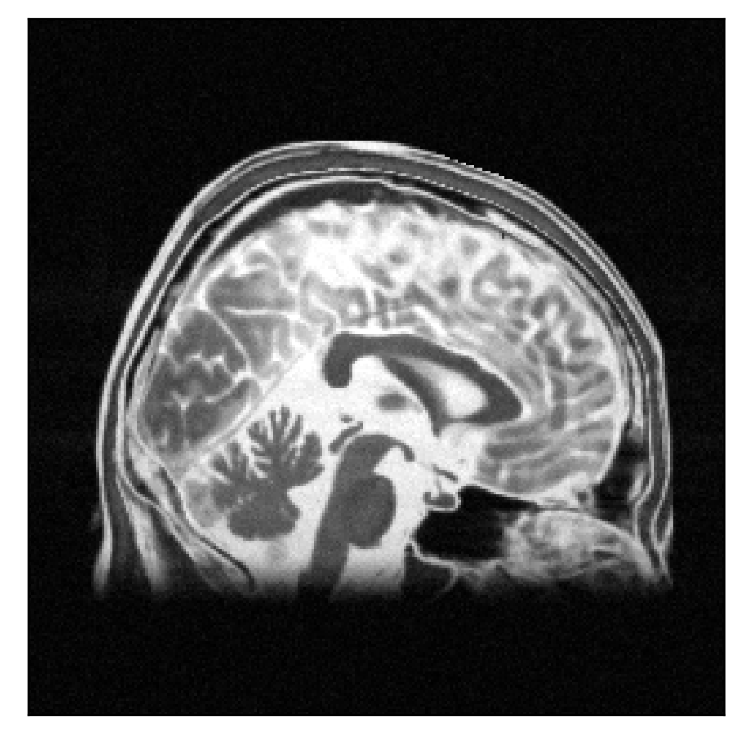
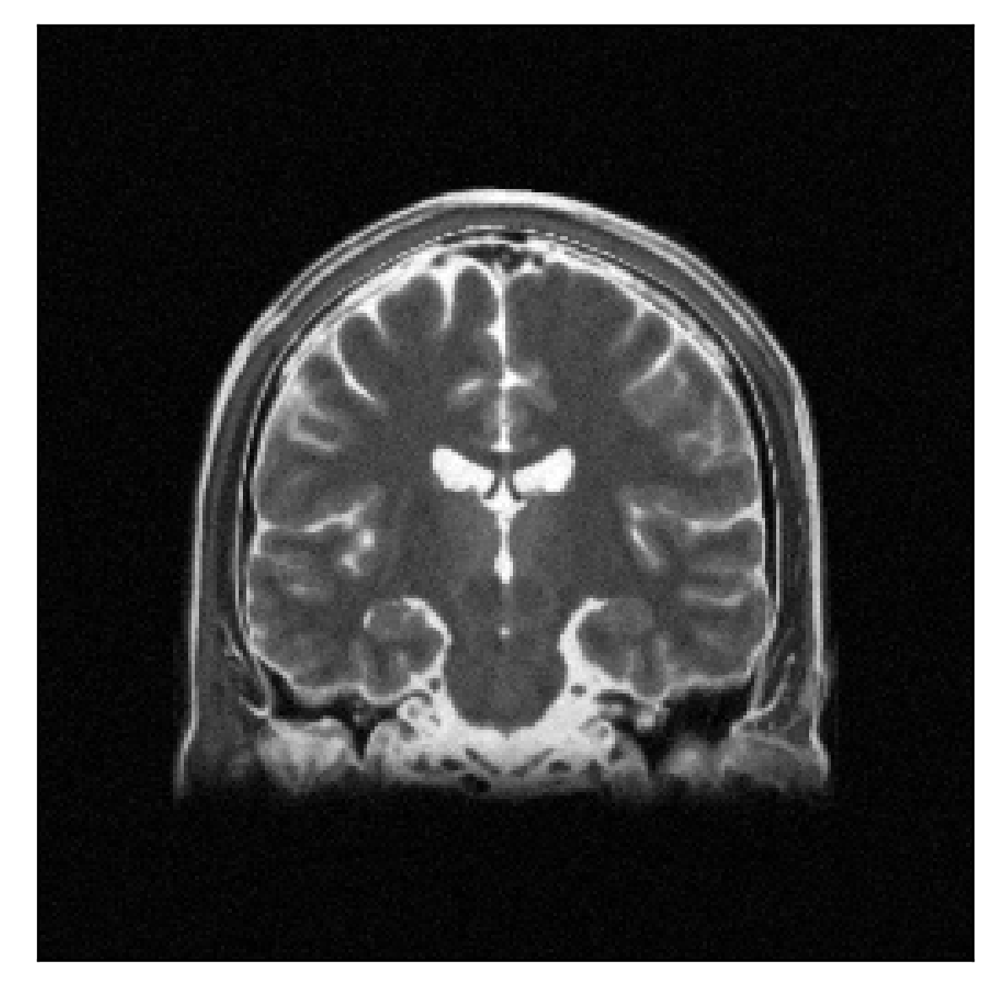
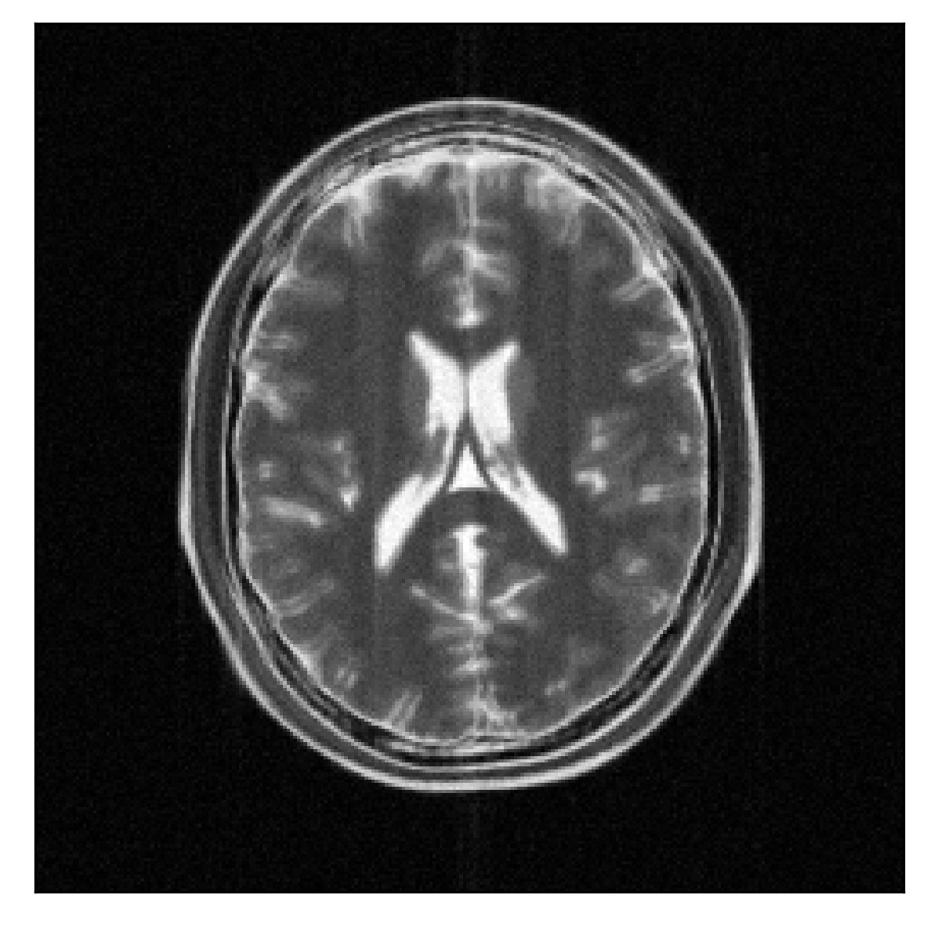
3D synthetics, sudden motion
Conventional, SSIM=0.33, PSNR=26.6

Slide 30
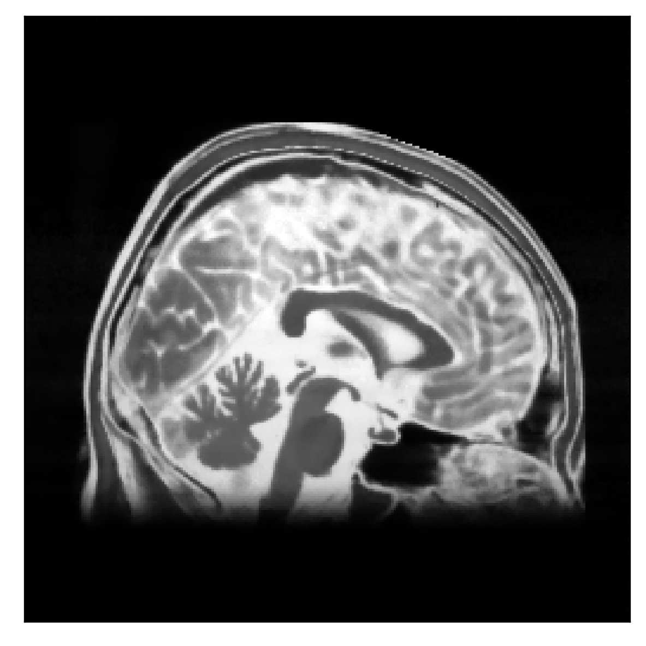


3D synthetics, sudden motion
Joint TV, SSIM=0.91, PSNR=28.0

Slide 31

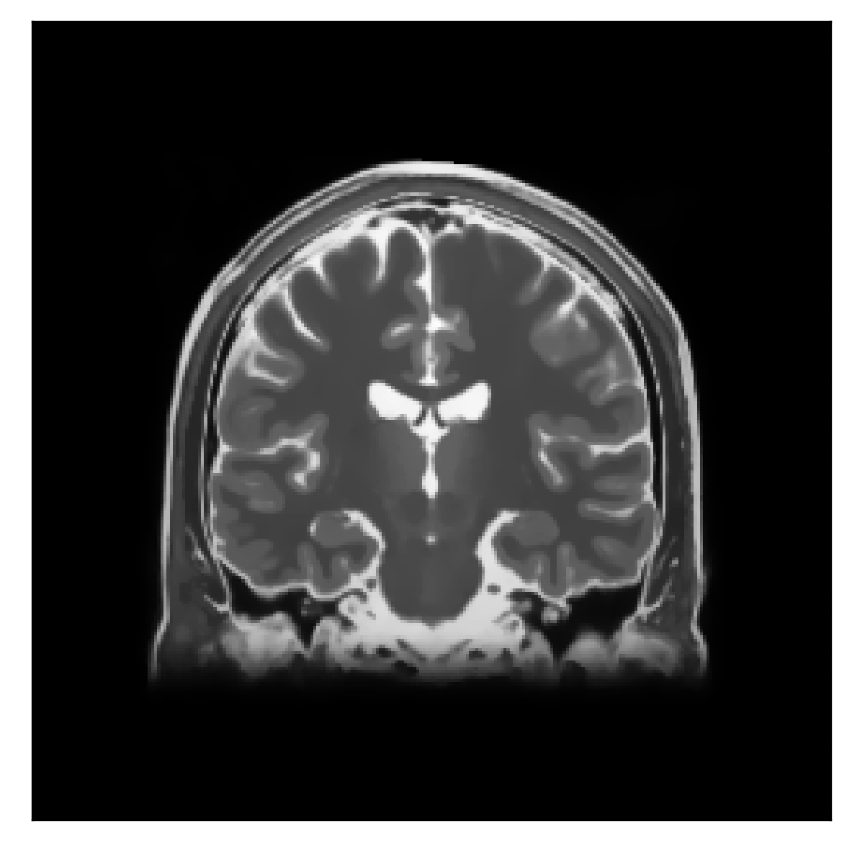

3D synthetics, sudden motion
Joint sTV, SSIM=0.96, PSNR=31.8

Slide 32
3D synthetics, sudden motion
Ground truth

Slide 33
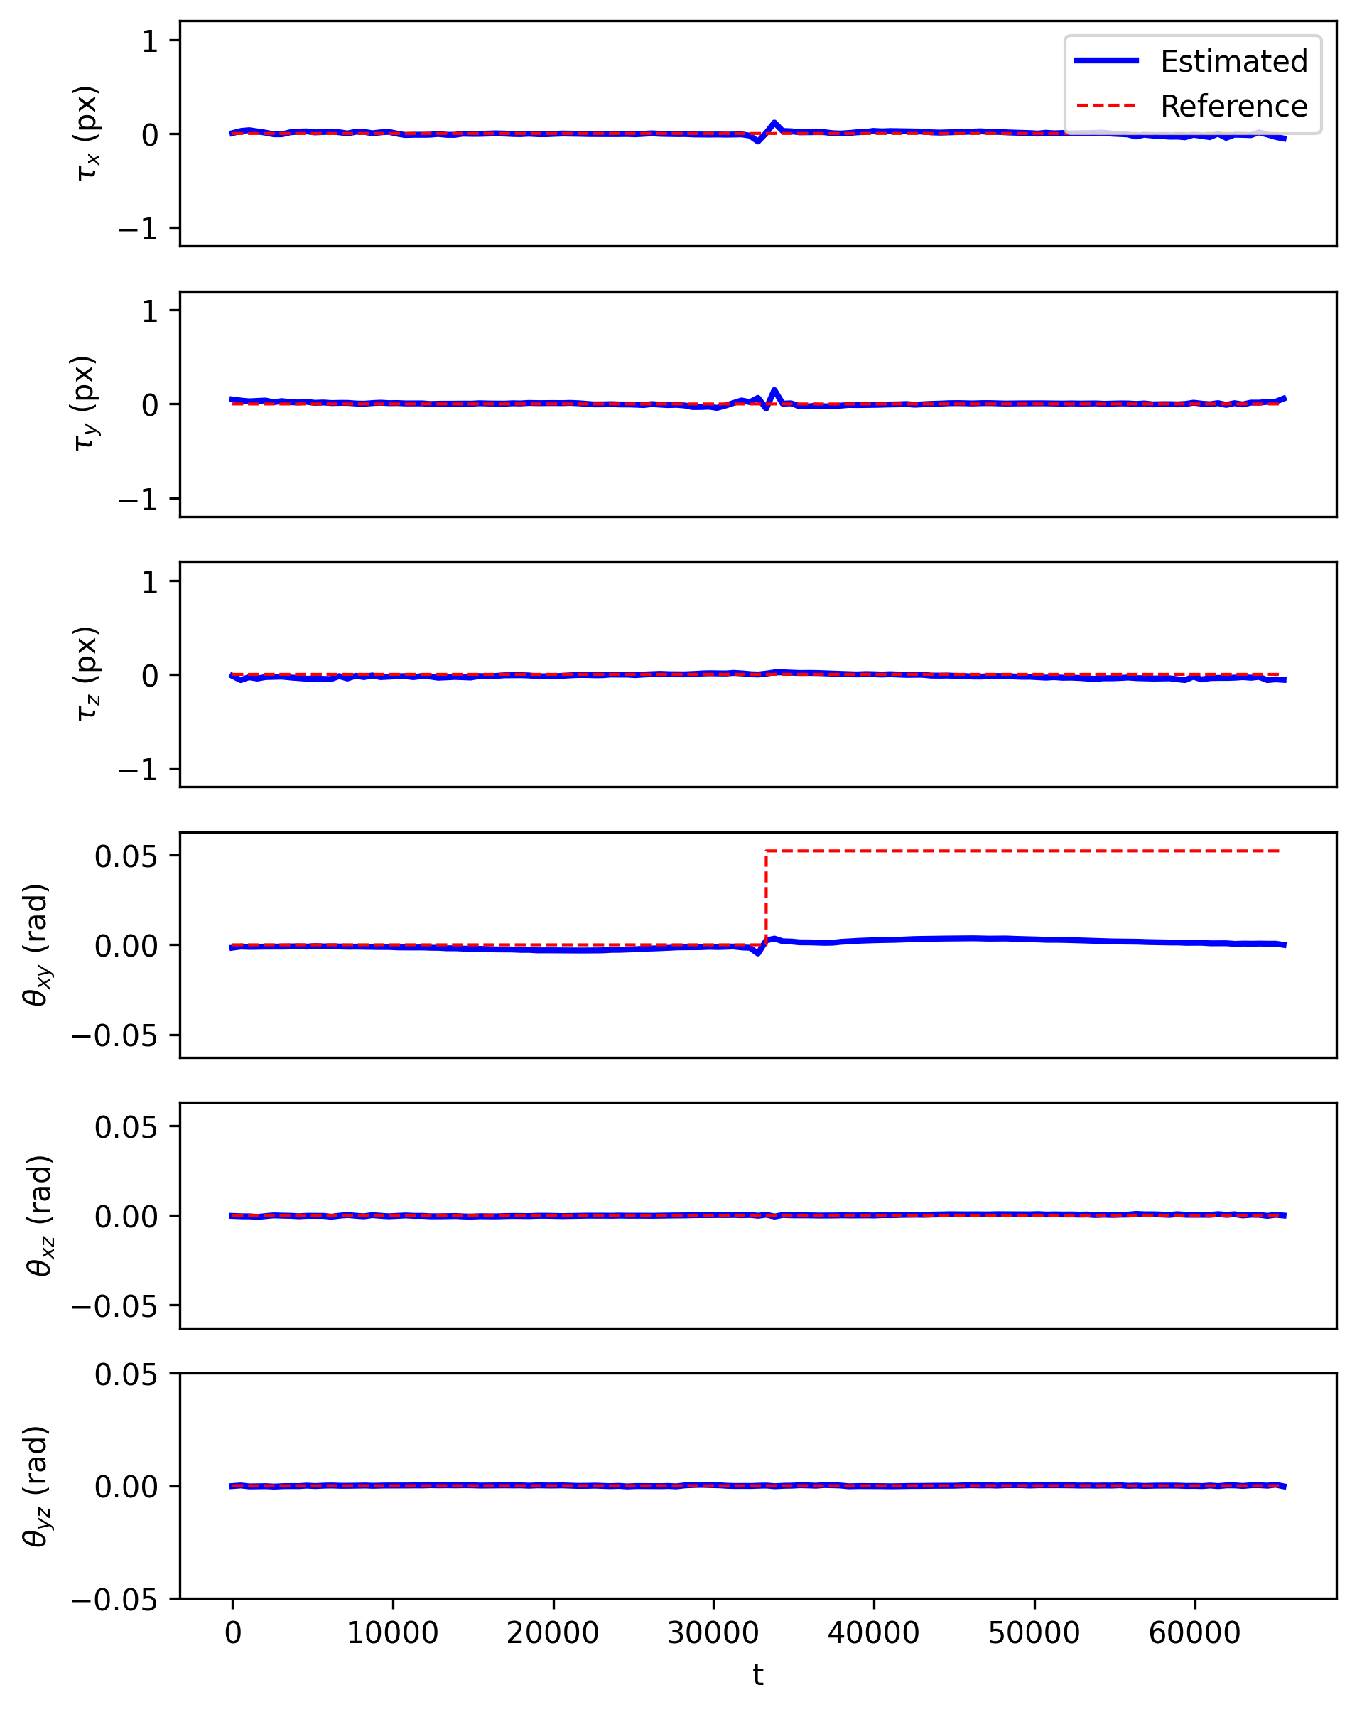
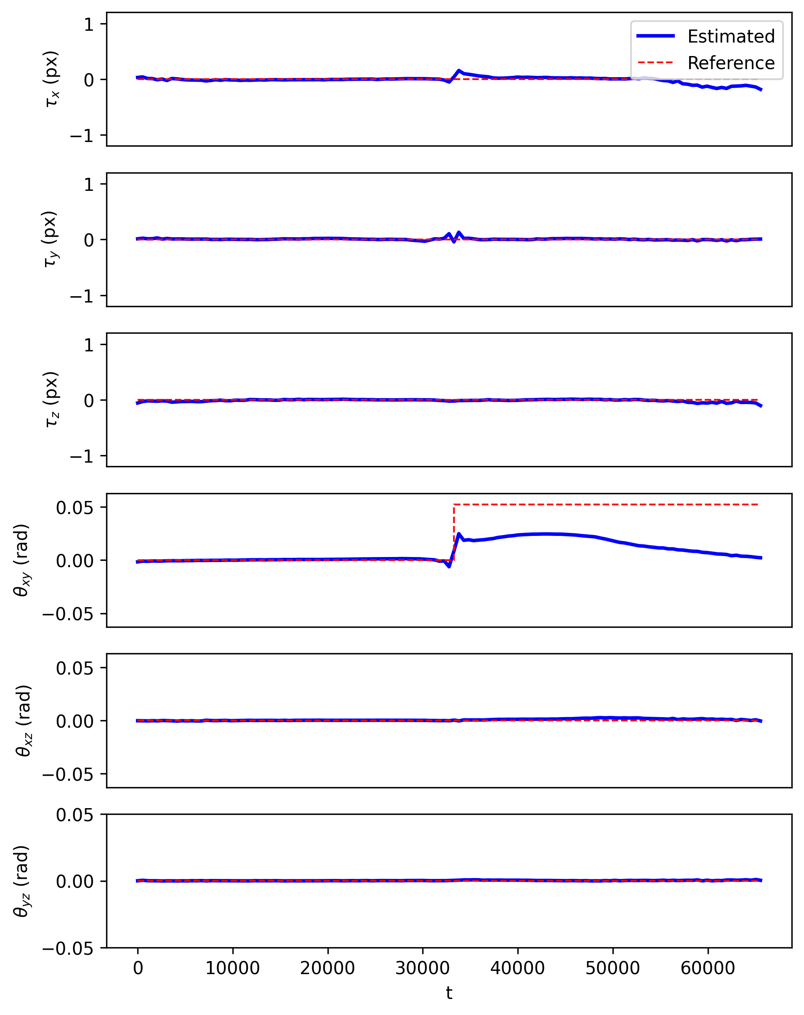
3D synthetics, sudden motion
Joint TV
Joint sTV

Slide 34
Phase-wrapping

Slide 35
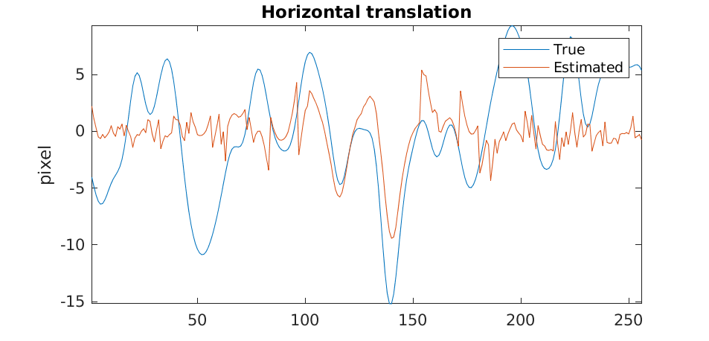
Phase-wrapping

