Slide 1

Blind Motion Correction and Reconstruction
for Brain MRI with Structural Priors
G. Rizzuti, A. Sbrizzi, T. van Leeuwen
SIAM,
25/03/2022

Slide 2
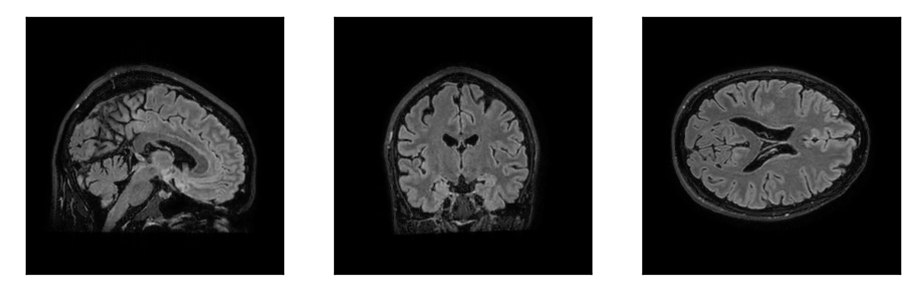
Patient moving inside MR scanner...
Sagittal
Coronal
Axial
M. Zaitsev et al., 2015, “Motion Artifacts in MRI: A Complex Problem With Many Partial Solutions”

Slide 3
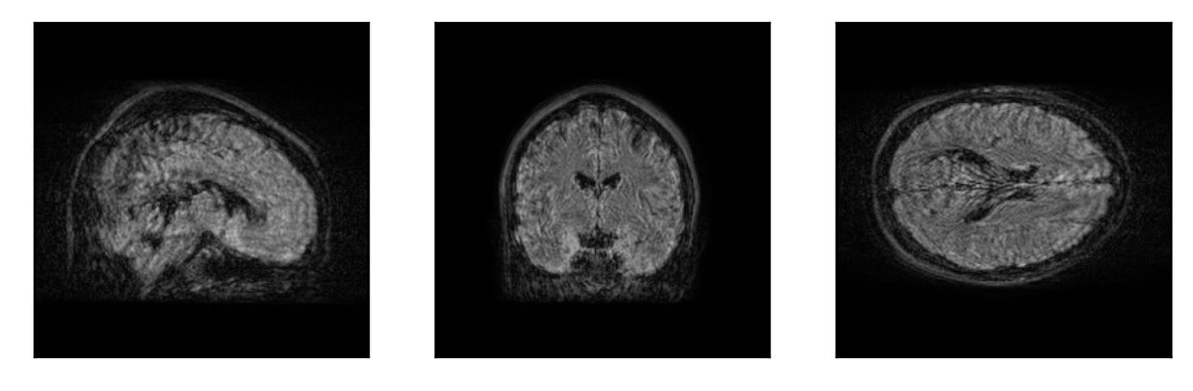
...MR reconstruction
Sagittal
Coronal
Axial
M. Zaitsev et al., 2015, “Motion Artifacts in MRI: A Complex Problem With Many Partial Solutions”
J. B. Andre et al., 2015, “Toward quantifying the prevalence, severity, and cost associated with patient motion during clinical MR examinations”

Slide 4
Motion artifacts in MRI
Motion-artifact reduction techniques
  preventive: physically restrain motion
  prospective: dynamically adjust acquisition
  retrospective (this talk): post-processing
M. Zaitsev et al., 2015, “Motion Artifacts in MRI: A Complex Problem With Many Partial Solutions”

Slide 5
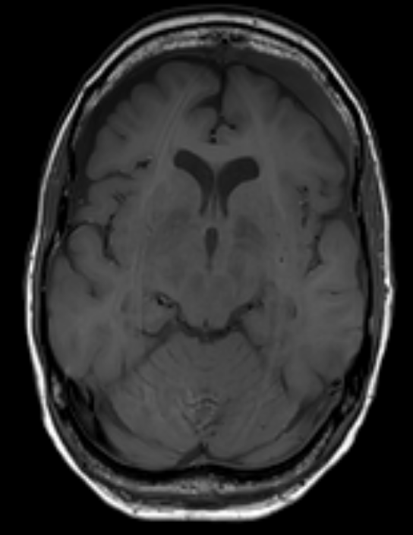
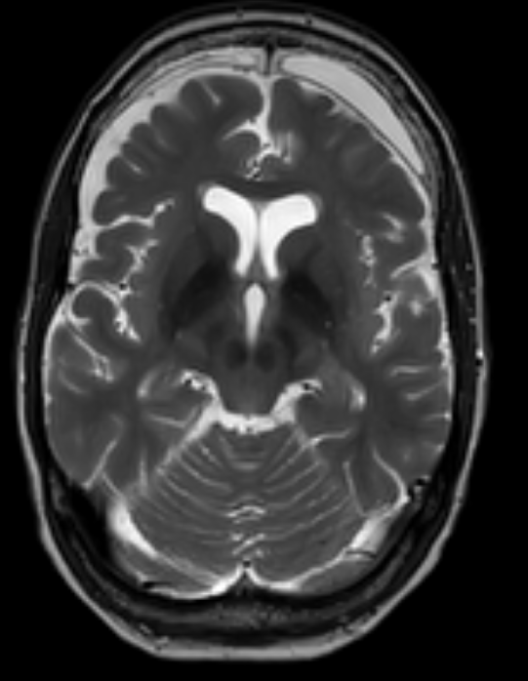
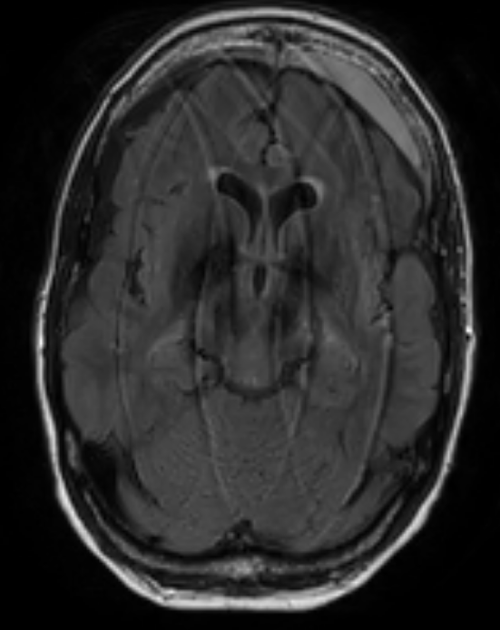
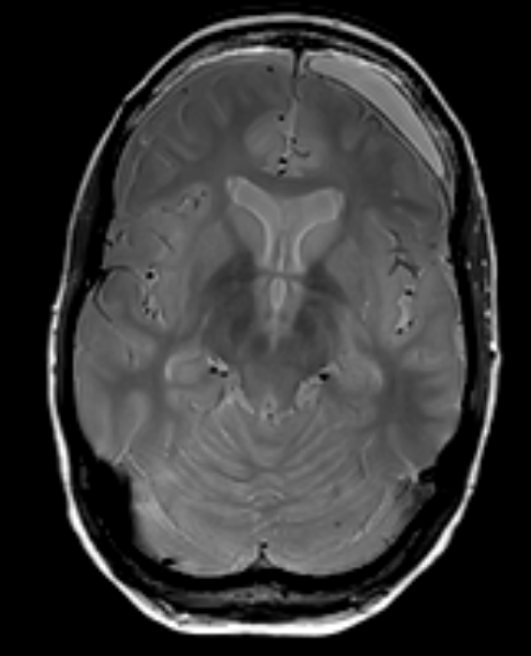
Method: sketch
T1w
T2w
FLAIR
PDw
  Detect motion-corrupted contrast(s)
  Select motion-free contrast(s)
  Artifact removal using structure-guided priors
M. J. Ehrhardt, M. M. Betcke, 2015, “Multi-contrast MRI reconstruction with structure-guided total variation”

Slide 6
Assumptions
T1w
T2w
FLAIR
PDw
  Rigid motion artifacts (brain imaging)
  Motion-free contrast is available
  Motion-free readouts
  Known k-space sampling pattern & ordering (Cartesian)

Slide 7
Features
T1w
T2w
FLAIR
PDw
Input from only amplitude/phase reconstructions
No need for scan modifications/navigators/markers

Slide 8
Rigid motion: x-space → k-space
rotation
translation
phase-shift
rotation
FINUFFT, https://finufft.readthedocs.io/

Slide 9
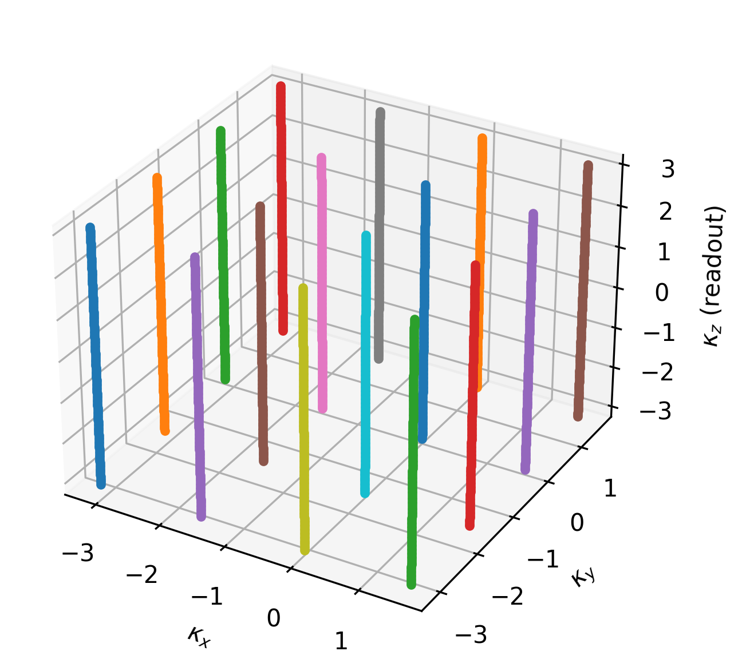
Sequential dynamic sampling
t5
t1
t6
t2
...
t3
t4
rigid motion parameters
k-space

Slide 10
Sequential dynamic sampling
signal loss...
this talk!
t5
t1
t6
t2
...
image registration
t3
t4
rigid motion parameters
k-space
F. Odille, https://imsc.uni-graz.at/mobis/imaging14/Talks/Odille.pdf

Slide 11
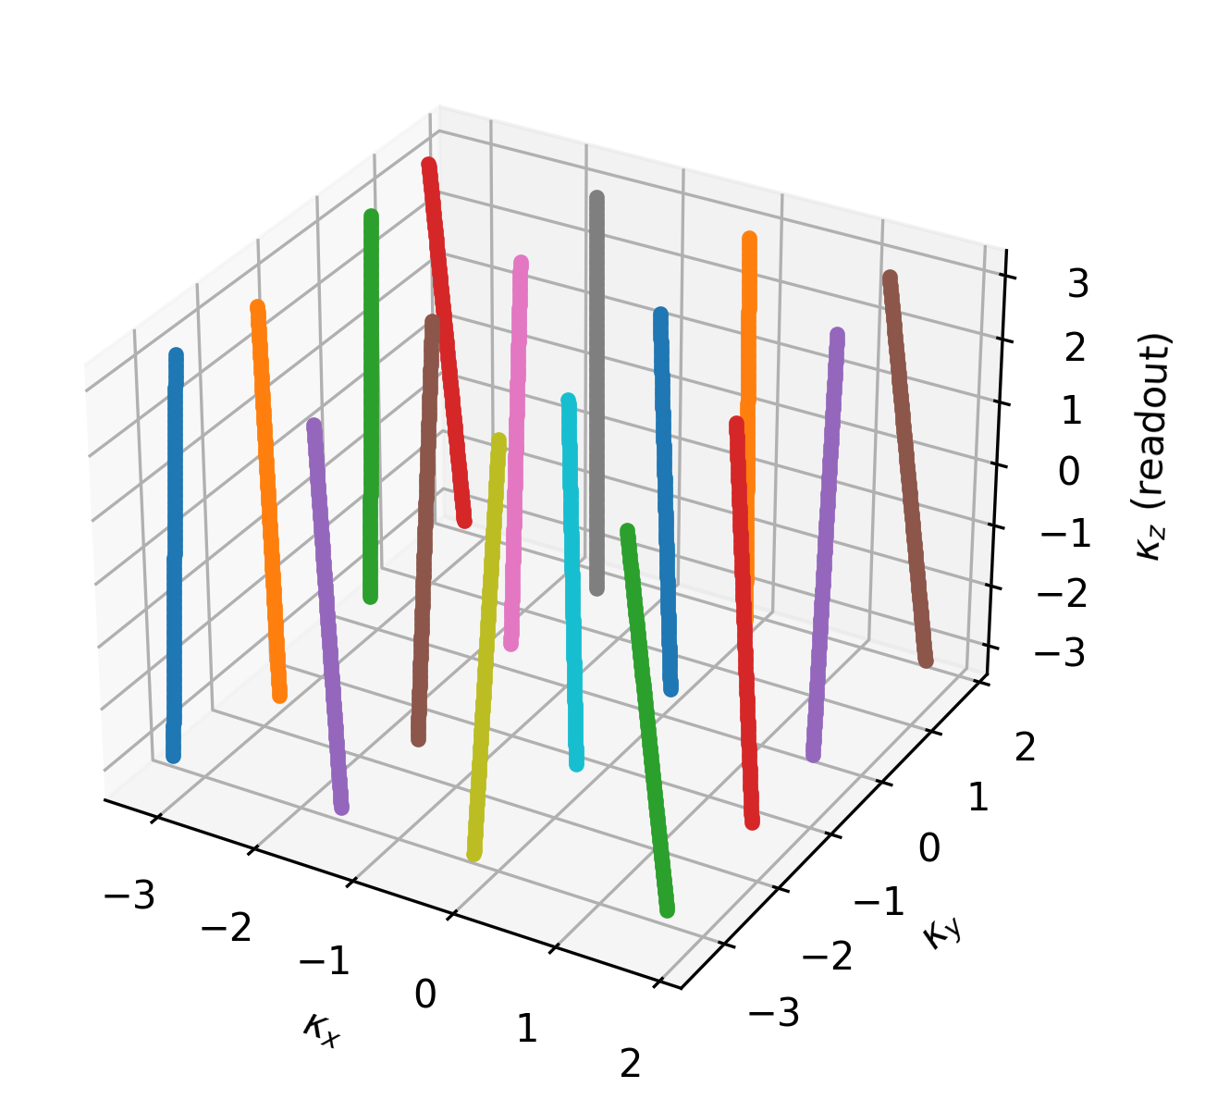
(Motion-induced) effective sampling
Nominal sampling
Effective sampling

Slide 12
Variational problem
Optimization via non-smooth variable projection
  reconstruction (FISTA, primal-dual, ADMM)
  motion update
T. van Leeuwen, A. Aravkin, 2021, “Variable projection for non-smooth problems”
A. Beck, M. Teboulle, 2009, “Fast Gradient-Based Algorithms for Constrained Total Variation Image Denoising and Deblurring Problems”
E. Esser, et al., 2010, “A General Framework for a Class of First Order Primal-Dual Algorithms for Convex Optimization in Imaging Science”

Slide 13
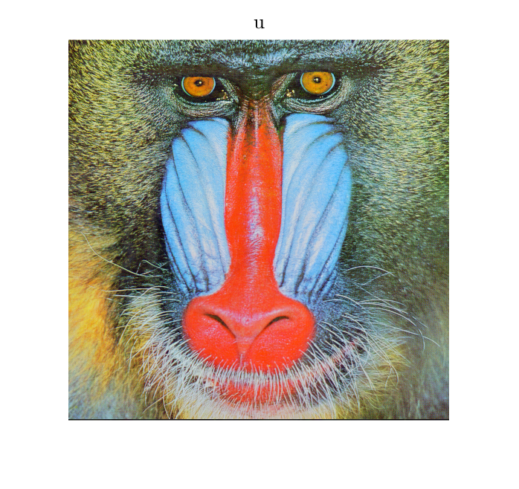
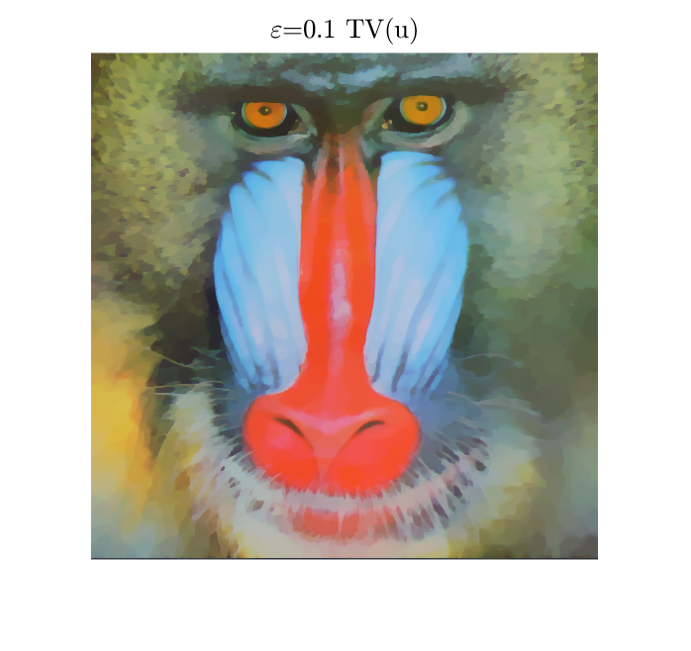
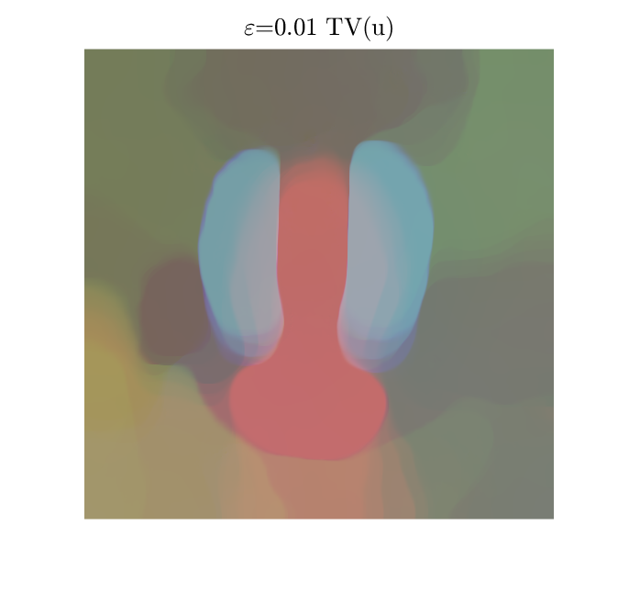
Constrained regularization
B. Peters, et al., 2018, “Projection methods and applications for seismic nonlinear inverse problems with multiple constraints”

Slide 14

Structure-guided TV
T1w
T2w
FLAIR
PDw
M. J. Ehrhardt, M. M. Betcke, 2015, “Multi-Contrast MRI Reconstruction with Structure-Guided Total Variation”

Slide 15
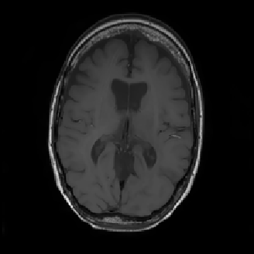
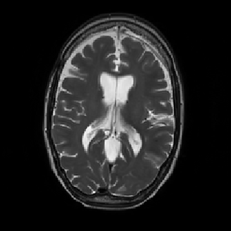
Numerical experiments: 2D synthetics
Prior (T1-weighted)
Ground truth (T2-weighted)
Sampling pattern

Slide 16
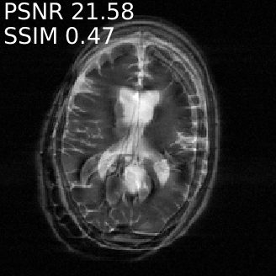
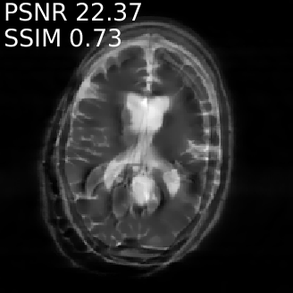
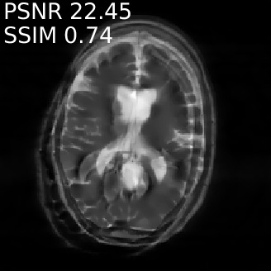
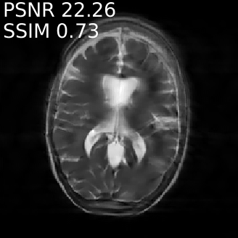
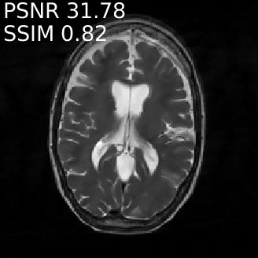
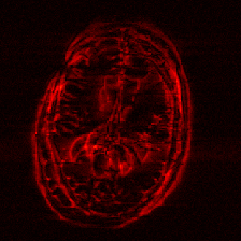
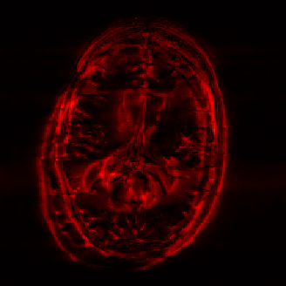

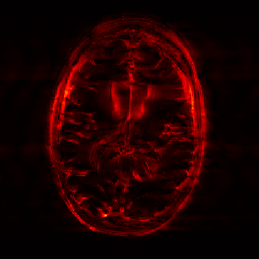
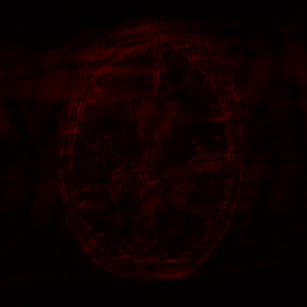

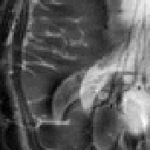


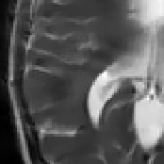
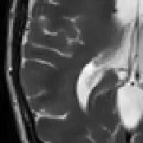
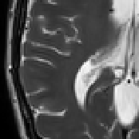
“Sudden” motion
Conventional
TV
sTV
Joint-TV
Joint-sTV
Ground truth
Reconstruction
Error
Detail

Slide 17
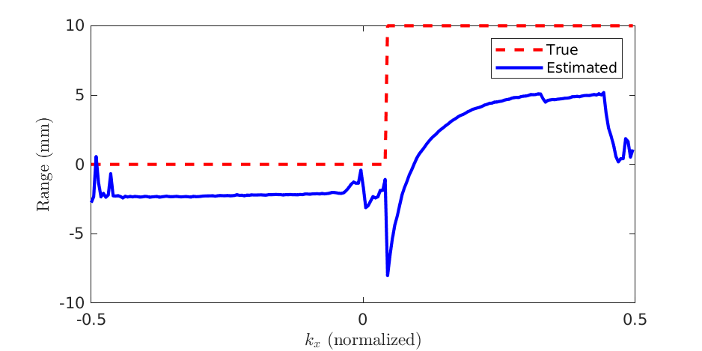
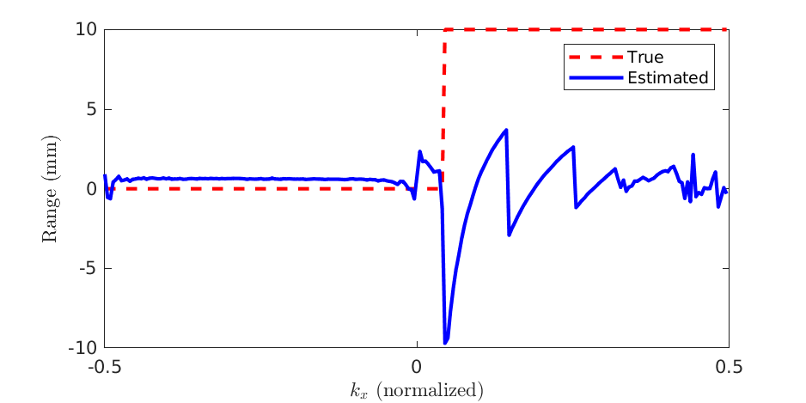
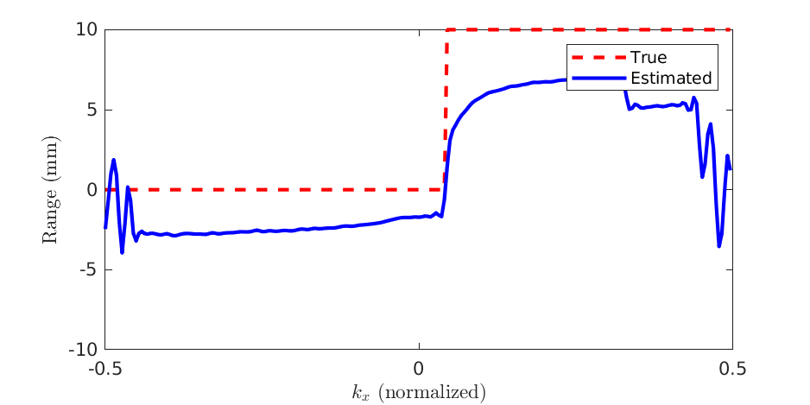
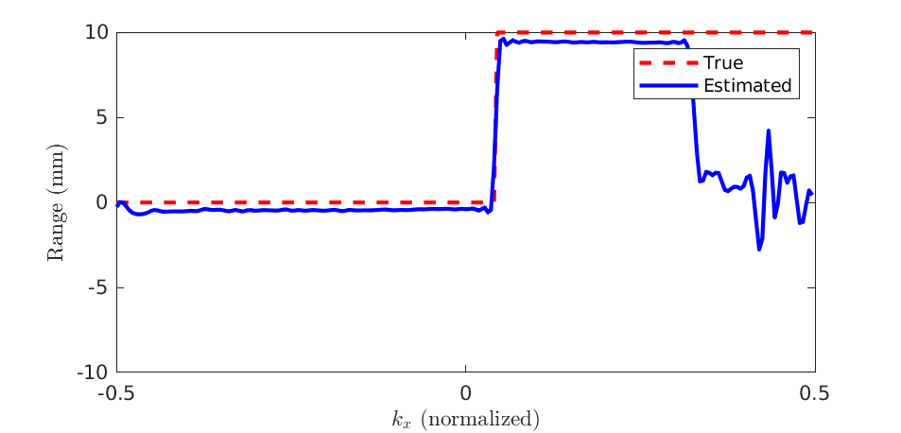
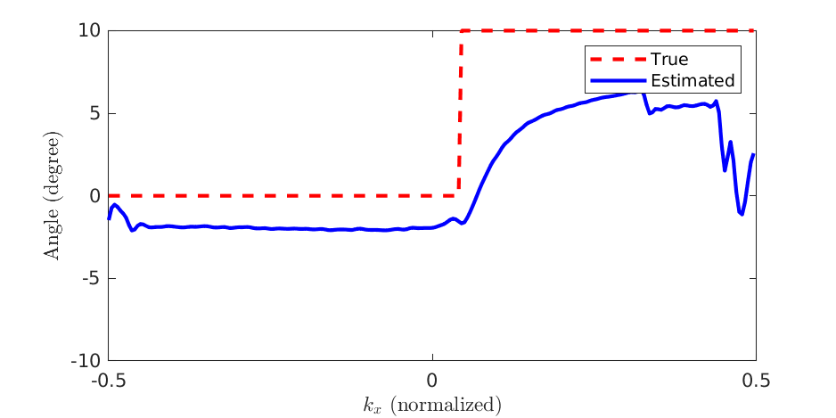
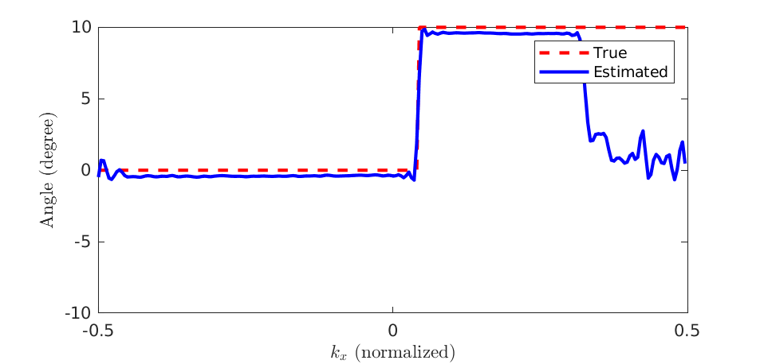
“Sudden” motion
Conventional
TV
sTV
Joint-TV
Joint-sTV
Ground truth
Joint-TV
Joint-sTV
Reconstruction
Error
Detail

Slide 18
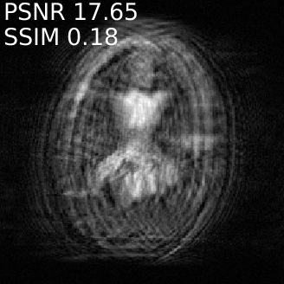
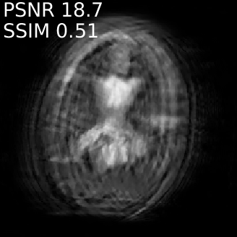
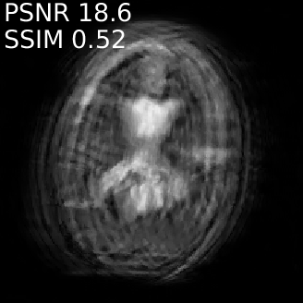
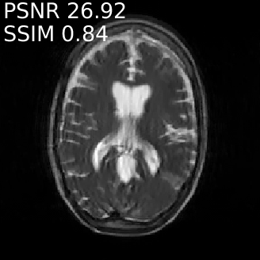
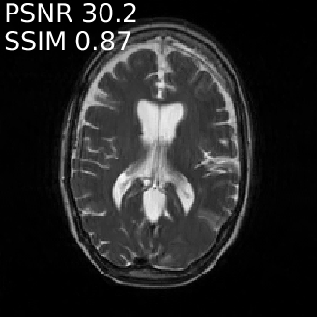
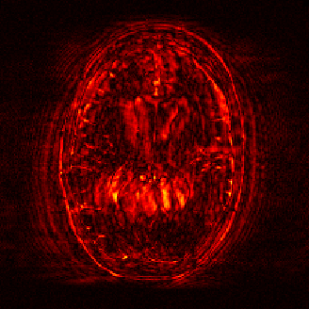
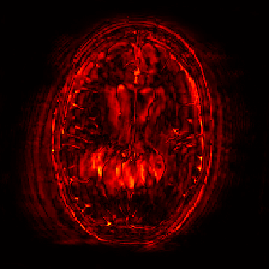
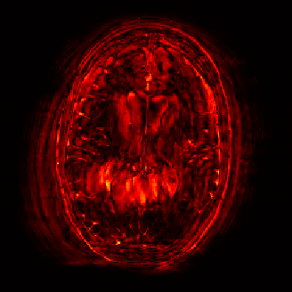
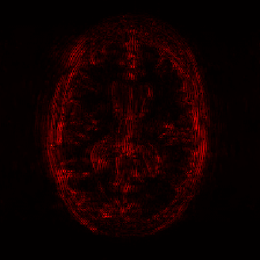
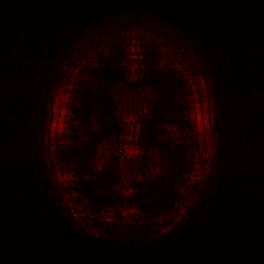
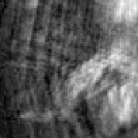
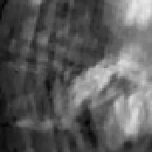

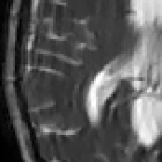
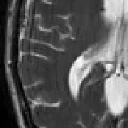
Periodic motion
Conventional
TV
sTV
Joint-TV
Joint-sTV
Ground truth
Reconstruction
Error
Detail

Slide 19
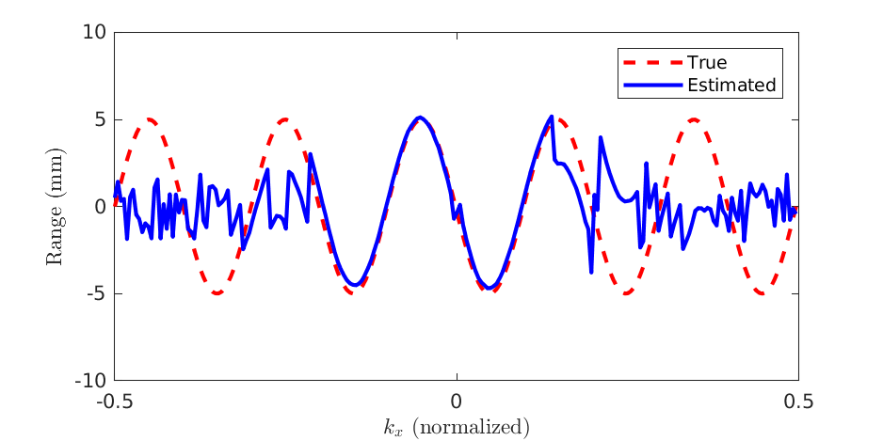
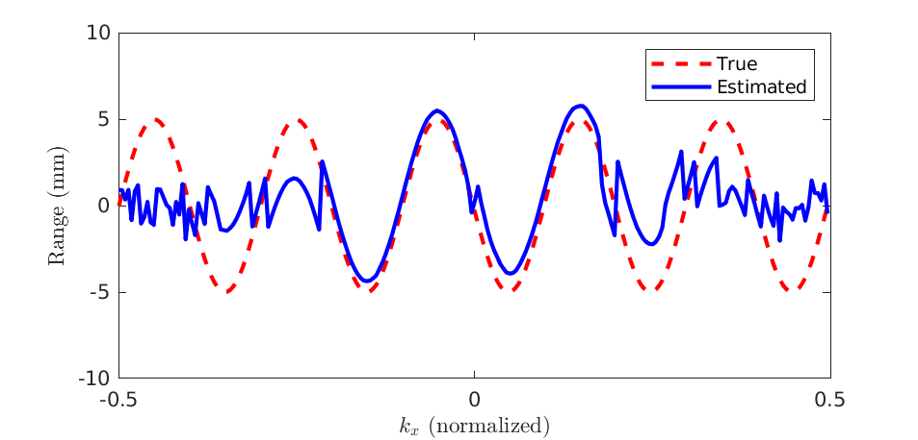
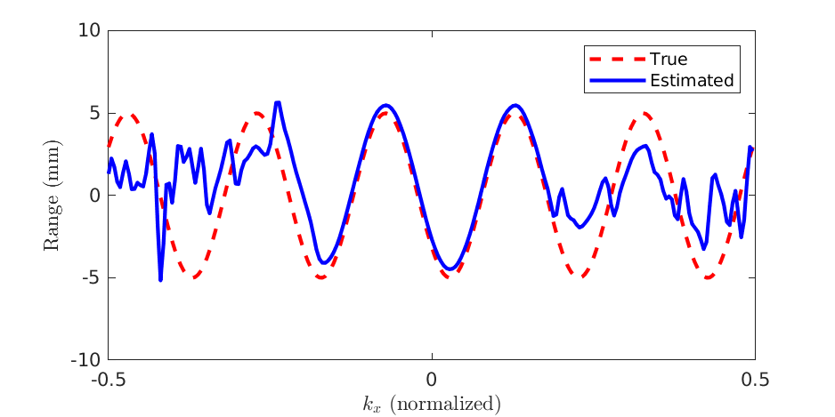
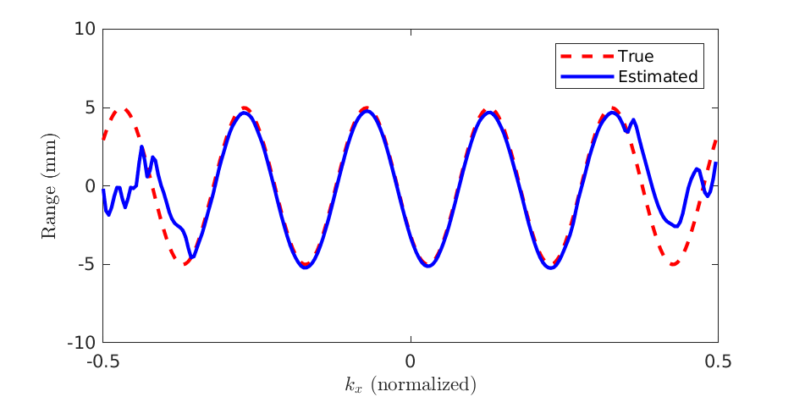


Periodic motion
Conventional
TV
sTV
Joint-TV
Joint-sTV
Ground truth
Joint-TV
Joint-sTV
Reconstruction
Error
Detail

Slide 20















Random smooth motion
Conventional
TV
sTV
Joint-TV
Joint-sTV
Ground truth
Reconstruction
Error
Detail

Slide 21






Random smooth motion
Conventional
TV
sTV
Joint-TV
Joint-sTV
Ground truth
Joint-TV
Joint-sTV
Reconstruction
Error
Detail

Slide 22






Numerical experiments: 3D synthetics
Sagittal
Coronal
Axial
Prior
Ground truth

Slide 23



Random smooth motion
Sagittal
Coronal
Axial
Conventional
SSIM: 0.24
PSNR: 23.4
Ground truth

Slide 24



Random smooth motion
Sagittal
Coronal
Axial
Joint-TV
SSIM: 0.90
PSNR: 27.2
Ground truth

Slide 25



Random smooth motion
Sagittal
Coronal
Axial
Joint-sTV
SSIM: 0.97
PSNR: 38.5
Ground truth

Slide 26


Random smooth motion
Sagittal
Coronal
Axial
Joint TV
Joint sTV
Joint-sTV
SSIM: 0.97
PSNR: 38.5
Ground truth

Slide 27






Numerical experiments: 3D in-vivo
Sagittal
Coronal
Axial
Prior
Target

Slide 28
Numerical experiments: 3D in-vivo
Sagittal
Coronal
Axial
Prior
Target

Slide 29



“Sudden” (voluntary) motion
Sagittal
Coronal
Axial
Conventional
Target

Slide 30
“Sudden” (voluntary) motion
Sagittal
Coronal
Axial
Joint-TV
Target

Slide 31



“Sudden” (voluntary) motion
Sagittal
Coronal
Axial
Joint-sTV
Target

Slide 32
Conclusions and discussion
Motion artifact removal:
structure-guided > conventional prior
Combination with:
    parallel imaging
    navigators
    motion-resilient acquisition sequences
Computational aspects
    GPU
    learned unrolling

Slide 33
References
J. B. Andre et al., 2015, “Toward quantifying the prevalence, severity, and cost associated with patient motion during clinical MR examinations.”, J Am Coll Radiol
F. Godenschweger et al., 2016, “Motion correction in MRI of the brain”, Phys Med Biol. 61(5)
Cordero-Grande et al., 2018, “Three-Dimensional Motion Corrected Sensitivity Encoding Reconstruction for Multi-Shot Multi-Slice MRI: Application to Neonatal Brain Imaging”, Magn Reson Med 79
Cordero-Grande et al., 2020, “Motion-corrected MRI with DISORDER: Distributed and incoherent sample orders for reconstruction deblurring using encoding redundancy”, Magn Reson Med 84
M. Zaitsev, 2015, “Motion Artifacts in MRI: A Complex Problem With Many Partial Solutions”, J Magn Reson Imaging 42
A. Barnett, et al., 2019, “A parallel non-uniform fast Fourier transform library based on an “exponential of semicircle” kernel”, SIAM J. Sci. Comput., 41(5)
A. Barnett, et al., 2021, “Aliasing error of the exp(\beta\sqrt{1-z^2}) kernel in the nonuniform fast Fourier transform”, arXiv
B. Peters, et al., 2018, “Projection methods and applications for seismic nonlinear inverse problems with multiple constraints”, Geophysics 84
A. Beck, M. Teboulle, 2009, “Fast Gradient-Based Algorithms for Constrained Total Variation Image Denoising and Deblurring Problems”
E. Esser, et al., 2010, “A General Framework for a Class of First Order Primal-Dual Algorithms for Convex Optimization in Imaging Science”, SIAM J Imaging Sciences 3(4)
G. Golub, V. Pereira, 2003, “Separable nonlinear least squares: the variable projection method and its applications”
T. van Leeuwen, A. Aravkin, 2021, “Variable projection for non-smooth problems”, SIAM J Imaging Sciences
M. J. Ehrhardt, M. M. Betcke, 2015, “Multi-Contrast MRI Reconstruction with Structure-Guided Total Variation”, SIAM J. Imaging Sciences 9(3)
R. Otazo, et al., 2015, “Low-Rank Plus Sparse Matrix Decomposition for Accelerated Dynamic MRI with Separation of Background and Dynamic Components”, Magnetic Resonance in Medicine 73

Slide 34



2D synthetics, sudden motion

Slide 35



3D synthetics, sudden motion
Conventional, SSIM=0.33, PSNR=26.6

Slide 36



3D synthetics, sudden motion
Joint TV, SSIM=0.91, PSNR=28.0

Slide 37



3D synthetics, sudden motion
Joint sTV, SSIM=0.96, PSNR=31.8

Slide 38
3D synthetics, sudden motion
Ground truth

Slide 39


3D synthetics, sudden motion
Joint TV
Joint sTV

Slide 40
Phase-wrapping

Slide 41

Phase-wrapping

Slide 42

“2D” in-vivo, sudden motion

Slide 43


“2D” in-vivo, sudden motion

