Slide 1

Retrospective
motion correction
and reconstruction
for brain MRI in 3D
G. Rizzuti, A. Sbrizzi, T. van Leeuwen
TRACKERS,
17/02/2022

Slide 2
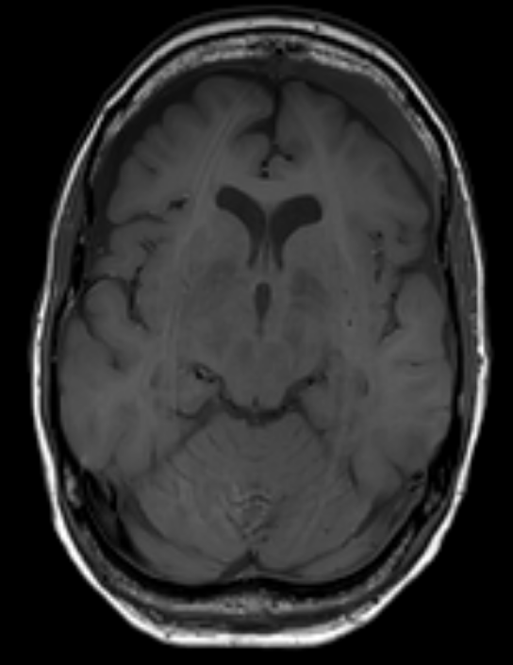
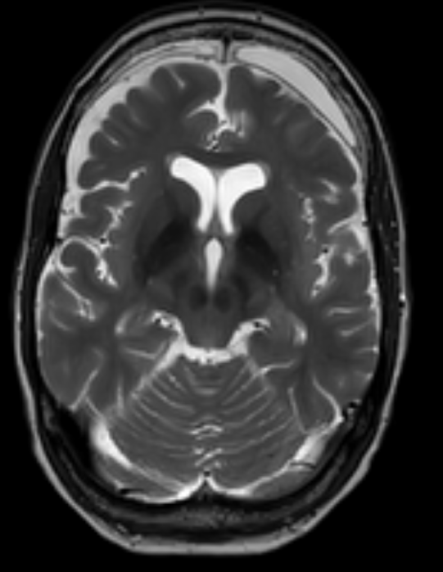
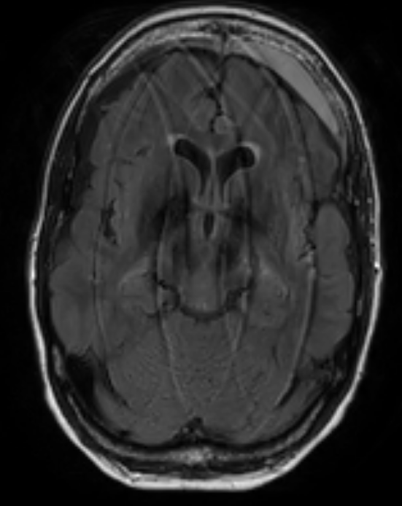
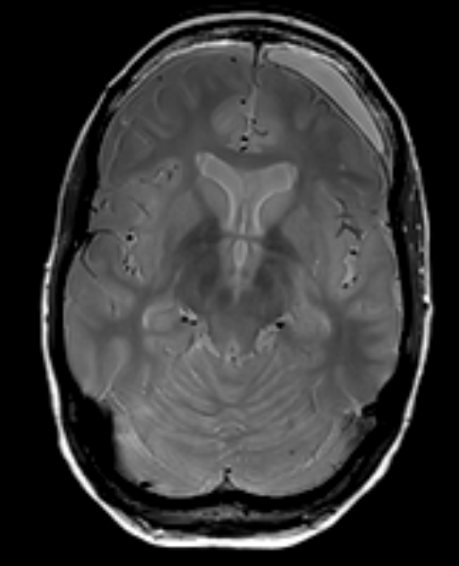
Method
Sketch of the proposed method:
  detect corrupted contrast(s)
  select well-resolved contrast(s)
  motion estimation / regularized reconstruction
  using structure-guided priors
M. Zaitsev et al., 2015, “Motion Artifacts in MRI: A Complex Problem With Many Partial Solutions”

Slide 3
Method
Applied purely as a post-processing step:
no need for scan modifications/navigators/markers!
Few assumptions:
rigid motions, clean scan available, dense Cartesian sampling

Slide 4
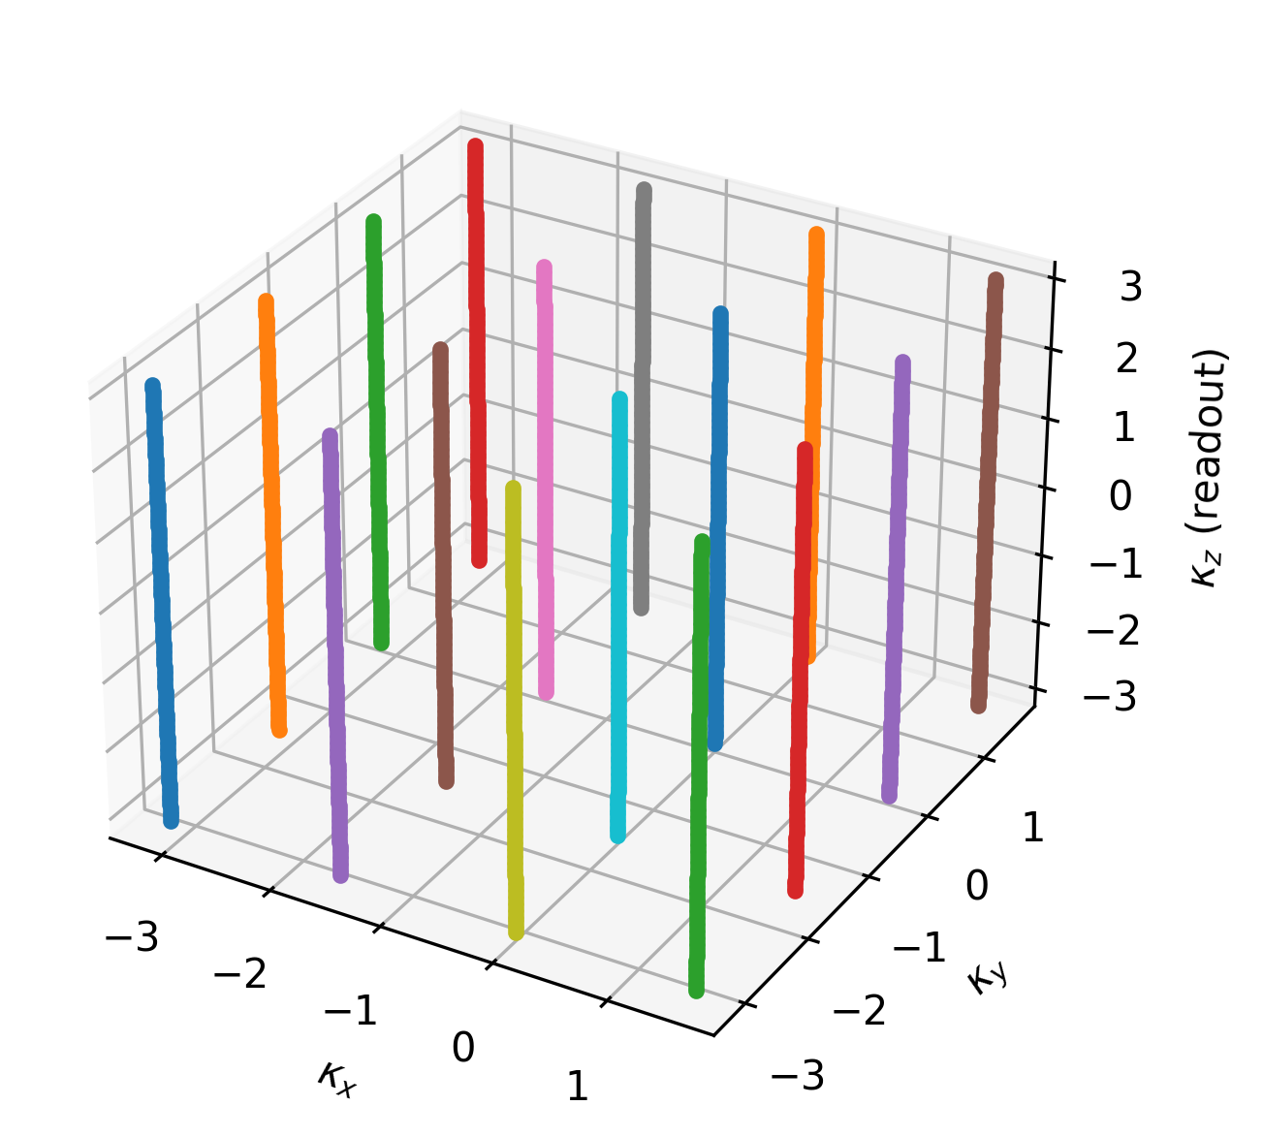
Sequential dynamic sampling
t5
t1
t6
t2
...
t3
t4
rigid motion parameters

Slide 5
Motion-corrupted data model
reconstructed image
motion parameters
NFFT
FINUFFT, https://finufft.readthedocs.io/

Slide 6
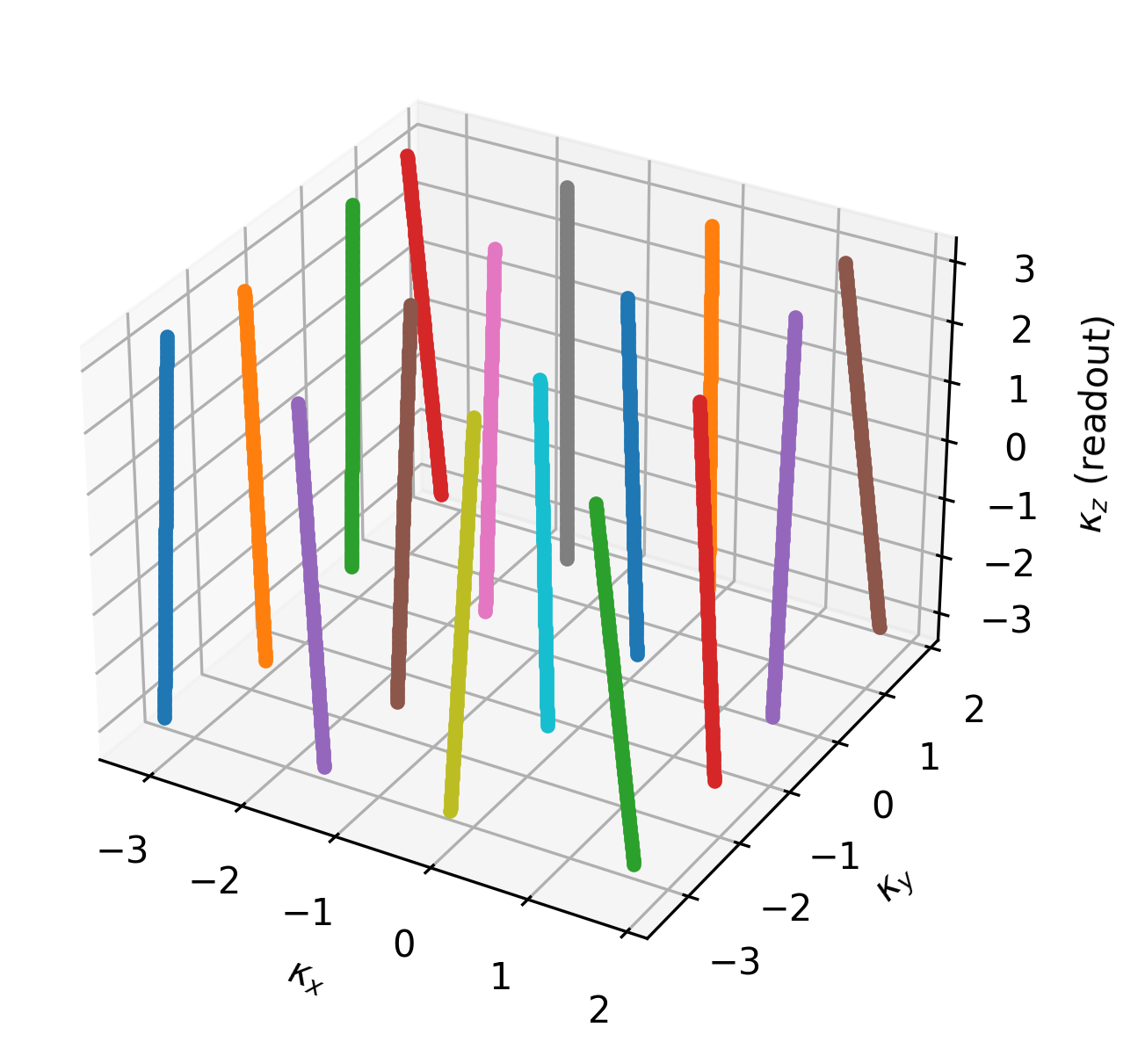
(Motion-induced) effective sampling
Nominal sampling
Effective sampling

Slide 7
Variational problem

Slide 8

Variational problem (loss)

Slide 9
Variational problem (regularization)

Slide 10
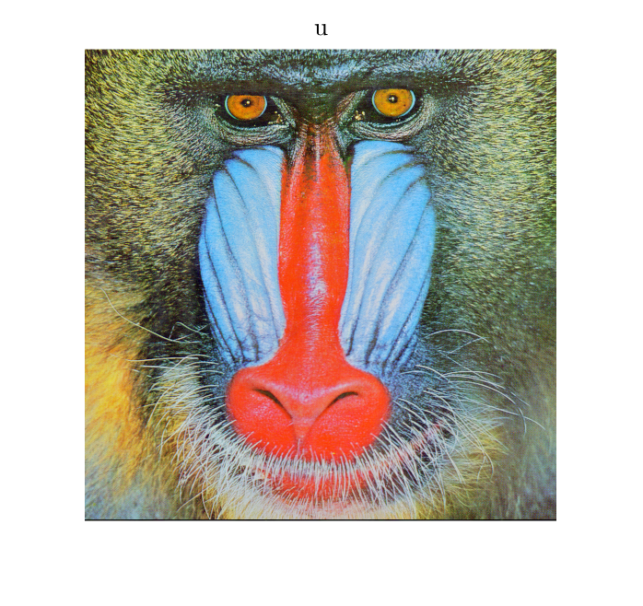
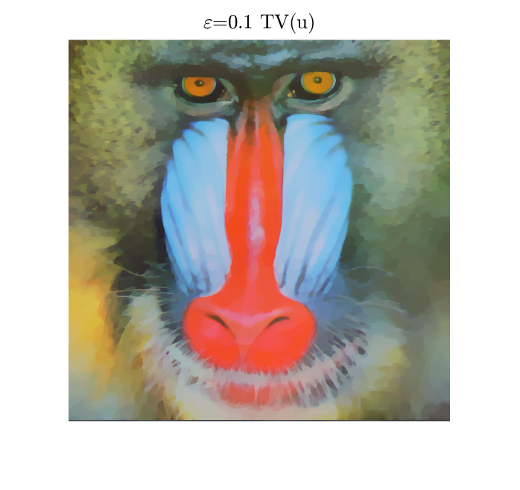
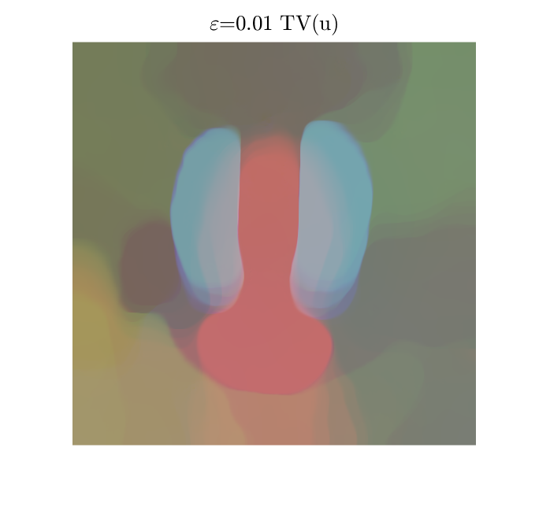
Variational problem (regularization)
B. Peters, et al., 2018, “Projection methods and applications for seismic nonlinear inverse problems with multiple constraints”

Slide 11

Regularization: structure-guided TV
T1w
T2w
FLAIR
PDw
M. J. Ehrhardt, M. M. Betcke, 2015, “Multi-Contrast MRI Reconstruction with Structure-Guided Total Variation”

Slide 12
Variational problem (regularization)

Slide 13
Optimization strategy
Alternately:
1. Reconstruction (FISTA, primal-dual, ADMM)
A. Beck, M. Teboulle, 2009, “Fast Gradient-Based Algorithms for Constrained Total Variation Image Denoising and Deblurring Problems”
E. Esser, et al., 2010, “A General Framework for a Class of First Order Primal-Dual Algorithms for Convex Optimization in Imaging Science”

Slide 14
Optimization strategy
Alternately:
2. Motion estimation (2nd order methods)
...or single update (variable projection)
G. Golub, V. Pereira, 2003, “Separable nonlinear least squares: the variable projection method and its applications”
T. van Leeuwen, A. Aravkin, 2021, “Variable projection for non-smooth problems”

Slide 15
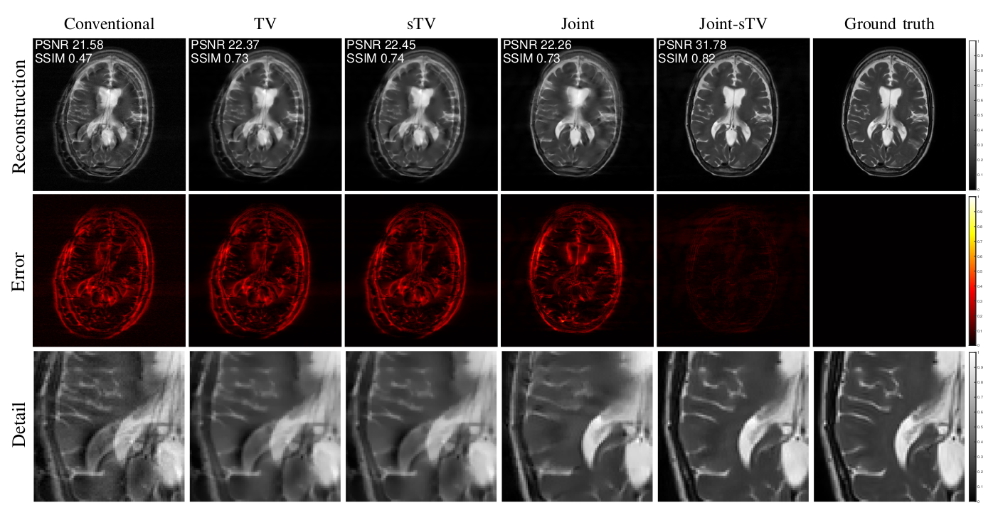
Previously (2D synthetics)...

Slide 16
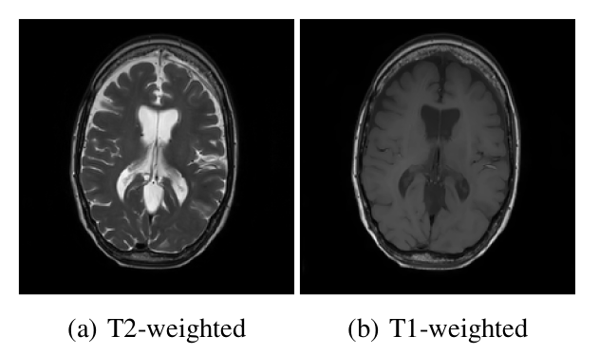
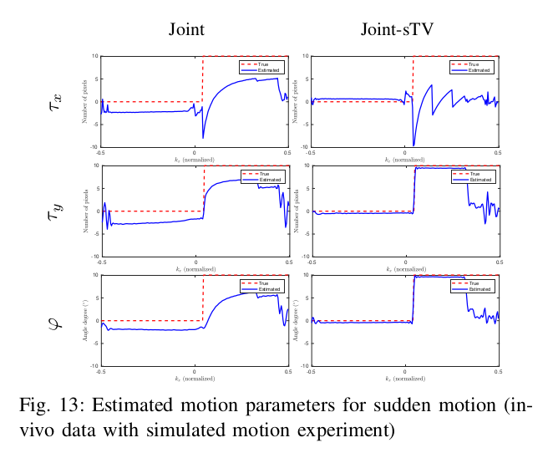
Previously (2D synthetics)...
Prior

Slide 17
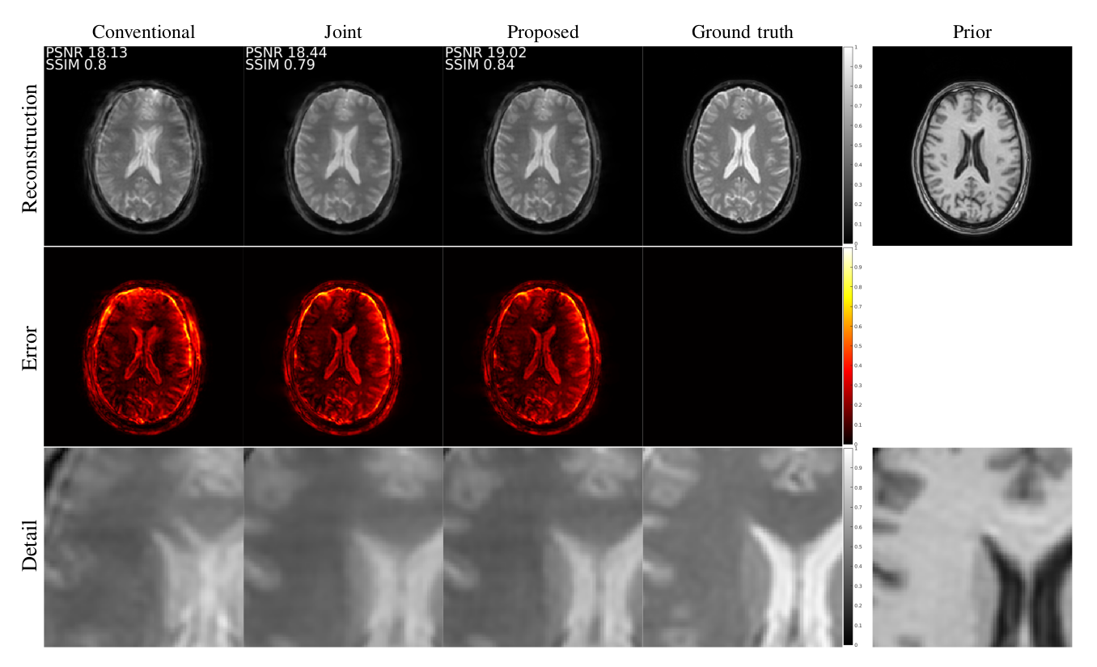
Previously (“2D” in-vivo)...

Slide 18
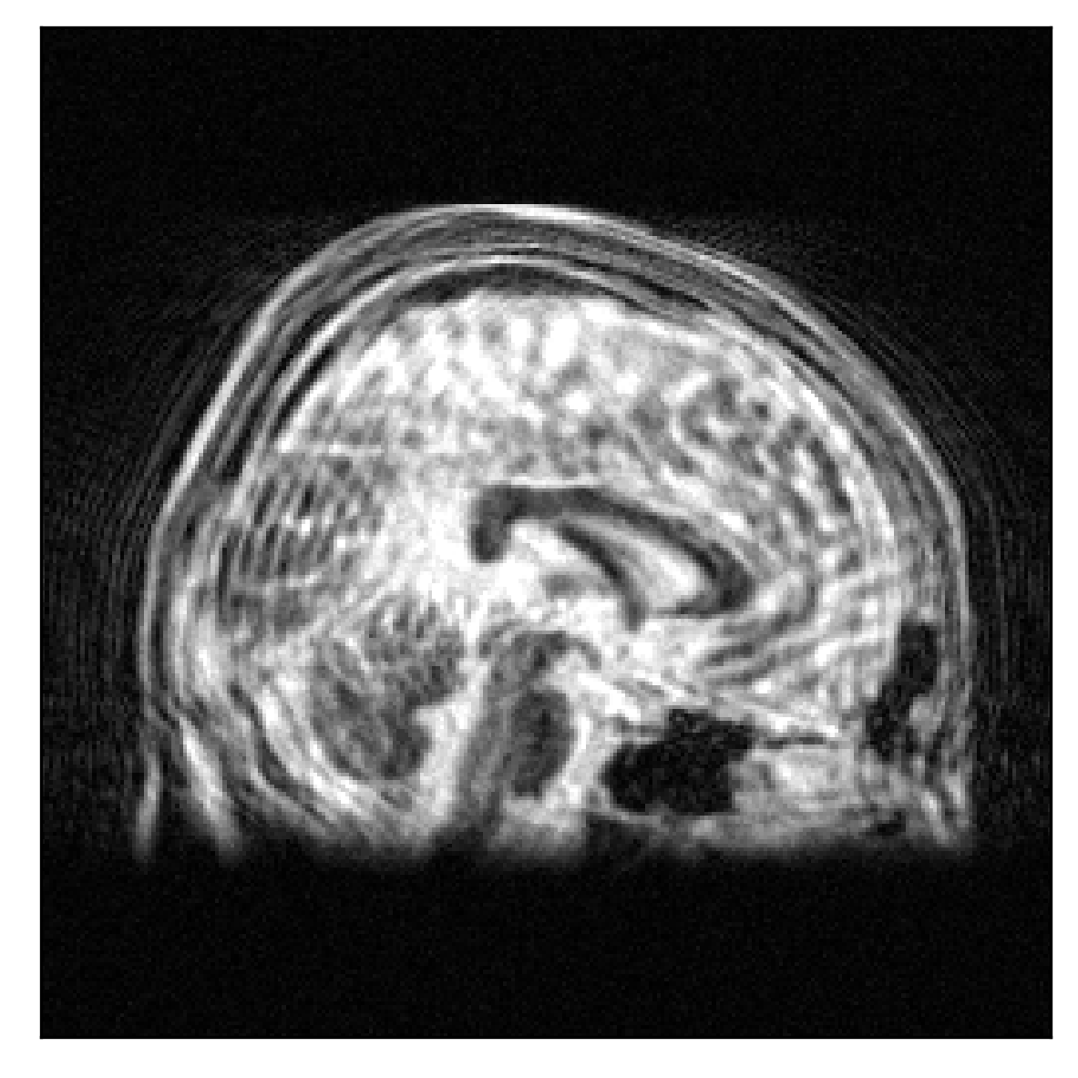
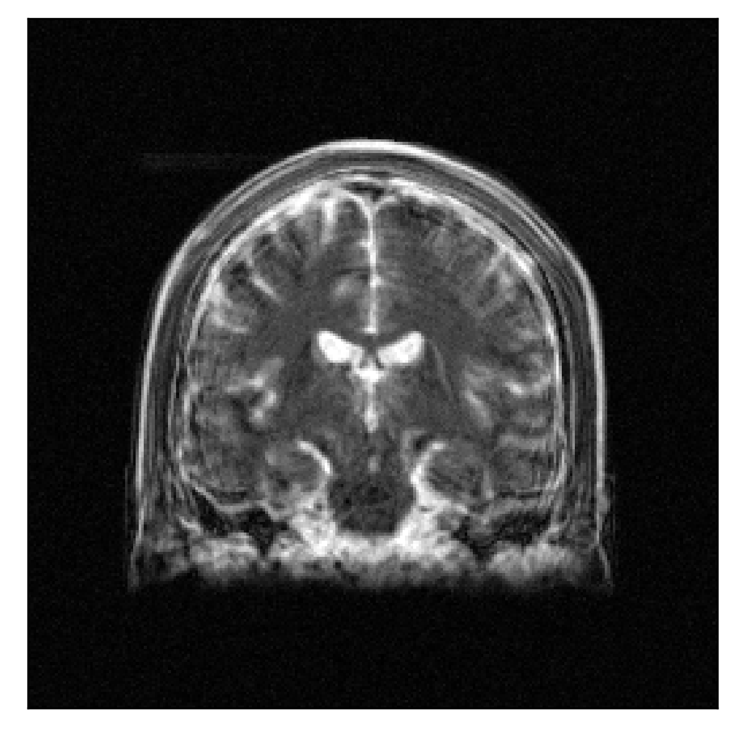
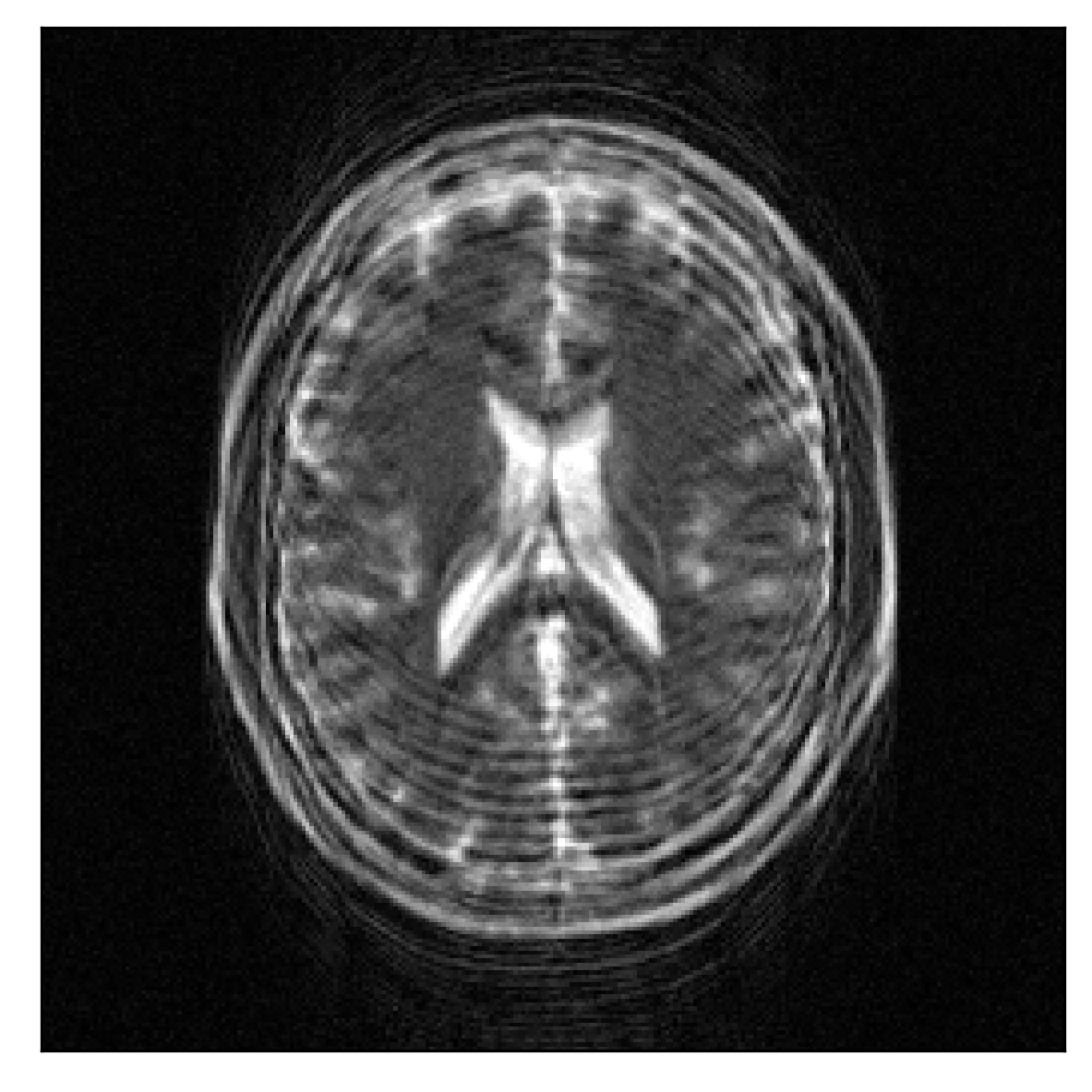
Rnd motion (conv., SSIM=0.238, PSNR=23.4)

Slide 19
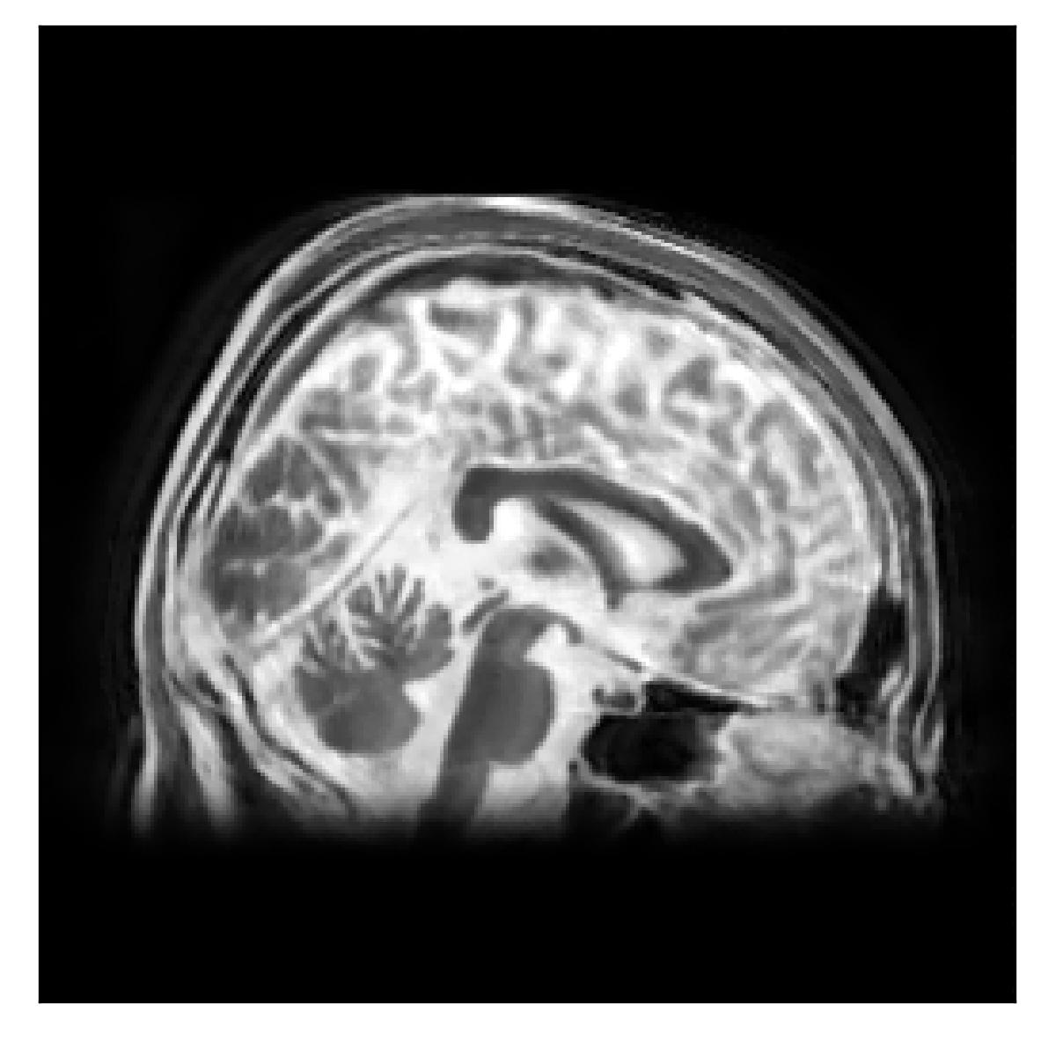

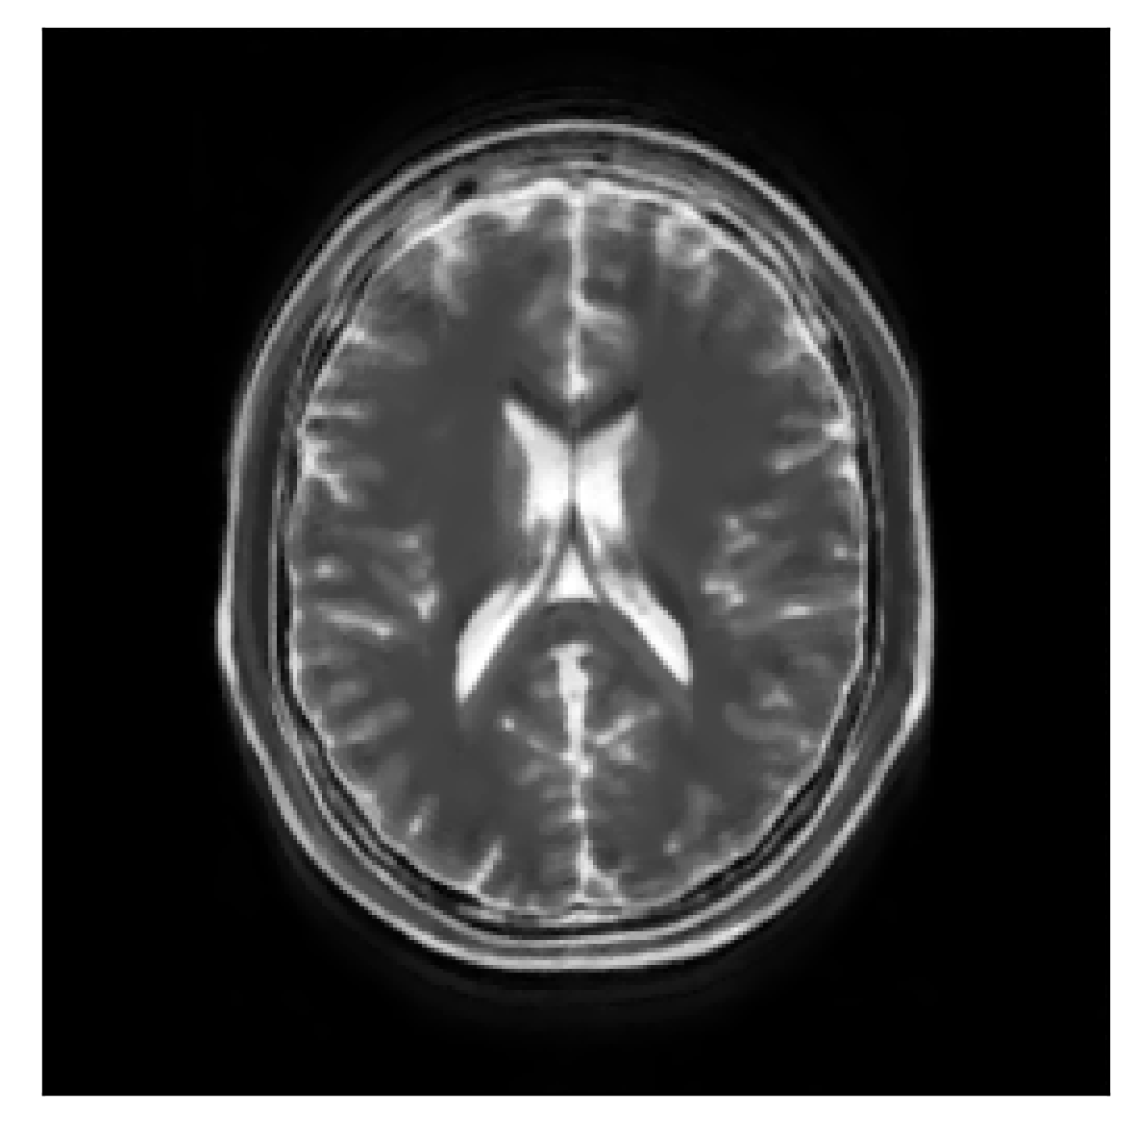
Rnd motion (joint TV, SSIM=0.90, PSNR=27.2)

Slide 20
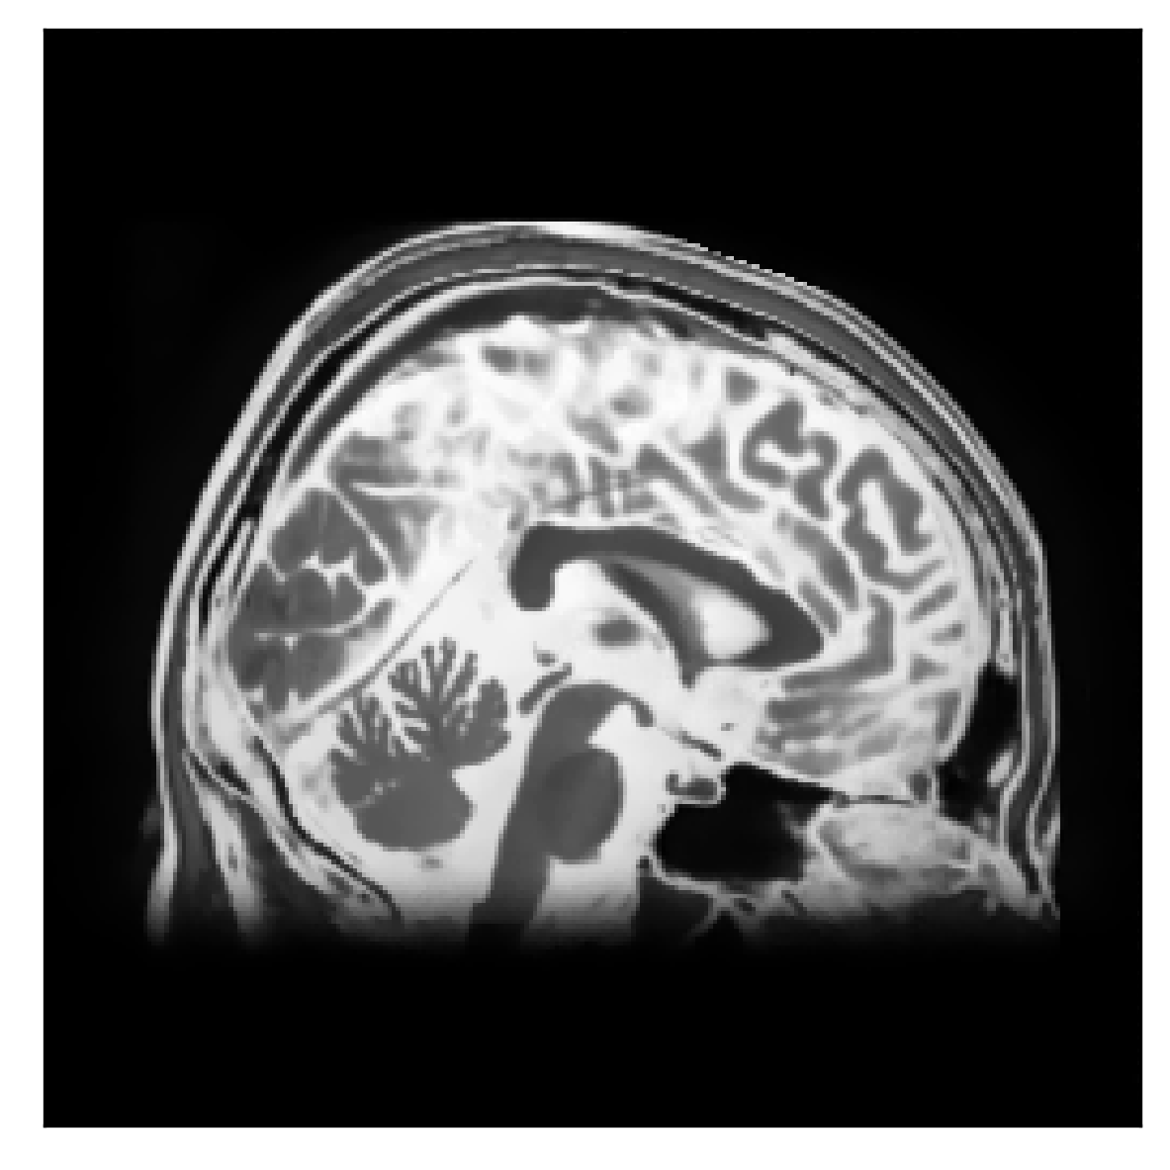

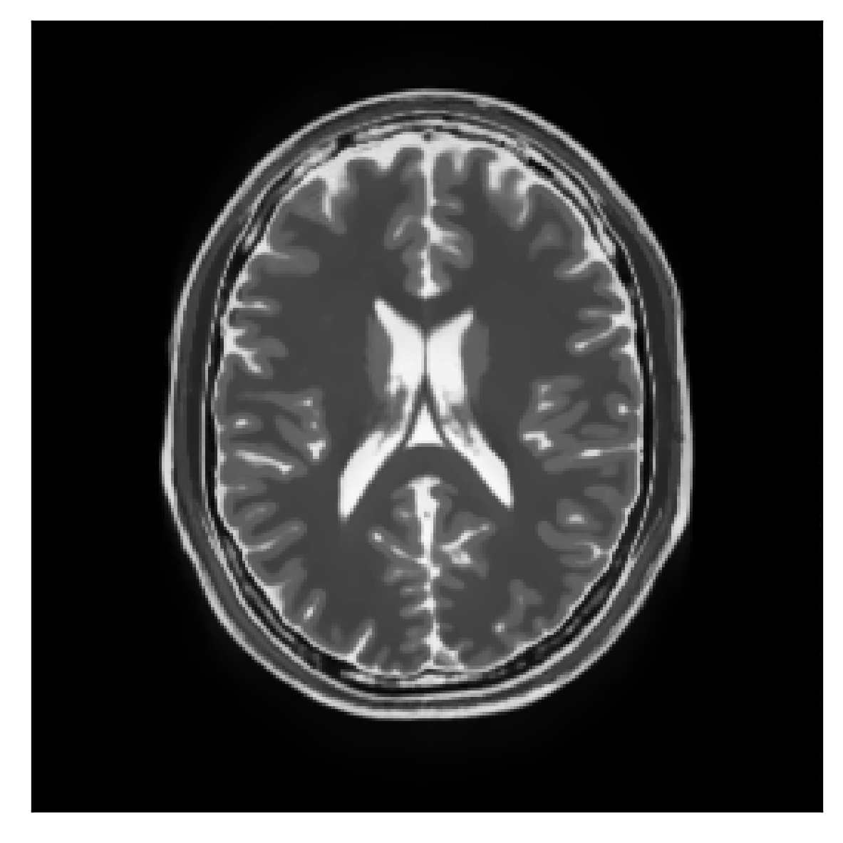
Rnd motion (joint sTV, SSIM=0.965, PSNR=38.5)

Slide 21


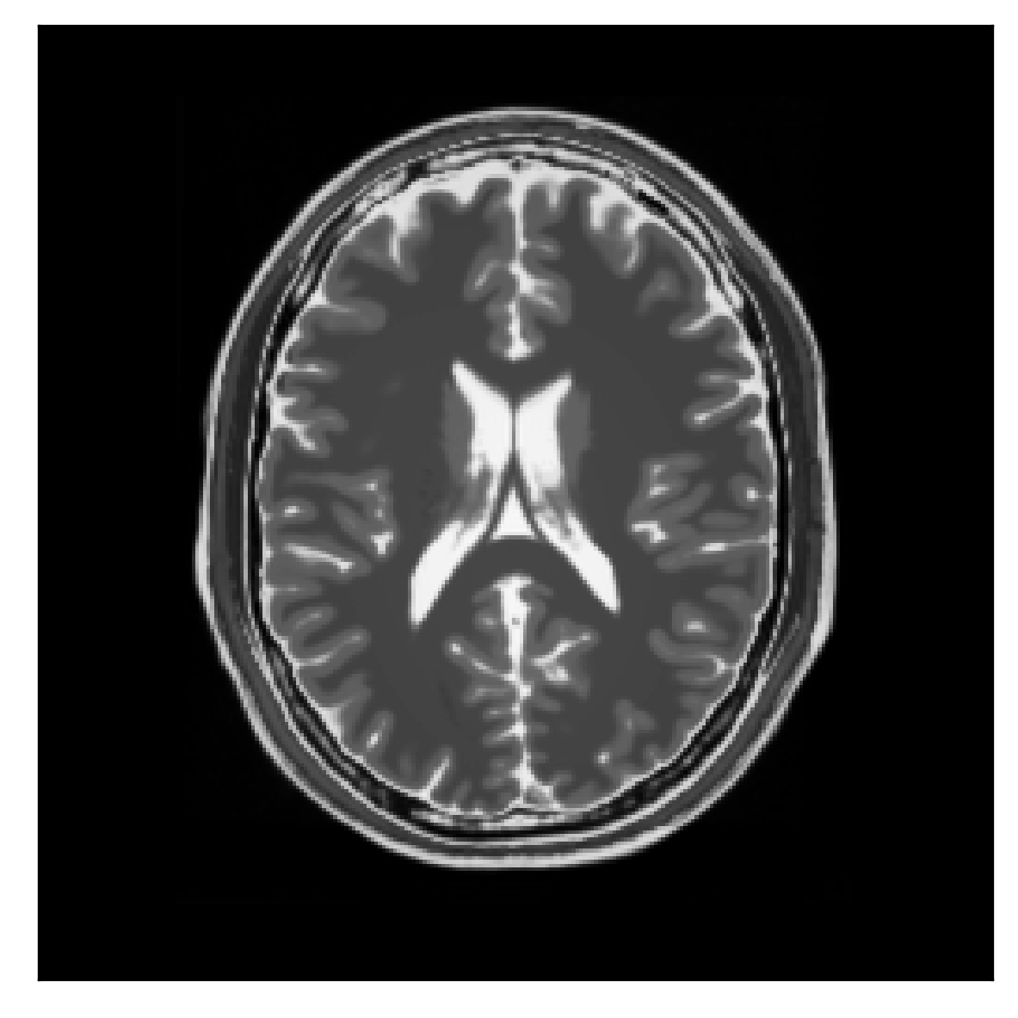
Rnd motion (ground truth)

Slide 22
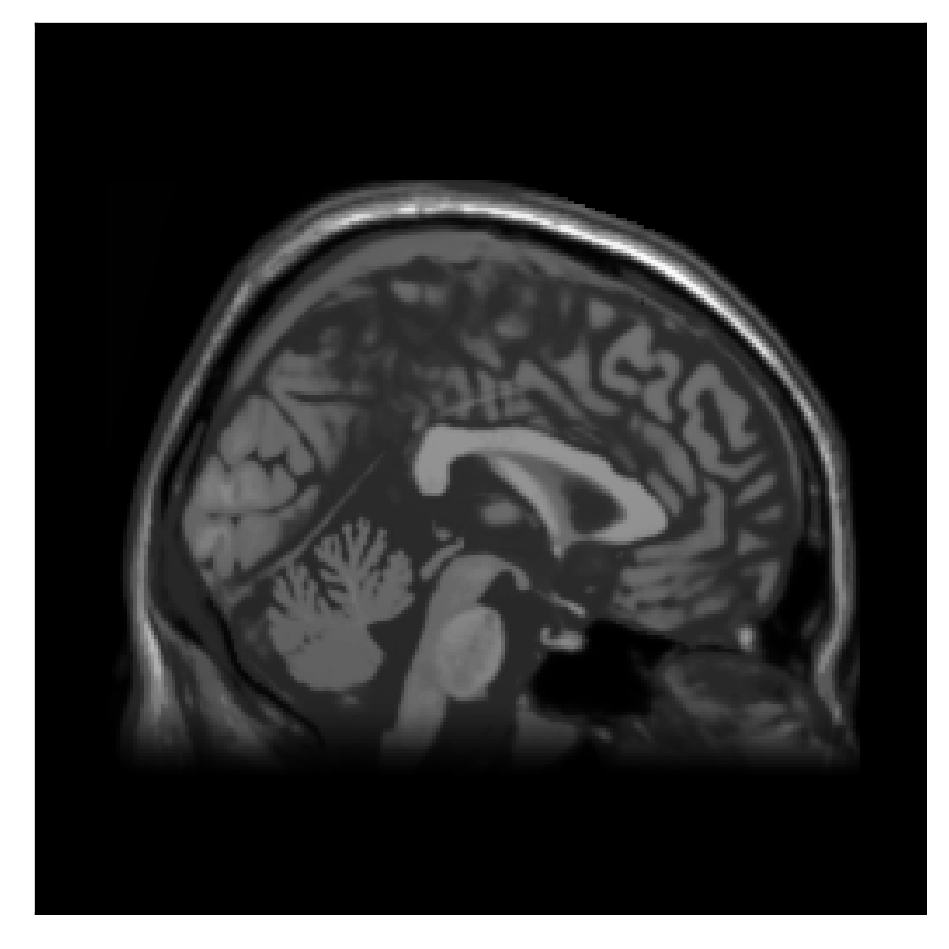
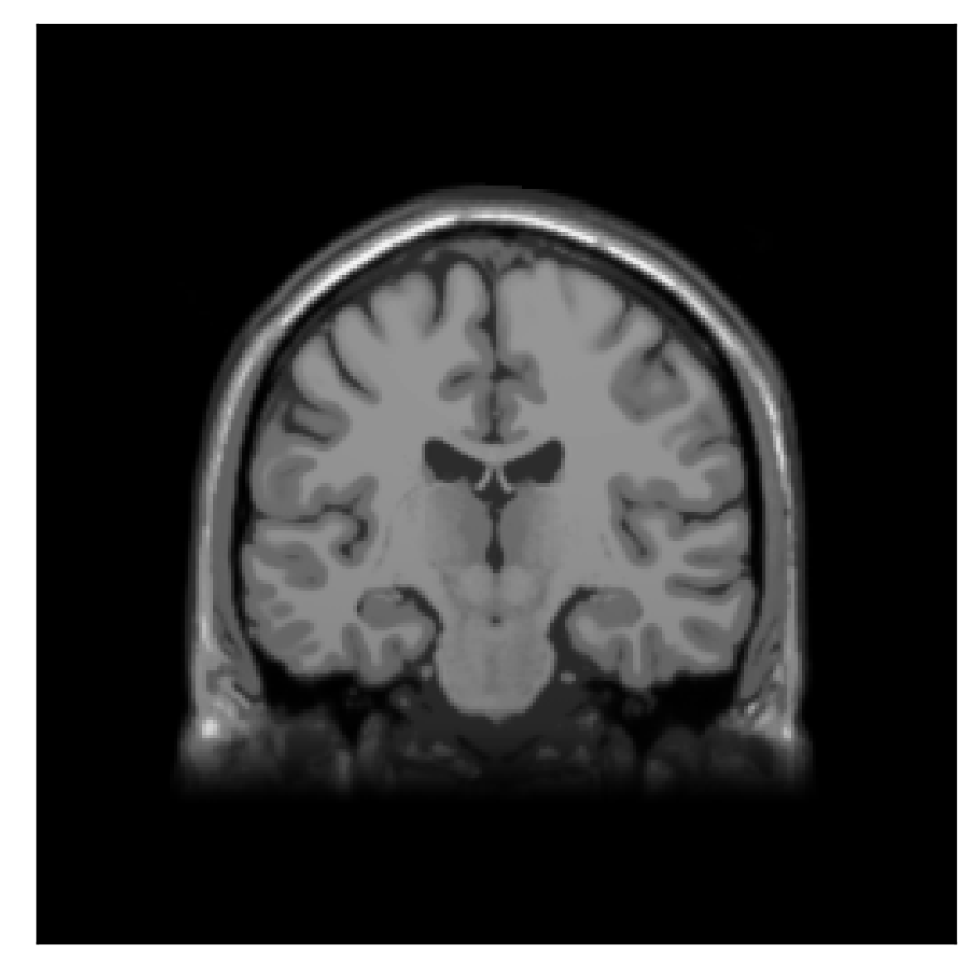
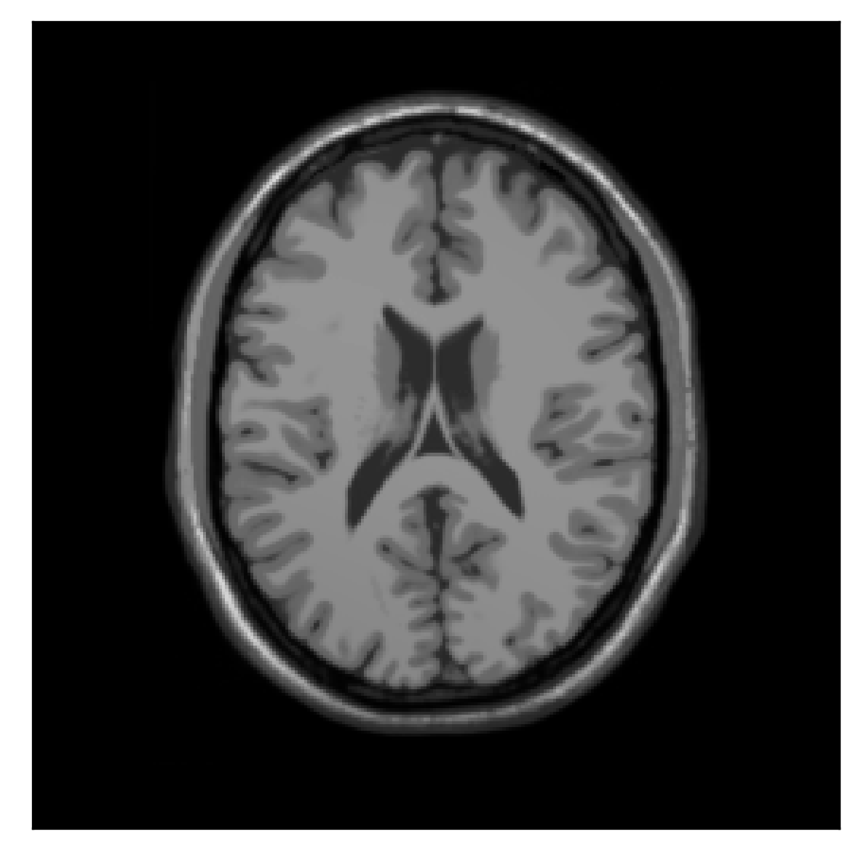
Rnd motion (prior for joint sTV)

Slide 23
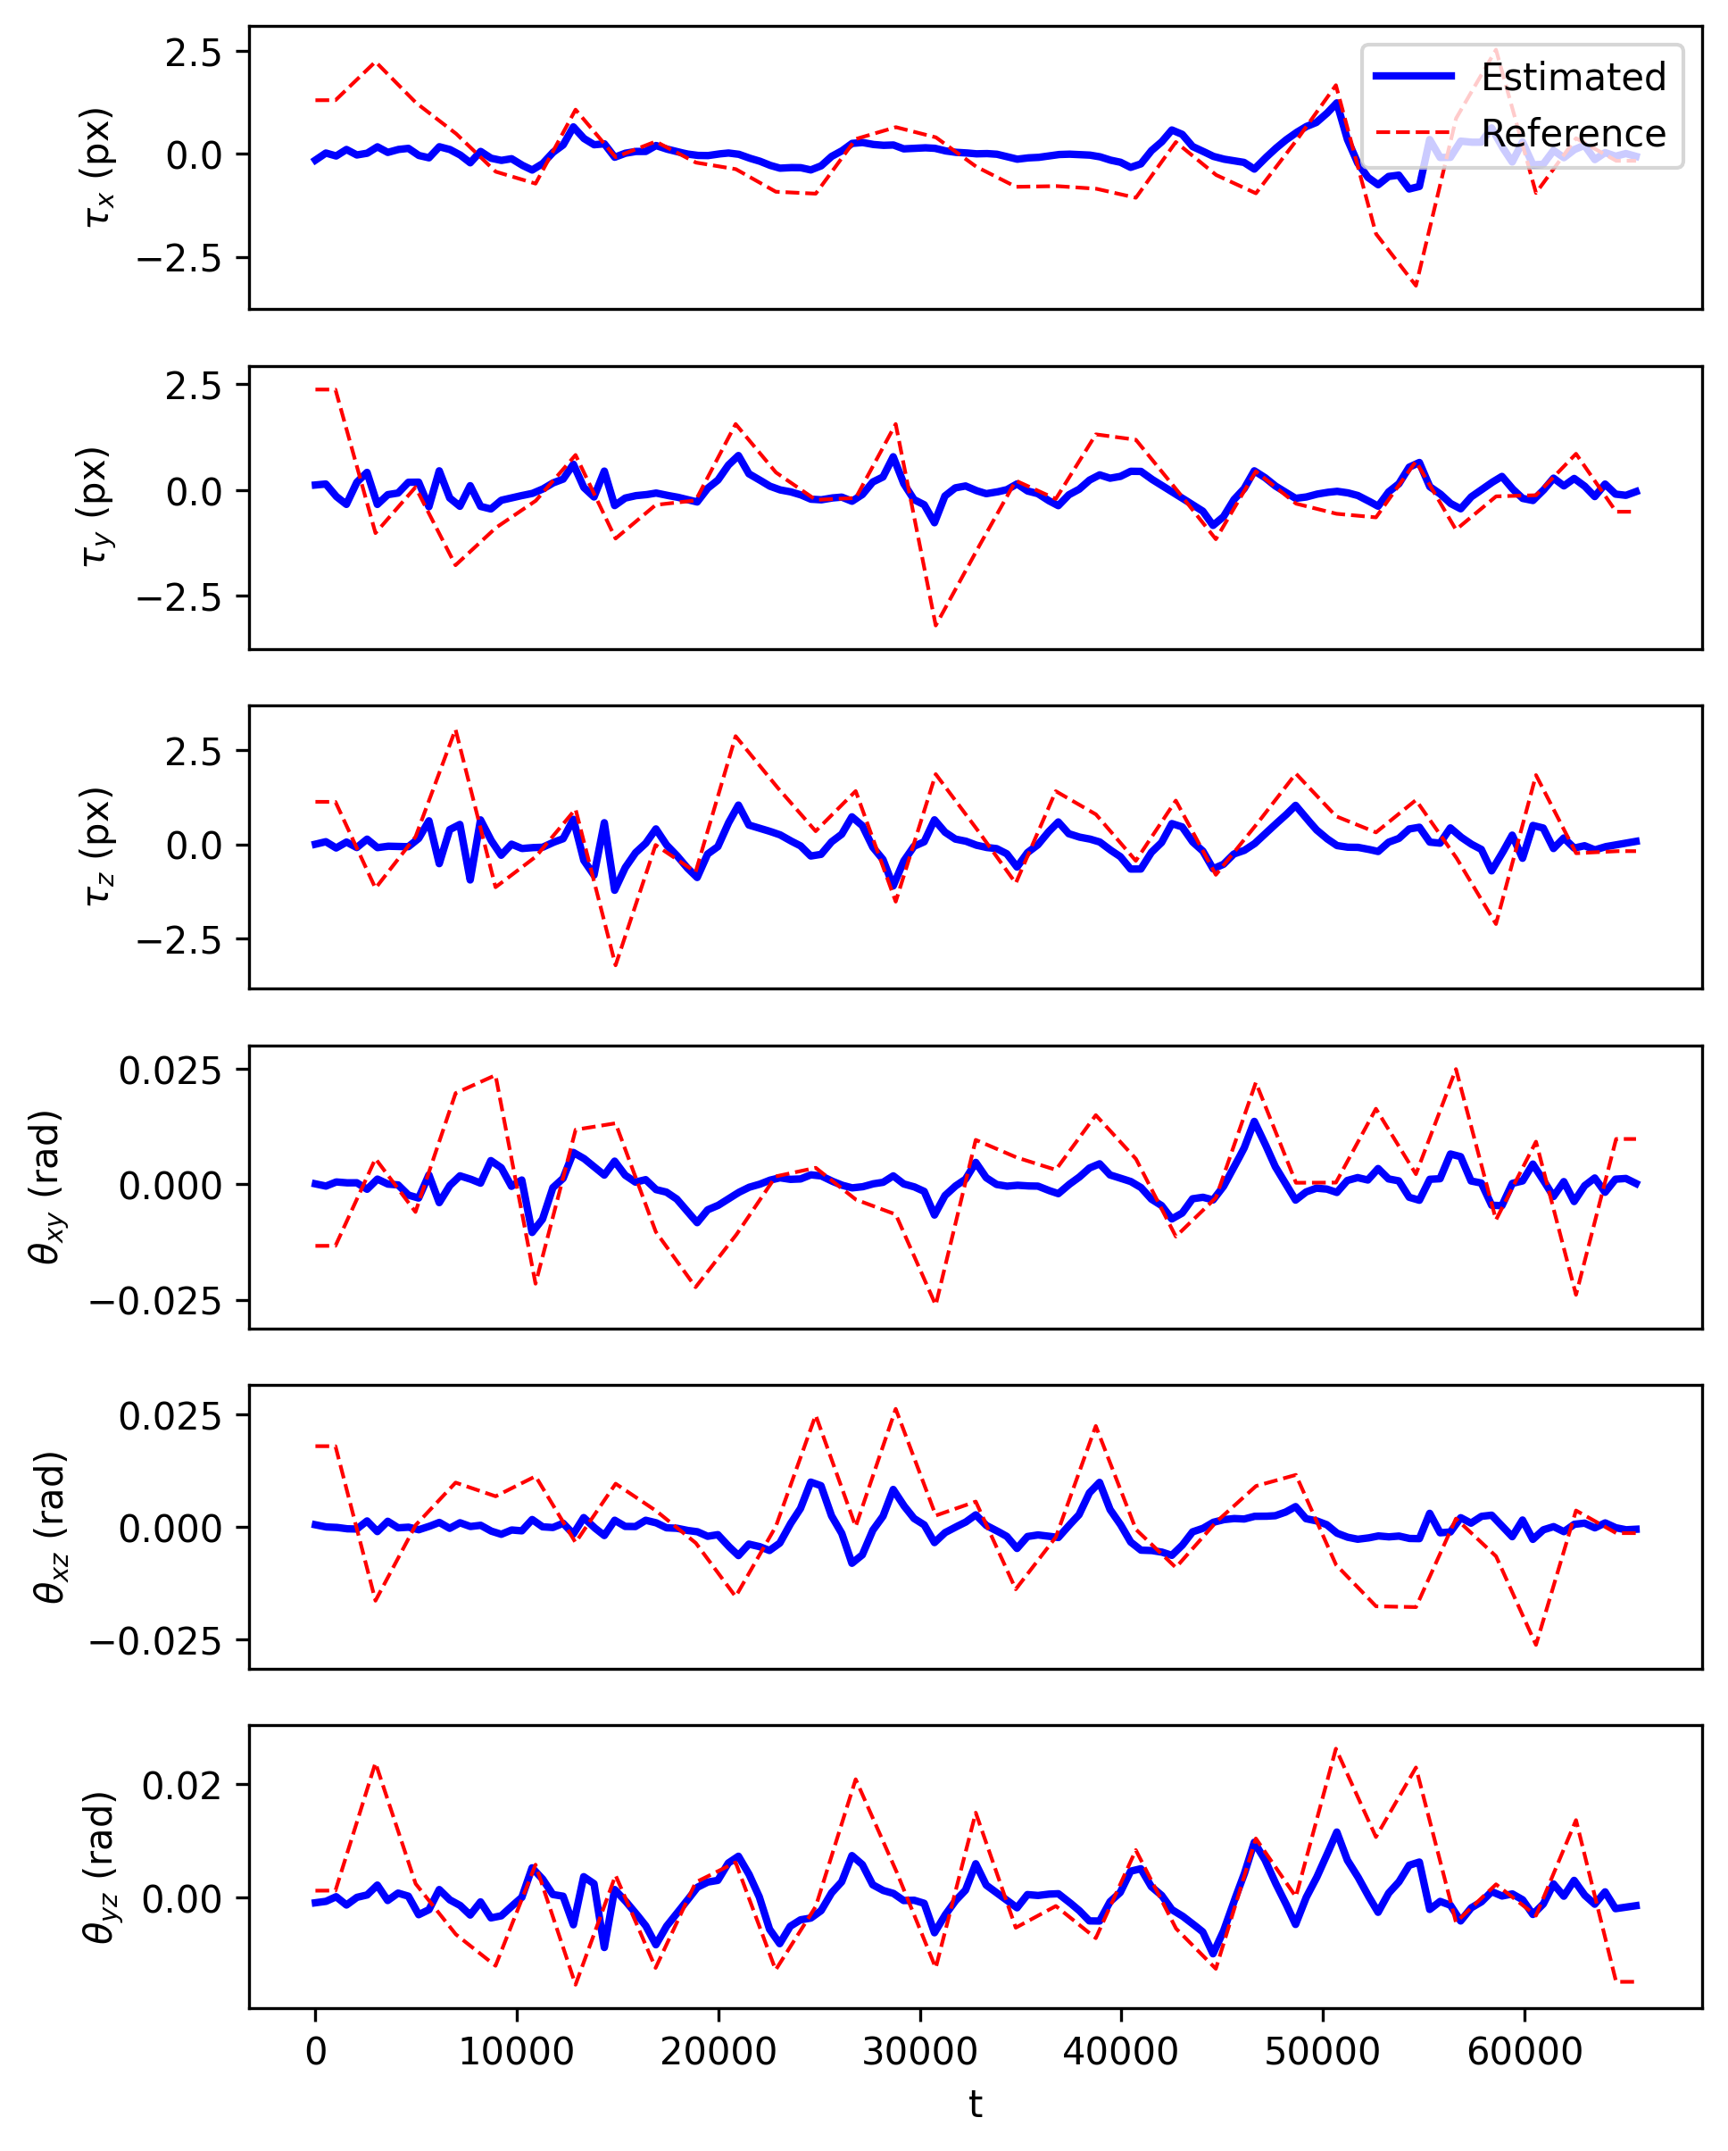
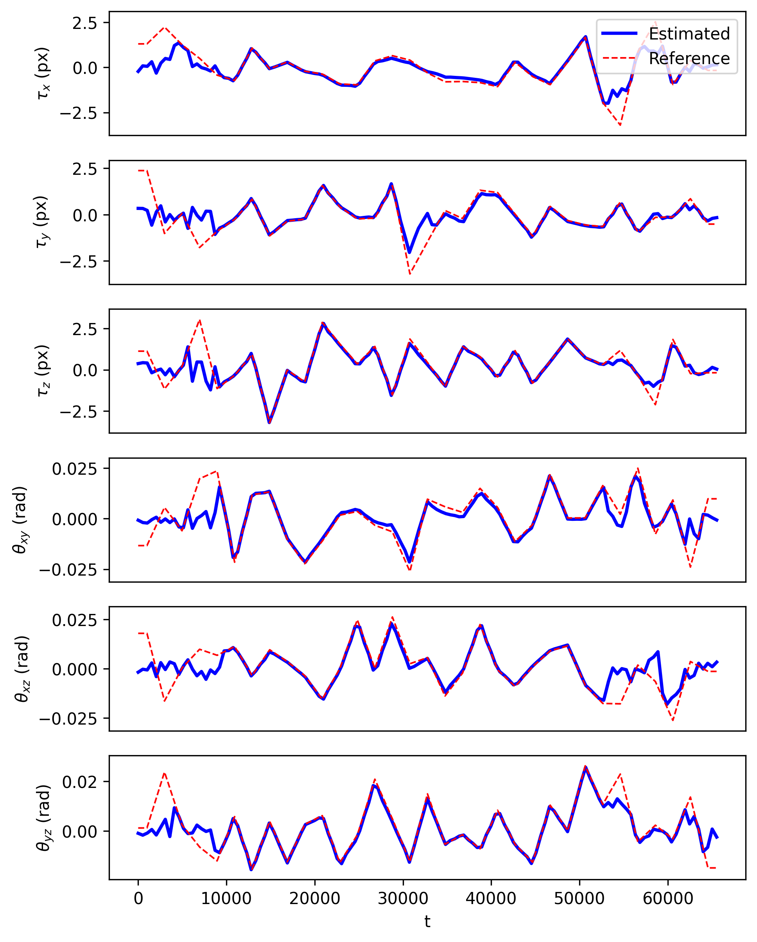
Rnd motion (estimated rigid-motion parameters)
Joint TV
Joint sTV

Slide 24
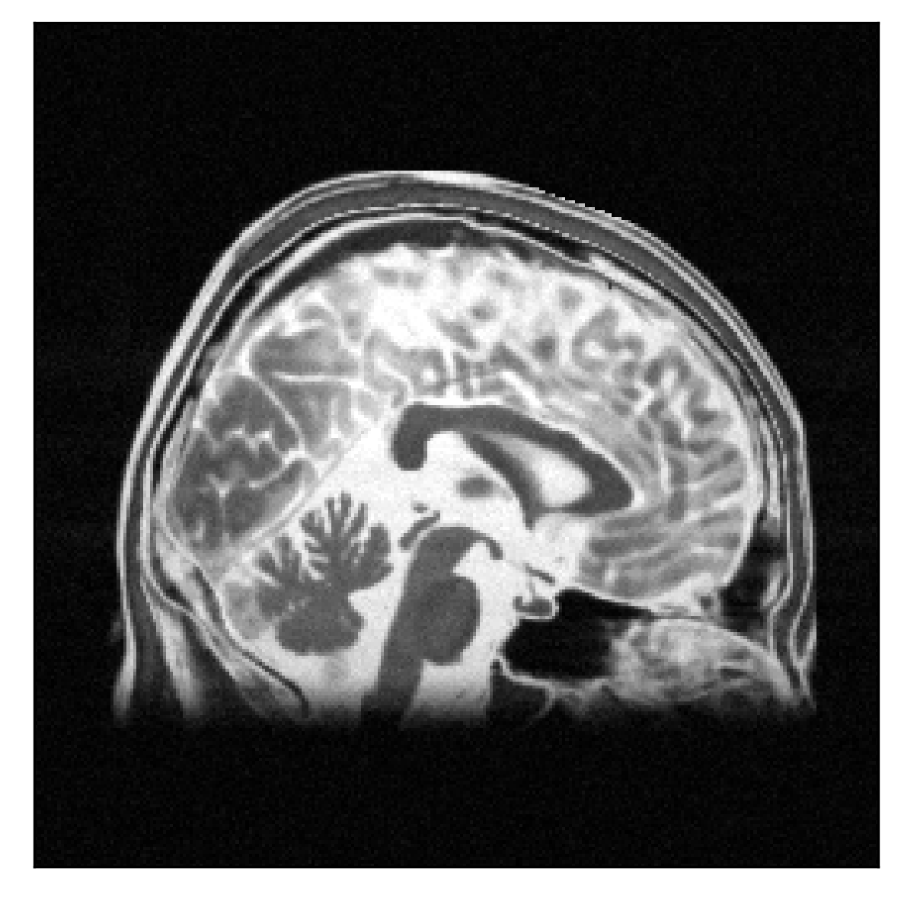
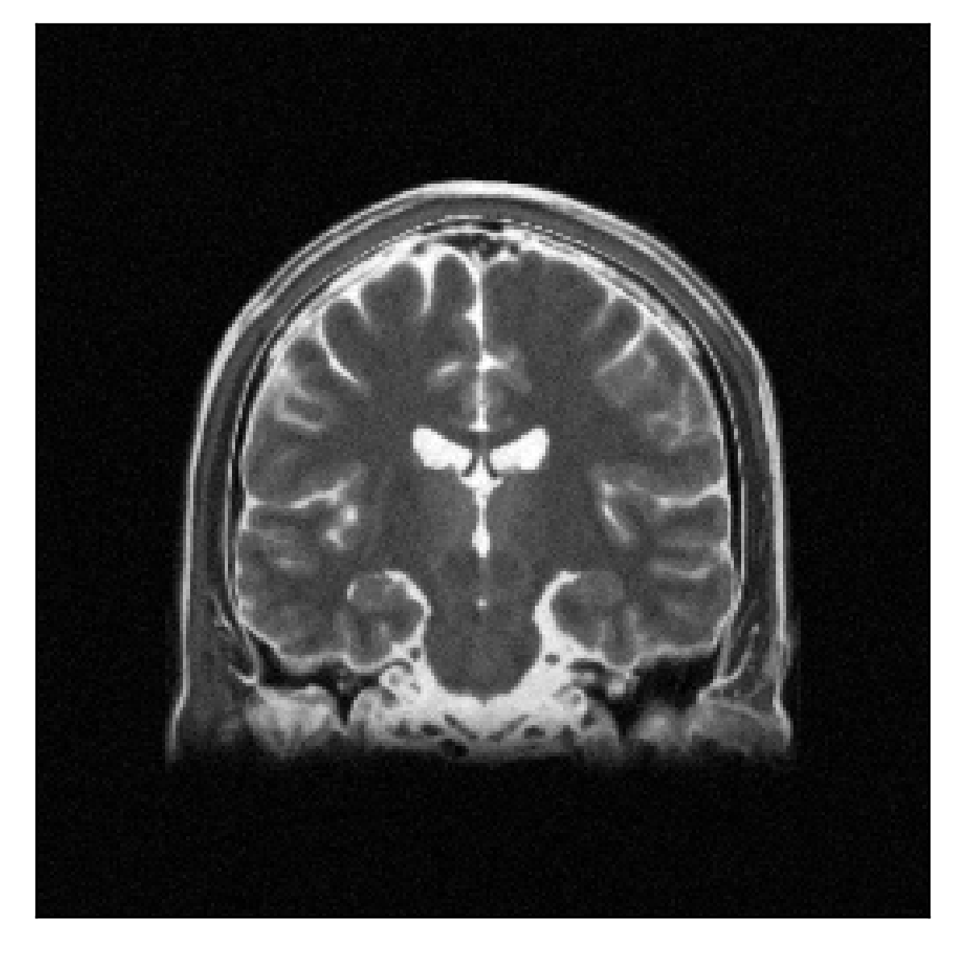
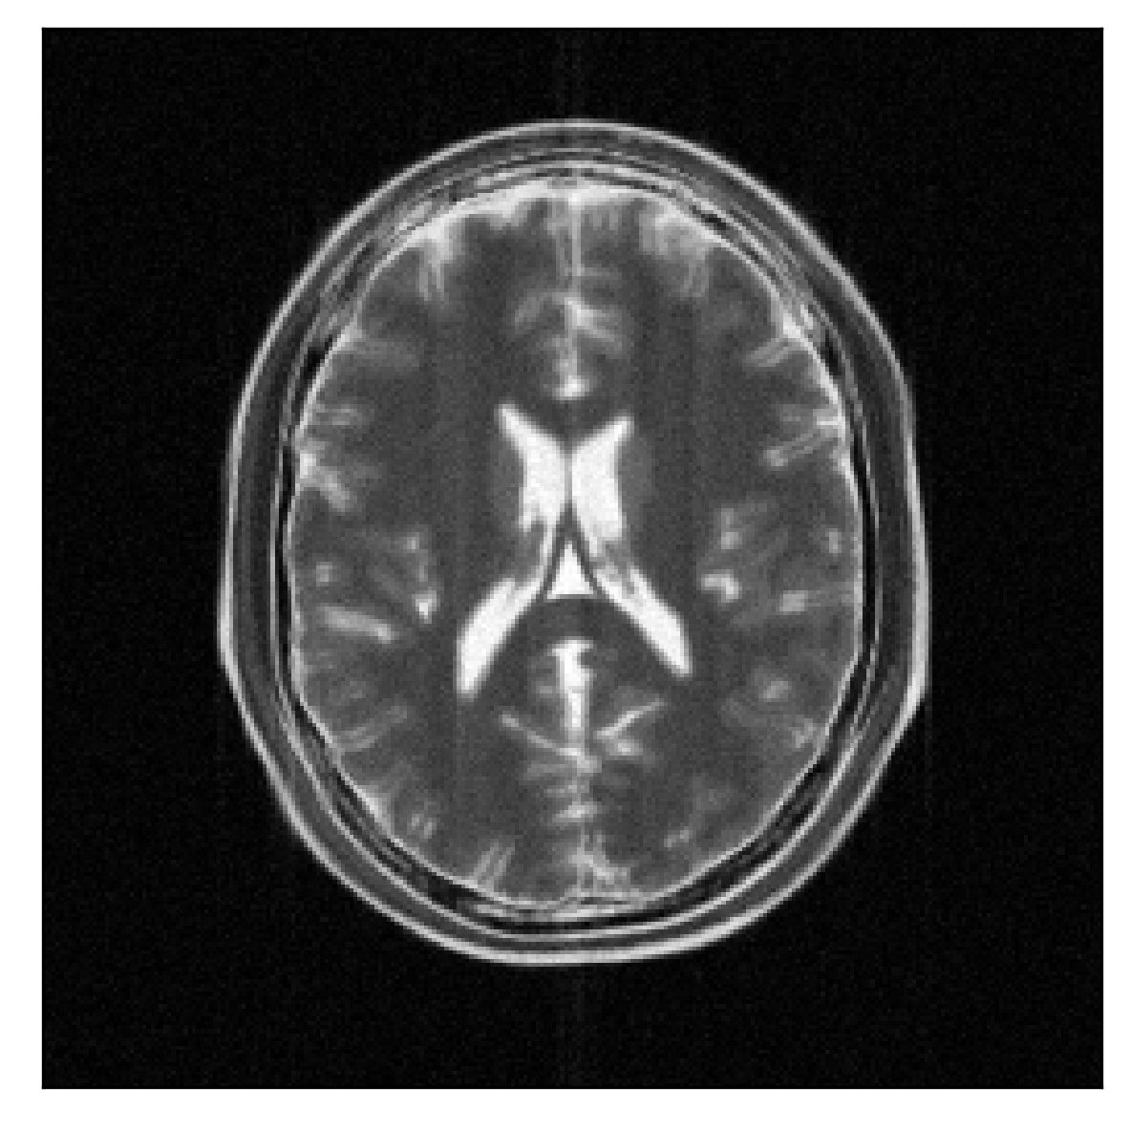
Sudden motion (conv., SSIM=0.33, PSNR=26.6)

Slide 25
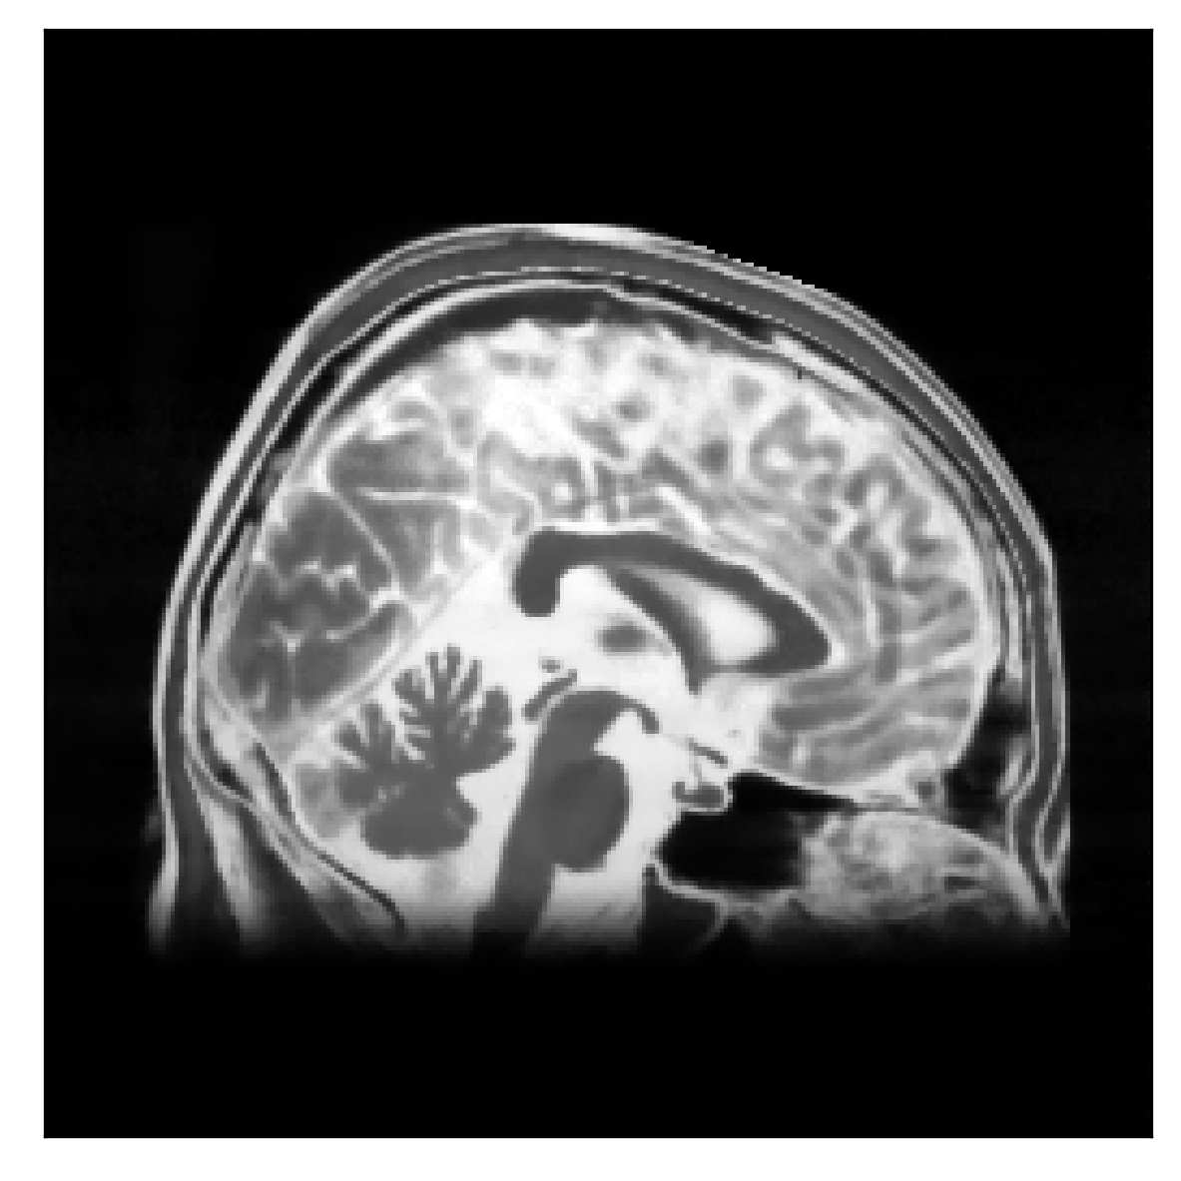


Sudden motion (joint TV, SSIM=0.91, PSNR=28.0)

Slide 26

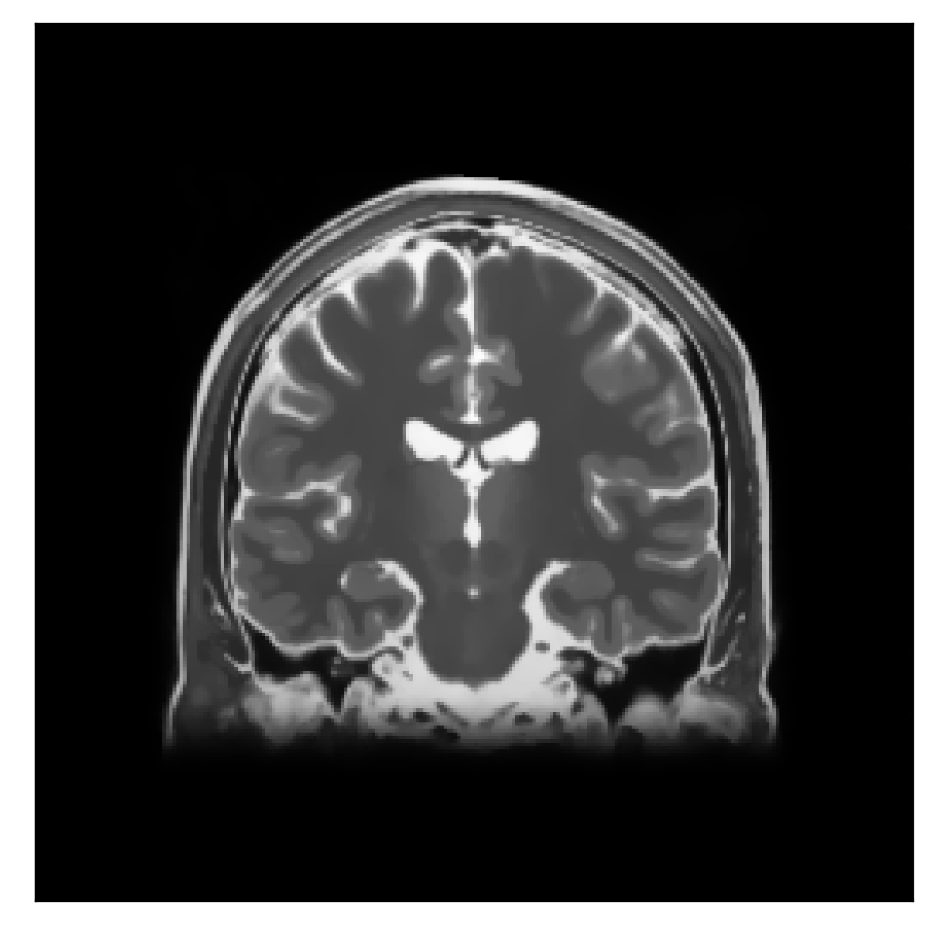

Sudden motion (joint sTV, SSIM=0.96, PSNR=31.8)

Slide 27
Sudden motion (ground truth)

Slide 28
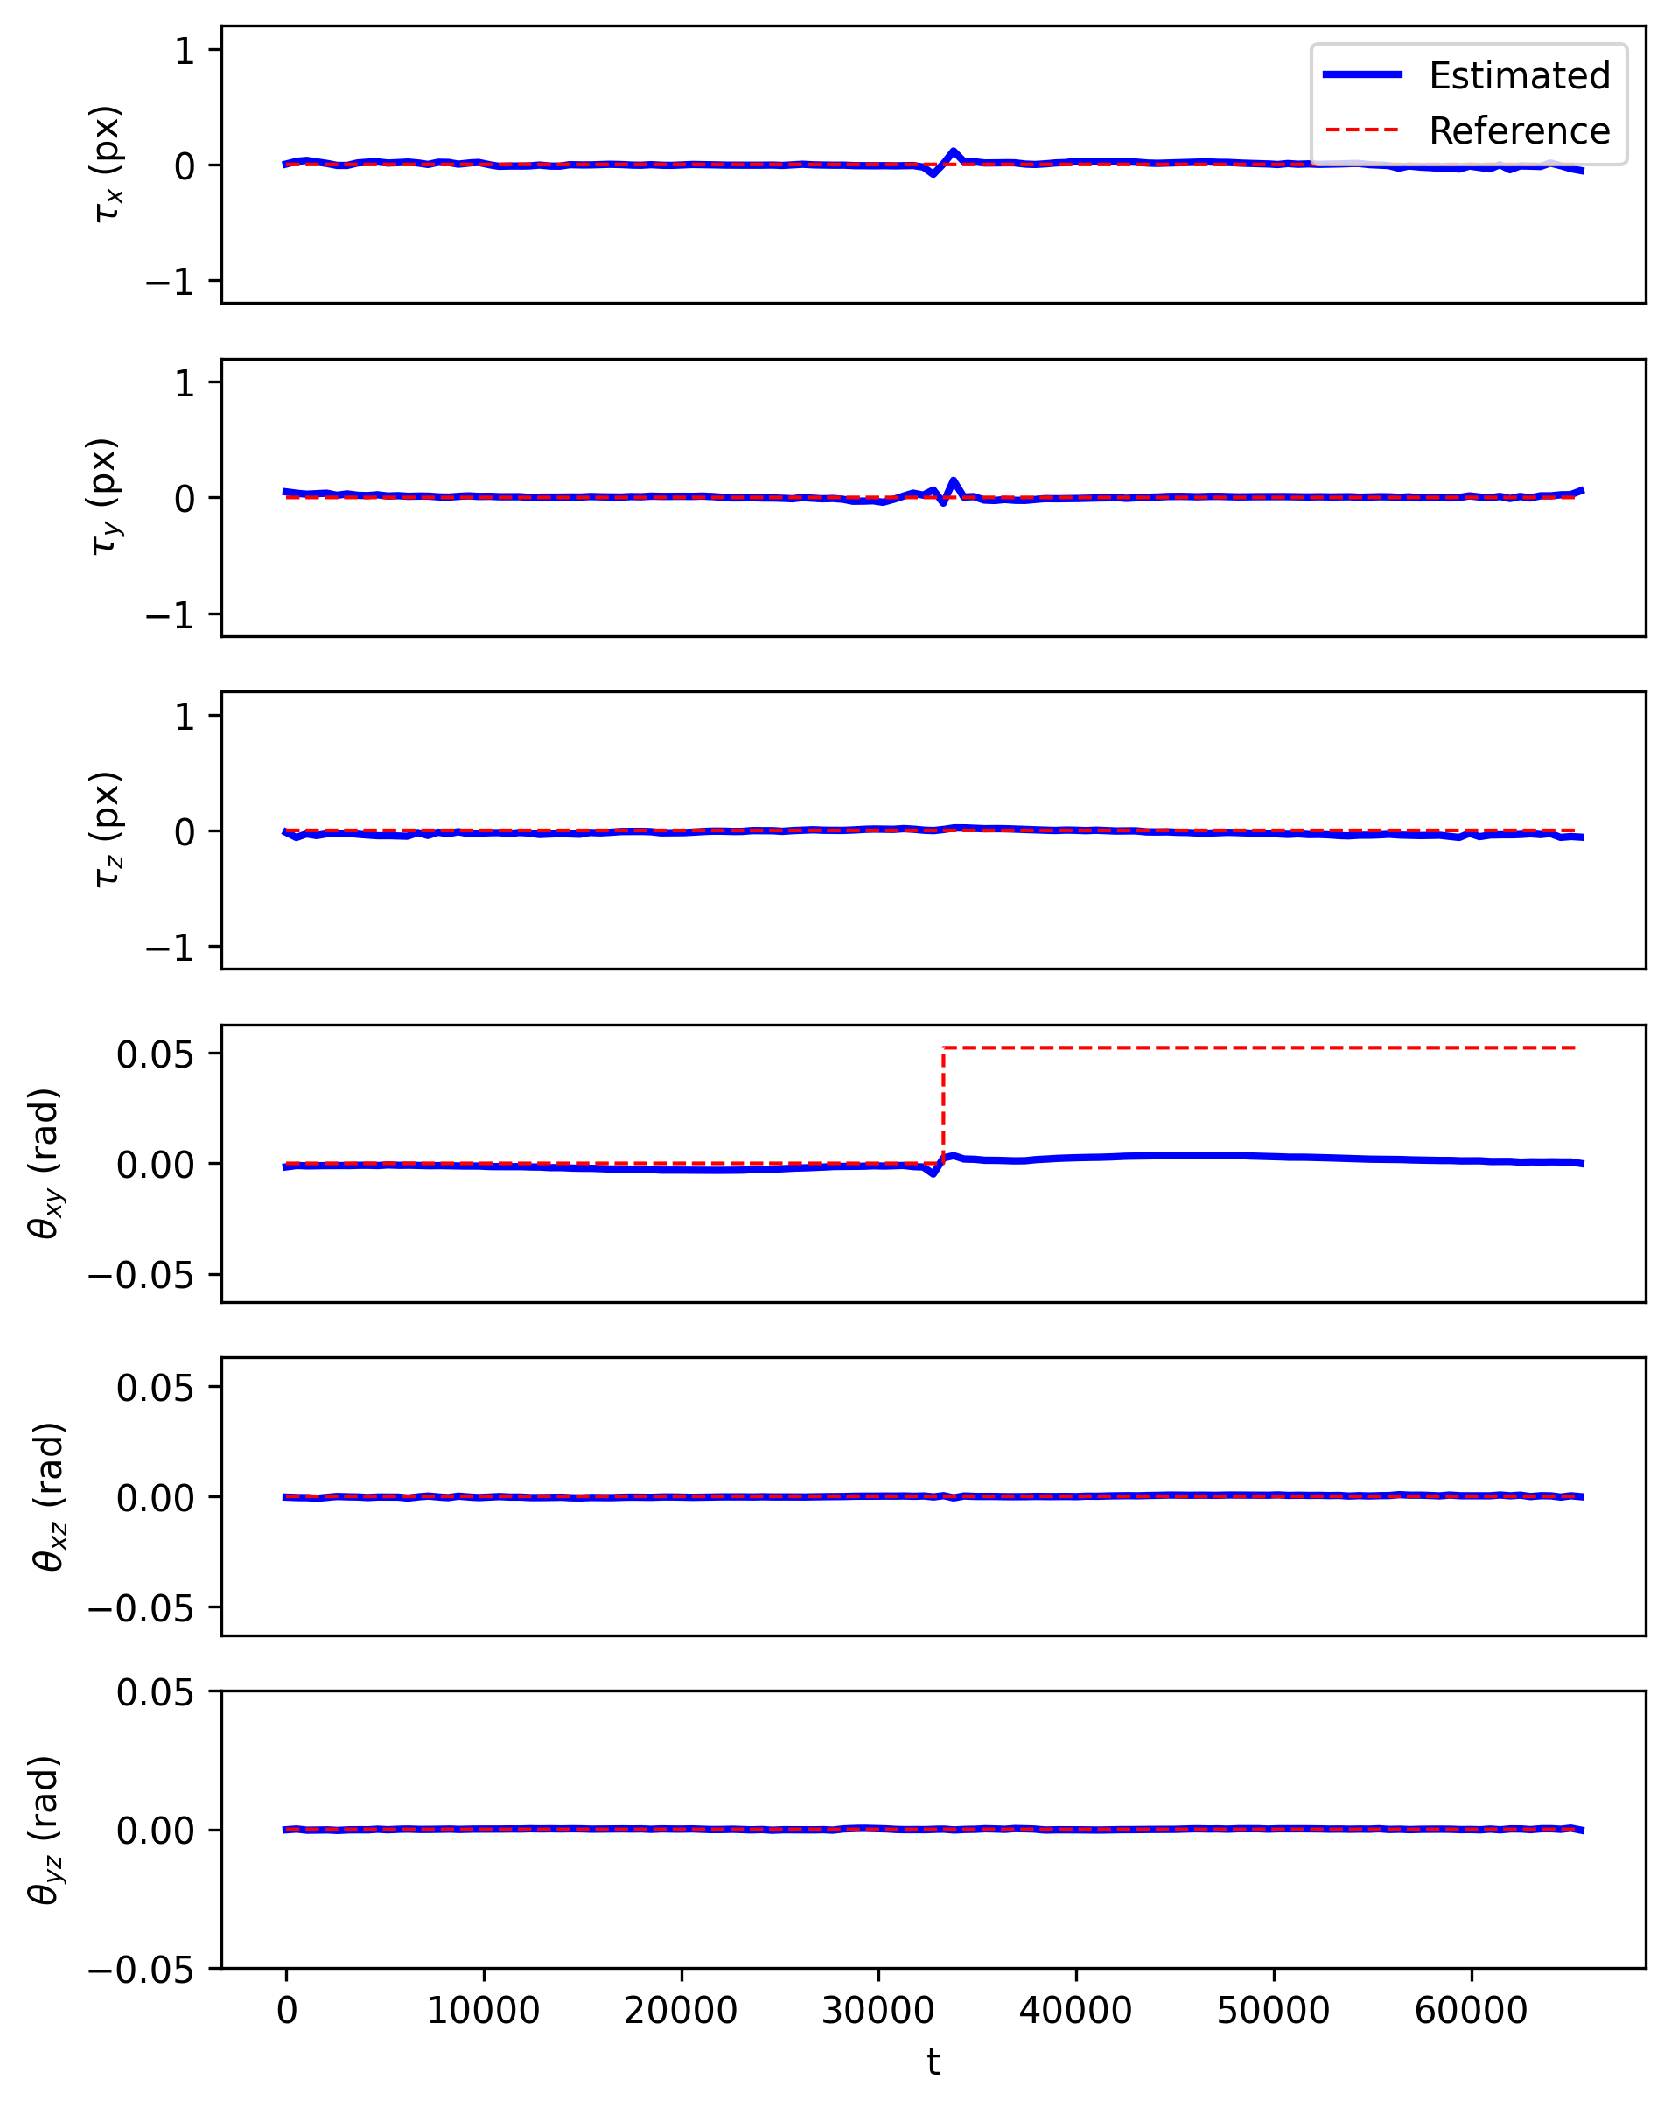
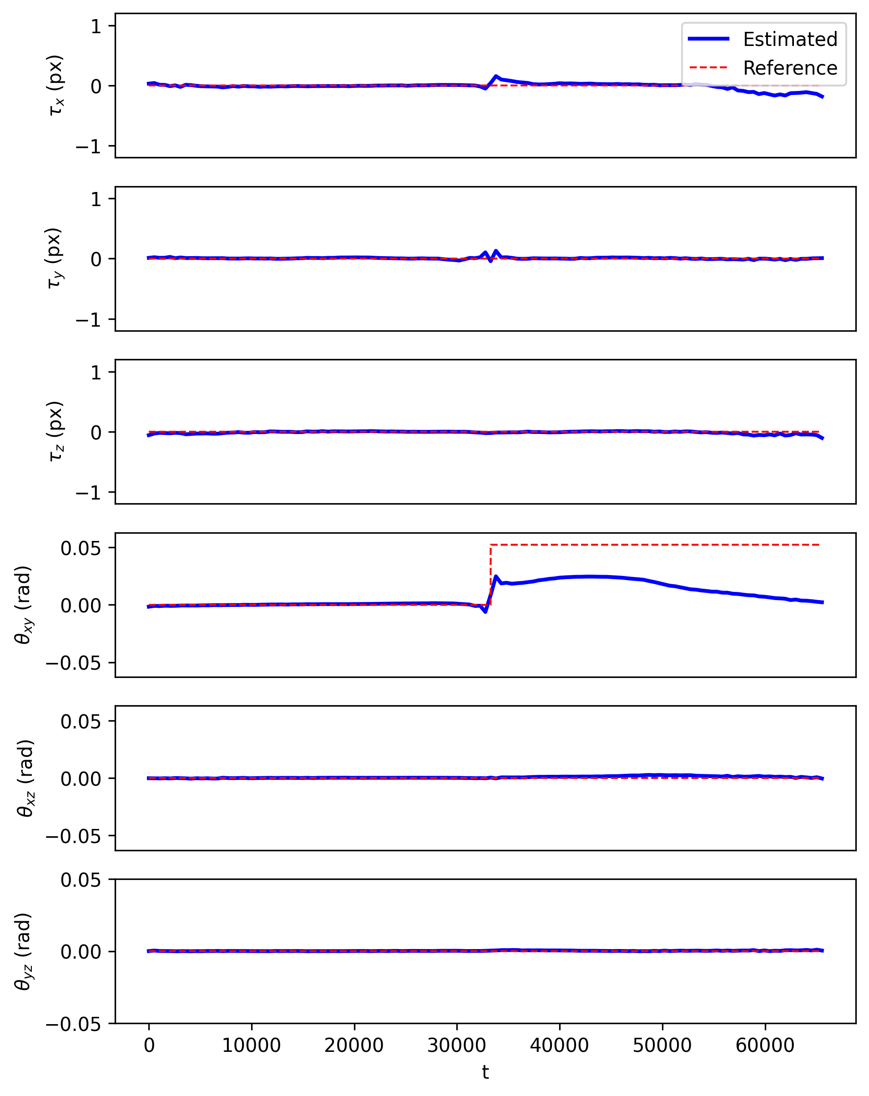
Sudden motion (estimated rigid-motion parameters)
Joint TV
Joint sTV

Slide 29
Discussion/Conclusions
Limitations
Structure-guided vs conventional prior
Computational aspects:
  NFFT vs FFT
  timings
Non-rigid motion leakage
Phase-wrapping artifacts in motion estimation
...

Slide 30
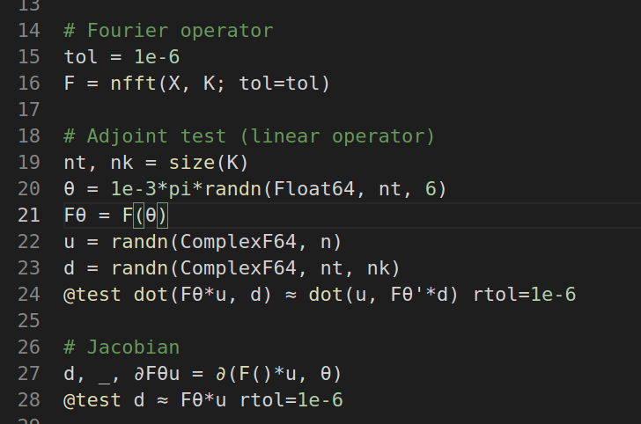
Software
Julia packages:
Structure-guided TV: FastSolversForWeightedTV.jl
Differentiable rigid-motion perturbed NFFT:
UtilitiesForMRI.jl

Slide 31
References
J. B. Andre et al., 2015, “Toward quantifying the prevalence, severity, and cost associated with patient motion during clinical MR examinations.”, J Am Coll Radiol
F. Godenschweger et al., 2016, “Motion correction in MRI of the brain”, Phys Med Biol. 61(5)
Cordero-Grande et al., 2018, “Three-Dimensional Motion Corrected Sensitivity Encoding Reconstruction for Multi-Shot Multi-Slice MRI: Application to Neonatal Brain Imaging”, Magn Reson Med 79
Cordero-Grande et al., 2020, “Motion-corrected MRI with DISORDER: Distributed and incoherent sample orders for reconstruction deblurring using encoding redundancy”, Magn Reson Med 84
M. Zaitsev, 2015, “Motion Artifacts in MRI: A Complex Problem With Many Partial Solutions”, J Magn Reson Imaging 42
A. Barnett, et al., 2019, “A parallel non-uniform fast Fourier transform library based on an “exponential of semicircle” kernel”, SIAM J. Sci. Comput., 41(5)
A. Barnett, et al., 2021, “Aliasing error of the exp(\beta\sqrt{1-z^2}) kernel in the nonuniform fast Fourier transform”, arXiv
B. Peters, et al., 2018, “Projection methods and applications for seismic nonlinear inverse problems with multiple constraints”, Geophysics 84
A. Beck, M. Teboulle, 2009, “Fast Gradient-Based Algorithms for Constrained Total Variation Image Denoising and Deblurring Problems”
E. Esser, et al., 2010, “A General Framework for a Class of First Order Primal-Dual Algorithms for Convex Optimization in Imaging Science”, SIAM J Imaging Sciences 3(4)
G. Golub, V. Pereira, 2003, “Separable nonlinear least squares: the variable projection method and its applications”
T. van Leeuwen, A. Aravkin, 2021, “Variable projection for non-smooth problems”, SIAM J Imaging Sciences
M. J. Ehrhardt, M. M. Betcke, 2015, “Multi-Contrast MRI Reconstruction with Structure-Guided Total Variation”, SIAM J. Imaging Sciences 9(3)
R. Otazo, et al., 2015, “Low-Rank Plus Sparse Matrix Decomposition for Accelerated Dynamic MRI with Separation of Background and Dynamic Components”, Magnetic Resonance in Medicine 73

Slide 32
Phase-wrapping

Slide 33
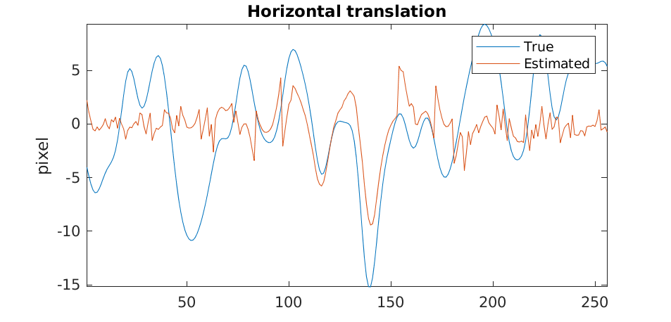
Phase-wrapping

