Slide 1

Retrospective motion correction
for brain MRI with structural priors
G. Rizzuti¹, T. van Leeuwen², A. Sbrizzi³
¹Utrecht University, ²CWI, ³UMC Utrecht
Trackers,
27/05/2021

Slide 2
Agenda
Motion correction for MRI:
motivation, intro & prior art
Retrospective motion-corrected MRI:
formulation, structural priors, optimization strategies
Numerical experiments (synthetic data)
Discussion and conclusions

Slide 3
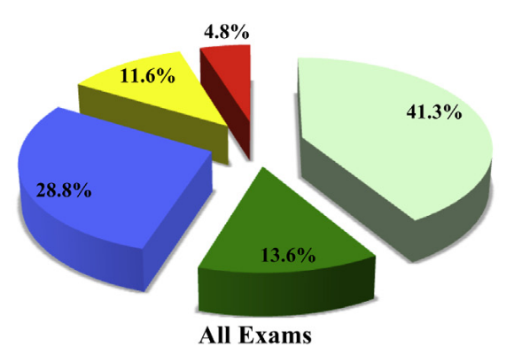
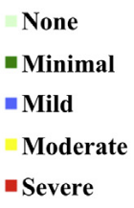
Prevalence of motion artifacts in MRI
~20% of MR sessions need scan repeat
Cost > 90.000$ / scanner / year
Extent of motion artifact distribution
J. B. Andre et al., 2015, “Toward quantifying the prevalence, severity, and cost associated with patient motion during clinical MR examinations.”

Slide 4
How does motion affect reconstruction?

Slide 5
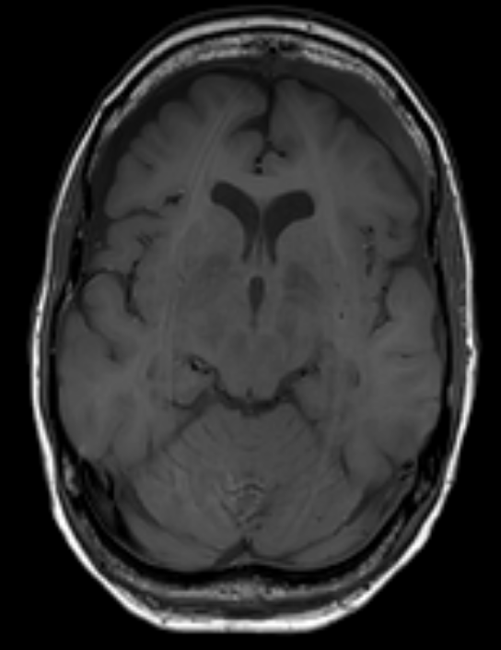
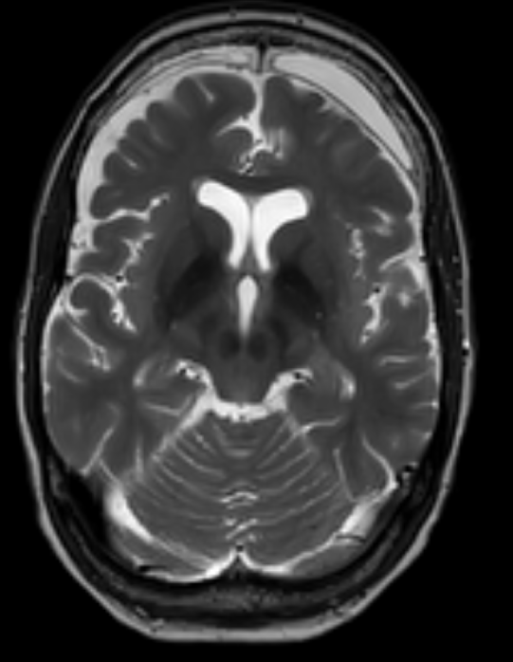
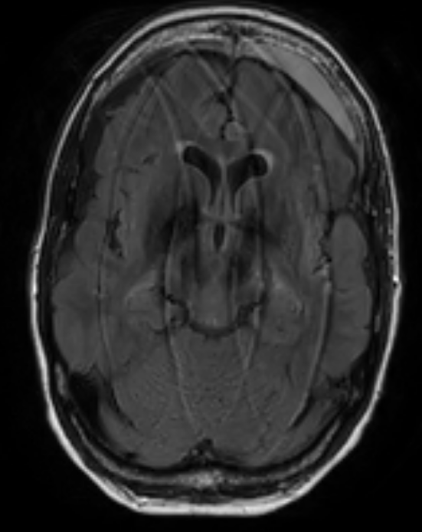
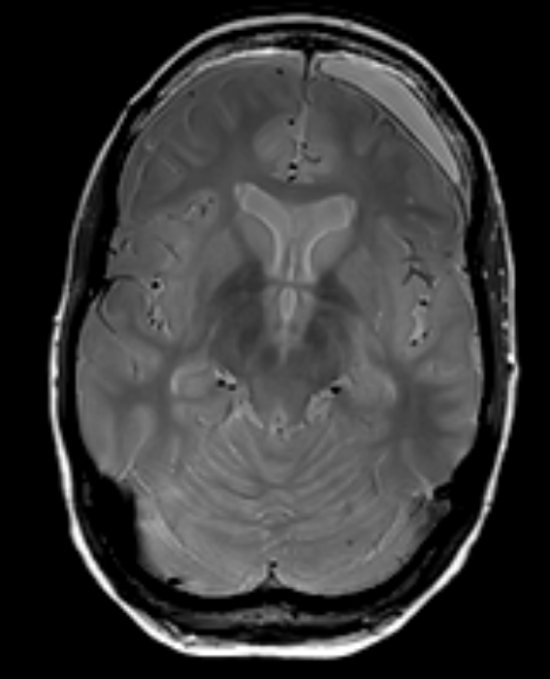
How does motion affect reconstruction?
T1w
T2w
FLAIR
PDw

Slide 6
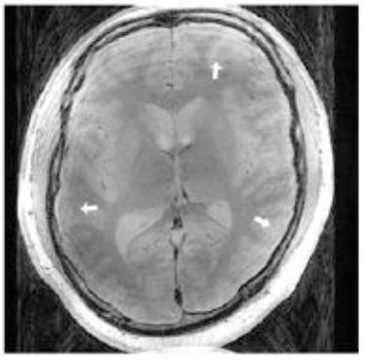
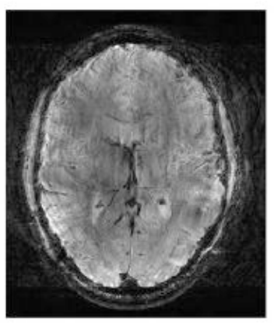
How does motion affect reconstruction?
F. Godenschweger et al., 2016, “Motion correction in MRI of the brain”

Slide 7
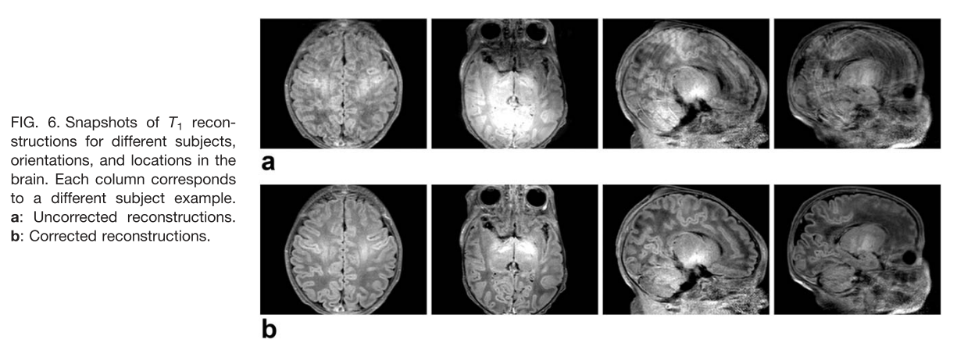
How does motion affect reconstruction?
Cordero-Grande et al., 2018, “Three-Dimensional Motion Corrected Sensitivity Encoding Reconstruction for Multi-Shot Multi-Slice MRI: Application to Neonatal Brain Imaging”

Slide 8
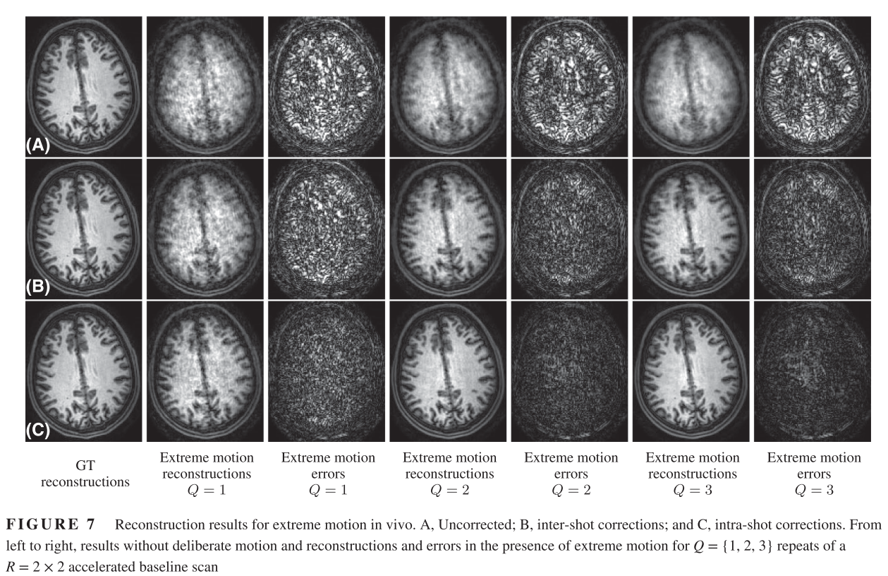
How does motion affect reconstruction?
Cordero-Grande et al., 2020, “Motion-corrected MRI with DISORDER: Distributed and incoherent sample orders for reconstruction deblurring using encoding redundancy”

Slide 9
How does motion affect reconstruction?
Typical effects:
blurring
ghosting
signal loss/spike*
F. Godenschweger et al., 2016, “Motion correction in MRI of the brain”
M. Zaitsev, 2015, “Motion Artifacts in MRI: A Complex Problem With Many Partial Solutions”

Slide 10
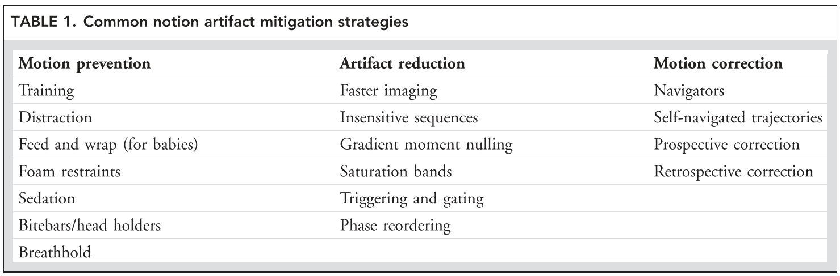
Motion mitigation strategies
M. Zaitsev, 2015, “Motion Artifacts in MRI: A Complex Problem With Many Partial Solutions”

Slide 11
Goal
Retrospective motion correction:
  avoid scan repetition
  joint motion estimation and reconstruction
Assumptions:
  rigid motion (suited for brain imaging)
  Cartesian sampling (dense)
  one or more contrasts well resolved

Slide 12
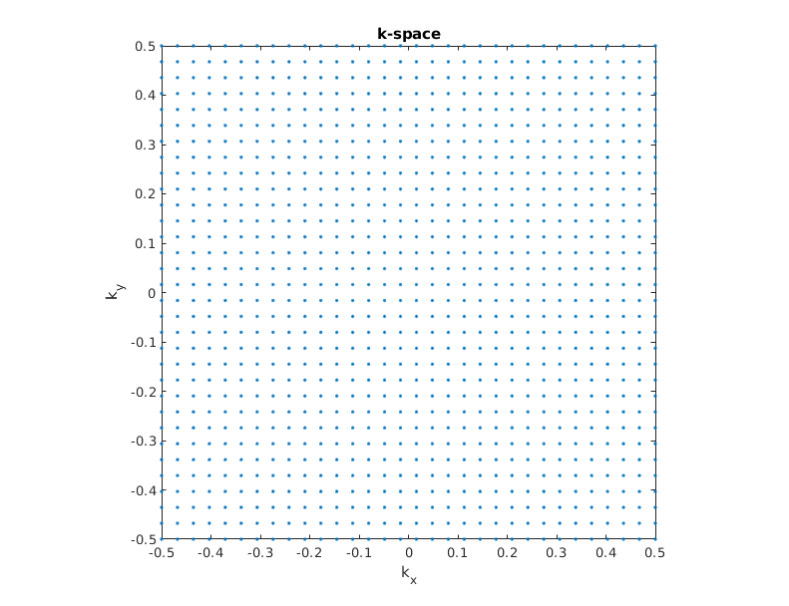
Sequential sampling while in motion
Cartesian sampling
Roto-translations
t

Slide 13
Motion-corrupted data model
reconstruction image
motion parameters
NUFFT
FINUFFT, https://finufft.readthedocs.io/
A. Barnett, et al., 2019, “A parallel non-uniform fast Fourier transform library based on an “exponential of semicircle” kernel”
A. Barnett, et al., 2021, “Aliasing error of the exp(\beta\sqrt{1-z^2}) kernel in the nonuniform fast Fourier transform”

Slide 14
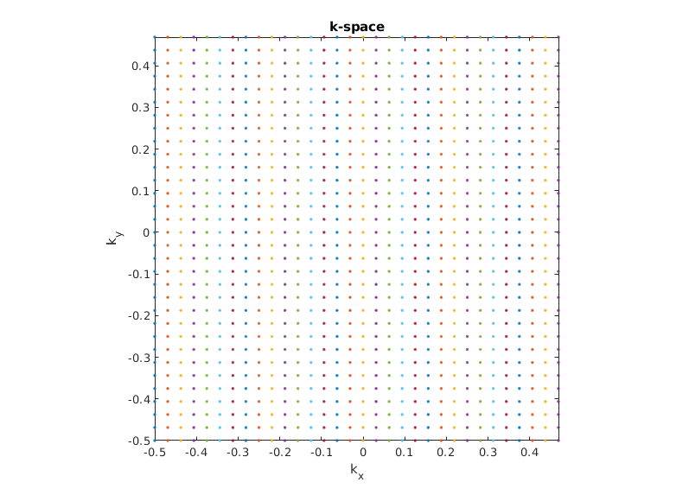
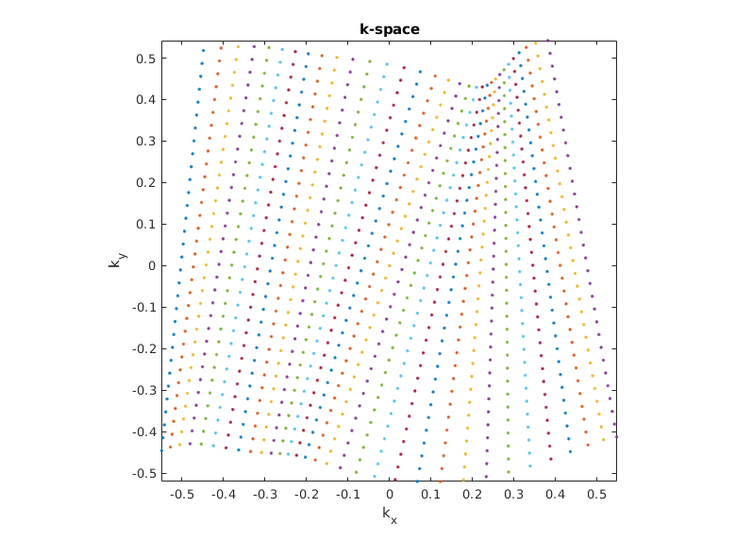
Effective sampling due to motion
spectral gap
Nominal sampling
Effective sampling

Slide 15
Variational problem
misfit loss
regularization

Slide 16

Loss function
misfit loss
regularization

Slide 17
Loss function
misfit loss
regularization
outlier robustness

Slide 18
Loss function
misfit loss
regularization
weighting

Slide 19
Regularization
misfit loss
regularization
additive penalty

Slide 20
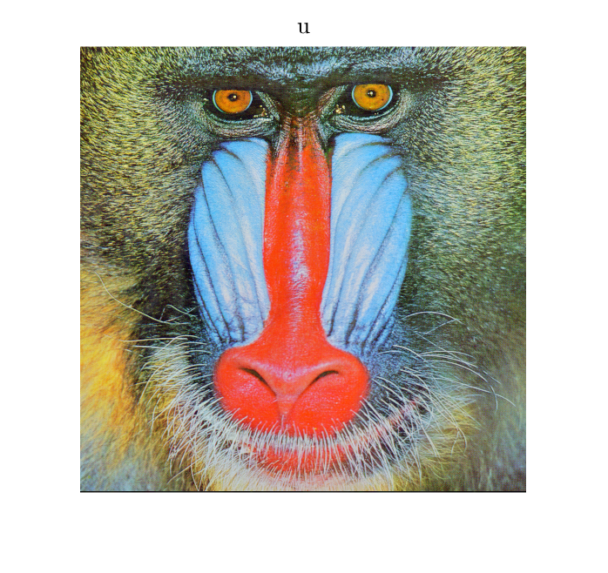
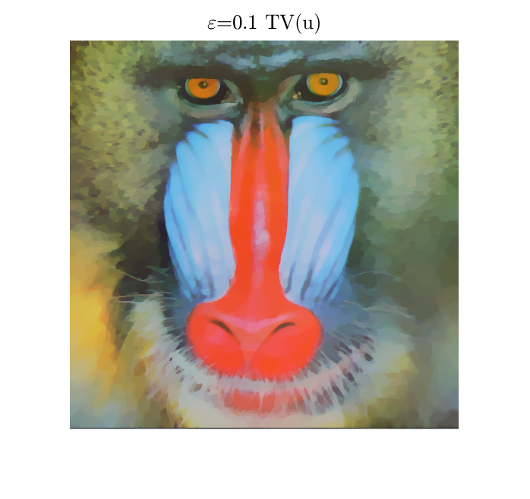
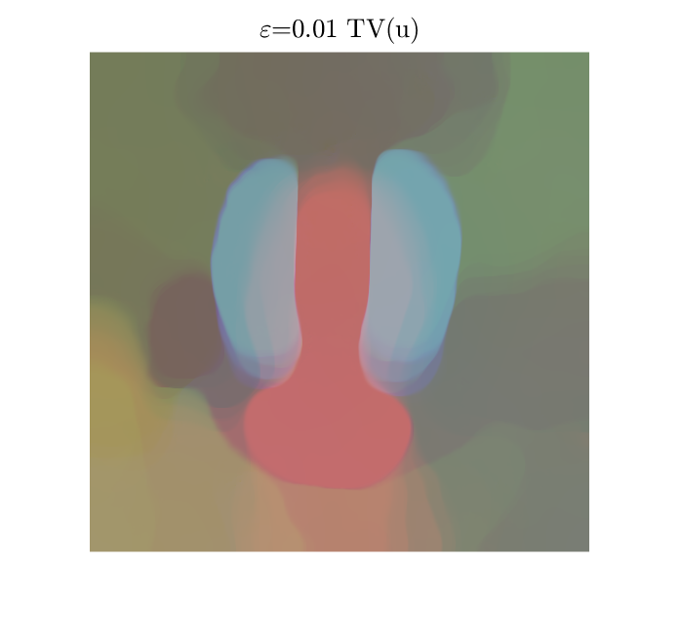
Regularization
misfit loss
regularization
constraint
B. Peters, et al., 2018, “Projection methods and applications for seismic nonlinear inverse problems with multiple constraints”

Slide 21

Regularization: structural TV
T1w
T2w
FLAIR
PDw
M. J. Ehrhardt, M. M. Betcke, 2015, “Multi-Contrast MRI Reconstruction with Structure-Guided Total Variation”

Slide 22

Regularization: structural TV
T1w
T2w
FLAIR
PDw
...when multiple well-resolved contrasts are available

Slide 23
Variational problem: regularization
misfit loss
regularization

Slide 24
Variational problem: regularization
misfit loss
regularization

Slide 25
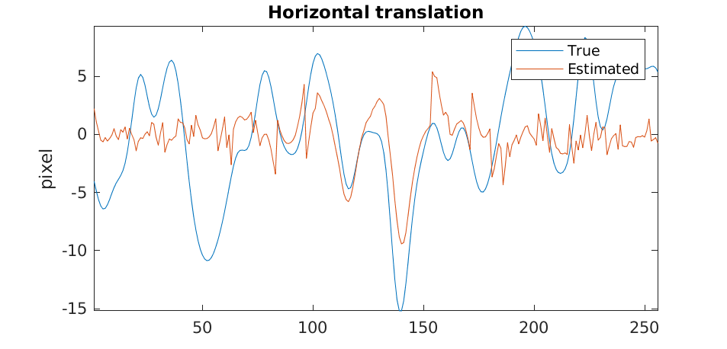
Variational problem: regularization
misfit loss
regularization
...phase-wrapping!

Slide 26
Optimization strategy
Alternately:
1. Reconstruction (FISTA, primal-dual, ADMM)
A. Beck, M. Teboulle, 2009, “Fast Gradient-Based Algorithms for Constrained Total Variation Image Denoising and Deblurring Problems”
E. Esser, et al., 2010, “A General Framework for a Class of First Order Primal-Dual Algorithms for Convex Optimization in Imaging Science”

Slide 27
Optimization strategy
Alternately:
2. Motion estimation (2nd order methods)
...or single update (variable projection)
G. Golub, V. Pereira, 2003, “Separable nonlinear least squares: the variable projection method and its applications”
T. van Leeuwen, A. Aravkin, 2021, “Variable projection for non-smooth problems”

Slide 28
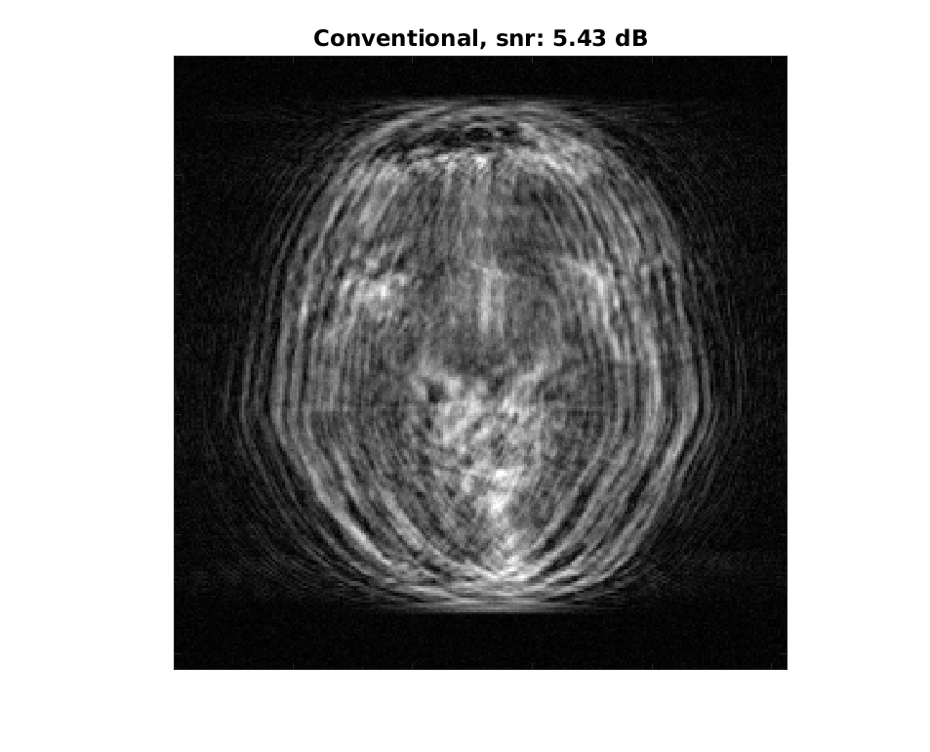
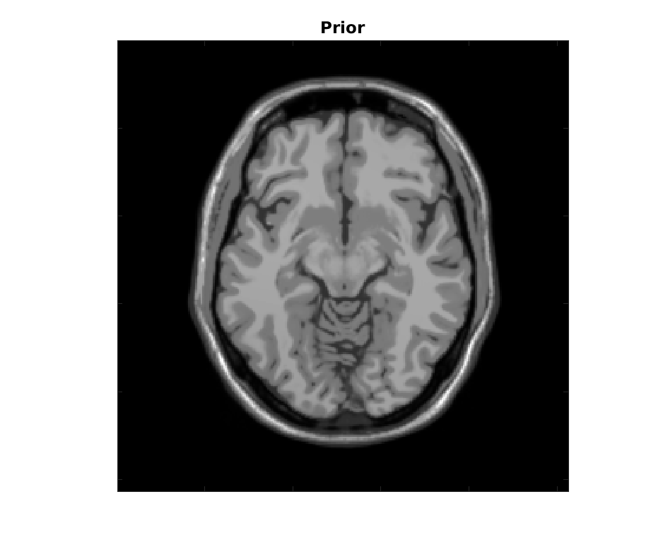
Results: BrainWeb

Slide 29
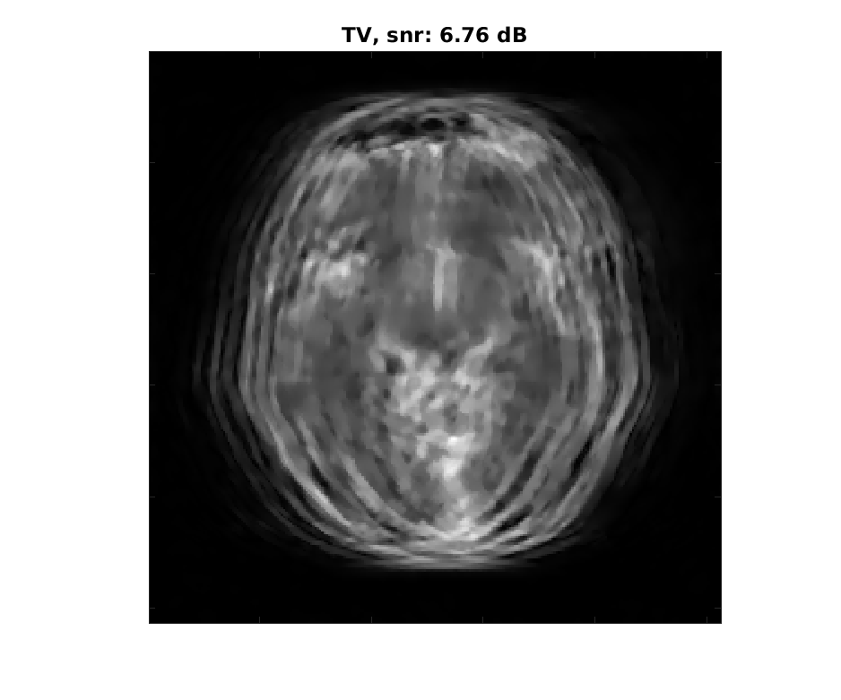
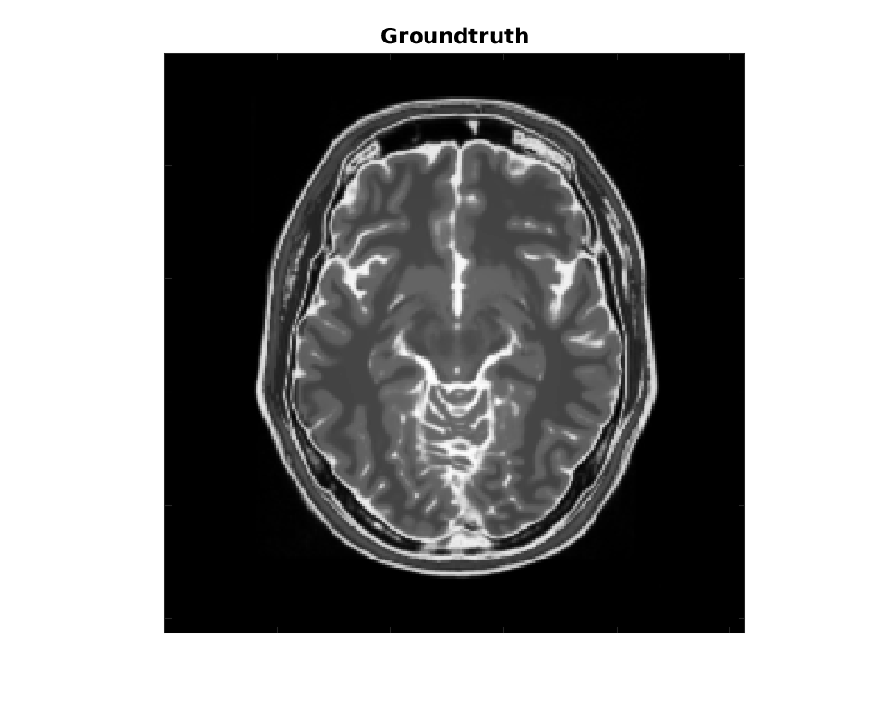
Results: BrainWeb

Slide 30
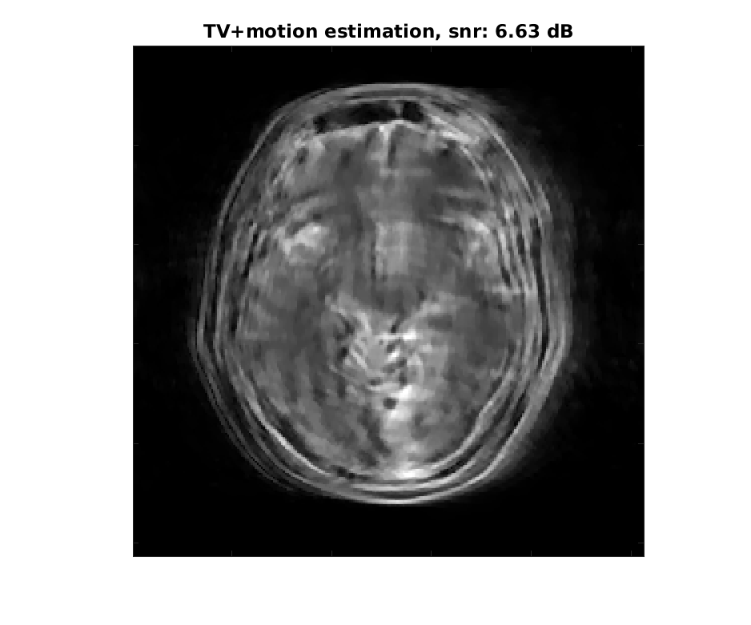
Results: BrainWeb
(no structural prior)

Slide 31
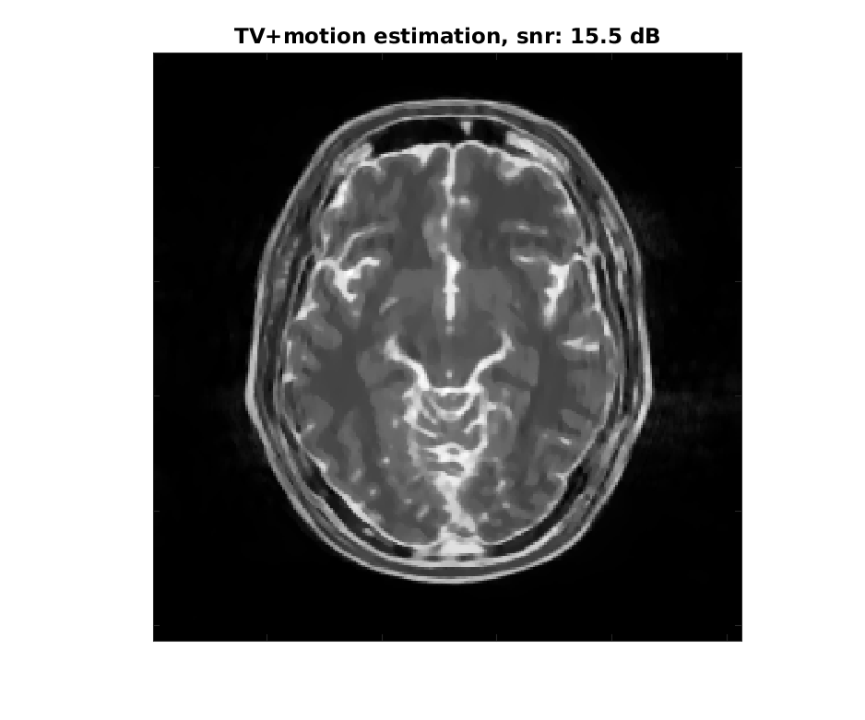
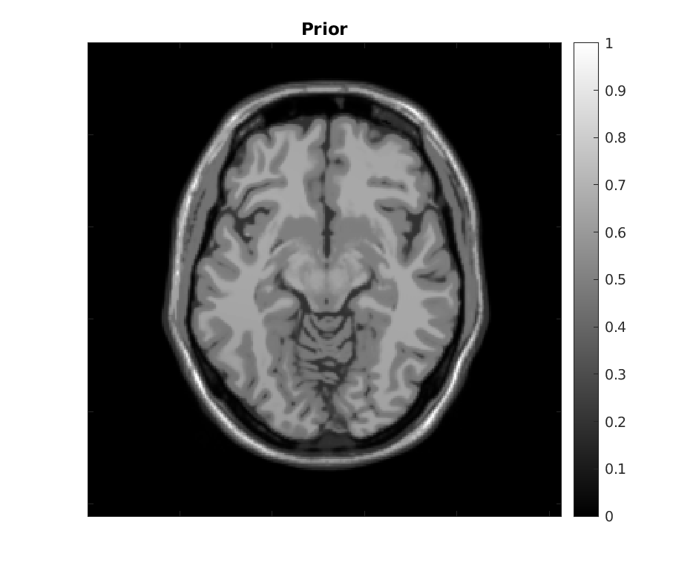
Results: BrainWeb

Slide 32
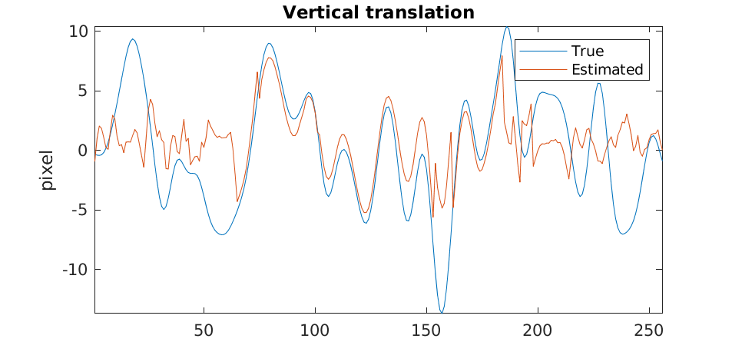
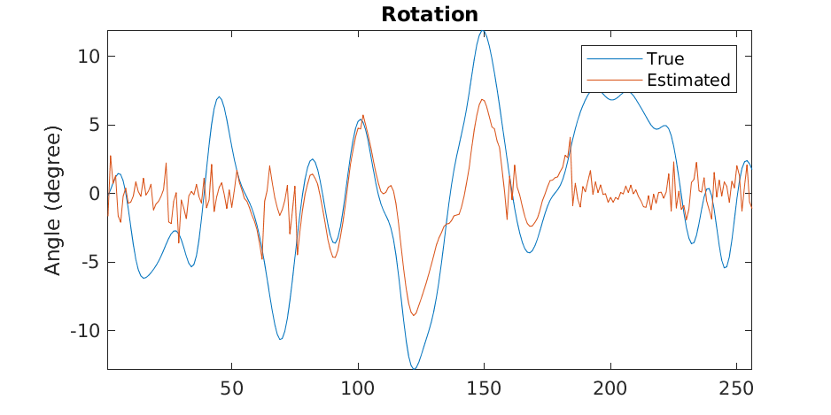
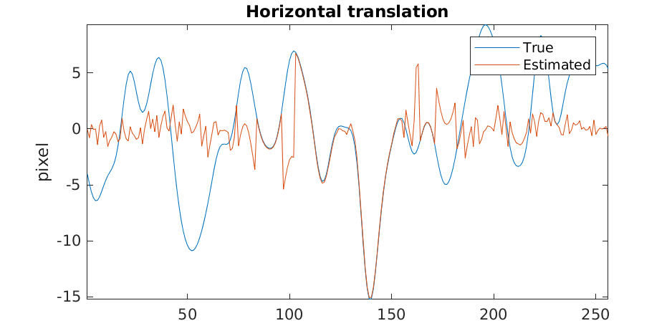
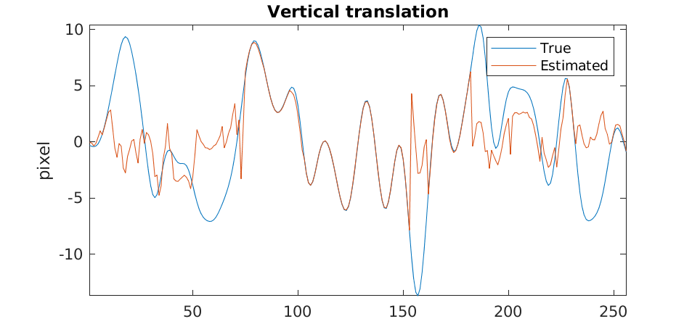
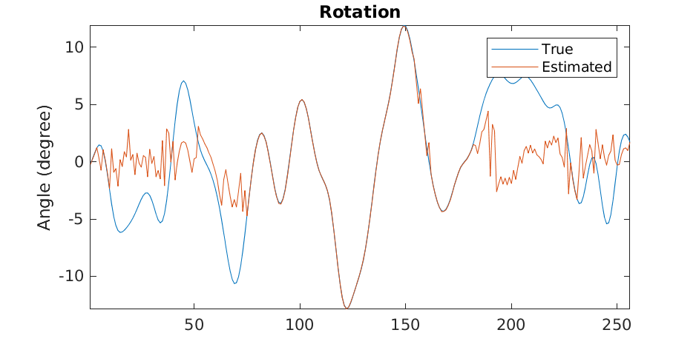
Results: BrainWeb
No structural prior
Structural prior

Slide 33
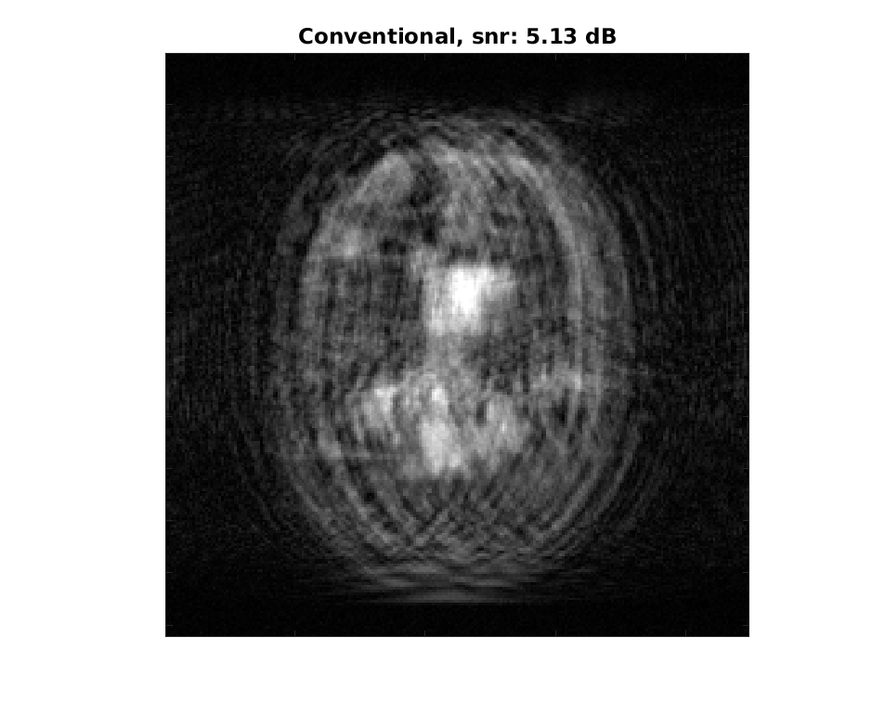
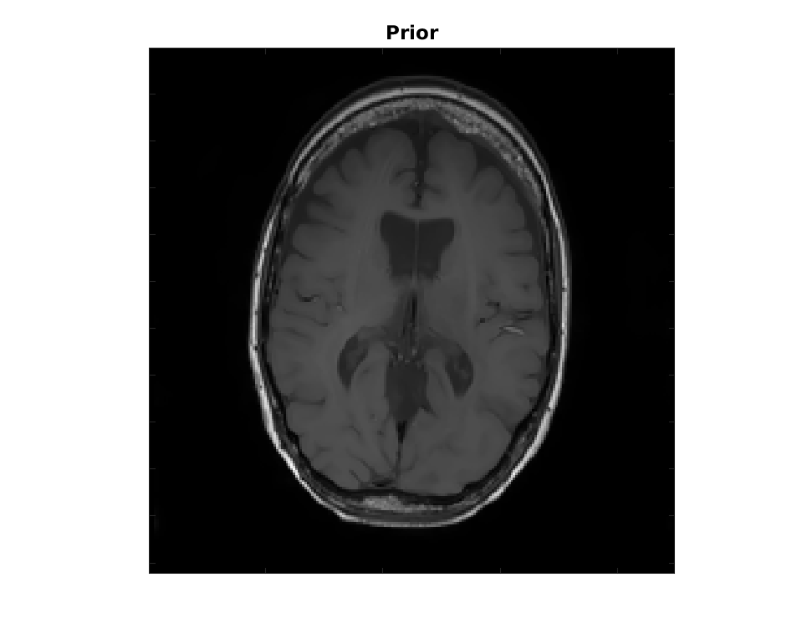
Results: realistic anatomy

Slide 34
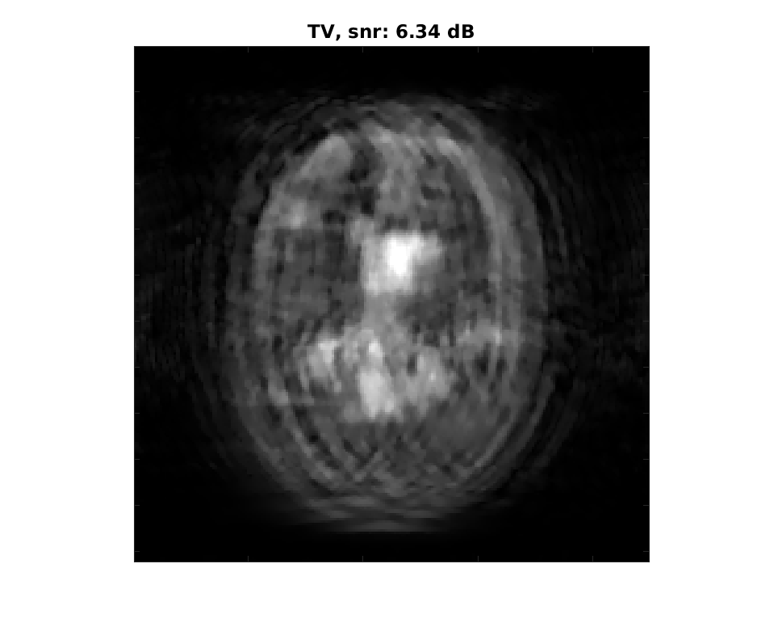
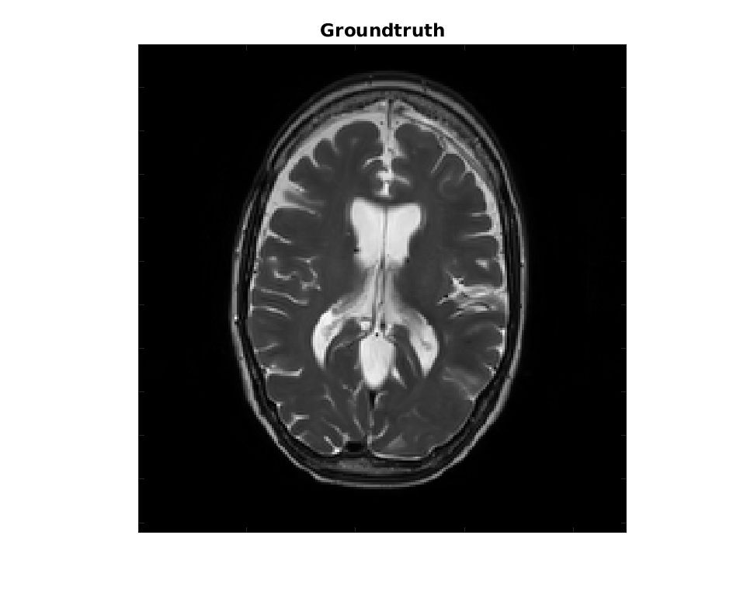
Results: realistic anatomy

Slide 35
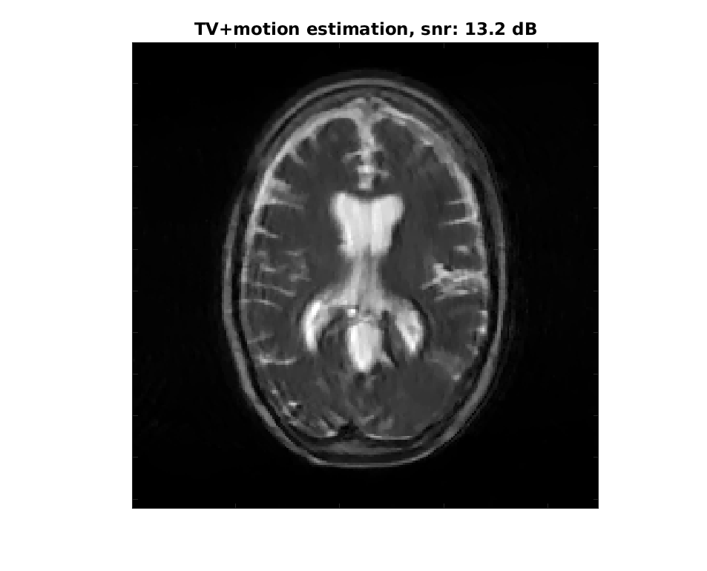
Results: realistic anatomy
(no structural prior)

Slide 36
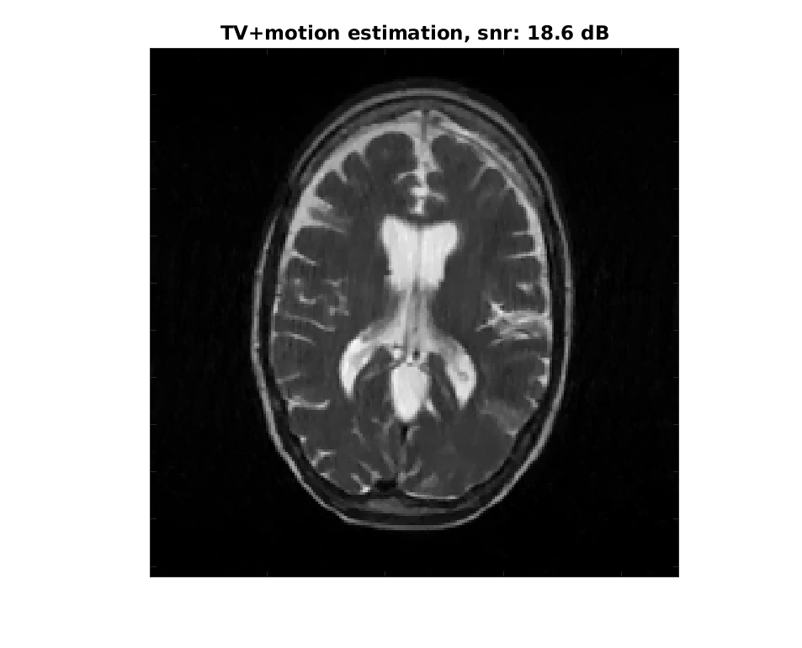

Results: realistic anatomy

Slide 37
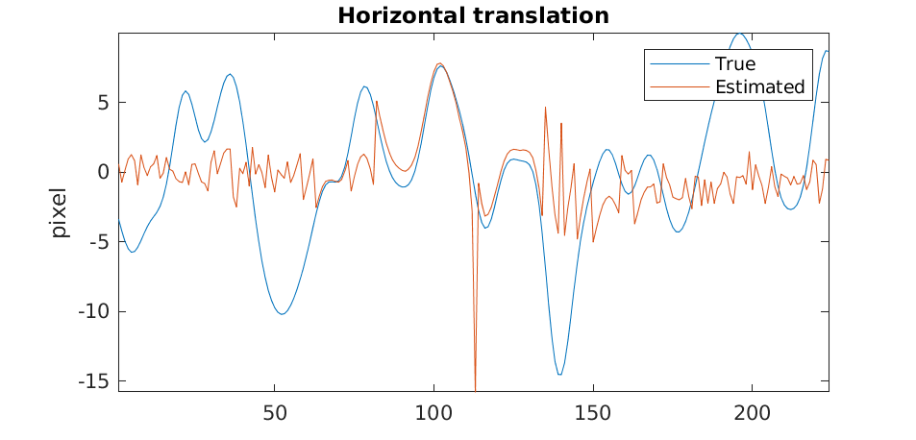
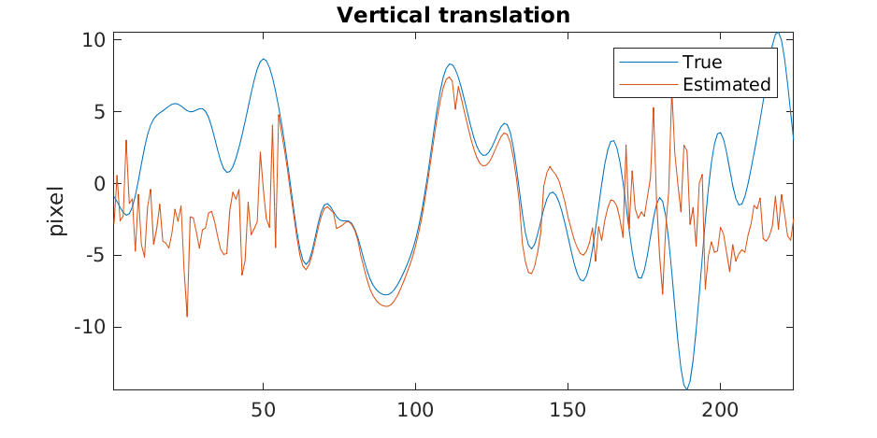
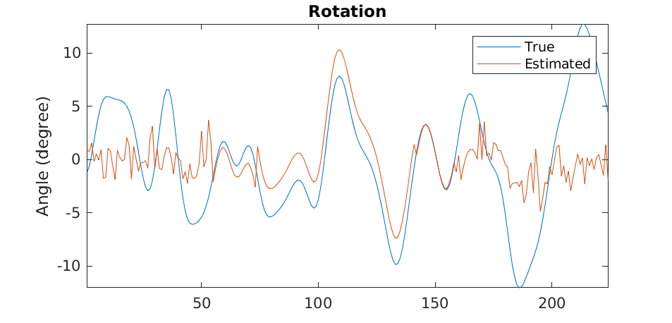
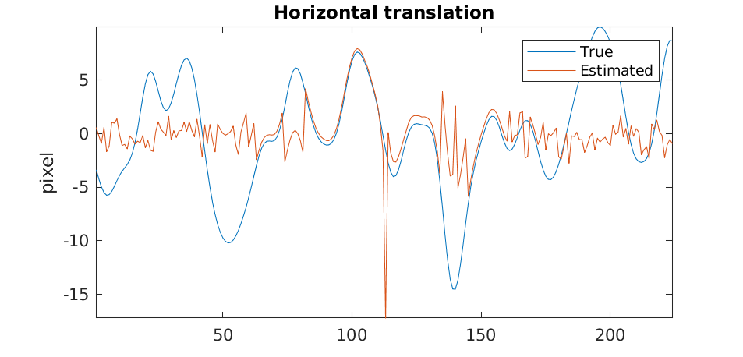
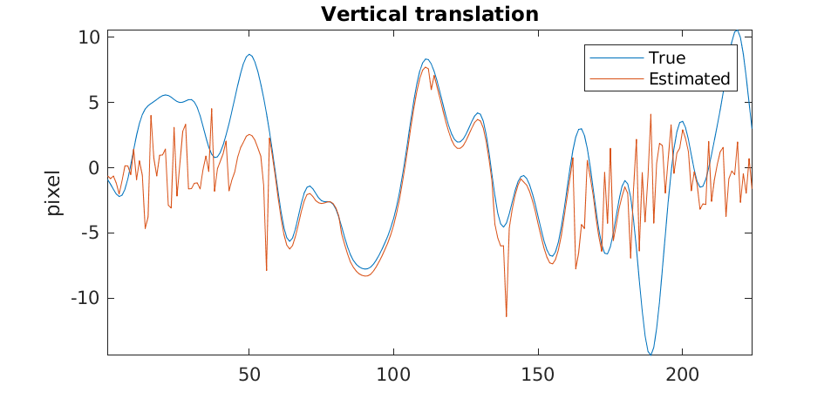
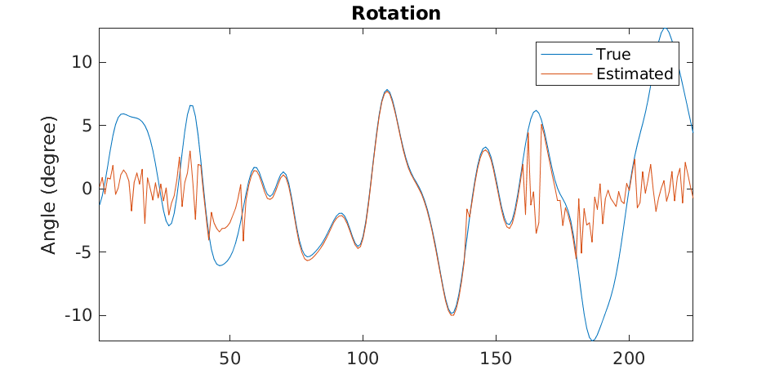
Results: realistic anatomy
No structural prior
Structural prior

Slide 38
Discussion
Complexity:
  rigid motions in x-space vs k-space
  3D: out-of-plane motion?
Multiscale strategies: spatial/temporal (or sequential oversmoothing)
Parallel imaging:
coil sensitivity

Slide 39
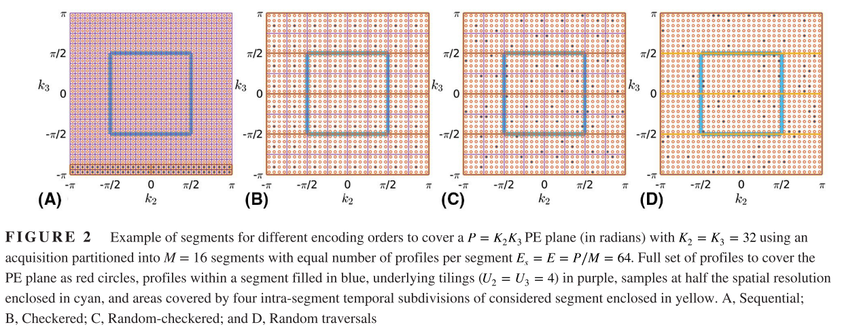
Discussion (continued)
Motion-robust sampling strategies: radial, spiral, DISORDER
Cordero-Grande et al., 2020, “Motion-corrected MRI with DISORDER: Distributed and incoherent sample orders for reconstruction deblurring using encoding redundancy”

Slide 40
Discussion (continued)
Motion-robust sampling strategies: radial, spiral, DISORDER
Convex formulation?
PDE-based formulation? E.g., via optical flow
Realistic patient motion?
R. Otazo, et al., 2015, “Low-Rank Plus Sparse Matrix Decomposition for Accelerated Dynamic MRI with Separation of Background and Dynamic Components”

Slide 41
References
J. B. Andre et al., 2015, “Toward quantifying the prevalence, severity, and cost associated with patient motion during clinical MR examinations.”, J Am Coll Radiol
F. Godenschweger et al., 2016, “Motion correction in MRI of the brain”, Phys Med Biol. 61(5)
Cordero-Grande et al., 2018, “Three-Dimensional Motion Corrected Sensitivity Encoding Reconstruction for Multi-Shot Multi-Slice MRI: Application to Neonatal Brain Imaging”, Magn Reson Med 79
Cordero-Grande et al., 2020, “Motion-corrected MRI with DISORDER: Distributed and incoherent sample orders for reconstruction deblurring using encoding redundancy”, Magn Reson Med 84
M. Zaitsev, 2015, “Motion Artifacts in MRI: A Complex Problem With Many Partial Solutions”, J Magn Reson Imaging 42
A. Barnett, et al., 2019, “A parallel non-uniform fast Fourier transform library based on an “exponential of semicircle” kernel”, SIAM J. Sci. Comput., 41(5)
A. Barnett, et al., 2021, “Aliasing error of the exp(\beta\sqrt{1-z^2}) kernel in the nonuniform fast Fourier transform”, arXiv
B. Peters, et al., 2018, “Projection methods and applications for seismic nonlinear inverse problems with multiple constraints”, Geophysics 84
A. Beck, M. Teboulle, 2009, “Fast Gradient-Based Algorithms for Constrained Total Variation Image Denoising and Deblurring Problems”
E. Esser, et al., 2010, “A General Framework for a Class of First Order Primal-Dual Algorithms for Convex Optimization in Imaging Science”, SIAM J Imaging Sciences 3(4)
G. Golub, V. Pereira, 2003, “Separable nonlinear least squares: the variable projection method and its applications”
T. van Leeuwen, A. Aravkin, 2021, “Variable projection for non-smooth problems”, SIAM J Imaging Sciences
M. J. Ehrhardt, M. M. Betcke, 2015, “Multi-Contrast MRI Reconstruction with Structure-Guided Total Variation”, SIAM J. Imaging Sciences 9(3)
R. Otazo, et al., 2015, “Low-Rank Plus Sparse Matrix Decomposition for Accelerated Dynamic MRI with Separation of Background and Dynamic Components”, Magnetic Resonance in Medicine 73

