Slide 1
An Introduction to Device Drivers
Ted Baker • Andy Wang
COP 5641 / CIS 4930

Slide 2
Introduction
Device drivers
  Black boxes to hide details of hardware devices
  Use standardized calls
    Independent of the specific driver
  Main role
    Map standard calls to device-specific operations
  Can be developed separately from the rest of the kernel
    Plugged in at runtime when needed

Slide 3
The Role of the Device Driver
Implements the mechanisms to access the hardware
  E.g., show a disk as an array of data blocks
Does not force particular policies on the user
  Examples
    Who many access the drive
    Whether the drive is accessed via a file system
    Whether users may mount file systems on the drive

Slide 4
Policy-Free Drivers
A common practice
  Support for synchronous and asynchronous operation
  Be opened multiple times
  Exploit the full capabilities of the hardware
Easier user model
Easier to write and maintain
To assist users with policies, release device drivers with user programs

Slide 5
Splitting the Kernel
Process management
  Creates, destroys processes
  Supports communication among processes
    Signals, pipes, etc.
  Schedules how processes share the CPU
Memory management
  Virtual addressing

Slide 6
Splitting the Kernel
File systems
  Everything in UNIX can be treated as a file
  Linux supports multiple file systems
Device control
  Every system operation maps to a physical device
    Few exceptions: CPU, memory, etc.
Networking
  Handles packets
  Handles routing and network address resolution issues

Slide 7
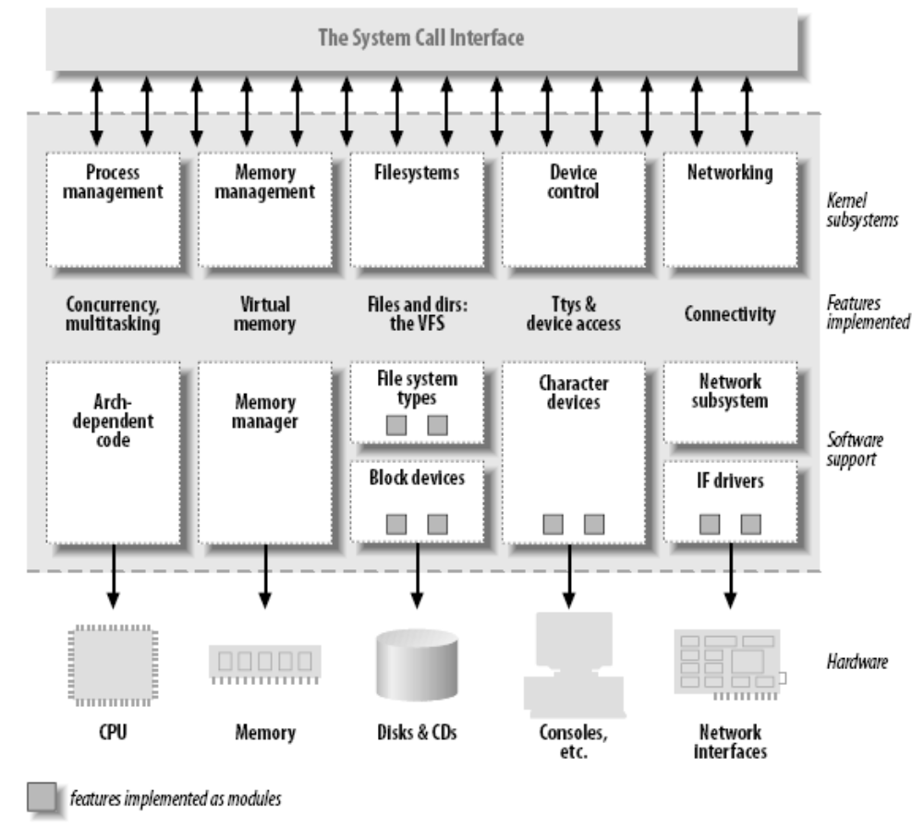
Splitting the Kernel

Slide 8
Loadable Modules
The ability to add and remove kernel features at runtime
Each unit of extension is called a module
Use insmod program to add a kernel module
Use rmmod program to remove a kernel module

Slide 9
Classes of Devices and Modules
Character devices
Block devices
Network devices
Others

Slide 10
Character Devices
Abstraction: a stream of bytes
  Examples
    Text console (/dev/console)
    Serial ports (/dev/ttyS0)
  Usually supports open, close, read, write
  Accessed sequentially (in most cases)
  Might not support file seeks
  Exception: frame grabbers
    Can access acquired image using mmap or lseek

Slide 11
Block Devices
Abstraction: array of storage blocks
However, applications can access a block device in bytes
  Block and char devices differ only at the kernel level
  A block device can host a file system

Slide 12
Network Devices
Abstraction: data packets
Send and receive packets
  Do not know about individual connections
Have unique names (e.g., eth0)
  Not in the file system
  Support protocols and streams related to packet transmission (i.e., no read and write)

Slide 13
Other Classes of Devices
Examples that do not fit to previous categories:
  USB
  SCSI
  FireWire
  I2O
  MTD

Slide 14
File System Modules
Software drivers, not device drivers
Serve as a layer between user API and block devices
Intended to be device-independent

Slide 15
Security Issues
Deliberate vs. incidental damage
Kernel modules present possibilities for both
System only does rudimentary checks at module load time
Relies on limiting privilege to load modules
  And trusts the driver writers
Driver writer must be on guard for security problems

Slide 16
Security Issues
Do not define security policies
  Provide mechanisms to enforce policies
Be aware of operations that affect global resources
  Setting up an interrupt line
    Could damage hardware
  Setting up a default block size
    Could affect other users

Slide 17
Security Issues
Beware of bugs
  Buffer overrun
    Overwriting unrelated data
  Treat input/parameters with utmost suspicion
  Uninitialized memory
    Kernel memory should be zeroed before being made available to a user
    Otherwise, information leakage could result
      Passwords

Slide 18
Security Issues
Avoid running kernels compiled by an untrusted friend
  Modified kernel could allow anyone to load a module

Slide 19
Version Numbering
Every software package used in Linux has a release number
  You need a particular version of one package to run a particular version of another package
  Prepackaged distribution contains matching versions of various packages

Slide 20
Version Numbering
Linux kernel version numbers:
  <major>.<minor>.<release>
  Even numbered minor versions are stable for general use (e.g., 2.6.x)
  Odd numbered minor versions are for developers only (e.g., 2.5.x)
The textbook uses examples from Linux 2.6.10.
  Tested on x86 platforms

Slide 21
License Terms
GNU General Public License (GPL)
  GPL allows anybody to redistribute and sell a product covered by GPL
    As long as the recipient has access to the source
    And is able to exercise the same rights
  Any software product derived from a product covered by the GPL be released under GPL

Slide 22
License Terms
Distribution of binary modules (that adhere to the published kernel interface)
  Tolerated so far
If you want your code to go into the mainline kernel
  Must use a GPL-compatible license

Slide 23
Joining the Kernel Development Community
The central gathering point
  Linux-kernel mailing list
  http://www.tux.org/lkml

