Slide 1
Communicating with Hardware
Ted Baker • Andy Wang
COP 5641 / CIS 4930

Slide 2
Topics
Port-mapped vs. memory-mapped I/O
Suppressing erroneous optimizations on I/O operations
I/O macros/operations
The parallel port
The short example module

Slide 3
I/O Ports and I/O Memory
Every peripheral device is controlled by writing and reading its registers
  Either in the memory address space (memory-mapped I/O)
    Can access devices like memory
  Or the I/O address space (port-mapped I/O)
    Need to use special instructions

Slide 4
I/O Ports and I/O Memory
Linux provides virtual I/O ports
A the hardware level
  Accessed at consecutive addresses
    Assert commands to the address bus and control bus
    Read from or write to the data bus

Slide 5
I/O Registers and Conventional Memory
Need to watch out for CPU and compiler optimizations
  I/O operations have side effects
  When accessing registers
    No caching
      Automatically handled by Linux initialization code
    No read and write reordering
      Need to insert memory barrier calls

Slide 6
I/O Registers and Conventional Memory
To prevent compiler optimizations across the barrier, call
  #include <linux/compiler.h>
  void barrier(void);
  Invalidate values in registers
  Forces refetches as needed
  Suppresses instruction reordering
  Hardware is free to do its own reordering

Slide 7
I/O Registers and Conventional Memory
Other barrier calls
  #include <asm/system.h>
  /* all reads are completed before this barrier */
  void rmb(void);
  /* blocks reordering of reads (across the barrier) that depend on data from other reads */
  void read_barrier_depends(void);
  /* all writes are completed before this barrier */
  void wmb(void);
  /* all reads & writes are completed before this barrier */
  void mb(void);

Slide 8
I/O Registers and Conventional Memory
A typical usage
  writel(dev->registers.addr, io_destination_address);
  writel(dev->registers.size, io_size);
  writel(dev->registers.operation, DEV_READ);
  wmb();
  writel(dev->registers.control, DEV_GO);
Different barrier calls for SMP
  void smp_rmb(void);
  void smp_read_barrier_depends(void);
  void smp_wmb(void);
  void smp_mb(void);

Slide 9
I/O Registers and Conventional Memory
Most synchronization primitives can function as memory barriers
  spinlock, atomic_t

Slide 10
Using I/O Ports
Allow drivers communicate with devices
To allocate, call
#include <linux/ioport.h>
struct resource *request_region(unsigned long first,
unsigned long n,
const char *name);
  Allocate n ports with first
  name is the name of the device
  Returns non-NULL on success

Slide 11
Using I/O Ports
See /proc/ioports to see the current allocation
0000-001f : dma1
0020-0021 : pic1
0040-0043 : timer0
0050-0053 : timer1
0060-006f : keyboard
0070-0077 : rtc
0080-008f : dma page reg
00a0-00a1 : pic2
00c0-00df : dma2
00f0-00ff : fpu
0170-0177 : ide1

Slide 12
Using I/O Ports
If your allocation fails
  Try other ports
  Remove the device module using those ports
To free I/O ports, call
void release_region(unsigned long start, unsigned long n);

Slide 13
Manipulating I/O Ports
Main interactions: reads and writes
Needs to differentiate 8-bit, 16-bit, 32-bit ports
#include <asm/io.h>
/* 8-bit functions */
unsigned inb(unsigned port);
void outb(unsigned char byte, unsigned port);
/* 16-bit functions */
unsigned inw(unsigned port);
void outw(unsigned short word, unsigned port);

Slide 14
Manipulating I/O Ports
/* 32-bit functions */
unsigned inl(unsigned port);
void outl(unsigned longword, unsigned port);

Slide 15
I/O Port Access from User Space
Via /dev/port
#include <sys/io.h>
Same inb/outb, inw/outw, inl/outl calls
  Must compile with –O option
  Must use ioperm and iopl calls to get permission to operate on ports
  Must run as root

Slide 16
I/O Port Access from User Space
See misc-progs/inp.c and misc-progs/outp.c
  Need to create symlinks to the binary
    ln –s inb inp
    ln –s inw inp
    ln –s inl inp
    ln –s outb outp
    ln –s outw outp
    ln –s outl outp

Slide 17
I/O Port Access from User Space
  Specify the port number to read and write
    To read 1 byte from port 0x40
    > inb 40
    To write 1 byte “0xa5” to port 0x40
    > outb 40 1 a5
      Don’t try this at home
/dev/port is a security hole

Slide 18
String Operations
String instructions can transfer a sequence of bytes, words, or longs
Available on some processors
The port and the host system might have different byte ordering rules

Slide 19
String Operations
Prototypes
void insb(unsigned port, void *addr, unsigned long count);
void outsb(unsigned port, void *addr, unsigned long count);
void insw(unsigned port, void *addr, unsigned long count);
void outsw(unsigned port, void *addr, unsigned long count);
void insl(unsigned port, void *addr, unsigned long count);
void outsl(unsigned port, void *addr, unsigned long count);

Slide 20
Pausing I/O
Sometimes the CPU transfers data too quickly to or from the bus
  Need to insert a small delay after each I/O instruction
    Send outb to port 0x80 (on the x86)
    Busy wait
      See <asm/io.h> for details
    Use pausing functions (e.g., inb_p, outb_p)

Slide 21
Platform Dependencies
I/O instructions are highly CPU dependent by their nature
  x86 and X86_64
    unsigned short port numbers
  ARM
    Ports are memory-mapped
    unsigned int port numbers

Slide 22
Platform Dependencies
  MIPS and MIPS64
    unsigned long port numbers
  PowerPC
    unsigned char * ports on 32-bit systems
    unsigned long on 64-bit systems
  SPARC
    Memory-mapped I/O
    unsigned long ports

Slide 23
An I/O Port Example
A digital I/O port
  Byte-wide I/O location
  Either memory-mapped or port-mapped
  Separate input pins and output pins (most of the time)
    E.g., parallel port

Slide 24
An Overview of the Parallel Port
5V (TTL) logic levels
Made up of three 8-bit ports
  12 output bits and 5 input bits
First parallel interface consists of port 0x378-0x37a, second at 0x278-0x27a
  First port (0x378/0x278) is a bidirectional data register
    Pins 2-9

Slide 25
An Overview of the Parallel Port
  Second port is a status register
    Online, out of paper, busy
  Third port is an output-only control register
    Controls whether interrupts are enabled

Slide 26
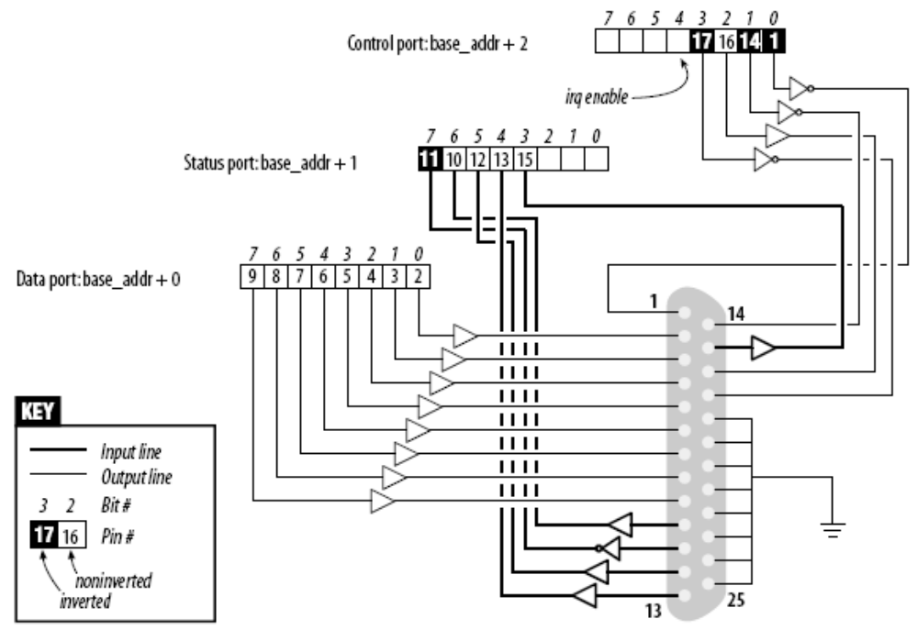
An Overview of the Parallel Port

Slide 27
A Sample Driver
short (Simple Hardware Operations and Raw Tests)
  Uses ports 0x378-0x37f
    /dev/short0 reads and writes the 8-bit port 0x378
    /dev/short1 reads and writes port 0x379…
  Not sophisticated enough to handle printers

Slide 28
A Sample Driver
/dev/short0 is based on a tight loop
  while (count--) {
  outb(*(ptr++), port);
  wmb(); /* write memory barrier */
  }
To test, try
  % echo –n “any string” > /dev/short0
  The last character stays on the output pins
  -n removes automatic insertion of “\n”

Slide 29
A Sample Driver
To read, try
  % dd if=/dev/short0 bs=1 count=1 | od –t x1
  1+0 records in
  1+0 records out
  1 byte (1 B) copied, 4.4e-5 seconds, 22.7 kB/s
  0000000 67
  0000001
  dd converts and copies a file
    bs = transfer granularity in bytes
    count = number of transfers
  od performs an octal dump
    -t x1 prints 1 byte in hex
“g” in hex

Slide 30
A Sample Driver
Variants of short
  /dev/short0p and the others use outb_p and inb_p pause functions
  /dev/short0s and the others use the string instructions

Slide 31
Using I/O Memory
Outside of the x86 world, the main mechanism used to communicate with devices is through memory-mapped I/Os

Slide 32
Using I/O Memory
Should not use pointers directly
  Use wrappers to improve portability
Depending on the platform
  I/O memory may or may not be accessed through page tables
  With the use of page tables, you need to call ioremap before doing any I/O
  Without using the page tables, just use wrapper functions

Slide 33
I/O Memory Allocation and Mapping
To allocate I/O memory, call
#include <linux/ioport.h>
struct resource *request_mem_region(unsigned long start,
unsigned long len,
char *name);
  start: starting memory location
  len: bytes
  name: displayed in /proc/iomem

Slide 34
I/O Memory Allocation and Mapping
more /proc/iomem
00000000-0009b7ff : System RAM
0009b800-0009ffff : reserved
000a0000-000bffff : Video RAM area
000c0000-000c7fff : Video ROM
000c8000-000c8fff : Adapter ROM
000f0000-000fffff : System ROM
00100000-7ff6ffff : System RAM
00100000-002c7f2f : Kernel code
002c7f30-003822ff : Kernel data
7ff70000-7ff77fff : ACPI Tables
7ff78000-7ff7ffff : ACPI Non-volatile Storage
...

Slide 35
I/O Memory Allocation and Mapping
To free memory regions, call
void release_mem_region(unsigned long start,
unsigned long len);
To make memory accessible, call
#include <asm/io.h>
void *ioremap(unsigned long phys_addr, unsigned long size);
void iounmap(void *addr);

Slide 36
Accessing I/O Memory
Should use predefined macros to perform memory-mapped I/Os
  unsigned int ioread8(void *addr);
  unsigned int ioread16(void *addr);
  unsigned int ioread32(void *addr);
  void iowrite8(u8 value, void *addr);
  void iowrite16(u16 value, void *addr);
  void iowrite32(u32 value, void *addr);

Slide 37
Accessing I/O Memory
To perform repeated I/Os, use
void ioread8_rep(void *addr, void *buf, unsigned long count);
void ioread16_rep(void *addr, void *buf, unsigned long count);
void ioread32_rep(void *addr, void *buf, unsigned long count);
void iowrite8_rep(void *addr, const void *buf,
unsigned long count);
void iowrite16_rep(void *addr, const void *buf,
unsigned long count);
void iowrite32_rep(void *addr, const void *buf,
unsigned long count);
  count: number of repetitions

Slide 38
Accessing I/O Memory
Other operations
void memset_io(void *addr, u8 value, unsigned int count);
void memcpy_fromio(void *dest, void *source,
unsigned int count);
void memcpy_toio(void *dest, void *source,
unsigned int count);
  count: in bytes

Slide 39
Ports as I/O Memory
Linux 2.6 introduces ioport_map
  Remaps I/O ports and makes them appear to be I/O memory
void *ioport_map(unsigned long port, unsigned int count);
void ioport_unmap(void *addr);
  port = first port number
  count = number of I/O ports

Slide 40
Reusing short for I/O Memory
To try the memory-mapped I/O, type
  % ./short_load use_mem=1 base=0xb7ffffc0
  % echo –n 7 > /dev/short0
The internal loop uses iowrite8
  while (count--) {
  iowrite8(*ptr++, address);
  wmb( );
  }

