Slide 1
Java Server Page (JSP)

Slide 2
Agenda
In this session we will see
1. Overview JSP
2. Life cycle of JSP
3. Scriptlet
4. Declaration
5. Expression
6. Action
7. Directive
8. MVC Overview

Slide 3
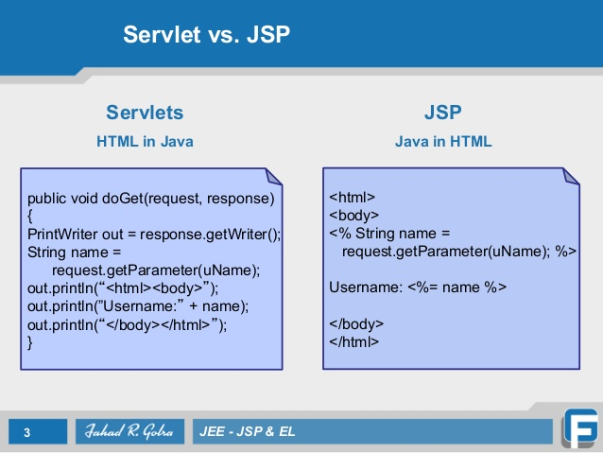

Slide 4
Overview JSP
JSP technology is used to create web application just like Servlet technology. It can be thought of as an extension to servlet because it provides more functionality than servlet such as expression language, jstl etc.
A JSP page consists of HTML tags and JSP tags. The jsp pages are easier to maintain than servlet because we can separate designing and development. It provides some additional features such as Expression Language, Custom Tag etc.

Slide 5
Overview JSP
Advantage of JSP over Servlet
1) Extension to Servlet
JSP technology is the extension to servlet technology. We can use all the features of servlet in JSP. In addition to, we can use implicit objects, predefined tags, expression language and Custom tags in JSP, that makes JSP development easy.
2) Easy to maintain
JSP can be easily managed because we can easily separate our business logic with presentation logic. In servlet technology, we mix our business logic with the presentation logic.
3) Fast Development: No need to recompile and redeploy
If JSP page is modified, we don't need to recompile and redeploy the project. The servlet code needs to be updated and recompiled if we have to change the look and feel of the application.
4) Less code than Servlet
In JSP, we can use a lot of tags such as action tags, jstl, custom tags etc. that reduces the code. Moreover, we can use EL, implicit objects etc.

Slide 6
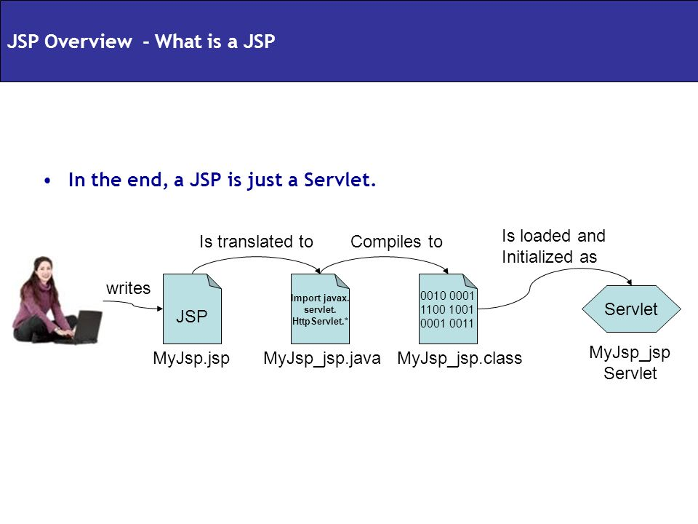

Slide 7
Life Cycle of JSP
Life cycle of a JSP Page
The JSP pages follows these phases:
•Translation of JSP Page
•Compilation of JSP Page
•Classloading (class file is loaded by the classloader)
•Instantiation (Object of the Generated Servlet is created).
•Initialization ( jspInit() method is invoked by the container).
•Reqeust processing ( _jspService() method is invoked by the container).
•Destroy ( jspDestroy() method is invoked by the container).
jspInit(), _jspService() and jspDestroy() are the life cycle methods of JSP.

Slide 8
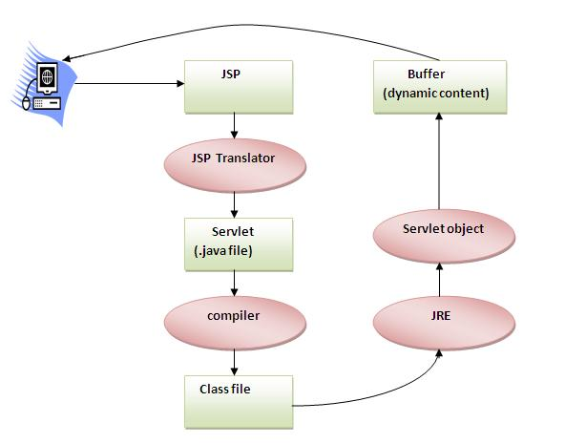
Life Cycle of JSP

Slide 9
Overview JSP
As depicted in the above diagram, JSP page is translated into servlet by the help of JSP translator. The JSP translator is a part of webcontainer that is responsible to translate the JSP page into servlet. After that Servlet page is compiled by the compiler and gets converted into the class file. Moreover, all the processes that happens in servlet is performed on JSP later like initialization, committing response to the browser and destroy.

Slide 10
javax.servlet.jsp package
javax.servlet.jsp package
The javax.servlet.jsp package has two interfaces and classes. The two interfaces are as follows:
1.JspPage
2.HttpJspPage
The classes are as follows:
•JspWriter
•PageContext
•JspFactory
•JspEngineInfo
•JspException
•JspError

Slide 11
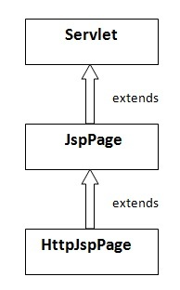
javax.servlet.jsp package
The JspPage interface
According to the JSP specification, all the generated servlet classes must implement the JspPage interface. It extends the Servlet interface. It provides two life cycle methods.

Slide 12
javax.servlet.jsp package
Methods of JspPage interface
1.public void jspInit(): It is invoked only once during the life cycle of the JSP when JSP page is requested firstly. It is used to perform initialization. It is same as the init() method of Servlet interface.
2.public void jspDestroy(): It is invoked only once during the life cycle of the JSP before the JSP page is destroyed. It can be used to perform some clean up operation.

Slide 13
javax.servlet.jsp package
The HttpJspPage interface
The HttpJspPage interface provides the one life cycle method of JSP. It extends the JspPage interface.
Method of HttpJspPage interface:
1.public void _jspService(): It is invoked each time when request for the JSP page comes to the container. It is used to process the request. The underscore _ signifies that you cannot override this method.

Slide 14
JSP tags
Types of JSP tags
Scriptlet
Declaration
Expression
Action
Directive

Slide 15
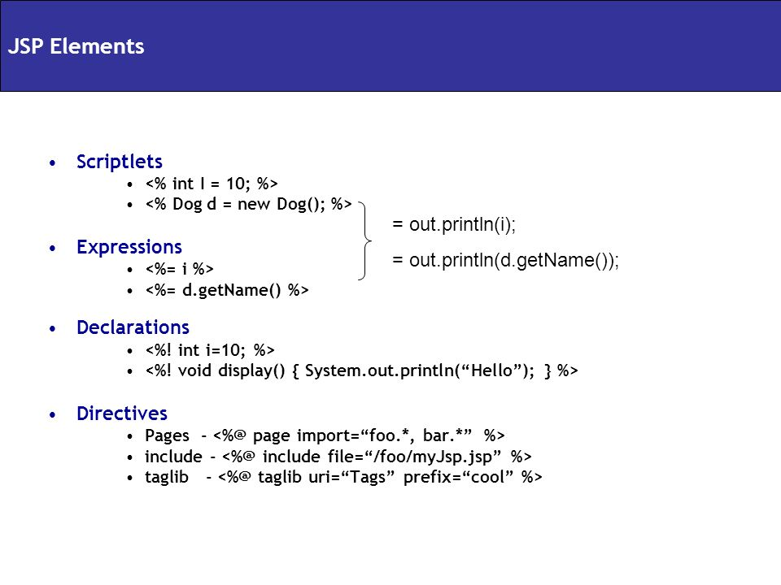

Slide 16
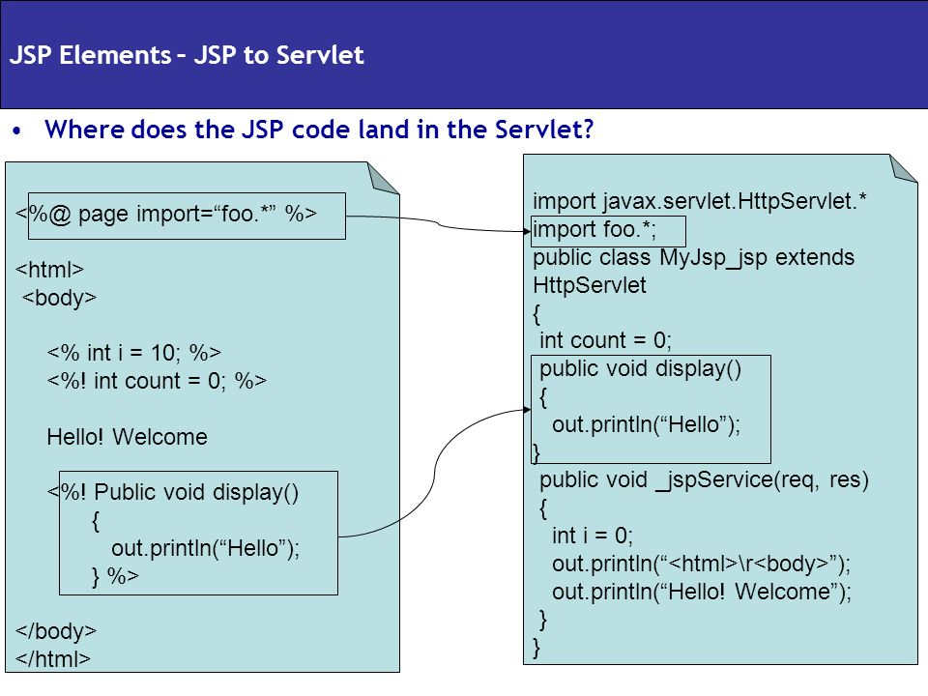

Slide 17
Scriptlet
JSP Scriptlet tag (Scripting elements)
A scriptlet tag is used to execute java source code in JSP. Syntax is as follows:
<% java source code %>

Slide 18
Scriptlet example
Index.html
<form method="get" action="adder.jsp">
Num1 <input type="text" name="num1"><br>
Num2 <input type="text" name="num2"><br>
<input type="submit" value="add">
</form>

Slide 19
Scriptlet example
Adder.jsp
<%
int a=Integer.parseInt(request.getParameter("num1"));
int b=Integer.parseInt(request.getParameter("num2"));
int c= a+b;
out.println("<b> Result is : "+c+"</b>");
%>

Slide 20
Declaration
JSP Declaration Tag
The JSP declaration tag is used to declare fields and methods.
The code written inside the jsp declaration tag is placed outside the service() method of auto generated servlet.
Syntax of JSP declaration tag
<%! field or method declaration %>

Slide 21
Declaration example
Index.html
same as last program
Adder.jsp
<%!
public int add(int x,int y)
{
return x+y;
}
%>
<%
int a=Integer.parseInt(request.getParameter("num1"));
int b=Integer.parseInt(request.getParameter("num2"));
int c= add(a,b);
out.println("<b> Result is : "+c+"</b>");
%>

Slide 22
Expression
JSP expression tag
The code placed within JSP expression tag is written to the output stream of the response. So you need not write out.print() to write data. It is mainly used to print the values of variable or method.
Syntax of JSP expression tag
<%= statement %>

Slide 23
Expression example
Index.html
same as last program
Adder.jsp
<%
int a=Integer.parseInt(request.getParameter("num1"));
int b=Integer.parseInt(request.getParameter("num2"));
int c= a+b;
%>
<form method="get" action="adder.jsp">
Num1 <input type="text" name="num1" value="<%=a%>"><br>
Num2 <input type="text" name="num2" value="<%=b%>"><br>
Result <input type="text" name="result" value="<%=c%>"><br>
<input type="submit" value="add">
</form>

Slide 24
Action Tags
JSP Action Tags
There are many JSP action tags or elements. Each JSP action tag is used to perform some specific tasks.
The action tags are used to control the flow between pages and to use Java Bean.
Some Jsp action tags are given below.
jsp:forward
jsp:include
jsp:useBean
jsp:setProperty
jsp:getProperty

Slide 25
Action Tags
jsp:include
<jsp:include page=“URL of the page” />
jsp:forward
<jsp:forward page=“URL of the page” />

Slide 26
Jsp:include example
Index.html
same as last program
Adder.jsp
<%
int a=Integer.parseInt(request.getParameter("num1"));
int b=Integer.parseInt(request.getParameter("num2"));
int c= a+b;
%>
<b> Result is <%=c%> </b> <br>
<jsp:include page="index.html"/>
Or <%@ include file=“index.html” %>

Slide 27
Java Bean
Java Bean
A java bean is a reusable java component , Which has following characteristics.
It is defined with in package.
It provides getter and setter methods
It provide default constructor.

Slide 28
jsp:useBean action tag
jsp:useBean action tag
The jsp:useBean action tag is used to locate or instantiate a bean class. If bean object of the Bean class is already created, it doesn't create the bean depending on the scope. But if object of bean is not created, it instantiates the bean.
Syntax of jsp:useBean action tag
<jsp:useBean id= "instanceName" scope= "page | request | session | application"
class= "packageName.className" type= "packageName.className" >
</jsp:useBean>

Slide 29
jsp:setProperty action tag
jsp:setProperty action tags
The jsp:setProperty action tag sets a property value or values in a bean using the setter method.
Syntax of jsp:setProperty action tag
<jsp:setProperty name="instanceOfBean"
property="propertyName"
value="property value"
/>

Slide 30
jsp:getProperty action tag
jsp:getProperty action tag
The jsp:getProperty action tag returns the value of the property.
Syntax of jsp:getProperty action tag
<jsp:getProperty name="bean name" property="propertyName" />

Slide 31
jsp:useBean example
Rectangle.java
package com.st;
public class Rectangle {
int length,breadth;
public int getLength() {
return length;
}
public void setLength(int length) {
this.length = length;
}
public int getBreadth() {
return breadth;
}
public void setBreadth(int breadth) {
this.breadth = breadth;
}}

Slide 32
jsp:useBean example
Index.html
<form method="get" action="createRectangle.jsp">
Length <input type="text" name="length"><br>
Breadth <input type="text" name="breadth"><br>
<input type="submit" value="create rectangle">
</form>

Slide 33
jsp:useBean example
createRectangle.jsp
<jsp:useBean id="rect" class="com.st.Rectangle" scope="session"/>
<jsp:setProperty property="*" name="rect"/>
<b>Rectangle Created</b>
<a href="viewRectangle.jsp">view Rectangle</a>

Slide 34
jsp:useBean example
viewRectangle.jsp
<jsp:useBean id="rect" class="com.st.Rectangle" scope="session"/>
<b> length : <%=rect.getLength() %> <br>
breadth : <%=rect.getBreadth() %> </b>

Slide 35
JSP directives
JSP directives
The jsp directives are messages that tells the web container how to translate a JSP page into the corresponding servlet.
There are three types of directives:
•page directive
•include directive
•taglib directive
Syntax of JSP Directive
<%@ directive attribute="value" %>

Slide 36
JSP directives
JSP page directive
The page directive defines attributes that apply to an entire JSP page.
Syntax of JSP page directive
<%@ page attribute="value" %>
Some attributes of JSP page directive
1)import
The import attribute is used to import class,interface or all the members of a package.It is similar to import keyword in java class or interface.

Slide 37
JSP directives
2)contentType
The contentType attribute defines the MIME(Multipurpose Internet Mail Extension) type of the HTTP response.The default value is "text/html;charset=ISO-8859-1".
3)extends
The extends attribute defines the parent class that will be inherited by the generated servlet.It is rarely used.
4)errorPage
The errorPage attribute is used to define the error page, if exception occurs in the current page, it will be redirected to the error page.
5)isErrorPage
The isErrorPage attribute is used to declare that the current page is the error page.

Slide 38
JSP directives
Include directive
used to ask the translator to include the content of specified page.
Syntax:
<%@ include file=“url of the page”>
If contents of static page are to be included, Include directive must be used and if dynamic content are to be included, Include action must be used.

Slide 39
JSP directives
Error Handling
Jsp supports centralized error handling. In centralized error handling one page of the application is marked as error handler page. Whenever any exception occurs in any of the jsp, request is forwarded to the error handler page.

Slide 40
JSP directives example
Index.html
<form action="divide.jsp">
Num1 <input type="text" name="num1"><br>
Num2 <input type="text" name="num2"><br>
<input type="submit" value="DIVIDE">
</form>

Slide 41
JSP directives example
divide.jsp
<%@page errorPage="error.jsp" %>
<%
int num1=Integer.parseInt(request.getParameter("num1"));
int num2=Integer.parseInt(request.getParameter("num2"));
int result= num1/num2;
%>
RESULT is <%= result%>
<%@include file="index.html" %>

Slide 42
JSP directives example
error.jsp
<%@page isErrorPage="true" %>
<%
if(exception instanceof ArithmeticException)
out.println("num2 can not be 0");
else
out.print("Both num's must be numeric");
%>
<br>
</b>
<%@include file="index.html" %>

Slide 43
Implicit Objects
Implicit Objects
Implicit Object | Type
Out | JspWriter(subclass of PrintWriter)
request | HttpServletRequest
response | HttpServletResponse
config | ServletConfig
session | HttpSession
application | ServletContext
page | JspBase(abstact class which impliments HttpJspPage)
exception | Throwable(Is made available only to error handler page)

Slide 44
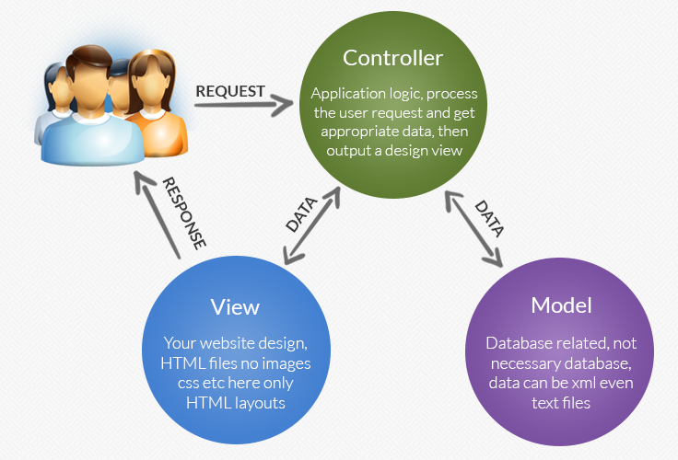
MVC Pattern

Slide 45
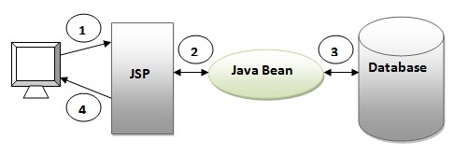
MVC 1 Architecture

Slide 46
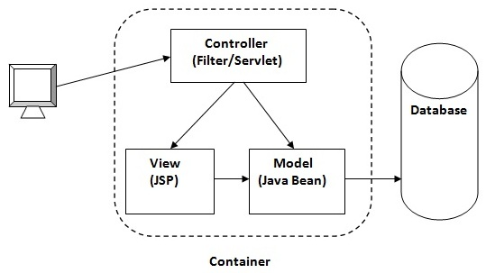
MVC 2 Architecture

Slide 47
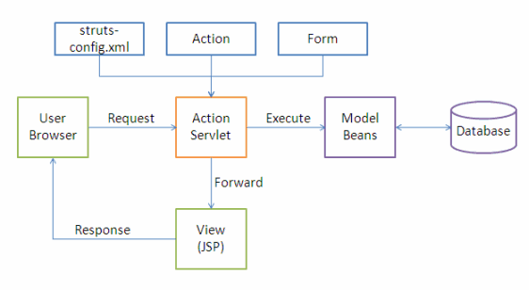
Struts MVC 2 model

