Slide 1


Regular Expressions
Chapter 11
Python for Informatics: Exploring Information
www.pythonlearn.com
Notes:
Note from Chuck. If you are using these materials, you can remove the UM logo and replace it with your own, but please retain the CC-BY logo on the first page as well as retain the entire last page.

Slide 2
Regular Expressions
In computing, a regular expression, also referred to as “regex” or “regexp”, provides a concise and flexible means for matching strings of text, such as particular characters, words, or patterns of characters. A regular expression is written in a formal language that can be interpreted by a regular expression processor.
http://en.wikipedia.org/wiki/Regular_expression

Slide 3
Regular Expressions
Really clever “wild card” expressions for matching and parsing strings
http://en.wikipedia.org/wiki/Regular_expression

Slide 4
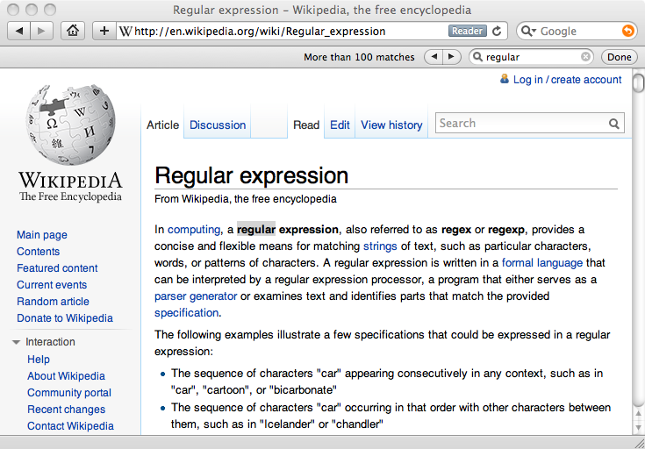
Really smart "Find" or "Search"

Slide 5
Understanding Regular Expressions
Very powerful and quite cryptic
Fun once you understand them
Regular expressions are a language unto themselves
A language of “marker characters” - programming with characters
It is kind of an “old school” language - compact

Slide 6
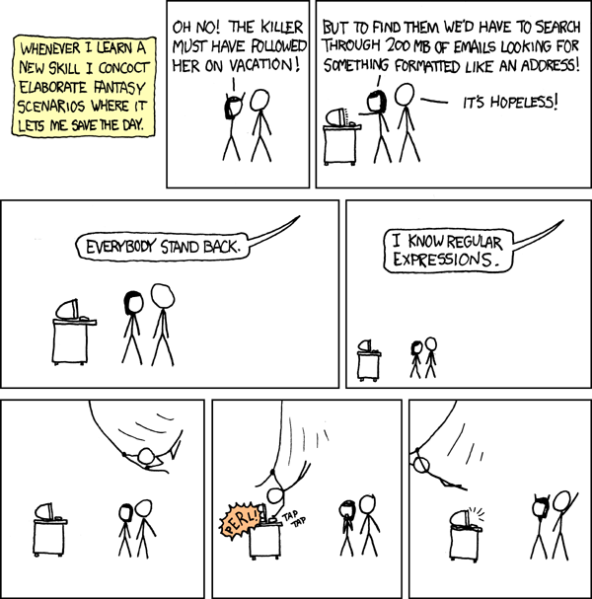
http://xkcd.com/208/

Slide 7
Regular Expression Quick Guide
^ Matches the beginning of a line
$ Matches the end of the line
. Matches any character
\s Matches whitespace
\S Matches any non-whitespace character
* Repeats a character zero or more times
*? Repeats a character zero or more times (non-greedy)
+ Repeats a character one or more times
+? Repeats a character one or more times (non-greedy)
[aeiou] Matches a single character in the listed set
[^XYZ] Matches a single character not in the listed set
[a-z0-9] The set of characters can include a range
( Indicates where string extraction is to start
) Indicates where string extraction is to end

Slide 8
The Regular Expression Module
Before you can use regular expressions in your program, you must import the library using "import re"
You can use re.search() to see if a string matches a regular expression, similar to using the find() method for strings
You can use re.findall() extract portions of a string that match your regular expression similar to a combination of find() and slicing: var[5:10]

Slide 9
Using re.search() like find()
import re
hand = open('mbox-short.txt')
for line in hand:
line = line.rstrip()
if re.search('From:', line) :
print line
hand = open('mbox-short.txt')
for line in hand:
line = line.rstrip()
if line.find('From:') >= 0:
print line

Slide 10
Using re.search() like startswith()
import re
hand = open('mbox-short.txt')
for line in hand:
line = line.rstrip()
if re.search('^From:', line) :
print line
hand = open('mbox-short.txt')
for line in hand:
line = line.rstrip()
if line.startswith('From:') :
print line
We fine-tune what is matched by adding special characters to the string

Slide 11
Wild-Card Characters
The dot character matches any character
If you add the asterisk character, the character is “any number of times”
X-Sieve: CMU Sieve 2.3
X-DSPAM-Result: Innocent
X-DSPAM-Confidence: 0.8475
X-Content-Type-Message-Body: text/plain
^X.*:

Slide 12
Wild-Card Characters
The dot character matches any character
If you add the asterisk character, the character is “any number of times”
Many times
Match the start of the line
X-Sieve: CMU Sieve 2.3
X-DSPAM-Result: Innocent
X-DSPAM-Confidence: 0.8475
X-Content-Type-Message-Body: text/plain
^X.*:
Match any character

Slide 13
Fine-Tuning Your Match
Depending on how “clean” your data is and the purpose of your application, you may want to narrow your match down a bit
Many times
Match the start of the line
X-Sieve: CMU Sieve 2.3
X-DSPAM-Result: Innocent
X-Plane is behind schedule: two weeks
^X.*:
Match any character

Slide 14
Fine-Tuning Your Match
Depending on how “clean” your data is and the purpose of your application, you may want to narrow your match down a bit
One or more times
Match the start of the line
X-Sieve: CMU Sieve 2.3
X-DSPAM-Result: Innocent
X-Plane is behind schedule: two weeks
^X-\S+:
Match any non-whitespace character

Slide 15
Matching and Extracting Data
The re.search() returns a True/False depending on whether the string matches the regular expression
If we actually want the matching strings to be extracted, we use re.findall()
>>> import re
>>> x = 'My 2 favorite numbers are 19 and 42'
>>> y = re.findall('[0-9]+',x)
>>> print y
['2', '19', '42']
[0-9]+
One or more digits

Slide 16
Matching and Extracting Data
When we use re.findall(), it returns a list of zero or more sub-strings that match the regular expression
>>> import re
>>> x = 'My 2 favorite numbers are 19 and 42'
>>> y = re.findall('[0-9]+',x)
>>> print y
['2', '19', '42']
>>> y = re.findall('[AEIOU]+',x)
>>> print y
[]

Slide 17
Warning: Greedy Matching
The repeat characters (* and +) push outward in both directions (greedy) to match the largest possible string
One or more characters
>>> import re
>>> x = 'From: Using the : character'
>>> y = re.findall('^F.+:', x)
>>> print y
['From: Using the :']
^F.+:
First character in the match is an F
Last character in the match is a :
Why not 'From:' ?

Slide 18
Non-Greedy Matching
Not all regular expression repeat codes are greedy! If you add a ? character - the + and * chill out a bit...
One or more characters but not greedy
>>> import re
>>> x = 'From: Using the : character'
>>> y = re.findall('^F.+?:', x)
>>> print y
['From:']
^F.+?:
First character in the match is an F
Last character in the match is a :

Slide 19
Fine-Tuning String Extraction
You can refine the match for re.findall() and separately determine which portion of the match is to be extracted by using parentheses
From stephen.marquard@uct.ac.za Sat Jan 5 09:14:16 2008
\S+@\S+
>>> y = re.findall('\S+@\S+',x)
>>> print y
['stephen.marquard@uct.ac.za']
At least one non-whitespace character

Slide 20
Fine-Tuning String Extraction
Parentheses are not part of the match - but they tell where to start and stop what string to extract
From stephen.marquard@uct.ac.za Sat Jan 5 09:14:16 2008
>>> y = re.findall('\S+@\S+',x)
>>> print y
['stephen.marquard@uct.ac.za']
>>> y = re.findall('^From:.*? (\S+@\S+)',x)
>>> print y
['stephen.marquard@uct.ac.za']
^From (\S+@\S+)

Slide 21
21
31
From stephen.marquard@uct.ac.za Sat Jan 5 09:14:16 2008
>>> data = 'From stephen.marquard@uct.ac.za Sat Jan 5 09:14:16 2008'
>>> atpos = data.find('@')
>>> print atpos
21
>>> sppos = data.find(' ',atpos)
>>> print sppos
31
>>> host = data[atpos+1 : sppos]
>>> print host
uct.ac.za
Extracting a host name - using find and string slicing

Slide 22
The Double Split Pattern
Sometimes we split a line one way, and then grab one of the pieces of the line and split that piece again
From stephen.marquard@uct.ac.za Sat Jan 5 09:14:16 2008
words = line.split()
email = words[1]
pieces = email.split('@')
print pieces[1]
print pieces[1]
stephen.marquard@uct.ac.za
['stephen.marquard', 'uct.ac.za']
'uct.ac.za'

Slide 23
The Regex Version
From stephen.marquard@uct.ac.za Sat Jan 5 09:14:16 2008
import re
lin = 'From stephen.marquard@uct.ac.za Sat Jan 5 09:14:16 2008'
y = re.findall('@([^ ]*)',lin)
print y
['uct.ac.za']
'@([^ ]*)'
Look through the string until you find an at sign

Slide 24
The Regex Version
From stephen.marquard@uct.ac.za Sat Jan 5 09:14:16 2008
import re
lin = 'From stephen.marquard@uct.ac.za Sat Jan 5 09:14:16 2008'
y = re.findall('@([^ ]*)',lin)
print y
['uct.ac.za']
'@([^ ]*)'
Match non-blank character
Match many of them

Slide 25
The Regex Version
From stephen.marquard@uct.ac.za Sat Jan 5 09:14:16 2008
import re
lin = 'From stephen.marquard@uct.ac.za Sat Jan 5 09:14:16 2008'
y = re.findall('@([^ ]*)',lin)
print y
['uct.ac.za']
'@([^ ]*)'
Extract the non-blank characters

Slide 26
Even Cooler Regex Version
From stephen.marquard@uct.ac.za Sat Jan 5 09:14:16 2008
import re
lin = 'From stephen.marquard@uct.ac.za Sat Jan 5 09:14:16 2008'
y = re.findall('^From .*@([^ ]*)',lin)
print y
['uct.ac.za']
'^From .*@([^ ]*)'
Starting at the beginning of the line, look for the string 'From '

Slide 27
Even Cooler Regex Version
From stephen.marquard@uct.ac.za Sat Jan 5 09:14:16 2008
import re
lin = 'From stephen.marquard@uct.ac.za Sat Jan 5 09:14:16 2008'
y = re.findall('^From .*@([^ ]*)',lin)
print y
['uct.ac.za']
'^From .*@([^ ]*)'
Skip a bunch of characters, looking for an at sign

Slide 28
Even Cooler Regex Version
From stephen.marquard@uct.ac.za Sat Jan 5 09:14:16 2008
import re
lin = 'From stephen.marquard@uct.ac.za Sat Jan 5 09:14:16 2008'
y = re.findall('^From .*@([^ ]*)',lin)
print y
['uct.ac.za']
'^From .*@([^ ]*)'
Start extracting

Slide 29
Even Cooler Regex Version
From stephen.marquard@uct.ac.za Sat Jan 5 09:14:16 2008
import re
lin = 'From stephen.marquard@uct.ac.za Sat Jan 5 09:14:16 2008'
y = re.findall('^From .*@([^ ]*)',lin)
print y
['uct.ac.za']
'^From .*@([^ ]*)'
Match non-blank character
Match many of them

Slide 30
Even Cooler Regex Version
From stephen.marquard@uct.ac.za Sat Jan 5 09:14:16 2008
import re
lin = 'From stephen.marquard@uct.ac.za Sat Jan 5 09:14:16 2008'
y = re.findall('^From .*@([^ ]*)',lin)
print y
['uct.ac.za']
'^From .*@([^ ]*)'
Stop extracting

Slide 31
Spam Confidence
import re
hand = open('mbox-short.txt')
numlist = list()
for line in hand:
line = line.rstrip()
stuff = re.findall('^X-DSPAM-Confidence: ([0-9.]+)', line)
if len(stuff) != 1 : continue
num = float(stuff[0])
numlist.append(num)
print 'Maximum:', max(numlist)
python ds.py
Maximum: 0.9907

Slide 32
Regular Expression Quick Guide
^ Matches the beginning of a line
$ Matches the end of the line
. Matches any character
\s Matches whitespace
\S Matches any non-whitespace character
* Repeats a character zero or more times
*? Repeats a character zero or more times (non-greedy)
+ Repeats a character one or more times
+? Repeats a character one or more times (non-greedy)
[aeiou] Matches a single character in the listed set
[^XYZ] Matches a single character not in the listed set
[a-z0-9] The set of characters can include a range
( Indicates where string extraction is to start
) Indicates where string extraction is to end

Slide 33
Escape Character
If you want a special regular expression character to just behave normally (most of the time) you prefix it with '\'
>>> import re
>>> x = 'We just received $10.00 for cookies.'
>>> y = re.findall('\$[0-9.]+',x)
>>> print y
['$10.00']
At least one or more
\$[0-9.]+
A real dollar sign
A digit or period

Slide 34
Summary
Regular expressions are a cryptic but powerful language for matching strings and extracting elements from those strings
Regular expressions have special characters that indicate intent

Slide 35
Acknowledgements / Contributions
These slides are Copyright 2010- Charles R. Severance (www.dr-chuck.com) of the University of Michigan School of Information and open.umich.edu and made available under a Creative Commons Attribution 4.0 License. Please maintain this last slide in all copies of the document to comply with the attribution requirements of the license. If you make a change, feel free to add your name and organization to the list of contributors on this page as you republish the materials.
Initial Development: Charles Severance, University of Michigan School of Information
… Insert new Contributors and Translations here
...

