Slide 1


Relational Databases and SQLite
Charles Severance
Python for Informatics: Exploring Information
www.pythonlearn.com
Notes:
Note from Chuck. If you are using these materials, you can remove the UM logo and replace it with your own, but please retain the CC-BY logo on the first page as well as retain the entire last page.

Slide 2
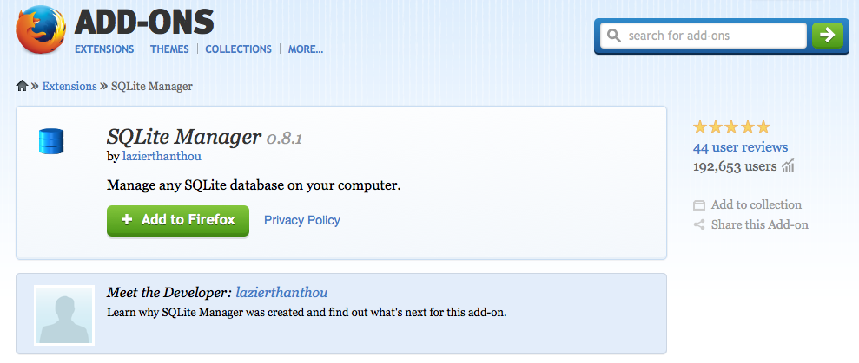
SQLite Manager for Firefox
https://addons.mozilla.org/en-US/firefox/addon/sqlite-manager/

Slide 3
Relational Databases
Relational databases model data by storing rows and columns in tables. The power of the relational database lies in its ability to efficiently retrieve data from those tables and in particular where there are multiple tables and the relationships between those tables involved in the query.
http://en.wikipedia.org/wiki/Relational_database

Slide 4
Terminology
Database - contains many tables
Relation (or table) - contains tuples and attributes
Tuple (or row) - a set of fields that generally represents an “object” like a person or a music track
Attribute (also column or field) - one of possibly many elements of data corresponding to the object represented by the row

Slide 5
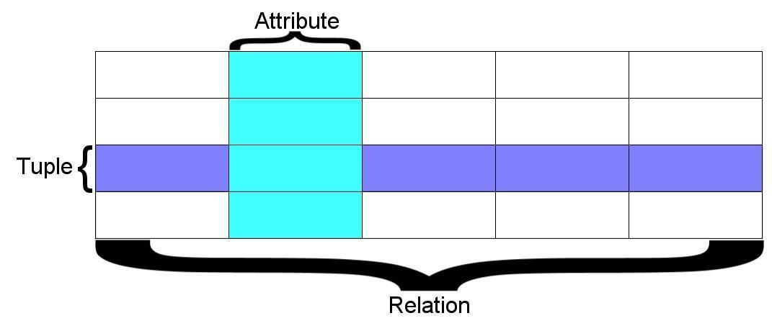
A relation is defined as a set of tuples that have the same attributes. A tuple usually represents an object and information about that object. Objects are typically physical objects or concepts. A relation is usually described as a table, which is organized into rows and columns. All the data referenced by an attribute are in the same domain and conform to the same constraints. (Wikipedia)

Slide 6
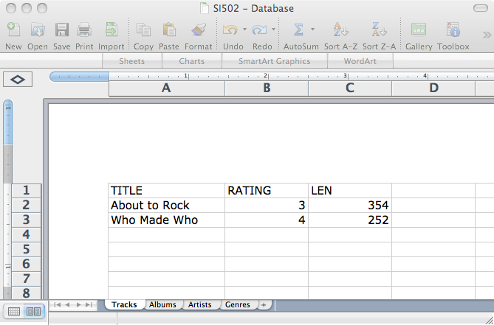
Columns / Attributes
Rows /
Tuples
Tables / Relations

Slide 7
Two Roles in Large Projects
Application Developer - Builds the logic for the application, the look and feel of the application - monitors the application for problems
Database Administrator - Monitors and adjusts the database as the program runs in production
Often both people participate in the building of the “Data model”

Slide 8

Application Structure
Application
Software
Database
Data Model
End
User
SQL
SQL
Developer
Database
Tools
DBA

Slide 9
Database Administrator (dba)
A database administrator (DBA) is a person responsible for the design, implementation, maintenance, and repair of an organization’s database. The role includes the development and design of database strategies, monitoring and improving database performance and capacity, and planning for future expansion requirements. They may also plan, coordinate, and implement security measures to safeguard the database.
http://en.wikipedia.org/wiki/Database_administrator

Slide 10
Database Model
A database model or database schema is the structure or format of a database, described in a formal language supported by the database management system, In other words, a “database model” is the application of a data model when used in conjunction with a database management system.
http://en.wikipedia.org/wiki/Database_model

Slide 11
SQL
Structured Query Language is the language we use to issue commands to the database
Create a table
Retrieve some data
Insert data
Delete data
http://en.wikipedia.org/wiki/SQL

Slide 12
Common Database Systems
Three Major Database Management Systems in wide use
Oracle - Large, commercial, enterprise-scale, very very tweakable
MySql - Simpler but very fast and scalable - commercial open source
SqlServer - Very nice - from Microsoft (also Access)
Many other smaller projects, free and open source
HSQL, SQLite, Postgress, ...

Slide 13
SQLite Database Manager
SQLite is a very popular database - it is free and fast and small
We have a Firefox plugin to manipulate SQLite databases
https://addons.mozilla.org/en-US/firefox/addon/sqlite-manager/
SQLite is embedded in Python and a number of other languages

Slide 14













SQLite is in lots of software...
http://www.sqlite.org/famous.html

Slide 15
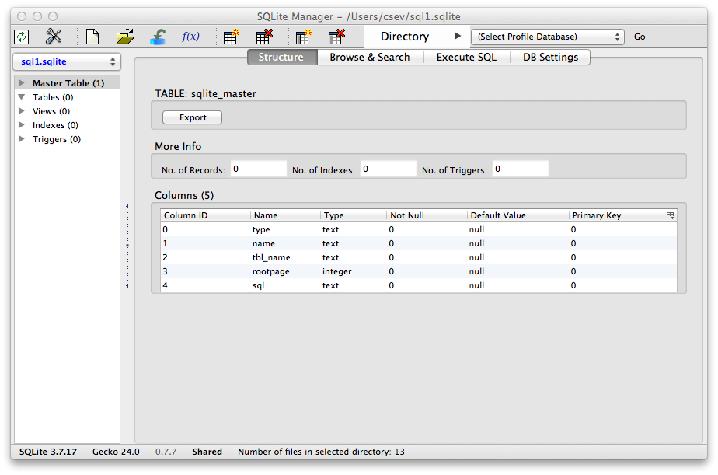
Text
https://addons.mozilla.org/en-US/firefox/addon/sqlite-manager/

Slide 16
Application Structure
Application
Software
Database
Data Model
End
User
SQL
SQL
Developer
Database
Tools
DBA

Slide 17
Start Simple - A Single Table
Lets make a table of People - with a Name and an Email using the “wizard” user interface...

Slide 18
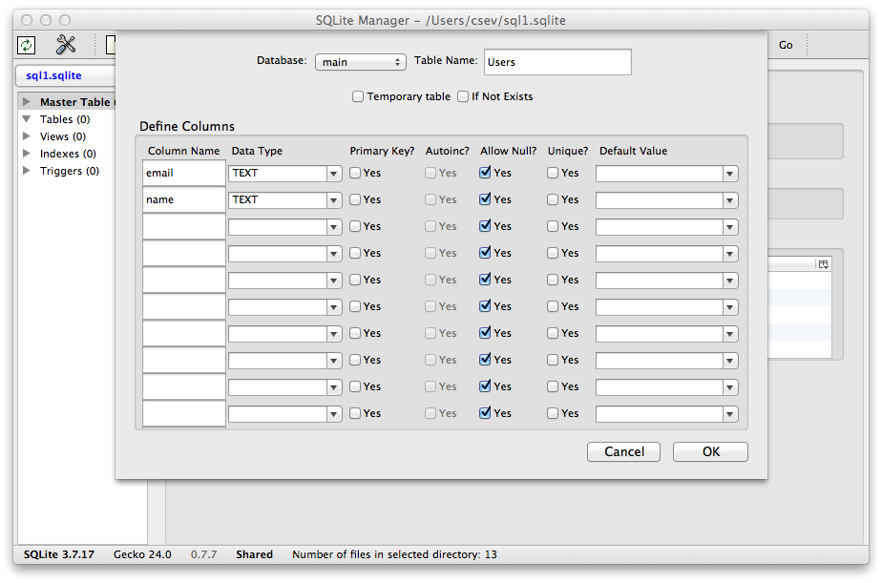
Our first table with two columns

Slide 19
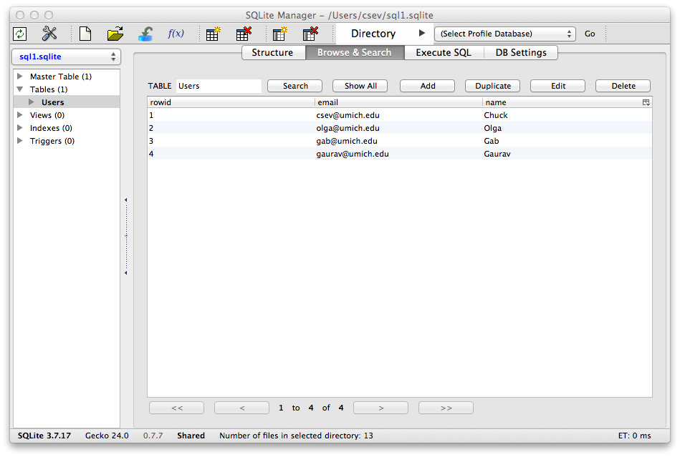
Our table with four rows

Slide 20
SQL
Structured Query Language is the language we use to issue commands to the database
Create a table
Retieve some data
Insert data
Delete data
http://en.wikipedia.org/wiki/SQL

Slide 21
SQL Insert
The Insert statement inserts a row into a table
INSERT INTO Users (name, email) VALUES ('Ted', 'ted@umich.edu')

Slide 22
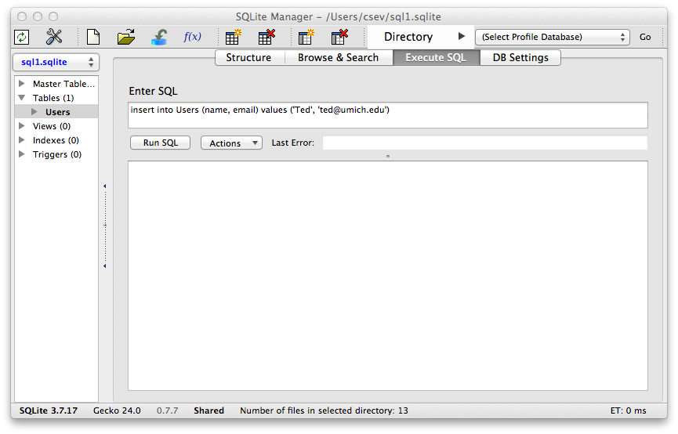
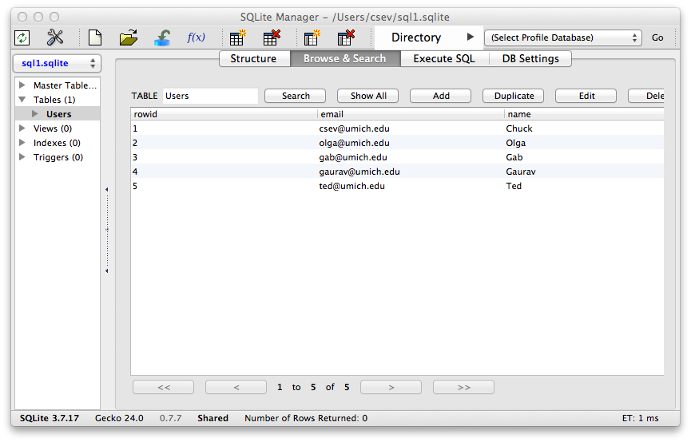

Slide 23
SQL Delete
Deletes a row in a table based on a selection criteria
DELETE FROM Users WHERE email='ted@umich.edu'

Slide 24

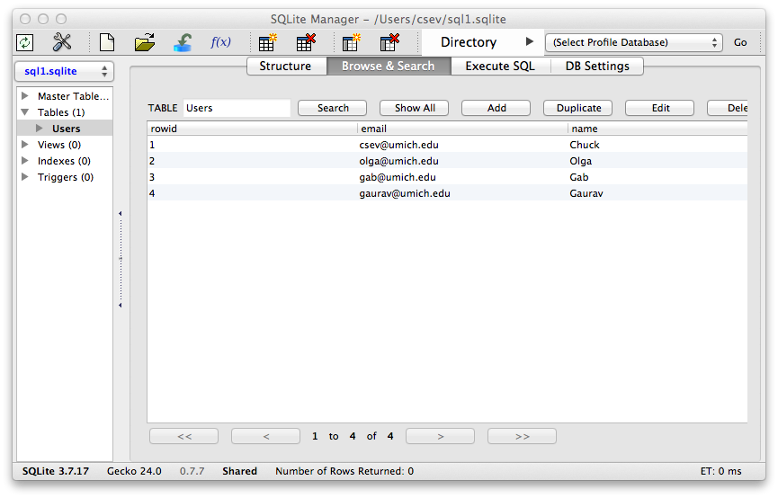

Slide 25
SQL: Update
Allows the updating of a field with a where clause
UPDATE Users SET name='Charles' WHERE email='csev@umich.edu'

Slide 26
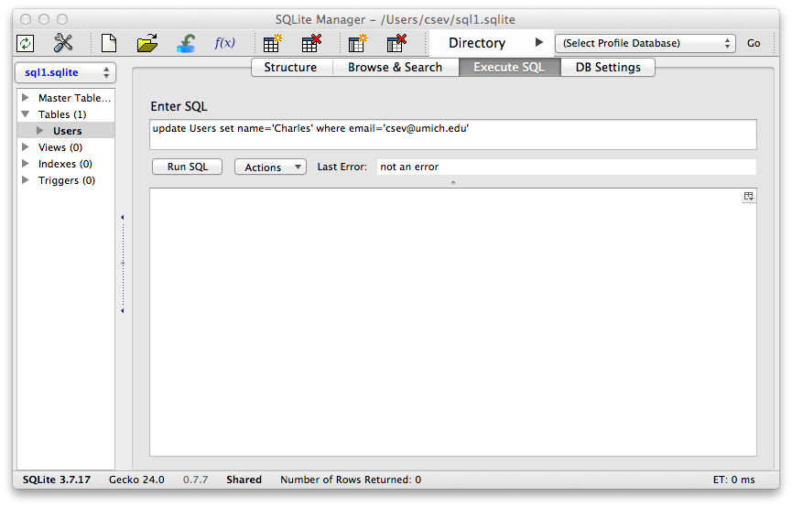
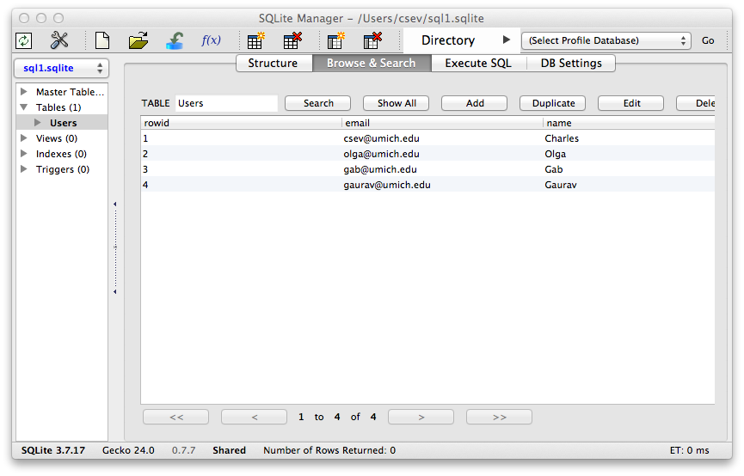

Slide 27
Retrieving Records: Select
The select statement retrieves a group of records - you can either retrieve all the records or a subset of the records with a WHERE clause
SELECT * FROM Users
SELECT * FROM Users WHERE email='csev@umich.edu'

Slide 28
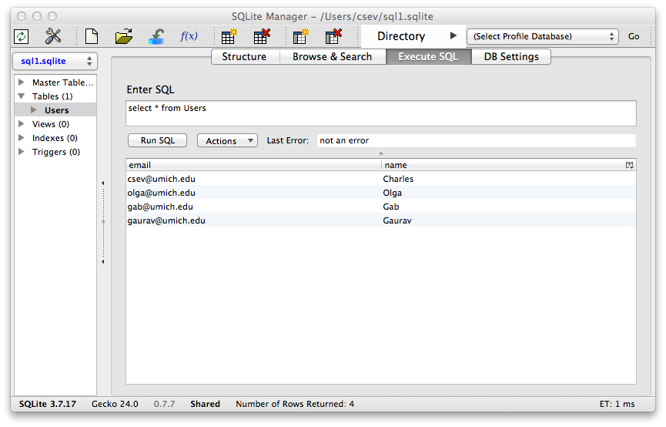
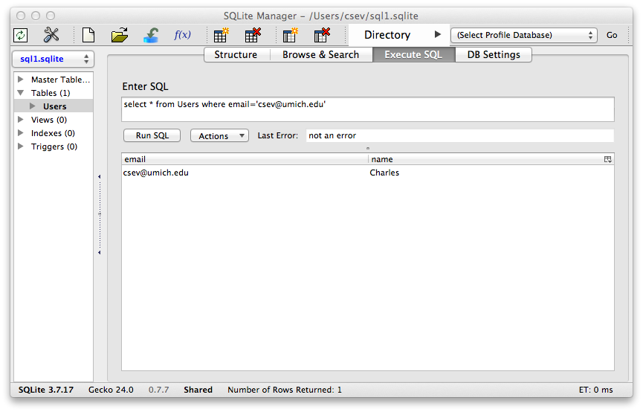

Slide 29
Sorting with ORDER BY
You can add an ORDER BY clause to SELECT statements to get the results sorted in ascending or descending order
SELECT * FROM Users ORDER BY email
SELECT * FROM Users ORDER BY name

Slide 30


Slide 31
SQL Summary
insert into Users (name, email) values ('Ted', 'ted@umich.edu')
delete from Users where email='ted@umich.edu'
update Users set name="Charles" where email='csev@umich.edu'
select * from Users
select * from Users where email='csev@umich.edu'
select * from Users order by email

Slide 32
This is not too exciting (so far)
Tables pretty much look like big fast programmable spreadsheets with rows, columns, and commands
The power comes when we have more than one table and we can exploit the relationships between the tables

Slide 33
Complex Data Models and Relationships
http://en.wikipedia.org/wiki/Relational_model

Slide 34
Database Design
Database design is an art form of its own with particular skills and experience
Our goal is to avoid the really bad mistakes and design clean and easily understood databases
Others may performance tune things later
Database design starts with a picture...

Slide 35
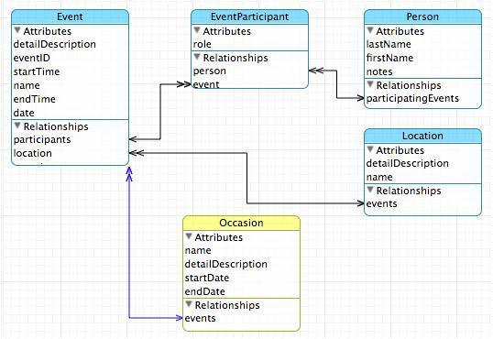

Slide 36
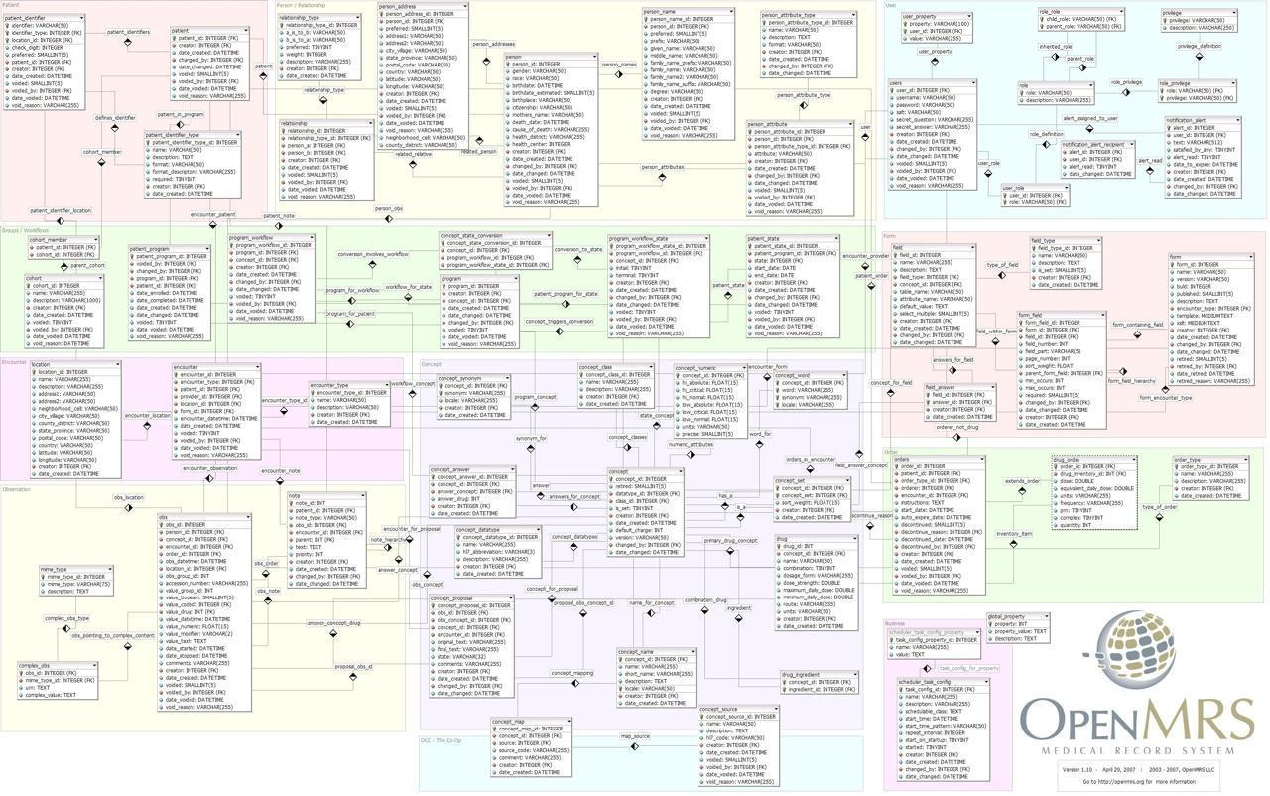

Slide 37
Building a Data Model
Drawing a picture of the data objects for our application and then figuring out how to represent the objects and their relationships
Basic Rule: Don’t put the same string data in twice - use a relationship instead
When there is one thing in the “real world” there should be one copy of that thing in the database

Slide 38
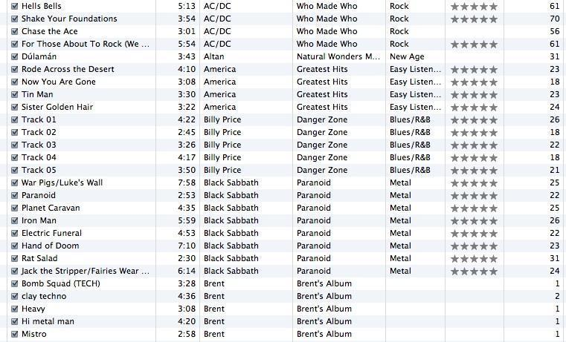
Track
Len
Artist
Album
Genre
Rating
Count

Slide 39
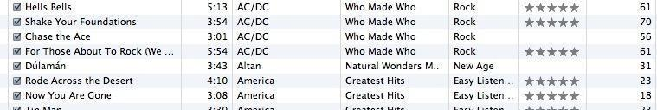
For each “piece of info”...
Is the column an object or an attribute of another object?
Once we define objects, we need to define the relationships between objects.
Len
Album
Genre
Artist
Rating
Track
Count

Slide 40
Track
Rating
Len
Count
Track
Album
Artist
belongs-to
Album
Artist
Genre
belongs-to
Rating
Len
Genre
belongs-to
Count

Slide 41
Track
Artist
Rating
belongs-to
Len
Count
Album
belongs-to
belongs-to
Genre

Slide 42
Representing Relationships in a Database

Slide 43
We want to keep track of which band is the “creator” of each music track...
What album does this song “belong to”??
Which album is this song related to?

Slide 44
Database Normalization (3NF)
There is *tons* of database theory - way too much to understand without excessive predicate calculus
Do not replicate data - reference data - point at data
Use integers for keys and for references
Add a special “key” column to each table which we will make references to. By convention, many programmers call this column “id”
http://en.wikipedia.org/wiki/Database_normalization

Slide 45


Integer Reference Pattern
Artist
We use integers to reference rows in another table
Album

Slide 46
Keys
Finding our way around....

Slide 47
Three Kinds of Keys
Primary key - generally an integer auto-increment field
Logical key - What the outside world uses for lookup
Foreign key - generally an integer key pointing to a row in another table
Site
id
title
user_id
...

Slide 48
Primary Key Rules
Best practices
Never use your logical key as the primary key
Logical keys can and do change, albeit slowly
Relationships that are based on matching string fields are far less efficient than integers performance-wise
User
id
login
password
name
email
created_at
modified_at
login_at

Slide 49
Foreign Keys
A foreign key is when a table has a column that contains a key which points to the primary key of another table.
When all primary keys are integers, then all foreign keys are integers - this is good - very good
If you use strings as foreign keys - you show yourself to be an uncultured swine
Site
id
title
user_id
...
User
id
login
...

Slide 50
Relationship Building (in tables)

Slide 51
Track
Artist
Rating
belongs-to
Len
Count
Album
belongs-to
belongs-to
Genre

Slide 52
belongs-to
Track
Album
Title
Rating
Len
Count
Track
id
Album
title
Table
Primary key
Logical key
Foreign key
id
rating
title
len
count
album_id

Slide 53
Track
Artist
id
id
Album
title
name
id
rating
title
len
artist_id
Table
Primary key
Logical key
Foreign key
count
album_id
genre_id
Genre
id
Naming FK artist_id is a convention
name

Slide 54
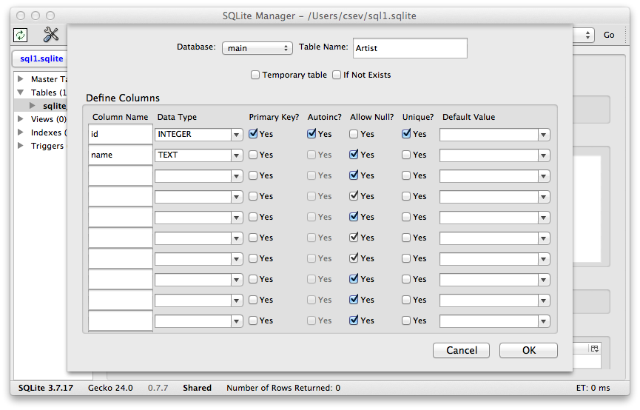

Slide 55
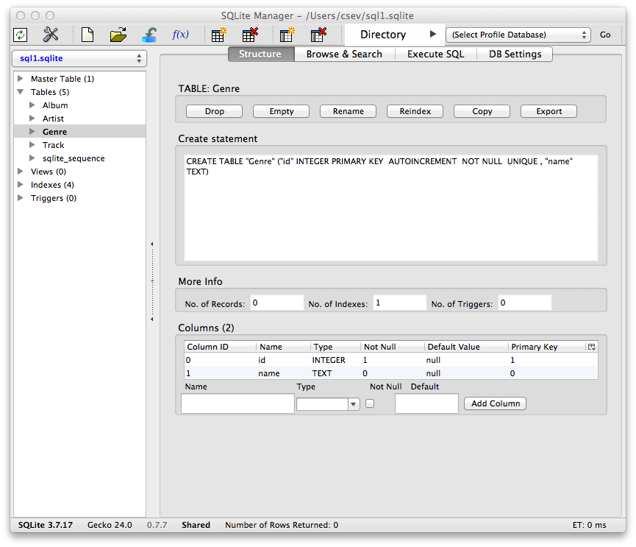

Slide 56
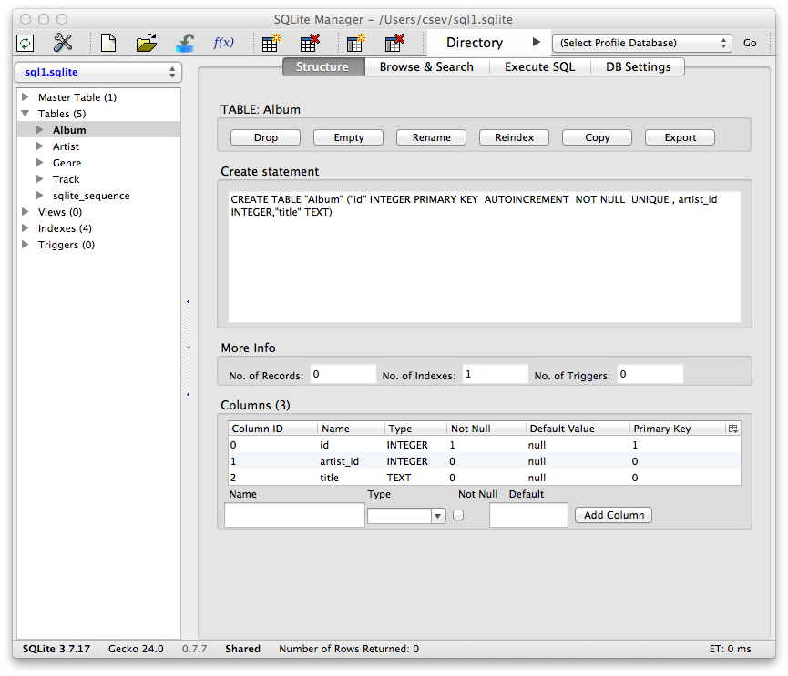

Slide 57
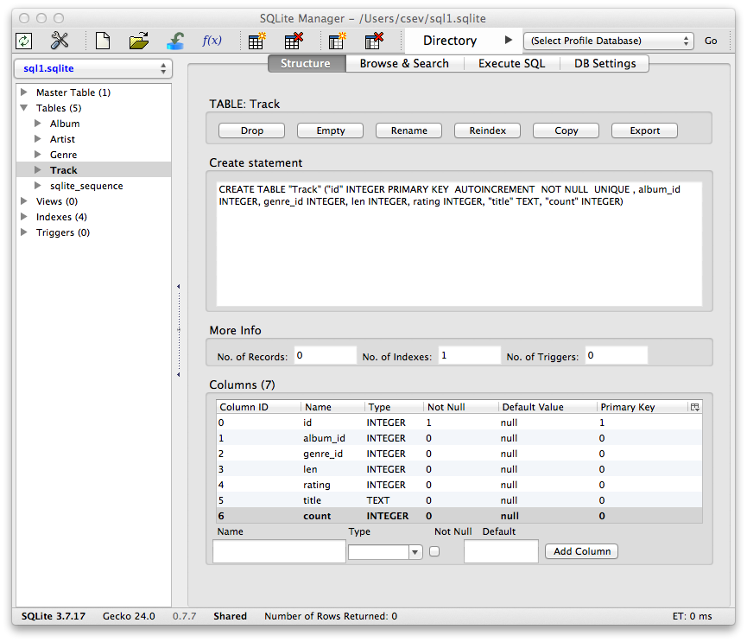

Slide 58
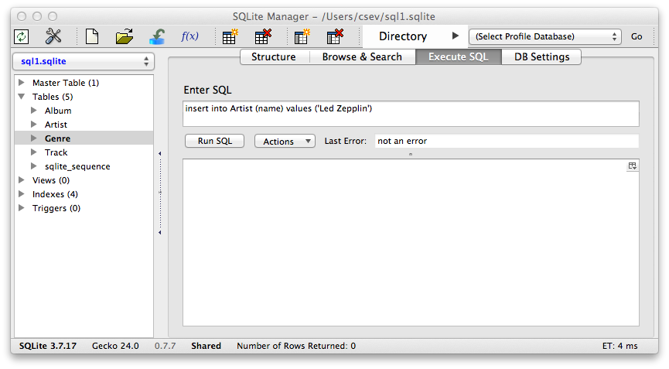
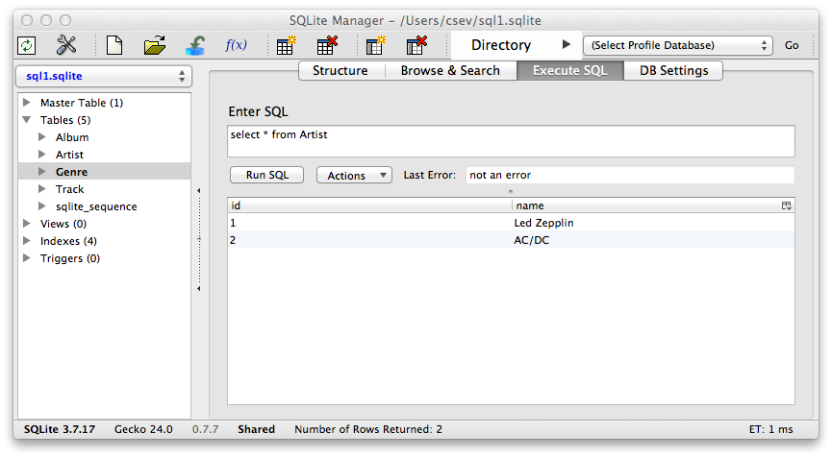
insert into Artist (name) values ('Led Zepplin')
insert into Artist (name) values ('AC/DC')

Slide 59

insert into Genre (name) values ('Rock')
insert into Genre (name) values ('Metal')

Slide 60
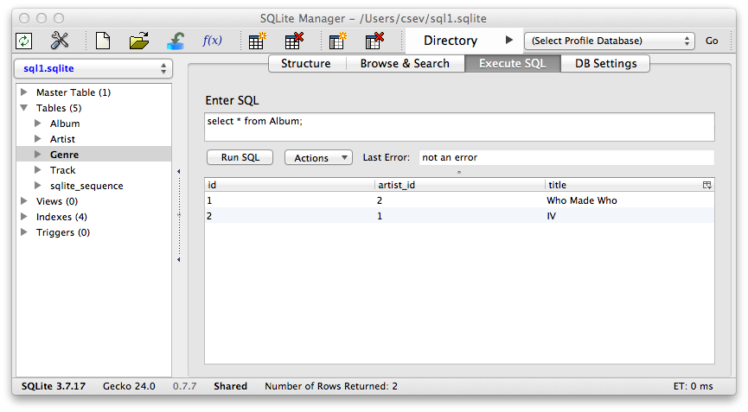
insert into Album (title, artist_id) values ('Who Made Who', 2)
insert into Album (title, artist_id) values ('IV', 1)

Slide 61
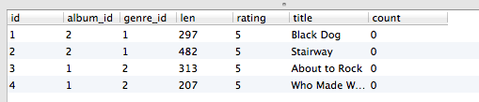
insert into Track (title, rating, len, count, album_id, genre_id)
values ('Black Dog', 5, 297, 0, 2, 1)
insert into Track (title, rating, len, count, album_id, genre_id)
values ('Stairway', 5, 482, 0, 2, 1)
insert into Track (title, rating, len, count, album_id, genre_id)
values ('About to Rock', 5, 313, 0, 1, 2)
insert into Track (title, rating, len, count, album_id, genre_id)
values ('Who Made Who', 5, 207, 0, 1, 2)

Slide 62

We have relationships!
Track
Album
Genre
Artist

Slide 63
Using Join Across Tables
http://en.wikipedia.org/wiki/Join_(SQL)

Slide 64
Relational Power
By removing the replicated data and replacing it with references to a single copy of each bit of data we build a “web” of information that the relational database can read through very quickly - even for very large amounts of data
Often when you want some data it comes from a number of tables linked by these foreign keys

Slide 65
The JOIN Operation
The JOIN operation links across several tables as part of a select operation
You must tell the JOIN how to use the keys that make the connection between the tables using an ON clause

Slide 66

select Album.title, Artist.name from Album join Artist on Album.artist_id = Artist.id
What we want to see
The tables that hold the data
How the tables are linked

Slide 67
Album.title Album.artist_id Artist.id Artist.name
select Album.title, Album.artist_id, Artist.id,Artist.name
from Album join Artist on Album.artist_id = Artist.id

Slide 68
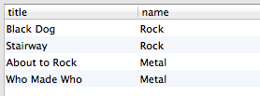
select Track.title, Genre.name from Track join Genre on Track.genre_id = Genre.id
What we want to see
The tables which hold the data
How the tables are linked

Slide 69

It can get complex...
select Track.title, Artist.name, Album.title, Genre.name from Track join Genre join Album join Artist on Track.genre_id = Genre.id and Track.album_id = Album.id and Album.artist_id = Artist.id
What we want to see
The tables which hold the data
How the tables are linked

Slide 71
Complexity Enables Speed
Complexity makes speed possible and allows you to get very fast results as the data size grows
By normalizing the data and linking it with integer keys, the overall amount of data which the relational database must scan is far lower than if the data were simply flattened out
It might seem like a tradeoff - spend some time designing your database so it continues to be fast when your application is a success

Slide 72
Additional SQL Topics
Indexes improve access performance for things like string fields
Constraints on data - (cannot be NULL, etc..)
Transactions - allow SQL operations to be grouped and done as a unit
See SI664 - Database Design (All Semesters)

Slide 73
Summary
Relational databases allow us to scale to very large amounts of data
The key is to have one copy of any data element and use relations and joins to link the data to multiple places
This greatly reduces the amount of data which much be scanned when doing complex operations across large amounts of data
Database and SQL design is a bit of an art form

Slide 74
Acknowledgements / Contributions
Thes slide are Copyright 2010- Charles R. Severance (www.dr-chuck.com) of the University of Michigan School of Information and open.umich.edu and made available under a Creative Commons Attribution 4.0 License. Please maintain this last slide in all copies of the document to comply with the attribution requirements of the license. If you make a change, feel free to add your name and organization to the list of contributors on this page as you republish the materials.
Initial Development: Charles Severance, University of Michigan School of Information
… Insert new Contributors here
...

