Slide 1

CRYPTO FORECASTINNG
Rahul Krishna Gunneri – 2210264
SriDivya Mandadapu – 2211703
Geethika Sai Kannikanti – 2210616
Sreeja Reddy Nannuri – 2205712
Sai Goutham Reddy Komatireddy – 2150153

Slide 2

AGENDA
Introduction
Problem Statement
Data Info
Previous approaches and limitations
Preprocessing
Visualizations
Model Building
Results

Slide 3

INTRODUCTION
Over $40 billion worth of cryptocurrencies are traded every day. They are among the most popular
assets for speculation and investment yet have proven wildly volatile.
The cryptocurrency market is known for its high volatility and
unpredictability, making accurate forecasting a significant challenge.
We are using Deep learning expertise to forecast short-term returns
in 14 popular cryptocurrencies

Slide 4
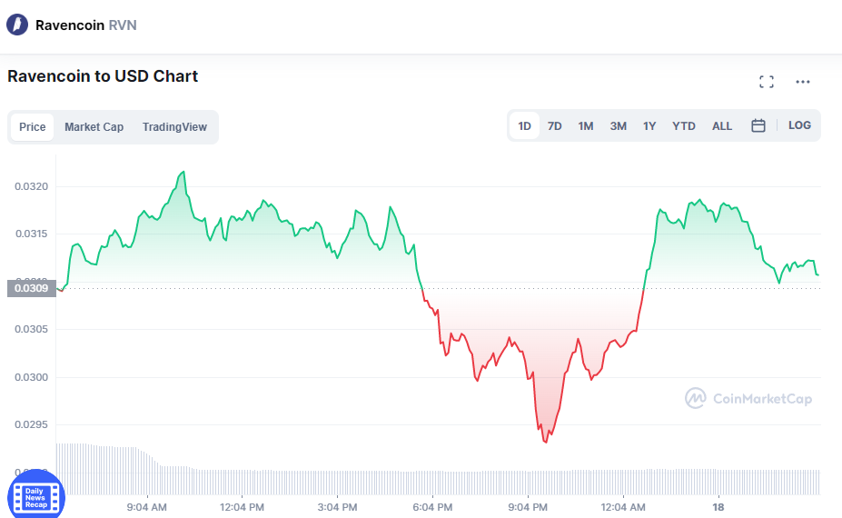
PROBLEM STATEMENT
Our dataset, Consists of 20 million of data which represents almost 3 years of 14 cryptocurrencies values.
Our problem is to forecast the close of each day in such to insure users maximum profit.
For each different asset ID we are forecasting the closing values based on the given date.

Slide 5
DATA INFO
Attributes Details:
timestamp - A timestamp for the minute covered by the row.
Asset_ID - An ID code for the crypto asset.
Count - The number of trades that took place this minute.
Open - The USD price at the beginning of the minute.
High - The highest USD price during the minute.
Low - The lowest USD price during the minute.
Close - The USD price at the end of the minute.
Volume - The number of crypto asset units traded during the minute.
VWAP - The volume weighted average price for the minute.
Target - 15-minute residualized returns. See the 'Prediction and Evaluation
section of this notebook for details of how the target is calculated.

Slide 6
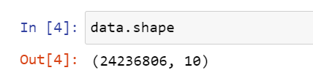
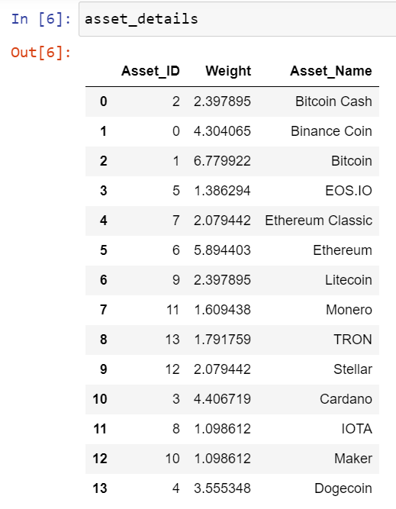
DATA INFO
We are taking data from a Kaggle source, the shape of the
dataset is (23486465, 10)
14 Asset ID refers to 14 Cryptocurrencies
3.10% null values are present in the original data

Slide 7
PREVIOUS APPROACHES
Technical Analysis
Fundamental Analysis
Market Sentiment Analysis
Machine Learning Techniques
Hybrid Approaches

Slide 8
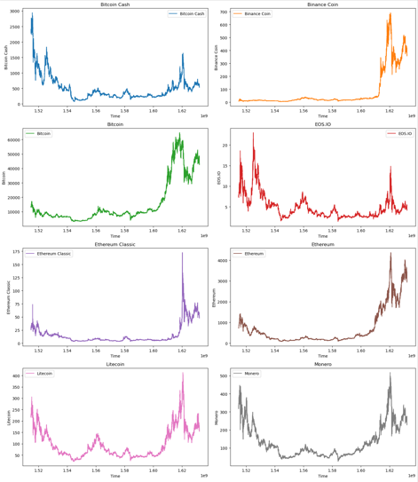
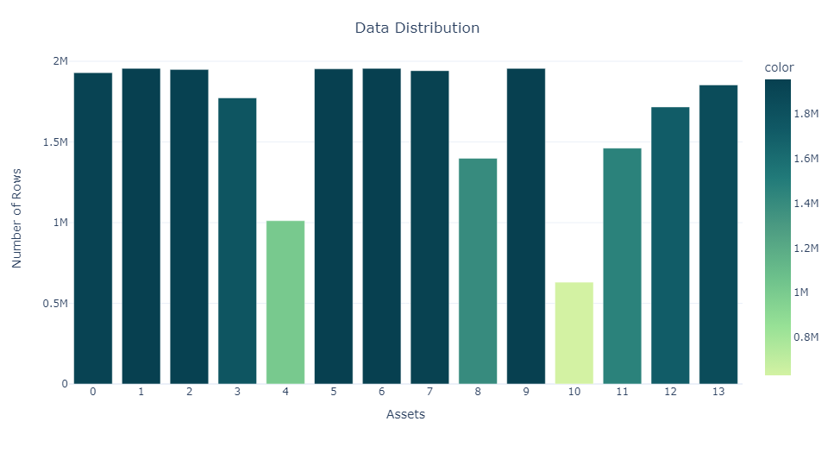
VISUALIZATIONS
Plotting the Frequency of each asset to see which asset has more records
Plotting graphs for each asset ID to the timestamp to observe the trends.
The graphical representation of a few asset IDs with respect to time stamps

Slide 9
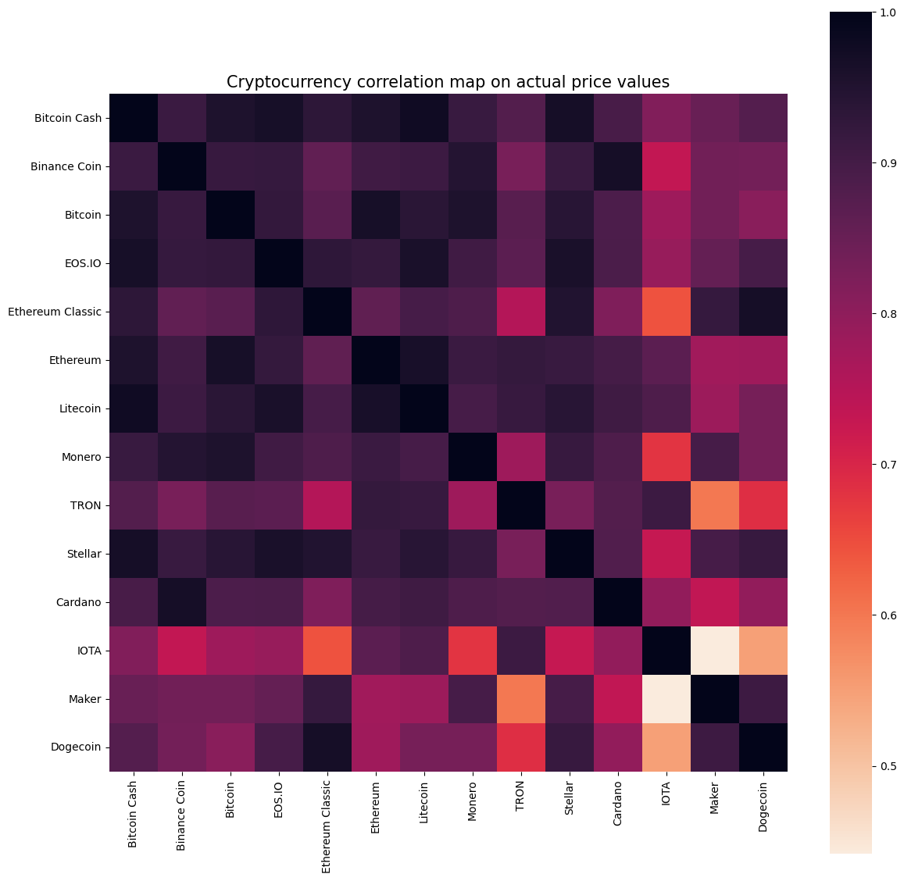
VISUALIZATIONS
Creating a correlation plot on the actual price values of these different assets for the latest time period.

Slide 10

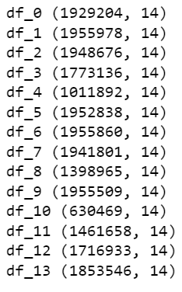
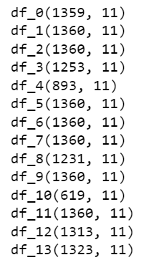
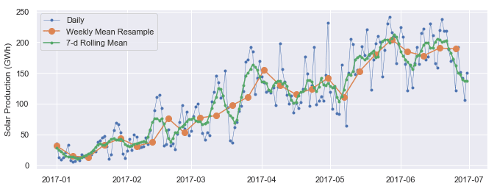
PREPROCESSING
There are ~20 million values in our dataset, we are preprocessing the dataset by checking null values and removing 750338 ‘ Target’ rows
The data is too huge to process on our systems, we need to resample the data based on the date column.

Slide 11
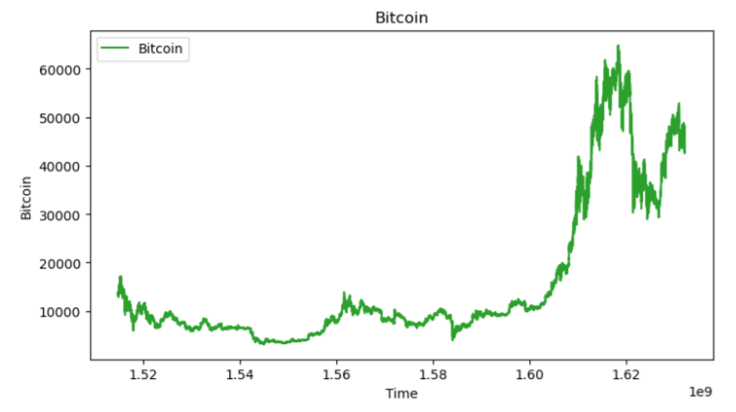
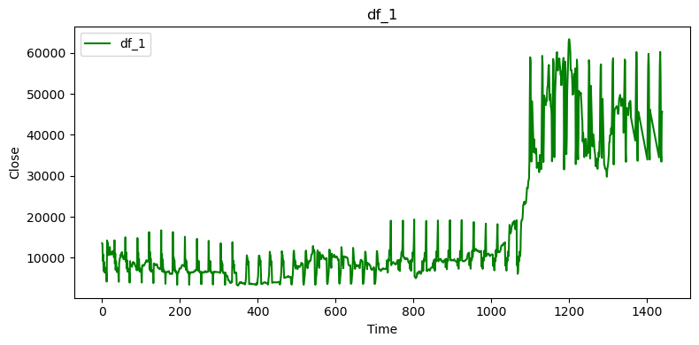
PREPROCESSING
Converting the 'timestamp' column to DateTime format and we are grouping unique date values by getting the mean values of other columns.
Resampling

Slide 12
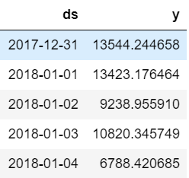
MODEL BUILDING
For this project we are using ‘PROPHET’ Deep Learning Model.
Prophet is a procedure for forecasting time series data based on an additive model where non-linear trends are fit with yearly, weekly and daily seasonality, plus holiday effects.
Prophet considers only date variable and the target variable (close value).
Predicted the data for last 365 days.
Created the forecast and the forecast plots.

Slide 13
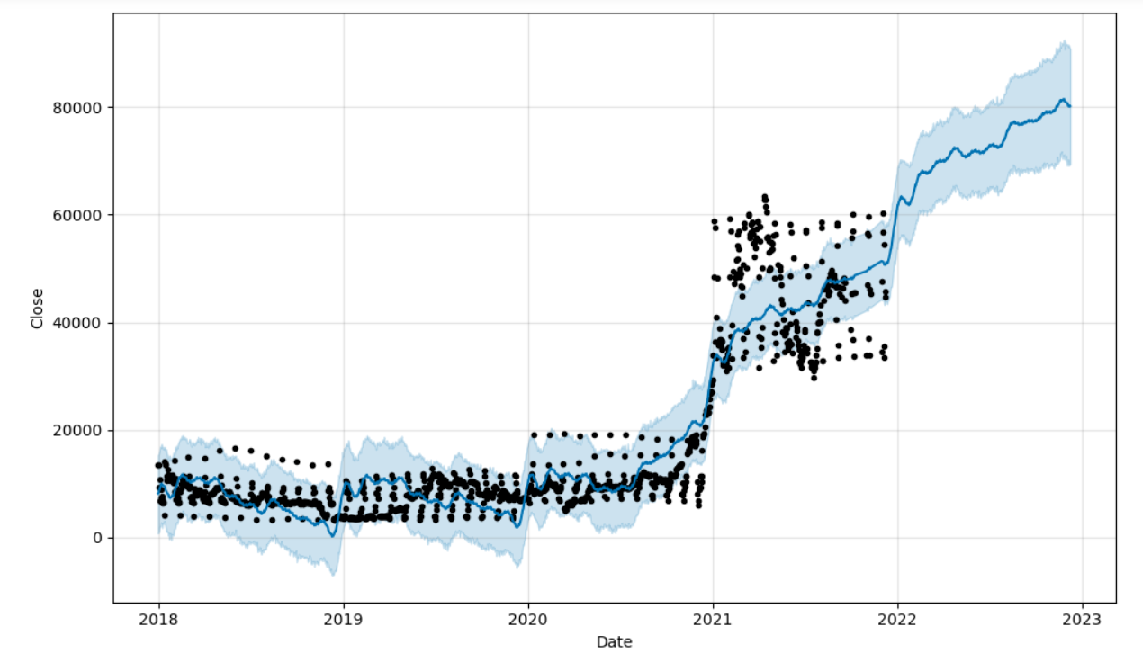
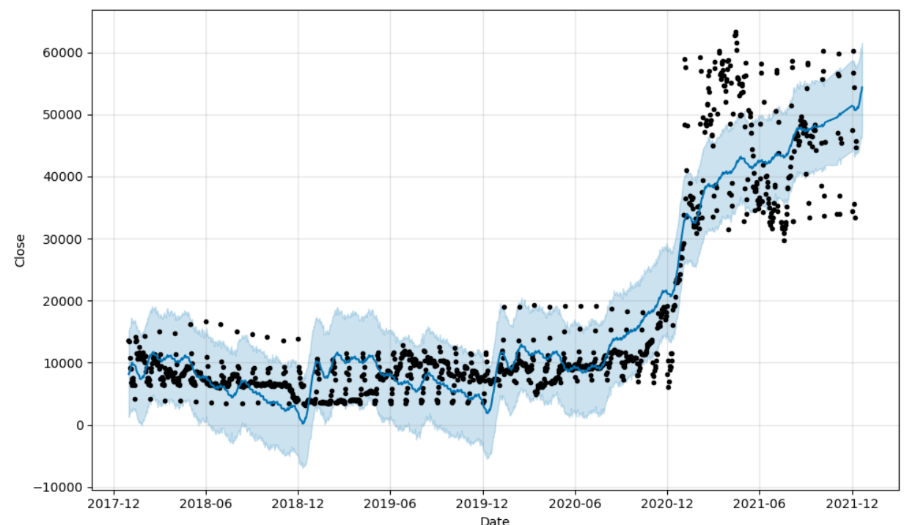
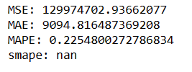
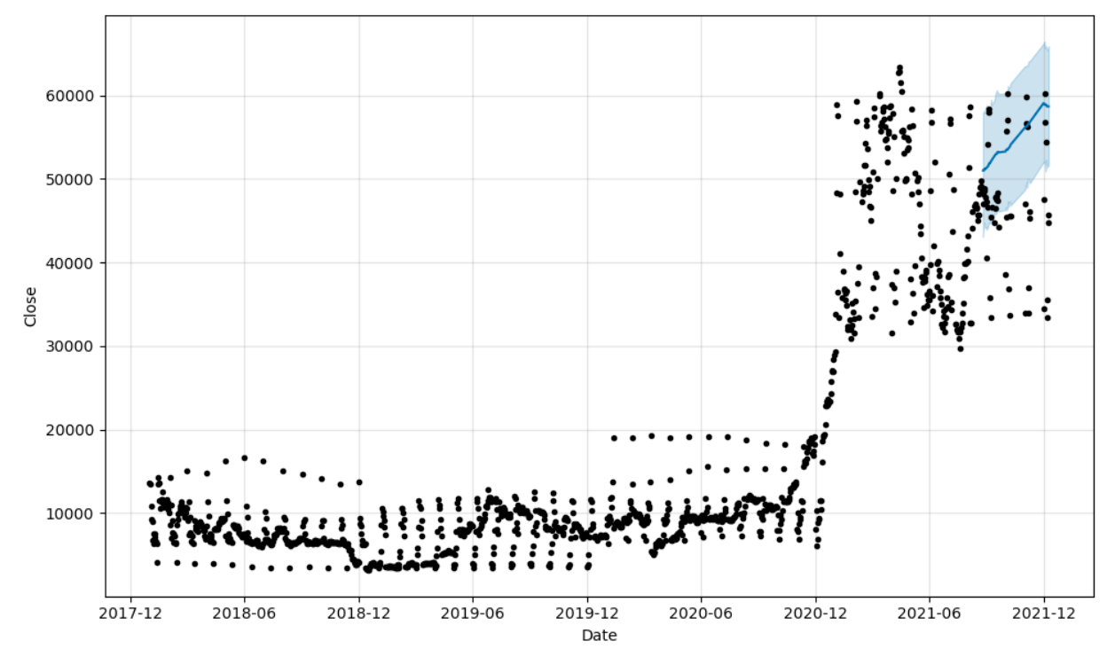
RESULTS:
Applying the model on Bitcoin assets, considering the last 50 date values for train data and the remaining values for the test data.
Splitting the train and test sets for other assets just like above mentioned.

Slide 14
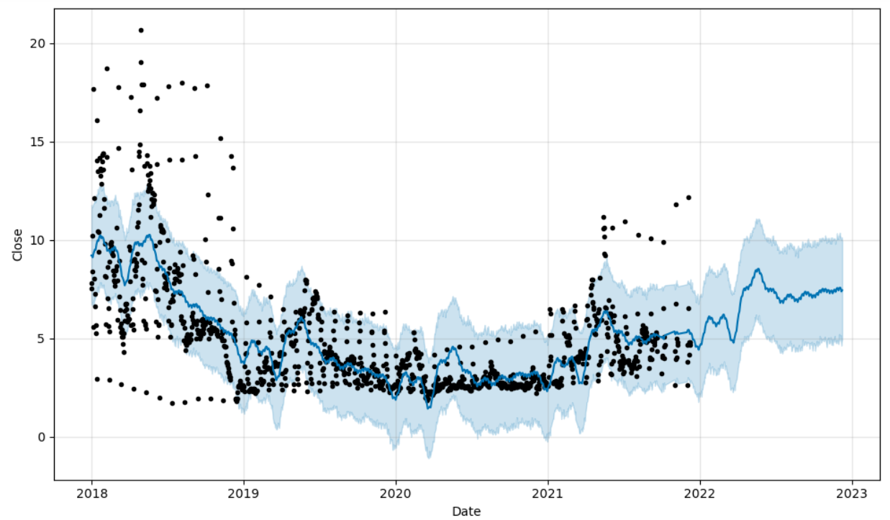
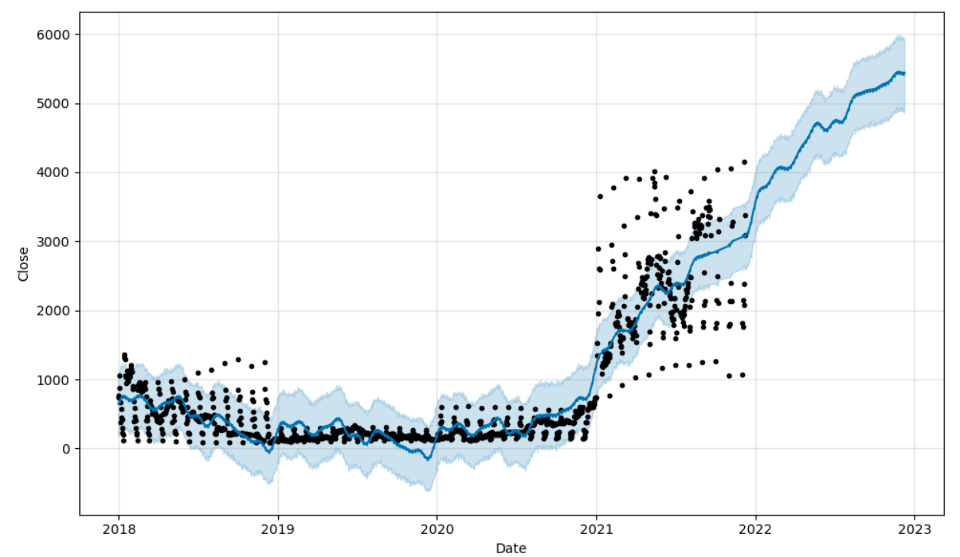
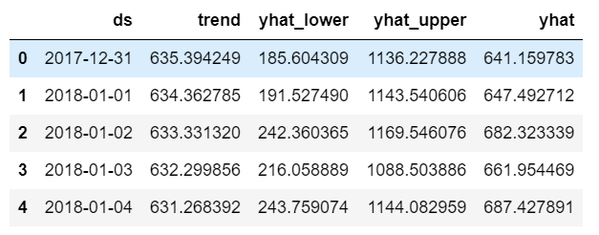
Etherium asset:
Litecoin
Etherium
Forecast band range= yhat_upper – yhat_lower
Did forecasting for all the 14 assets

Slide 15
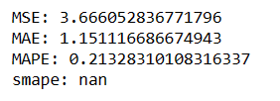

CONCLUSION:
Prophet model works better on Bitcoin cash and Binance coin but underperforms on Litecoin
So to attain maximum profit, One needs to forecast Close value using multiple models.

Slide 16
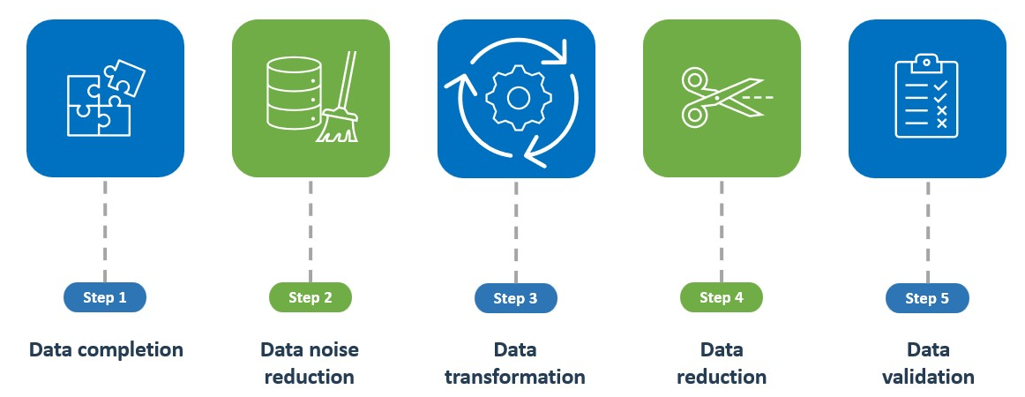
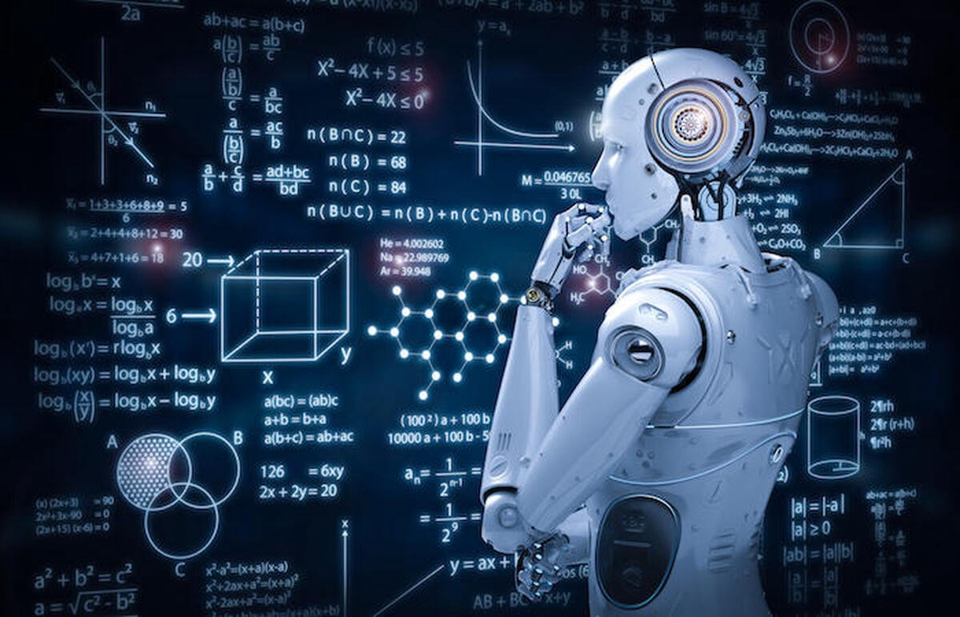
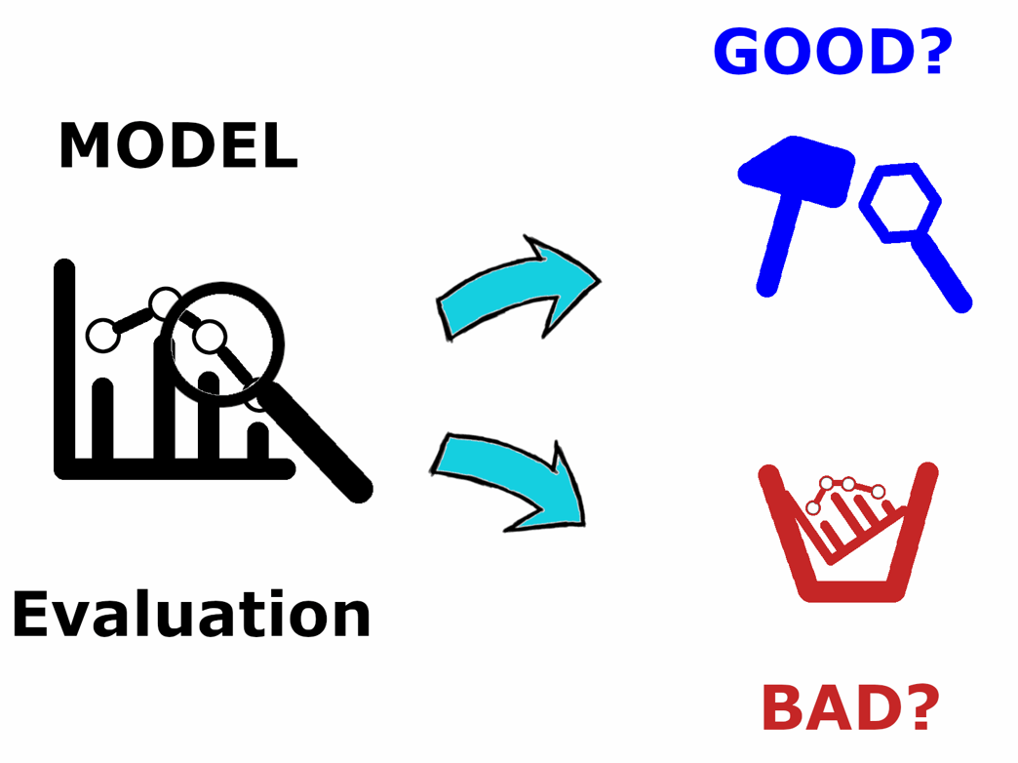
GROUP MEMBER PARTICIPATION:
Data Preprocessing
- Rahul Krishna Gunneri
Sri Divya Mandadapu
Model Selection
- Sai Goutham Reddy Komatireddy
Model Evaluation
- Geethika Sai Kannikanti
Sreeja Reddy Nannuri

Slide 17


