Slide 1
Driver Alerter
GörkeM KILINÇ
Mustafa onur eken

Slide 2
Team
Mustafa Onur Eken
MSc TUM Informatics, 2016 – ongoing
Contact: m.onureken@gmail.com
Görkem Kılınç
MSc TUM Informatics, 2016 – ongoing
Contact: grkemkilinc@gmail.com

Slide 3
Motivation
Increased rate of car accidents in the recent years
Mostly due to cell phone usage, eating etc.
According to the NSC, the estimate for crashes caused by texting rose to at least 6% in 2013
Additionally, 21% of crashes in 2013 were related to the use of handheld or hands-free phones
The council estimates that talking on the phone led to 1.2 million wrecks in 2013 , while texting was involved in at least 341,000 more

Slide 4
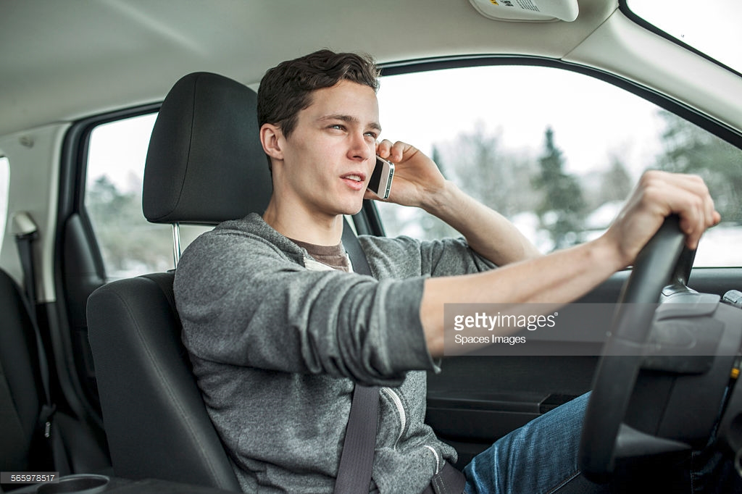
Project
Alert tool for driver assistance
Camera system for collecting images
Customizable cues (using cell phone, eating, smoking etc.)
Warning using different stimuli (sound, vibrating seat)

Slide 5
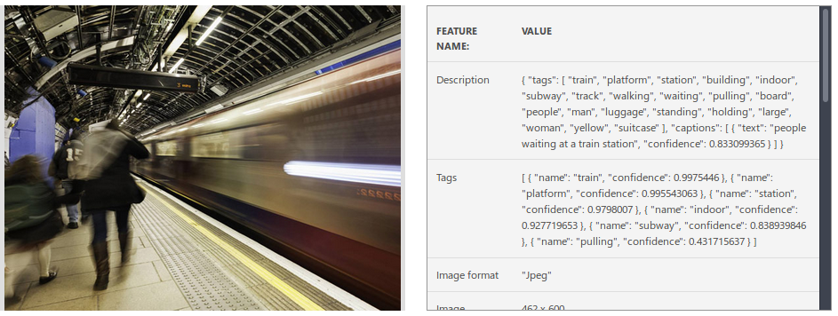
Technology
Requirements
Microsoft Azure Computer Vision API
Object Classification
Web Connection
Connection to server might be occluded
side solution: NN to be implemented to work offline

Slide 6
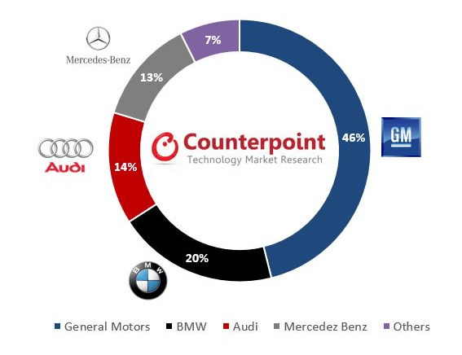
Market
All BMW cars to join Internet of Things with Connected Drive SIM card technology to feature in every BMW road car; enables remote updates to software(2016, Autocar)
Connected Car Market to Grow 270% by 2022 GM Bests BMW, Audi & Mercedes-Benz(2018, Counterpoint)

Slide 7
DEMO

