Slide 1




ENHANCING VEHICLE SAFETY: A MACHINE LEARNING APPROACH TO PREDICTIVE MAINTENANCE
Presented by:- Team ID_2783
Mentored By: Dulari Bhatt

Slide 2

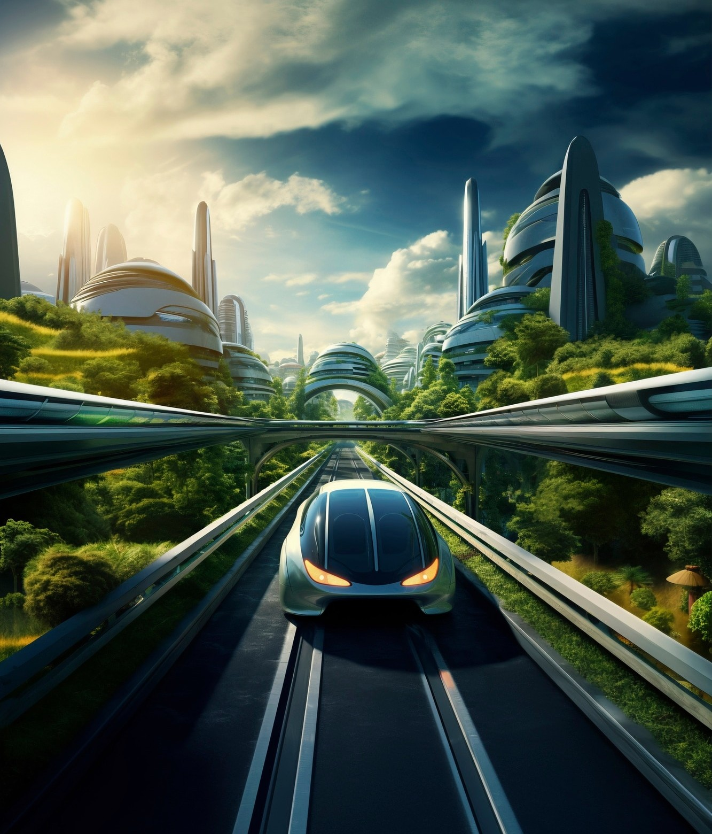
INTRODUCTION
•Every year, numerous accidents
occur due to emphasizing
part failures, the need
for proactive measures.
•Predictive maintenance can signiﬁcantly reduce accident risks by addressing potential faults before they escalate.

Slide 3
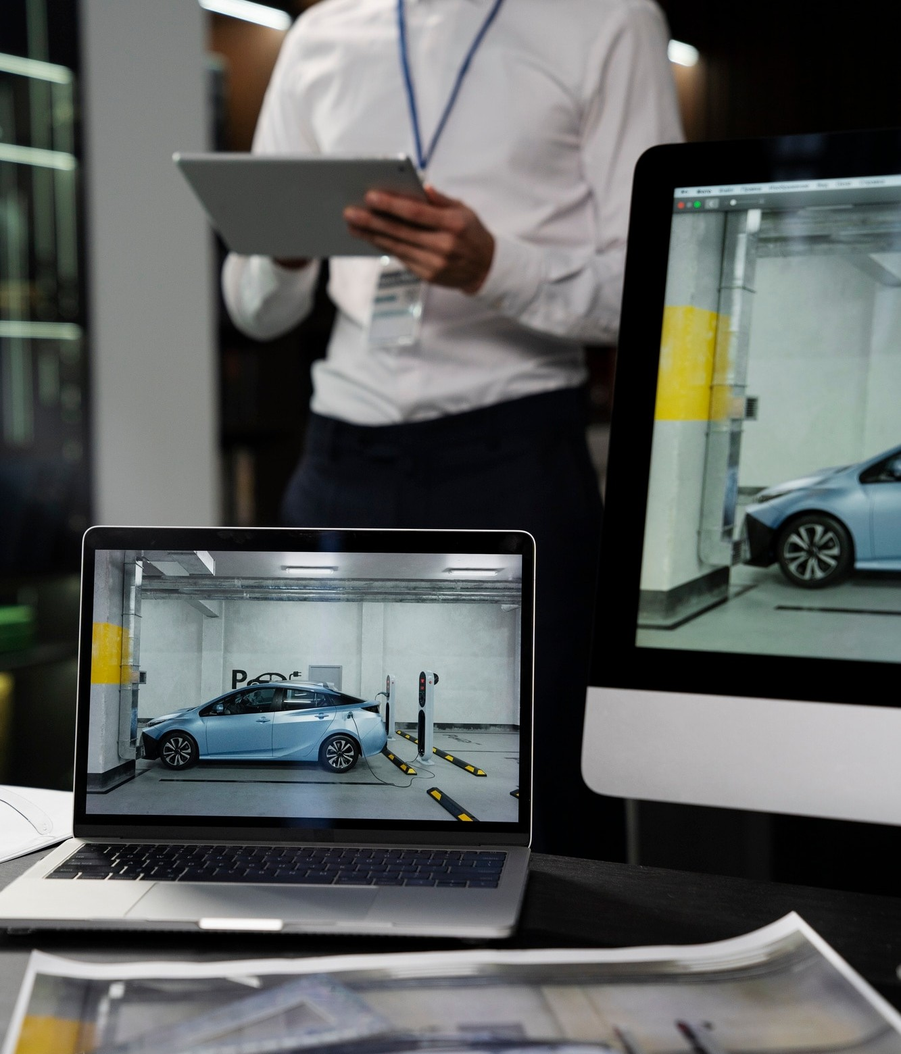
OBJECTIVE
Our goal is to create a machine- learning model for predicting automobile
maintenance requirements.
•Foresee potential issues, intervene before critical failures and enhance overall
vehicle safety.

Slide 4


APPROACH
& PREDICTIVE CAPABILITY
We leverage historical maintenance data to identify patterns and trends as crucial components.
•Empower proactive interventions, signiﬁcantly lowering the risk of accidents caused by unforeseen mechanical faults.

Slide 5
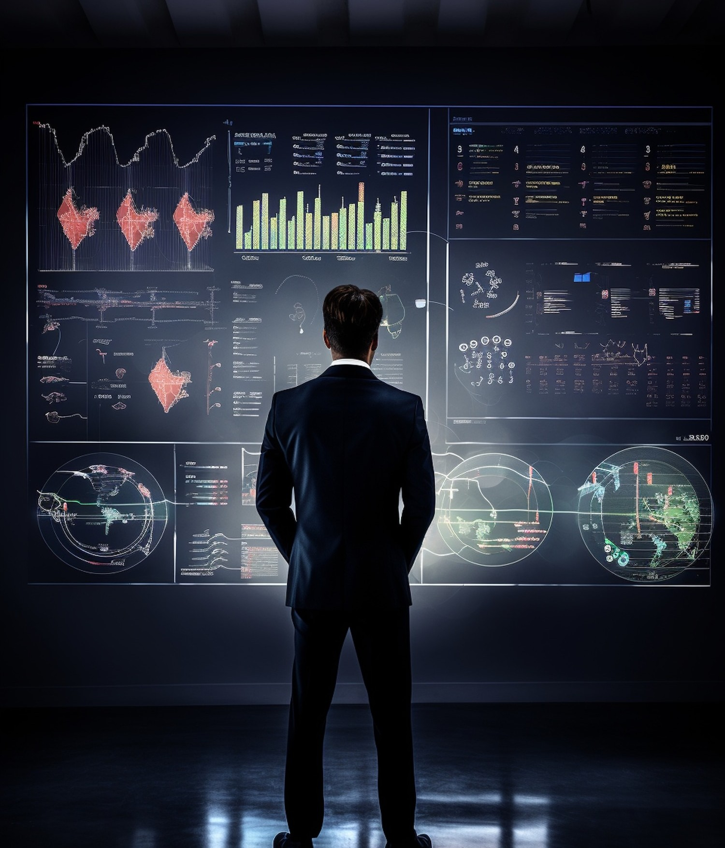
STATISTICS & URGENCY
About 2% i.e. 1,20,000 accidents occur every year because of parts failure.
•Urgency to implement predictive maintenance procedures highlighted by alarming accident
rates related to mechanical failures.

Slide 6
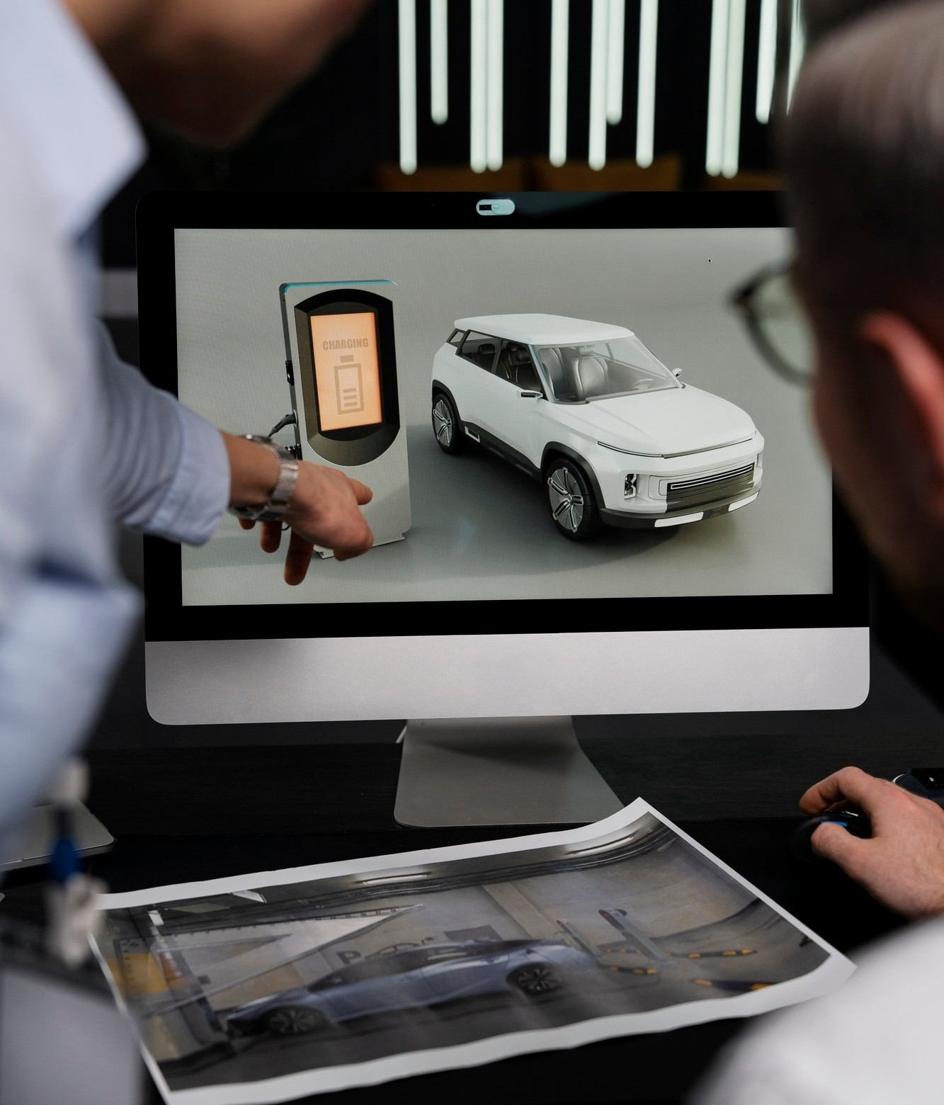
MODEL DETAILS & ACCURACY
•Used the sigmoid function in our machine-learning model for classiﬁcation.
Achieved an accuracy of 64.42%, showcasing the model's effectiveness in predicting maintenance requirements.

Slide 7
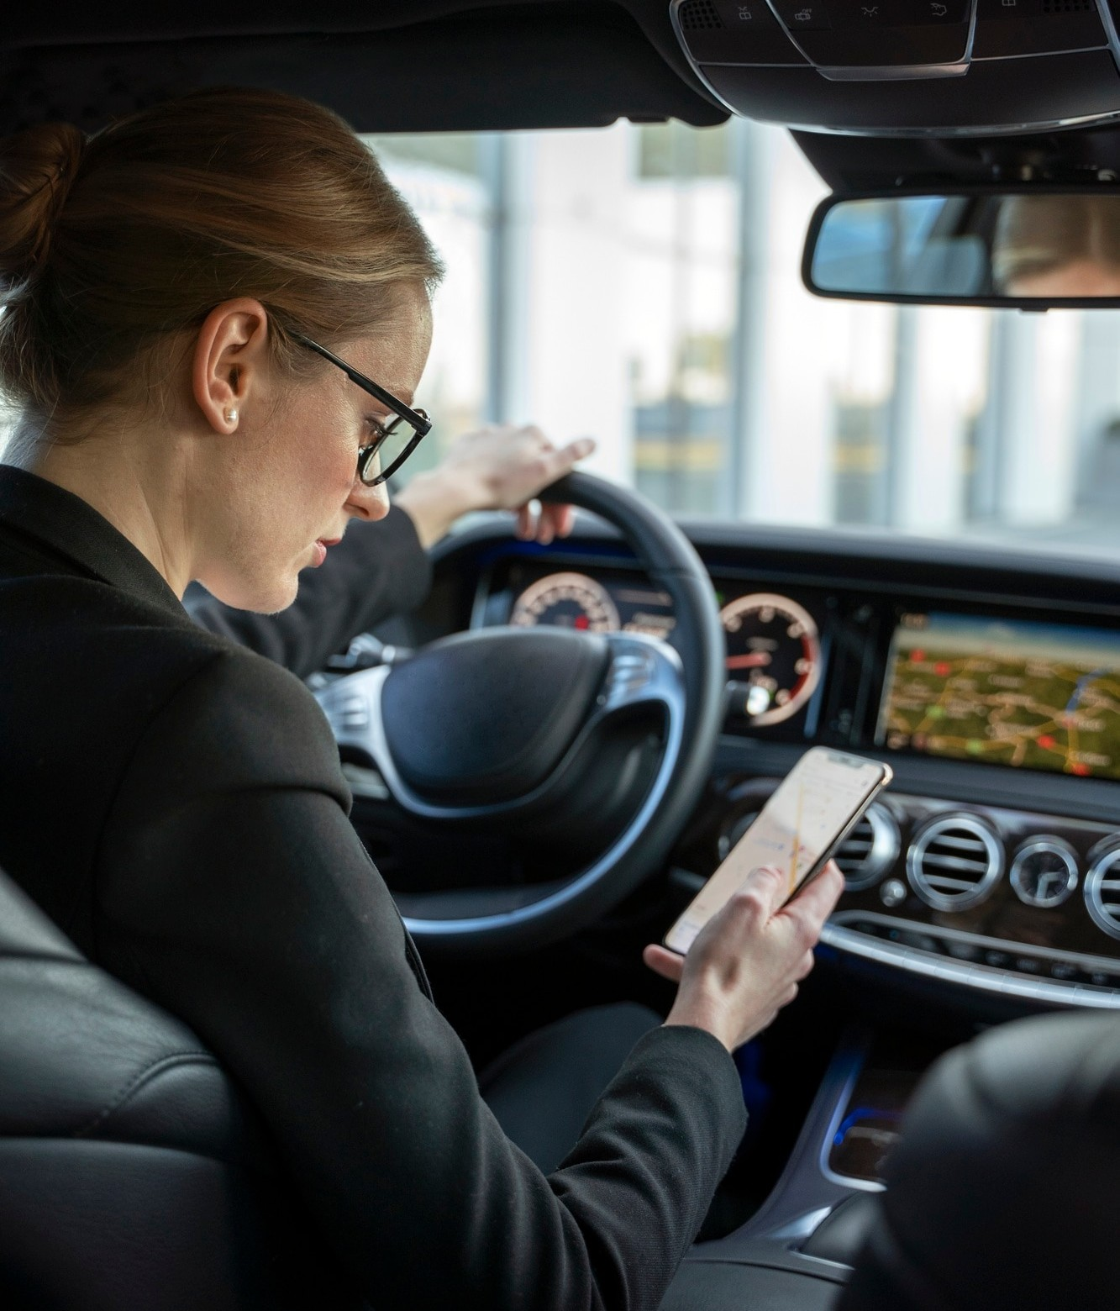
IMPACT
•Implementing predictive maintenance can revolutionize vehicle safety, reducing accidents caused by mechanical problems.
Contribute to safer roads by minimizing the impact of part failures on vehicle safety.

Slide 8

Future Steps
Actively exploring avenues to enhance the accuracy and efﬁciency of our predictive maintenance model.
Continuous reﬁnement and adaptation are key to staying at the forefront of predictive maintenance technology.

Slide 9
CONCLUSION
Our machine-learning enhancing vehicle maintenance.
model safety
holds through
promise in proactive
Addressing maintenance needs proactively to make the roads safer for everyone.

Slide 10
Q&A
•Thank you. I invite any questions or discussions regarding our approach, ﬁndings, or future directions.

Slide 11




Hope you love our idea and will contribute to make it great in the future!

