Slide 1




Project Name:
Jewellery Classification
Srushti Bhagat
Rahul Kapar

Slide 2

Project Objectives
Problem Statement
Project Overview – Introduction
End Users
Wow Factor in Project
Modelling/Block Diagram/Flow of Project
Result/outcomes
Conclusion
Future Perspective

Slide 3
The problem is to create a Residual Network (ResNet) model capable of classifying five types of jewelry: Bracelet, Earrings, Necklace, Rings, and Wristwatch.
Problem Statement
This involves gathering and preprocessing a labeled dataset of jewelry images, designing and training a ResNet architecture, implementing data augmentation techniques, splitting the dataset for training and evaluation, optimizing hyperparameters, and validating the model's predictions.
Success criteria include achieving high accuracy (>77%) on the test dataset and demonstrating robustness against real-world variations.

Slide 4
Project overview - Introduction
Jewellery Classification is a Residual Network(ResNet) model that designed for 5 different jewelleries such as Bracelet, Earrings, Necklace, Rings, Wristwatch and able to predict sample test data.

Slide 5
End User
Gather and Preprocess Data:
Collect a dataset of jewelry images with labels for each category.
Design ResNet Architecture:
Choose a suitable ResNet architecture like VGG, ResNet, or custom design.

Slide 6
Wow Factor in Solution
1:Implement Data Augmentation:
Apply a variety of data augmentation techniques such as rotation, flipping, zooming, shearing, and color jittering. 2:Split Dataset for Training and Evaluation:
Split the dataset into training, validation, and test sets, ensuring that each set is representative of the overall distribution of classes.

Slide 7
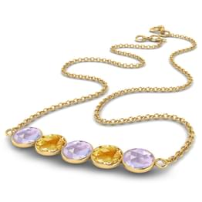
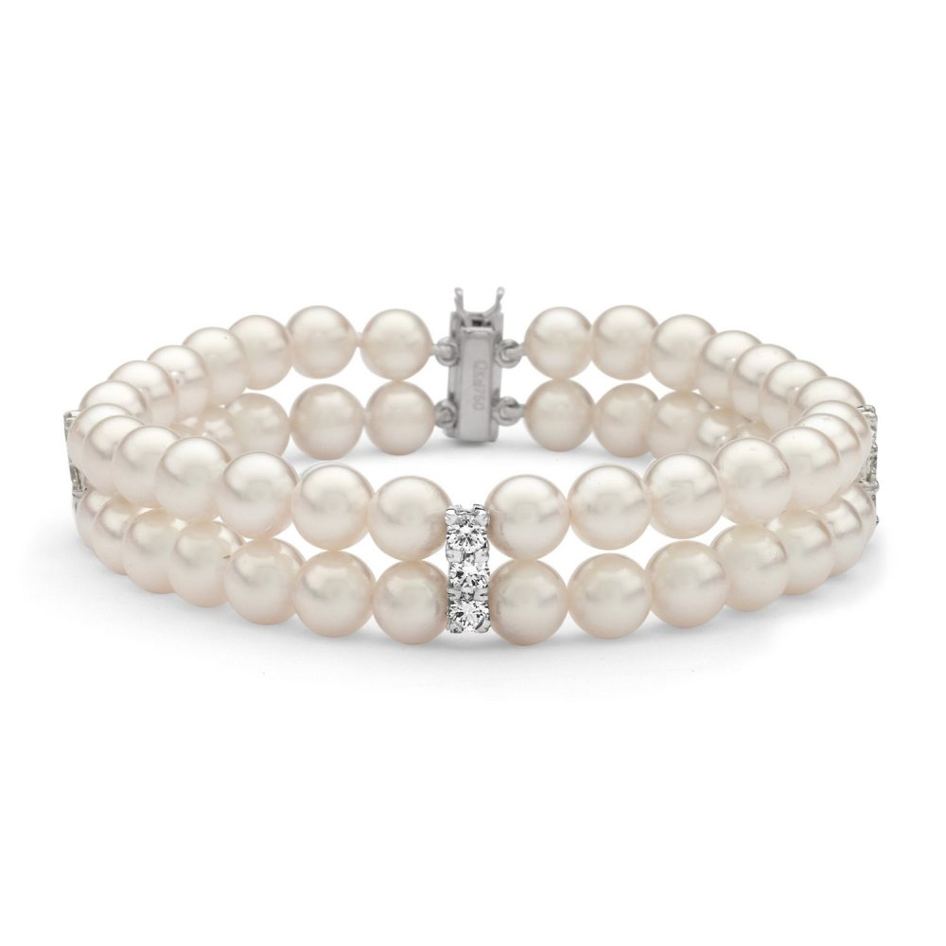
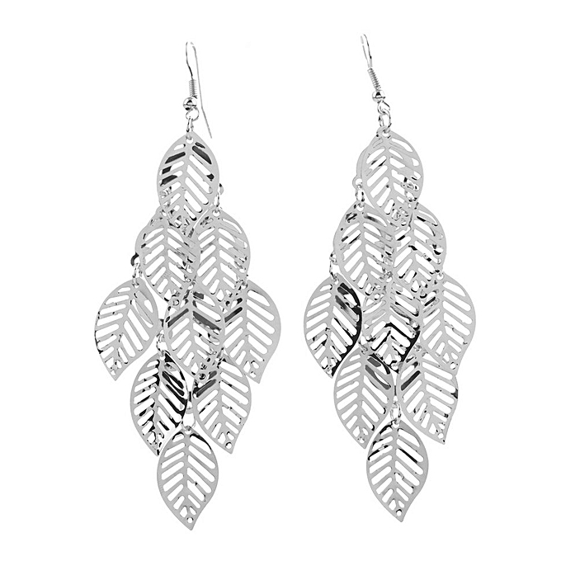
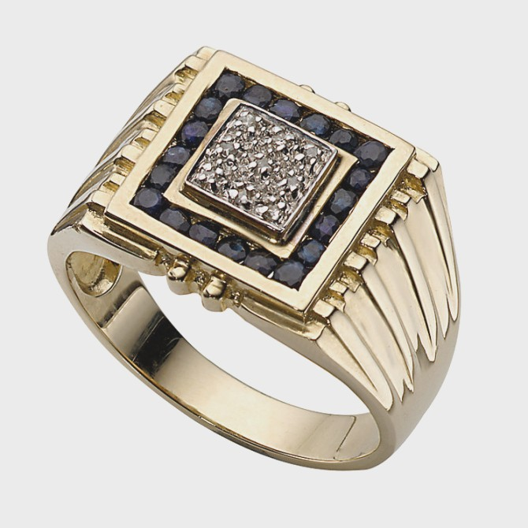
Modelling
Teams can add block diagram, Circuit diagram, wireframe etc​

Slide 8
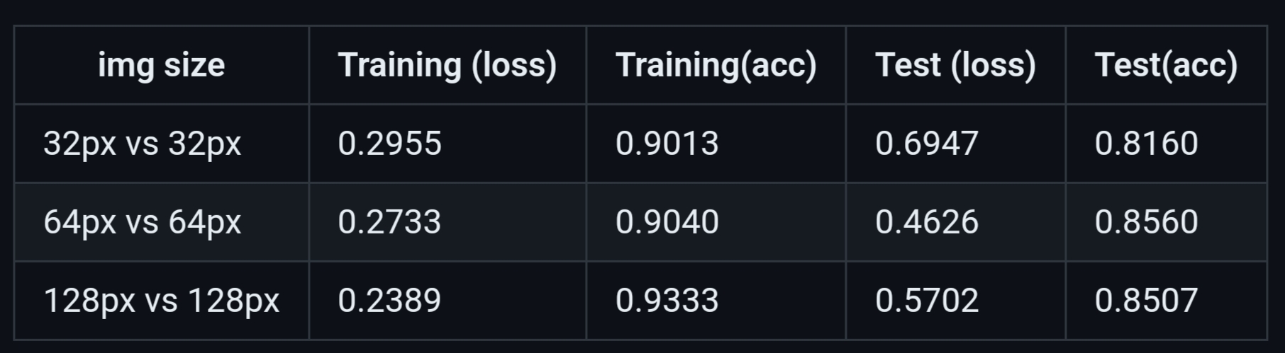
Result / Outcomes
Teams can add Prototype level solution and Add result​

Slide 9
Conclusion
Summarize the findings, including the model's accuracy on the test dataset, its robustness against real-world variations, and any insights gained during the experimentation process.
Document the entire workflow, from dataset collection and preprocessing to model training and evaluation, along with the achieved results and conclusions.

Slide 10
Future Perspective
Document the entire process, including dataset collection, preprocessing steps, model architecture, hyperparameter optimization, and evaluation results.
Discuss potential future enhancements such as continual learning, domain adaptation, or ensemble methods to further improve model performance and robustness.
Prepare a detailed report or presentation summarizing the findings, insights, and recommendations for future research directions.

Slide 11
Thank you...!
Notes:
11

