Slide 1
DOKUZ EYLUL UNİVERSİTY
COMPUTER ENGİNEERİNG / FİRST PROJECT
GÜRKAN BIYIK
YUSUF BADAKOL
YASİN ATICI

Slide 2
INTRODUCTION
We thought about how to design the project.
We exchanged ideas.
We set the roadmap.

Slide 3
PROGRESS SUMMARY
We make a plan.
Draw a flowchart.
Writing codes.
Presentation and poster preparation

Slide 4
Requirements
Visual studio
c#
Math library
Function

Slide 5
Task Sharing
Gürkan Bıyık : Enter coordinates / Preparing the leaderboard
Yusuf Badakol : Random shoots / Menu
Yasin Atıcı : Properties of the ship / condition of the ship sinking

Slide 6
Scheduling
WEEKS:
1. Understanding the game ,discussing , drawing flowchart.
2. Drawing the ship,calculating basic properties of the ship.
3. Calculating advanced properties of the ship,triangle validation,shooting.
4. Playing the game with all rules,high score table.

Slide 7
Completed Tasks
Flowchart
Drawing ship
Ship’s properties
Shooting
High score table

Slide 8
Incomplete Tasks: Reasons, Explanations
If an input other than a number is entered while entering a coordinate, the program crashes.

Slide 9
Additional Improvements
The flowchart has been reworked.

Slide 10
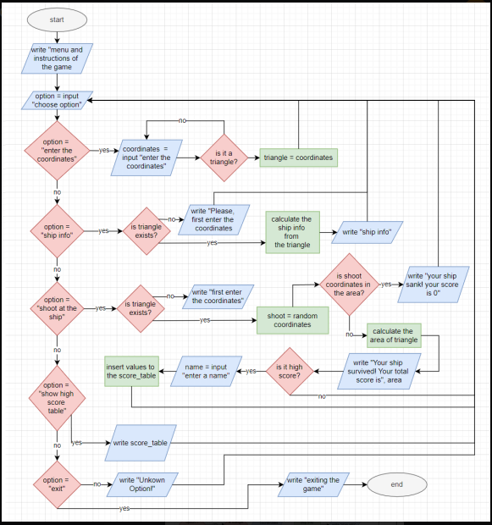

Slide 11
PROBLEMS ENCOUNTERED
Creating the coordinate system

Slide 12
ALGORITHMS AND SOLUTION STRATEGIES
We created the coordinate system in string type. Every dot in the 30x12 cartesian coordinate system has a space. So, we have “12| “ string like that. We made a variable that returns index of triangle corner with using the x,y values of the corner. Then, the corner name is added to coordinate system with using substrings trough that variable as the index. We wrote the random fire code. We calculated the basic properties of the triangle with the entered coordinates. We used Math.Abs , area formula and perimeter formula in the project.

Slide 13
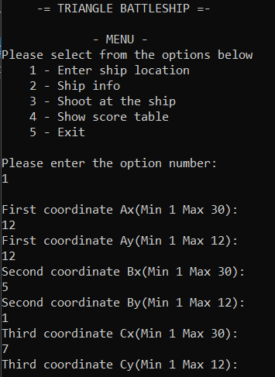
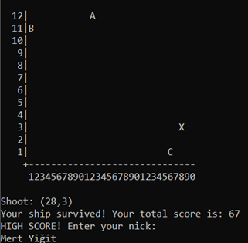
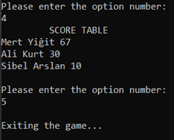
SCREENSHOTS

Slide 14
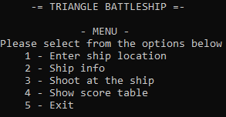
1.menu

Slide 15
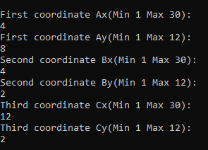
2.CoordInates

Slide 16
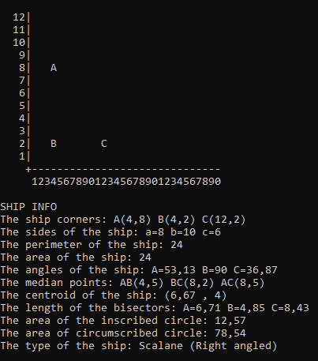
3.SHIP INFO

Slide 17
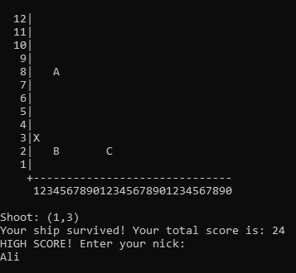
4.SHOOT AND HIGH SCORE

Slide 18

5.SCORE TABLE

Slide 19

6.EXIT

Slide 20
conclusıon
WE FINISHED THE PROJECT AFTER 3-4 WEEKS OF WORK. IT WAS A PROJECT DEVELOPING OUR GROUP WORK AND OPINION SKILLS.

Slide 21
REFERENCES
https://www.eokultv.com/kosinus-teoremi-ve-sinus-teoremi-11-sinif/19890/11-sinif-sinus-alan-formulu-1
https://www.matematiktutkusu.com/forum/geometri-formulleri/2393-ucgende-alan-formulleri-ucgenin-alan-formulu-bagintilari.html
https://trakademi.com/aciortay/
https://umitsen.wordpress.com/2013/04/07/nokta-ucgenin-icinde-mi-degil-mi-test-etme/
https://www.techiedelight.com/replace-character-specific-position-string-csharp/

